Slide 1
NetCat
Gouasmia Zakaria

Slide 2
Notice
All information provided here is for educational and development purposes only

Slide 3
What is Netcat?
Netcat is a great network utility for reading and writing to network connections using the TCP and UPD protocol.
Netcat is often referred to as the Swiss army knife in networking tools
Most common use for Netcat when it comes to penetration testing is setting up reverse and bind shells, piping and redirecting network traffic, port listening, debugging programs and scripts and banner grabbing.

Slide 4
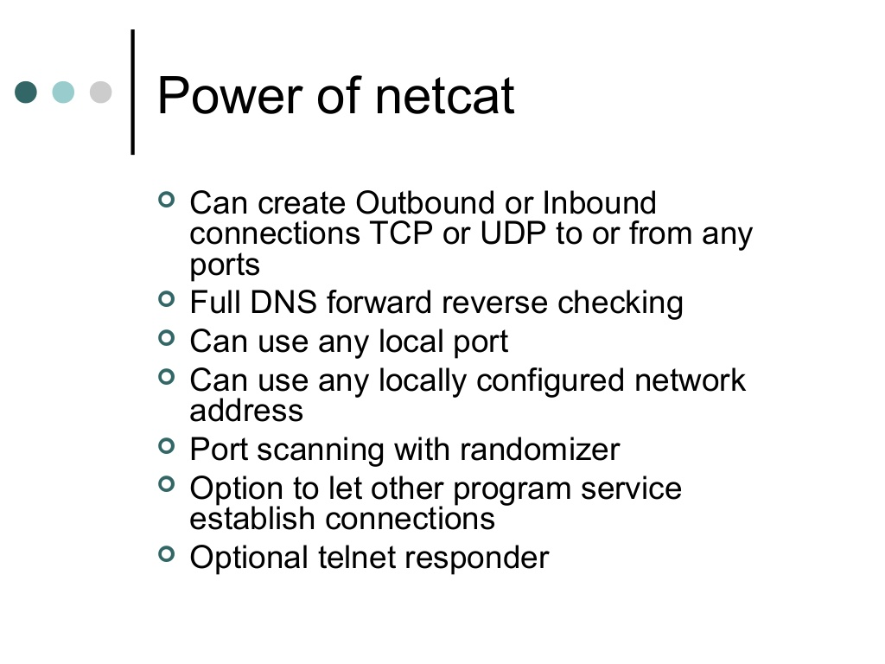

Slide 5
In this slide we will be learning how to use the basic features from Netcat such as:
Banner grabbing
Raw connections
Webserver interaction
File transfers

Slide 6
Working
We will demonstrate these techniques using a couple virtual machines running Linux and through some visualization. The penetration testing with Netcat will be divided in the following 3 parts:
Hacking with Netcat part 1: The Basics
#Hacking with Netcat part 2: Bind and Reverse shells
#Hacking with Netcat part 3: Advanced Netcat techniques

Slide 7
Penetration testing with Netcat part 1: The Basics

Slide 8
Netcat Installation
In kali linux : $ apt-get install netcat
In windows : download the netcat and put it in the system file to be able to open from cmd .

Slide 9
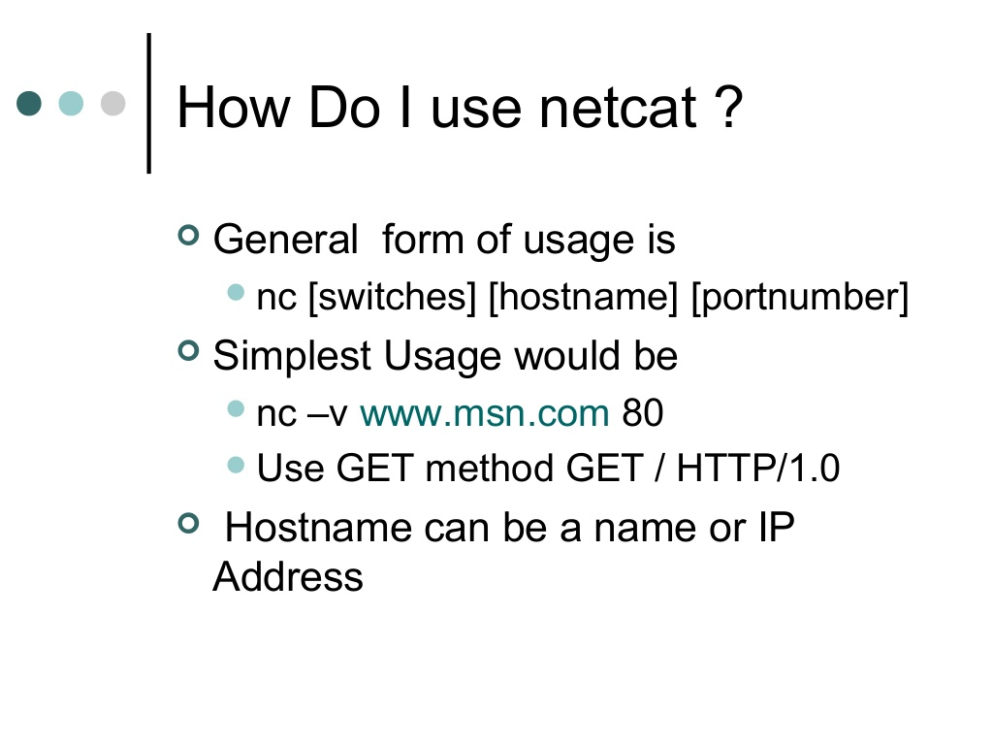

Slide 10
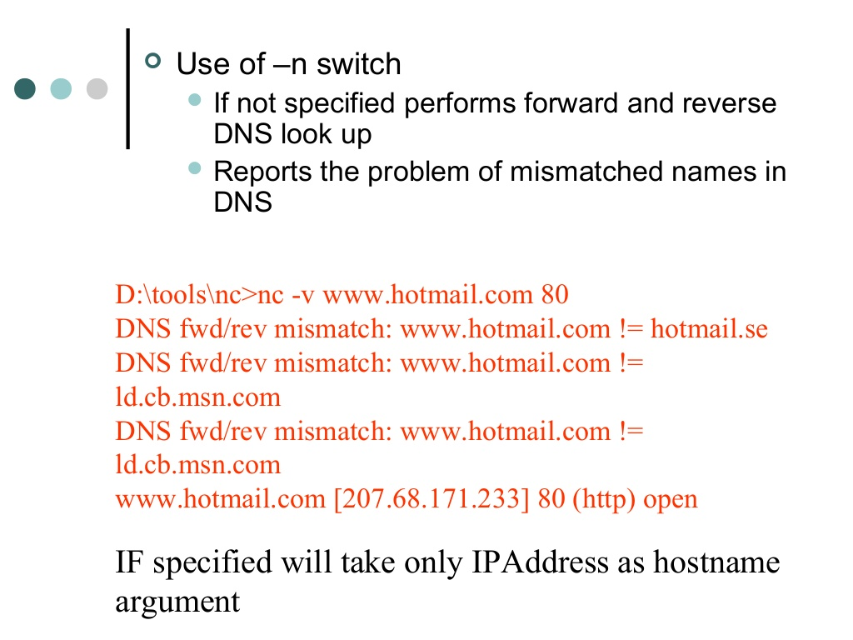

Slide 11
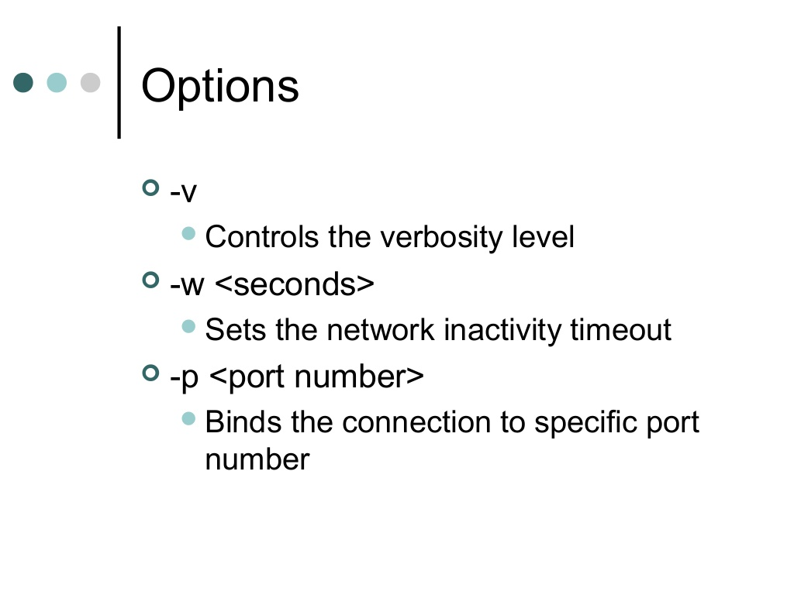

Slide 12
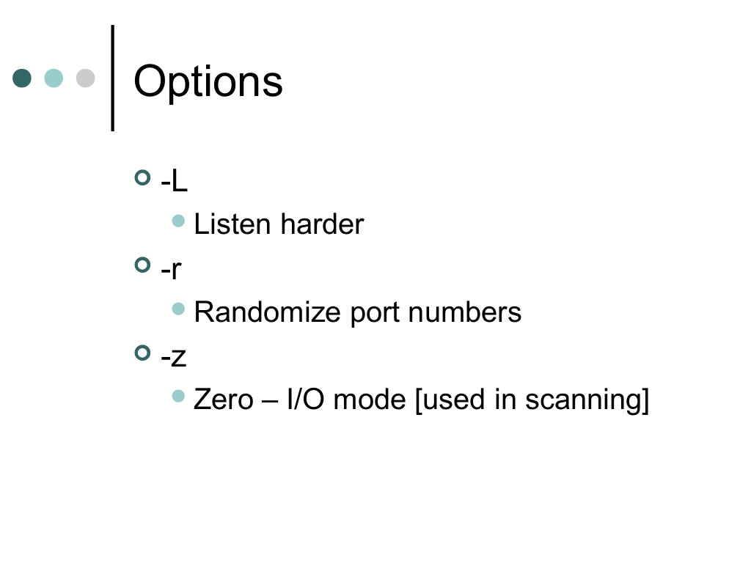

Slide 13
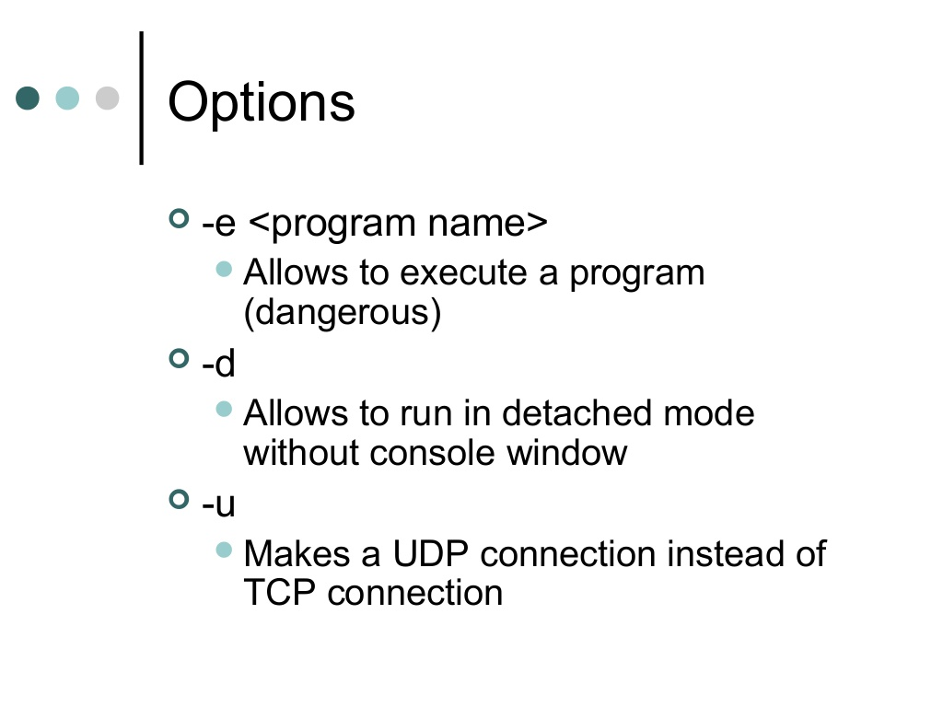

Slide 14
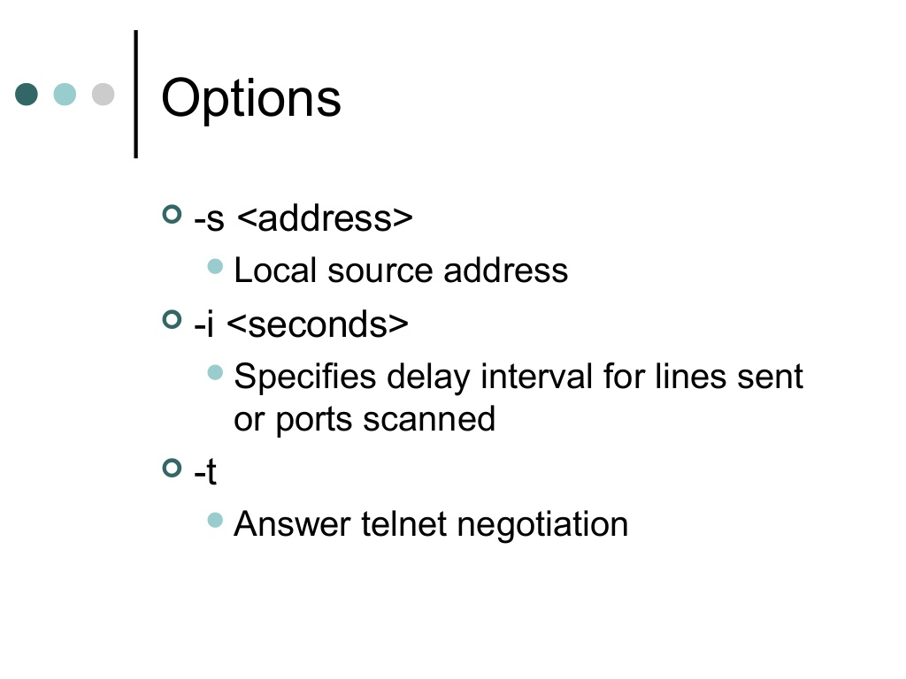

Slide 15
What are the most basic uses?
Simple chat Transfer
So as an example, we will start two copies of netcat on the same machine locally:
host : To listen for inbound connections
nc -l -p port
Exemple :
nc -lvp -p 4444
client :To connect to another machine:
nc options host IP address port
Exemple :
nc 192.168.1.102 4444

Slide 16
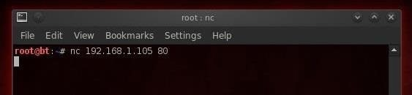
Use Netcat to Connect to a Remote System
use netcat to connect to a remote system. In this case, we will try to connect to a web server on port 80. We type:
This gives us a TCP connection, by default, to the web server (port 80) at 192.168.1.105. Now, whatever we type, we will be sent directly to the web server when we hit enter.

Slide 17
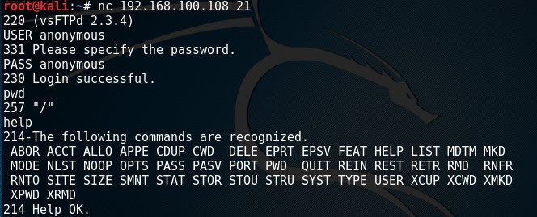
Use Netcat to Banner Grab for OS Fingerprinting

Slide 18
Web server interaction
Once we have a TCP connection to a web server, we can use netcat to grab the banner of the web server to identify what web serving software the victim is running.
nc 192.168.100.108 80
HEAD / HTTP/1.0

Slide 19
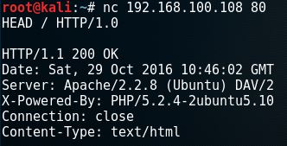

Slide 20
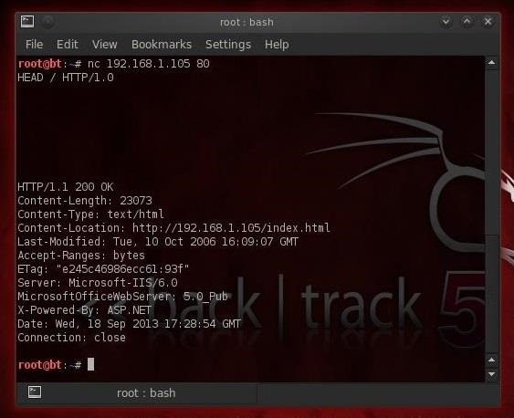

Slide 21
File transfers with Netcat
In this example we will be using a Netcat connection to transfer a text file. Let’s assume we have remote command execution on the target host and we want to transfer a file from the attack box to the host. First we would need to set up a listener on the target host and connect to it from the attack box. We will be using port 8080 for this purpose and we safe the file to the desktop:
nc -lvp 8080 > /root/Desktop/transfer.txt
On the attack box we connect to port 8080 and send a file name transfer.txt:
nc 192.168.100.107 8080 < /root/Desktop/transfer.txt

Slide 22
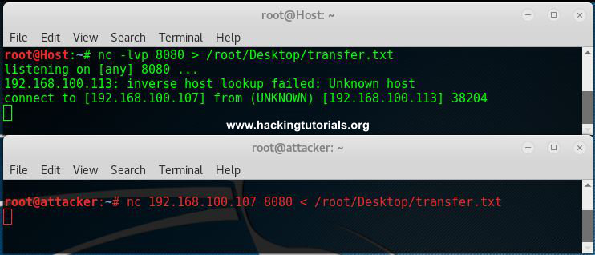

Slide 23
Remote Administration using Netcat
In this example we will be using a Netcat connection to remote a Cmd of windows or execute program.
the target :
nc -lvp 8080 -e cmd.exe
On the attack box we connect to port 8080
nc 192.168.100.107 8080

Slide 24
Thank you

