Slide 1

RECIDIVISM TITLE PLACEHOLDER XXX
Group 4

Slide 2

AGENDA
01
PROBLEM STATEMENT
02
DATA OVERVIEW
03
EXPLORATORY DATA ANALYSIS
04
MODELING
CONCLUSIONS AND RECOMMENDATIONS
05

Slide 3
PROBLEM STATEMENT

Slide 4
PROBLEM STATEMENT
We are a team of policy researchers trying to determine if an algorithm can accurately predict whether an inmate will be reincarcerated. We will build and evaluate a series of different classification models to determine what features should be included. Types of features to consider will include demographic, behavioral and criminal history.
Recidivism is measured by criminal acts that resulted in rearrest, reconviction or return to prison with or without a new sentence.

Slide 5
DATA OVERVIEW

Slide 6
DATA OVERVIEW
BASIC
New York: 188,000 observations with 5 features
CRIMINAL HISTORY
Florida: 11,000 observations with 25 features
BEHAVIORAL
Georgia: 26,000 observations with 53 features

Slide 7
EDA

Slide 8
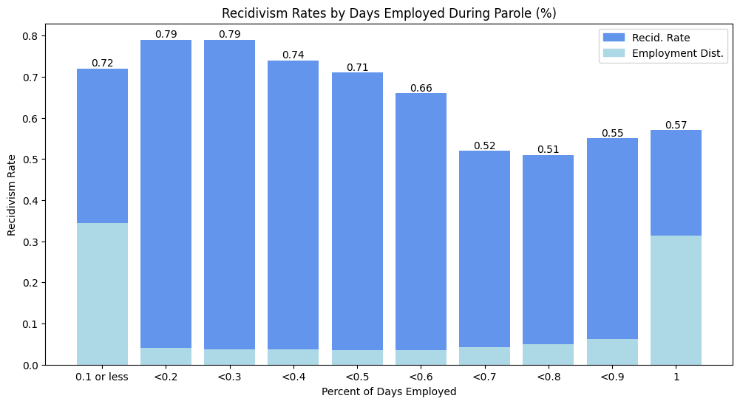
Percent of Days Employed
Percent days employed represents the percentage of days an individual was employed over the course of their parole.
Strong indication that increasing employment opportunities for those recently released from prison will decrease recidivism rates.

Slide 9
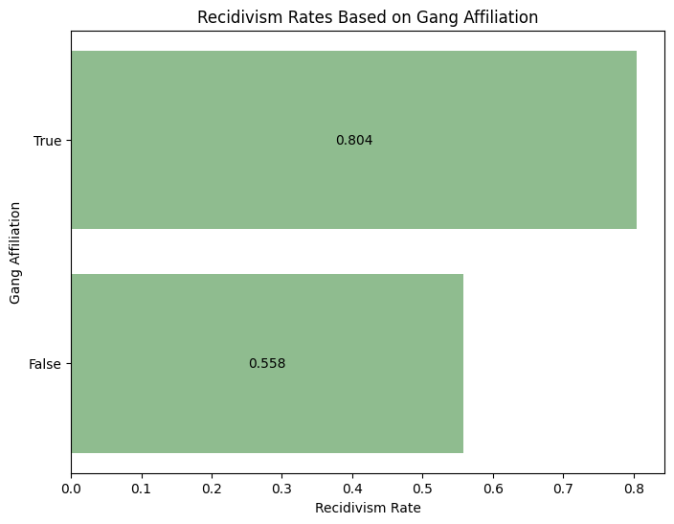
Gang Affiliation
Those who are gang-affiliated have a 25% greater mean recidivism rate than those who are not.
During feature importance, we found that those who are gang-affiliated are twice as likely to reoffend compared to their non-affiliated counterparts.

Slide 10
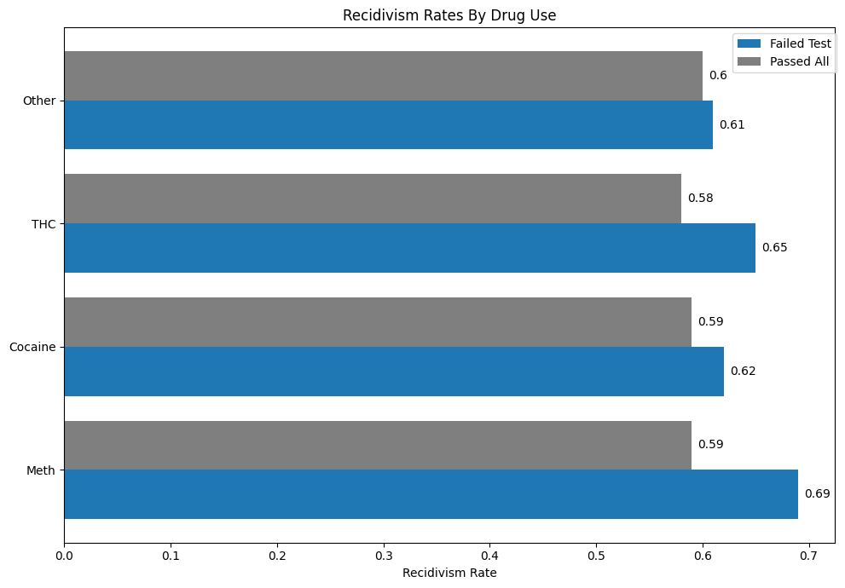
Substance Abuse
Those who tested positive at least once for THC, cocaine, or methamphetamine during their parole were more likely to recidivate that those who did not test positive at all.
We see the largest discrepancy among meth users and non-meth users.

Slide 11
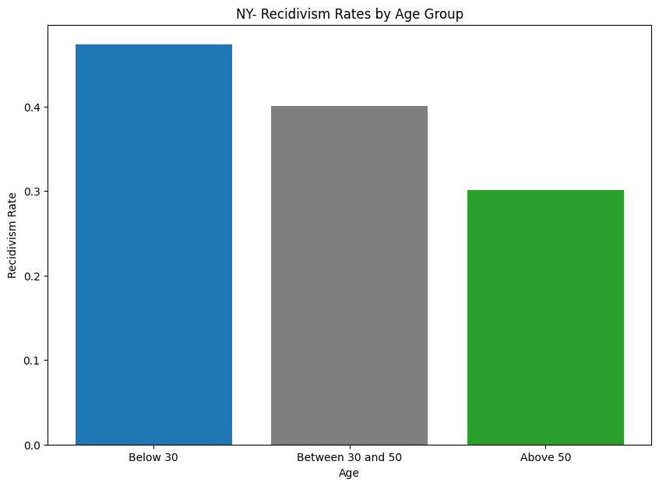
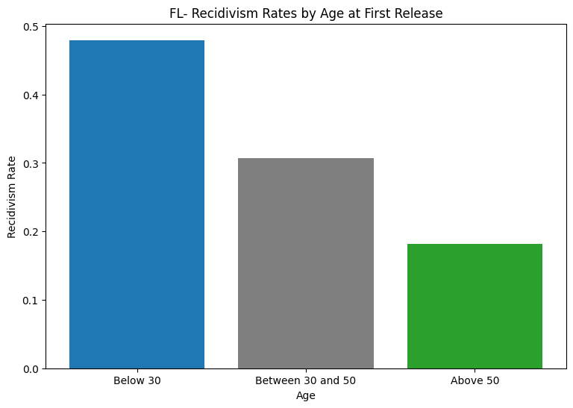
Age at Release
There is a clear relationship between an individual’s age at their initial prison release and their likelihood of reincarceration. In all three datasets, we found that those who are younger were significantly more likely to be arrested again.

Slide 12
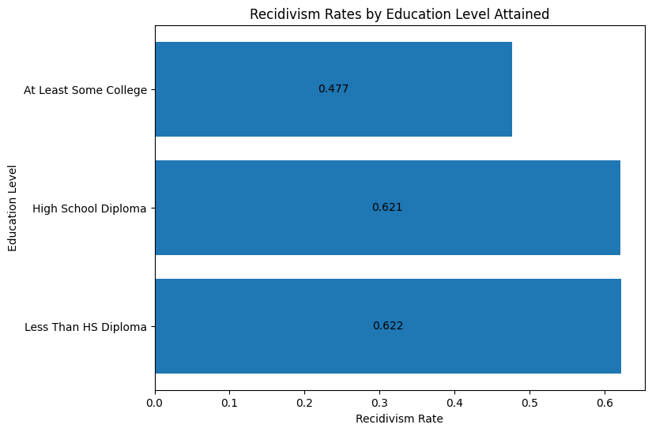
Education Level
Those who did not graduate from high school and those who do not have any education beyond a high school diploma have similar average recidivism rates of about 62%.
The lowest recidivism rate is seen in those that have at least some college experience.

Slide 13
Charge Type
possession of
fail to
license suspended
grand theft
in the
theft in
3rd degree
the 3rd
or less
possess cannabis
Add interpretations here

Slide 14
MODELING

Slide 15
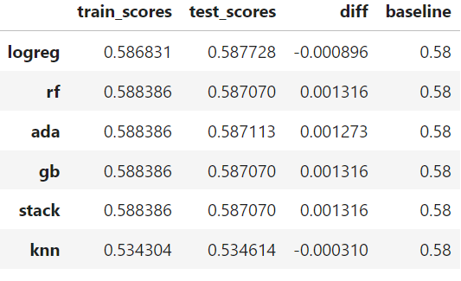
Basic Dataset
Age at Release/Gender/County of Indictment
Modeling with only age, gender, and county of indictment was unsuccessful (in what way).
Baseline accuracy: 0.58
Best performing model: Stacked model using Random Forest, Gradient Boost, and Logistic Regression,
60% accuracy.

Slide 16
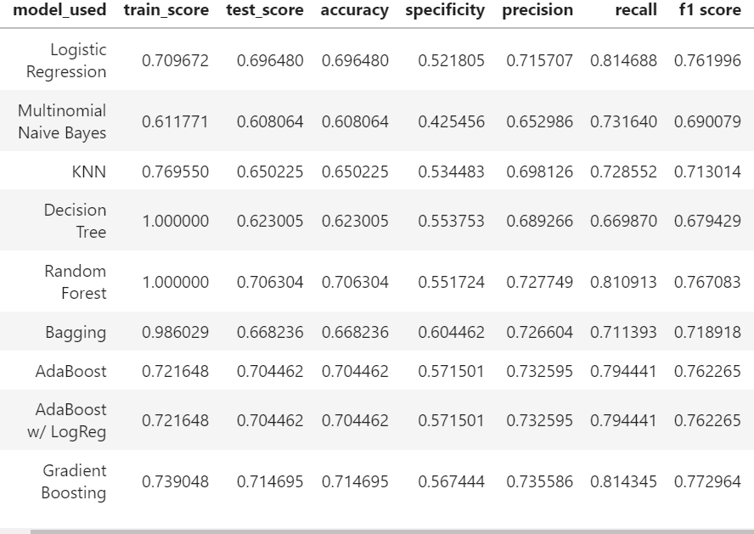
Behavioral Dataset
Comprehensive Features Model
Significant jump in accuracy from the basic model, as various behavioral features are factored in. Specificity score leaves room for improvement.
Baseline accuracy: 0.59
Best performing model: Gradient Boost model,
71% accuracy.

Slide 17
Criminal History Dataset
Non-NLP Model
Another big increase in accuracy scores (why) with the extra engineered features and x modeling.
Baseline accuracy: 0.61, before rebalancing
Best performing model: Neural Net, 86% accuracy.

Slide 18
CONCLUSIONS AND RECOMMENDATIONS

Slide 19
Conclusions
Can we predict recidivism?
In theory, yes. Our neural network model scored 86% in test accuracy, a 25% increase from the baseline.
Should we predict recidivism?
It’s critical to maintain objectivity throughout, as there are many opportunities for implicit bias to leak into modeling. We recommend excluding features that are outside of the subject’s control e.g. age, race, gender, etc.
What factors should be included in predictive models?
We found that certain behavioral and demographic features like gang affiliation, employment during parole, previous charges, and education level are strong determinants of one’s likelihood of recidivism.

Slide 20
Recommendations
Increase employment opportunities for prisoners and parolees.
Strong indication in our analysis that being employed during parole will reduce probability of recidivism.
There can be limited job opportunities for those who have been released from prison, but involvement in employment programs both during and after prison have been shown to reduce the likelihood of recidivism by up to 60%.
Target gang affiliates to break the cycle of recidivism.
Those who are gang-affiliated were twice as likely to be rearrested compared to those who are not.
Nonprofits like Filthy Rags Outreach focus on reducing gang violence by targeting current and former gang members in prison and equipping them with the skills needed to reenter their communities.

Slide 21
Recommendations
Increase access to educational programs and support for the incarcerated.
Our analysis showed a 20% decrease in the likelihood of recidivism for those who were
According to the Bureau of Justice Statistics, there is a 43% reduction in recidivism rates for individuals who participate in prison education programs.
Programs like The Last Mile focus on education for workforce reentry, and have significantly reduced recidivism rates of their participants.
Improve rehabilitation services, such as mental health and substance abuse programs.
More than 60% of individuals with a history of mental illness do not receive mental health treatment while incarcerated.
Because x, y, z. Effective reentry

