Slide 1


Slide 2
Online Pharmacy Portal
Project by: Gayatri Sravani Akella
Soujanya Akella
Chahnitha Chandu
Nikithanjali Dodla

Slide 3

Description
The proposed plan is to create a web page where a user can buy medicines and other pharmacy products online.
The page consists of
Login page
Admin page
Customer page
Registration page

Slide 4

Login Page
The login page is also the home page.
Each user, either admin or customer has to provide username and password to login.
Also has a button for new users to register.

Slide 5
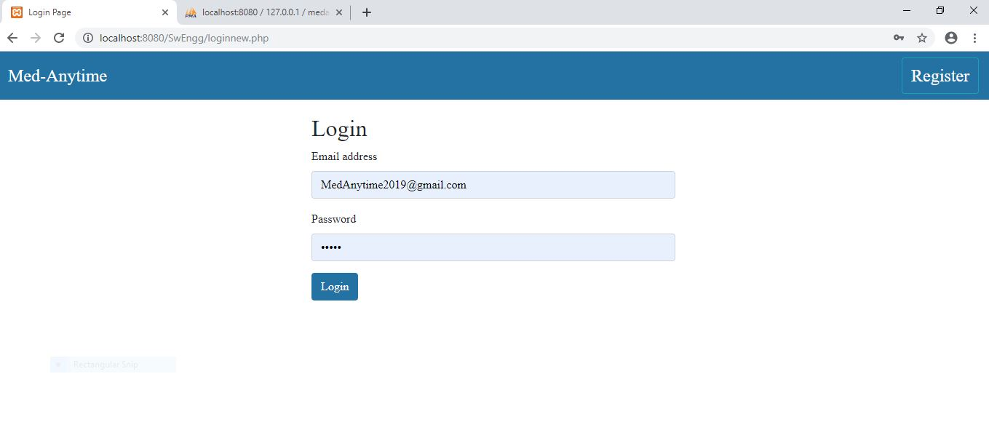
Login page:

Slide 6
Admin Page
The admin is the person who manages the website.
Operations and functionalities include:
Notification for every order
Accept/reject orders, generate FedEx tracking number
Add medicines in database
Update medicines count to reflect correct availability
Delete any medicines we do not sell anymore

Slide 7
Cont…
Admin login also is pretty similar. There is no registration option for admin as the page can only have one admin and was created manually.
The admin just has to enter his/her email-id and password and the page will take them to the admin home page instead of the user homepage.
The admin on the other hand can view all the products in the inventory by clicking on the Inventory button on the top bar in his home page

Slide 8


Slide 9
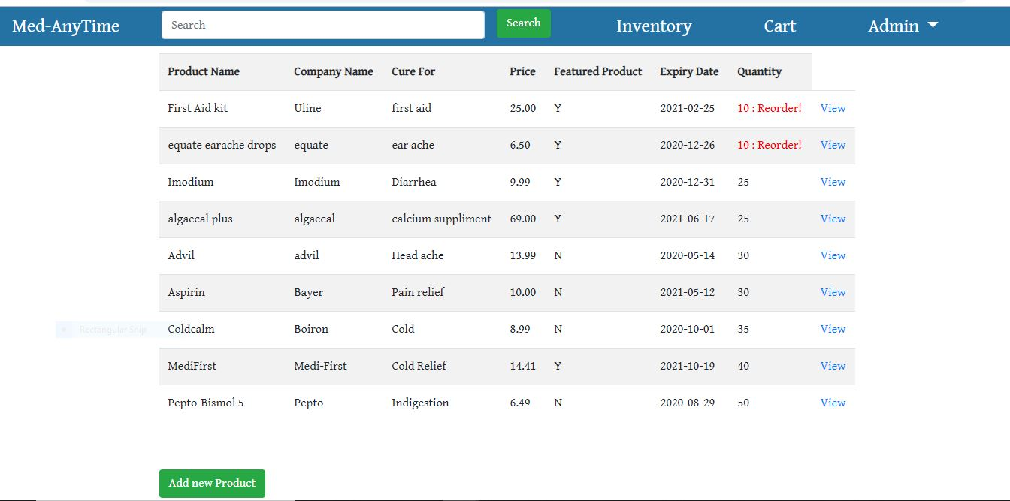
Cont.…
The list of products will be displayed as shown below.

Slide 10
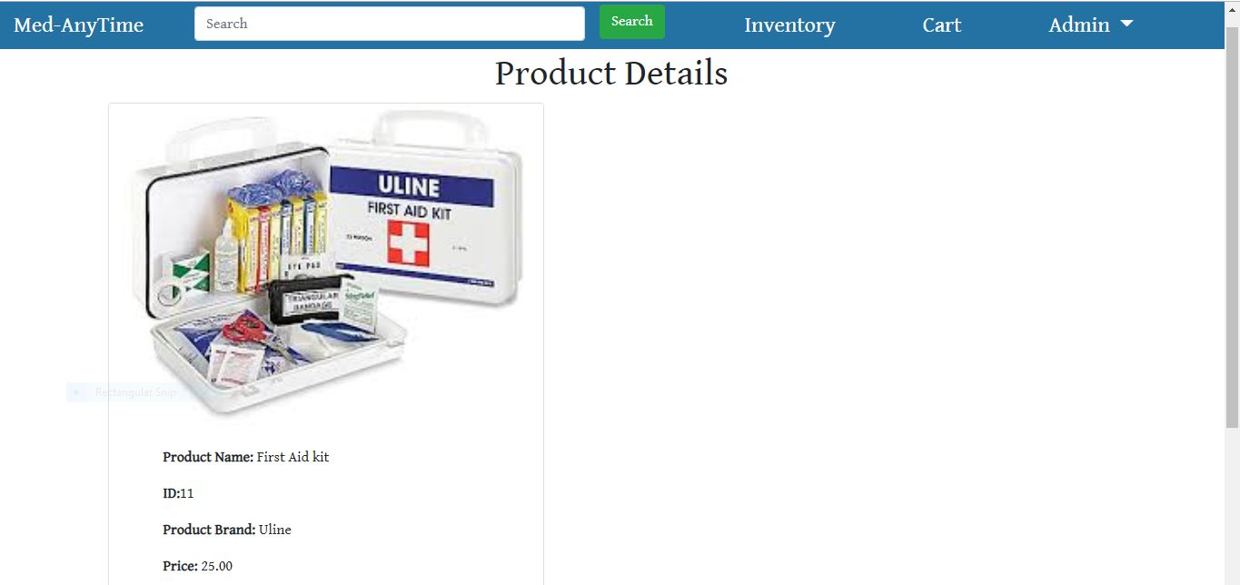
Cont.…
The admin clicks on the view button to view the product details and also can edit the details.

Slide 11
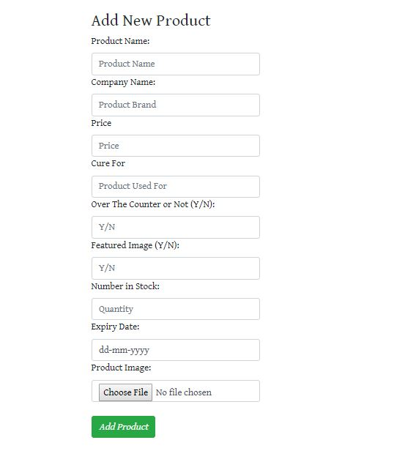
Cont.…..
The admin can see a Add new Product button. On clicking this button, admin can add more products to the webpage.

Slide 12
User Page
The user page or the customer page is where the medicines can be ordered and bought.
Functionalities include
Search bar for “over the counter” medicines
Search bar to directly look for a particular drug
Cart to see what all we have added
Redirection to payment page

Slide 13
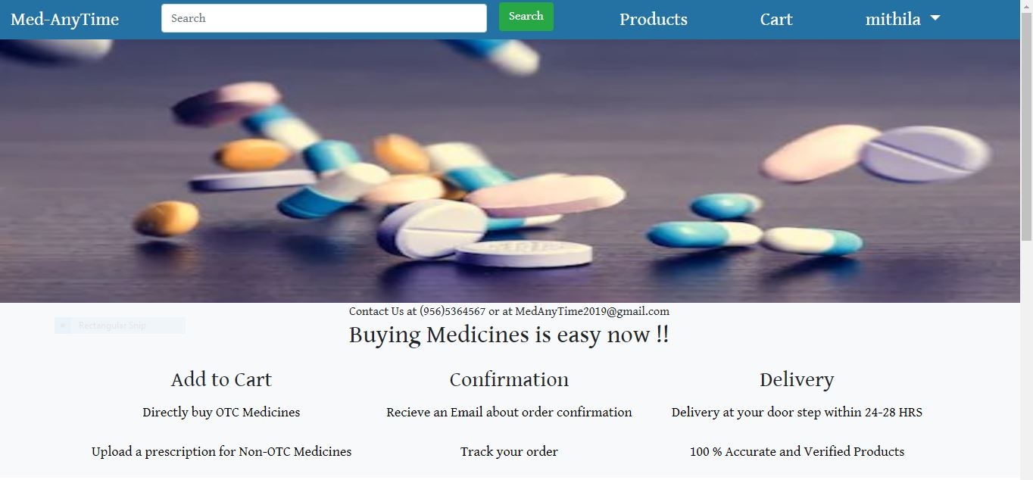
User home page:
This is how the user page looks after the user login with the email-id and the password provided at the registration.

Slide 14


Slide 15
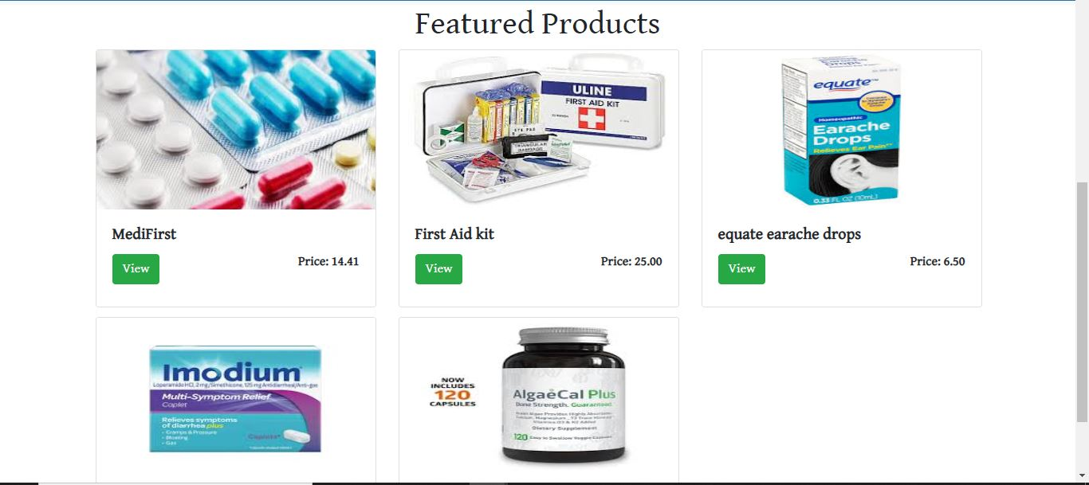
User page:
The user page displays the list of products that can be bought on MedAnytime. Some of the products can be seen below:

Slide 16

Registration Page
In this page all new users can register themselves as customers of Med-AnyTime.
To register they need to provide:
First name
Last name
Gender
Government Id
Date of Birth
Email-Id

Slide 17
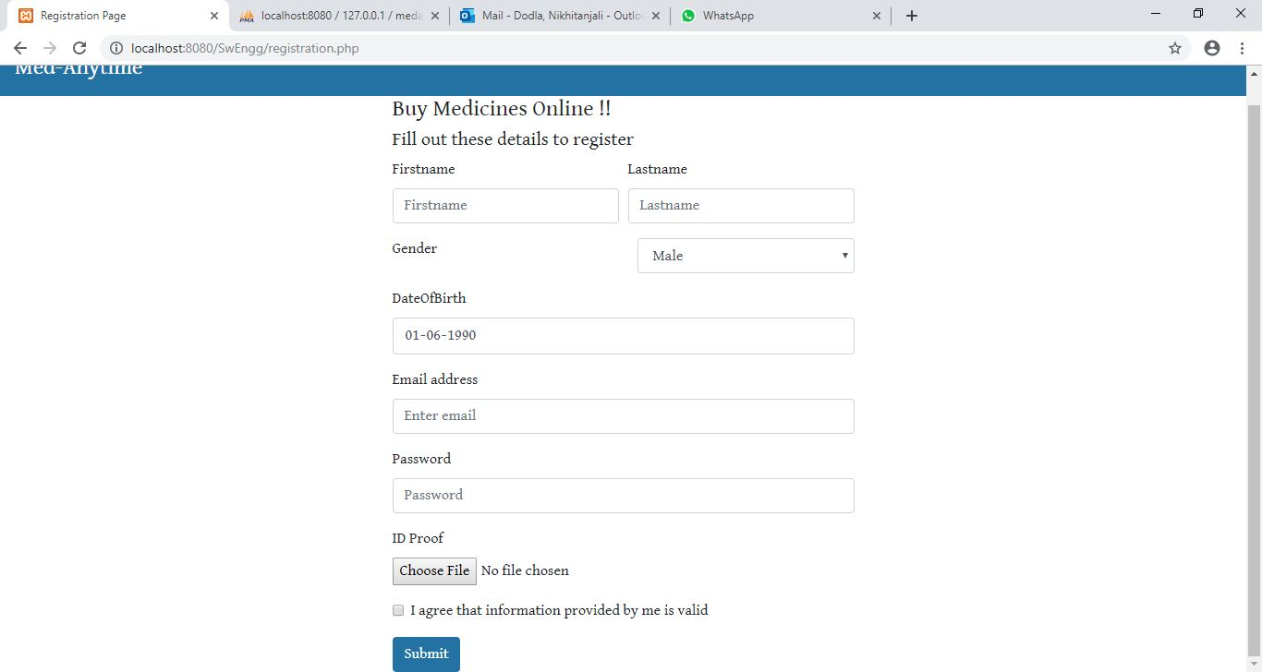
Registration page:

Slide 18
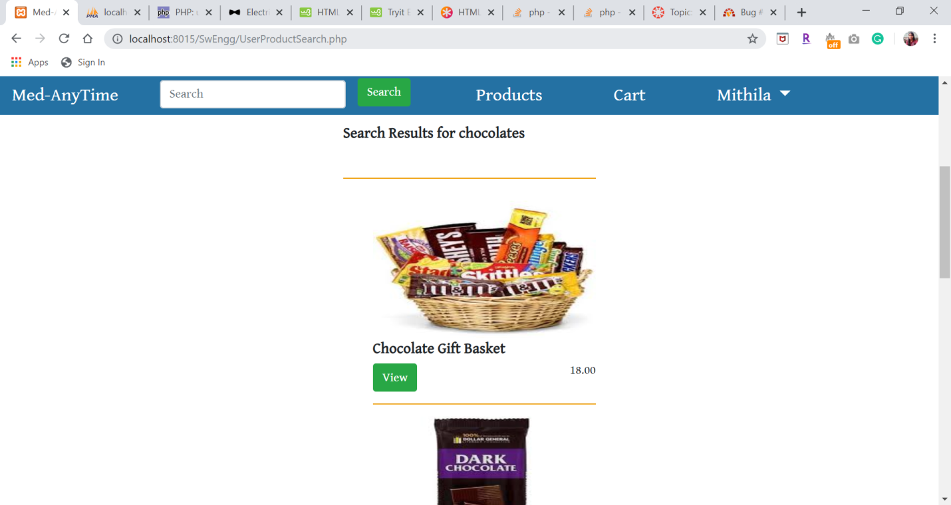
Search bar:
It allows the user to search for specific medicines by typing in the title of the medicine. The screenshot is shown below:

Slide 19
Add to cart functionality:
The user can add products to his/her cart. To do so, user must click on the specific product to open its details. The page should show a button ‘Add to cart’ on it.
The user should click on the button and the product will be added to the cart in their account.

Slide 20
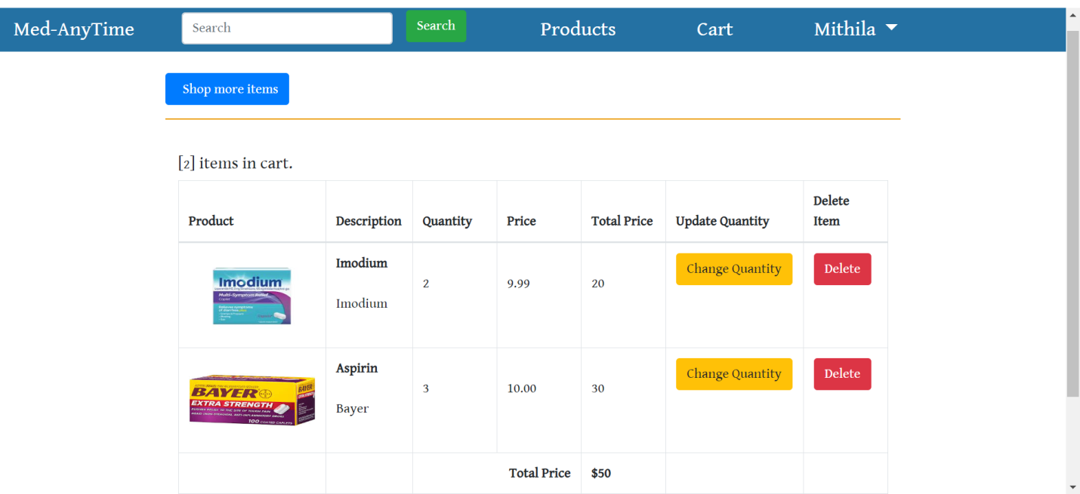
Cont.…
The below screenshot shows that a user has added a product to their cart

Slide 21
Checkout functionality:
To place an order, the user needs to click on the cart symbol on their page, where they will be able to view all the products in it.
It also shows a button ‘check out’ in the cart page. If the user clicks on it, they will be asked for an address to ship the order to.
The user should now type in the address, as street address, county, city, state and Zip code. After typing the details, click on ‘save address’ and then click on ‘continue’.

Slide 22
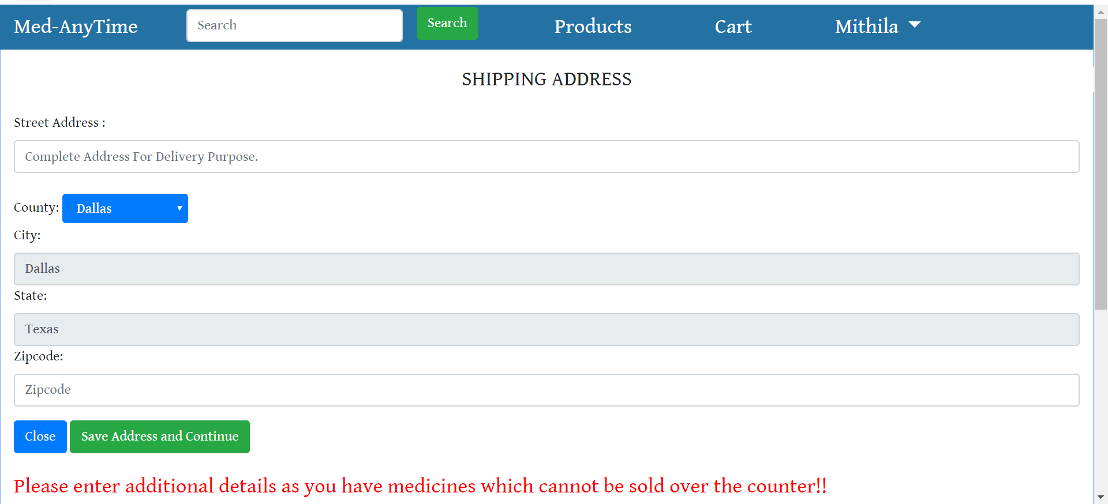
Cont.

Slide 23
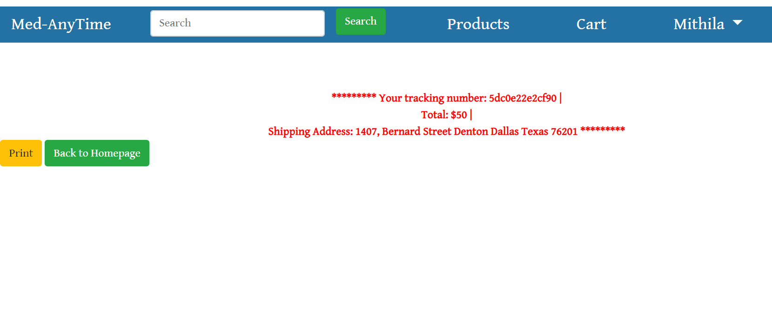
Cont..

Slide 24
Cont..
The user can also order for medicines with prescriptions. These medicines are specifically flagged.
Therefore, if they are present in the cart, the user will be prompted for a prescription and doctor details (doctor name, email id and an NPI number). These details will be physically checked by the admin.

Slide 25
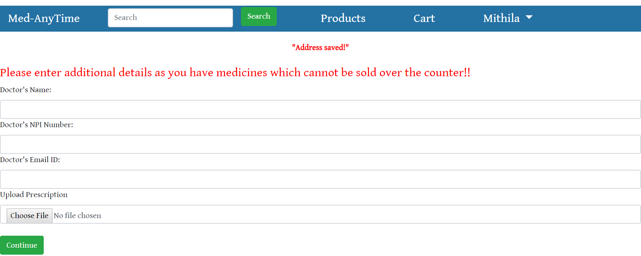
Cont..

Slide 26
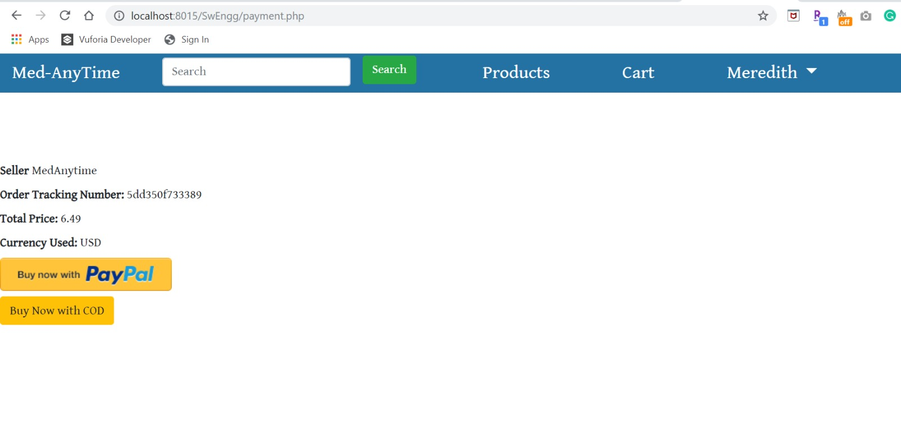
Payment functionality:
The PayPal is used for the online payment of the products. The screenshots are seen below:

Slide 27
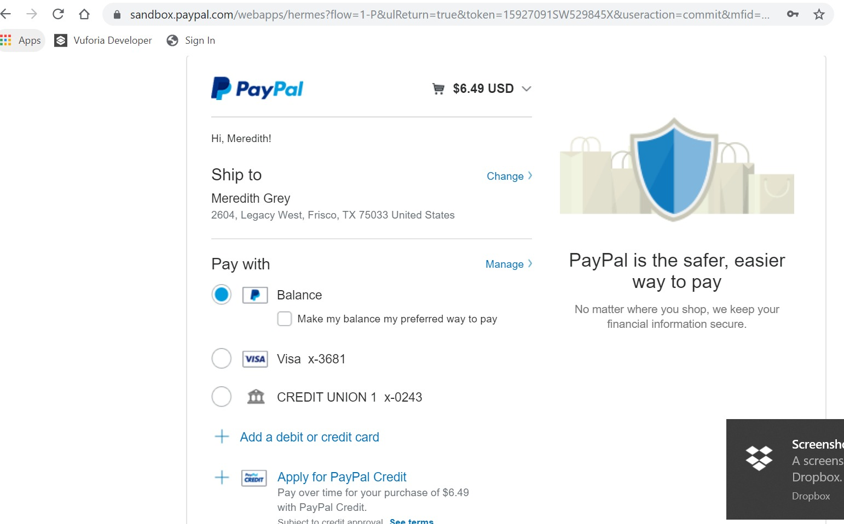
Cont..

Slide 28
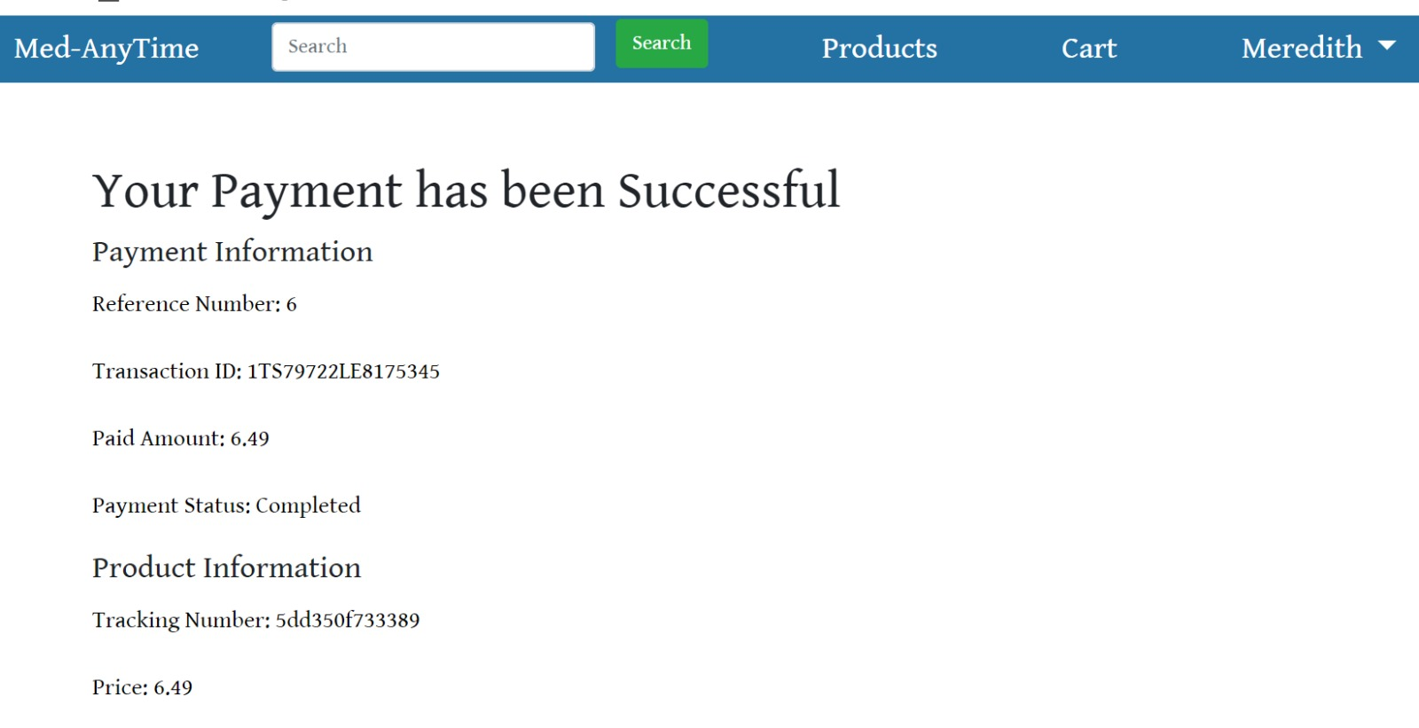
Cont..

Slide 29
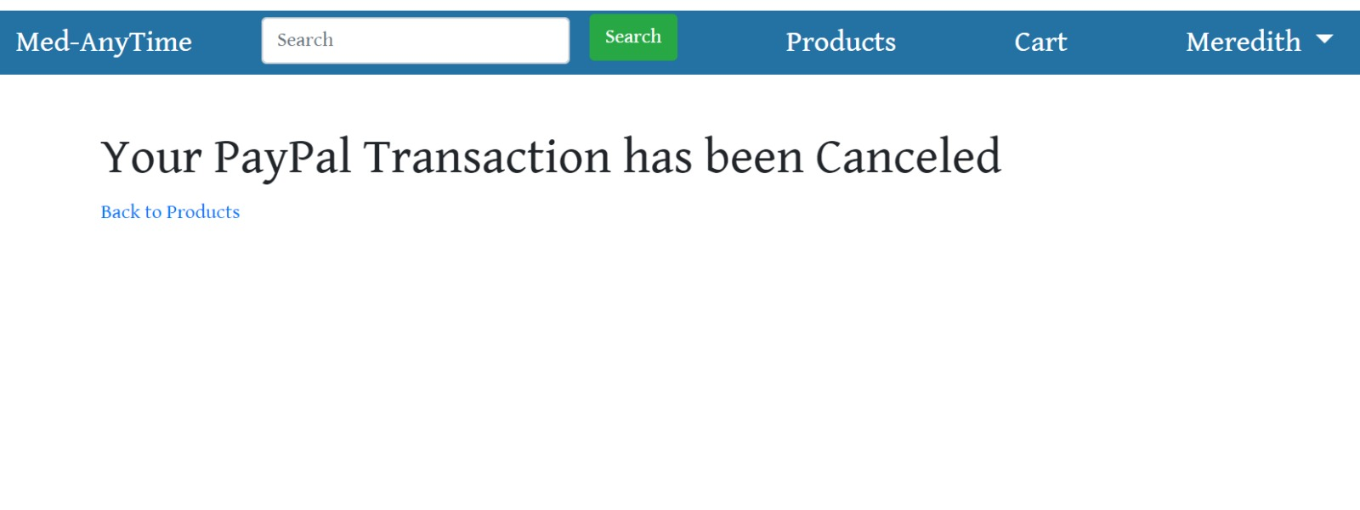
Cont..
If the balance is insufficient then we get a message that the payment was cancelled.

Slide 30
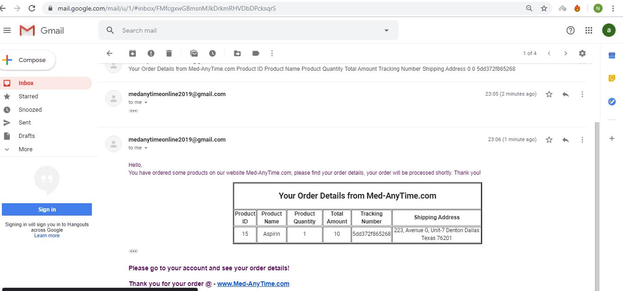
Email verification:
After the order is placed, the user receives an email confirmation that the order is placed. The screenshot is shown as below:

Slide 31
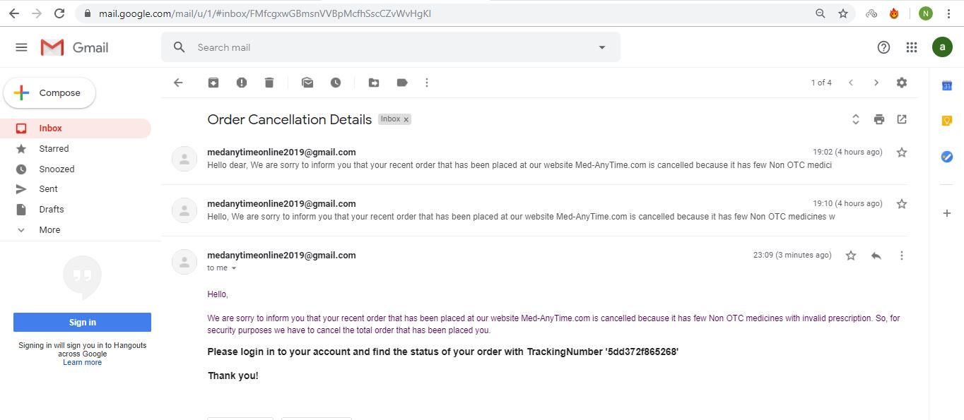
Cont..
If the order is cancelled as well, the user receives ane mail that the order was cancelled.

Slide 32
Requirements & Specifications
Languages Used: PhP, Bootstrap, CSS, Sql
Server Used: XAMPP
Development Environment: Visual Studio Code

Slide 33
Team member’s responsibilities:
Gayatri Sravani Akella- Creation of the database, development of the inventory page, Database manager for the admin account, Cart functionality for user, PayPal integration for payments, testing and documentation.
Soujanya Akella- Development of login and registration page, Validations for registering users , products add/delete in admin page, Development of page that asks for the address, generation of tracking numbers, PayPal integration, Testing and documentation.

Slide 34
Cont.….
Chahnitha Chandu- Configuration of XAMPP server, Development of admin page, Page to page navigation, Search functionality for the admin and the user, Testing and documentation.
Nikithanjali Dodla- Development of user page, products display in user page, Database changes whenever admin makes any changes, Notify admin when the order is placed by user, orders page in user side , Testing and documentation.

Slide 35
Testing:
For the unit testing, we used the PHPUnit. PHPUnit is a unit testing framework for the PHP programming language.
We have done the unit testing for the Login and the Registration n deliverable 3. It was successfully implemented.
The screenshots of the login and registration test code is shown below:

Slide 36
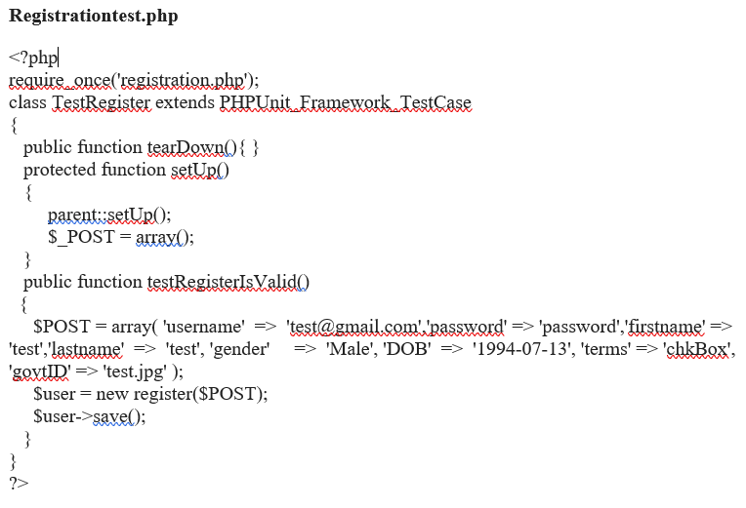
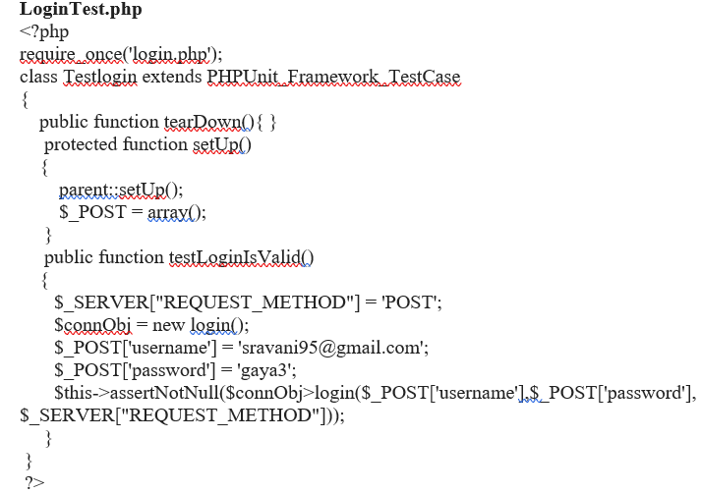
Cont.…

Slide 37
Cont.…
The unit testing was also done for the adding of the products, update, checking the doc details, And adding of products in the deliverable 4. It was also successfully implemented.
In the final deliverable, the unit testing of the payment and the mailing was done.

Slide 38
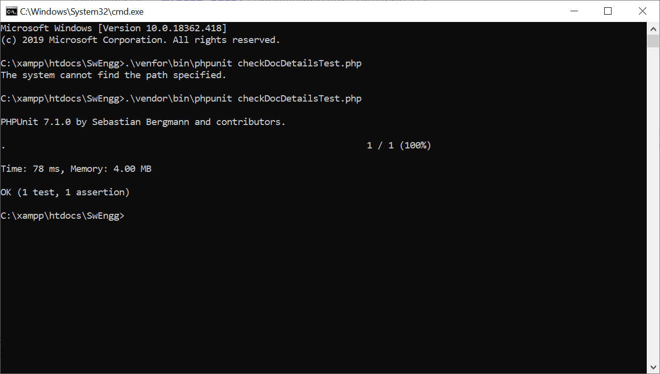
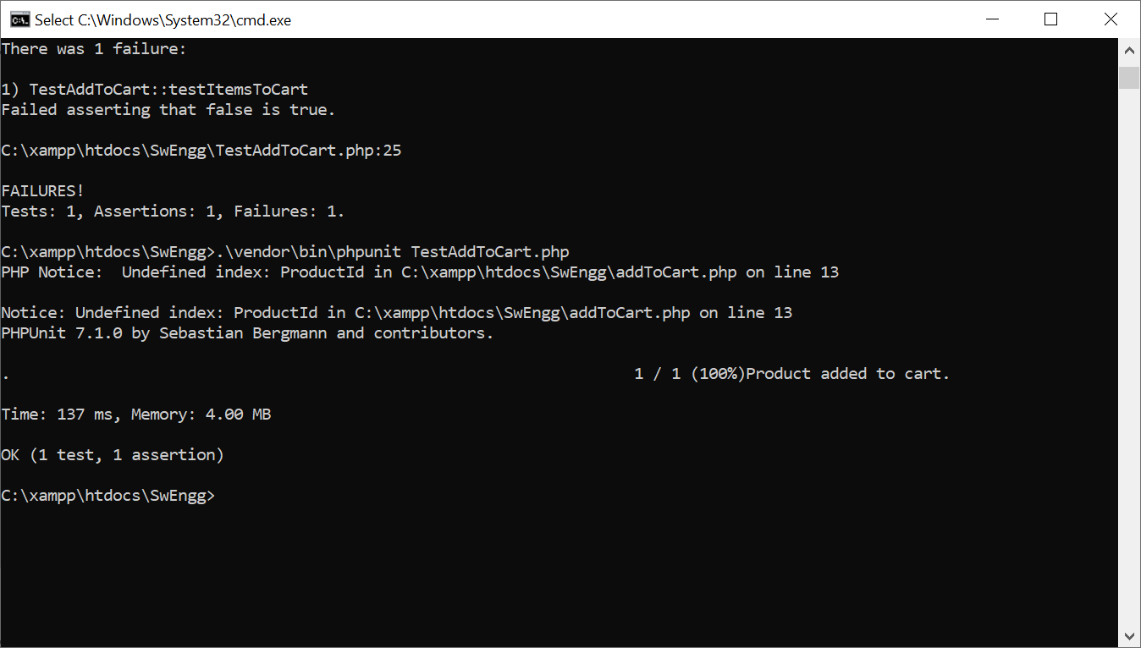
Cont..
Below are some of the screenshots showing the unit testing is successfully implemented.

Slide 39
Feedback from Peer reviews:
In the first peer review session, the following feedback and suggestions were received:
1) Including system architecture would be more helpful than having ER diagrams in the SRS document.
2)They felt that our Development plan phases are not clearly explained.

Slide 40
Cont.…
For the system architecture part, the architecture and overall structure was specified in the next deliverable document.
All the phases of development phases were discussed with our peers and clarified all their questions. Any other minor ambiguities were also discussed.

Slide 41
Code Inspection details:
The functions and classes were not used in the code since we used the PHP .
But by using PHP it was quite useful for implementing the unit testing.

Slide 42
Limitations:
The application we have come up with right now is a mere prototype. It will still not work in real-time as the whole application is working on Xampp and is on the localhost. Therefore, the product changes and orders will reflect in the same system only.
Refunding the bill total to the customer when their order is either cancelled or rejected.
Also, tracking of each individual order is still out of scope for the project.

Slide 43


