Slide 1










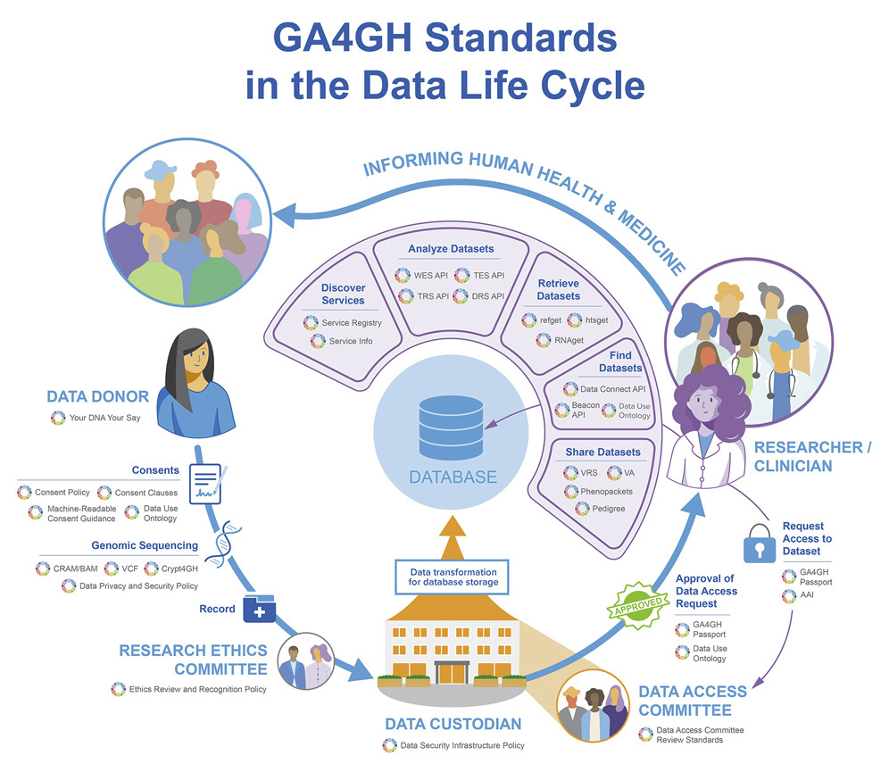














Quality Control of Whole Genome Sequencing
HEBRARD Maxime¹, HOFMANN Oliver², BERTIN Nicolas¹, SMITH Lindsay^{3,} on behalf of GHIF QC for WGS Workgroup
Precision Health Research Singapore (PRECISE), Genome Institute of Singapore (GIS), Singapore
Australian Genomics, Melbourne, Australia
Global Alliance for Genomics and Health (GA4GH), Ontario Institute for Cancer Research (OICR), Canada
Motivation
Goals
Robust quality control (QC) is key for the successful population-scale sequencing efforts. Multiple studies have discussed the need to evaluate the performance of variant calling pipelines prior to introducing them in production, and to monitor the quality of results beyond initial validation.
QC of Whole Genome Sequencing (WGS) results can be achieved through a range of tools that compute metrics from FASTQ, BAM, and/or VCF files. Recommendations on which metrics to include in routine QC have been discussed in published guidelines and continue to be actively developed. Nonetheless, standardized definitions and implementations of such metrics have yet to be addressed.
For the initial round of this project, we propose to focus on QC of human WGS datasets (germline), generated with short-read technologies for research and/or clinical use. The proposal has been based on previous work from the GA4GH Benchmarking Team. We intend to adopt an equivalent structure:
Metric Definitions:
Landscape analysis / Compile available quality metrics
Prioritize metadata fields
Develop a schema for QC reporting
Lack of standard
Reference Tool Implementations:
Landscape analysis / Compile available tools and pipelines
Identify gaps
Integration with GA4GH Tool Registry Service
Non-N bases in autosomes
Whole genome
Duplicates ⨯
31.7
36
✓ Duplicates
Overlapping bases ⨯
NA12878 Coverage
✓ Overlapping bases
Secondary alignment ⨯
✓ Secondary alignment
Benchmarking Resources:
Benchmarking reference tools
Develop a “Common Practice” resource guide
Given the increasing number of population-scale studies, we believe that creating a common framework for the QC of WGS results is needed to ensure that data generation adheres to published guidelines, in turn establishing confidence in the data quality and facilitating the exchange of results across initiatives. We propose to engage with GHIF/GA4GH participants and relevant tool developers to work on a reference implementation that would provide practical recommendations on this matter. Such work would complement the existing guidelines by providing (i) standardized definition for key QC metrics, (ii) tools for calculating them, and (iii) benchmarking resources that would aid in the interpretation and monitoring of results.
Ontology for QC Metrics:
Test Case - Ontologize “mean autosome coverage”
Workgroup Progress
Fall 2020: Singapore suggests creation of QC for WGS workgroup
Integration in GA4GH Ecosystem
2020-2021: Draft project proposal
Available @bit.ly link below
Feb 2021: Proof Of Concept
Available @github link below
June 2021: First workgroup meeting
June 2022: Draft roadmap
Available @bit.ly link below
July 2022: Draft reference implementation
Available @github link below
QC for WGS
Get in Touch
Agreeing on QC metrics is insufficient – we need standardized definitions. The GHIF QC for WGS workgroup is a collaboration of various national-scale initiatives to define a common language for WGS QC. Currently discussing definitions for BAM/CRAM-derived metrics
SEND YOUR FEEDBACK | ghif-qc@ga4gh.org
FOLLOW THE GROUP | https://bit.ly/GHIF-QC
FIND US ON GITHUB| https://github.com/c-BIG/wgs-sample-qc
NEXT WORKGROUP MEETING | October 19th 12pm GMT

