Slide 1
Data Science Challenge
Facial Expression Recognition
Georgios Athanasiou
06 September 2023

Slide 2
Overview
Introduction
Setup
Data
Modelling Approaches
Results
Discussion

Slide 3
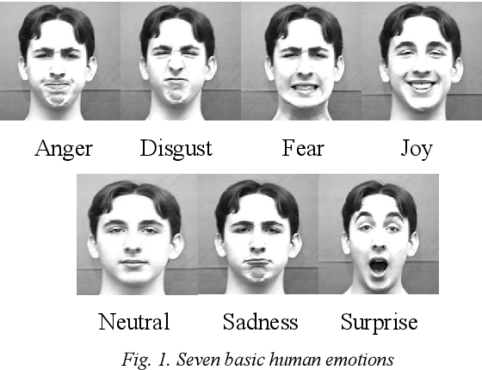
Introduction
Image classification problem
Supervised learning problem

Slide 4
Setup
Environment
Programming language: Python
Libraries: NumPy, SciPy, PyTorch, TensorFlow, …
GitHub Repository
https://github.com/ga83wuw/facial_expression_recognition
Files
requirements.txt
notebooks
source code

Slide 5
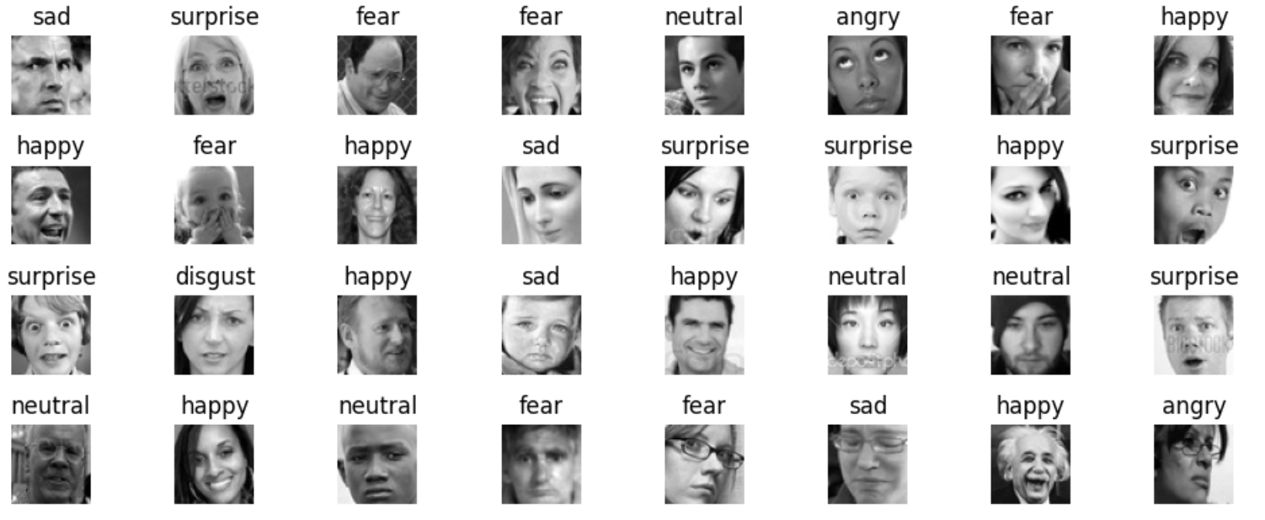
Data
FER-2013 Database¹
Training set:
size: 35,887
image dims: 48x48x1
Classes:
angry
fear
disgust
sad
happy
surprised
neutral
¹https://www.kaggle.com/datasets/msambare/fer2013

Slide 6
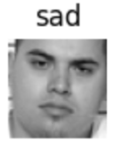
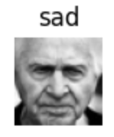
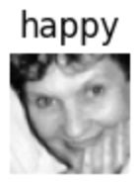
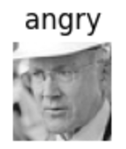

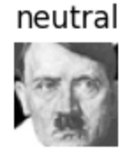
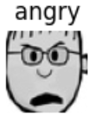
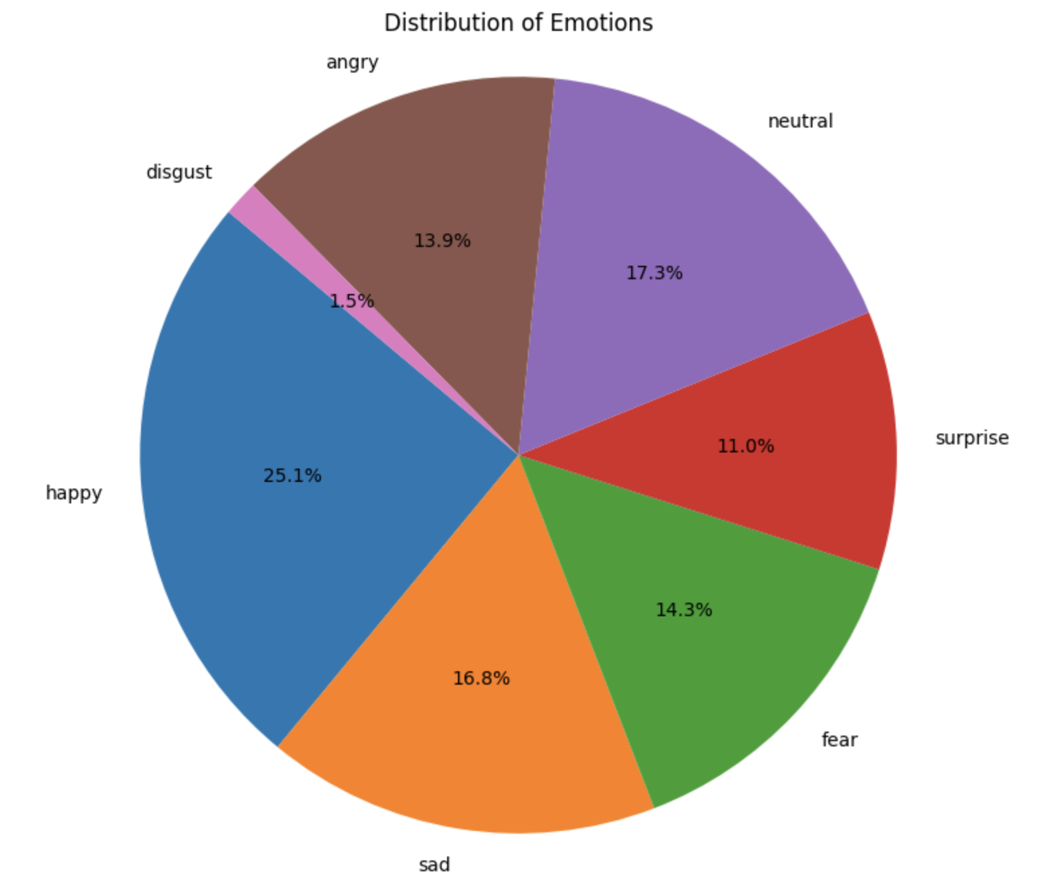
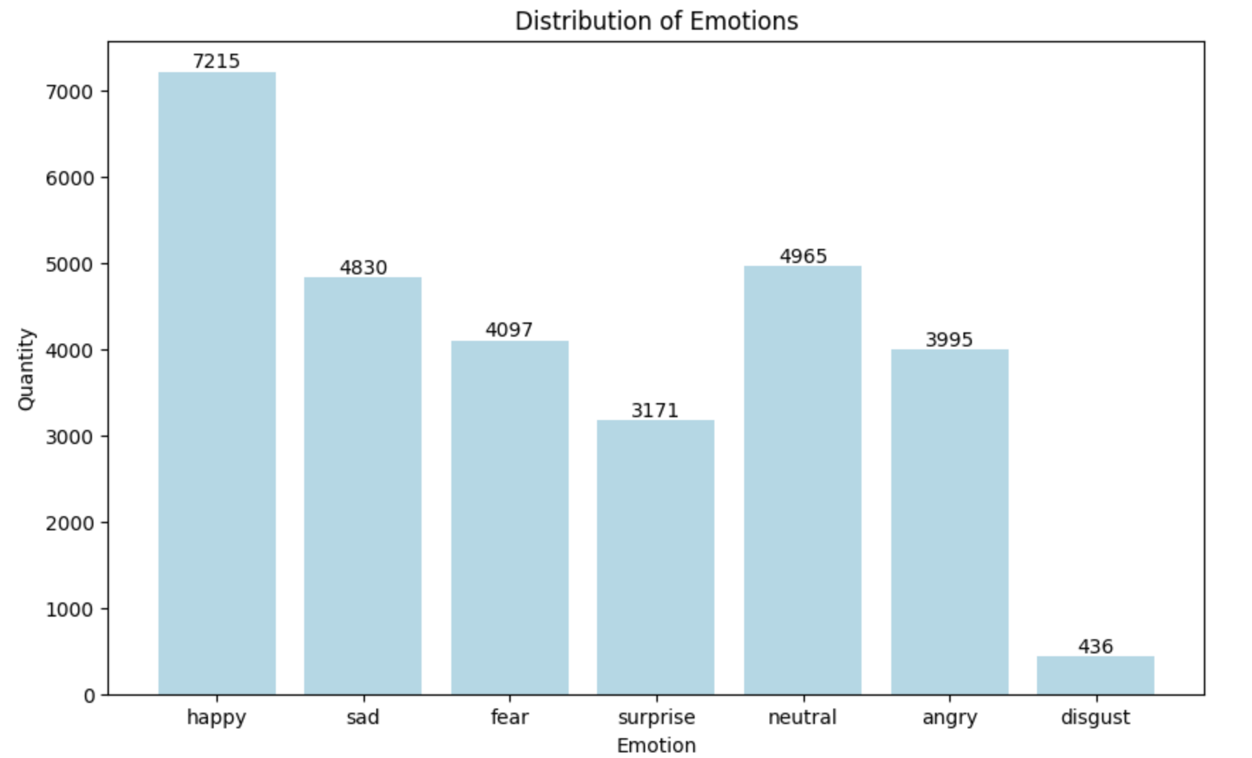
Data
Insights
ambiguous cases
cartoons
pretty balanced
‘disgust’ case

Slide 7
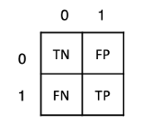
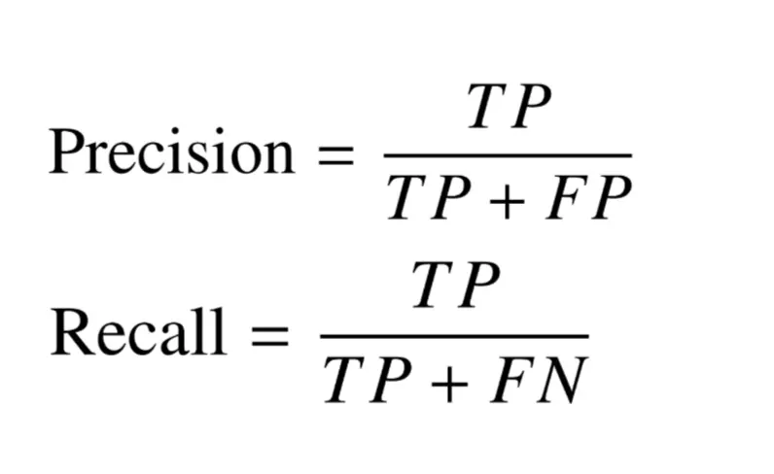
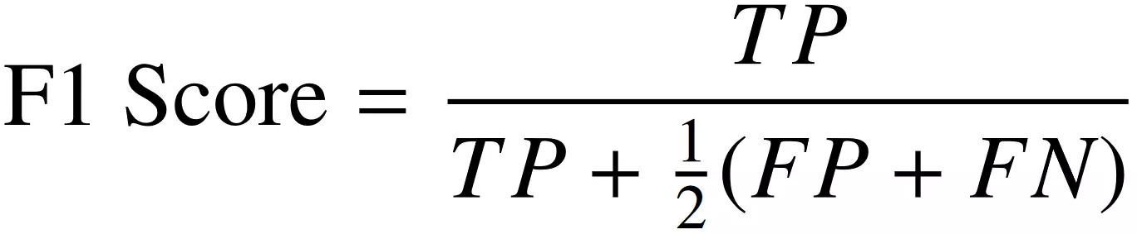
Data
Tackle ‘disgust’ case
Oversampling
Undersampling
Data Augmentation
Weighted loss functions
Evaluation metrics
Accuracy
Recall
Precision
F1-score
Ensemble methods

Slide 8
Data
Tackle ‘disgust’ case
Oversampling
Undersampling
Data Augmentation
Weighted loss functions
Evaluation metrics
Accuracy
Recall
Precision
F1-score
Ensemble methods

Slide 9
Modelling Approaches - Initial Training
2x Conv2d layers
2x Conv2d layers
Batch Norm
ReLU
Batch Norm
ReLU
Batch Norm
ReLU
Batch Norm
ReLU
dropout
dropout
dropout

Slide 10
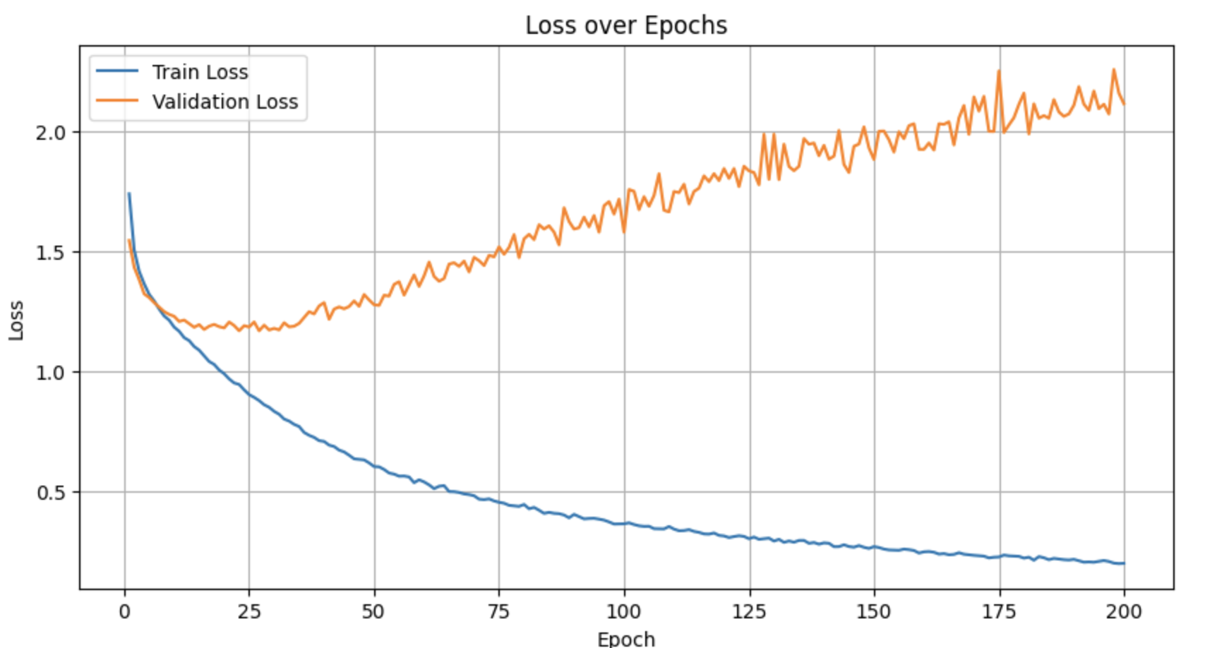
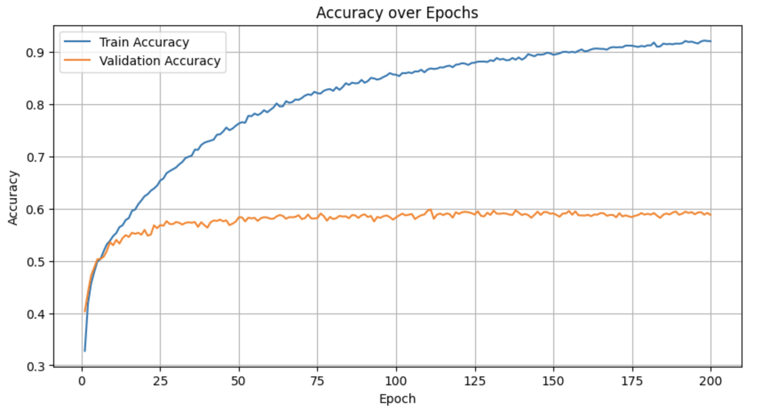
Modelling Approaches - Initial Training

Slide 11
Modelling Approaches - Initial Training
overfitting

Slide 12
Modelling Approaches - Background Research
Kaggle competition
top 10 scores around 65%
Several different architectures in GitHub
Best approach²
Ensemble Resnet50 + Vgg16
Score 67.2% on Kaggle dataset
Score 78.3% on external datasets
External datasets for transfer learning
²https://www.semanticscholar.org/paper/Recognizing-Facial-Expressions-Using-Deep-Learning-Savoiu-Wong/59b50e396e657627cc503a0747c5b84bd17c5468

Slide 13
Modelling Approaches - Best model
Modified architecture
Data oversampling

Slide 14
Modelling Approaches - Data
sad
angry
surprsd
neutral
happy
fear
disgust

Slide 15
Modelling Approaches - Data
sad
angry
surprsd
neutral
happy
fear
disgust

Slide 16
Modelling Approaches - Data
sad
angry
surprsd
neutral
happy
fear
disgust

Slide 17
Modelling Approaches - Data
sad
angry
surprsd
neutral
happy
fear
disgust

Slide 18
Modelling Approaches - Data
sad
angry
fear
neutral
disgust
surprsd
happy

Slide 19
Modelling Approaches - Data
sad
angry
fear
positive
happy
neutral
surprised
negative
neutral
disgust
angry
surprsd
sad
fear
happy

Slide 20
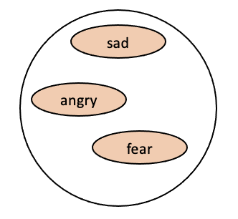

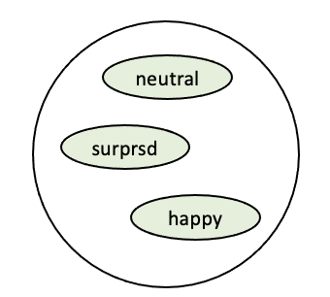
Modelling Approaches - Pipeline
CNN
angry
sad
CNN
fear
CNN
happy
surprised
neutral

Slide 21
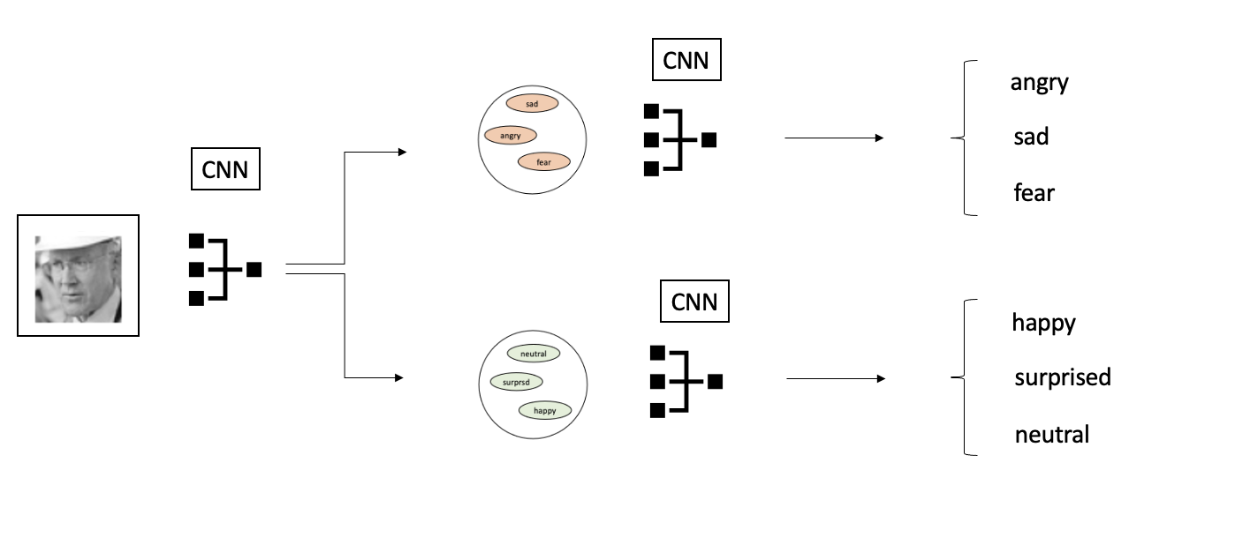
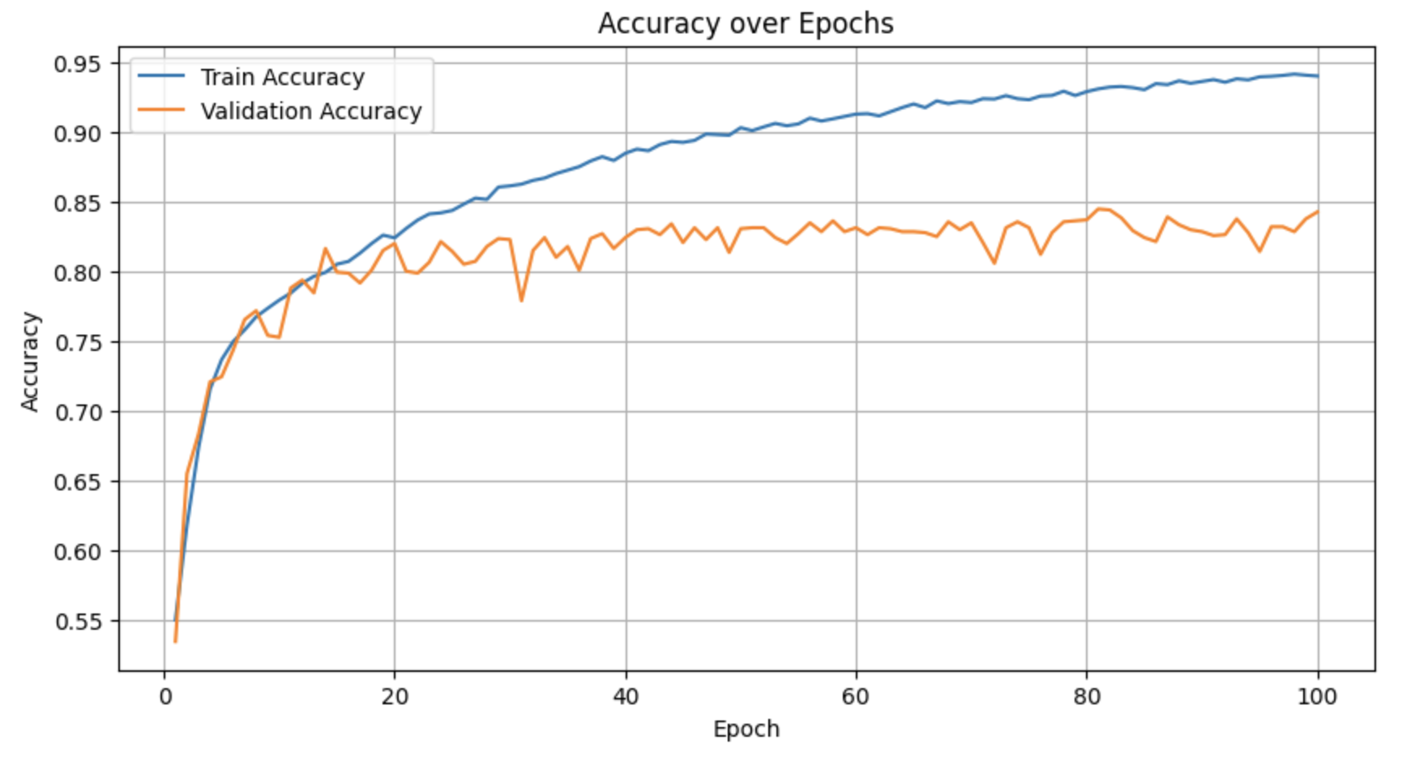
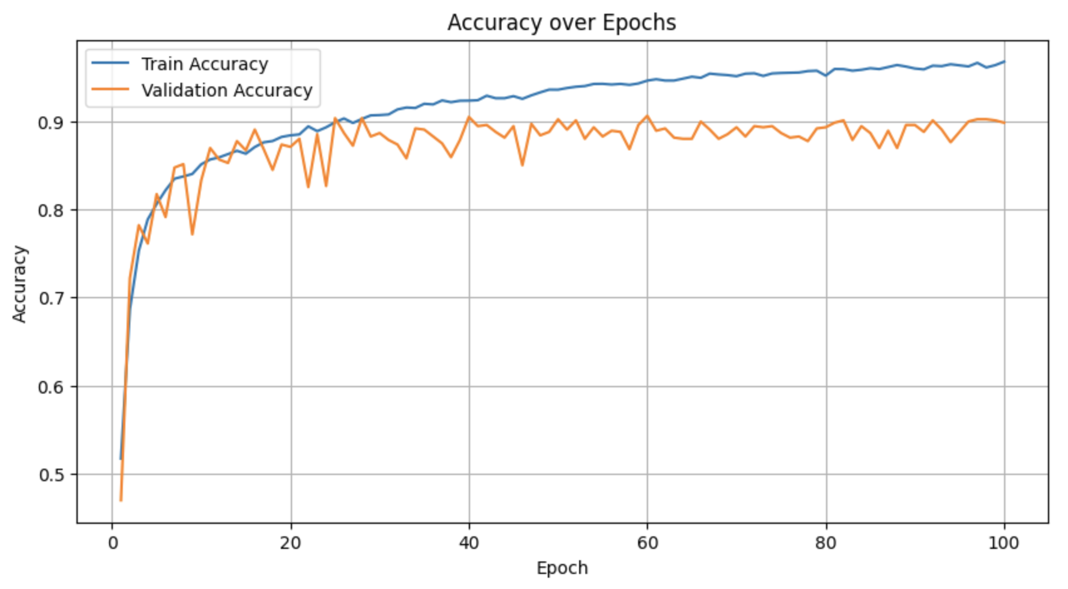
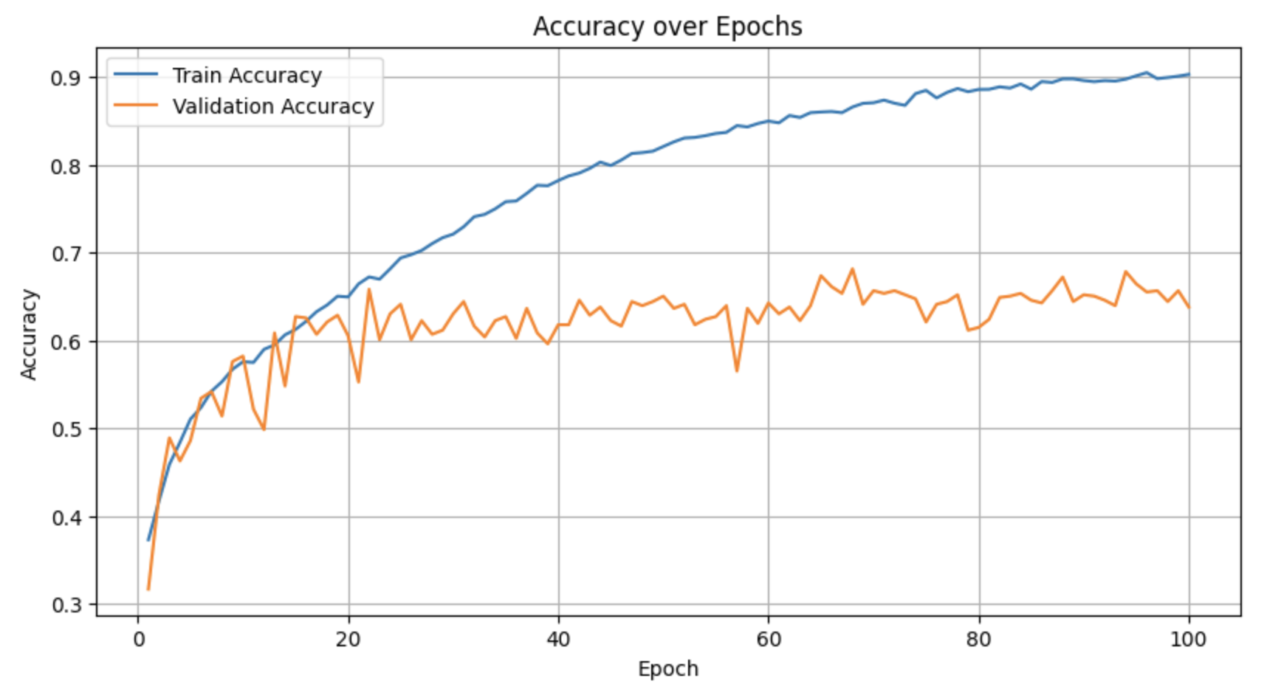
Modelling Approaches - Pipeline
85% on test set
90% on test set
70% on test set

Slide 22
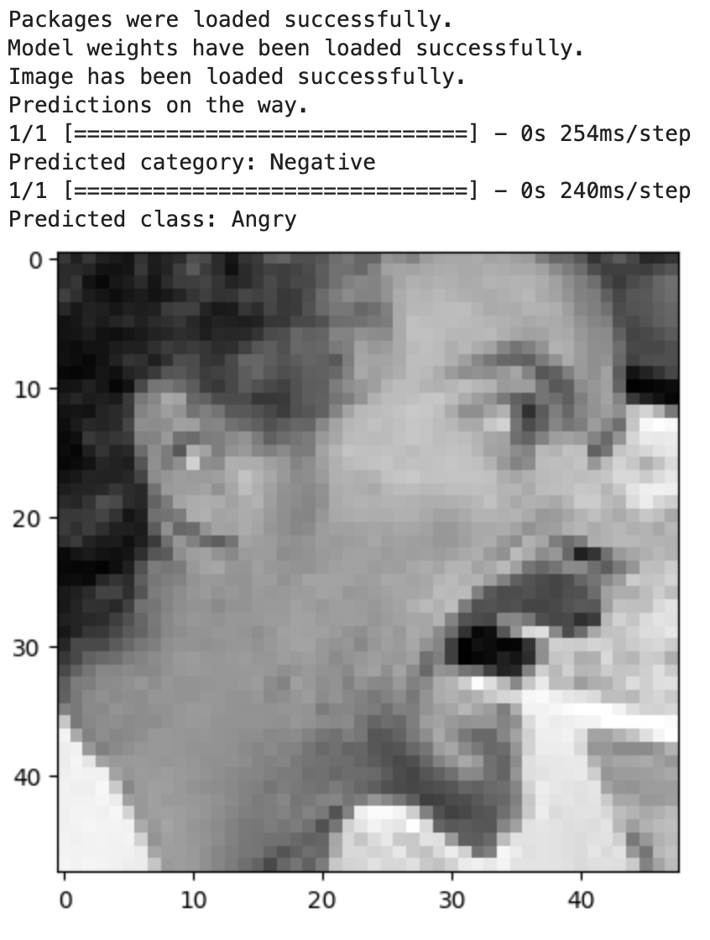
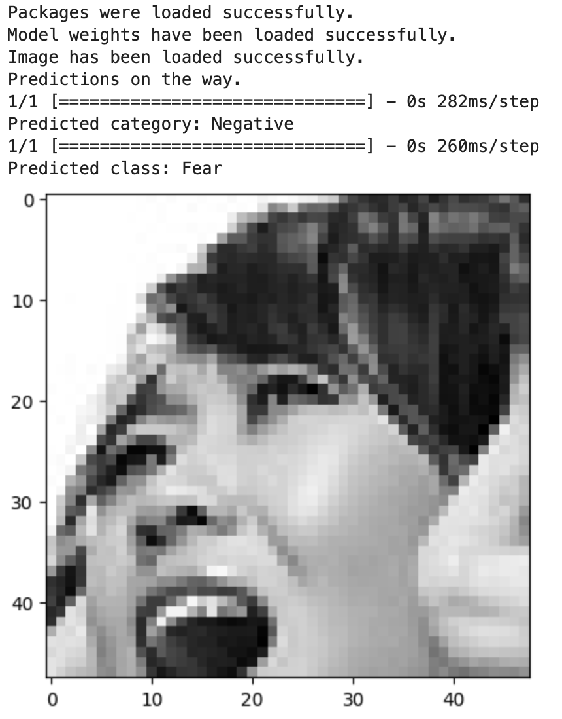
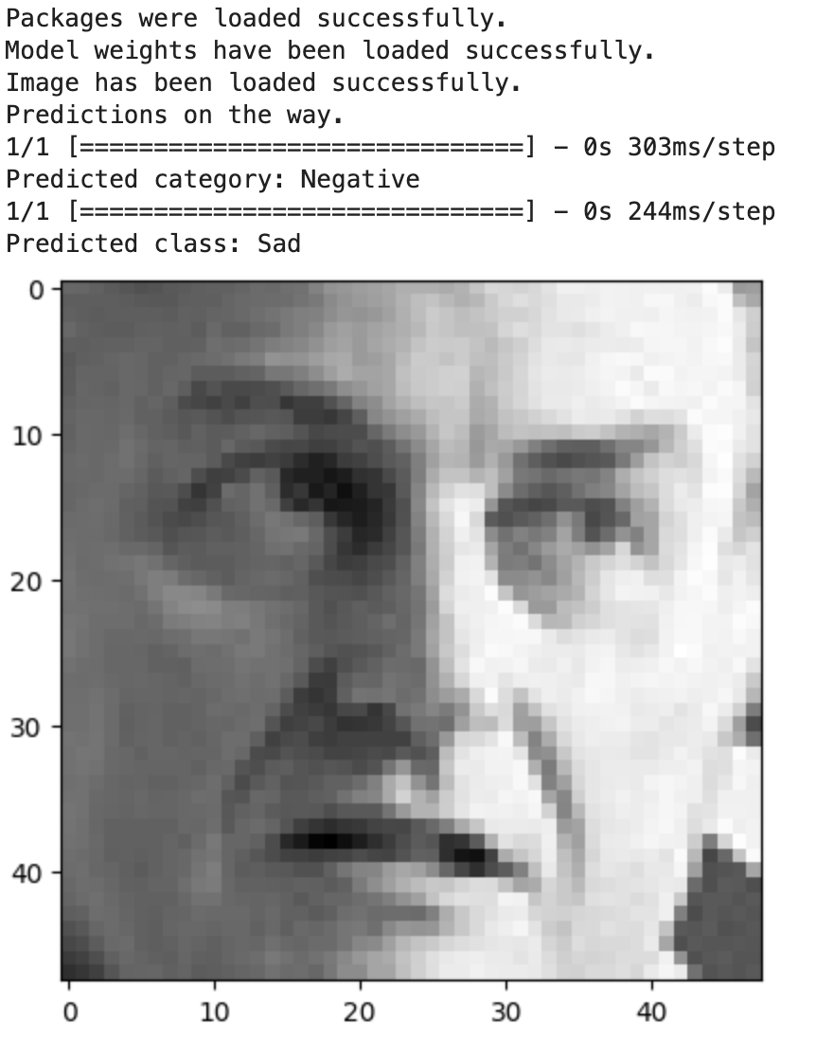
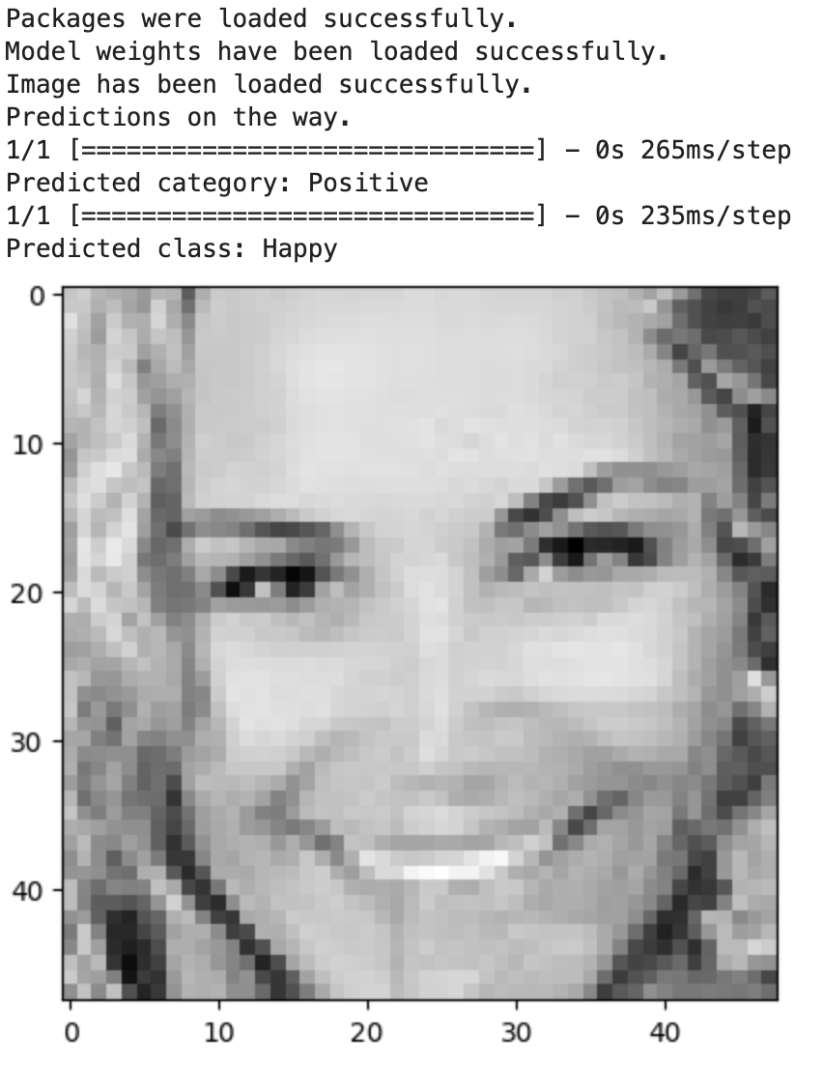
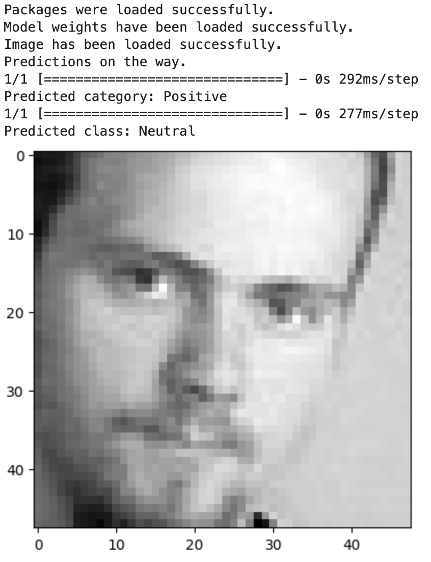
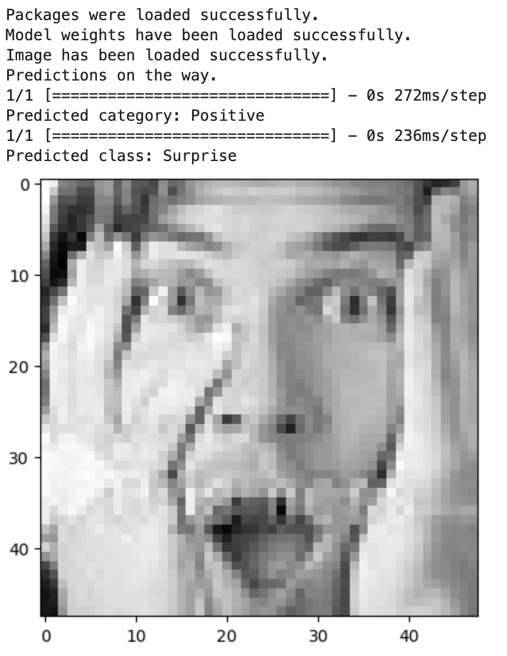
Results

Slide 23
Results
happy | 83.99%
surprise | 75.81%
neutral | 58.72%
angry | 58.25%
sad | 59.26%
fear | 45.21%

Slide 24
Results - Comparison
proposed method
base method
happy | 83.99%
surprise | 75.81%
neutral | 58.72%
angry | 58.25%
sad | 59.26%
fear | 45.21%
happy | 85.79%
surprise | 83.51%
neutral | 72.99%
angry | 56.78%
sad | 48.52%
fear | 42.19%

Slide 25
Discussion
Improvements
Modifications in step-methodology
Transfer learning
GANs for more images of the smaller groups.
Examine more efficient architectures
Active learning with likelihood
Detect RoIs within images and train over them
eyebrows
lips shape
eyes
hands touching face
…

