Slide 1

Bit-Interleaved Coded Modulation in Fading Rayleigh Channel
Kevin Li
Technische Universität München
Elektro und Informationstechnik
Lehrstuhl für Nachrichtentechnik
Ort, Datum (Schreibweise: 00. Januar 2015)

Slide 2
Roadmap
Communication Chain
Capacity in AWGN Channel
Frame Error Rate in AWGN Channel
Frame Error Rate in Rayleigh Fading Channel
Validation of the Implementation for Rayleigh Fading Channel

Slide 3
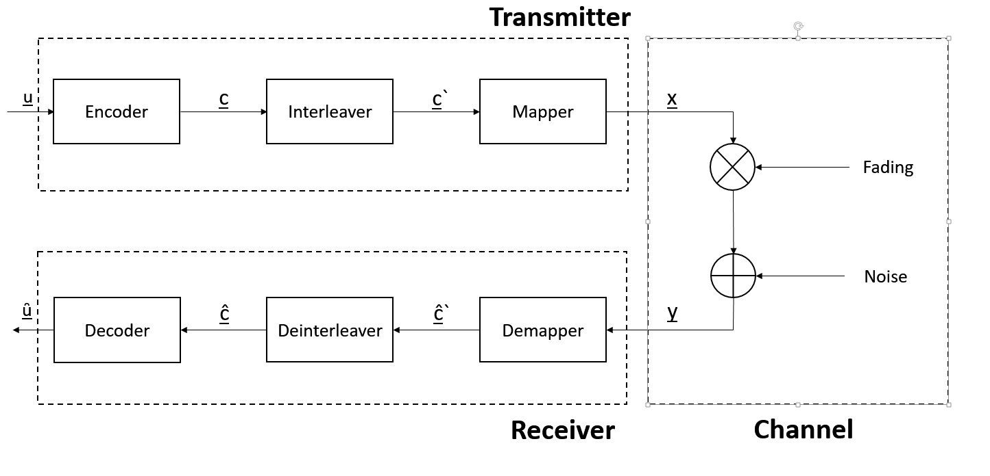
Communication Chain
Notes:
Insert Communication Chain
Explain BICM
Stand for bit interleaved coded modulation, which means that before any modulation is done the codeword is interleaved
Used in standard communication protocols (4G, WiMax,…)

Slide 4
Communication Chain Blocks
Encoder/Decoder
Used for error correction
WiMax LDPC used
Different rates and classes for encoding
Interleaver/De-Interleaver
Improve communication by preventing burst errors
Especially useful in LDPC codes
Mapper/Demapper
Modulation: Assigning codeword a corresponding symbol sequence
Classical modulation schemes:
M-PSK, M-FSK, M-AM and M-QAM
In this thesis: QPSK, 16-QAM and 64-QAM

Slide 5
Endoder/Decoder
Implementation for stable/less error prone communication
Many forms of encoder:
Linear block code
Convolutional codes
Turbo Code
Further look into LDPC codes
Especially WiMax Encoding:
List technial details

Slide 6
Bit Interleaver
Interleaver used to improve communication chain for both AWGN and Fading channels
Especially useful for LDPC codes
Distributing burst errors uniformly helps decoding the mesasage correctly

Slide 7
Mapper/Demapper
Creates symbol sequence out of codeword
Different constellations possible
Used here:
QPSK, 16-QAM and 64-QAM
Explain those shortly

Slide 8
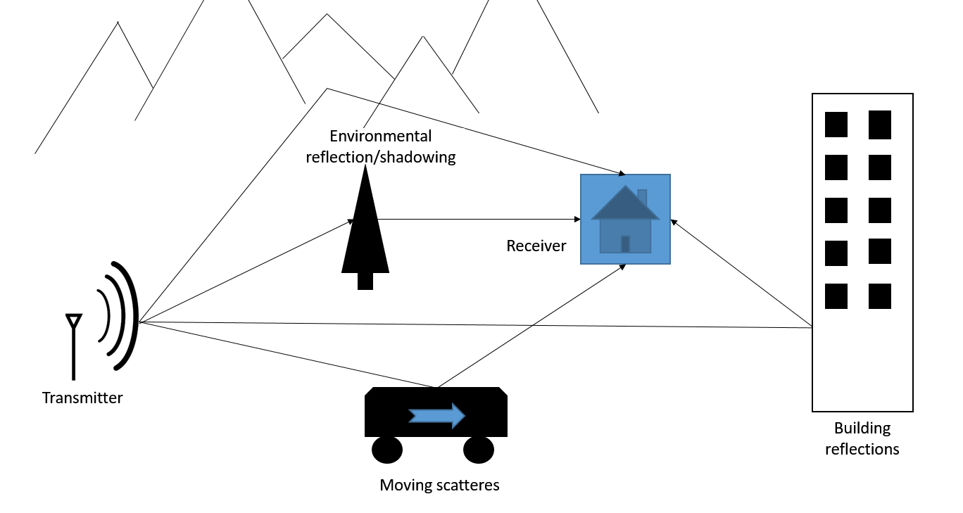
Channel

Slide 9
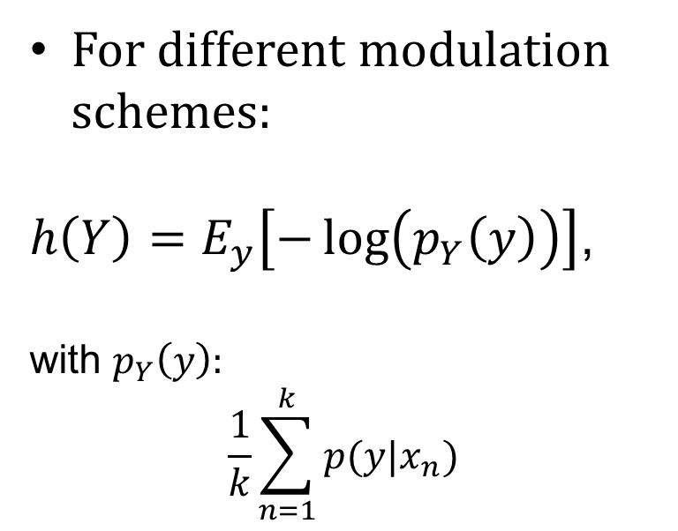
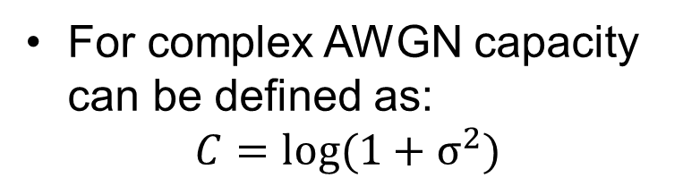
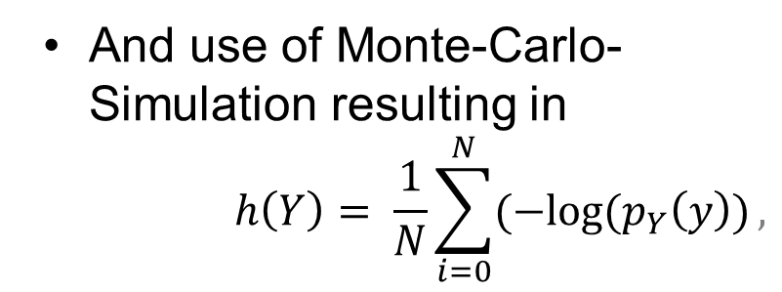
Capacity in AWGN Channel
For complex AWGN capacity can be defined as:
$$C=log⁡(1+σ^{2})$$
For different modulation schemes:
$h\left(Y\right)=E_{y}\left[−\log\left(p_{Y}\left(y\right)\right)\right]$,
with $p_{Y}\left(y\right):$
$$\frac{1}{k}\sum_{n=1}^{k}{p(y|x_{n})}$$
And use of Monte-Carlo-Simulation resulting in
$$h\left(Y\right)= \frac{1}{N}\sum_{i=0}^{N}{(−log⁡(p_{Y}\left(y\right))},$$

Slide 10
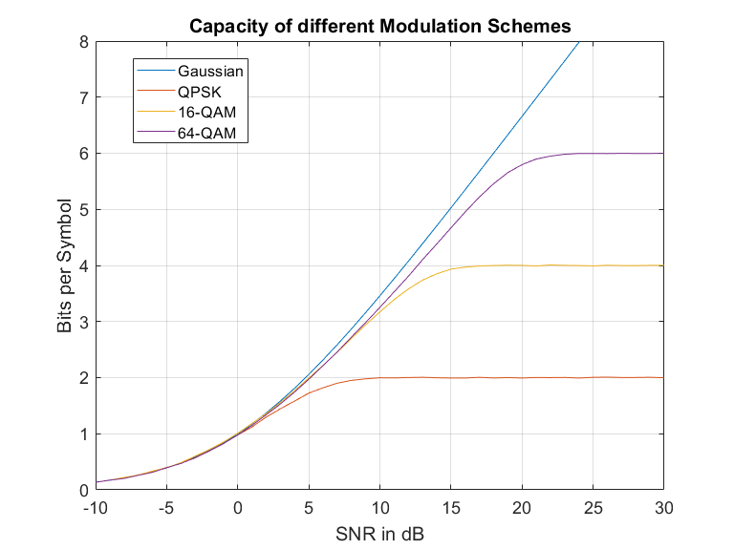
Results Capacity for AWGN
All three modulation schemes reaching expected bits per symbol
All three modulation schemes in boundary
Notes:
Shortly explain results

Slide 11
Frame error Rate for AWGN Channel
What is FER?
Frame error rate: Determining the sucess rate over all transmissions
Soft decision demapping
More precise/accurate demapping
More complex system overall
Notes:
What is FER? Define
Mention LDPC and CML
Hard-decision vs. Soft-decisionl

Slide 12
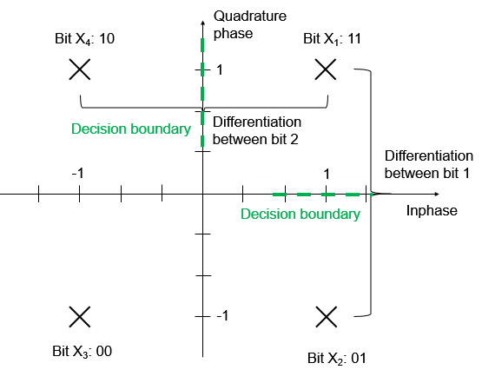
Log-Likelihood ratio
Log-likelihood gives reliability of decision
Use of euclidian distance

Slide 13
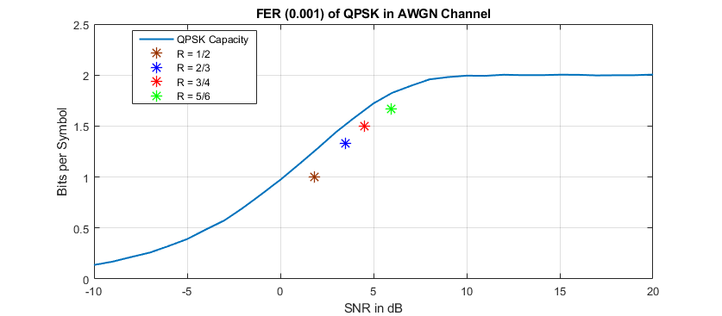
Simulation Results
1.5 dB
2 dB
Four FER rates calculated
SNR difference between optimal capacity to FER
Higher rates need less SNR to achieve desired FER
All four rates do not exceed optimal capacity boundary

Slide 14
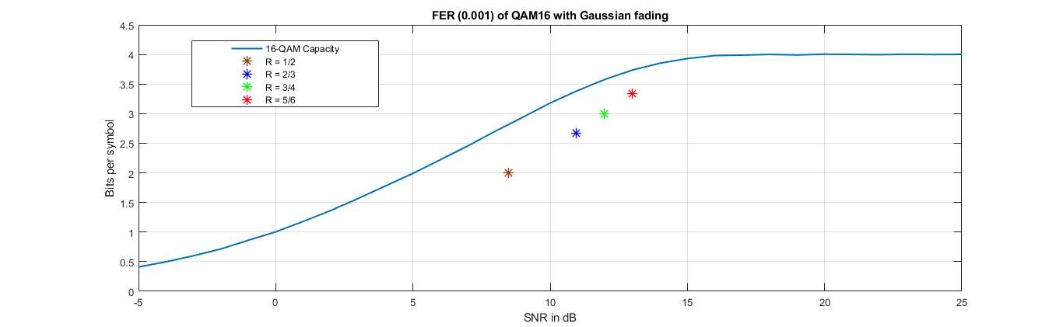
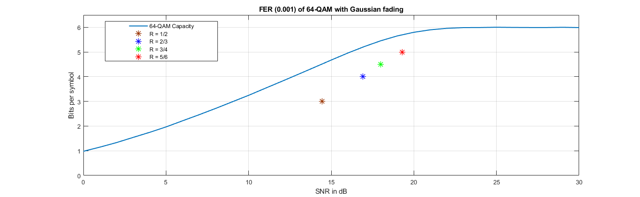
Simulation Results
2 dB
3 dB
3 dB
5 dB

Slide 15
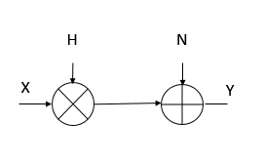
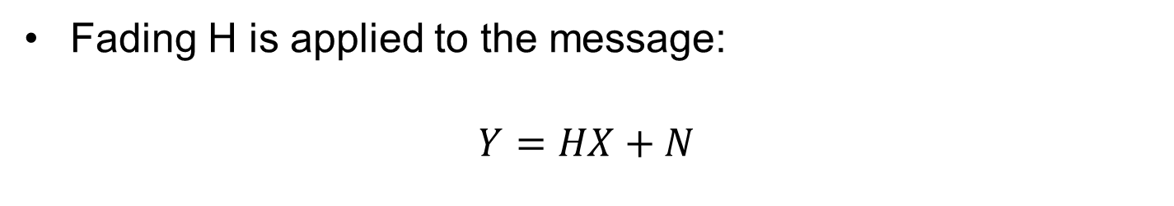
Capacity in a Rayleigh Channel
Fading H is applied to the message:
$$Y=HX+N$$
Block fading used:
Slow fading is applied
CDI is applied
Two different receiver settings simulated:
Receiver CSI
Unknown fading coefficient

Slide 16
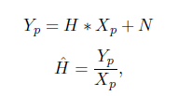

Receiver CSI vs. Estimated Fading
Receiver CSI:
Division by known fading coefficient:
Message restored with scaled noise factor
Estimated fading:
Estimate of fading coefficient with pilot symbol:
Division of message by estimated fading coefficient

Slide 18
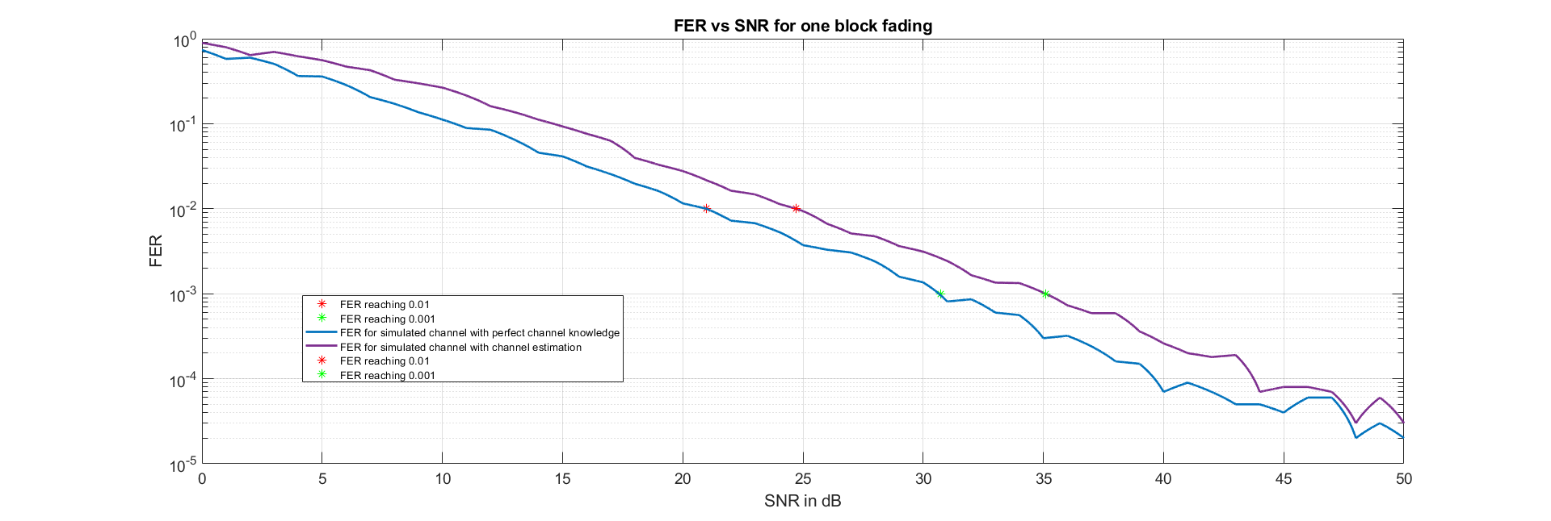
Receiver CSI vs. Unknown Channel
Simulated for a codeword being one whole block
Better performance with known fading coefficient
4 dB improvement to unknown fading

Slide 19
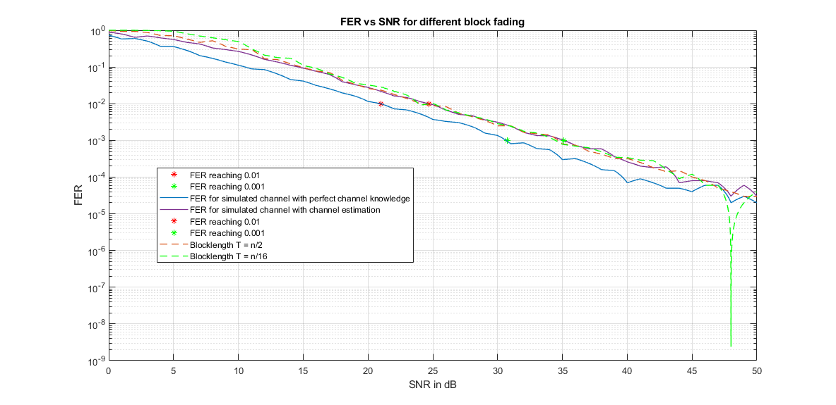
FER for different block lengths
For shorter blocklengths improvement can be seen for high SNR
Overall tradeoff between FER and speed of transmission

Slide 20
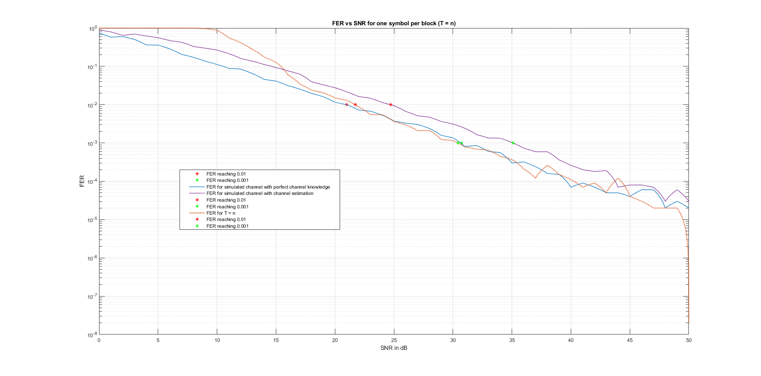
FER for blocklength equaling T = 2

Slide 21
Simulated Rayleigh FER with AWGN Channel
Validation of previous simulated Rayleigh fading channel
Simulation of Rayleigh fading channel:
Rayleigh with CSI can be seen as Gaussian with modified noise
Add Equation 6.1 and 6.2

Slide 22
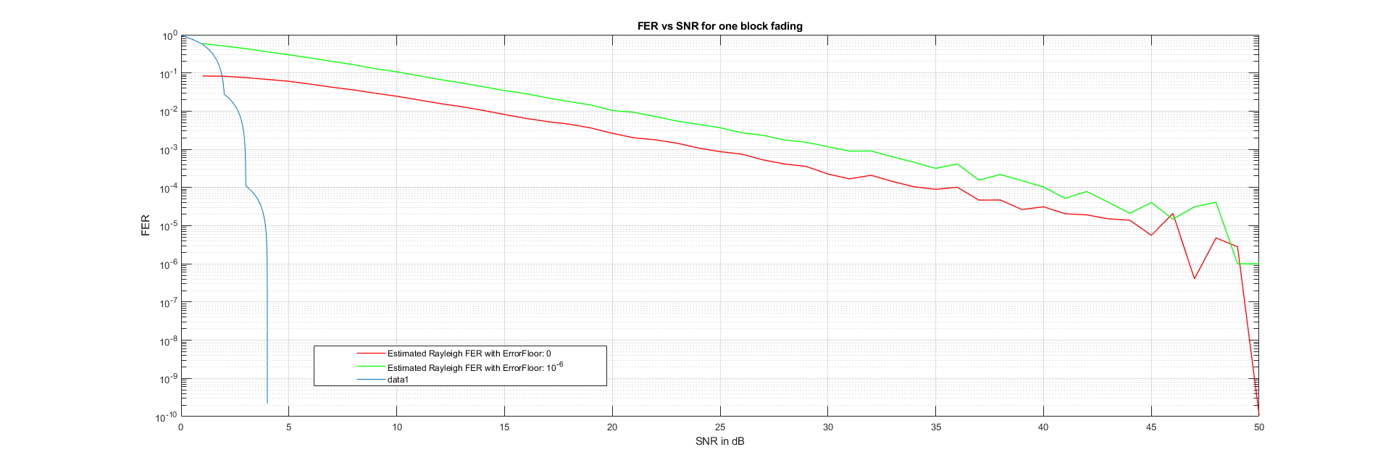
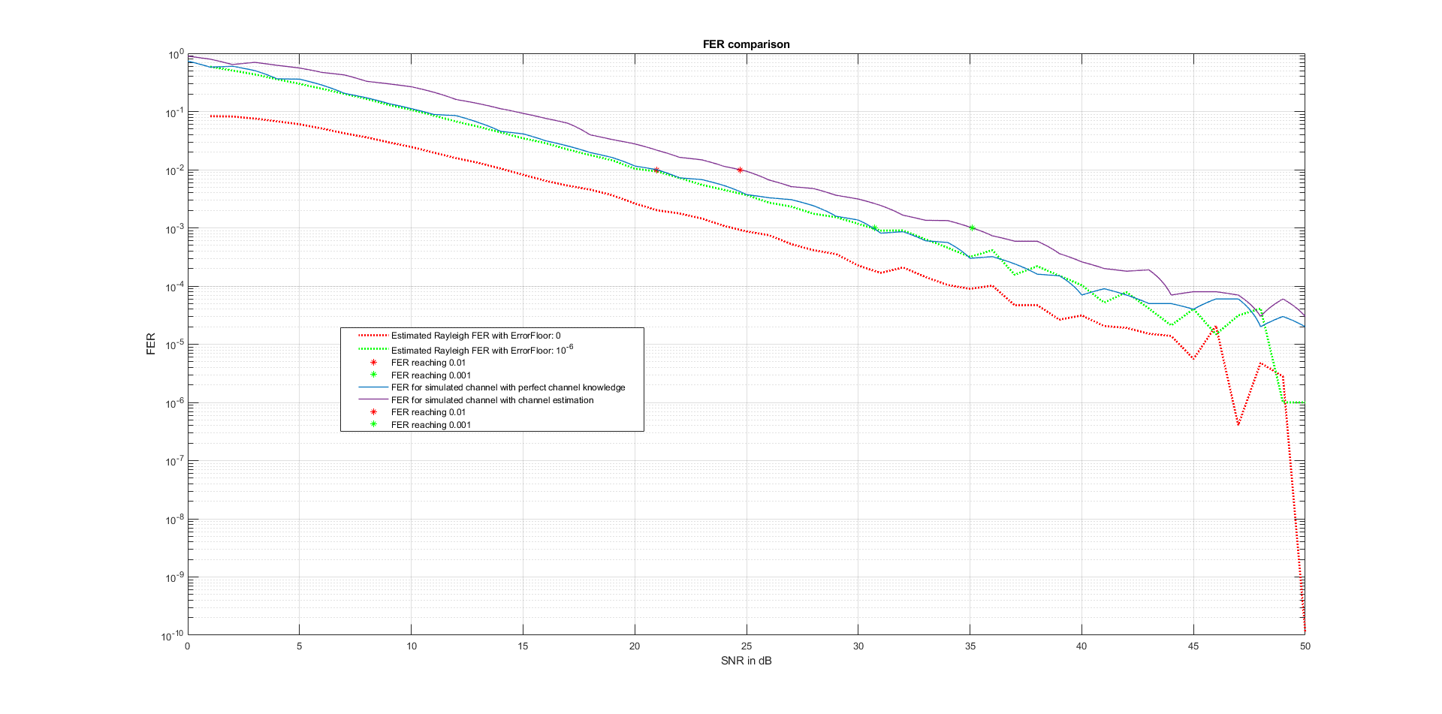
Simulation Result

Slide 23
Error Floor Calculation
Error Floor is where for the FER the decrease in FER slows down, breaking the „waterfall“ characteristic curve
Seen before for the error floor can drastically increase/decrease performance
For very low error floors increases computation time
Longer SNR range
Higher frame count to be simulated

Slide 24
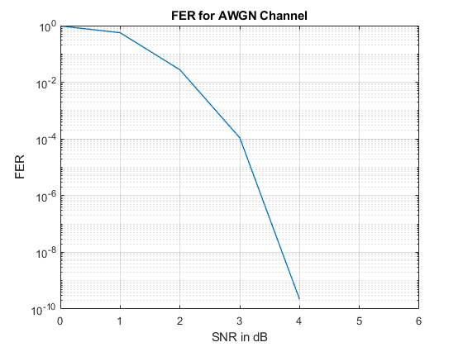
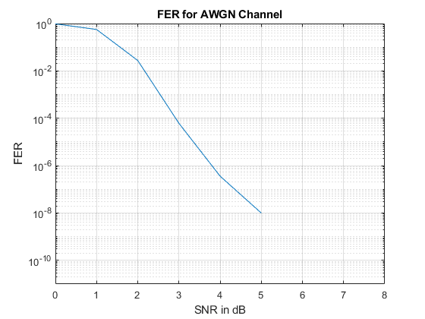
Comparison for Error Floor Simulation
Left plot with 10^5 frames
Continouus „waterfall“ curve
Right plot with 10^8 frames
Break of „waterfall“ curve

Slide 25
Summary
A summary for the AWGN and Rayleigh fading channel in a BICM communication system was given
The drastic difference in performace based on FER simulations was shown
Validation of FER with AWGN and error floor in AWGN was shown
Future Outlook:
Add more channel models, e.g., Rician fading
Expanding single channel into MIMO system

