Slide 1
INVESTMENT ASSIGNMENT SUBMISSION
Name:Gayathri Swaminathan

Slide 2
Investment plan of Spark Funds
Problem Statement
Spark Funds wants to makes investment in the range of 5-15 million USD per round of investment.
The criteria for investmemt would be to invest in the English Speaking Countries.

Slide 3
Steps in Problem Solving
Step 1:Understanding the Business Problem,and Objective of Spark Funds
Step 2: Check on the 3 datsets provided in form of csv files and one wikipedia link to infer the Countries with English as thoer official Language
Step 3: Understand the Data Preparation needed to answer the questions as way of providing indicators to the Spark Funds firm.
Step 4: Data preparation and Presentation of Data in the expected form of tables and plots.
Step 5: Draw inferences that may be infered from the plots and tables prepared in step 3 and 4 .

Slide 4
Flow Chart of Problem Solving Details.
Delete the unwanted columns
of the rounds2 , companies and
mapping dataset
Clean the dataset of
missplet words in the
mapping dataset
Start
Data set companies,
round2, mapping
Merge the companies ,
rounds2 ,
mapping datasets
Of the top 9 countries select the
top 3 english speaking countries
by finding which of the english
speaking countries that have been
scraped exist in top nine countries
From the wikipedia
Source page , scrape
the names of English
Speaking Countries
Select top 9 countries
which has highest
Funding
in the venture fund type
Select Venture
funds as the Fund type
as it meets the criteria
Choose a sector in
which the average
investment is in the
range of 5-15 million USD
For each of the top 3
countries DF’s
fill the investment sum
investment count by
Adding 2 additional columns to
the existing DFs
Select the top Company for the first
two top sectors for each country
Update the tables
in investment.xlsx
Plot the 3 charts.
Create D1, D2 ,D3 data frames
Having data set for each of
the 3 selected countries
End

Slide 5
Business Objective :
The Objective is to invest identify the best fund type , sectors and the countries to invest in .
The Criteria to decide the best investment shall be based on where everyone else is investing .
So the most suitable Fund type within the range and within Top sector in top countries and within the range of investment shall be considered.

Slide 6
Data Analysis
The csv and text data were checked to see if there are any inconsistencies . As a result the spelling mistakes were corrected in the csv and text files before importing into data frames.
The data from the three csv files of Companies , Rounds2 and mapping was merged to form the master data frame.
The encoding and separtors were identified and used to convert csv data into Data frames.
The data values were converted to lowercase so as to be able to join the data across data frames.
The additional Data columns were deleted from the Data frames.
The NaN values are not deleted or imputed as the count and mean values returned are not affected by the presence of the NaN values. Hence the NaN values in the rows for the columns are being ignored.

Slide 7
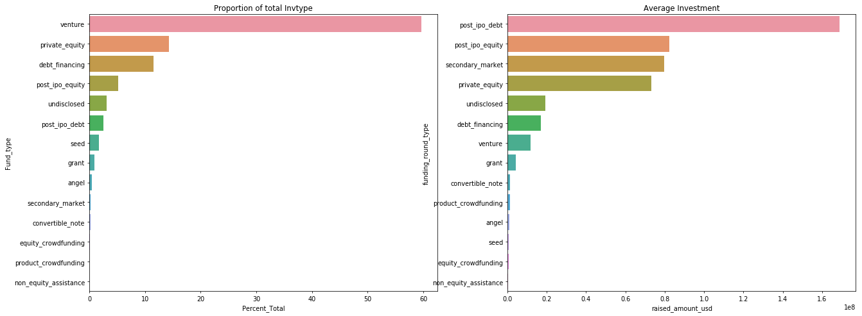
Results
Plot 1: Proportion of total Invtype vs Average Investment

Slide 8
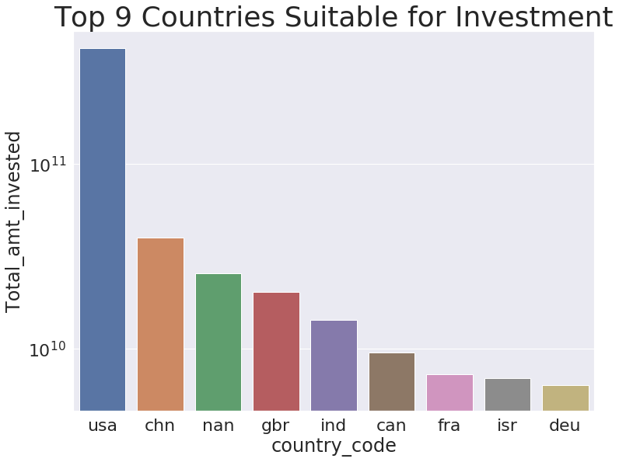
Plot 2:

Slide 9
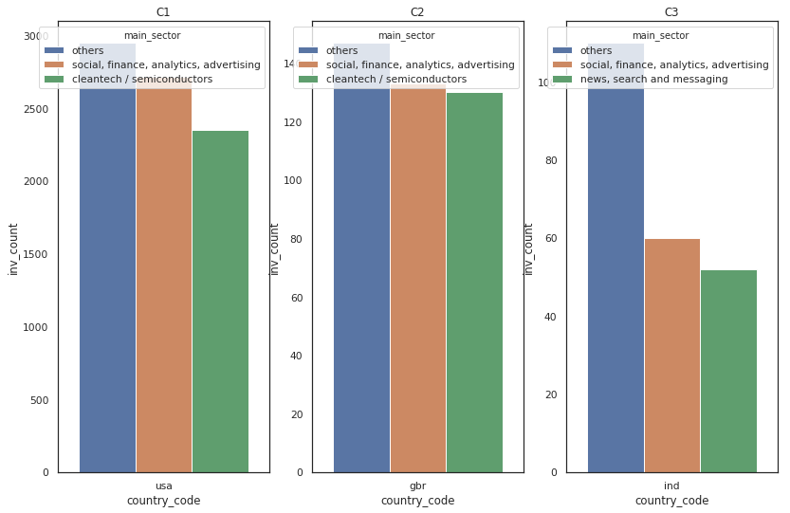
Plot 3 :

Slide 10
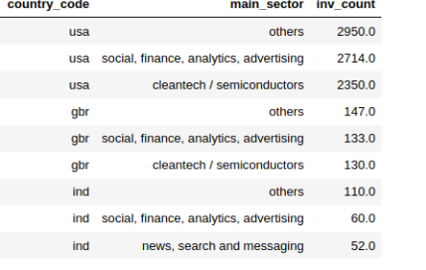
Conclusions
As per the Data Analysis of the data set provided it may be infered as follows:
1.Venture Fund is the most suitable Fund type of investment in the range of 5 – 15 million USD. It is also the highest investment type that is funded across globally.
2. The Top 3 countries with English as official language are :
i) United States of America (usa)
ii) Great Britain ( gbr)
iii) India (ind)
3. Top 3 sectors of the Top countries for investment are :

