Slide 1
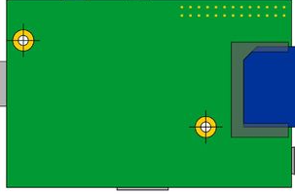
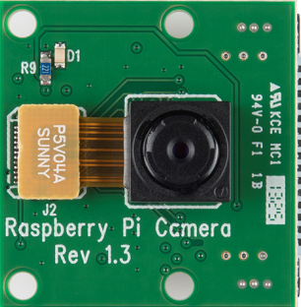
Camera module
5V Battery pack
Temperature & pressure sensor
GPS module

Slide 2
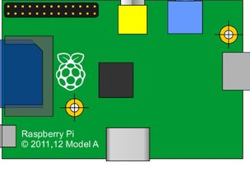
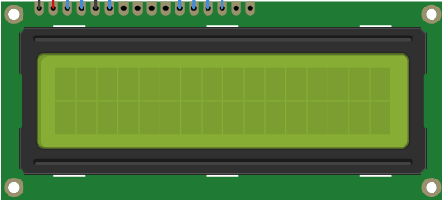
Capture / Record button
LCD with 16 x 2 characters
SD card
Selection Left
Selection Right
Wi-Fi
Current selection
Go left button
Enter button
Go right button

