Slide 1
CS50P Final Project
Project title: A simple rock, paper and scissors game in Python
Author: Gaál Csongor
Github username: gaal_csongor
EDX username: gaal_csongor
Email: gaal.csongor@gmail.com
Country and city: Hungary, Sopron
Date: 22.09.2024

Slide 2
A brief overwiev
This is a game where you can play rock, paper and scissors with the computer as your opponent
This version interacts with the user through simple console commands
Im also working on a version which has a GUI implemented in Tkinter
The player and the computer both have a starting balance of 100$ each
The player is asked to make a bid in $
The game is implemented in rounds, and after each round the bid is subtracted from the account of the loser and added to the account of the winner
The game ends if one of the accounts reaches 0$, or if the player doesn‘t choose to continue the game after the end of the last round

Slide 3
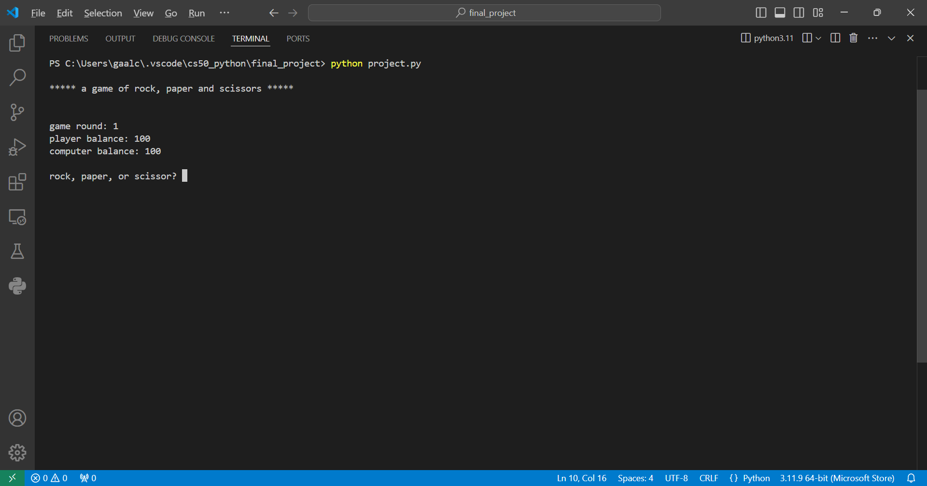
How the game runs
The player is asked to choose between rock, paper, and scissors, and make a bid

Slide 4
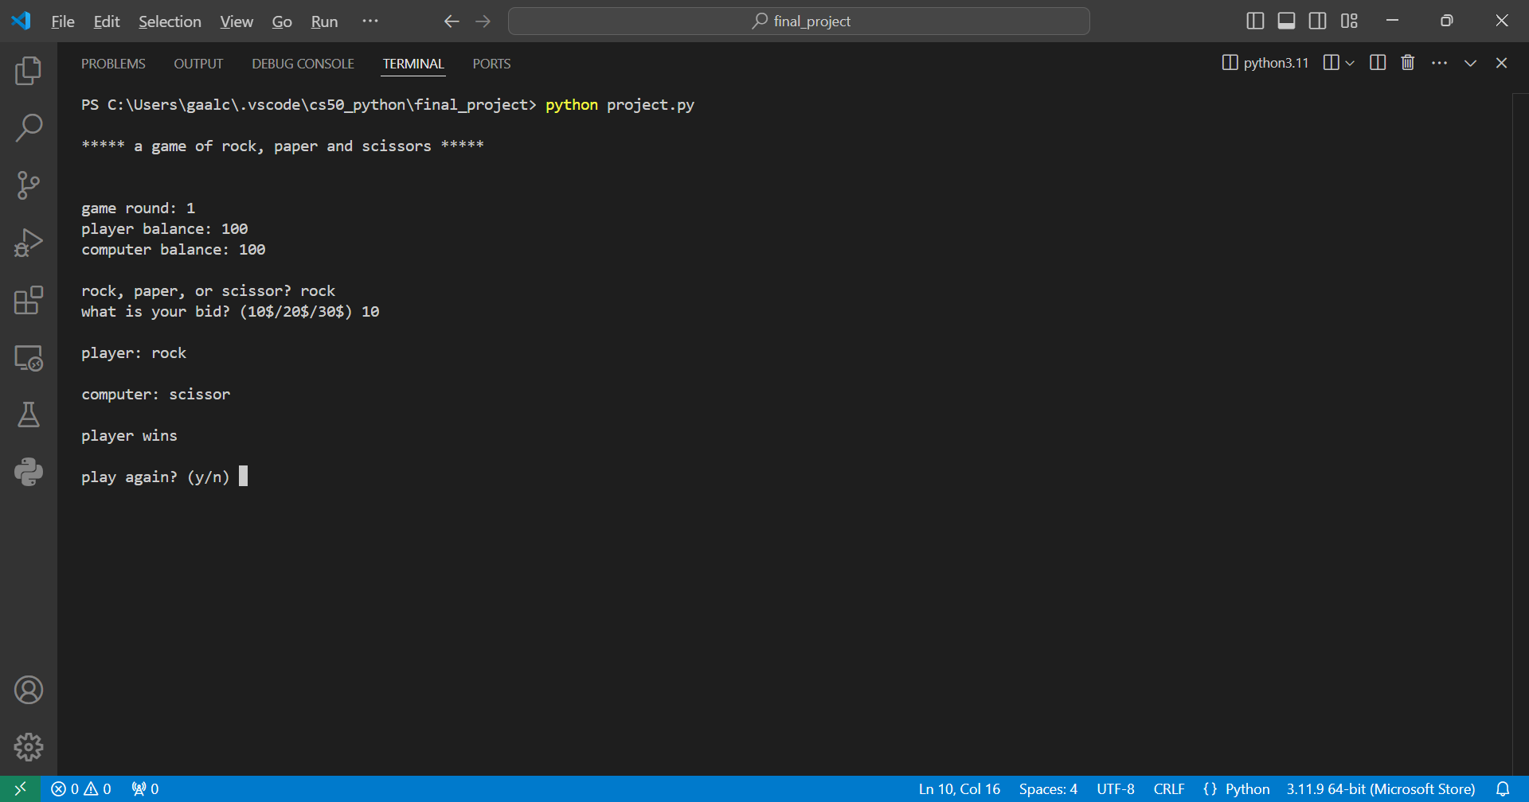
How the game runs
The computer makes it‘s choice, accounts are updated and the player is prompted to play again

Slide 5
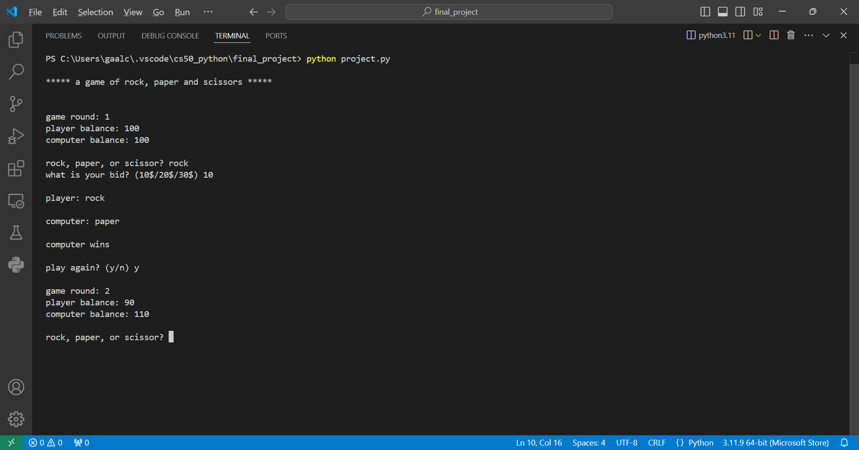
How the game runs
If the player inputs „y“ or „yes“ (case-insensitively) another round begins

Slide 6
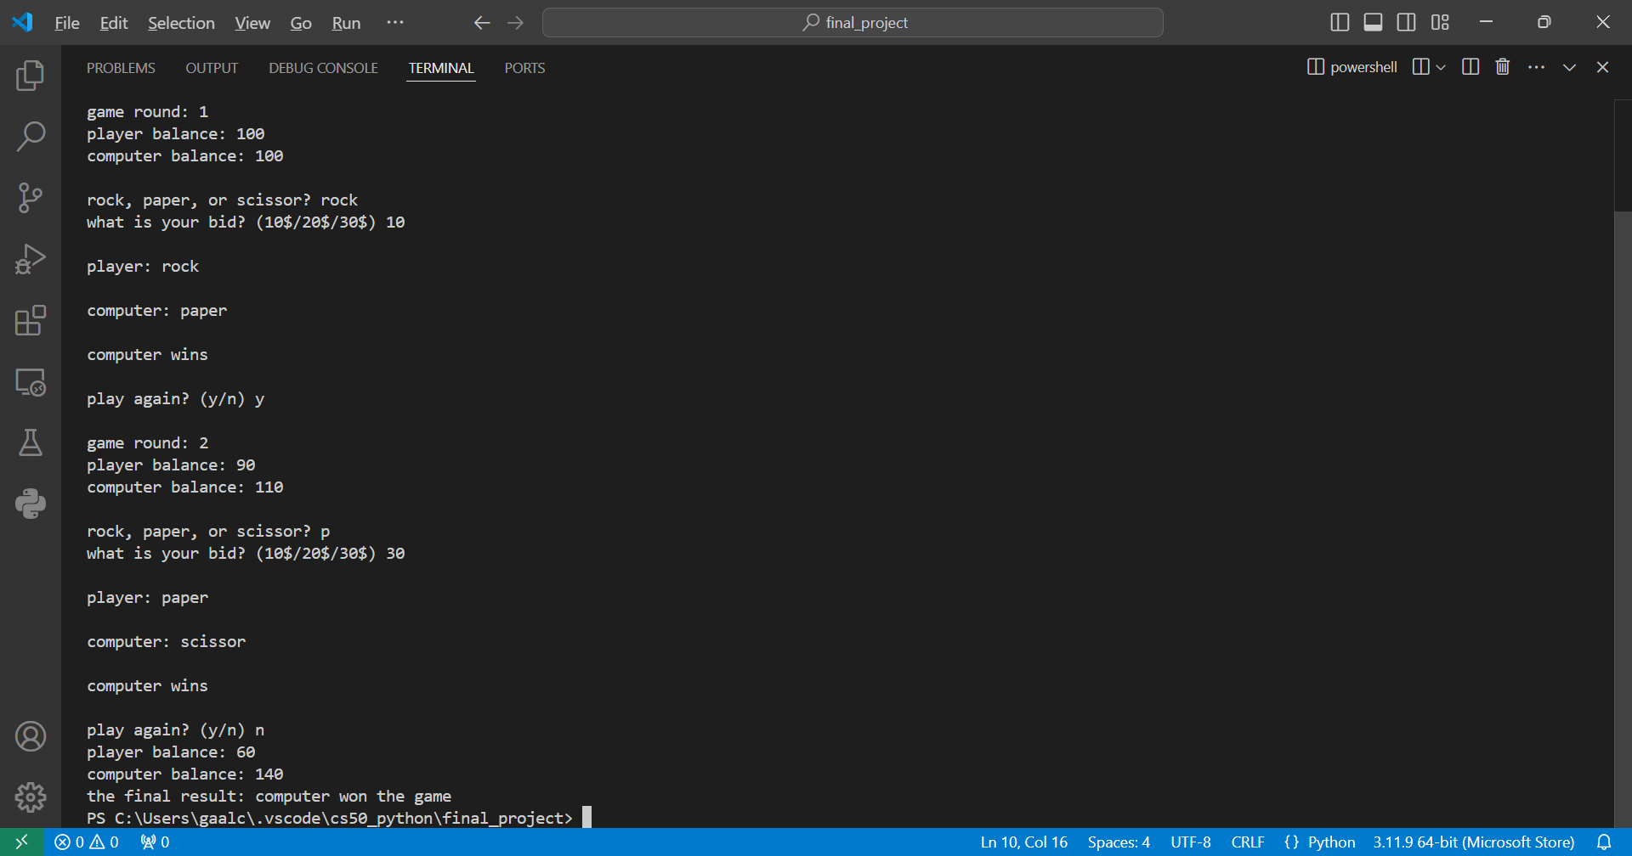
How the game runs
If the player inputs „n“ or „no“, the game ends and the winner is determined depending on who has a bigger account

Slide 7
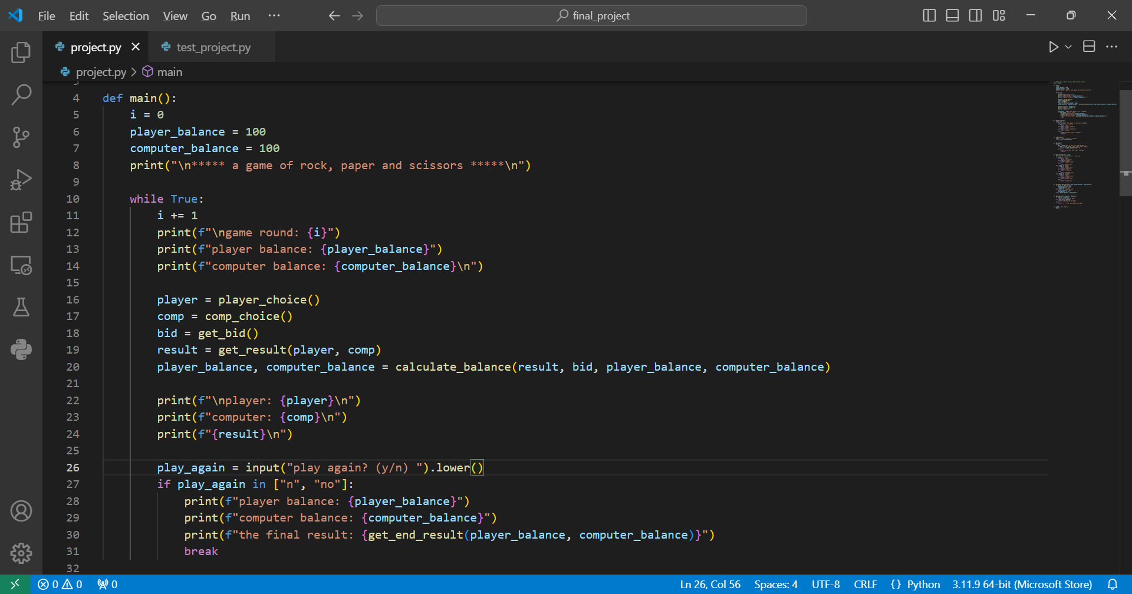
Technical demonstration
The game runs in a while loop which is implemented within the main function

Slide 8
Technical demonstration
The player and the computer have starting accounts stored in variables which have an integer value of 100, and a global scope so all functions can access them
The game has six functions, and all are called within main()
The player is prompted to choose between rock, paper and scissors through a function called player_choice() which implements a while loop in order to reprompt the user if the input is not correct
All user prompts are treated case-insensitively
The computer‘s choice is implemented through the use of the random library‘s choice() function combined with a list of string items

Slide 9
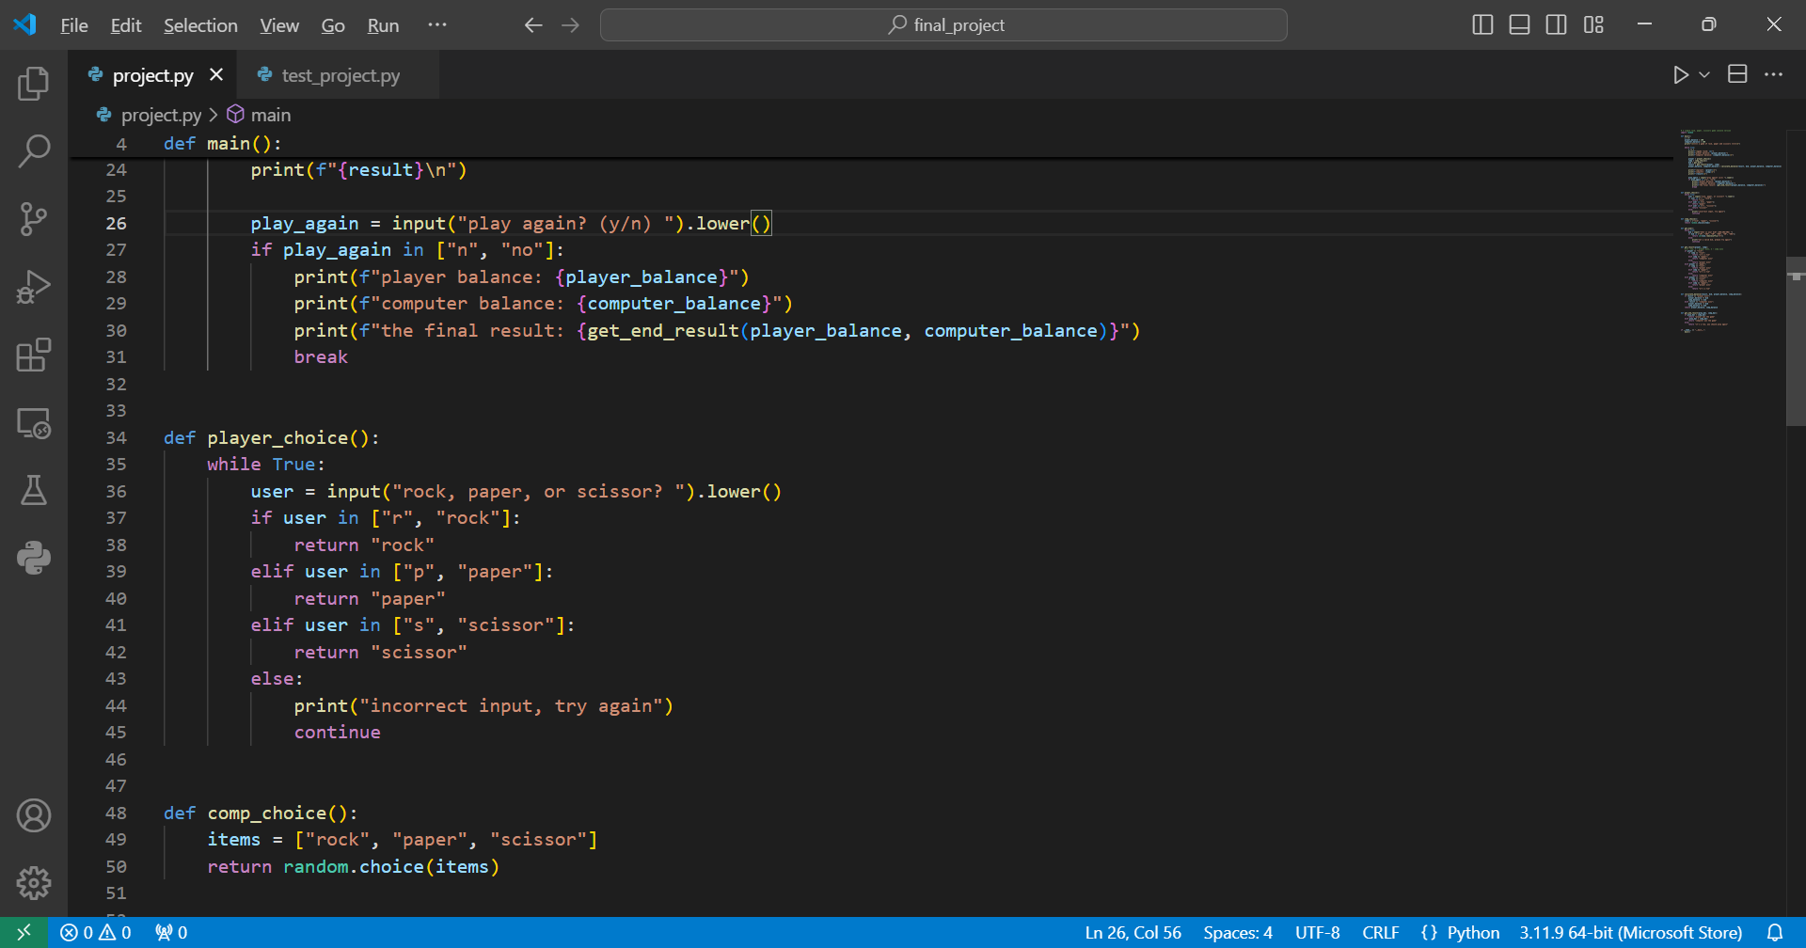
Technical demonstration
The player_choice() and comp_choice() functions both return string values which are used by other functions later

Slide 10
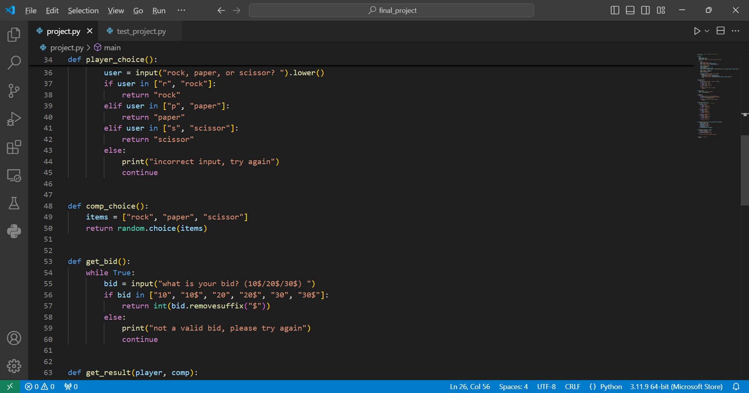
Technical demonstration
The get_bid() function prompts the user for a str value and returns an int, also reprompts if the input is not correct

Slide 11
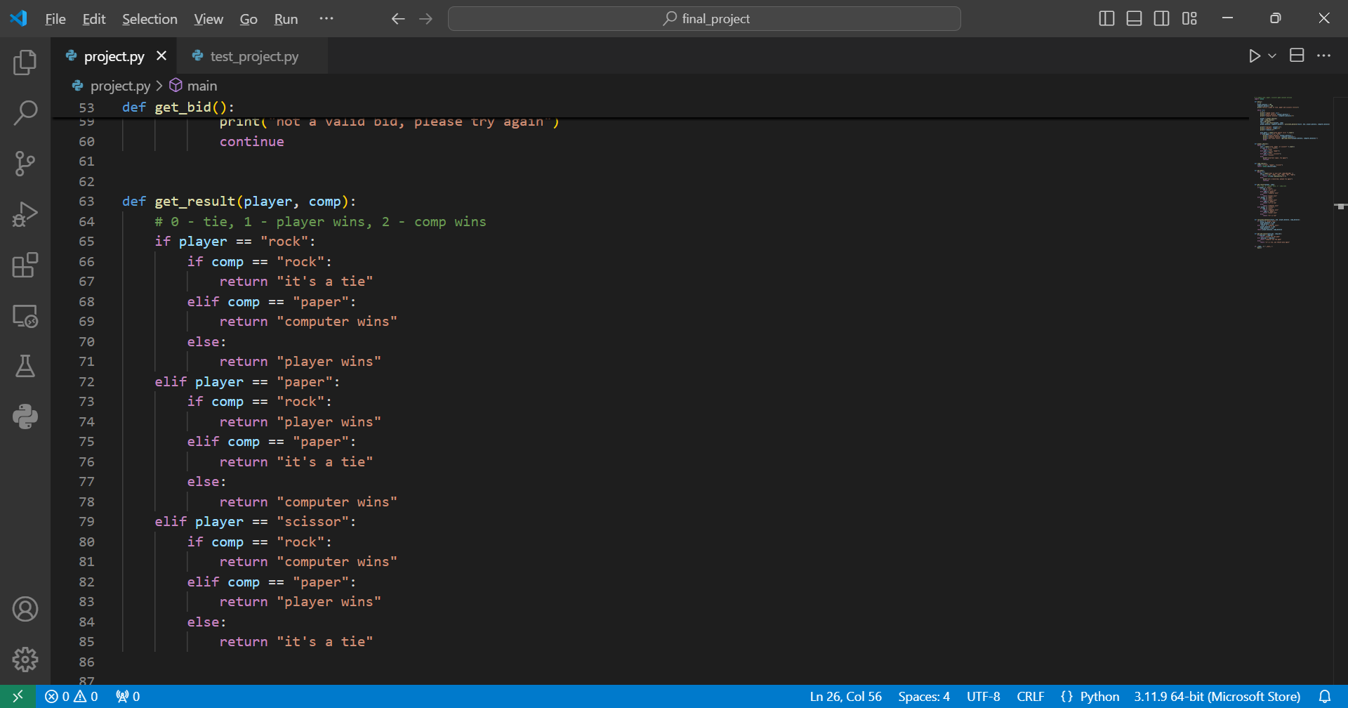
Technical demonstration
The get_result() function takes two str arguments, determines the outcome of the round by returning a str

Slide 12
Technical demonstration
The calculate_balance() function takes one str and three int arguments, and keeps track of both accounts through the game rounds. It returns the actual balance of the player and computer as an int value
The get_end_result() function is only called if the player inputs „n“ or „no“ at the end of the round. It takes the balances in int values as arguments, and determines the final outcome of the game. Returns a str value

Slide 13
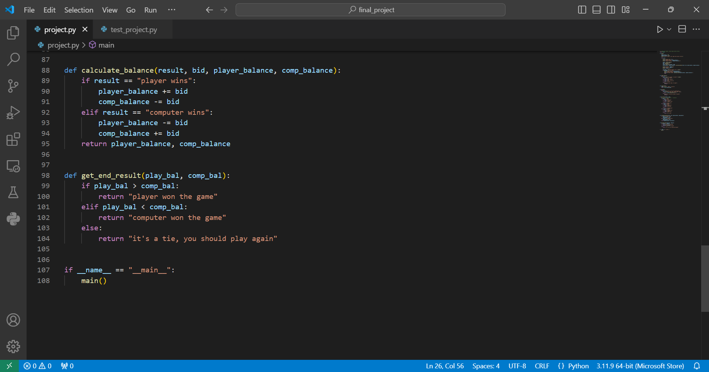
Technical demonstration
The calculate_balance() and get_end_result() functions in action

