Slide 1

Disapproving Corgies
Team members:
Alexandra Gaál
Dániel Berdó
Dorottya Nyárády

Slide 2




Visual Speech Recognition

Slide 3
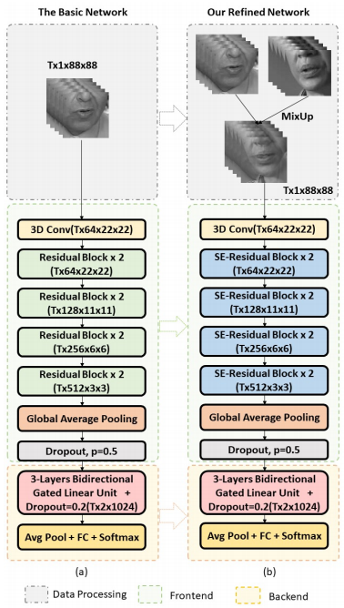
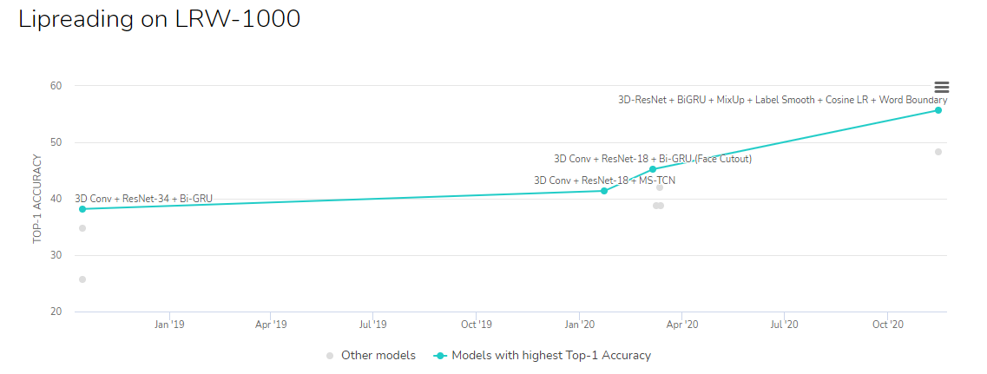
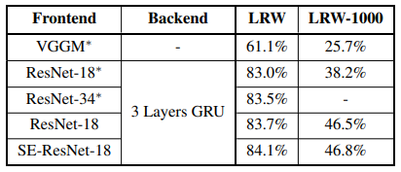
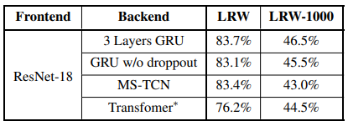
Related works

Slide 4
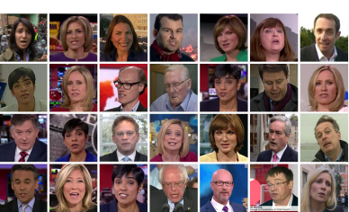
Database
LRW dataset ~ 80 GB
Request permission from Rob Cooper
BBC videos - the background, the lightning and the speaker’s appearance is very diverse

Slide 5
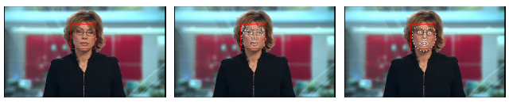
Data processing
1. Face detection
2. Detect the points of the mouth with shape predictor according to the facial landmarks
3. Crop the mouth with the bounding box around the found points

Slide 6
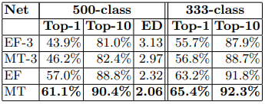
Network examples on the dataset
EF – Early Fusion
EF-3 – 3D Convolution with Early Fusion
MT – Multiple Towers
MT-3 – 3D Convolution with Multiple Towers

Slide 7
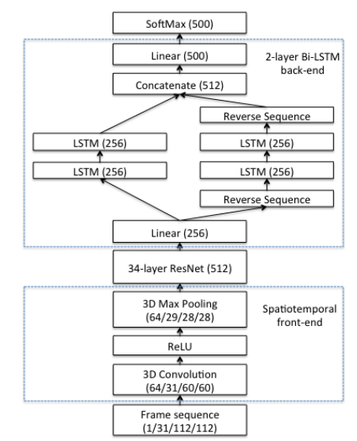
Network

Slide 8
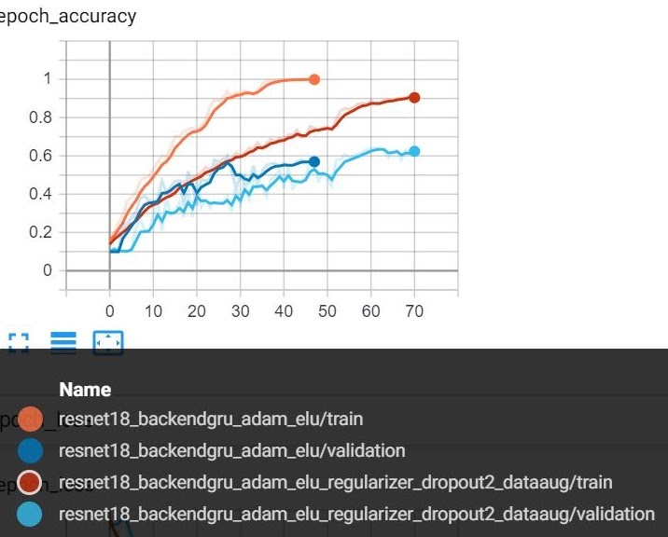
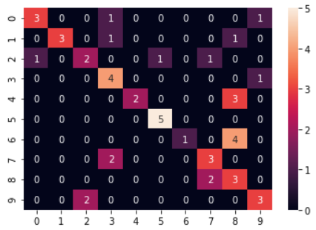
Training
60 % validation accuracy
Confusion matrix for 10 classes
Optimizer: Adam
Starting learning rate: 0,0008
Activation function: ELU (Elastic ReLu)
Dropout: 20%
Batch size: 64

Slide 9
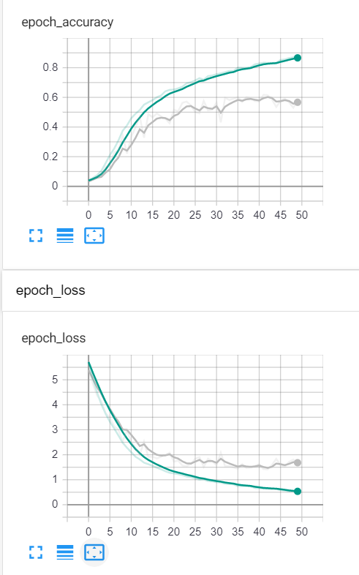
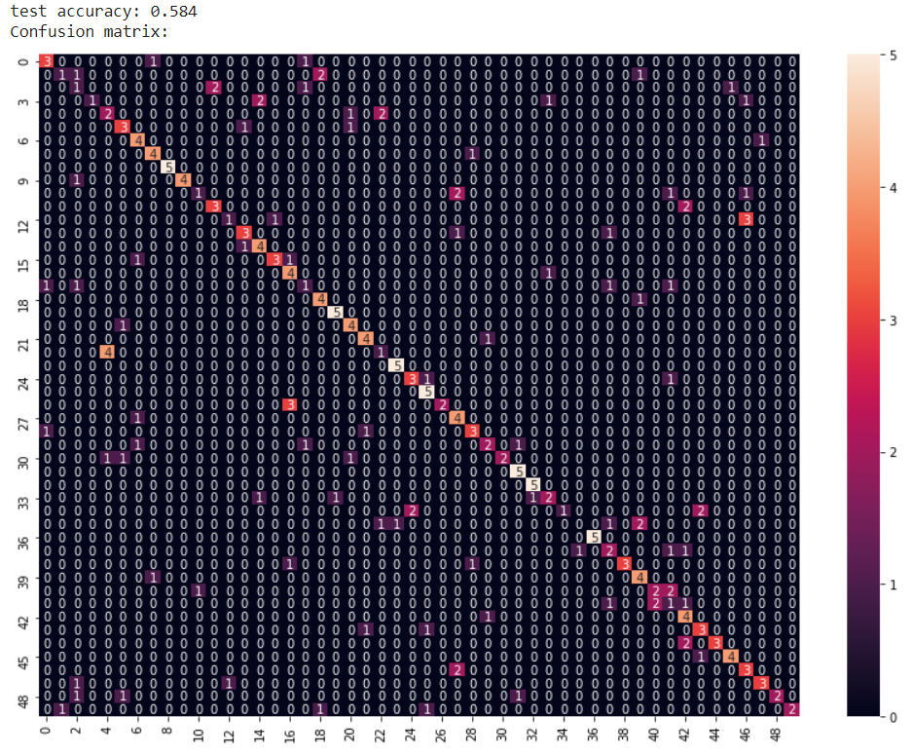
Training
59 % validation accuracy
Optimizer: SGD
Starting learning rate: 0,008
Activation function: ELU (Elastic ReLu)
Dropout: 20%
Batch size: 32
Confusion matrix for 50 classes

Slide 10
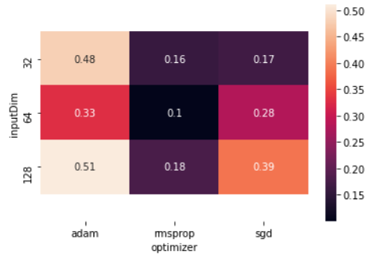
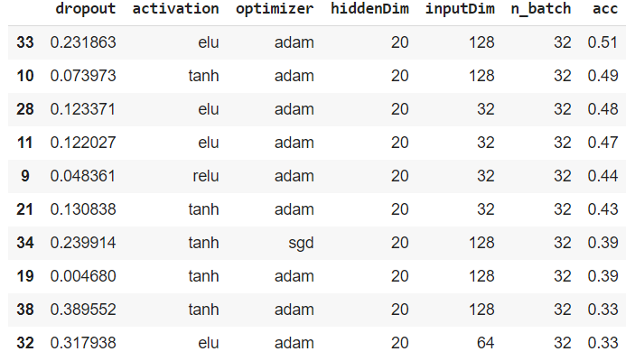
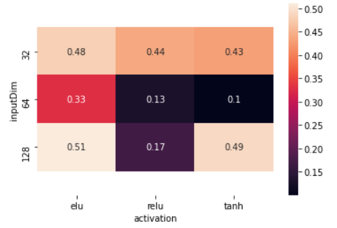
Hyperparameter optimization
Input dimension
–
Optimizer type
The best 10 accuracy, after using hyperas optimization
Input dimension
–
Activation type

Slide 11
Results
We achieved adequate accuracy on recognizing 10 different words
We struggled with overfitting because of the high amount of the parameters.
But we applied different methods to solve this problem.
Dropout layers
L2 regularization
Data augmentation methods
Decreased the parameters of the network
Batch normalization
In the further experiments we want to focus on creating a network, which recognizes at least 100 different words.
It is a complicated task considering the difficulties in lip reading

Slide 12
Conclusion
The task is not as trivial to do as we first imagined.
It is very important to make a good model that can determine the spelled word in the whole sequence of the video frames.
We could also use the audio as a helping hand.
Detect a word easier by its spectrum.
It is also difficult to connect the words.
We can use a language model from NLP to bound the detected words with the right conjunction word to create a grammarly proper sentence.
We have to apply tricks and examine the root cause of the problems.

Slide 13
Thank you for the attention !

