Slide 1
DATA ANALYTICS PORTFOLIO PROJECT
Customer Shopping Behavior Analysis
End-to-End Analysis using Python, PostgreSQL and Power BI — 3,900 transaction records analyzed for actionable retail insights.
Prepared by Ganavi · B.E. Data Science, RNS Institute of Technology, Bengaluru · September 2026

Slide 2
EXECUTIVE SUMMARY
Project at a Glance
A complete data analyst workflow applied to a retail dataset — from raw data ingestion through cleaning, EDA, SQL analysis, and a business-ready Power BI dashboard.
3,900
18
Transactions
Columns
Customer records analyzed
Original dataset attributes
$59.76
3.75
Avg Purchase
Avg Rating
Average transaction value
Average product review score

Slide 3




OBJECTIVES
What This Project Aims to Do
Clean & Preprocess
Store & Query
Use Python and Pandas to ensure data quality and consistency before analysis.
Persist cleaned data into PostgreSQL for structured, repeatable SQL analysis.
Analyze & Segment
Visualize
Answer 10 business questions using SQL aggregations, CTEs, and window functions.
Build an interactive Power BI dashboard for self-service, filter-driven exploration.

Slide 4
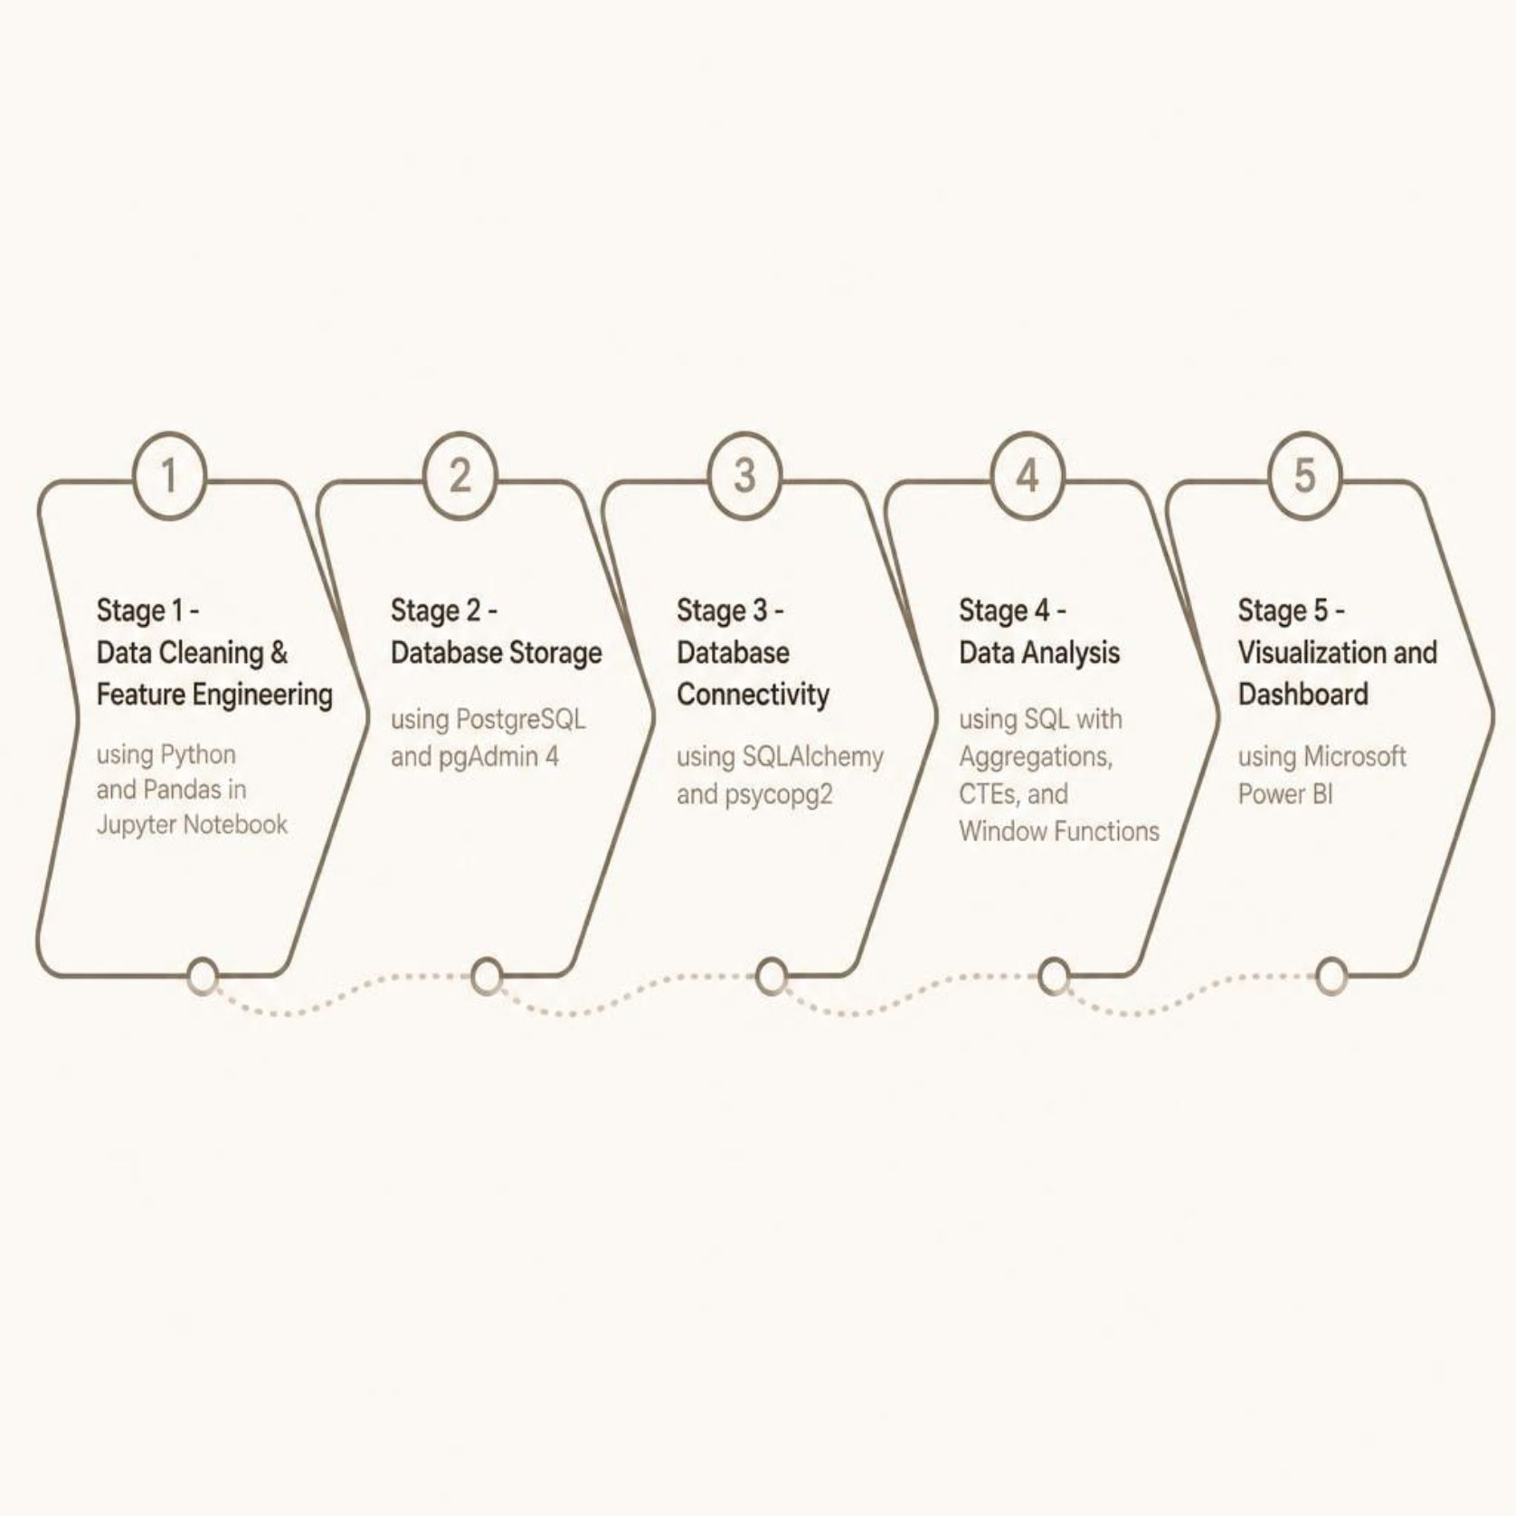
TOOLS & TECHNOLOGIES
The Analytics Pipeline
End-to-End Workflow
Each tool plays a distinct role — from raw CSV to interactive dashboard — reflecting how professional data analysts work in real business environments.

Slide 5


DATASET
Dataset Overview
Structure
Key Summary Stats
3,900 rows × 18 columns — each row is a single customer transaction spanning 50 locations, 25 products, and 4 categories.
Average Purchase: $59.76
Average Rating: 3.75 / 5.0
Age Range: 18–70 years
Categories: Clothing, Footwear, Outerwear, Accessories
Demographics
Transaction
Behavior
Age, Gender, Location
Purchase Amount, Category, Shipping
Subscription, Previous Purchases, Frequency

Slide 6
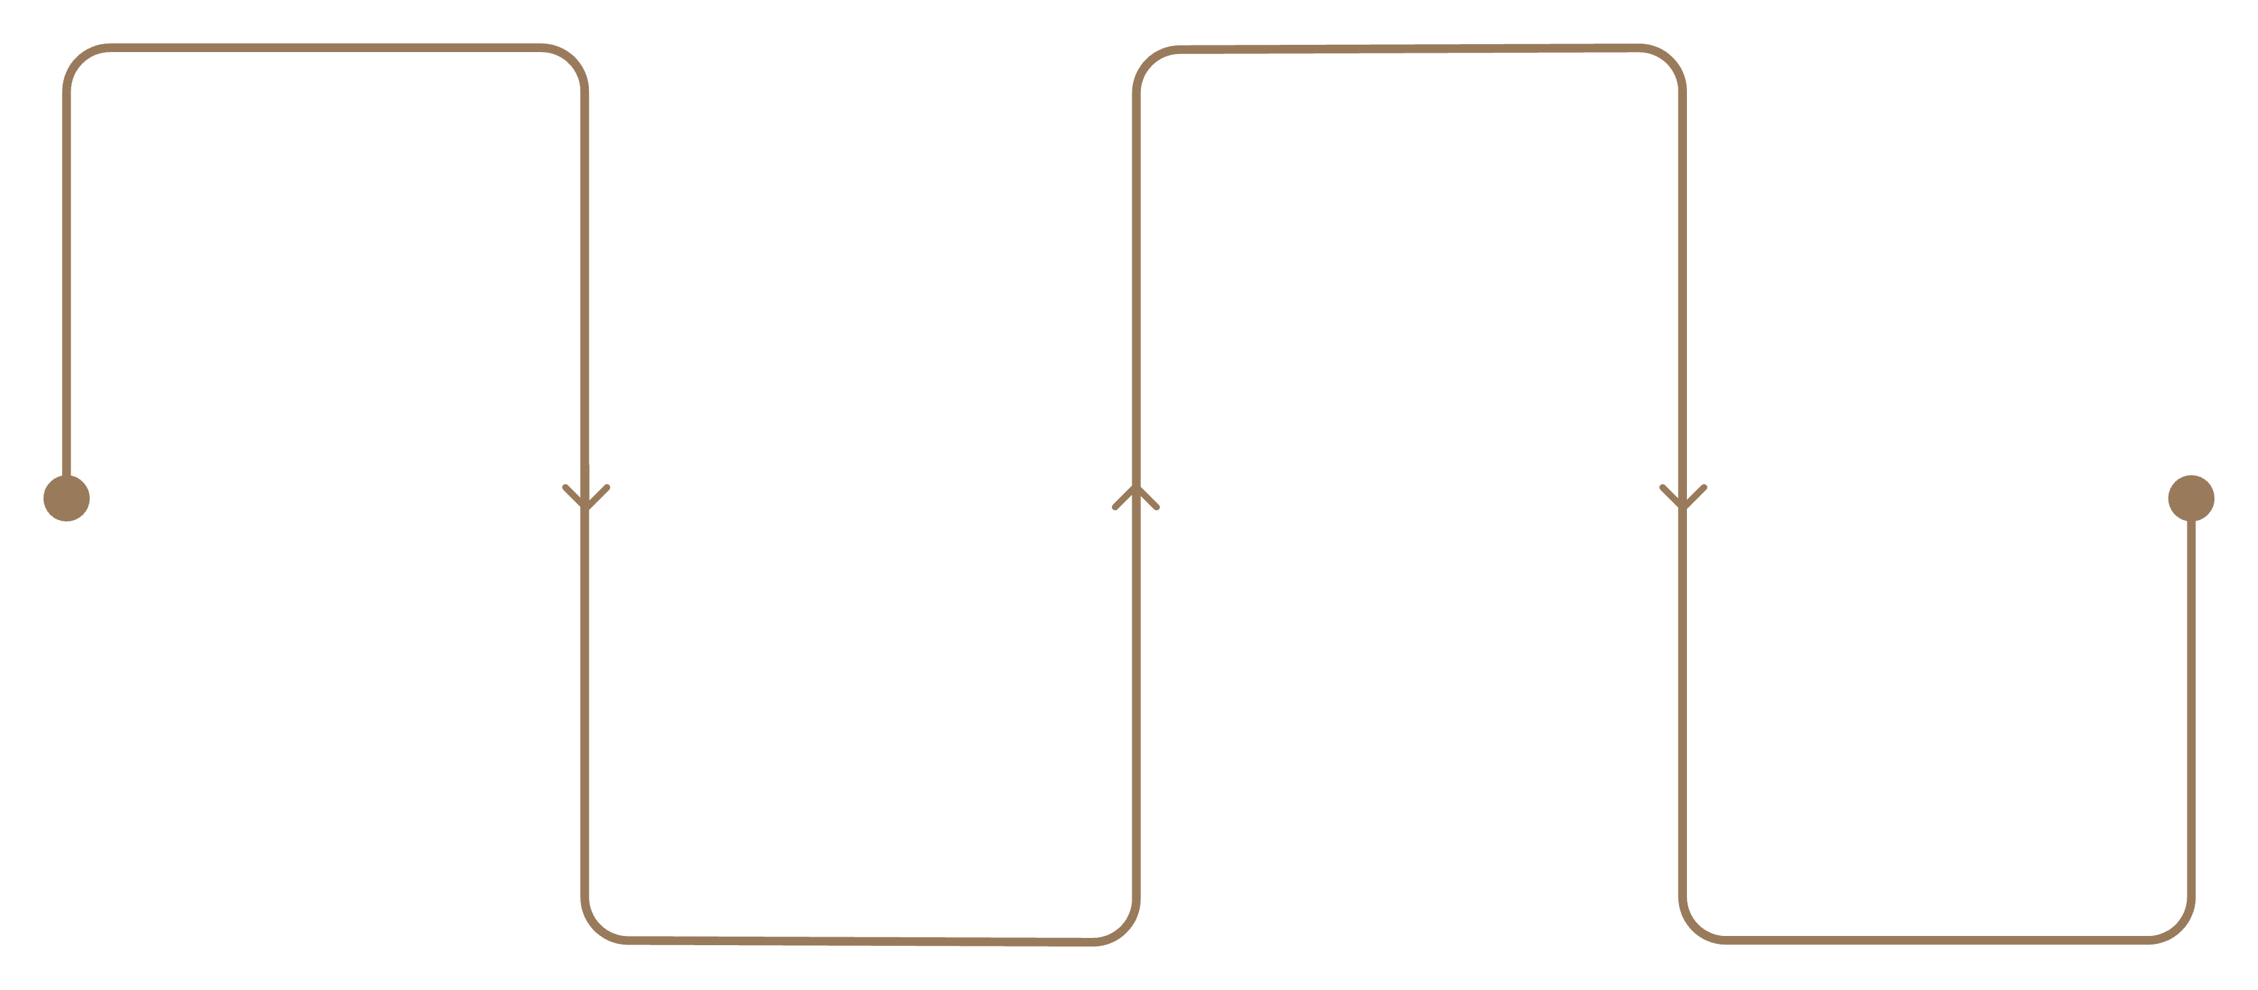
METHODOLOGY
Data Preparation Workflow
Import & Inspect
Feature Engineer
Load CSV, df.info(), df.describe(), 37 missing ratings
Create age_group via quartiles, map purchase frequency to days
Clean
Load to PostgreSQL
Impute ratings by category median, standardize names, drop promo_code_used
Write cleaned DataFrame to customer table via SQLAlchemy
Each step follows professional EDA practice — inspection guides cleaning decisions, feature engineering enables segmentation, and loading into PostgreSQL supports repeatable, auditable SQL analysis.

Slide 7
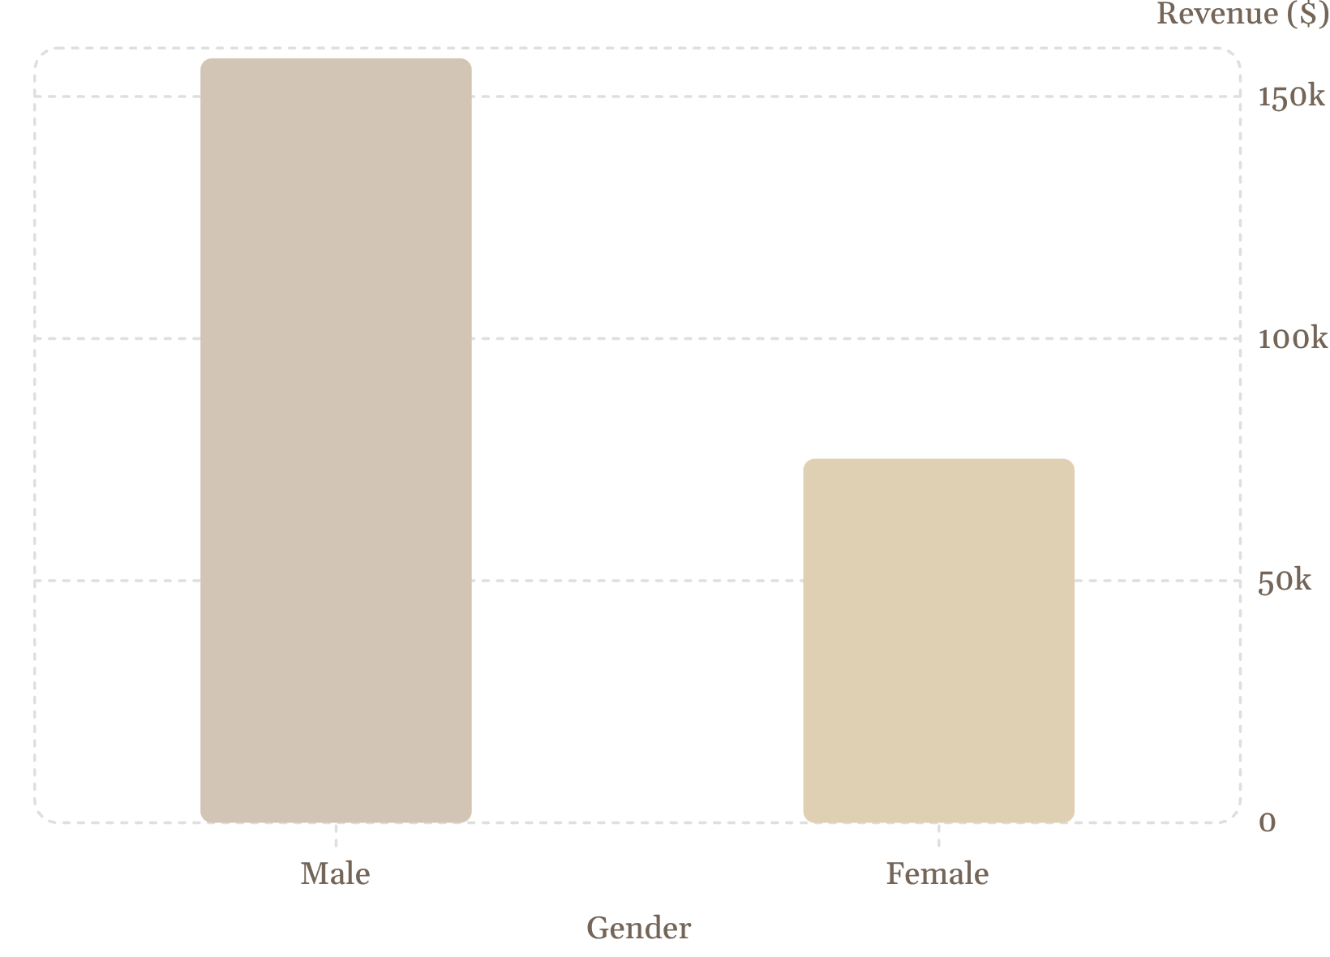

SQL ANALYSIS — PART 1
Revenue & Customer Insights
Key Findings
Gender Revenue Gap: Male customers generate 2.1x the revenue of females ($157,890 vs $75,191).
Discount Paradox: 839 customers (~22%) used a discount yet spent above the $59.76 average — discount usage ≠ low-value customer.
Subscription Impact: Subscribers and non-subscribers have nearly identical average spend (~$59–60); non-subscribers simply outnumber subscribers 3:1.

Slide 8
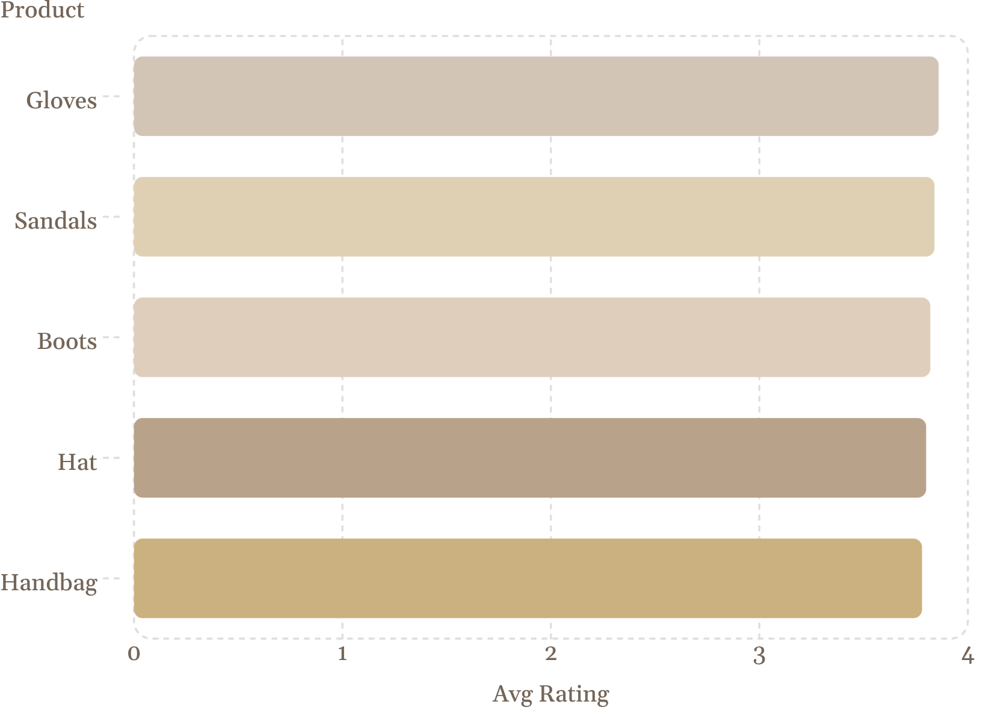

SQL ANALYSIS — PART 2
Products, Shipping & Segmentation
Top-Rated Products
All five score above 3.78/5 — strong candidates for promotional prioritization.
Other Key Findings
Shipping: Express customers spend marginally more ($60.48 vs $58.46) — not a primary revenue lever.
Discount Rates: Hats, Coats, Sneakers see ~48–50% discount usage — may be compressing margins.
Customer Segments: 80% are Loyal (>10 purchases), 18% Returning, only 2% New.

Slide 9
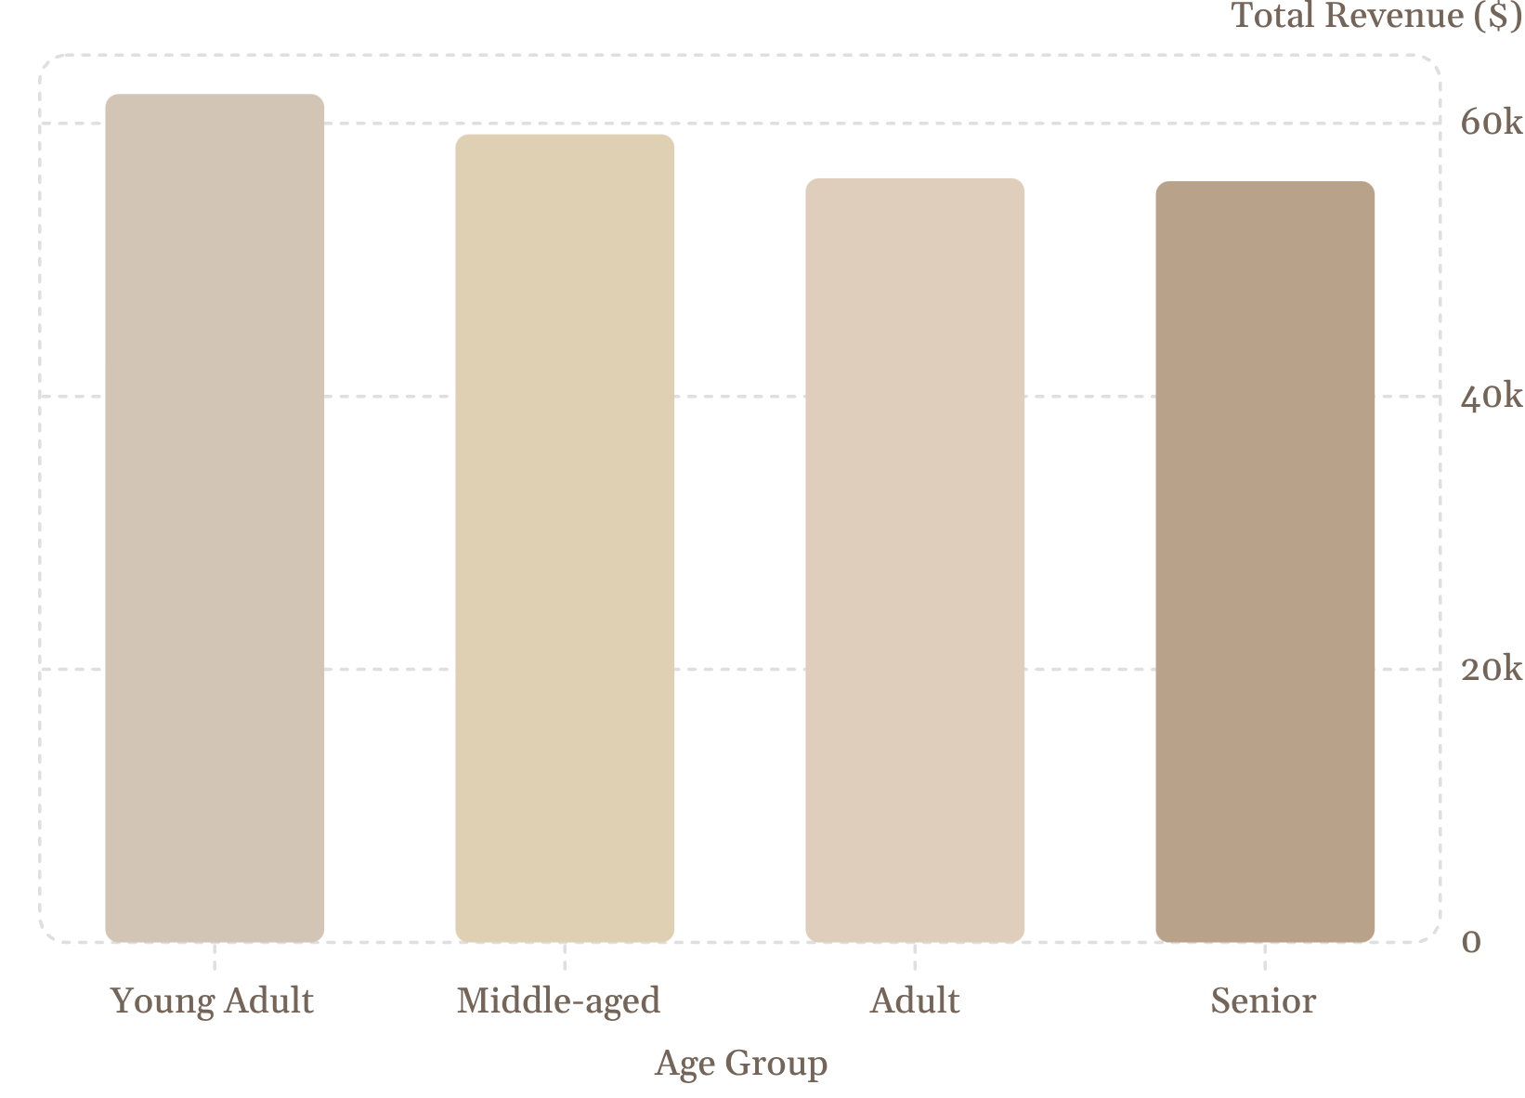

SQL ANALYSIS — PART 3
Age Groups, Loyalty & Subscriptions
Age Group Revenue
Revenue is fairly evenly distributed. Young Adults lead marginally at $62,143 — broad, age-inclusive marketing is recommended.
Loyalty ≠ Subscription
Among repeat buyers (>5 purchases), 72% are still non-subscribers — a clear conversion opportunity.
Top products by category: Jewelry (Accessories), Blouse/Pants (Clothing), Sandals (Footwear), Jacket (Outerwear).

Slide 10
DASHBOARD & CONCLUSION
Power BI Dashboard & Key Takeaways
Dashboard Highlights
Actionable Insights
KPIs: 3.9K customers · $59.76 avg purchase · 3.75 avg rating. Filters: subscription, gender, category, shipping type. Only 27% are subscribers. Clothing leads revenue by category.
1
Target male customers for revenue growth; investigate female segment gap.
2
Launch a subscription conversion campaign aimed at loyal, non-subscribed repeat buyers (72% of repeat buyers).
3
Prioritize high-rated products (Gloves, Jewelry, Blouse) for promotions and inventory.
4
Review discount policy on Hats, Coats, Sneakers where ~50% of purchases use discounts.

