Slide 1
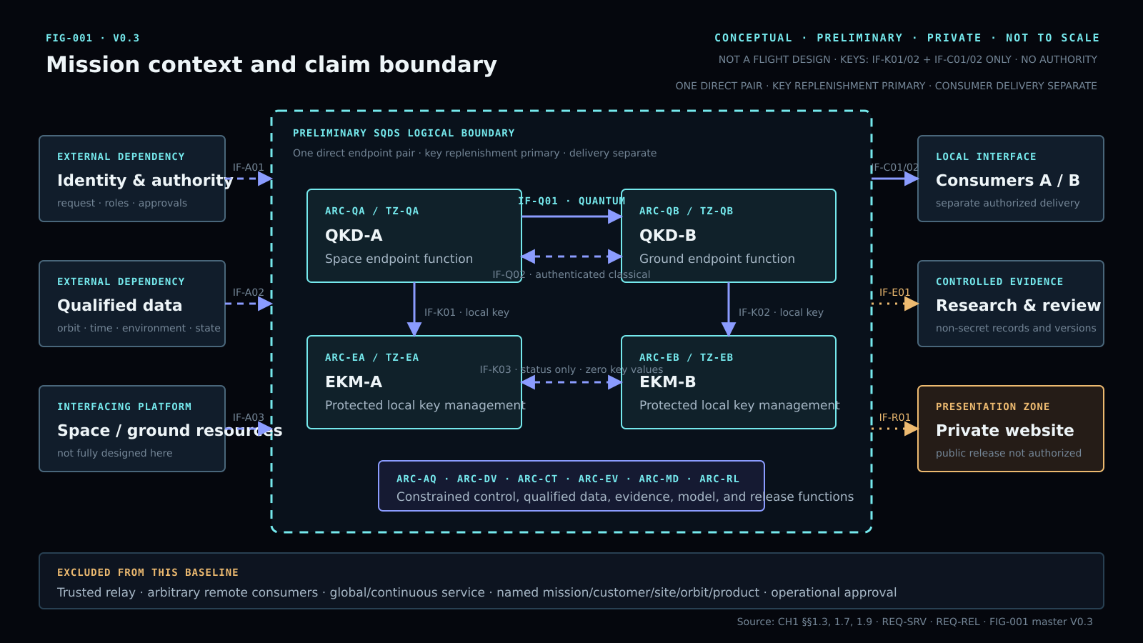
V1.0-RC3 · SUBMISSION BRIEFING
Q-Orbit
Evidence-gated satellite QKD study
A reproducible theoretical baseline with explicit proof, device, site, hardware, and release boundaries.
Controlled disposition
PRIVATE THEORETICAL INTEGRATION ONLY
26 AUG 2026
01
Notes:
Open by defining the work as a controlled academic integration, not a flight or procurement proposal.
The diagram is conceptual and not to scale.
[Sources]
- Q-Orbit Engineering Design Document V1.0-RC3
- Q-Orbit Master Integration and Consistency Audit V1.0-RC3
- FIG-001 Q-Orbit Mission Context V0.3
[/Sources]

Slide 2
01 · FRAMING
What does the study actually test?
Research question
IN SCOPE
Can a declared satellite-to-ground QKD model reproduce a controlled finite-key result—and how quickly does that result lose positivity under bounded theoretical stresses?
Finite-key reproduction
Deterministic perturbation screens
Independent numerical checks
Fail-closed release logic
OUT OF SCOPE
The answer is about model behavior and evidence discipline, not delivered secret keys.
Hardware acceptance · outdoor emission
Qualified Tabuk parcel · operational key release
Mission performance · public deployment
Q-ORBIT · PRIVATE PRELIMINARY · THEORETICAL ONLY
02
Notes:
Separate the scientific question from any implementation claim.
The study asks whether the software model is reproducible and locally robust within declared ranges.
[Sources]
- Q-Orbit Engineering Design Document V1.0-RC3, Sections 1–2
- Q-Orbit Master Integration and Consistency Audit V1.0-RC3
[/Sources]

Slide 3
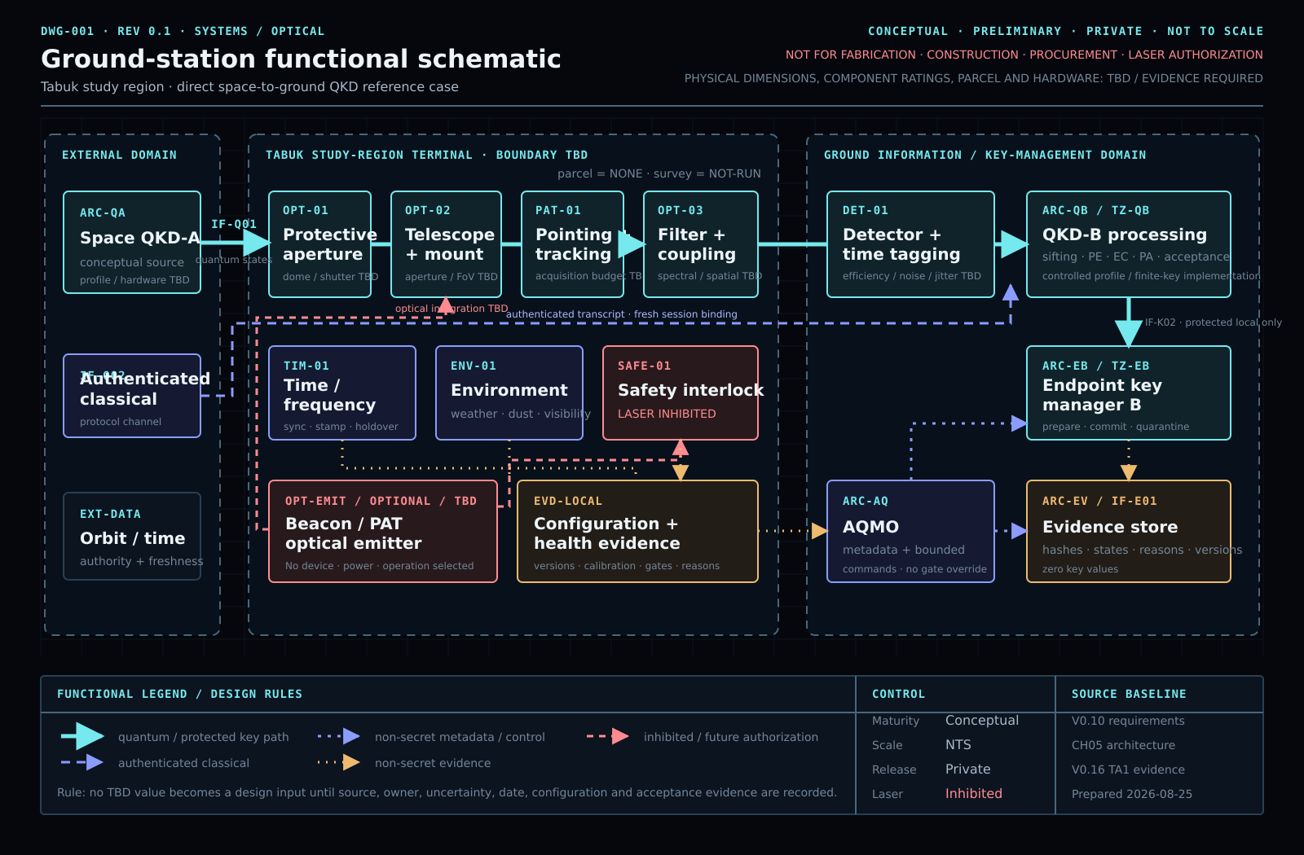
02 · ARCHITECTURE
Ground-station functional boundary
DWG-001 · CONCEPTUAL / PRELIMINARY / NTS · no fabrication, procurement, construction, or operating authority
Q-ORBIT · PRIVATE PRELIMINARY · THEORETICAL ONLY
03
Notes:
Use this drawing to explain functions and trust boundaries only.
No component in this schematic is selected, serialized, purchased, installed, or accepted.
[Sources]
- DWG-001 Q-Orbit Ground Station Functional Schematic V0.1
- Q-Orbit Engineering Design Document V1.0-RC3, Chapter 3
[/Sources]

Slide 4
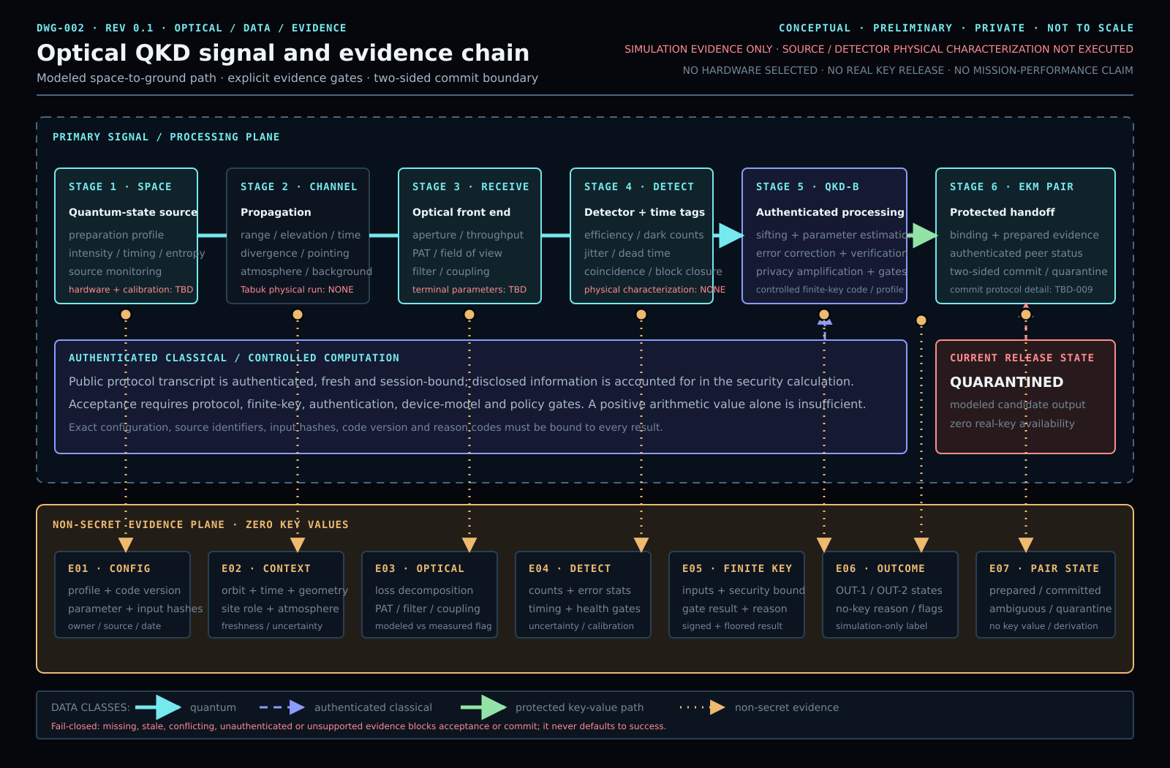
03 · METHOD
Optical QKD signal and evidence chain
DWG-002 · every modeled transition requires a traceable input, transform, output, and acceptance state
Q-ORBIT · PRIVATE PRELIMINARY · THEORETICAL ONLY
04
Notes:
Walk left to right: declared inputs, optical/channel transformations, detection statistics, finite-key processing, then evidence-gated release.
A numerical output is not automatically acceptable evidence.
[Sources]
- DWG-002 Q-Orbit Optical QKD Evidence Chain V0.1
- Q-Orbit Engineering Design Document V1.0-RC3, Chapters 5 and 8
[/Sources]

Slide 5
04 · CONTROLLED RESULT
Frozen fixture: exact reproduction succeeded
The V0.16-TA1 implementation exactly reproduces the controlled V0.6 fixture under its declared profile.
102 s
41,338.624
41,338
half-window
signed margin · bits
floored candidate bits
Controlled temporal convention
Full value: 41,338.62418456675
floor(max(M, 0))
Interpretation
PASS-THEORETICAL means the software reproduces one frozen fixture. It does not establish robustness, physical validity, device security, or mission performance.
Q-ORBIT · PRIVATE PRELIMINARY · THEORETICAL ONLY
05
Notes:
State the full signed value once, then the controlled floored convention.
Do not convert candidate bits into delivered key material.
[Sources]
- Q-Orbit V0.16-TA1 baseline result
- Q-Orbit Engineering Design Document V1.0-RC3, Section 8.2
[/Sources]

Slide 6
05 · ROBUSTNESS
V0.7 screen: the nominal result is not robust
A broad 8,192-point theoretical screen changed the governing interpretation from “positive nominal case” to “unstable across the tested ranges.”
3,947 / 8,192
0 bits
−8,738.764
positive samples
clipped median
signed median · bits
48.18115234375%
Central result after nonnegative clipping
Negative central signed margin
Scientific consequence
The screen falsifies any claim that the positive nominal pass is representative across the declared multi-parameter domain.
Q-ORBIT · PRIVATE PRELIMINARY · THEORETICAL ONLY
06
Notes:
This screen is deliberately presented as a robustness screen, not a probability distribution.
The most influential factors in that controlled screen were receive aperture, beam divergence, background counts, atmosphere, and coupling efficiency.
[Sources]
- Q-Orbit Mission-Case Evidence Build V0.7
- Q-Orbit Engineering Design Document V1.0-RC3, Section 8.3
[/Sources]

Slide 7
05 · ROBUSTNESS
V0.16-TA1: coupled deterministic screen
33.789411%
positive fraction
568 positive / 1,113 nonpositive
Median signed margin
−2,624.947
Range
−3,828.415 to 142,540.748 bits
1,681 GRID POINTS
Q-ORBIT · PRIVATE PRELIMINARY · THEORETICAL ONLY
07
Notes:
The 41 × 41 coupled screen is deterministic and locally bounded.
The 33.789411% positive fraction is a grid fraction, not a mission availability probability.
[Sources]
- Q-Orbit V0.16-TA1 coupled deterministic screen
- Q-Orbit Engineering Design Document V1.0-RC3, Section 8.3
[/Sources]

Slide 8
06 · INTERPRETATION
Reproducible is not the same as robust—or operational
REPRODUCIBLE
ROBUST
OPERATIONAL
PASS-THEORETICAL
NOT ESTABLISHED
BLOCKED
Exact fixture behavior is recovered under controlled software conditions.
Both declared perturbation screens have nonpositive central outcomes.
Proof/device, physical, site, HIL, authority, key, and release gates remain open.
One exact case
Across tested ranges
Real system and authority
Q-ORBIT · PRIVATE PRELIMINARY · THEORETICAL ONLY
08
Notes:
Use this slide to prevent category errors.
A reproducible mathematical fixture is valuable but narrower than a robust model, and far narrower than an operational system.
[Sources]
- Q-Orbit Master Integration and Consistency Audit V1.0-RC3
- Q-Orbit Engineering Design Document V1.0-RC3, acceptance-state tables
[/Sources]

Slide 9
07 · VERIFICATION
Independent checks agree within the declared scope
50 / 971 / 0
15 / 15
12 / 12
independent numerical comparison
non-emitting rehearsal
V0.16 regression suite
vectors / metrics / open discrepancies
98 events · 128 / 128 checks
20 / 20 independent package checks
What these checks prove
What they do not prove
Internal consistency, exact numerical reproduction, and fail-closed software behavior in dry-run scope.
Source/detector qualification, hardware integration, optical safety, site suitability, or key secrecy in operation.
Q-ORBIT · PRIVATE PRELIMINARY · THEORETICAL ONLY
09
Notes:
Independent checks reduce software and integration uncertainty.
Their scope remains numerical and non-emitting; do not generalize them to hardware or mission acceptance.
[Sources]
- Q-Orbit V0.13 Numerical Cross-Check
- Q-Orbit V0.14 Non-Emitting Rehearsal
- Q-Orbit V0.16-TA1 Validation Record
- Q-Orbit Master Integration and Consistency Audit V1.0-RC3
[/Sources]

Slide 10
08 · OPEN SCIENCE
Seven proof-to-device obligations still block acceptance
No single “device penalty” or QBER threshold may substitute for explicit security-model closure.
01
Phase randomization
05
Detector efficiency mismatch across channel, time, wavelength, or polarization
02
Pulse independence and intensity correlations
06
Device-characterization confidence and parameter coverage
03
State-preparation flaws and source leakage
07
Memory across protocol instances and device aging
04
Detector dead time, recovery, saturation, jitter, and event history
PROOF-TO-DEVICE: BLOCKED
Required next theoretical gate: select and review a proof/device-assumption profile with zero unmapped security-relevant effects.
Q-ORBIT · PRIVATE PRELIMINARY · THEORETICAL ONLY
10
Notes:
These are scientific-security obligations, not shopping items.
The correct theoretical next step is a reviewed proof/device-assumption profile; physical evidence is only needed if a later hardware program is authorized.
[Sources]
- Q-Orbit Engineering Design Document V1.0-RC3, Sections 7.2 and 8.5
- Q-Orbit Master Integration and Consistency Audit V1.0-RC3
[/Sources]

Slide 11
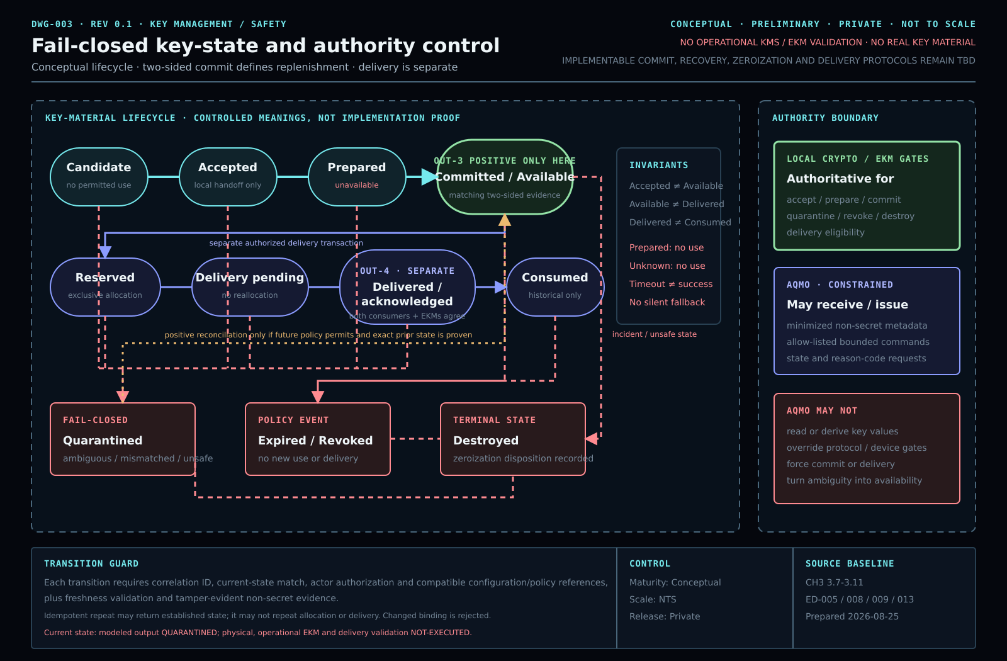
09 · CONTROL
Fail-closed key state and authority
Terminal states
LASER · INHIBITED
KEY · QUARANTINED
RELEASE · ZERO
PUBLIC · BLOCKED
Default-deny behavior is part of the evidence model: an absent authority or failed gate cannot silently become permission.
Q-ORBIT · PRIVATE PRELIMINARY · THEORETICAL ONLY
11
Notes:
The control logic defaults to inhibition, quarantine, zero release, and private status.
This is a conceptual control architecture; it has not been validated on integrated hardware.
[Sources]
- DWG-003 Q-Orbit Fail-Closed Key State Control V0.1
- Q-Orbit Engineering Design Document V1.0-RC3, Chapters 5 and 8
[/Sources]

Slide 12
10 · SITE BOUNDARY
Tabuk is a study region—not a qualified site
Current controlled position
Region
TABUK · STUDY ONLY
Tabuk is retained only as the theoretical study region. No coordinate is a real parcel, no local atmospheric or horizon survey has been run, and no equipment or laser case has been authorized.
Parcel
NONE
Local survey
NOT-RUN
Hardware
DEFERRED
The academic submission does not require hardware procurement.
Laser authority
NONE / INHIBITED
Q-ORBIT · PRIVATE PRELIMINARY · THEORETICAL ONLY
12
Notes:
Reaffirm the earlier decision to keep the project theoretical for submission.
Any parcel, field survey, procurement, GACA/SANS coordination, or outdoor emission belongs to a later separately authorized program.
[Sources]
- Q-Orbit Engineering Design Document V1.0-RC3, Section 8.6
- Q-Orbit Tabuk Ground Station and Laser Requirements V0.10
[/Sources]

Slide 13
11 · ACCEPTANCE
Current evidence and release disposition
Frozen numerical fixture
PASS-THEORETICAL
Tabuk site and mission case
NOT-RUN / NONE
Independent numerical comparison
PASS-NUMERICAL
Laser operation
INHIBITED
Proof-to-device completeness
BLOCKED
Operational key release
ZERO-RELEASED
Physical characterization
NOT-EXECUTED
Public release
PRIVATE-BLOCKED
Hardware-in-the-loop
BLOCKED
Audit disposition
PASS · PRIVATE THEORETICAL INTEGRATION ONLY
Q-ORBIT · PRIVATE PRELIMINARY · THEORETICAL ONLY
13
Notes:
Read the acceptance state exactly; do not paraphrase BLOCKED or NOT-EXECUTED as partial readiness.
The package passes only for its declared private theoretical academic purpose.
[Sources]
- Q-Orbit Master Integration and Consistency Audit V1.0-RC3, Sections 5 and 9
- Q-Orbit Engineering Design Document V1.0-RC3, acceptance-state table
[/Sources]

Slide 14
12 · CONCLUSION
Defensible theoretical submission—no wider claim
What is complete
Next before submission
• Controlled report, paper, engineering document, audit, and private website
• Three controlled conceptual engineering drawings
• Exact numerical fixture and bounded robustness screens
• Independent checks and fail-closed states
1. Final editorial proof
2. Rehearse this briefing
3. Verify all files open
4. Preserve the private archive
Final scientific statement
NO PURCHASE
NO PUBLISH
The model is reproducible, but the modeled positive output is not robust across the declared screens.
NO EMISSION
THEORY ONLY
Q-ORBIT · PRIVATE PRELIMINARY · THEORETICAL ONLY
14
Notes:
Close on the bounded achievement: the work is coherent and auditable for a theoretical academic submission.
The next immediate work is presentation rehearsal and final file integrity—not hardware, fieldwork, or public deployment.
[Sources]
- Q-Orbit Submission Manifest V1.0-RC3
- Q-Orbit Master Integration and Consistency Audit V1.0-RC3
- Q-Orbit Engineering Design Document V1.0-RC3
[/Sources]

