Slide 1
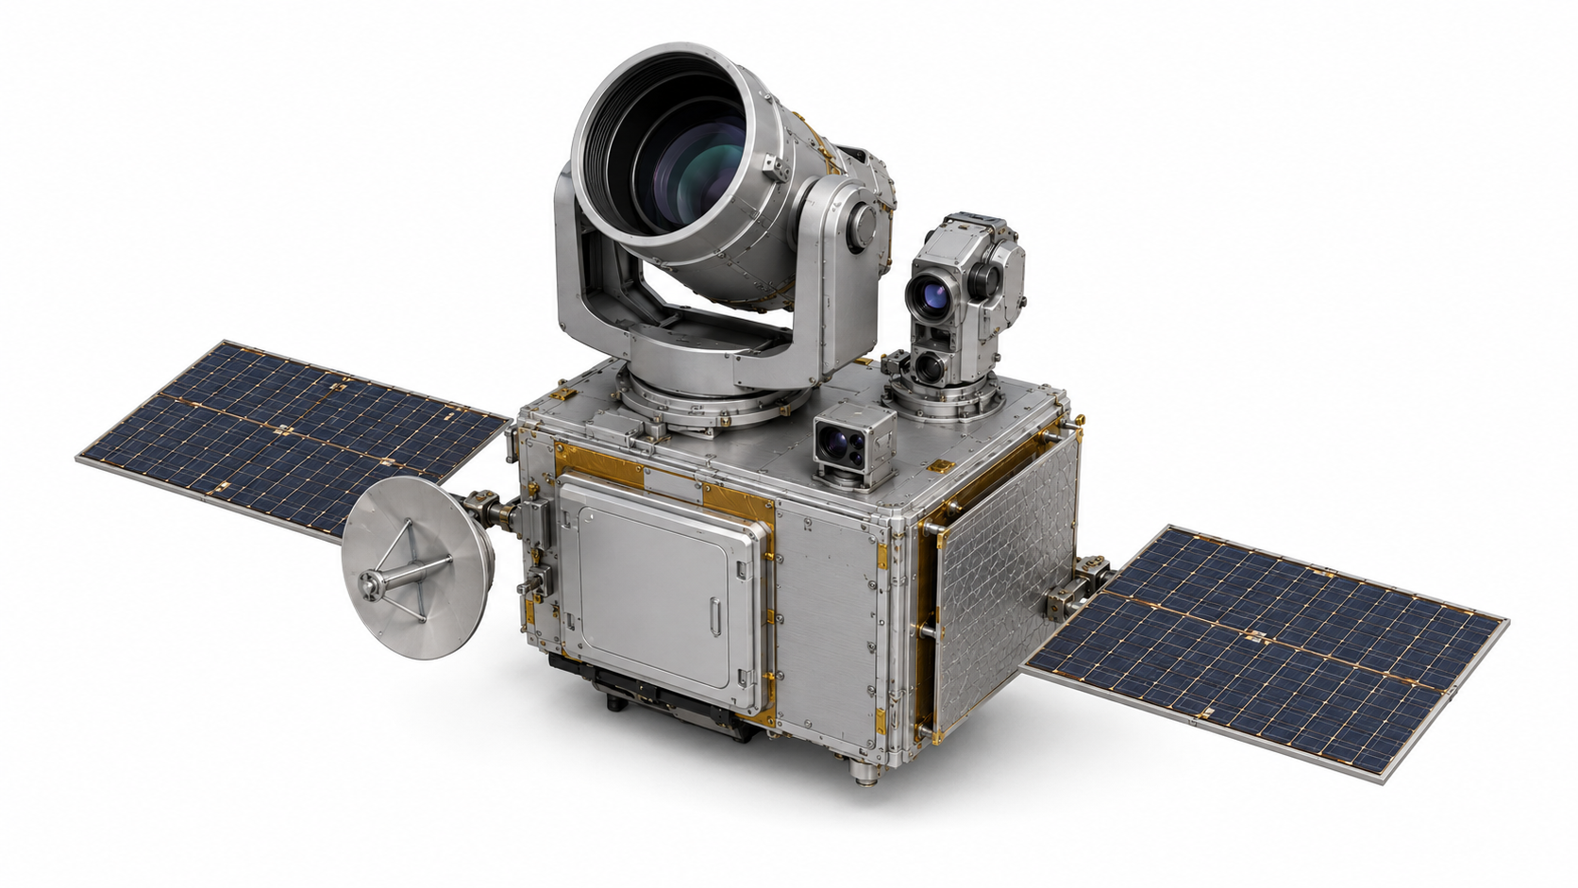
DWG-101 · REV 0.2
SPACE TERMINAL · ANNOTATED CONCEPT
Q-ORBIT
QKD Optical Telescope
Solar Array (x2)
Coarse-Pointing Gimbal
Radiator
Fine-Steering / Tracking Head
Star Tracker
Authenticated Classical Antenna
Payload & Evidence Computer
CONCEPTUAL · PRIVATE · NTS
NOT FOR FABRICATION / PROCUREMENT / OPERATION
UNSPECIFIED VALUES REMAIN TBD
Notes:
Illustrative spacecraft terminal plate only.
The plate identifies required functions; it does not select a flight platform, supplier, mass, power, aperture, divergence, or qualification state.
[Sources]
- Q-Orbit Engineering Design Document V1.0-RC3 (component naming and evidence boundaries)
- User-provided visual reference: annotated spacecraft or quantum-network technical illustration
- Q-Orbit generated base illustration V0.2; deterministic labels and boundaries added in this plate
[/Sources]

Slide 2
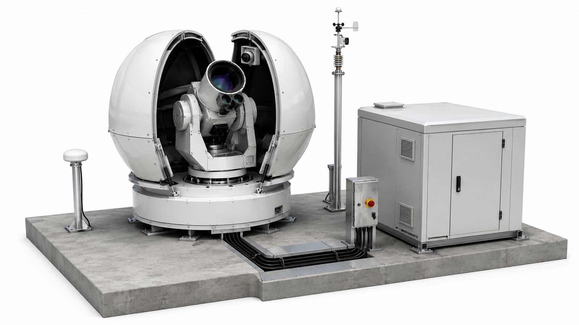
DWG-102 · REV 0.2
GROUND OPTICAL STATION · ANNOTATED CONCEPT
Q-ORBIT
Protective Clamshell Enclosure
Weather & Visibility Mast
Az–El Optical Telescope
Safety Interlock Cabinet
Receive / Tracking Aperture
Control & Evidence Shelter
Tracking Camera
GNSS / Timing Antenna
Protected Service / Cable Trench
CONCEPTUAL · PRIVATE · NTS
NOT FOR FABRICATION / PROCUREMENT / OPERATION
UNSPECIFIED VALUES REMAIN TBD
Notes:
Illustrative external station plate for the Tabuk study-region concept.
Parcel, foundation, dimensions, equipment, emissions authority, weather qualification, and laser safety approvals remain unselected or blocked.
[Sources]
- Q-Orbit Engineering Design Document V1.0-RC3 (component naming and evidence boundaries)
- User-provided visual reference: annotated spacecraft or quantum-network technical illustration
- Q-Orbit generated base illustration V0.2; deterministic labels and boundaries added in this plate
[/Sources]

Slide 3
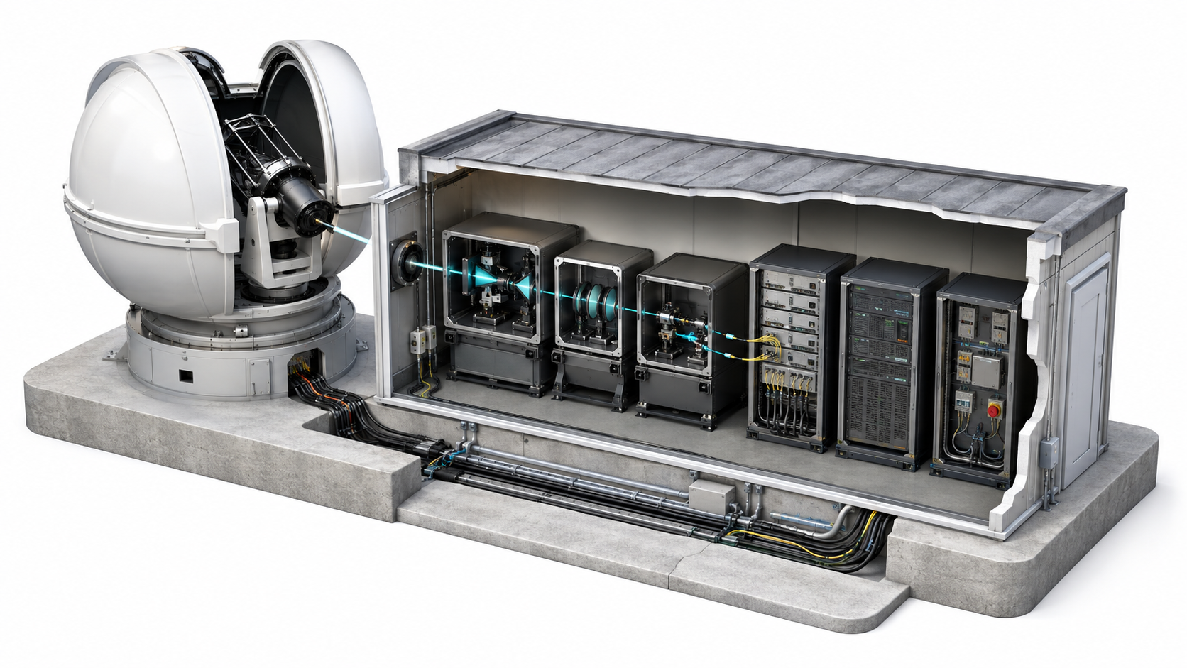
DWG-103 · REV 0.2
GROUND OPTICAL CHAIN · CUTAWAY CONCEPT
Q-ORBIT
Telescope / Coude Entry
Detector & Time Tagging
Relay Optics
Processing & Evidence Rack
Spectral Filter
Safety Interlock
Spatial Coupling / Fiber Injection
Protected Service Trench
CONCEPTUAL · PRIVATE · NTS
NOT FOR FABRICATION / PROCUREMENT / OPERATION
UNSPECIFIED VALUES REMAIN TBD
Notes:
Illustrative cutaway separates optical transport, detection/time-tagging, processing/evidence, and safety functions.
The cyan beam trace is illustrative; optical prescription, wavelength, filters, coupling, detectors, calibration, and loss budget remain controlled TBDs.
[Sources]
- Q-Orbit Engineering Design Document V1.0-RC3 (component naming and evidence boundaries)
- User-provided visual reference: annotated spacecraft or quantum-network technical illustration
- Q-Orbit generated base illustration V0.2; deterministic labels and boundaries added in this plate
[/Sources]

Slide 4
DWG-104 · REV 0.2
QUANTUM / CLASSICAL / EVIDENCE PATHS
Q-ORBIT
CONTROLLED Q-ORBIT SYSTEM BOUNDARY
QUANTUM OPTICAL PATH
AUTHENTICATED CLASSICAL PATH
ACQUIRE &
TRACK
DETECT &
TIME-TAG
SIFT &
FINITE-KEY
QKD-A
QKD-B
Space Endpoint
Ground Endpoint
Optical terminal concept
AQMO
RELEASE GATE
Tabuk region concept
Metadata only
KEY QUARANTINED
No key values
Fail closed
NON-SECRET EVIDENCE / CONTROL
No EPR / entanglement-source / repeater claim · no operational key release
CONCEPTUAL · PRIVATE · NTS
NOT FOR FABRICATION / PROCUREMENT / OPERATION
UNSPECIFIED VALUES REMAIN TBD
Notes:
The visual grammar follows the user-provided network reference: distinct path classes and a bounded system box.
Q-Orbit does not claim EPR distribution, quantum repeaters, or a validated network controller; the current key state remains quarantined.
[Sources]
- Q-Orbit Engineering Design Document V1.0-RC3 (component naming and evidence boundaries)
- User-provided visual reference: annotated spacecraft or quantum-network technical illustration
- Q-Orbit generated base illustration V0.2; deterministic labels and boundaries added in this plate
[/Sources]

