Slide 1
EXTENDING THE OPENSEES FINITE ELEMENT FRAMEWORK FOR GPU SUPPORT
Gustavo A. Araújo R.
BIODS 253 – Software Engineering for Scientists
March 18th, 2025
Stanford University

Slide 2
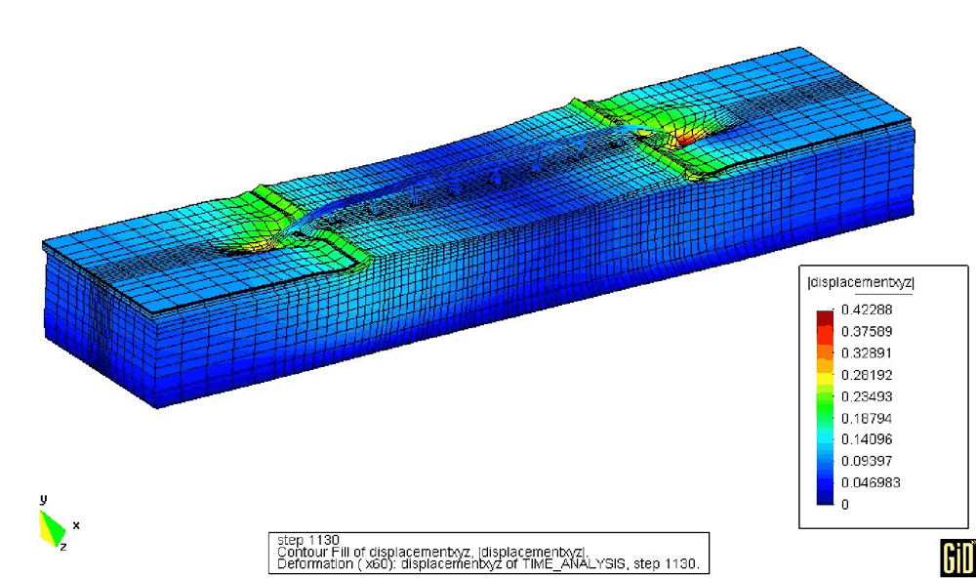

INTRODUCTION
Object-oriented finite element framework
Serial and parallel CPU-based execution
Open source

Slide 3
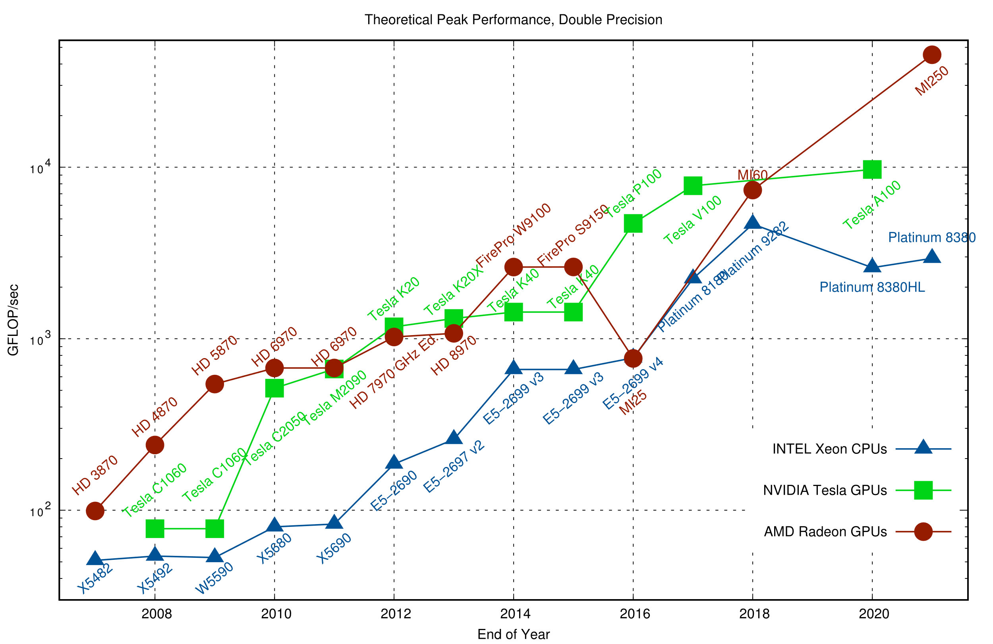
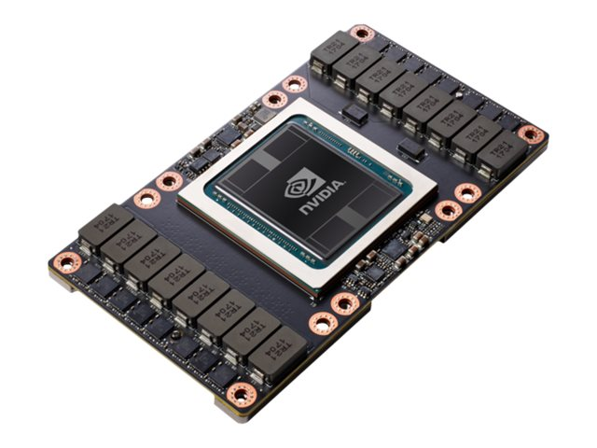
OBJECTIVE
Leverage GPU computing to accelerate CPU-based simulations in OpenSees

Slide 4
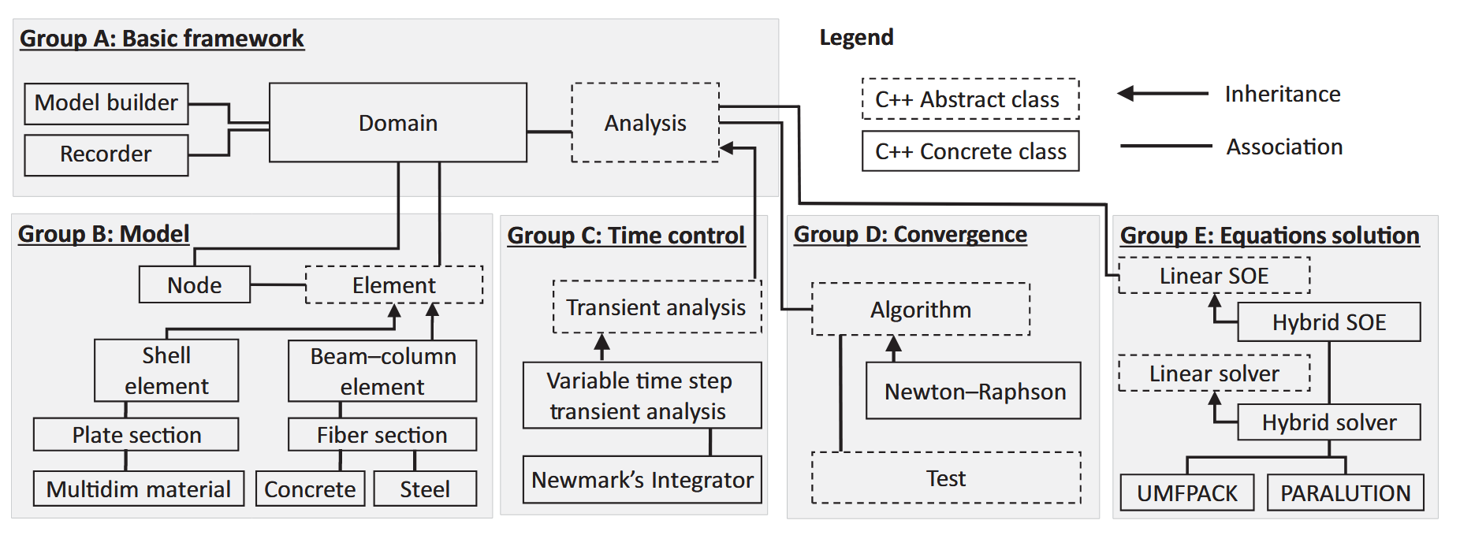
OPENSEES ARCHITECTURE
We can “easily” insert our custom sparse solver into OpenSees
Sparse SOE
Sparse Solver
AMGXSolver

Slide 5
REQUIREMENTS AND INITIAL CHALLENGES
Requirements:
Integrate a sparse solver into OpenSees without significantly modifying its existing data structures.
Adapt to OpenSees' coding style, tends to favor C arrays and C strings over STL containers and returning negative values rather than using exceptions.
Initial Challenges:
OpenSees' source code is large, intricate, and lacks clear documentation.
No built-in testing framework, minimal exception handling, and a reliance on outdated programming practices.
GPUs have their own dedicated memory, with quite primitive memory operations compared to standard C++. It’s very easy to run into memory errors that simply force the program to abort.

Slide 6
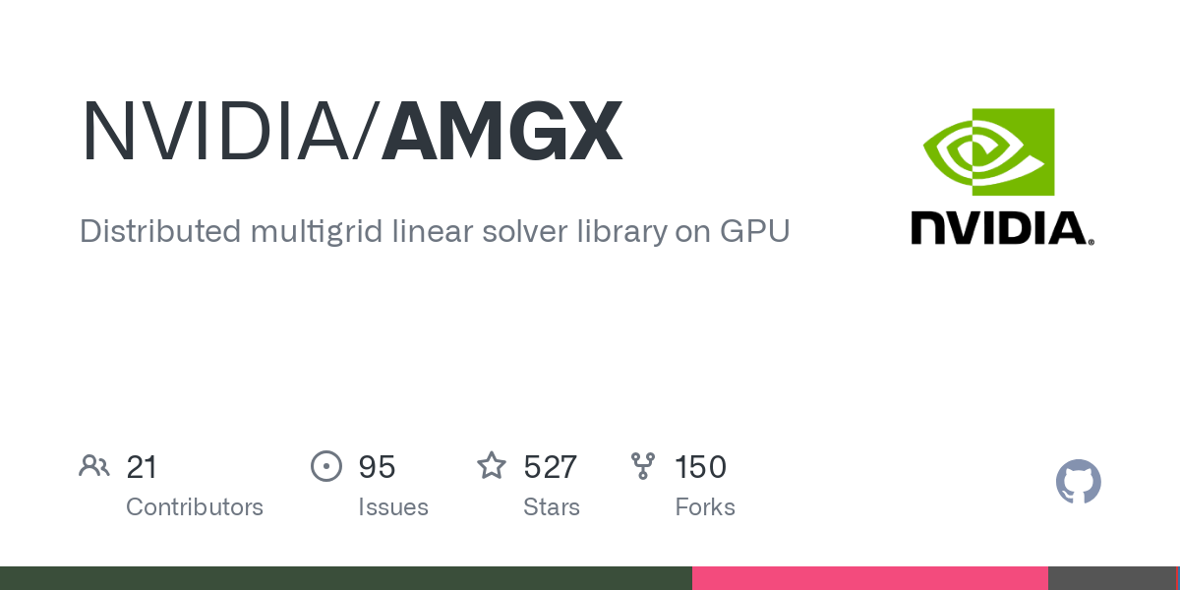
HARDWARE AND PROGRAMMING TOOLS
Scope:
Single-GPU implementation using NVIDIA GPUs.
AMGX: optimized NVIDIA linear algebra library.
Additional challenges:
AMGX documentation is not complete and has not been updated since 2017.
Theoretical knowledge required of all the possible solver configurations.
Error handling is also done through return values rather than through exceptions.
https://github.com/NVIDIA/AMGX

Slide 7
COURSE PROJECT
Develop an AMGXSolver interface that can be independently tested, free from OpenSees' complexities, while adhering to the API of OpenSees' sparse solvers to enable integration with the rest of the framework after thorough validation.
Linear Solver Interface in OpenSees
class AMGXSolver {
public:
// basic interface to mimic OpenSees solvers
AMGXSolver(/* a bunch of parameters for the constructor*/);
~AMGXSolver();
int solve(double* x, const double* b, int num_rows);
// methods that simulate the LinearSOE tied to the solver
void initializeMatrix(int num_rows, const int* row_ptr,
const int* col_indices, const double* values);
void replaceCoefficients(int num_rows, int num_non_zeros,
const double *values);
// new methods needed for AMGX
int getNumIterations(void);
double getFinalResidual(void);
// + some other methods
private:
// a bunch of pointers to AMGX resources
};
class LinearSOE;
class LinearSOESolver : public MovableObject {
public:
LinearSOESolver(int classTag);
virtual ~LinearSOESolver();
virtual int solve(void) = 0;
virtual int setSize(void) = 0;
virtual double getDeterminant(void) {
return 1.0;
};
protected:
private:
};

Slide 8
#include <pybind11/pybind11.h>
#include <pybind11/numpy.h>
#include "AMGXSolver.h"
namespace py = pybind11;
class PyAMGXSolver {
public:
AMGXSolver* solver;
PyAMGXSolver(const std::string& cfg) : solver(new AMGXSolver(cfg.c_str())) {}
py::array_t<double> solve(py::array_t<double> b) {
py::array_t<double> x(b.size());
solver->solve(x.mutable_data(), b.data(), b.size());
return x;
}
~PyAMGXSolver() { delete solver; }
};
PYBIND11_MODULE(pyAMGXSolver, m) {
py::class_<PyAMGXSolver>(m, "AMGXSolver")
.def(py::init<const std::string&>())
.def("solve", &PyAMGXSolver::solve);
}
To facilitate extensive testing before integrating AMGXSolver into OpenSees, I developed a Python wrapper around my C++ solver.

Slide 9
$ cd build
$ cmake .. -DAMGX_CUSTOM_PATH=../../amgx
$ make -j$(nproc)
$ ./test_solver
=====================================
✅ Tests Passed: 24
❌ Tests Failed: 0
=====================================
=====================================
✅ Exception Tests Passed: 16
❌ Exception Tests Failed: 0
=====================================
$ python3 ../SRC/tests/test_pyAMGXSolver.py
=====================================
Exception Tests Summary:
✅ Passed: 9, ❌ Failed: 0
=====================================
=====================================
✅ Solver Tests Passed: 24
❌ Solver Tests Failed: 0
=====================================
Created tests for both the C++ and Python interfaces.
Note: I did not use unit tests ☹
Handling exceptions in Python was challenging because Python's garbage collection is delayed, leading to memory leaks in AMGX unless the solver object was explicitly deleted in Python (e.g., `solver = None`).

Slide 10
The main application is a Python script that takes a CSV file containing a list of matrices from the SuiteSparse data set and tests the AMGX Solver
$ python3 main.py --help
usage: main.py [-h] [-MATRIX_DIR MATRIX_DIR] [-LOG_DIR LOG_DIR] [-CONFIG_DIR CONFIG_DIR] [-PLOT_DIR PLOT_DIR] [-TEMP_DIR TEMP_DIR] [-INPUT_CSV_FILE INPUT_CSV_FILE] [-OUTPUT_CSV_FILE OUTPUT_CSV_FILE]
Run AMGX solver tests on a set of matrices from the SuiteSparse data set with different AMGX configuration files.
options:
-h, --help show this help message and exit
-MATRIX_DIR MATRIX_DIR
Directory containing matrix files (.mtx)
-LOG_DIR LOG_DIR Directory to store solver logs
-CONFIG_DIR CONFIG_DIR
Directory containing solver config files (.json)
-PLOT_DIR PLOT_DIR Directory to save plots
-TEMP_DIR TEMP_DIR Temporary directory for downloads
-INPUT_CSV_FILE INPUT_CSV_FILE
CSV file containing matrix metadata
-OUTPUT_CSV_FILE OUTPUT_CSV_FILE
CSV file containing timings, number of iterations, and convergence

Slide 11
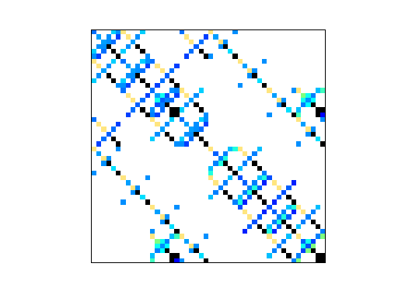
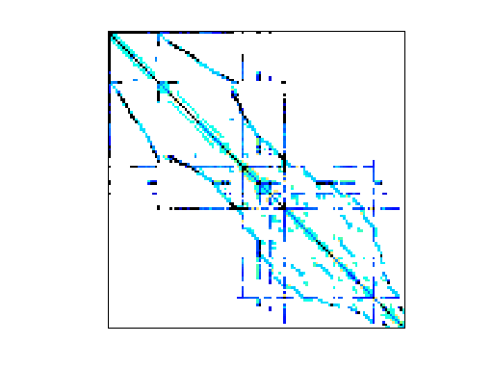
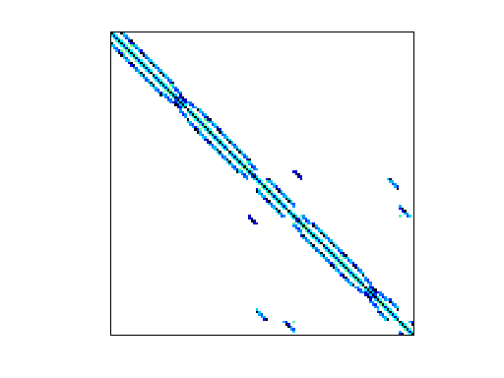
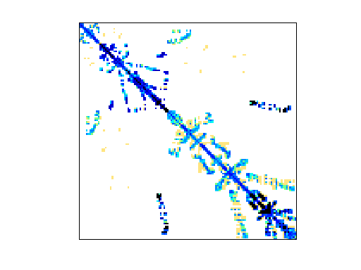
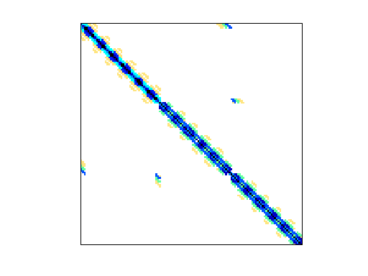
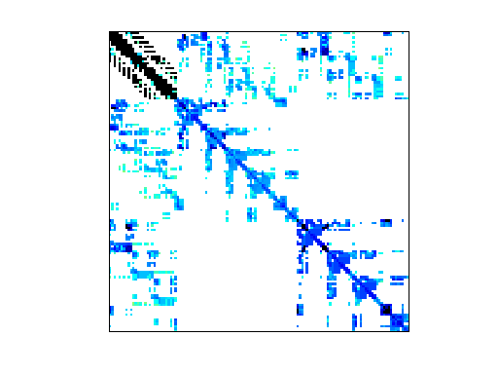
EXAMPLES OF INPUT MATRICES
bcsstk01: 48 x 48
bcsstk08: 1074 x 1074
bcsstk11: 1473 x 1473
bcsstk13: 2003 x 2003
Kuu: 7102 x 7102
thread: 29736 x 29736

Slide 12
INPUT MATRIX CSV FILE
Name | Group | Kind | NumRows | NumNonzeros | Date | Author | Rank | ConditionNumber
bcsstk01 | HB | Structural | 48 | 400 | 1982 | J. Lewis | 48 | 8.82E+05
bcsstk02 | HB | Structural | 66 | 4356 | 1982 | J. Lewis | 66 | 4.32E+03
bcsstk03 | HB | Structural | 112 | 640 | 1982 | J. Lewis | 112 | 6.79E+06
bcsstk04 | HB | Structural | 132 | 3648 | 1982 | J. Lewis | 132 | 2.29E+06
bcsstk06 | HB | Structural | 420 | 7860 | 1982 | J. Lewis | 420 | 7.57E+06
bcsstk08 | HB | Structural | 1074 | 12960 | 1982 | J. Lewis | 1074 | 2.60E+07
bcsstk09 | HB | Structural | 1083 | 18437 | 1982 | J. Lewis | 1083 | 9.52E+03
bcsstk10 | HB | Structural | 1086 | 22070 | 1982 | J. Lewis | 1086 | 5.24E+05
bcsstk11 | HB | Structural | 1473 | 34241 | 1982 | J. Lewis | 1473 | 2.21E+08
bcsstk13 | HB | CFD | 2003 | 83883 | 1982 | J. Lewis | 2003 | 1.10E+10
bcsstk14 | HB | Structural | 1806 | 63454 | 1985 | M. Will | 1806 | 1.19E+10
bcsstk15 | HB | Structural | 3948 | 117816 | 1985 | M. Will | 3948 | 6.54E+09
bcsstk16 | HB | Structural | 4884 | 290378 | 1985 | M. Will | 4884 | 4.94E+09
Kuu | MathWorks | Structural | 7102 | 340200 | 2006 | B. Cheng | 7102 | 1.58E+04
msc10848 | Boeing | Structural | 10848 | 1229776 | 1995 | R. Grimes | 10848 | 9.97E+09
bcsstk17 | HB | Structural | 10974 | 428650 | 1985 | M. Will | 10974 | 1.30E+10
smt | TKK | Structural | 25710 | 3749582 | 2008 | R. Kouhia | 25710 | 1.59E+09
thread | DNVS | Structural | 29736 | 4444880 | 1999 | C. Damhaug | 29736 | 2.57E+10
vanbody | GHS_psdef | Structural | 47072 | 2329056 | 2004 | S. Mayer | 47072 | --
nasasrb | Nasa | Structural | 54870 | 2667324 | 1995 | NASA | 54870 | --
crankseg_2 | GHS_psdef | Structural | 63838 | 14148858 | 2004 | S. Mayer | 63838 | --
s3dkq4m2 | GHS_psdef | Structural | 90449 | 4427725 | 1997 | R. Kouhia | 90449 | --
x104 | DNVS | Structural | 108384 | 8713602 | 1999 | C. Damhaug | 108384 | ---
shipsec8 | DNVS | Structural | 114919 | 3303553 | 1999 | C. Damhaug | 114919 | --
pwtk | Boeing | Structural | 217918 | 11524432 | 1995 | R. Grimes | 217918 | --
hood | GHS_psdef | Structural | 220542 | 9895422 | 2004 | J. Weiher | 2020542 | --
inline_1 | GHS_psdef | Structural | 503712 | 36816170 | 2004 | S. Mayer | 503712 | --
Fault_639 | Janna | Structural | 638802 | 27245944 | 2011 | C. Janna, M. Ferronato | 638802 | --

Slide 13
AMGX CONFIGURATION FILES
{
"config_version": 2,
"determinism_flag": 1,
"solver": {
"preconditioner": {
"print_grid_stats": 1,
"algorithm": "AGGREGATION",
"print_vis_data": 0,
"solver": "AMG",
"smoother": {
"relaxation_factor": 0.8,
"scope": "jacobi",
"solver": "BLOCK_JACOBI",
"monitor_residual": 0,
"print_solve_stats": 0
},
"print_solve_stats": 0,
"presweeps": 0,
"interpolator": "D2",
"selector": "SIZE_2",
"coarse_solver": "NOSOLVER",
"max_iters": 1,
"monitor_residual": 0,
"store_res_history": 0,
"scope": "amg",
"max_levels": 100,
"postsweeps": 3,
"cycle": "V"
},
"solver": "PCG",
"print_solve_stats": 1,
"obtain_timings": 1,
"max_iters": 1000,
"monitor_residual": 1,
"store_res_history": 1,
"convergence": "RELATIVE_INI",
"scope": "main",
"tolerance": 0.0001,
"norm": "L2"
}
}
{
"config_version": 2,
"solver": {
"preconditioner": {
"scope": "precond",
"solver": "MULTICOLOR_DILU"
},
"solver": "PCG",
"print_solve_stats": 1,
"obtain_timings": 1,
"max_iters": 20,
"monitor_residual": 1,
"store_res_history": 1,
"scope": "main",
"tolerance": 1e-06,
"norm": "L2"
}
}
Can be very simple or very complicated.

Slide 14
PRELIMINARY RESULTS
Name | NumRows | NumNonzeros | PCG_AGGREGATION_JACOBI.json |  |  | PCG_BLOCK_JACOBI.json |  |  | PCG_DILU.json |  |  | minjie.json (custom)
 |  |  | SolveTime | Iterations | Success | SolveTime | Iterations | Success | SolveTime | Iterations | Success | SolveTime | Iterations | Success
Kuu | 7102 | 340200 | 0.08976084 | 101 | 1 | 3.03556 | 1000 | 0 | 2.63217 | 20 | 0 | 0.06833218 | 581 | 1
bcsstk01 | 48 | 400 | 0.208777 | 1000 | 0 | 0.006097365 | 8 | 1 | 0.04942637 | 8 | 1 | 0.004078942 | 48 | 1
bcsstk02 | 66 | 4356 | 0.02246375 | 70 | 1 | 0.03969719 | 38 | 1 | 1.88111 | 20 | 0 | 0.006565881 | 71 | 1
bcsstk03 | 112 | 640 | 0.236196 | 1000 | 0 | 0.579908 | 1000 | 0 | 0.0914595 | 20 | 0 | 0.01423783 | 169 | 1
bcsstk04 | 132 | 3648 | 0.07960273 | 256 | 1 | 0.03433481 | 38 | 1 | 0.672344 | 20 | 0 | 0.007362283 | 83 | 1
bcsstk06 | 420 | 7860 | 0.330733 | 1000 | 0 | 0.799405 | 1000 | 0 | 0.415527 | 20 | 0 | 0.03608711 | 421 | 1
bcsstk08 | 1074 | 12960 | 0.03540326 | 51 | 1 | 0.2902059 | 118 | 1 | 0.764251 | 20 | 0 | 0.01843721 | 176 | 1
bcsstk09 | 1083 | 18437 | 0.0359227 | 84 | 1 | 0.01640428 | 20 | 1 | 0.397795 | 20 | 0 | 0.02239459 | 257 | 1
bcsstk10 | 1086 | 22070 | 0.350485 | 1000 | 0 | 0.824722 | 1000 | 0 | 0.442281 | 20 | 0 | 0.07757769 | 900 | 1
bcsstk11 | 1473 | 34241 | 0.389879 | 1000 | 0 | 0.908076 | 1000 | 0 | 0.599481 | 20 | 0 | 0.0855085 | 1000 | 0
bcsstk13 | 2003 | 83883 | 0.516217 | 1000 | 0 | 1.50027 | 1000 | 0 | 2.63064 | 20 | 0 | 0.0932932 | 1000 | 0
bcsstk14 | 1806 | 63454 | 0.479514 | 1000 | 0 | 1.05934 | 1000 | 0 | 1.16096 | 20 | 0 | 0.04293991 | 490 | 1
bcsstk15 | 3948 | 117816 | 0.554467 | 1000 | 0 | 1.41065 | 1000 | 0 | 0.917998 | 20 | 0 | 0.05909937 | 624 | 1
bcsstk16 | 4884 | 290378 | 0.03733153 | 41 | 1 | 2.33254 | 1000 | 0 | 3.12778 | 20 | 0 | 0.02178663 | 202 | 1
bcsstk17 | 10974 | 428650 | 0.812636 | 1000 | 0 | 3.55364 | 1000 | 0 | 1.83924 | 20 | 0 | 0.116225 | 1000 | 0
crankseg_2 | 63838 | 14148858 | 8.46805 | 1000 | 0 | 91.607 | 1000 | 0 | 118.476 | 20 | 0 | 1.0036 | 1000 | 0
hood | 220542 | 9895422 | 6.56544 | 1000 | 0 | 81.2329 | 1000 | 0 | 10.3597 | 20 | 0 | 0.943376 | 1000 | 0
msc10848 | 10848 | 1229776 | 1.38602 | 1000 | 0 | 9.58827 | 1000 | 0 | 25.9239 | 20 | 0 | 0.182185 | 1000 | 0
nasasrb | 54870 | 2667324 | 2.22664 | 1000 | 0 | 20.555 | 1000 | 0 | 4.83274 | 20 | 0 | 0.292397 | 1000 | 0
pwtk | 217918 | 11524432 | 7.81859 | 1000 | 0 | 86.5561 | 1000 | 0 | 11.5453 | 20 | 0 | 0.994524 | 1000 | 0
s3dkq4m2 | 90449 | 4427725 | 3.29529 | 1000 | 0 | 35.5802 | 1000 | 0 | 4.61744 | 20 | 0 | 0.446456 | 1000 | 0
shipsec8 | 114919 | 3303553 | 5.19808 | 1000 | 0 | 48.1186 | 1000 | 0 | 8.54009 | 20 | 0 | 0.587988 | 1000 | 0
smt | 25710 | 3749582 |  |  | 0 |  |  | 0 |  |  | 0 |  |  | 0
thread | 29736 | 4444880 | 3.28448 | 1000 | 0 | 31.6125 | 1000 | 0 | 39.1639 | 20 | 0 | 0.390284 | 1000 | 0
vanbody | 47072 | 2329056 | 2.14894 | 1000 | 0 | 17.9832 | 1000 | 0 | 6.60537 | 20 | 0 | 0.267374 | 1000 | 0
x104 | 108384 | 8713602 | 6.37873 | 1000 | 0 | 69.8191 | 1000 | 0 | 21.638 | 20 | 0 | 0.804441 | 1000 | 0

Slide 15
FUTURE WORK
Analyze why default AMGX configs struggle, explore parameter tuning.
Use Git submodules to fetch the latest AMGX automatically.
Use unit test for Python or Google Test for C++
against `cg` from scipy to understand convergence issues.
Merge into OpenSees.

