Slide 1
Alzheimer Prediction Using Machine Learning

Slide 2
Problem: Alzheimer’s disease is a neurodegenerative disorder leading to cognitive decline. Early detection is crucial for better management.
Objective: Build a machine learning model to predict whether a patient has Alzheimer’s based on health data.
Introduction
1

Slide 3
Data Collection & Preprocessing
Data Source: Tabular data with health-related features like age, BMI,
cholesterol levels, and MMSE scores.
Steps:
Handling missing values:
Mean imputation for numerical columns.
Backward fill for certain columns.
Mode imputation for categorical data.
Dropped: PatientID, DoctorInCharge columns.
Feature Scaling: Normalization and standardization of numerical columns.
2

Slide 4
Feature Selection
Selected Features:
Age, BMI, AlcoholConsumption, PhysicalActivity, DietQuality, SleepQuality, Cholesterol levels, MMSE, etc.
Reason: These features are critical indicators for Alzheimer’s prediction
3

Slide 5
Model Selection & Training
We used a Random Forest model with 200 estimators to predict whether a patient has Alzheimer's disease or not.
Training: The model was trained on the preprocessed dataset.
Testing: Predictions were made on the test set, and the model's performance was evaluated.
4

Slide 6
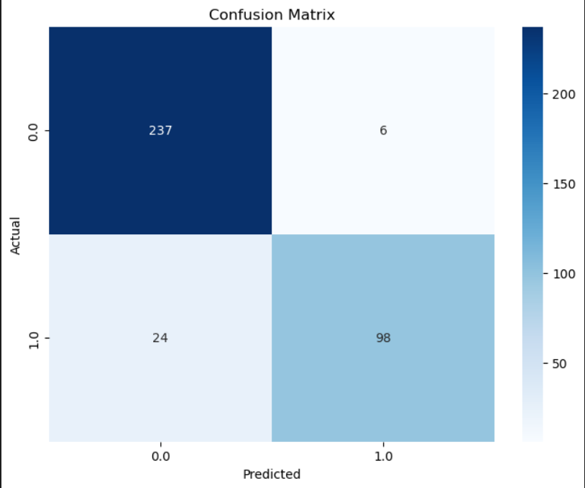
Model Evaluation
Accuracy: 92%
Confusion Matrix:
5

Slide 7
Web User Interface with Streamlit
UI Integration: The model is integrated with Streamlit for easy user interaction.
Users can input patient data via form fields.
Predict Alzheimer’s status with a button click.
UI Components:
Input fields: Age, BMI, Cholesterol levels, MMSE score, etc.
Prediction button: Show the prediction (Alzheimer’s or Not).
6

Slide 8
Future Work & Improvements
Hyperparameter Tuning: Improve the model’s accuracy by fine-tuning hyperparameters.
Additional Features: Add more features or data sources to enhance prediction accuracy.
Alternative Models: Explore other machine learning models like XGBoost or SVM.
7

Slide 9
Conclusion
Summary: We successfully built a machine learning model to predict Alzheimer’s disease using Random Forest, which performed well.
Impact: Early prediction of Alzheimer’s can lead to better management and care.
Next Steps: Deploy the model for real-time predictions via a web interface.
8

Slide 10
“Any questions?”
9

Slide 11

Thank You

