Slide 1

Introduction to Deep Learning for Time Series Forecasting
Rockefeller,
Data Scientist,
PhD Candidate, Stellenbosch University,
South Africa

Slide 2
Outline || Goals
Time Series forecasting as a Supervised Learning Task
How do Feed Forward Neural Networks Learn?
From Feedforward Neural Networks to Recurrent Neural Networks
Recurrent Neural Network (RNN) Architecture
An LSTM Architecture
Hands on!!!!

Slide 3
Target Audience
Beginner to intermediate Level
Know the basics of Python || Pytorch
Know the basics concepts of Machine Learning
Have some little experience of building machine learning models

Slide 4
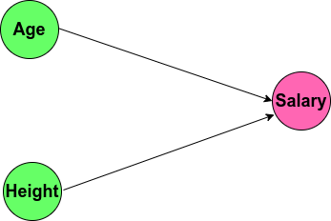
Raw observations
Shallow Neural Network
Age | Height | Salary
24 | 165 | 20
46 | 142 | 36
33 | 155 | 65
46 | 172 | 35

Slide 5
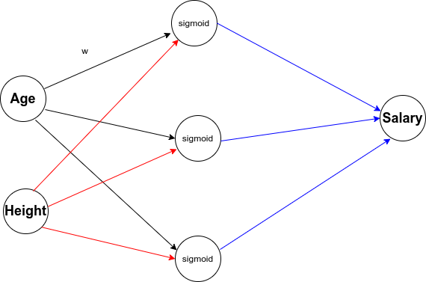
Raw observations
Deep Neural Network
Age | Height | Salary
24 | 165 | 20
46 | 142 | 36
33 | 155 | 65
46 | 172 | 35
input layer
output layer
hidden layer

Slide 6

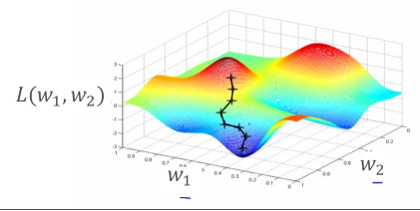
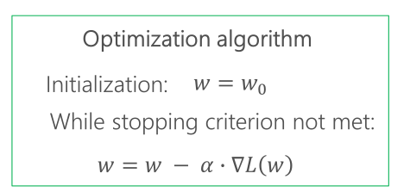
Training Overview
Feed forward Neural Network
The loss function L(weight, biases) measures the discrepancy between predicted and true values.
Activation functions could be tanh, sigmoid, ReLu depending on the use case.
Optimization algorithm (gradient-based) tries to find weights and biases that minimize the loss function

Slide 7
Time Series requires are observations taken sequentially in time
Time Series forecasting predicts future based on the past
Date | Temperature
2022-11-01 | 19
2022-11-02 | 17
2022-11-03 | 12
2022-11-04 | 22
2022-11-05 | 25
2022-11-06 | 21
2022-11-07 | ?
2022-11-08 | ?
2022-11-09 | ?
Age | Height | Salary
24 | 165 | 20
46 | 142 | 36
33 | 155 | 65
46 | 172 | 35
History
Future

Slide 8
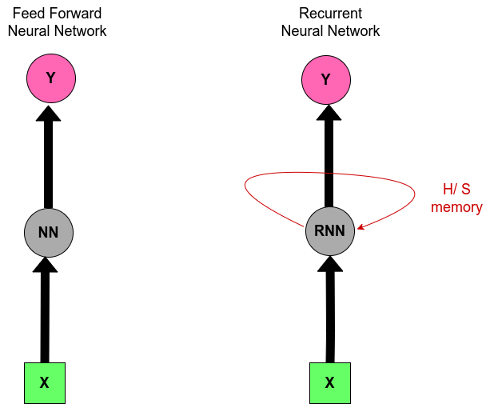
Feed forward Neural Net vs Recurrent Neural Net

Slide 9
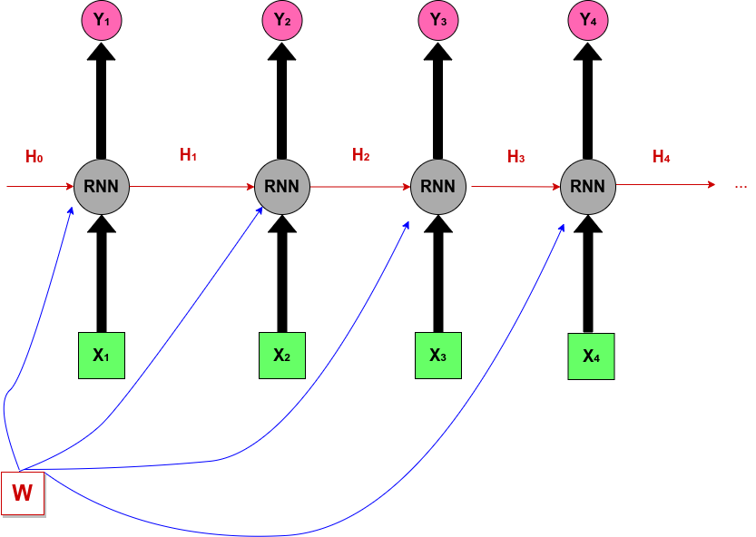
Unfolded Recurrent Neural Network

Slide 10
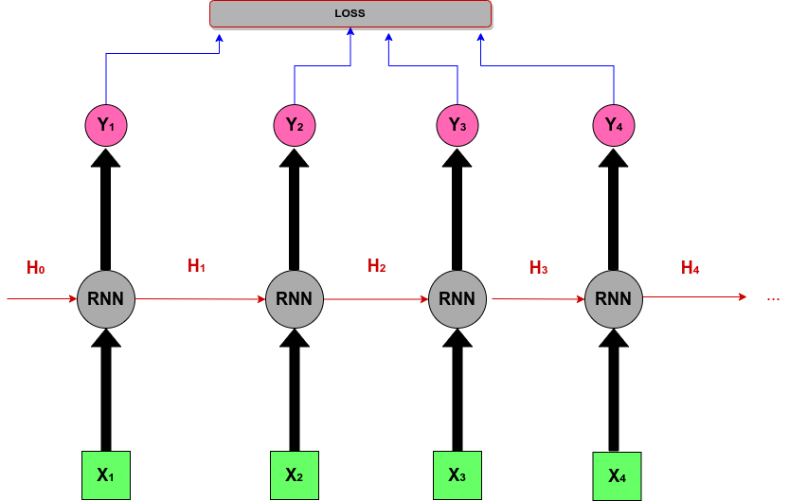
Training a Recurrent Neural Network
forward through the entire sequence to compute loss

Slide 11
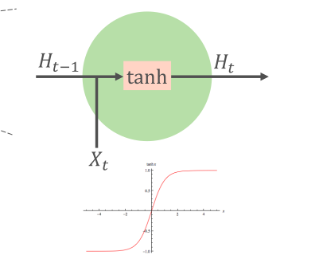
An RNN Cell
Transition Equation

Slide 12

An RNN Cell
Output Equation
Transition Equation

Slide 13
Training a Recurrent Neural Network
forward through the entire sequence to compute loss

Slide 14





Training a Recurrent Neural Network
forward through the entire sequence to compute loss
then, backward through the entire sequence to compute gradient

Slide 15
To improve on Vanilla Recurrent Neural Network
During Backpropagation, the computation of the gradient of H0 involves repeated tanh and many factors of W. This could lead to:
Exploding Gradient (e.g. 5*5*5*5*5*....) The gradient will grow exponentially and the program will crash. Usually, this is solved through gradient clipping which consists of clipping the gradient when it goes higher than a treshold value.
Vanishing Gradient (e.g. 0.7*0.7*0.7*0.7....). Here, this is more problematic because it is not obvious whren they occur or how to deal with them.
Solution: Change in activation function, proper initialization, regularization, or change of architecture to LSTM or GRU.

Slide 16
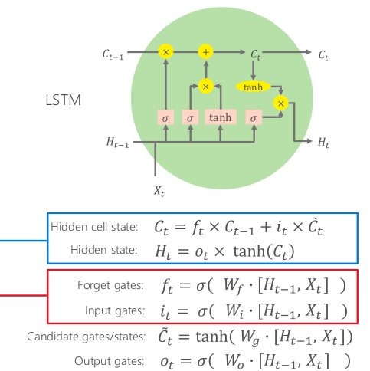
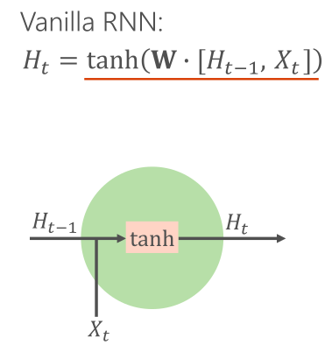
An RNN Cell vs an LSTM Cell

