Slide 1
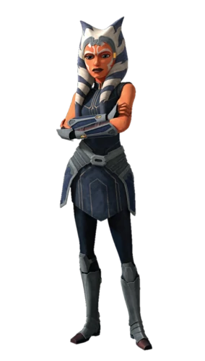




gabbie de los angeles
UC Santa Cruz
Star Wars Fan
Currently watching the Ahsoka Series on Disney
Associate Product Manager at Epson
BA in Film and Digital Media

