Slide 1
The ontology of „Transparency” App
The ontology of „Transparency” App
Applied System Software(English)(1),21/22-P - Sándor Burian | 220ADM028
Final Step 3 – Ontology

Slide 2
What is an ontology?
„An ontology encompasses a representation, formal naming, and definition of the categories, properties, and relations between the concepts, data, and entities that substantiate one, many, or all domains of discourse”
„The software engineering ontology defines common sharable software engineering knowledge including particular project information. Reaching a consensus of understanding is of benefit in a distributed multi-site software development environment” „Core ideas and objectives of ontology engineering are also central in conceptual modelling”

Slide 3
Phases of ontology
Design
Implementation
Integration
Maintenence
Retirement

Slide 4
Ontology types
Static
Dynamic
Intentional
Social

Slide 5
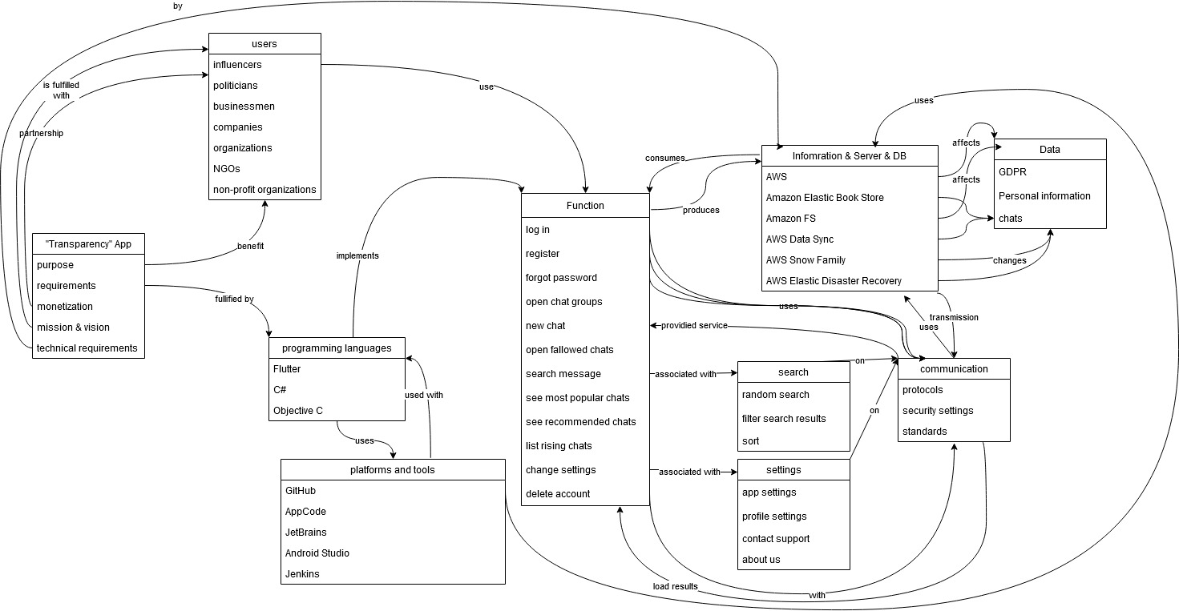
Ontology of Transparency app

Slide 6
Bibliography
Gasevic, D., Kaviani, N., & Milanović, M. (2009). Ontologies and Software Engineering (pp. 593–615). https://doi.org/10.1007/978-3-540-92673-3_27
Ontology engineering. (2022). In Wikipedia. https://en.wikipedia.org/w/index.php?title=Ontology_engineering&oldid=1090103162
Ontology (information science). (2022). In Wikipedia. https://en.wikipedia.org/w/index.php?title=Ontology_(information_science)&oldid=1085831526
Piattini, M., Calero, C., & Ruiz, F. (2006). Ontologies for Software Engineering and Software Technology. https://doi.org/10.1007/3-540-34518-3_4
Wongthongtham P, Chang E, Dillon T, & Sommerville I. (2007). Software Engineering Ontology – the Instance Knowledge (Part I). 7. https://espace.curtin.edu.au/bitstream/handle/20.500.11937/7780/20390_downloaded_stream_378.pdf?sequence=2&isAllowed=y

