Slide 1

Progress meeting
Gabriele Spina
Ph.D. student, TU/e – Philips
Bert den Brinker, Philips
g.spina@tue.nl
gabriele.spina@philips.com
03 February 2015

Slide 2
Ph.D. in Electrical Engineering overview
Patient monitoring strategies in Chronic Obstructive Pulmonary Disease (COPD) patients
Unobtrusive technologies, signal processing and machine learning algorithms for modular patient training and monitoring systems
Notes:
Investigate the feasibility of using unobtrusive technologies (smartphones, sensor network technology) in order to provide useful and modular patient training and monitoring methodologies that allow to capture physiological information (i.e., heart activity, oxygen saturation, breathing sounds), physical activity, patient data, and environmental context.
Signal processing and machine learning methods will be investigated to develop reliable algorithms to derive COPD relevant indicators and trends including patient characteristics, physical state, activity and behavior patterns. The information extracted will be mapped to clinically meaningful metrics of the overall physiologic and functional status of COPD patients. The development of daily routine analysis and automatic segmentation based on physiological information will be used to obtain objective patient's behavioral assessment and new markers of patient's improvements under laboratory (pulmonary rehabilitation) and (if possible) free living conditions. The algorithms will be the basis for risk classification of patients for developing an exacerbation and continuous home coaching and training.

Slide 3
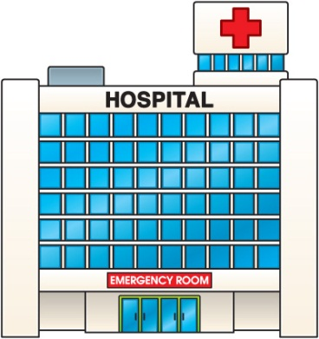

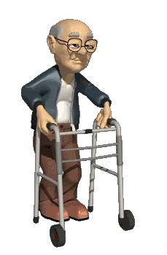
Introduction
Paradigm shift towards the home environment
Essential to develop new technologies and service concepts that permit monitoring and management of patients at home (remotely)

Slide 4
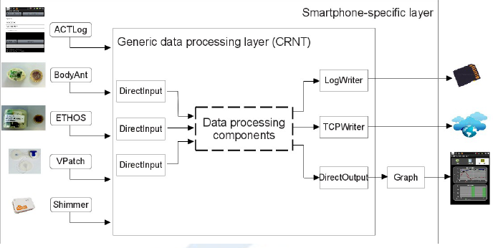
Smartphone monitoring and training approaches
- Spina et al. CRNTC+: A smartphone-based sensor processing framework for prototyping personal healthcare applications. Iinternational joint conference on Pervasive Computing Technologies for Healthcare, 2013.

Slide 5
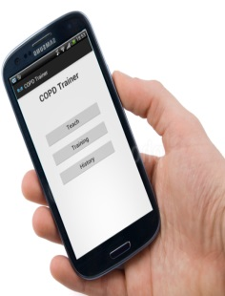
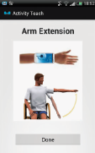
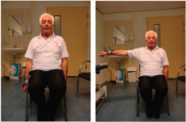
Smartphone monitoring and training approaches
- Spina et al. CRNTC+: A smartphone-based sensor processing framework for prototyping personal healthcare applications. Iinternational joint conference on Pervasive Computing Technologies for Healthcare, 2013.
- Spina et al. COPDTrainer: COPDTrainer: a smartphone-based motion rehabilitation training system with real-time acoustic feedback. ACM international joint conference on Pervasive and ubiquitous computing, 2013
- Spina et al. Toward smartphone assisted personal rehabilitation training. XRDS: Crossroads, The ACM Magazine for Students, 2013

Slide 6
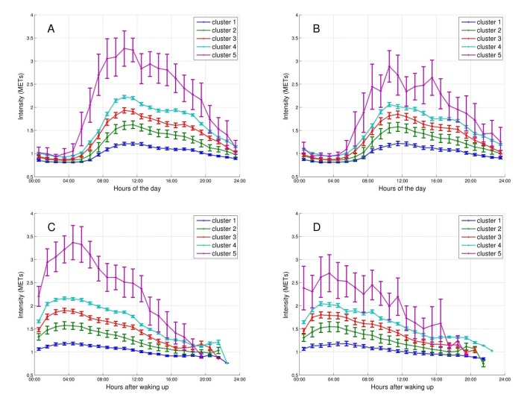
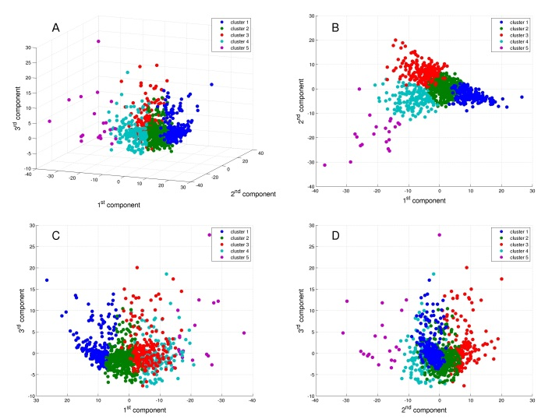
New insights in COPD
- Mesquita, Spina et al. Cluster analysis of objectively measured physical activity in 1001 COPD patients. Late-breaking abstract ERS 2014
- Mesquita, Spina et al. Physical activity patterns and clusters in 1001 patients with chronic obstructive pulmonary disease. Submitted to ERJ.

Slide 7
New insights in COPD
- Mesquita, Spina et al. Cluster analysis of objectively measured physical activity in 1001 COPD patients. Late-breaking abstract ERS 2014
- Mesquita, Spina et al. Physical activity patterns and clusters in 1001 patients with chronic obstructive pulmonary disease. Submitted to ERJ.
Spina et al. Identifying Physical Activity Profiles in COPD Patients Using Topic Models. Submitted to IEEE JOURNAL OF BIOMEDICAL AND HEALTH INFORMATICS, 2015
Spina et al. Plan clinical analysis after notifications.

Slide 8
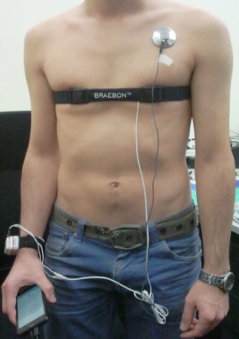
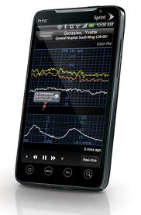
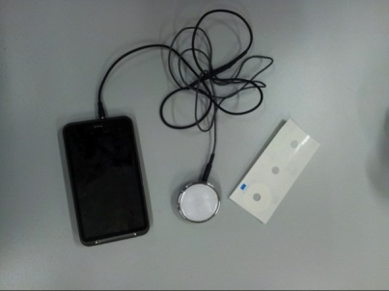
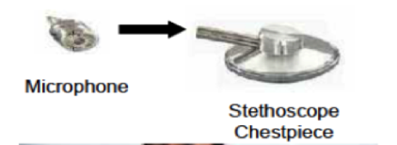
New monitoring solutions
- Spina et al. Smartscope. Planned submission to EMBC 2014.
- Spina et al. Smartscope extended. Planned submission to Special issue on Smartphone-Based Sensors for Non-Invasive Physiological Monitoring.

Slide 9
To add in the plan (if necessary-time):
Clinical analysis Topic modelling results
Activity intensity prediction based on sleeping (IP possible issue)
Activity recognition based on ADL data (EMBC 2015)
Review (introduction)

Slide 10
Actions to take
Decide PhD committee
  Promoter (1) Prof. Ronald Aarts (TUe)
  Promoter (2) Prof. Wouters
  Co-promoter (1) Bert den Brinker
  Co-promoter (2) Martijn Spruit
  + 1 decided by CIRO
  Pierluigi Casale (? Holst)
  Pieter Wijn (? TU/e) / Aki Harma (? Philips)
Travel budget conferences

Slide 11
2 Conferences published
2 Jurnals (1-2) (submitted)
1 Conference in progress (3)
1 Journal related to Conference (3)
1 Journal related to Journal (2)

Slide 12
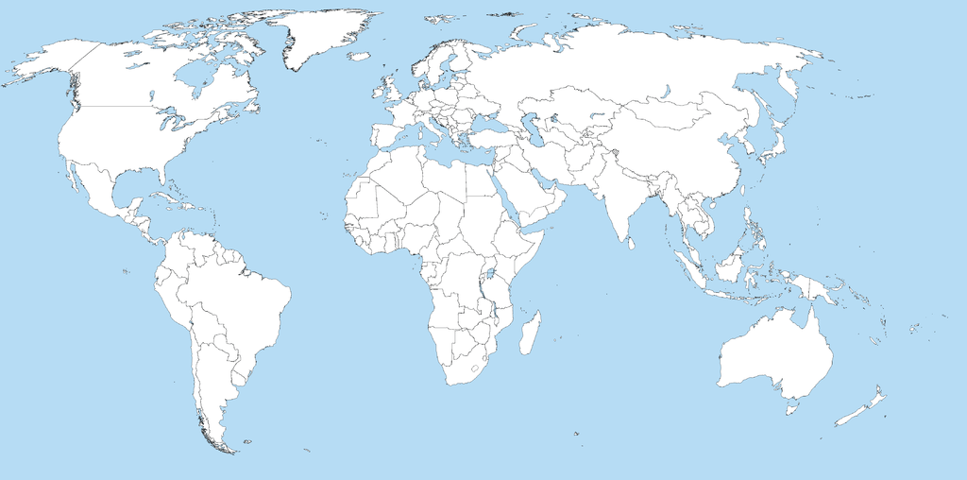
10 countries, 18 rehab centers, 1399 patients
977 patients – 66 healthy control subjects (age, gender, BMI)
5846 days (3916 weekdays - 1930 weekend days)

Slide 13
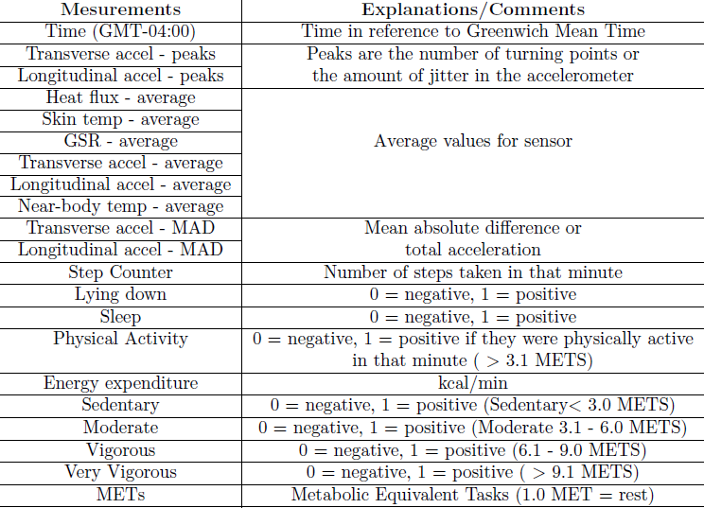
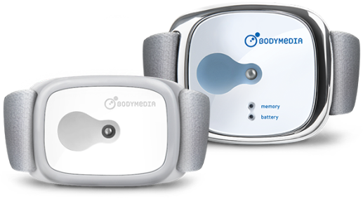
SenseWear armband activity monitor

Slide 14
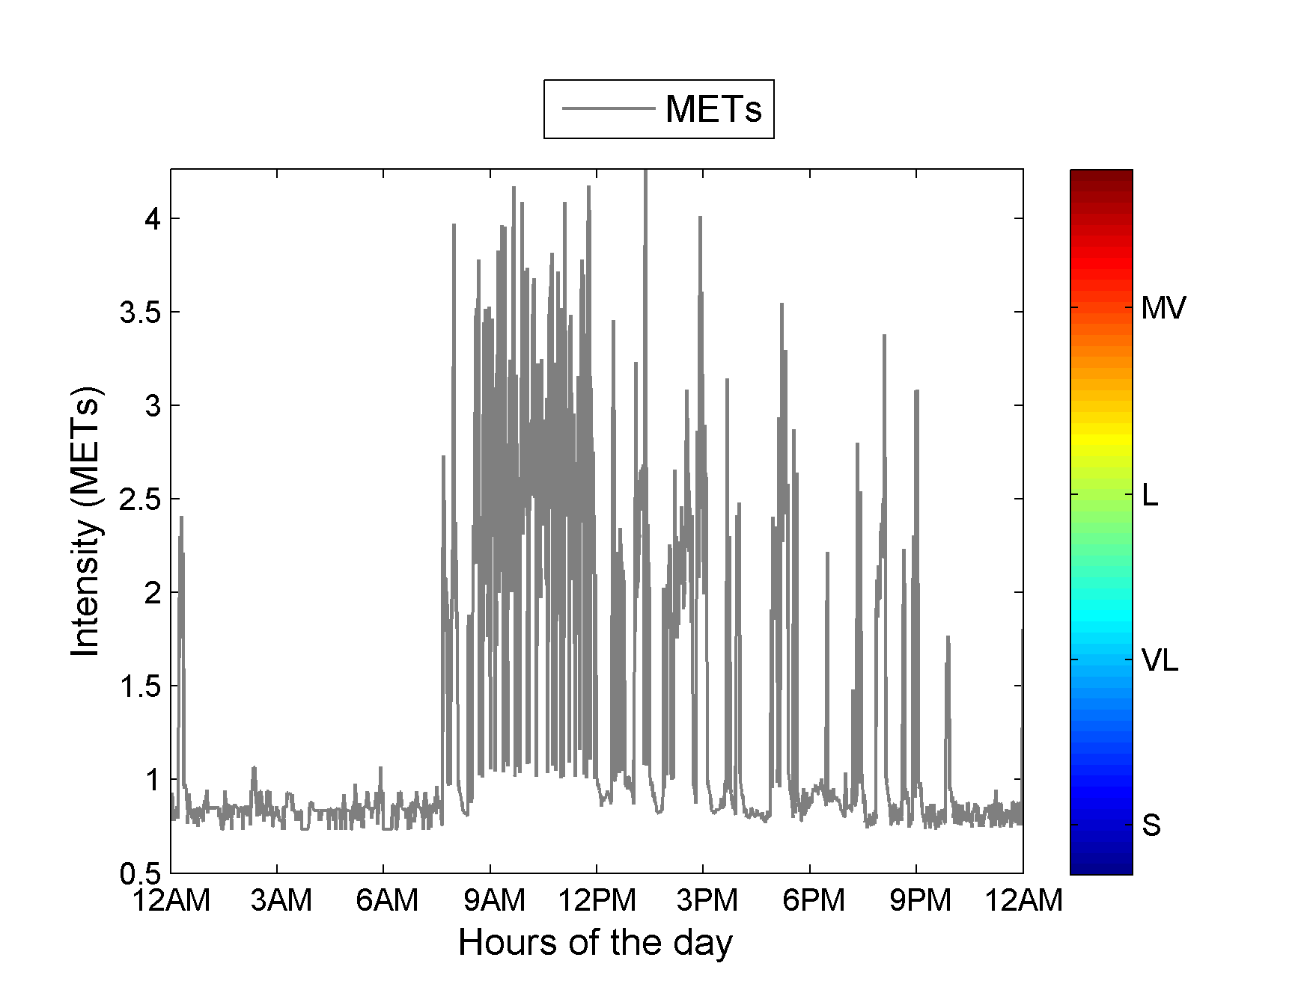

Slide 15
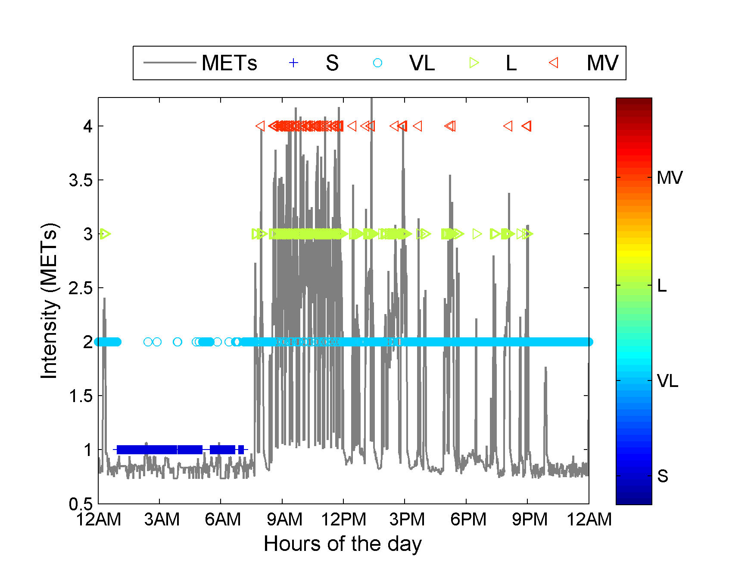

Slide 16
$IC, d$, $μ_{ST}^{}$,$μ_{GSR}^{},μ_{VM}^{}{, μ}_{SC}^{}$

Slide 17

$IC, d$, $μ_{ST}^{}$,$μ_{GSR}^{},μ_{VM}^{}{, μ}_{SC}^{}$
Feature selection
$IC,$ $f_{1}^{}$,$f_{2}^{},f_{3}^{}$

Slide 18



… … … …
… … … … … … … …
$IC, d$, $μ_{ST}^{}$,$μ_{GSR}^{},μ_{VM}^{}{, μ}_{SC}^{}$
Feature selection
$IC,$ $f_{1}^{}$,$f_{2}^{},f_{3}^{}$

Slide 19

… … … … … … … …
… … … … … … … …
… … … …
… … … … … … … …
… … … …
… … … … … … … …
… … … … … … … …
What are the topics present in the set of documents?

Slide 20









… … … … … … … …
… …
… … … … … …
… … … … …
$$α$$
$$θ_{d}$$
$$Z_{d,n}$$
$$W_{d,n}$$
$$β_{k}$$
$$η$$
$$N_{d}$$
$$D$$
$$K$$

Slide 21
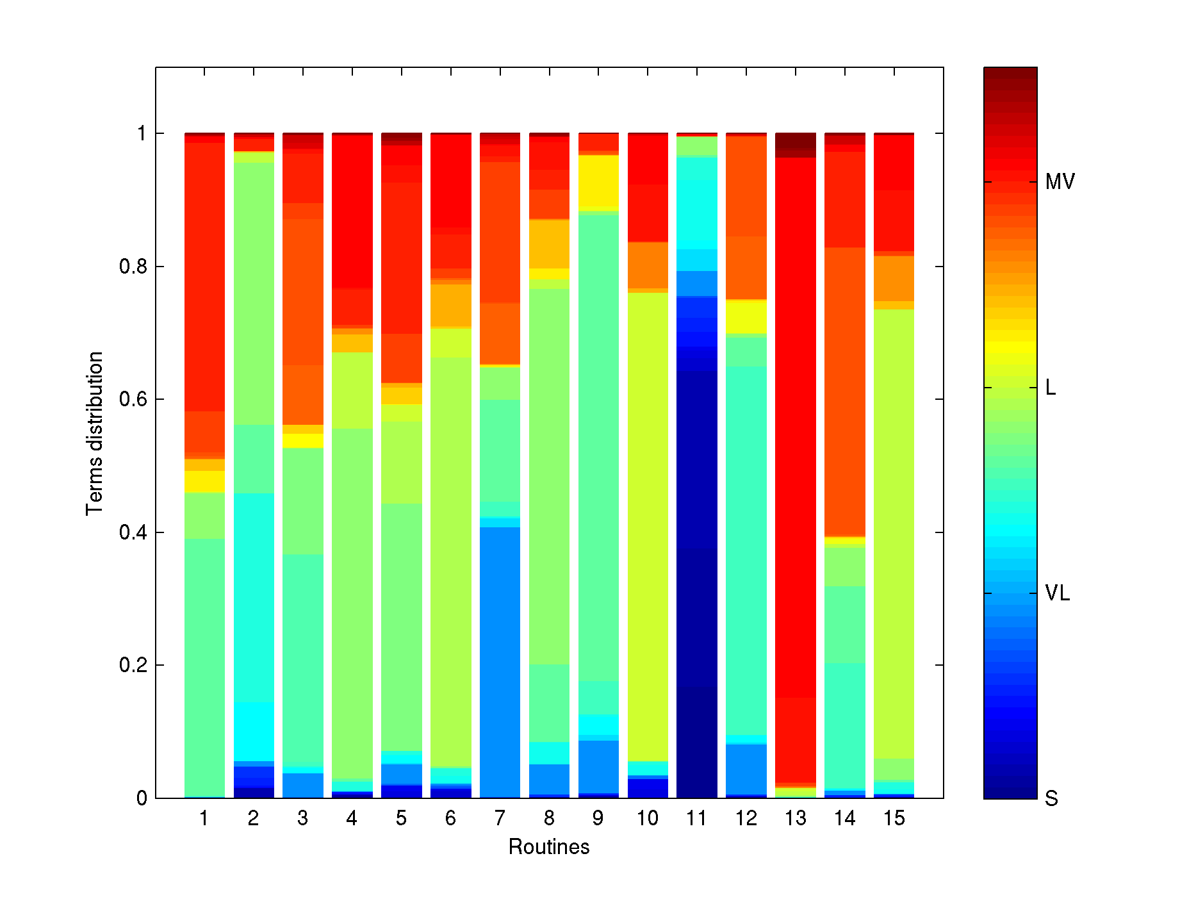
… … … … … … … …
… …
… … … … … …
… … … … …
$$α$$
$$θ_{d}$$
$$Z_{d,n}$$
$$W_{d,n}$$
$$β_{k}$$
$$η$$
$$N_{d}$$
$$D$$
$$K$$

Slide 22
COPD patient
Healthy subject

Slide 23
