Slide 1

Introduction to prof. Tjalkens
Gabriele Spina, Ph.D. student, TU/e – Philips
g.spina@tue.nl
gabriele.spina@philips.com
Bert den Brinker, Philips
24 February 2015

Slide 2
Ph.D. overview
Patient monitoring strategies in Chronic Obstructive Pulmonary Disease (COPD) patients
Unobtrusive technologies, signal processing and machine learning algorithms for modular patient training and monitoring systems
Notes:
Investigate the feasibility of using unobtrusive technologies (smartphones, sensor network technology) in order to provide useful and modular patient training and monitoring methodologies that allow to capture physiological information (i.e., heart activity, oxygen saturation, breathing sounds), physical activity, patient data, and environmental context.
Signal processing and machine learning methods will be investigated to develop reliable algorithms to derive COPD relevant indicators and trends including patient characteristics, physical state, activity and behavior patterns. The information extracted will be mapped to clinically meaningful metrics of the overall physiologic and functional status of COPD patients. The development of daily routine analysis and automatic segmentation based on physiological information will be used to obtain objective patient's behavioral assessment and new markers of patient's improvements under laboratory (pulmonary rehabilitation) and (if possible) free living conditions. The algorithms will be the basis for risk classification of patients for developing an exacerbation and continuous home coaching and training.

Slide 3
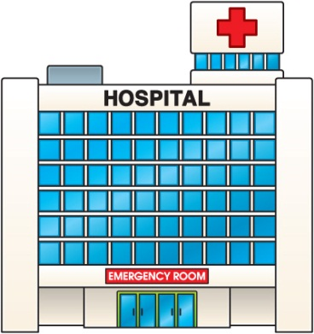

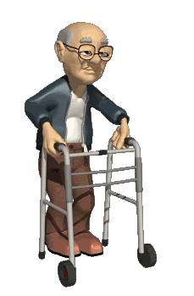
Introduction
Paradigm shift towards the home environment
Essential to develop new technologies and service concepts that permit monitoring and management of patients at home (remotely)

Slide 4
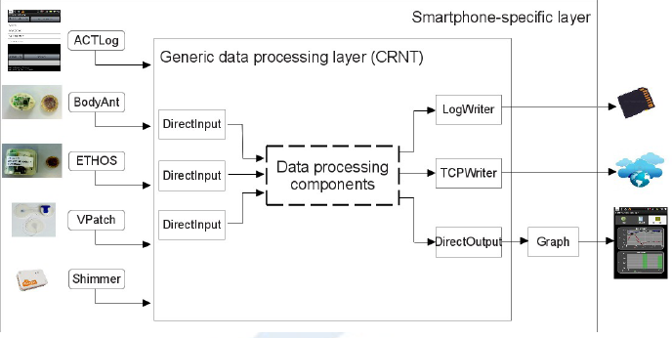
Smartphone monitoring and training approaches
- Spina et al. CRNTC+: A smartphone-based sensor processing framework for prototyping personal healthcare applications. Iinternational joint conference on Pervasive Computing Technologies for Healthcare, 2013.

Slide 5
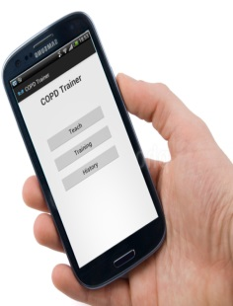
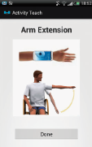
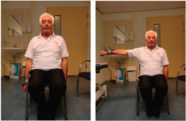
Smartphone monitoring and training approaches
- Spina et al. CRNTC+: A smartphone-based sensor processing framework for prototyping personal healthcare applications. Iinternational joint conference on Pervasive Computing Technologies for Healthcare, 2013.
- Spina et al. COPDTrainer: COPDTrainer: a smartphone-based motion rehabilitation training system with real-time acoustic feedback. ACM international joint conference on Pervasive and ubiquitous computing, 2013
- Spina et al. Toward smartphone assisted personal rehabilitation training. XRDS: Crossroads, The ACM Magazine for Students, 2013

Slide 6
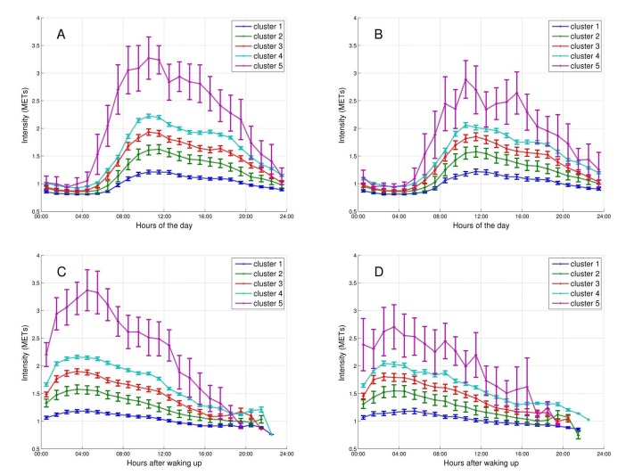
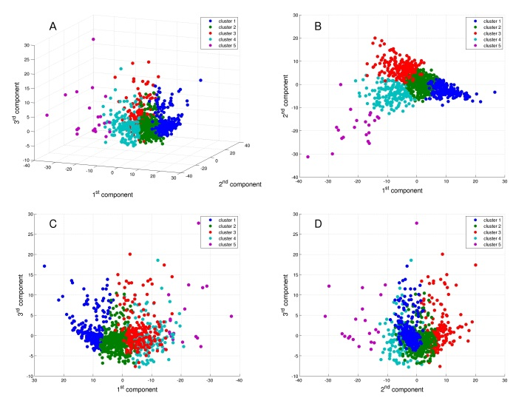
New insights in COPD
- Mesquita, Spina et al. Cluster analysis of objectively measured physical activity in 1001 COPD patients. Late-breaking abstract ERS 2014
- Mesquita, Spina et al. Physical activity patterns and clusters in 1001 patients with chronic obstructive pulmonary disease. Submitted to ERJ.

Slide 7
New insights in COPD
- Mesquita, Spina et al. Cluster analysis of objectively measured physical activity in 1001 COPD patients. Late-breaking abstract ERS 2014
- Mesquita, Spina et al. Physical activity patterns and clusters in 1001 patients with chronic obstructive pulmonary disease. Submitted to ERJ.
Spina et al. Identifying Physical Activity Profiles in COPD Patients Using Topic Models. Submitted to IEEE JOURNAL OF BIOMEDICAL AND HEALTH INFORMATICS, 2015
Spina et al. Plan clinical analysis after notifications.

Slide 8
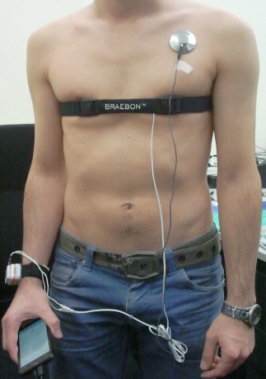
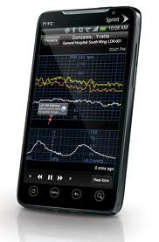
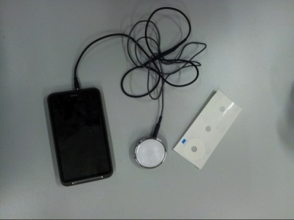
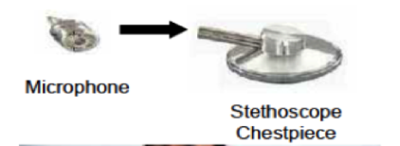
New monitoring solutions
- Spina et al. Smartscope. Planned submission to EMBC 2014.
- Spina et al. Smartscope extended. Planned submission to Special issue on Smartphone-Based Sensors for Non-Invasive Physiological Monitoring.

Slide 9
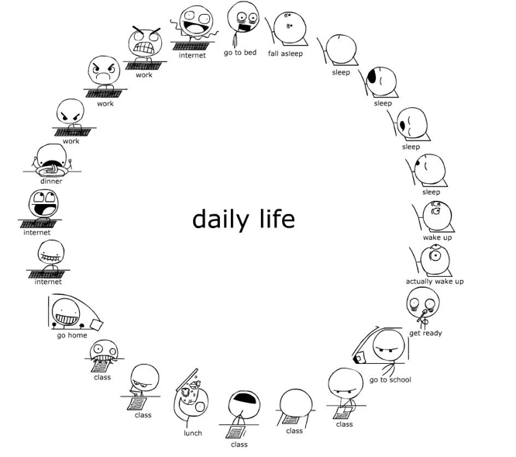
Automatically discover daily routines as a probabilistic combination of activity patterns without user annotation

Slide 10
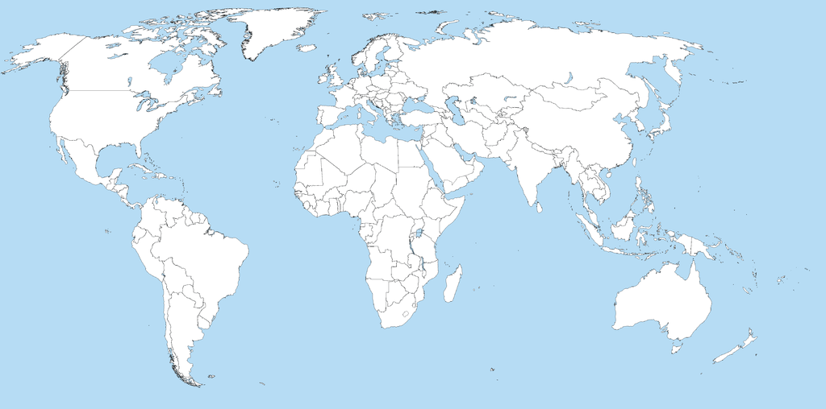
10 countries, 18 rehab centers, 1399 patients
977 patients – 66 healthy control subjects (age, gender, BMI)
5846 days (3916 weekdays - 1930 weekend days)

Slide 11
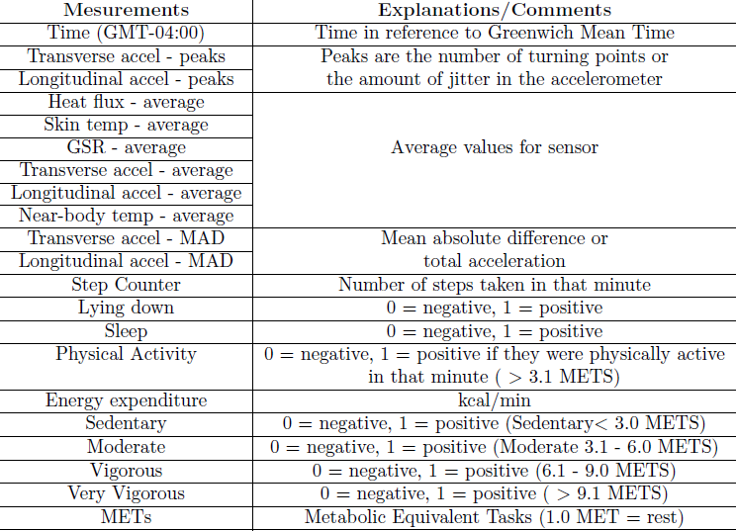
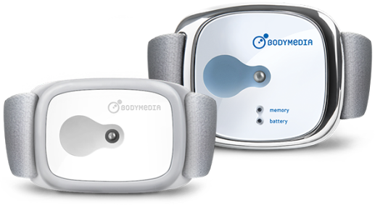
SenseWear armband activity monitor

Slide 12
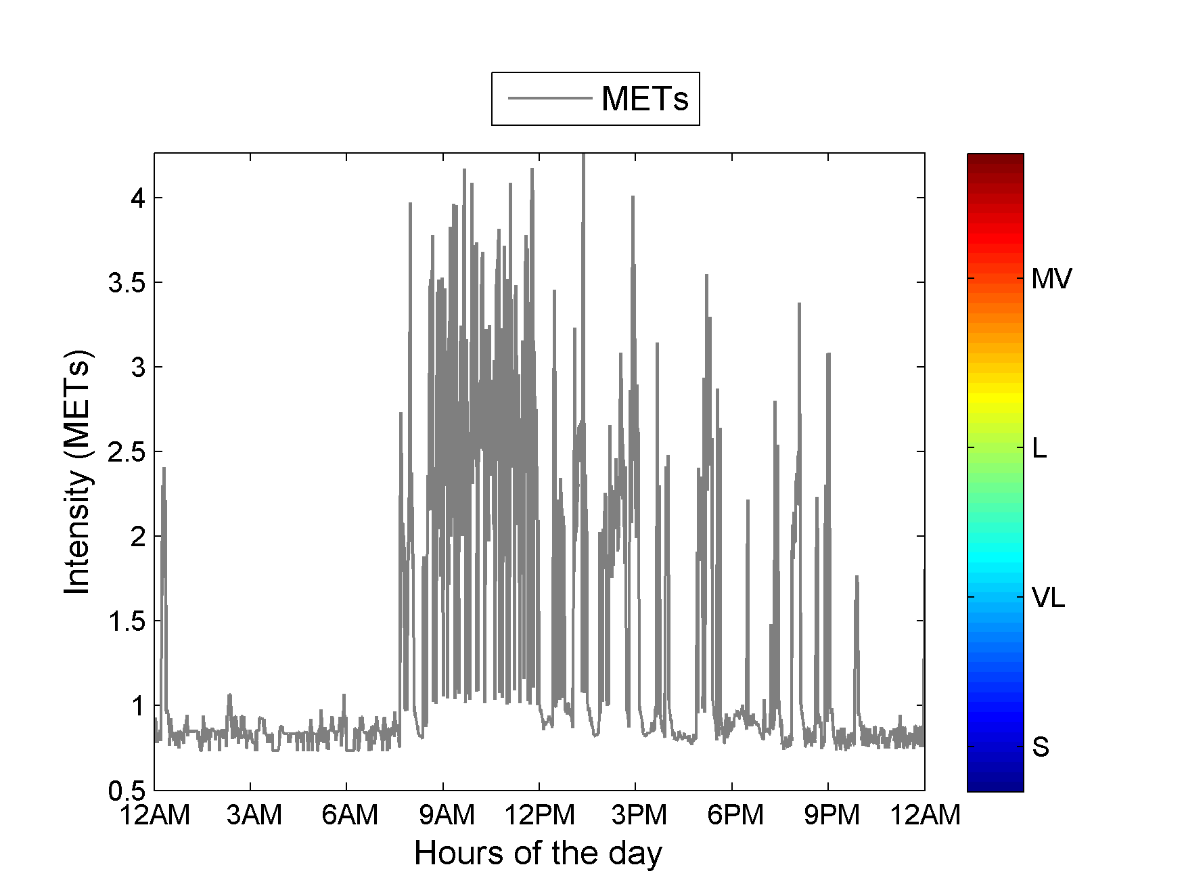

Slide 13
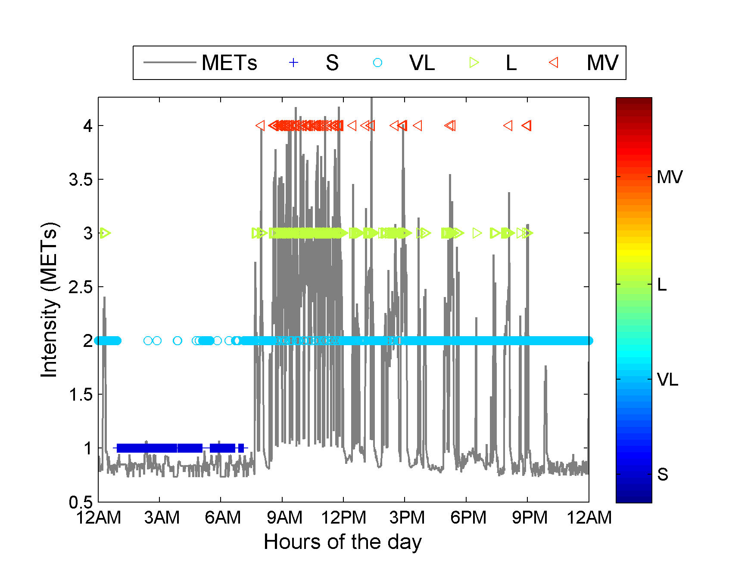

Slide 14
$IC, d$, $μ_{ST}^{}$,$μ_{GSR}^{},μ_{VM}^{}{, μ}_{SC}^{}$

Slide 15

$IC, d$, $μ_{ST}^{}$,$μ_{GSR}^{},μ_{VM}^{}{, μ}_{SC}^{}$
Feature selection
$IC,$ $f_{1}^{}$,$f_{2}^{},f_{3}^{}$

Slide 16








Sleeping
$f_{1}^{}$ = duration$f_{2}^{}=temperature f_{3}^{}$ = vector magnitude unit
$S,$ $f_{1}^{}$,$f_{2}^{},f_{3}^{}$
$S,$ $f_{1}^{}$,$f_{2}^{},f_{3}^{}$
$S,$ $f_{1}^{}$,$f_{2}^{},f_{3}^{}$
$$….$$
$S,$ $f_{1}^{}$,$f_{2}^{},f_{3}^{}$
$IC, d$, $μ_{ST}^{}$,$μ_{GSR}^{},μ_{VM}^{}{, μ}_{SC}^{}$
$S,$ $f_{1}^{}$,$f_{2}^{},f_{3}^{}$
Feature selection
$S,$ $f_{1}^{}$,$f_{2}^{},f_{3}^{}$
$IC,$ $f_{1}^{}$,$f_{2}^{},f_{3}^{}$

Slide 17


$$Subject 1$$
$$Subject n$$
$S,$ $f_{1}^{}$,$f_{2}^{},f_{3}^{}$
$S,$ $f_{1}^{}$,$f_{2}^{},f_{3}^{}$
$S,$ $f_{1}^{}$,$f_{2}^{},f_{3}^{}$
$S,$ $f_{1}^{}$,$f_{2}^{},f_{3}^{}$
$S,$ $f_{1}^{}$,$f_{2}^{},f_{3}^{}$
$S,$ $f_{1}^{}$,$f_{2}^{},f_{3}^{}$
$$….$$
$$….$$
$S,$ $f_{1}^{}$,$f_{2}^{},f_{3}^{}$
$S,$ $f_{1}^{}$,$f_{2}^{},f_{3}^{}$
$S,$ $f_{1}^{}$,$f_{2}^{},f_{3}^{}$
$S,$ $f_{1}^{}$,$f_{2}^{},f_{3}^{}$
$S,$ $f_{1}^{}$,$f_{2}^{},f_{3}^{}$
$S,$ $f_{1}^{}$,$f_{2}^{},f_{3}^{}$

Slide 18
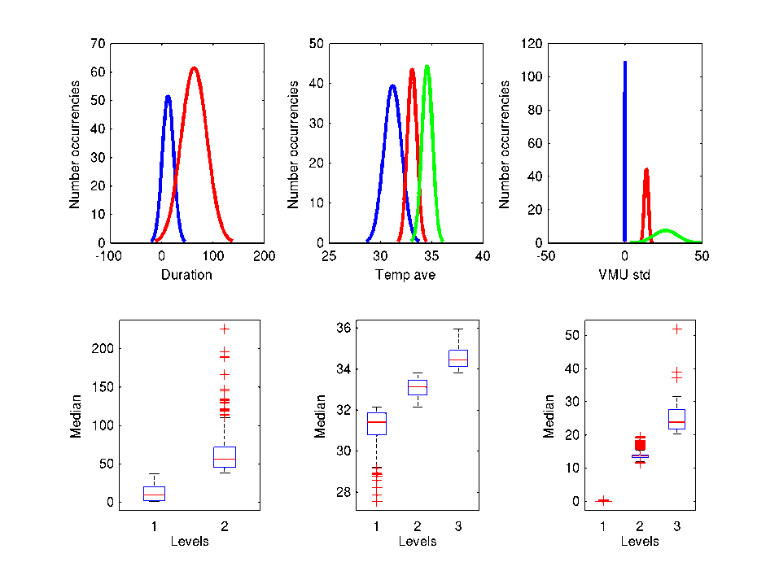
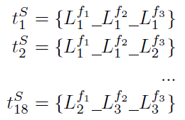
Sleeping

Slide 19
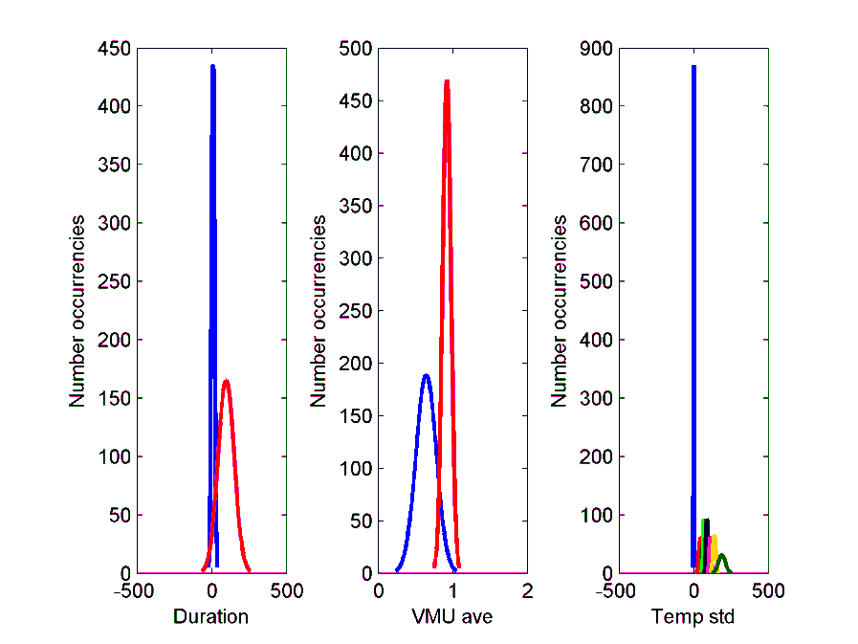

Very light
Feature selection
${IC}_{i},$ $f_{i}^{1}$,$f_{i}^{2},f_{i}^{3}$

Slide 20
Very light
Feature selection
${IC}_{i},$ $f_{i}^{1}$,$f_{i}^{2},f_{i}^{3}$

Slide 21
Very light
Feature selection
${IC}_{i},$ $f_{i}^{1}$,$f_{i}^{2},f_{i}^{3}$
=
VL_L1_L2_L1

Slide 22



… … … …
… … … … … … … …
$IC, d$, $μ_{ST}^{}$,$μ_{GSR}^{},μ_{VM}^{}{, μ}_{SC}^{}$
Feature selection
$IC,$ $f_{1}^{}$,$f_{2}^{},f_{3}^{}$
=
VL_L1_L2_L1

Slide 23

… … … … … … … …
… … … … … … … …
… … … …
… … … … … … … …
… … … …
… … … … … … … …
… … … … … … … …
What are the topics present in the set of documents?

Slide 24









… … … … … … … …
… …
… … … … … …
… … … … …
$$α$$
$$θ_{d}$$
$$Z_{d,n}$$
$$W_{d,n}$$
$$β_{k}$$
$$η$$
$$N_{d}$$
$$D$$
$$K$$

Slide 25
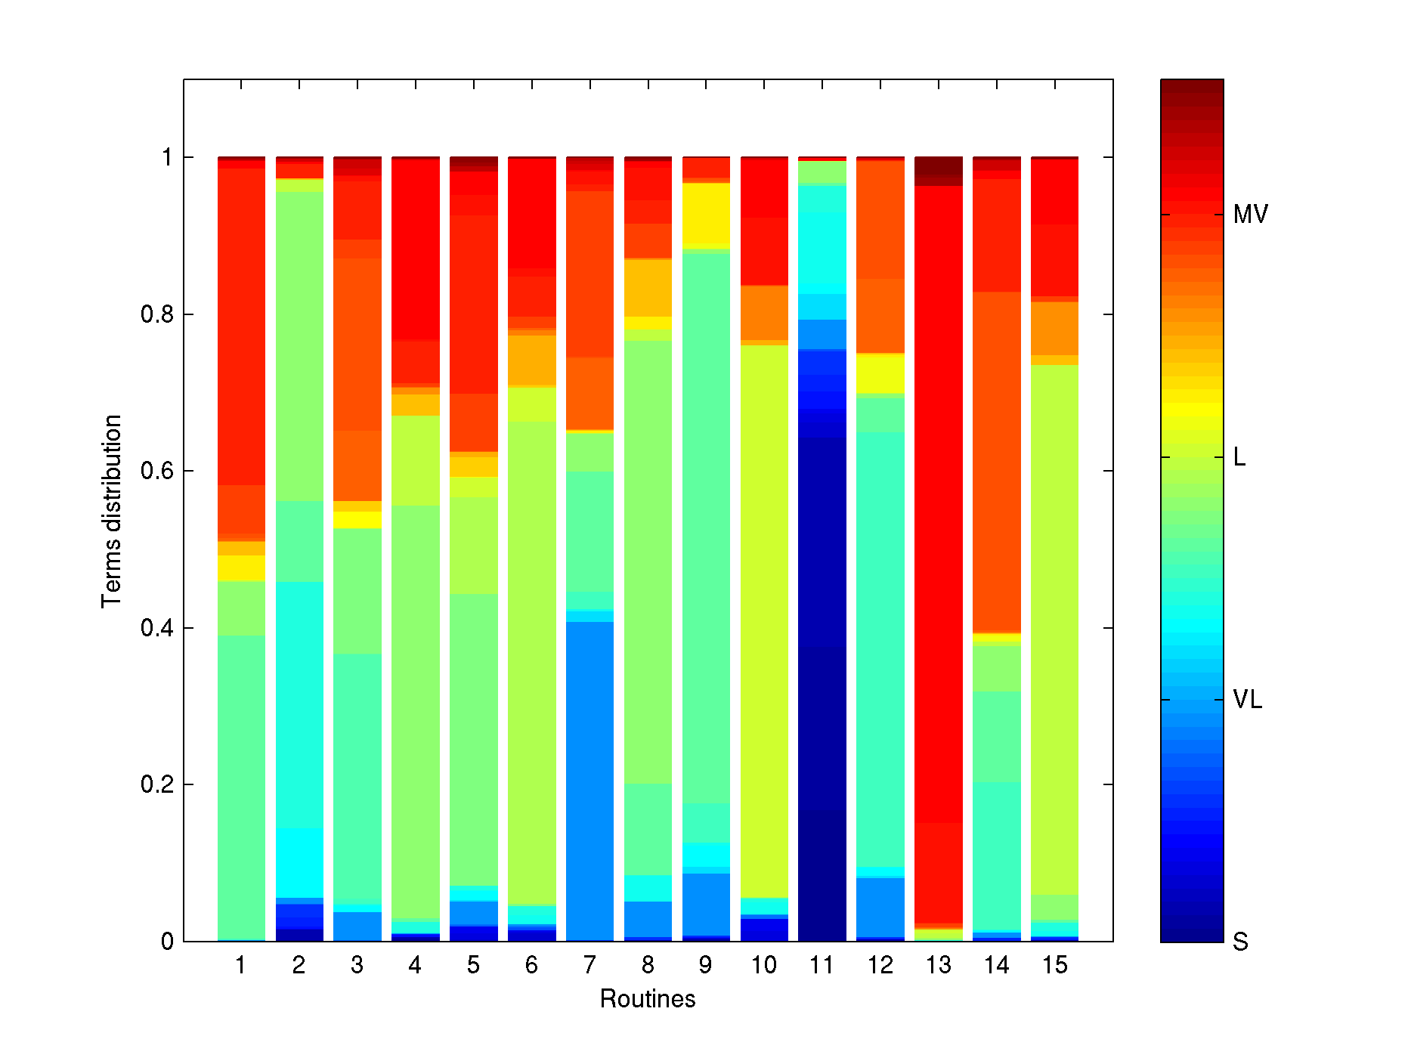
… … … … … … … …
… …
… … … … … …
… … … … …
$$α$$
$$θ_{d}$$
$$Z_{d,n}$$
$$W_{d,n}$$
$$β_{k}$$
$$η$$
$$N_{d}$$
$$D$$
$$K$$

Slide 26
COPD patient
Healthy subject

Slide 27
