Slide 1

Progress Update
Gabriele Spina, Ph.D. student, TU/e – Philips
g.spina@tue.nl
gabriele.spina@philips.com
Bert den Brinker, Philips
01 July 2015

Slide 2
Ph.D. overview
Patient monitoring strategies in Chronic Obstructive Pulmonary Disease (COPD) patients
Unobtrusive technologies, signal processing and machine learning algorithms for modular patient training and monitoring systems
Notes:
Investigate the feasibility of using unobtrusive technologies (smartphones, sensor network technology) in order to provide useful and modular patient training and monitoring methodologies that allow to capture physiological information (i.e., heart activity, oxygen saturation, breathing sounds), physical activity, patient data, and environmental context.
Signal processing and machine learning methods will be investigated to develop reliable algorithms to derive COPD relevant indicators and trends including patient characteristics, physical state, activity and behavior patterns. The information extracted will be mapped to clinically meaningful metrics of the overall physiologic and functional status of COPD patients. The development of daily routine analysis and automatic segmentation based on physiological information will be used to obtain objective patient's behavioral assessment and new markers of patient's improvements under laboratory (pulmonary rehabilitation) and (if possible) free living conditions. The algorithms will be the basis for risk classification of patients for developing an exacerbation and continuous home coaching and training.

Slide 3



Introduction
Paradigm shift towards the home environment
Essential to develop new technologies and service concepts that permit monitoring and management of patients at home (remotely)

Slide 4
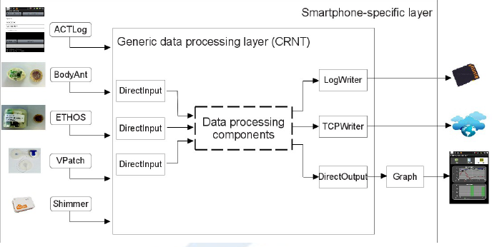
Smartphone monitoring and training approaches
Spina et al. CRNTC+: A smartphone-based sensor processing framework for prototyping personal healthcare applications. Iinternational joint conference on Pervasive Computing Technologies for Healthcare, 2013.
  Evaluation of a framework able to handle various multi-modal sensors and recognition solutions, which are essential to prototype patient care solutions with phones.

Slide 5
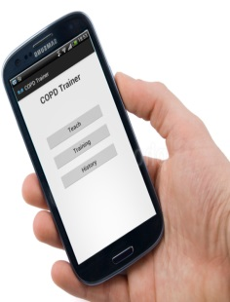
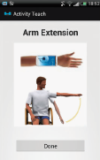
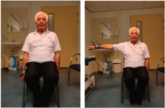
Smartphone monitoring and training approaches (cont’d)
Spina et al. COPDTrainer: COPDTrainer: a smartphone-based motion rehabilitation training system with real-time acoustic feedback. ACM international joint conference on Pervasive and ubiquitous computing, 2013
Spina et al. Toward smartphone assisted personal rehabilitation training. XRDS: Crossroads, The ACM Magazine for Students, 2013
  The validation with healthy participants showed an overall accuracy of 96.2% in recognizing exercise performances.
  Exercise repetitions were counted at 96.7% accuracy during an intervention with 7 COPD patients
  Trainee performance classification rate was 87.5%

Slide 6
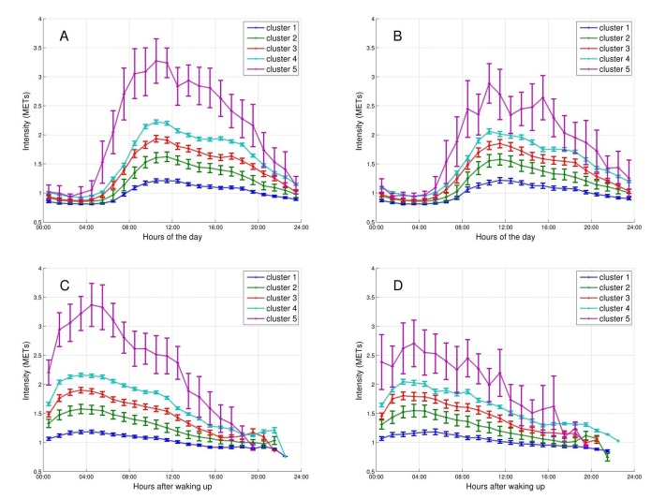
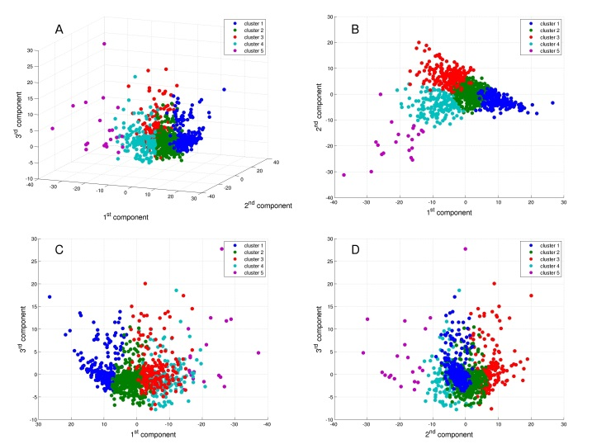
New insights in COPD
Mesquita, Spina et al. Cluster analysis of objectively measured physical activity in 1001 COPD patients. Late-breaking abstract ERS 2014
Mesquita, Spina et al. Physical activity patterns and clusters in 1001 patients with chronic obstructive pulmonary disease. Submitted to PLOS ONE.
  Compared with healthy subjects, COPD patients spent:
    less time in higher intensities of physical activity (PA)
    more time in lower intensities.
    more time in very light intensity
    no difference for the time in light intensity.
  In general, healthy subjects performed their activities at higher intensities compared to patients with COPD, and this difference was more pronounced during weekdays.
  Reducing the time in very light intensity without necessarily increasing the time in moderate-to-vigorous intensity may be an important strategy for achieving health benefits in patients with COPD.
  5 subgroups of patients were identified each with distinct PA measures and PA hourly temporal trends, which can be useful to tailor interventions according to the needs of each group.

Slide 7
New insights in COPD (cont’d)
Spina et al. Identifying Physical Activity Profiles in COPD Patients Using Topic Models. IEEE JBHI, 2015
  Physical activity (PA) routines can be used effectively to integrate and represent the underlying structure of PA measures and physiological responses that characterize the activities of the subjects under study.
  PA routines in COPD patients and healthy subjects are considerably different regarding their composition and that they show certain consistent trends depending on COPD clinical characteristics.
  The discovered PA routines were found suitable to label, in an unsupervised way, subjects and assessed days.
  Inferring the routine structure on day segments of relatively short duration it was possible to model PA routine patterns across the day and to identify moments in time in which transitions of the most active routines occur.
  The discovered PA routines apparently reflect the stage of the disease as measured by common clinical practice and could be valid constructs to quantify PA behavior change in patient with limited exercise capacity such as with COPD.

Slide 8
New insights in COPD (cont’d)
Probabilistic sensor fusion of activity and physiological data based on topic models for identifying sleep characterization in COPD
  We would like to show:
    COPD and healthy subjects have different sleeping patterns
    COPD and healthy subjects could be recognized according to their sleeping patterns
    Sleeping patterns are correlated to the activity level during the day
  Methodology:
    Explained in the next slide
  Conclusion:
    When analyzing physical activities sleeping patterns should be taken into account

Slide 9
New insights in COPD (cont’d)
Patient 1
Word creation
Corpus of documents
Sensor data 1
Conversion to symbol
A A B B A A A B B
Document 1 (patient 1)
Sensor data 2
Conversion to symbol
C A C B A A D D B
A C A, A A B, B C C, …, B B A
.
.
.
Document n (patient n)
A A A, B A A, A A C, …, C C A
Sensor data n
Conversion to symbol
A B C A B C A A A
Topic Models (find topics)
Topic 1
ACA
BBC
Topic 2
AAA
AAC
Topic n
BBB
CAC

Slide 10
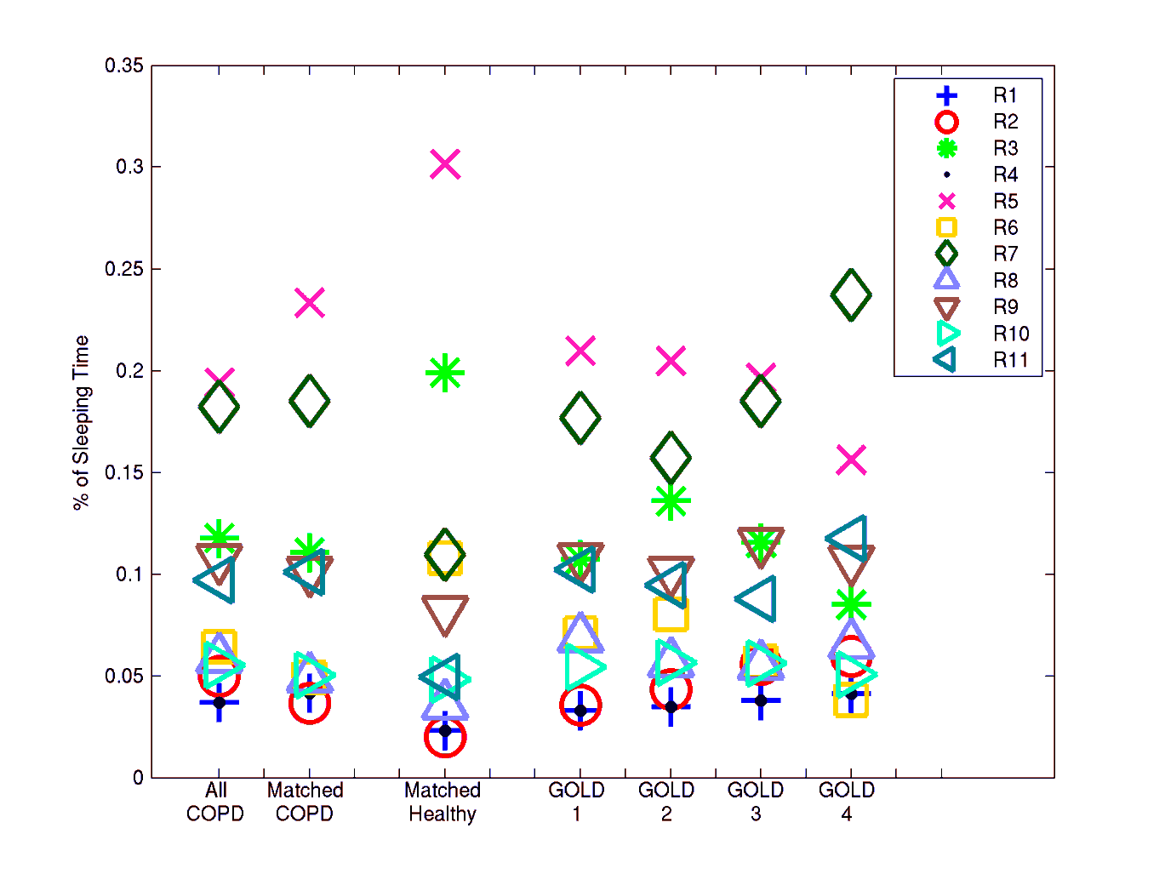
New insights in COPD (cont’d)
Preliminary results
Correlated ~0.2 with the step performed during the day. + R2 -> - steps
R2 is a routine composed by words representing very light intensity activities -> user was in bed, but he was not sleeping

Slide 11
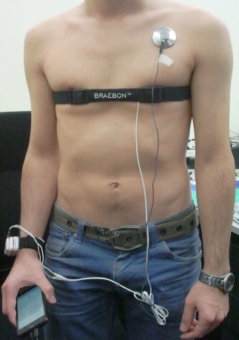
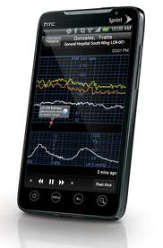
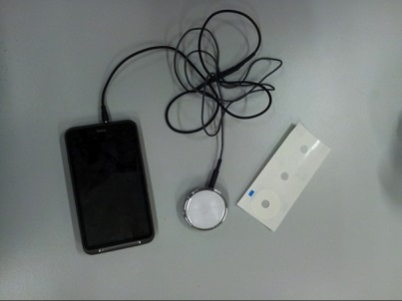
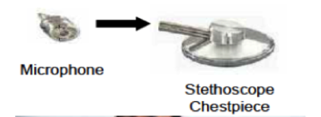
New monitoring solutions
G. Spina et al. Smartscope. Planned submission to Special issue on Smartphone-Based Sensors for Non-Invasive Physiological Monitoring.
G. Spina, A.C. den Brinker. System and method to detect respiration markers. European Patent application 12-12-2014, Philips Internal Reference 2014PF01453
  The proposed system provides a robust method to continuously monitor breathing parameters as respiration onsets and duration of respiration phases. The unobtrusive monitoring of such variables may provide further insights into the role of dynamic hyperinflation in the genesis of dyspnea.

Slide 13
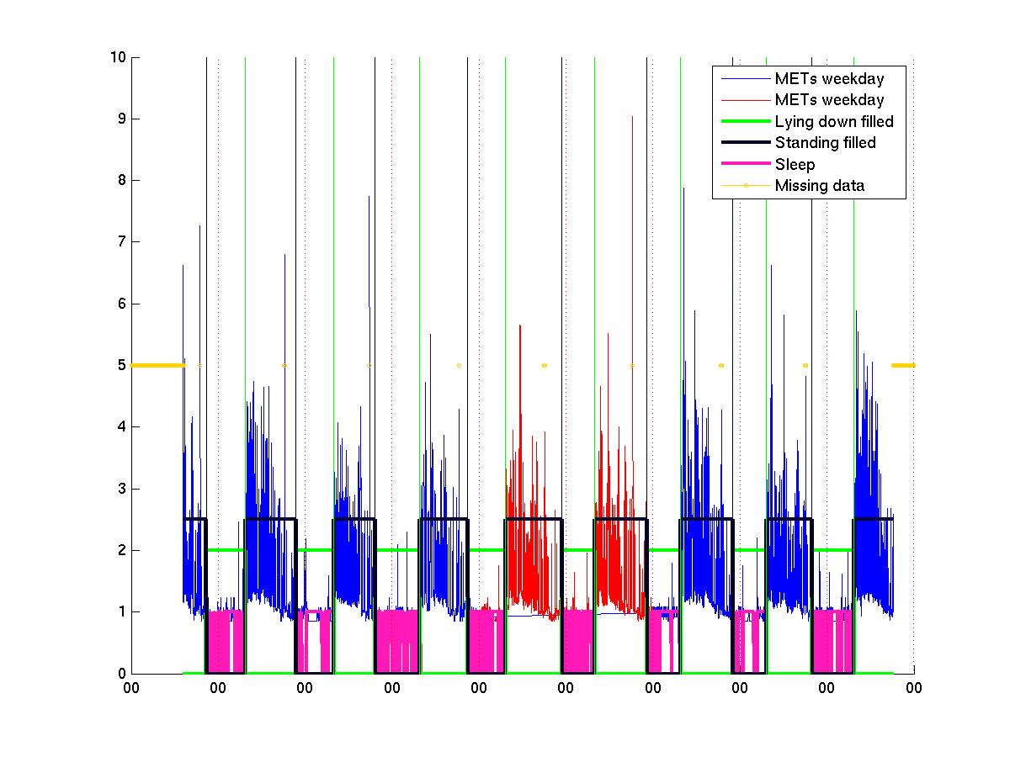

Slide 14
