Slide 1

Thesis overview
Gabriele Spina
Ph.D. student, TU/e – Philips
Bert den Brinker, Philips
g.spina@tue.nl
gabriele.spina@philips.com
19 January 2015

Slide 2
Ph.D. in Electrical Engineering overview
Patient monitoring strategies in Chronic Obstructive Pulmonary Disease (COPD) patients
Unobtrusive technologies, signal processing and machine learning algorithms for modular patient training and monitoring systems
Notes:
Investigate the feasibility of using unobtrusive technologies (smartphones, sensor network technology) in order to provide useful and modular patient training and monitoring methodologies that allow to capture physiological information (i.e., heart activity, oxygen saturation, breathing sounds), physical activity, patient data, and environmental context.
Signal processing and machine learning methods will be investigated to develop reliable algorithms to derive COPD relevant indicators and trends including patient characteristics, physical state, activity and behavior patterns. The information extracted will be mapped to clinically meaningful metrics of the overall physiologic and functional status of COPD patients. The development of daily routine analysis and automatic segmentation based on physiological information will be used to obtain objective patient's behavioral assessment and new markers of patient's improvements under laboratory (pulmonary rehabilitation) and (if possible) free living conditions. The algorithms will be the basis for risk classification of patients for developing an exacerbation and continuous home coaching and training.

Slide 3


PhD project
ICare4COPD
  Start: January 2011
  End: December 2013 (December 2014 extended)
Partners
  TU/e
  Philips
  CIRO+
iCare4COPD

Slide 4
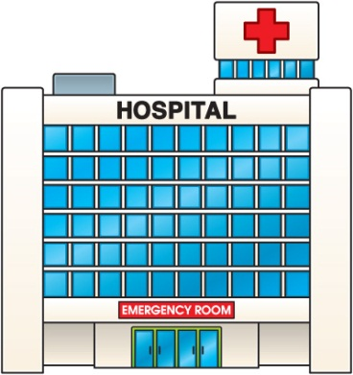

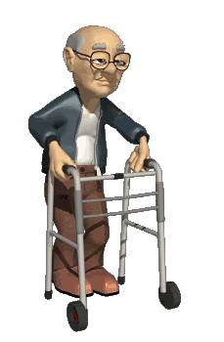
Introduction
Paradigm shift towards the home environment
Essential to develop new technologies and service concepts that permit monitoring and management of patients at home (remotely)

Slide 5
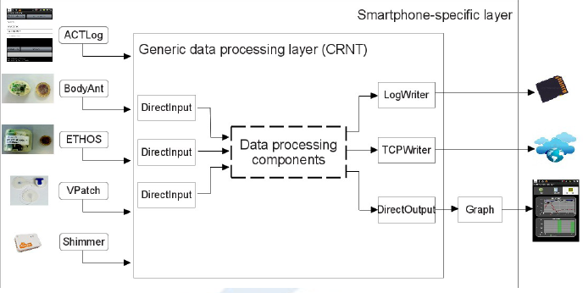
Smartphone monitoring and training approaches
Spina et al. CRNTC+: A smartphone-based sensor processing framework for prototyping personal healthcare applications. Iinternational joint conference on Pervasive Computing Technologies for Healthcare, 2013.

Slide 6
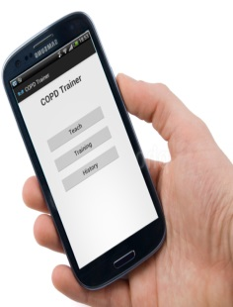
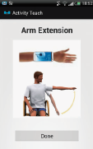
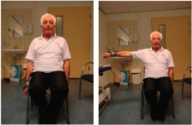
Smartphone monitoring and training approaches
Spina et al. CRNTC+: A smartphone-based sensor processing framework for prototyping personal healthcare applications. Iinternational joint conference on Pervasive Computing Technologies for Healthcare, 2013.
Spina et al. COPDTrainer: COPDTrainer: a smartphone-based motion rehabilitation training system with real-time acoustic feedback. ACM international joint conference on Pervasive and ubiquitous computing, 2013

Slide 7
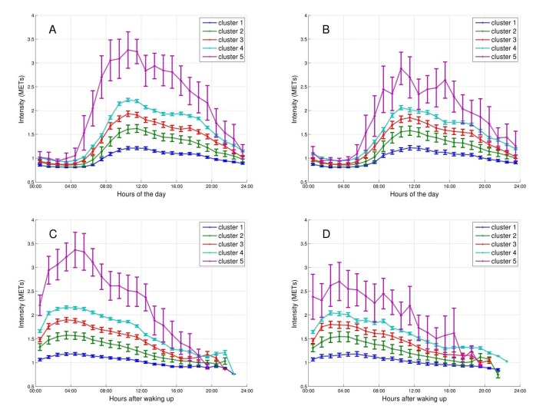
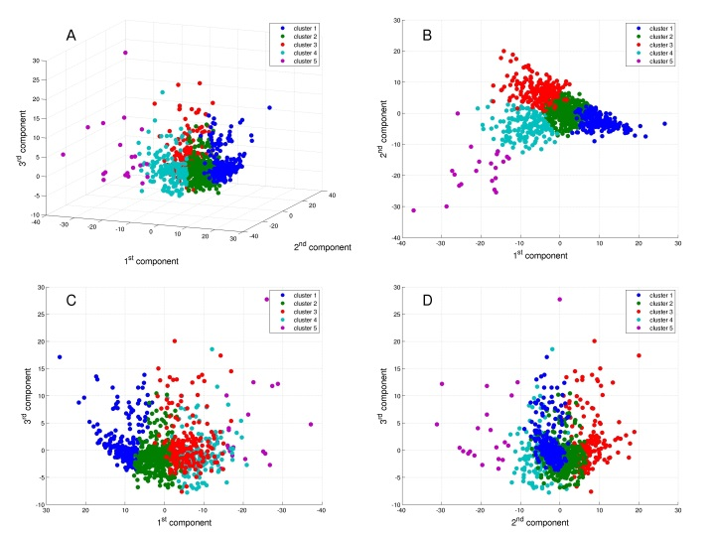
New insights in COPD
Mesquita, Spina et al. Physical activity patterns and clusters in 1001 patients with chronic obstructive pulmonary disease. Submitted to Thorax, (submitted).

Slide 8
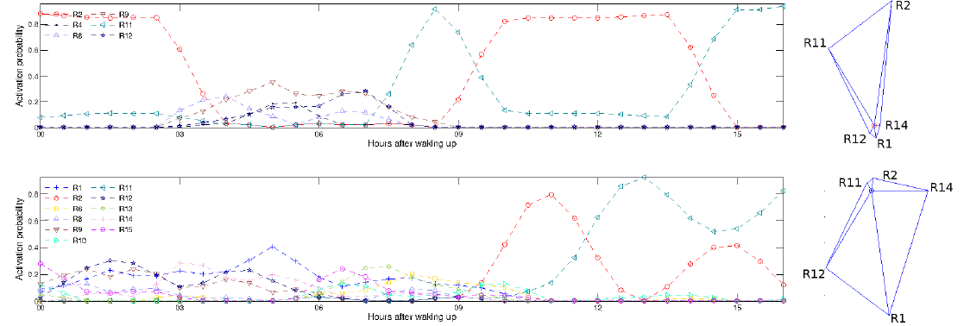
New insights in COPD
Mesquita, Spina et al. Physical activity patterns and clusters in 1001 patients with chronic obstructive pulmonary disease. Submitted to Thorax, (submitted).
Spina et al. Identifying Physical Activity Profiles in COPD Patients Using Topic Models. IEEE JOURNAL OF BIOMEDICAL AND HEALTH INFORMATICS, 2015 (submitted)

Slide 9
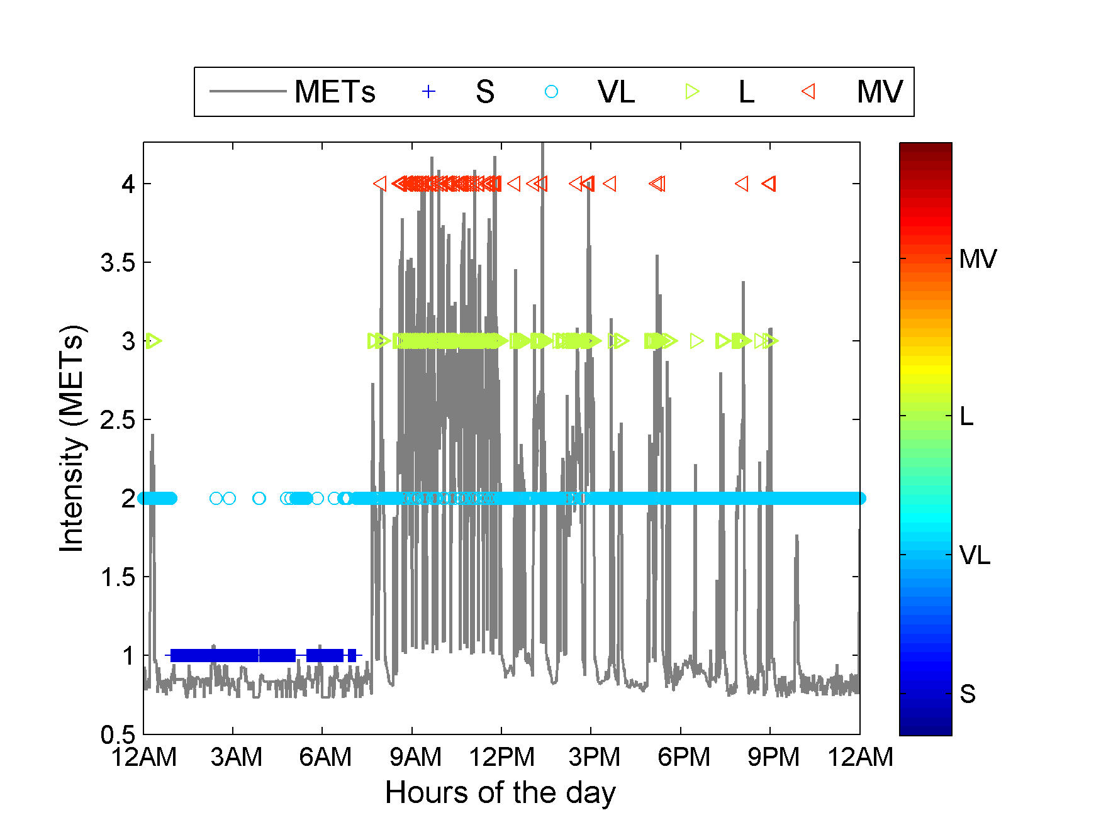



… … … … … … … …
… … … … … … … …
… … … …
… … … … … … … …
… … … … … … … …
$IC, d$, $μ_{ST}^{}$,$μ_{GSR}^{},μ_{VM}^{}{, μ}_{SC}^{}$
Feature selection
$IC,$ $f_{1}^{}$,$f_{2}^{},f_{3}^{}$

Slide 10
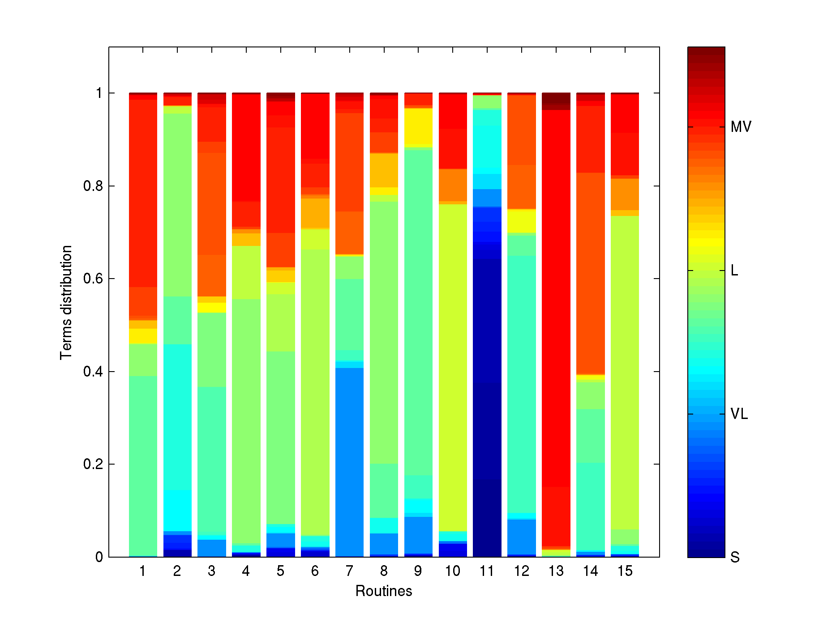









… … … … … … … …
… …
… … … … … …
… … … … …
$$α$$
$$θ_{d}$$
$$Z_{d,n}$$
$$W_{d,n}$$
$$β_{k}$$
$$η$$
$$N_{d}$$
$$D$$
$$K$$

Slide 12
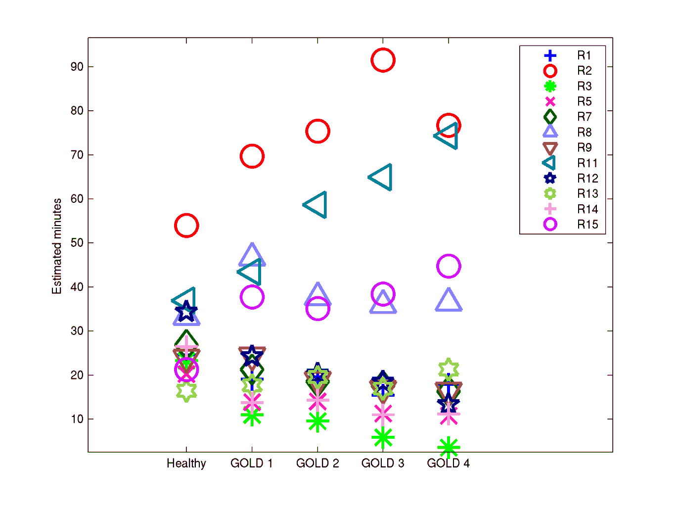

Slide 13
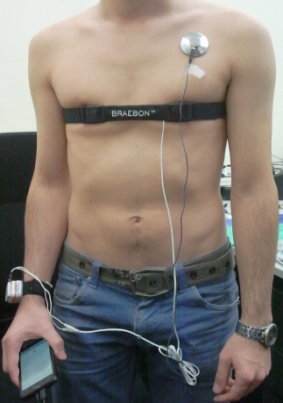
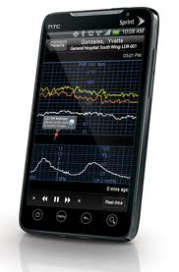
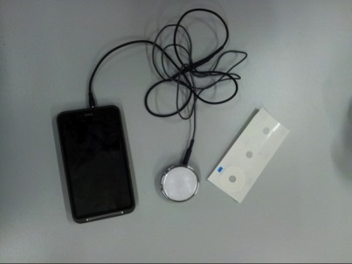
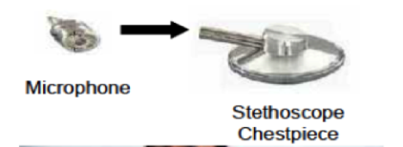
New monitoring solutions
Spina et al. Smartscope. Planned.

Slide 15
Decide PhD committee
  Prof. Ronald Aarts (TUe)
  Bert den Brinker
  Martijn Spruit
  Prof. Wouters
  Pieter Wijn
  ?
  ?
  ?

