Slide 1






Day 1
Day 3
Summary
Inactive routines
Inactive routines
Inactive routines
Healthy subject
…
…
Active routines
Active routines
Active routines
Inactive routines
Inactive routines
Inactive routines
COPD patient
…
…
Active routines
Active routines
Active routines
What did you do around lunch time? Please minimize this behavior

Slide 2
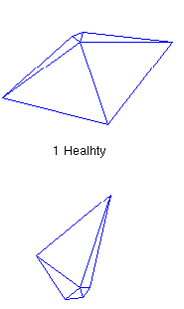
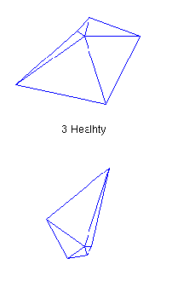

Day 1
Day 3
Summary
Inactive routines
Inactive routines
Inactive routines
Healthy subject
…
…
Active routines
Active routines
Active routines
Inactive routines
Inactive routines
Inactive routines
…
…
COPD patient
Active routines
Active routines
Active routines
What did you do around lunch time? Please minimize this behavior

Slide 3
Patients feel breathless
Patients avoid activities that make them breathless
Patients get more
breathless
Patients do less
Patients muscles become weaker and less efficient
Night symptoms
Patients suffer from sleep
disturbances
Patients get more
night symptoms
Falls in
FEV1 and FVC
Progression
disease

