Slide 1


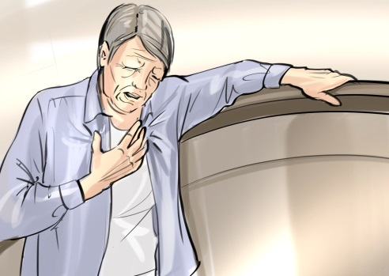
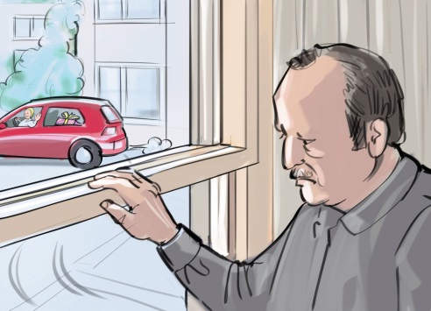
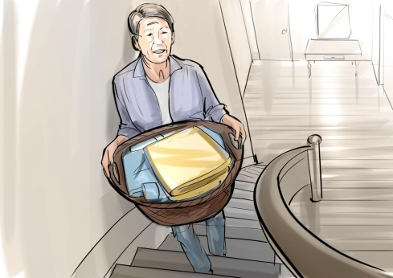
COPD
Patients feel breathless
Patients avoid activities that make them breathless
Patients get more
breathless
Patients do less
Patients muscles become weaker and less efficient

