Slide 1
Probabilistic sensor fusion of activity and physiological data based on topic models for sleep characterization in COPD

Slide 2
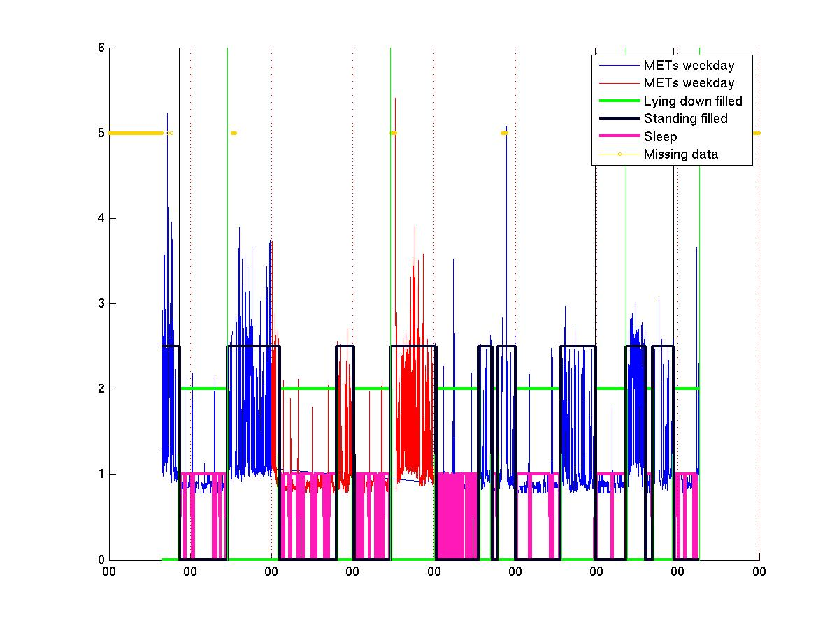

Slide 3
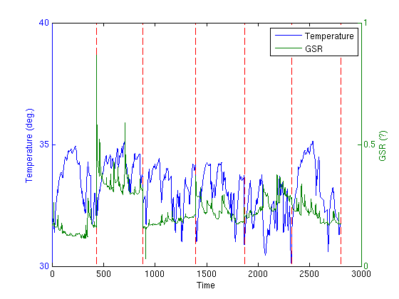
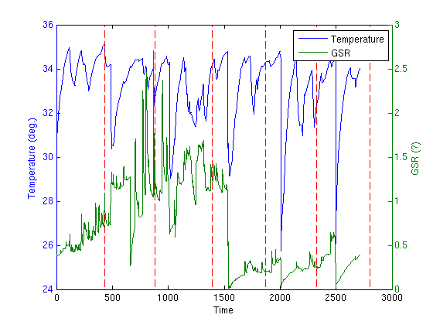
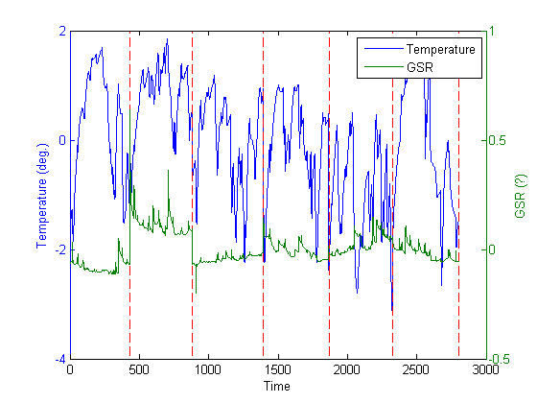
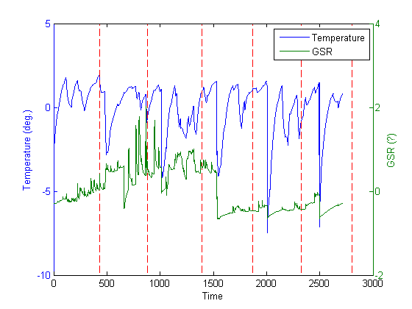
Smooth temperature and gsr data with a moving average filter of window = 10 minutes.
Remove data out of range: temperature [24-40] , gsr: [-inf-8]
  Most of the values removed are very low temperature values at the beginning of the recordings.
Center data of a patients according to the mean across all the assessed days
Centering ( - mean_S1_alldays)
Is centering necessary/helpful?
Centering ( - mean_S7_alldays)

Slide 4
Smooth temperature and gsr data with a moving average filter of window = 10 minutes.
Remove data out of range: temperature [24-40] , gsr: [-inf-8]
  Most of the values removed are very low temperature values at the beginning of the recordings.
Center data of a patients according to the mean across all the assessed days
Consider all the data from all the days of all the patients
All 132 subjects all days
Temperature
GSR
-1.27842787061420 -0.0625728866524465
-1.25645521436420 -0.0633059641785385
-1.25645521436420 -0.0633059641785385
-1.23447492871971 -0.0618397942251925
-1.23447492871971 -0.0611067017979385
-1.23447492871971 -0.0581743320889235
-1.30039480481830 -0.0552419176764255
-1.36625364576070 -0.0552419176764255
-1.41012647901260 -0.0545088103480105
-1.43205335889540 -0.0537757030195955
-1.43205335889540 -0.0537757030195955
-1.41012647901260 -0.0537757030195955
-1.36625364576070 -0.0545088103480105
-1.34430769239150 -0.0537757030195955
-1.32235410962790 -0.0545088103480105
-1.27842787061420 -0.0589074245161775
-1.32235410962790 -0.0567081323332555
-1.49779394422260 0.0334798344903225
-1.71650007520400 -0.0244495025343665
-1.67281034742080 -0.0501101067728765
-1.62909582410540 -0.0552419176764255
-1.73833540235250 -0.0501101067728765
-1.84741476331440 -0.0567081323332555
-1.82561186109270 -0.0611067017979385
-1.78198698316300 -0.0633059641785385
………. ……..
-1.69465902600970 -0.0640390566057925

Slide 5
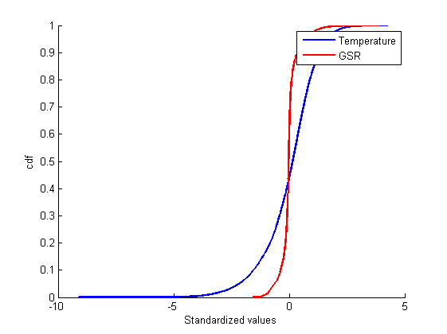
Smooth temperature and gsr data with a moving average filter of window = 10 minutes.
Remove data out of range: temperature [24-40] , gsr: [-inf-8]
  Most of the values removed are very low temperature values at the beginning of the recordings.
Center data of a patients according to the mean across all the assessed days
TO DO: Perform PAA (at the moment in the next step window is set to 1 -> not performed) It could be useful to reduce distortion Lloyd
Calculate cdf

Slide 6
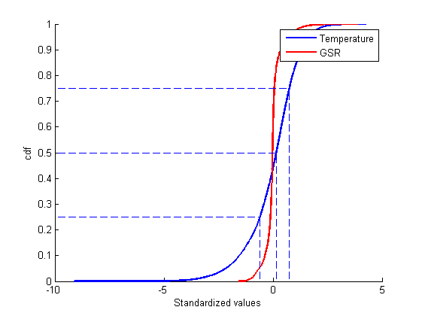
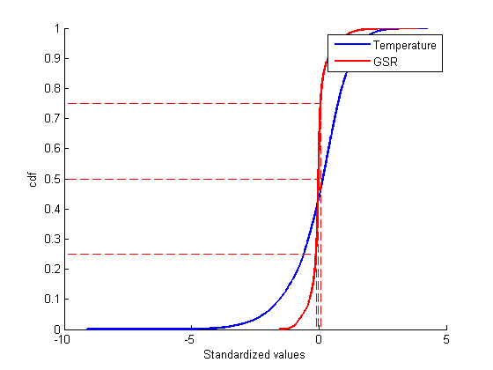
Equip. region (sax approach)
Smooth temperature and gsr data with a moving average filter of window = 10 minutes.
Remove data out of range: temperature [24-40] , gsr: [-inf-8]
  Most of the values removed are very low temperature values at the beginning of the recordings.
Center data of a patients according to the mean across all the assessed days
TO DO: Perform PAA (at the moment in the next step window is set to 1 -> not performed) It could be useful to reduce distortion Lloyd
Calculate cdf
Calculate equiprobable regions

Slide 7
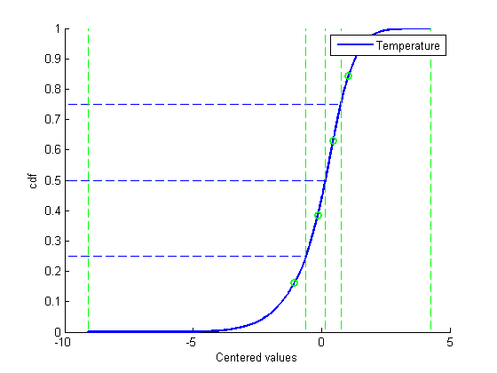
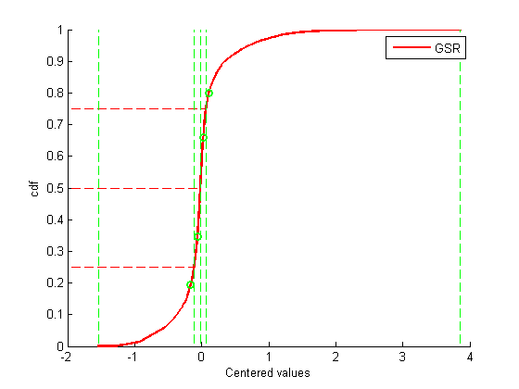
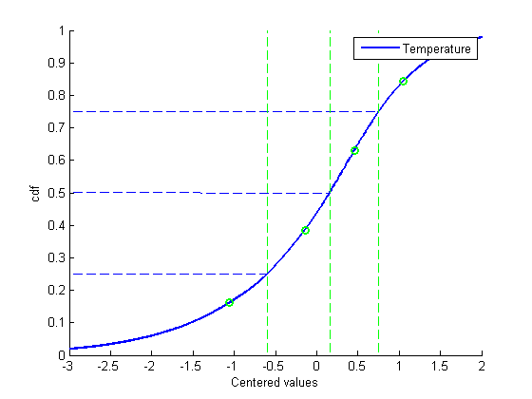
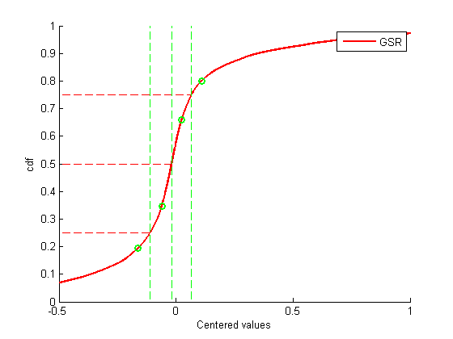
Initial codebooks (sax approach)
Smooth temperature and gsr data with a moving average filter of window = 10 minutes.
Remove data out of range: temperature [24-40] , gsr: [-inf-8]
  Most of the values removed are very low temperature values at the beginning of the recordings.
Center data of a patients according to the mean across all the assessed days
TO DO: Perform PAA (at the moment in the next step window is set to 1 -> not performed) It could be useful to reduce distortion Lloyd
Calculate cdf
Calculate equiprobable regions
Calculate initial centroids: center of mass points equiprobable regions.
Partitions
-0.6003 0.1579 0.7557
Partitions
-0.1117 -0.0186 0.0660
Final mean square distortion SAX algorithm:
Temperature: 0.3403
GSR: 0.1079
Codebook (centers)
-1.0598 -0.1409 0.4568 1.0545
Codebook (centers)
-0.1625 -0.0609 0.0237 0.1083

Slide 8
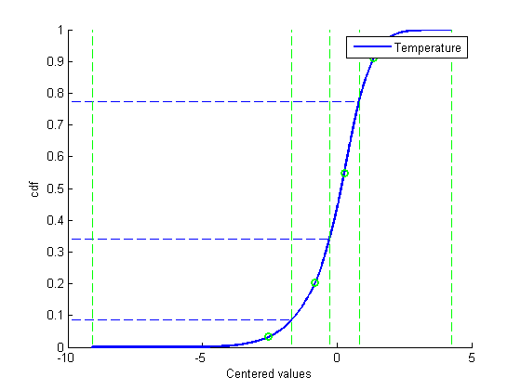
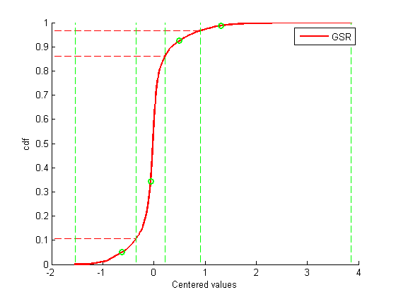
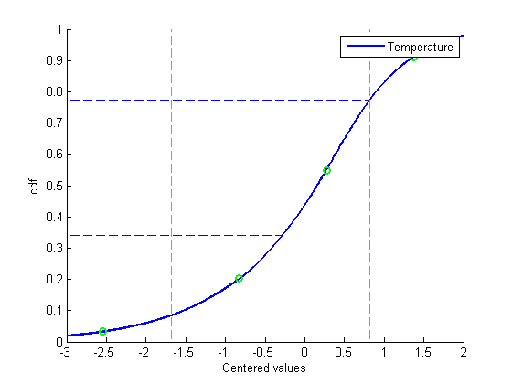
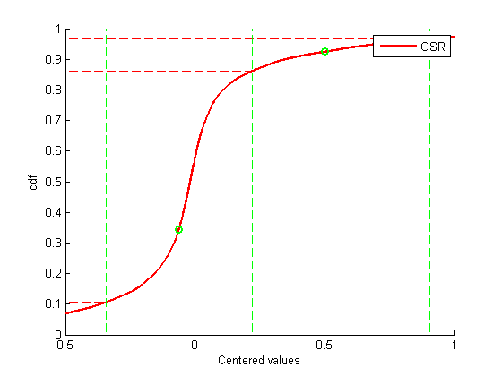
Llyod’s partitions and codebooks
Smooth temperature and gsr data with a moving average filter of window = 10 minutes.
Remove data out of range: temperature [24-40] , gsr: [-inf-8]
  Most of the values removed are very low temperature values at the beginning of the recordings.
Center data of a patients according to the mean across all the assessed days
TO DO: Perform PAA (at the moment in the next step window is set to 1 -> not performed) It could be useful to reduce distortion Lloyd
Calculate cdf
Calculate equiprobable regions
Calculate initial centroids: center of mass points equiprobable regions.
Calculate centroids Llyods’s algorithm and new parititons
Partitions
-1.6853 -0.2754 0.8194
Partitions
-0.3433 0.2202 0.9054
Final mean square distortion Llyod’s algorithm:
Temperature: 0.1776
GSR: 0.0259
Codebook (centers)
-2.5480 -0.8227 0.2720 1.3667
Codebook (centers)
-0.6251 -0.0615 0.5020 1.3087

Slide 9
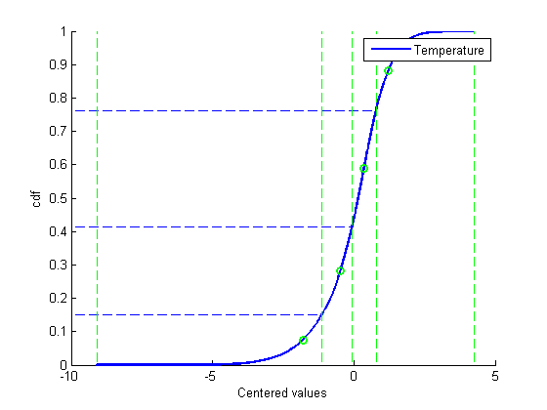
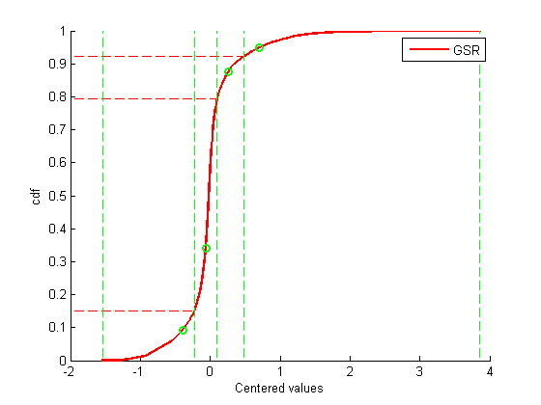
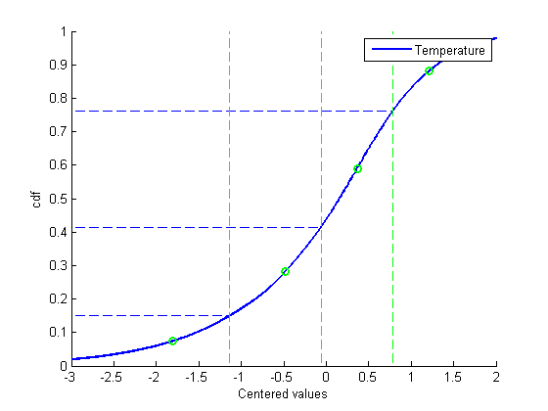
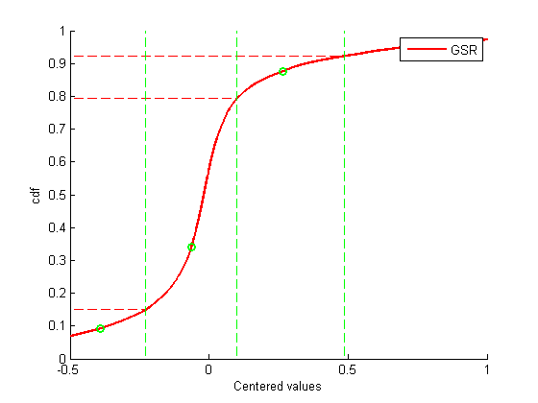
Mean partitions and codebooks
Smooth temperature and gsr data with a moving average filter of window = 10 minutes.
Remove data out of range: temperature [24-40] , gsr: [-inf-8]
  Most of the values removed are very low temperature values at the beginning of the recordings.
Center data of a patients according to the mean across all the assessed days
TO DO: Perform PAA (at the moment in the next step window is set to 1 -> not performed) It could be useful to reduce distortion Lloyd
Calculate cdf
Calculate equiprobable regions
Calculate initial centroids: center of mass points equiprobable regions.
Calculate centroids Llyods’s algorithm and new parititons
Calculate the mean of the partitions computed with SAX and Lloyds and calculate new codebooks.
Partitions
-1.1428 -0.0587 0.7875
Partitions
-0.2275 0.1008 0.4857
Final mean square distortion Llyod’s algorithm:
Temperature: 0.2068
GSR: 0.0400
Codebook (centers)
-1.8039 -0.4818 0.3644 1.2106
Codebook (centers)
-0.3917 -0.0633 0.2650 0.7064

Slide 10
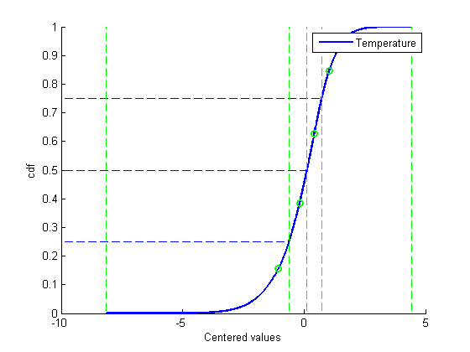
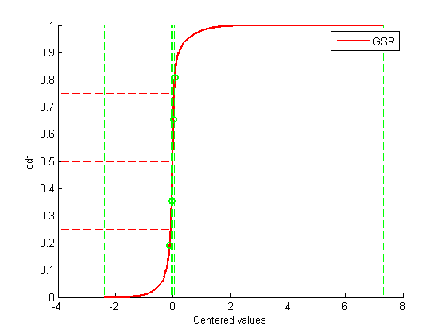
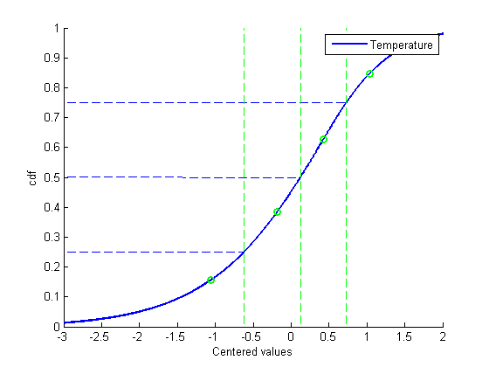
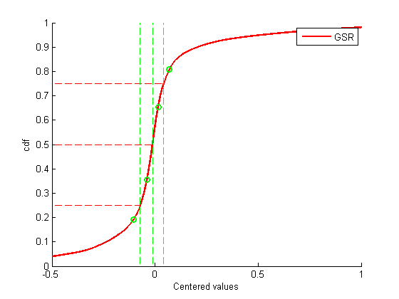
SAX 1000 subjects
Smooth temperature and gsr data with a moving average filter of window = 10 minutes.
Remove data out of range: temperature [24-40] , gsr: [-inf-8]
  Most of the values removed are very low temperature values at the beginning of the recordings.
Center data of a patients according to the mean across all the assessed days
TO DO: Perform PAA (at the moment in the next step window is set to 1 -> not performed) It could be useful to reduce distortion Lloyd
Calculate cdf
Calculate equiprobable regions
Calculate initial centroids: center of mass points equiprobable regions.
Partitions
-0.6191 0.1239 0.7324
Partitions
-0.0716 -0.0121 0.0421
Final mean square distortion SAX algorithm:
Temperature: 0.2802
GSR: 0.0874
Codebook (centers)
-1.0579 -0.1803 0.4282 1.0366
Codebook (centers)
-0.1041 -0.0392 0.0150 0.0692

Slide 11
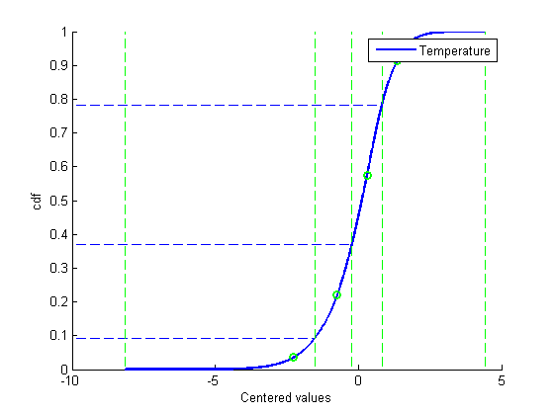
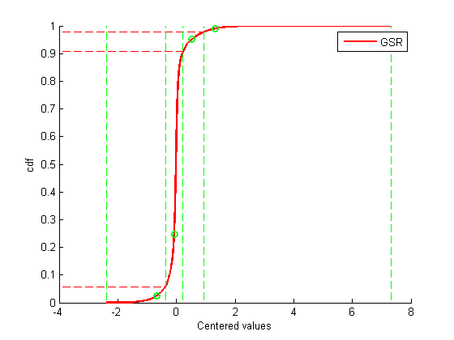
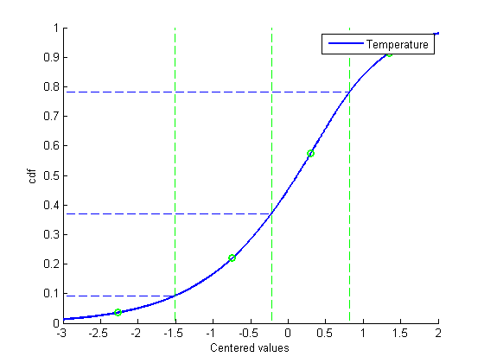
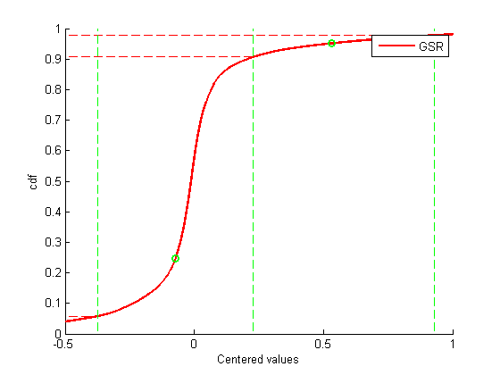
Llyod’s partitions and codebooks
Smooth temperature and gsr data with a moving average filter of window = 10 minutes.
Remove data out of range: temperature [24-40] , gsr: [-inf-8]
  Most of the values removed are very low temperature values at the beginning of the recordings.
Center data of a patients according to the mean across all the assessed days
TO DO: Perform PAA (at the moment in the next step window is set to 1 -> not performed) It could be useful to reduce distortion Lloyd
Calculate cdf
Calculate equiprobable regions
Calculate initial centroids: center of mass points equiprobable regions.
Calculate centroids Llyods’s algorithm and new parititons
Partitions
-1.5060 -0.2206 0.8240
Partitions
-0.3741 0.2291 0.9278
Final mean square distortion Llyod’s algorithm:
Temperature: 0.1618
GSR: 0.0234
Codebook (centers)
-2.2691 -0.7429 0.3017 1.3463
Codebook (centers)
-0.6757 -0.0725 0.5307 1.3249

Slide 12

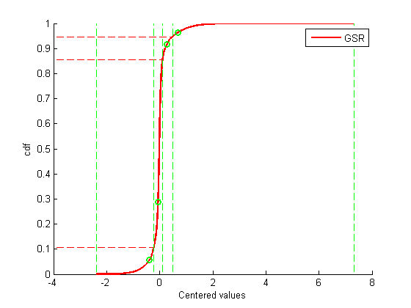
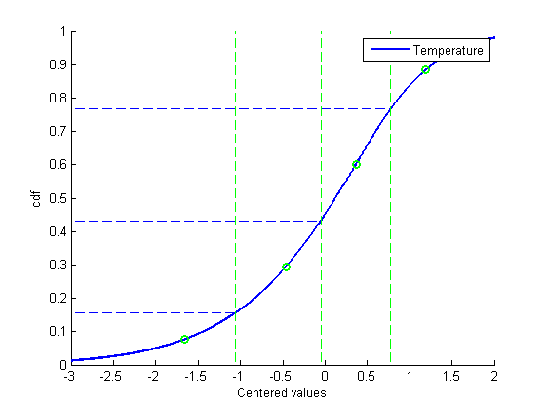
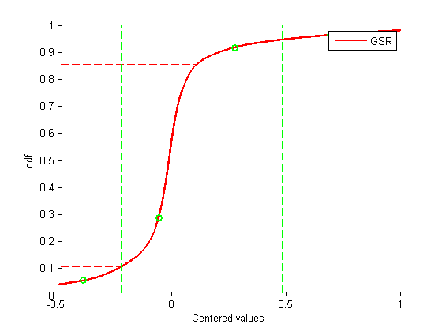
Mean partitions and codebooks
Smooth temperature and gsr data with a moving average filter of window = 10 minutes.
Remove data out of range: temperature [24-40] , gsr: [-inf-8]
  Most of the values removed are very low temperature values at the beginning of the recordings.
Center data of a patients according to the mean across all the assessed days
TO DO: Perform PAA (at the moment in the next step window is set to 1 -> not performed) It could be useful to reduce distortion Lloyd
Calculate cdf
Calculate equiprobable regions
Calculate initial centroids: center of mass points equiprobable regions.
Calculate centroids Llyods’s algorithm and new parititons
Calculate the mean of the partitions computed with SAX and Lloyds and calculate new codebooks.
Partitions
-1.0626 -0.0484 0.7782
Partitions
-0.2228 0.1085 0.4850
Final mean square distortion Llyod’s algorithm:
Temperature: 0.1846
GSR: 0.0328
Codebook (centers)
-1.6635 -0.4616 0.3649 1.1915
Codebook (centers)
-0.3885 -0.0572 0.2742 0.6957

Slide 13
Linux 132 -1000 subjects
Partitions
-0.6003 0.1579 0.7557
Codebook (centers)
-1.0598 -0.1409 0.4568 1.0545
132
Partitions
-0.1117 -0.0186 0.0660
Codebook (centers)
-0.1625 -0.0609 0.0237 0.1083
sax
Partitions
-0.6191 0.1239 0.7324
Codebook (centers)
-1.0579 -0.1803 0.4282 1.0366
Partitions
-0.0716 -0.0121 0.0421
Codebook (centers)
-0.1041 -0.0392 0.0150 0.0692
1000
Partitions
-1.6853 -0.2754 0.8194
Codebook (centers)
-2.5480 -0.8227 0.2720 1.3667
Partitions
-0.3433 0.2202 0.9054
Codebook (centers)
-0.6251 -0.0615 0.5020 1.3087
132
lloyd
Partitions
-1.5060 -0.2206 0.8240
Codebook (centers)
-2.2691 -0.7429 0.3017 1.3463
Partitions
-0.3741 0.2291 0.9278
Codebook (centers)
-0.6757 -0.0725 0.5307 1.3249
1000
Partitions
-1.1428 -0.0587 0.7875
Codebook (centers)
-1.8039 -0.4818 0.3644 1.2106
Partitions
-0.2275 0.1008 0.4857
Codebook (centers)
-0.3917 -0.0633 0.2650 0.7064
132
mean
Partitions
-1.0626 -0.0484 0.7782
Codebook (centers)
-1.6635 -0.4616 0.3649 1.1915
Partitions
-0.2228 0.1085 0.4850
Codebook (centers)
-0.3885 -0.0572 0.2742 0.6957
1000

Slide 14
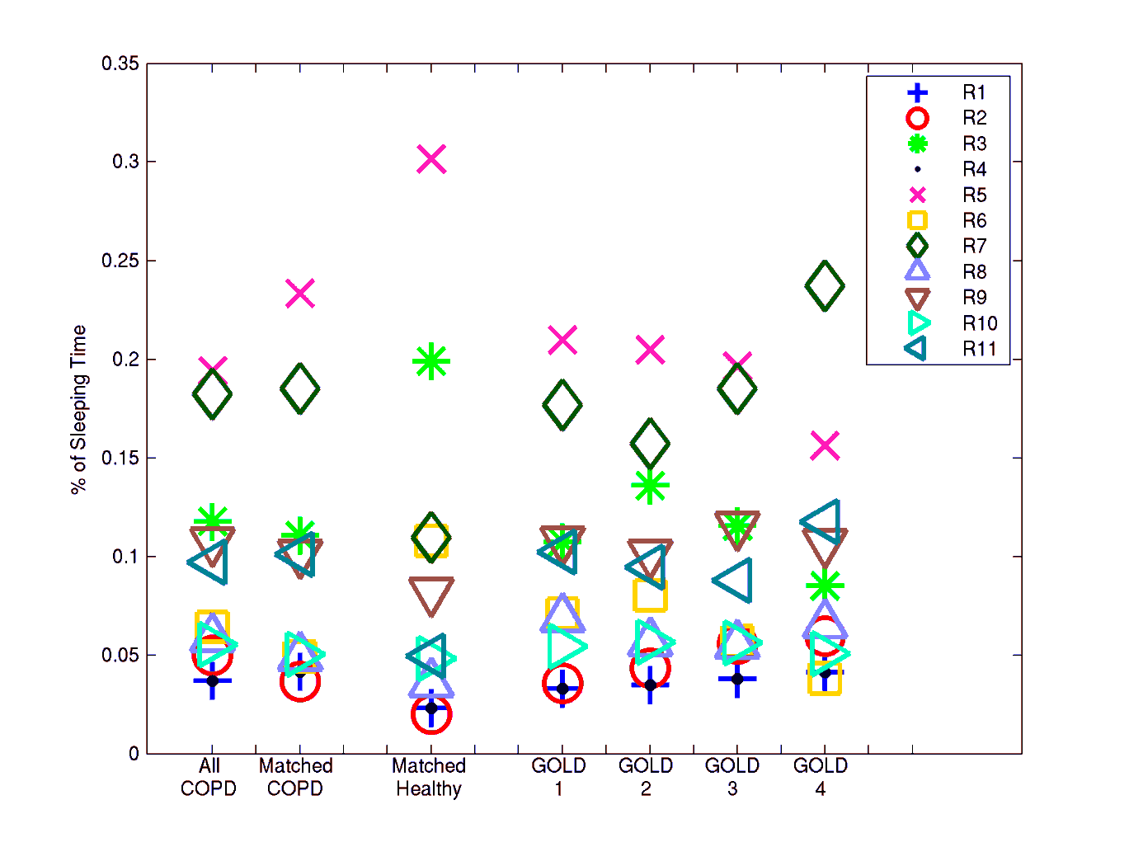
Correlated ~0.2 with the step performed during the day. + R2 -> - steps

Slide 15
Create all possible words
Remove data out of range: temperature [24-40] , gsr: [-inf-8]
Center data of a patients according to the mean across all the assessed days
Smooth data to attenuate outliers (window=10mins)
TO DO: Perform PAA (at the moment in the next step window is set to 1 -> not performed) It could be useful to reduce distortion Lloyd
TO DO: Perform PAA (at the moment in the next step window is set to 1 -> not performed) It could be useful to reduce distortion Lloyd
Calculate cdf and equiprobable regions
Calculate initial centroids: mid points equiprobable regions.
Initialize Lloyd’s algorithm with initial centroids and calculate new codebook vectors and partitions
Decide how many variables for each intensity and for each variable how many letters => estimate all the possible words

Slide 16
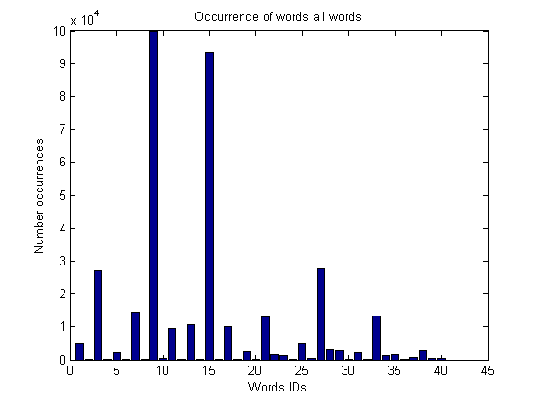
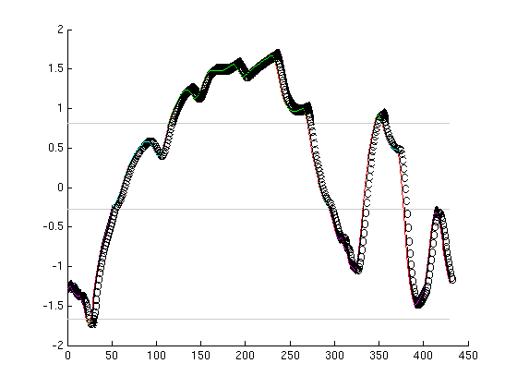
Extract routines
Remove data out of range: temperature [24-40] , gsr: [-inf-8]
Center data of a patients according to the mean across all the assessed days
Smooth data to attenuate outliers (window=10mins)
Perform PAA (at the moment window is set to 1 -> not performed)
Convert to SAX strings (Temperature – GSR)
NOT CONSIDERING DURATION AS 1 DIMENSION
sleeping has 3 variables: temp (3) – gsr (3) – step (2) -> 18 words
very light has 3 variables: temp (3) – gsr (3) – step (2) -> 18 words
light has 1 variable: step (2) -> 2 words
moderate to vigorous has 1 variable: step (2) -> 2words
40 words
19
20
21
22
23
24
25
26
27
28
29
30
31
32
33
34
35
36
'2_1_1_1'
'2_1_1_2'
'2_1_2_1'
'2_1_2_2'
'2_1_3_1'
'2_1_3_2'
'2_2_1_1'
'2_2_1_2'
'2_2_2_1'
'2_2_2_2'
'2_2_3_1'
'2_2_3_2'
'2_3_1_1'
'2_3_1_2'
'2_3_2_1'
'2_3_2_2'
'2_3_3_1'
'2_3_3_2'
37
38
39
40
1
2
3
4
5
6
7
8
9
10
11
12
13
14
15
16
17
18
'1_1_1_1'
'1_1_1_2'
'1_1_2_1'
'1_1_2_2'
'1_1_3_1'
'1_1_3_2'
'1_2_1_1'
'1_2_1_2'
'1_2_2_1'
'1_2_2_2'
'1_2_3_1'
'1_2_3_2'
'1_3_1_1'
'1_3_1_2'
'1_3_2_1'
'1_3_2_2'
'1_3_3_1'
'1_3_3_2'
'3_1_0_0'
'3_2_0_0'
'4_1_0_0'
'4_2_0_0'

Slide 17
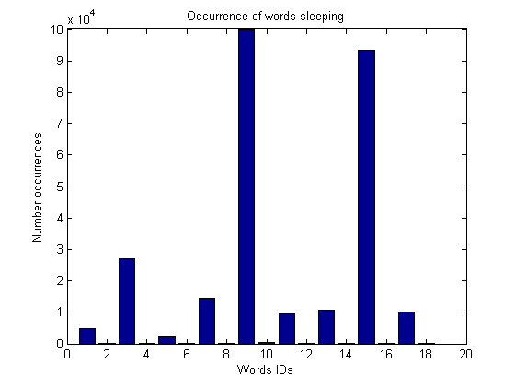
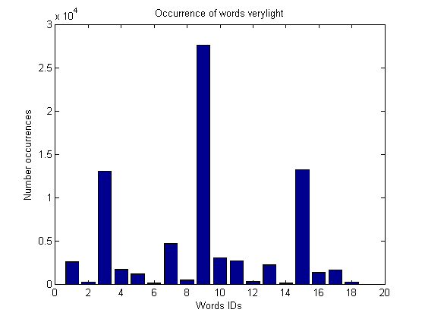
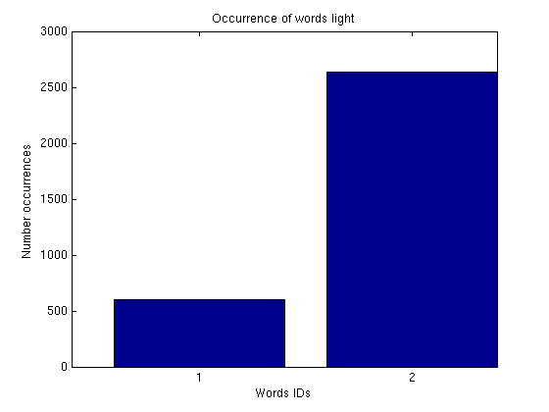
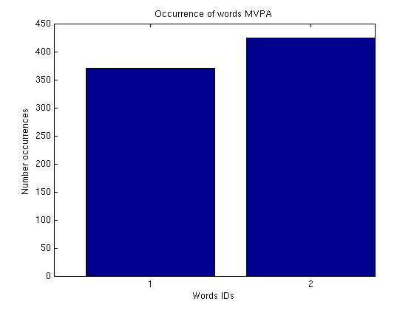
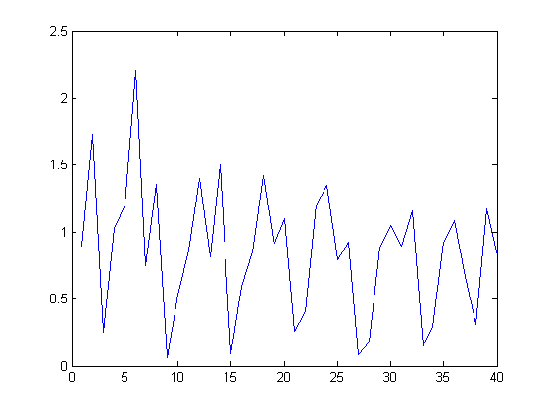
0.9747
0.7587
0.4924
0.9962
37
38
39
40
1
2
3
4
5
6
7
8
9
10
11
12
13
14
15
16
17
18
'1_1_1_1'
'1_1_1_2'
'1_1_2_1'
'1_1_2_2'
'1_1_3_1'
'1_1_3_2'
'1_2_1_1'
'1_2_1_2'
'1_2_2_1'
'1_2_2_2'
'1_2_3_1'
'1_2_3_2'
'1_3_1_1'
'1_3_1_2'
'1_3_2_1'
'1_3_2_2'
'1_3_3_1'
'1_3_3_2'
19
20
21
22
23
24
25
26
27
28
29
30
31
32
33
34
35
36
'2_1_1_1'
'2_1_1_2'
'2_1_2_1'
'2_1_2_2'
'2_1_3_1'
'2_1_3_2'
'2_2_1_1'
'2_2_1_2'
'2_2_2_1'
'2_2_2_2'
'2_2_3_1'
'2_2_3_2'
'2_3_1_1'
'2_3_1_2'
'2_3_2_1'
'2_3_2_2'
'2_3_3_1'
'2_3_3_2'
'3_1_0_0'
'3_2_0_0'
'4_1_0_0'
'4_2_0_0'
Occur in the 80% of the patients
Some words have a very low IDF => they are in all the documents
Words with GSR = 2 not so informative
  We can remove them removing words in 80%
  Increase letter for gsr?
Has high IDF (more in COPD patients)
Has high IDF (more in healthy patients)

Slide 18
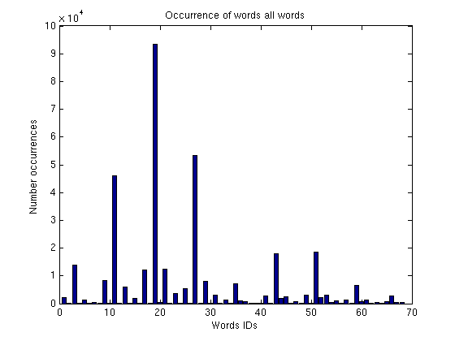
Extract routines
Remove data out of range: temperature [24-40] , gsr: [-inf-8]
Center data of a patients according to the mean across all the assessed days
Smooth data to attenuate outliers (window=10mins)
Perform PAA (at the moment window is set to 1 -> not performed)
Convert to SAX strings (Temperature – GSR)
NOT CONSIDERING DURATION AS 1 DIMENSION
sleeping has 3 variables: temp (4) – gsr (4) – step (2) -> 32 words
very light has 3 variables: temp (4) – gsr (4) – step (2) -> 32 words
light has 1 variable: step (2) -> 2 words
moderate to vigorous has 1 variable: step (2) -> 2words
68 words
33
34
35
36
37
38
39
40
41
42
43
44
45
46
47
48
49
50
51
52
53
54
55
56
57
58
59
60
61
62
63
64
'2_1_1_1'
'2_1_1_2'
'2_1_2_1'
'2_1_2_2'
'2_1_3_1'
'2_1_3_2'
'2_1_4_1'
'2_1_4_2'
'2_2_1_1'
'2_2_1_2'
'2_2_2_1'
'2_2_2_2'
'2_2_3_1'
'2_2_3_2'
'2_2_4_1'
'2_2_4_2'
'2_3_1_1'
'2_3_1_2'
'2_3_2_1'
'2_3_2_2'
'2_3_3_1'
'2_3_3_2'
'2_3_4_1'
'2_3_4_2'
'2_4_1_1'
'2_4_1_2'
'2_4_2_1'
'2_4_2_2'
'2_4_3_1'
'2_4_3_2'
'2_4_4_1'
'2_4_4_2'
65
66
67
68
1
2
3
4
5
6
7
8
9
10
11
12
13
14
15
16
17
18
19
20
21
22
23
24
25
26
27
28
29
30
31
32
'1_1_1_1'
'1_1_1_2'
'1_1_2_1'
'1_1_2_2'
'1_1_3_1'
'1_1_3_2'
'1_1_4_1'
'1_1_4_2'
'1_2_1_1'
'1_2_1_2'
'1_2_2_1'
'1_2_2_2'
'1_2_3_1'
'1_2_3_2'
'1_2_4_1'
'1_2_4_2'
'1_3_1_1'
'1_3_1_2'
'1_3_2_1'
'1_3_2_2'
'1_3_3_1'
'1_3_3_2'
'1_3_4_1'
'1_3_4_2'
'1_4_1_1'
'1_4_1_2'
'1_4_2_1'
'1_4_2_2'
'1_4_3_1'
'1_4_3_2'
'1_4_4_1'
'1_4_4_2'
'3_1_0_0'
'3_2_0_0'
'4_1_0_0'
'4_2_0_0'

Slide 19
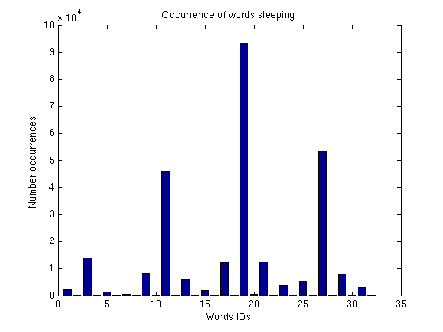
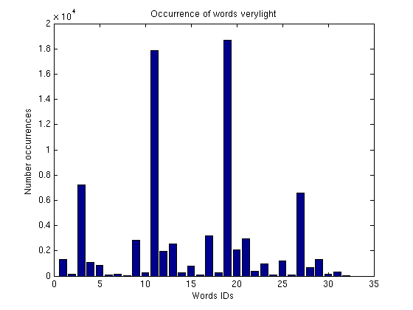
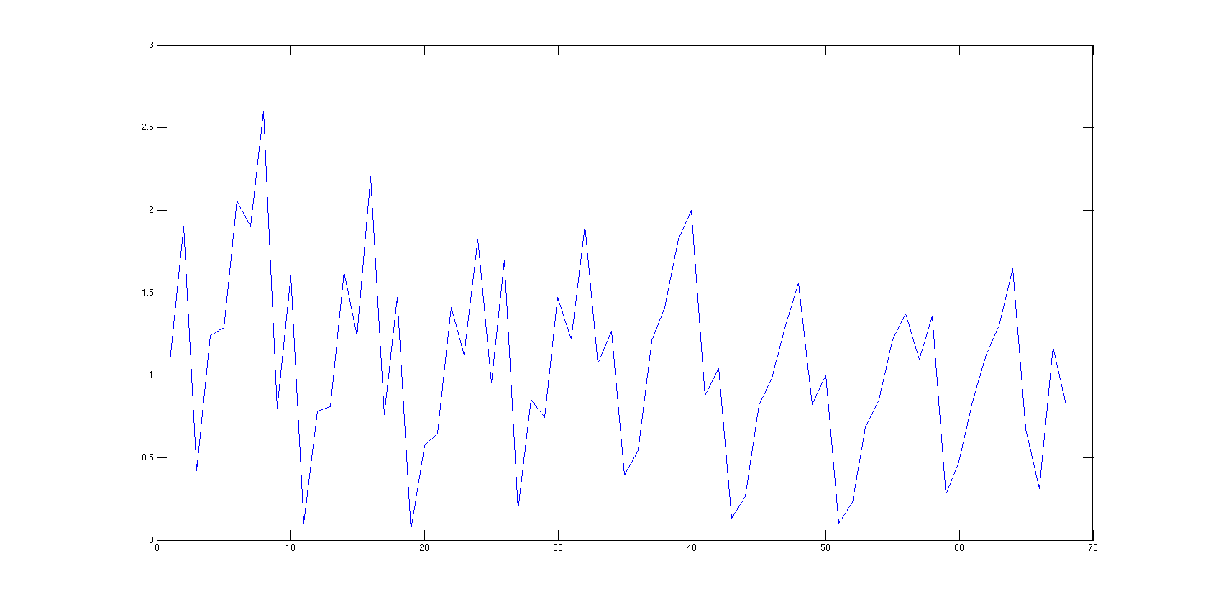
65
66
67
68
1
2
3
4
5
6
7
8
9
10
11
12
13
14
15
16
17
18
19
20
21
22
23
24
25
26
27
28
29
30
31
32
'1_1_1_1'
'1_1_1_2'
'1_1_2_1'
'1_1_2_2'
'1_1_3_1'
'1_1_3_2'
'1_1_4_1'
'1_1_4_2'
'1_2_1_1'
'1_2_1_2'
'1_2_2_1'
'1_2_2_2'
'1_2_3_1'
'1_2_3_2'
'1_2_4_1'
'1_2_4_2'
'1_3_1_1'
'1_3_1_2'
'1_3_2_1'
'1_3_2_2'
'1_3_3_1'
'1_3_3_2'
'1_3_4_1'
'1_3_4_2'
'1_4_1_1'
'1_4_1_2'
'1_4_2_1'
'1_4_2_2'
'1_4_3_1'
'1_4_3_2'
'1_4_4_1'
'1_4_4_2'
33
34
35
36
37
38
39
40
41
42
43
44
45
46
47
48
49
50
51
52
53
54
55
56
57
58
59
60
61
62
63
64
'2_1_1_1'
'2_1_1_2'
'2_1_2_1'
'2_1_2_2'
'2_1_3_1'
'2_1_3_2'
'2_1_4_1'
'2_1_4_2'
'2_2_1_1'
'2_2_1_2'
'2_2_2_1'
'2_2_2_2'
'2_2_3_1'
'2_2_3_2'
'2_2_4_1'
'2_2_4_2'
'2_3_1_1'
'2_3_1_2'
'2_3_2_1'
'2_3_2_2'
'2_3_3_1'
'2_3_3_2'
'2_3_4_1'
'2_3_4_2'
'2_4_1_1'
'2_4_1_2'
'2_4_2_1'
'2_4_2_2'
'2_4_3_1'
'2_4_3_2'
'2_4_4_1'
'2_4_4_2'
'3_1_0_0'
'3_2_0_0'
'4_1_0_0'
'4_2_0_0'
Some words have a very low IDF => they are in all the documents
Words with GSR = 2 not so informative (increase letter for gsr?)

Slide 20
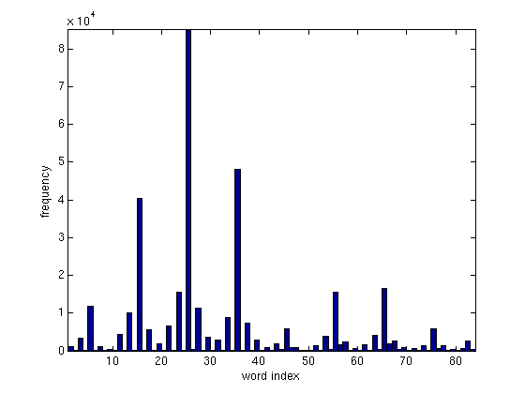
Extract routines
sleeping has 3 variables: temp (4) – gsr (5) – step (2) -> 40 words
very light has 3 variables: temp (4) – gsr (5) – step (2) -> 40 words
light has 1 variable: step (2) -> 2 words
moderate to vigorous has 1 variable: step (2) -> 2words
84 words
Remove data out of range: temperature [24-40] , gsr: [-inf-8]
Center data of a patients according to the mean across all the assessed days
Smooth data to attenuate outliers (window=10mins)
Perform PAA (at the moment window is set to 1 -> not performed)
Convert to SAX strings (Temperature – GSR)
NOT CONSIDERING DURATION AS 1 DIMENSION
41
42
43
44
45
46
47
48
49
50
51
52
53
54
55
56
57
58
59
60
61
62
63
64
65
66
67
68
69
70
71
72
73
74
75
76
77
78
79
80
'2_1_1_1'
'2_1_1_2'
'2_1_2_1'
'2_1_2_2'
'2_1_3_1'
'2_1_3_2'
'2_1_4_1'
'2_1_4_2'
'2_1_5_1'
'2_1_5_2'
'2_2_1_1'
'2_2_1_2'
'2_2_2_1'
'2_2_2_2'
'2_2_3_1'
'2_2_3_2'
'2_2_4_1'
'2_2_4_2'
'2_2_5_1'
'2_2_5_2'
'2_3_1_1'
'2_3_1_2'
'2_3_2_1'
'2_3_2_2'
'2_3_3_1'
'2_3_3_2'
'2_3_4_1'
'2_3_4_2'
'2_3_5_1'
'2_3_5_2'
'2_4_1_1'
'2_4_1_2'
'2_4_2_1'
'2_4_2_2'
'2_4_3_1'
'2_4_3_2'
'2_4_4_1'
'2_4_4_2'
'2_4_5_1'
'2_4_5_2'
81
82
83
84
1
2
3
4
5
6
7
8
9
10
11
12
13
14
15
16
17
18
19
20
21
22
23
24
25
26
27
28
29
30
31
32
33
34
35
36
37
38
39
40
'1_1_1_1'
'1_1_1_2'
'1_1_2_1'
'1_1_2_2'
'1_1_3_1'
'1_1_3_2'
'1_1_4_1'
'1_1_4_2'
'1_1_5_1'
'1_1_5_2'
'1_2_1_1'
'1_2_1_2'
'1_2_2_1'
'1_2_2_2'
'1_2_3_1'
'1_2_3_2'
'1_2_4_1'
'1_2_4_2'
'1_2_5_1'
'1_2_5_2'
'1_3_1_1'
'1_3_1_2'
'1_3_2_1'
'1_3_2_2'
'1_3_3_1'
'1_3_3_2'
'1_3_4_1'
'1_3_4_2'
'1_3_5_1'
'1_3_5_2'
'1_4_1_1'
'1_4_1_2'
'1_4_2_1'
'1_4_2_2'
'1_4_3_1'
'1_4_3_2'
'1_4_4_1'
'1_4_4_2'
'1_4_5_1'
'1_4_5_2'
'3_1_0_0'
'3_2_0_0'
'4_1_0_0'
'4_2_0_0'

Slide 21
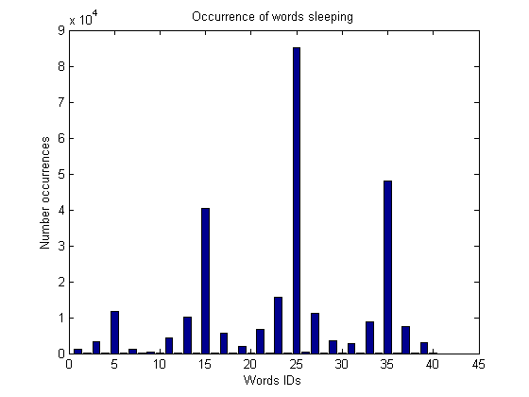
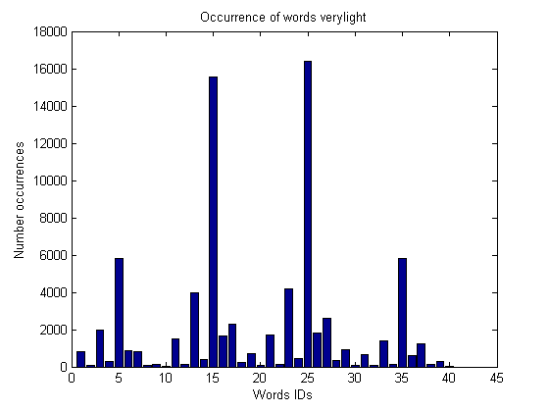
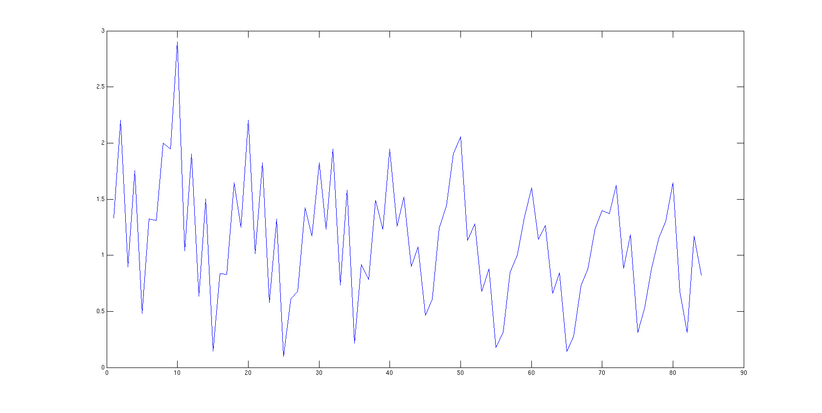
81
82
83
84
1
2
3
4
5
6
7
8
9
10
11
12
13
14
15
16
17
18
19
20
21
22
23
24
25
26
27
28
29
30
31
32
33
34
35
36
37
38
39
40
'1_1_1_1'
'1_1_1_2'
'1_1_2_1'
'1_1_2_2'
'1_1_3_1'
'1_1_3_2'
'1_1_4_1'
'1_1_4_2'
'1_1_5_1'
'1_1_5_2'
'1_2_1_1'
'1_2_1_2'
'1_2_2_1'
'1_2_2_2'
'1_2_3_1'
'1_2_3_2'
'1_2_4_1'
'1_2_4_2'
'1_2_5_1'
'1_2_5_2'
'1_3_1_1'
'1_3_1_2'
'1_3_2_1'
'1_3_2_2'
'1_3_3_1'
'1_3_3_2'
'1_3_4_1'
'1_3_4_2'
'1_3_5_1'
'1_3_5_2'
'1_4_1_1'
'1_4_1_2'
'1_4_2_1'
'1_4_2_2'
'1_4_3_1'
'1_4_3_2'
'1_4_4_1'
'1_4_4_2'
'1_4_5_1'
'1_4_5_2'
41
42
43
44
45
46
47
48
49
50
51
52
53
54
55
56
57
58
59
60
61
62
63
64
65
66
67
68
69
70
71
72
73
74
75
76
77
78
79
80
'2_1_1_1'
'2_1_1_2'
'2_1_2_1'
'2_1_2_2'
'2_1_3_1'
'2_1_3_2'
'2_1_4_1'
'2_1_4_2'
'2_1_5_1'
'2_1_5_2'
'2_2_1_1'
'2_2_1_2'
'2_2_2_1'
'2_2_2_2'
'2_2_3_1'
'2_2_3_2'
'2_2_4_1'
'2_2_4_2'
'2_2_5_1'
'2_2_5_2'
'2_3_1_1'
'2_3_1_2'
'2_3_2_1'
'2_3_2_2'
'2_3_3_1'
'2_3_3_2'
'2_3_4_1'
'2_3_4_2'
'2_3_5_1'
'2_3_5_2'
'2_4_1_1'
'2_4_1_2'
'2_4_2_1'
'2_4_2_2'
'2_4_3_1'
'2_4_3_2'
'2_4_4_1'
'2_4_4_2'
'2_4_5_1'
'2_4_5_2'
'3_1_0_0'
'3_2_0_0'
'4_1_0_0'
'4_2_0_0'
Some words have a very low IDF => they are in all the documents
Words with GSR = 3 not so informative (increase letter for gsr?)

Slide 22
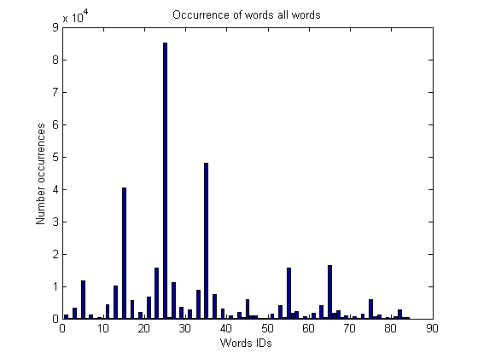
S=temp(4) gsr(4) step(2) - VL= temp(4) gsr(4) step(2) - L= step(2) - MV= step(2)
S 1.2048
VL 0.9714
L 0.4924
MV 0.9962
S=temp(4) gsr(4) step(2) - VL= temp(4) gsr(5) step(2) - L= step(2) - MV= step(2)
S 1.2691
VL 1.0294
L 0.4924
MV 0.9962

Slide 23
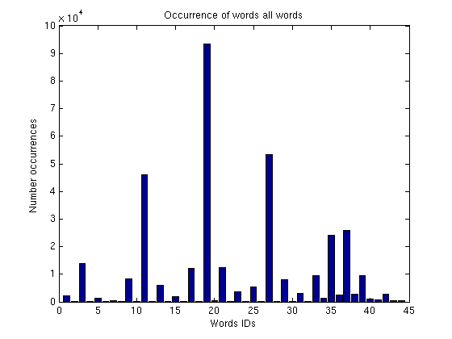
Extract routines (vl_temp)
Remove data out of range: temperature [24-40] , gsr: [-inf-8]
Center data of a patients according to the mean across all the assessed days
Smooth data to attenuate outliers (window=10mins)
Perform PAA (at the moment window is set to 1 -> not performed)
Convert to SAX strings (Temperature – GSR)
NOT CONSIDERING DURATION AS 1 DIMENSION
sleeping has 3 letters: temperature – gsr – step -> 32 words
very light has 2 letters: temp– step -> 8 words
light has 1 letter: step -> 2 words
moderate to vigorous has 1 letter: step -> 2words
44 words
41
42
43
44
1
2
3
4
5
6
7
8
9
10
11
12
13
14
15
16
17
18
19
20
21
22
23
24
25
26
27
28
29
30
31
32
'1_1_1_1'
'1_1_1_2'
'1_1_2_1'
'1_1_2_2'
'1_1_3_1'
'1_1_3_2'
'1_1_4_1'
'1_1_4_2'
'1_2_1_1'
'1_2_1_2'
'1_2_2_1'
'1_2_2_2'
'1_2_3_1'
'1_2_3_2'
'1_2_4_1'
'1_2_4_2'
'1_3_1_1'
'1_3_1_2'
'1_3_2_1'
'1_3_2_2'
'1_3_3_1'
'1_3_3_2'
'1_3_4_1'
'1_3_4_2'
'1_4_1_1'
'1_4_1_2'
'1_4_2_1'
'1_4_2_2'
'1_4_3_1'
'1_4_3_2'
'1_4_4_1'
'1_4_4_2'
33
34
35
36
37
38
39
40
'2_1_1_0'
'2_1_2_0'
'2_2_1_0'
'2_2_2_0'
'2_3_1_0'
'2_3_2_0'
'2_4_1_0'
'2_4_2_0'
'3_1_0_0'
'3_2_0_0'
'4_1_0_0'
'4_2_0_0'

Slide 24
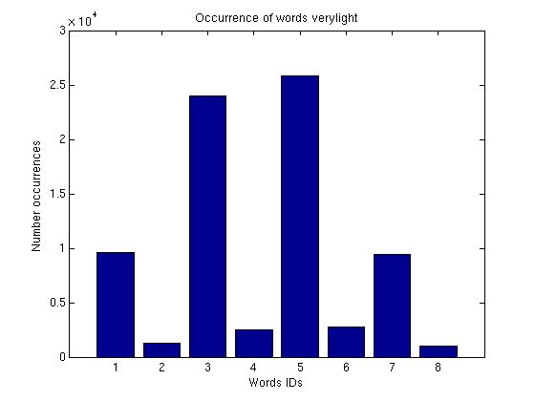

41
42
43
44
1
2
3
4
5
6
7
8
9
10
11
12
13
14
15
16
17
18
19
20
21
22
23
24
25
26
27
28
29
30
31
32
'1_1_1_1'
'1_1_1_2'
'1_1_2_1'
'1_1_2_2'
'1_1_3_1'
'1_1_3_2'
'1_1_4_1'
'1_1_4_2'
'1_2_1_1'
'1_2_1_2'
'1_2_2_1'
'1_2_2_2'
'1_2_3_1'
'1_2_3_2'
'1_2_4_1'
'1_2_4_2'
'1_3_1_1'
'1_3_1_2'
'1_3_2_1'
'1_3_2_2'
'1_3_3_1'
'1_3_3_2'
'1_3_4_1'
'1_3_4_2'
'1_4_1_1'
'1_4_1_2'
'1_4_2_1'
'1_4_2_2'
'1_4_3_1'
'1_4_3_2'
'1_4_4_1'
'1_4_4_2'
33
34
35
36
37
38
39
40
'2_1_1_0'
'2_1_2_0'
'2_2_1_0'
'2_2_2_0'
'2_3_1_0'
'2_3_2_0'
'2_4_1_0'
'2_4_2_0'
'3_1_0_0'
'3_2_0_0'
'4_1_0_0'
'4_2_0_0'
Some words have a very low IDF => they are in all the documents
Increase number of letters of temp?
Use GSR instead of temp for VL?

Slide 25

Extract routines (vl_gsr)
Remove data out of range: temperature [24-40] , gsr: [-inf-8]
Center data of a patients according to the mean across all the assessed days
Smooth data to attenuate outliers (window=10mins)
Perform PAA (at the moment window is set to 1 -> not performed)
Convert to SAX strings (Temperature – GSR)
NOT CONSIDERING DURATION AS 1 DIMENSION
sleeping has 3 letters: temperature – gsr – step -> 32 words
very light has 2 letters: gsr – step -> 8 words
light has 1 letter: step -> 2 words
moderate to vigorous has 1 letter: step -> 2words
44 words
41
42
43
44
1
2
3
4
5
6
7
8
9
10
11
12
13
14
15
16
17
18
19
20
21
22
23
24
25
26
27
28
29
30
31
32
'1_1_1_1'
'1_1_1_2'
'1_1_2_1'
'1_1_2_2'
'1_1_3_1'
'1_1_3_2'
'1_1_4_1'
'1_1_4_2'
'1_2_1_1'
'1_2_1_2'
'1_2_2_1'
'1_2_2_2'
'1_2_3_1'
'1_2_3_2'
'1_2_4_1'
'1_2_4_2'
'1_3_1_1'
'1_3_1_2'
'1_3_2_1'
'1_3_2_2'
'1_3_3_1'
'1_3_3_2'
'1_3_4_1'
'1_3_4_2'
'1_4_1_1'
'1_4_1_2'
'1_4_2_1'
'1_4_2_2'
'1_4_3_1'
'1_4_3_2'
'1_4_4_1'
'1_4_4_2'
33
34
35
36
37
38
39
40
'2_1_1_0'
'2_1_2_0'
'2_2_1_0'
'2_2_2_0'
'2_3_1_0'
'2_3_2_0'
'2_4_1_0'
'2_4_2_0'
'3_1_0_0'
'3_2_0_0'
'4_1_0_0'
'4_2_0_0'

Slide 26


41
42
43
44
1
2
3
4
5
6
7
8
9
10
11
12
13
14
15
16
17
18
19
20
21
22
23
24
25
26
27
28
29
30
31
32
'1_1_1_1'
'1_1_1_2'
'1_1_2_1'
'1_1_2_2'
'1_1_3_1'
'1_1_3_2'
'1_1_4_1'
'1_1_4_2'
'1_2_1_1'
'1_2_1_2'
'1_2_2_1'
'1_2_2_2'
'1_2_3_1'
'1_2_3_2'
'1_2_4_1'
'1_2_4_2'
'1_3_1_1'
'1_3_1_2'
'1_3_2_1'
'1_3_2_2'
'1_3_3_1'
'1_3_3_2'
'1_3_4_1'
'1_3_4_2'
'1_4_1_1'
'1_4_1_2'
'1_4_2_1'
'1_4_2_2'
'1_4_3_1'
'1_4_3_2'
'1_4_4_1'
'1_4_4_2'
33
34
35
36
37
38
39
40
'2_1_1_0'
'2_1_2_0'
'2_2_1_0'
'2_2_2_0'
'2_3_1_0'
'2_3_2_0'
'2_4_1_0'
'2_4_2_0'
'3_1_0_0'
'3_2_0_0'
'4_1_0_0'
'4_2_0_0'
Some words have a very low IDF => they are in all the documents

Slide 27
S=temp(4) gsr(4) step(2) - VL= temp(4) step(2) - L= step(2) - MV= step(2)
S 1.2048
VL 0.2117
L 0.4924
MV 0.9962
S=temp(4) gsr(4) step(2) - VL= gsr (4) step(2) - L= step(2) - MV= step(2)
S 1.2048
VL 0.6489
L 0.4924
MV 0.9962

Slide 28


Subject 1
Subject 7
….
Standardize ( - mean_S1_alldays / std_S1_alldays)
Is standardization necessary/helpful?
Standardize ( - mean_S7_alldays / std_S7_alldays)

Slide 29
Subject 1
Subject 7
….
Centering ( - mean_S1_alldays)
Is centering necessary/helpful?
Centering ( - mean_S7_alldays)

Slide 30
Subject 1 standardized
Temperature
GSR
-1.23863617021723
-1.21734742377123
-1.21734742377123
-1.19605128539942
-1.19605128539942
-1.19605128539942
-1.25991937271884
-1.32372832463151
-1.36623559422788
-1.38747998911877
-1.38747998911877
-1.36623559422788
-1.32372832463151
-1.30246544992593
-1.28119518329462
-1.23863617021723
-1.28119518329462
-1.45117436618081
-1.66307316055837
-1.62074329718234
-1.57838941004732
-1.68422885233914
-1.78991306418809
-1.76878878809222
-1.72652175608589
-1.64191192483331
-1.55720230258174
-1.45117436618081
-1.36623559422788
-1.28119518329462
-1.19605128539942
-1.11080390054226
-1.02544933276039
-0.961361335646870
-0.897217899089556
-0.833011631162536
-0.790171724902853
……..
-0.881936296374597
-0.861510598491489
-0.851297645753430
-0.810445834801209
-0.769593401070001
-0.769593401070001
-0.759380240738946
-0.749167080407892
-0.749167080407892
-0.749167080407892
-0.759380240738946
-0.749167080407892
-0.759380240738946
-0.820658787539268
-0.790019721732109
0.466418632379658
-0.340614095261985
-0.698100448380638
-0.769593401070001
-0.698100448380638
-0.790019721732109
-0.851297645753430
-0.881936296374597
-0.892149249112656
-0.902361994257719
-0.902361994257719
-0.912574739402768
-0.902361994257719
-0.902361994257719
-0.902361994257719
-0.912574739402768
-0.922787484547831
-0.922787484547831
-0.922787484547831
-0.922787484547831
-0.933000229692880
-0.943212767244934
……….
Standardize again?
….
cdf
Subject n standardized

Slide 31


Breakpoints 132 subjects
A B C D
-0.6134 0.1627 0.7257
-0.7305 -0.2310 0.6387
Different breakpoints -> adding more patients distributions change
Breakpoints 1000 subjects
A B C D
-0.6426 0.1283 0.7378
-0.7091 -0.2005 0.5936

Slide 32

Breakpoints 64 subjects (8-8-8-8)
A B C D
-0.5973 0.1667 0.7154
-0.7279 -0.2229 0.6438
Different breakpoints -> adding more patients distributions change, even if the first distribution is evaluated using a balanced dataset
Breakpoints 1000 subjects
A B C D
-0.6426 0.1283 0.7378
-0.7091 -0.2005 0.5936

Slide 33
Effect of smoothing on data (moving average window = 10min -> removing outliers)
132 no smoothing
breakpoints_values
-1.6853 -0.2754 0.8194
-0.3430 0.2213 0.9093
breakpoints_codebook
-2.5354 -0.8353 0.2846 1.3541
-0.6543 -0.0316 0.4742 1.3444
132 after smoothing
breakpoints_values
-1.6276 -0.2610 0.8000
-0.3393 0.2187 0.9005
breakpoints_codebook
-2.4546 -0.8006 0.2786 1.3213
-0.6475 -0.0312 0.4686 1.3325

