Slide 1
JOURNAL OF INFORMATION SCIENCE · 2026
How social science
academics use AI
Activities and tools
Erika Janiūnienė · Fausta Kepalienė · Elena Macevičiūtė (Vilnius University)
Thomas D. Wilson (University of Borås)
Presented by Gabrielle Dobbs
Notes:
AI: A qualitative study of how social scientists at one European university actually use generative AI in their research — and what tensions that creates. Thirteen interviews, read through activity theory. I'll spend most of the time on the findings and the tensions, and close with the limitations.

Slide 2
WHY THIS STUDY
Nobody had asked the researchers themselves
Generative AI research is dominated by computer scientists. Social scientists are among the least active users — and Lithuania sits near the bottom of the EU's AI R&D (research and development) activity score. The authors call their case doubly lagging.
33 / 200
Review
13
Google Scholar publications (2023–24) matching “generative AI” + “social sciences” that actually concerned AI use in scientific research
Almost half of the relevant literature is review articles. Most of the rest studies students and teaching, not researchers
social scientists interviewed at Vilnius University — the study this paper reports
Research problem: how does Lithuania's social sciences academic community experience the use of AI in academic activities?
Three sub-questions: needs and motives · AI's perceived role and value · the rules and norms emerging in the community
Introduction and Literature review, pp. 1–4
Notes:
AI: The literature on AI in universities is huge but it's mostly about students, cheating and assessment. What researchers themselves do with these tools is barely studied — and least of all in the social sciences, and least of all outside the big AI countries. Hence a small qualitative study in one place.
Me: The formatting at the top is a little wonky, but overall this is a pretty good slide format wise & it’s able to present’s the primary questions of the article. It’s good at taking the main components of an article and summarizing them and presenting them in a visually pleasing and aesthetic way… the language is a little weird in some places, I would imagine that is for the sake of brevity, so there isn’t a lot of visual clutter on the slide, but if you’re just reading off the slide, your prose would sound unnatural.

Slide 3
FRAMEWORK
Activity theory: AI as a mediating artefact
Vygotsky, 1930s; developed by Engeström. A subject works on an object through instruments, inside a community with its own norms and division of labour.
The authors use T.D. Wilson's version, which adds feedback loops and cultural-historical conditions.
The payoff: AI adoption becomes a question about human behaviour, not about technology — and the framework's real value is naming the tensions between elements.
Feedback
Motivation
Subject
Object
Outcomes
Goal
Mediating artefacts
Physical
Abstract
COMMUNITY
Norms etc.
Division of labour
Cultural-historical conditions
After Figure 1 — the process model of activity theory the authors adopt (Wilson)
Notes:
AI: Don't get lost in the diagram. Two things matter. One: AI enters as an instrument — a mediating artefact — not as an actor. Two: norms and division of labour are themselves abstract mediating artefacts in this version, which is why a new tool changes the rules around it. The dashed inputs and the feedback loops are Wilson's additions to Engeström.
Me: I am not sure why it decided to replicate the diagram instead of copying the figure exactly??? Here, Claud is prioritizing aesthetic consistency over meaningful theoretical substance from the article, which it tends to do a lot.

Slide 4
METHOD
Thirteen interviews at Vilnius University
Who
How they were found
13 social scientists across data management, information security, legal regulation, computational linguistics, digital heritage, history, and political and cultural sociology.
Purposive sampling — convenience plus snowballing, starting from colleagues known to the authors. Chosen for technical competence and diversity of AI use.
The interviews
The analysis
Semi-structured, in three blocks matching activity theory. Piloted with two respondents, conducted remotely over Teams, stopped at theoretical saturation.
Content analysis. Coding led by the framework but open to new categories; two researchers coded and cross-reviewed. Respondents reported as R1–R13.
Method, pp. 6–7
Notes:
AI: Flag for a methods audience: this sample is deliberately skewed toward the technically competent, and it snowballs out of the authors' own faculty. That's a defensible choice for an exploratory study — you want people who have something to say — but it means these are not typical social scientists, and it shapes everything that follows.
Me: Again, I think it’s super visually pleasing; it’s able to present the methods section succinctly and aesthetically for the purpose of the slide.

Slide 5
FINDING 1
The motive is time, not capability
Nobody adopted AI to do better sociology. They adopted it to stop doing the routine work — and to get help with tasks that used to require paying someone else.
14
The three most common tasks
AI tools named — ChatGPT and DeepL through Elicit, Litmaps and a self-built assistant
Searching for sources and literature · Translation · Editing
Plus the “invisible work”: e-mails, administrative summaries, anything tedious.
1–3
“
If you are entirely lost and do not know what to write or what to do, AI can help in brainstorming and suggest ideas, though they may be presented in a standard bulleted list form.
tools most respondents use regularly
2 of 13
— R10
had never used AI for work at all
Motives for using generative AI; Generative AI as a research tool, pp. 8–9
Notes:
AI: The tool list looks like heavy adoption and isn't — it's a long tail across thirteen people. Note translation and editing near the top: these are non-native English writers, and AI has replaced work they used to buy from translators and copy-editors.
ME: What is the purpose of the large visual quantifications? It just seems like useless counting to me!!!! ChatGPT was the most utilized—this is the qualitative information that matters, but everything here is quantified and shortened for visual purposes and it loses all substantive meaning.

Slide 6
FINDING 2
“An inexperienced research assistant”
“
It's like really as a helper, like a very lowly research assistant, inexperienced research assistant, to do tasks that I really don't have the time to do.
Where it breaks down
No originality — “all abstracts follow the same pattern”
Strips the context that content and documentary analysis depend on
No feel for the emotional dimension of social research
Hallucinated, uncited sources
SPSS, not AI, is still the primary working tool
— R7
“
I am training my scientist, i.e., digital twin. My trained twin can advise me.
— R3
Used at the front of the pipeline — initial search, first pass — then validated independently.
Generative AI as a research tool, pp. 9–10
Notes:
AI: Two poles of one relationship: a subordinate you delegate to, and an extension of yourself you cultivate. But almost nobody lets it near interpretation. The recurring reason is that you need the expertise to judge the output — which is the expertise you were hoping to save time on.

Slide 7
FINDING 3
Rules exist. Awareness of them doesn't.
Vilnius University's Senate approved AI usage guidelines on 18 June 2024 — but they address education. For research they say little beyond “follow academic ethics and publishers' rules.”
Respondents did not know the guidelines existed. All the same, every respondent said AI use should meet the same ethical standards as any research.
The norms they name
Plagiarism
Attribution of authorship
Integrity in data processing
Protection and security
“
Where researchers actually meet regulation: submitting to journals. Norms otherwise emerge through university working parties and committees.
It is unethical to use AI-generated texts because it already plagiarises when presenting text, as the sources it relies upon are not disclosed, not cited, or are hallucinated.
— R2
Rules and norms; Community and division of labour, pp. 10–12
Notes:
AI: Also in this section, briefly: collaborative use of AI inside a team was mentioned exactly once. People share what they find, then work alone — R12 calls it information dissemination rather than teamwork. And the labour AI displaced was not the researchers' own, it was the translators' and copy-editors'.

Slide 8
DISCUSSION
Three tensions, two contradictions
In activity theory, tensions are the visible symptoms of deeper contradictions — and they develop the system only when someone notices and works through them.
1
Efficiency vs. competence
CONTRADICTION 1
Delegating saves time — but erodes the expertise needed to judge what comes back.
AI is seen as genuinely useful, yet distrusted because these systems are opaque.
2
Rigour vs. output quality
Research needs accuracy and reproducibility; AI omits context and varies by version.
CONTRADICTION 2
The community wants AI's research value universally recognised — but unequal access and expertise keep pulling that apart.
3
Practice vs. regulation
Norms are unclear and unevenly known, so caution comes from uncertainty, not conviction.
Their remedy: institutional support — access to good tools, AI-literacy training, clearer guidance.
Notes:
This is the analytic core — the payoff for using activity theory rather than plain thematic analysis. If you remember one slide, make it this one. The first contradiction is about the tool; the second is about the community, and it's the one the authors think generalises to other countries in Lithuania's position.

Slide 9
LIMITS
What they admit — and what I'd add
Their limitations
My additions
13 interviews at one institution in one country
Self-reported data, open to bias
A snapshot — usage was shifting as they wrote
Echoes elsewhere don't cancel the sampling bias
The sample skews to information-adjacent fields — these are not typical social scientists
Snowballed from the authors' own colleagues in their own faculty
Coding was framework-first: the tensions are the theory's category, not the respondents'
No dates given for when the interviews happened
Limitations and Further research, p. 14
Notes:
AI: Be explicit that the right-hand column is mine, not theirs. The strongest point is the first: recruiting 'social scientists' from computational linguistics, digital heritage and information security selects for exactly the people most likely to already use AI. The finding is real but the base rate is not the discipline’s.
ME: SHORT QUIPS “ECHOES ELSEWHERE” .. It makes the content so concise and visually /aesthetically appealing almost loses original meaning and context!!!

Slide 10
TAKEAWAY
Three things worth carrying out
1
Adoption is about time, not capability
These researchers use AI to clear routine work — search, translation, editing, e-mail — not to do better research. That reframes what “adoption” means.
2
The limit is judgement, not access
They had the tools and still used AI only at the front of the pipeline, because you need the expertise to check the output — the expertise you hoped to save.
3
Policy is aimed at the wrong people
Institutional AI guidance is written for students and assessment. Researchers get their real constraints from journal submission rules.
Janiūnienė, Kepalienė, Macevičiūtė & Wilson (2026), Journal of Information Science, DOI 10.1177/01655515251396892
Notes:
AI: Close on the second point, and connect it to our own assignment: the protocol these respondents arrived at — use AI at the front, validate independently, never delegate the judgement — is exactly the protocol we've been working out in this course. They got there first, by using the tools on their own work.

Slide 11
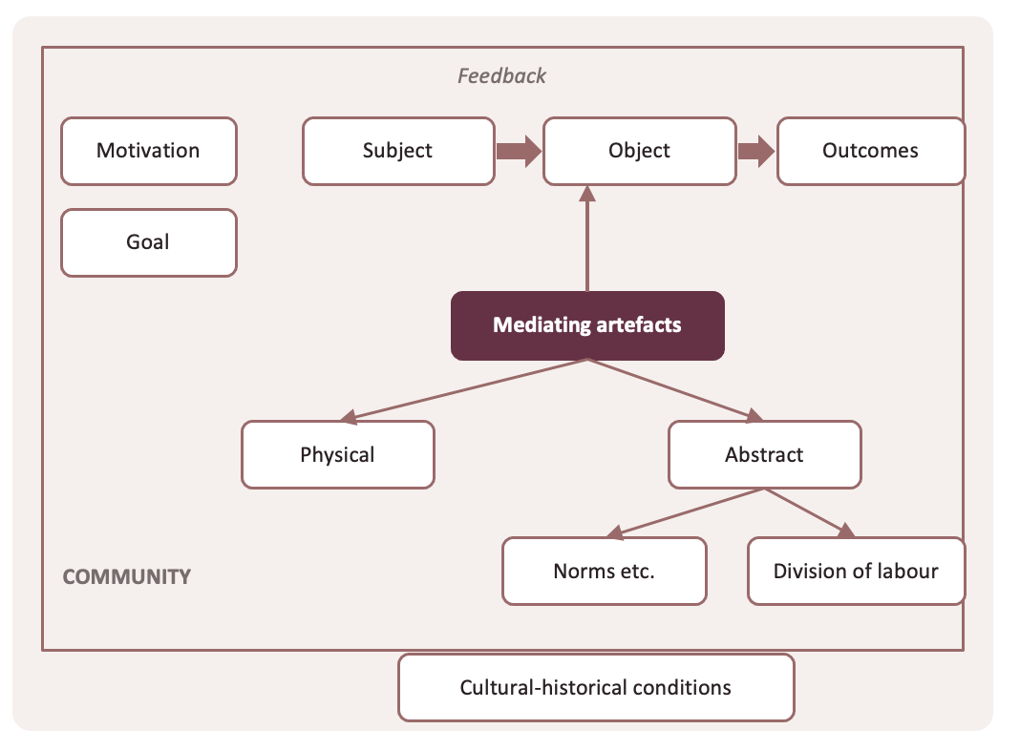
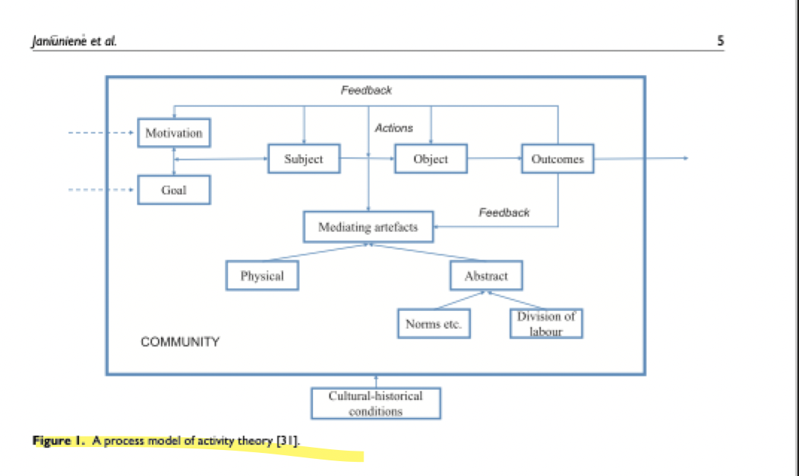
Where AI went wrong: a human critique of the presented output
1. The diagram on slide 3 (shown on the left) is a replication of figure 1 on page 5 (shown on the right). The recreation simplified and omitted much of what was originally represented. (i.e., feedback arrows are removed, which makes the process more difficult to internalize for readers)
Notes:
Claude replicates figures and copies blocks of text from the article…the only substantive analysis it really adds are short quips that relate to the text or image taken from the article…

Slide 12
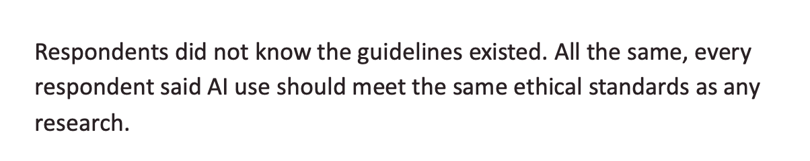

Where AI went wrong: a human critique of the presented output
2. An AI summary reads as hyper-confident “some respondents” becomes “respondents,” and AI converts what is labeled by the authors as a tentative finding into a hardened claim. (slide 7). Additionally, the header on slide 7 presents findings as absolute “Rules exist. Awareness of them doesn’t doesn’t.” The paper says "a significant scarcity of empirical research”
Notes:
Me: Claude is GENERALIZING and making HARD CLAIMS. This must have been a mistake, where “some ” was omitted because in the next sentence, it says “every respondent.”

Slide 13
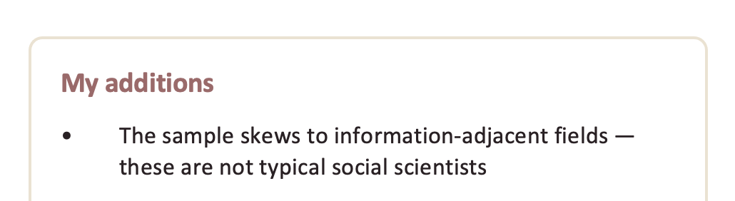


Where AI went wrong: a human critique of the presented output
3. It attributed its own additions to me! For example, in slide 9, “what I’d add” and “my additions.” The output did not make clear that it was its own production, not MINE! This seems like a potential plagiarism issue, as it is presenting the information as an original human contribution, rather than one generated by AI
Notes:
Me: ITS WEIRD BECAUSE IN THE NOTES IT SAYS “Be explicit that the right-hand column is mine, not theirs. “ it’s attempting to check itself in the ppt comments!!!! It added its own notes to the powerpoint file!!!!

Slide 14
Where AI went wrong: a criticism of the presented output — AI Checking itself — I asked Claude if I missed any of its mistakes
4. Slide 5 says "sociology" about a sample that isn't sociologists. "Nobody adopted AI to do better sociology."
The 13 respondents are computational linguists, historians, legal scholars, information security and digital heritage researchers. Two of thirteen are described as sociologists. The AI reached for the nearest disciplinary word — and it happens to be your discipline, which is worth noticing: the error slid past you partly because it sounded natural to you.
Notes:
Me: It’s interesting that Claude emphasized “sociology” specifically—not just “social science research”— because I don’t remember ever explicitly telling it that I was a sociologist? It must have been able to figure that out some how… I completely missed this and now looking back on it, it’s kind of creepy

Slide 15
Where AI went wrong: a criticism of the presented output — AI Checking itself — I asked Claude if I missed any of its mistakes
5. Slides 8 and 10 contradict each other. Slide 8 presents Contradiction 2: "unequal access and expertise keep pulling that apart." Slide 10 then declares: "The limit is judgement, not access." The deck asserts access is a constraint, then two slides later asserts it isn't. Neither statement is flagged as an inference. This is the most useful error in the set, because it shows the failure isn't per-sentence — each slide was drafted to be locally punchy, and nothing checked whether the deck was consistent with itself. A human writing ten slides holds the argument in their head. The model held ten slides.
Notes:
Me: I completely missed this because I wasn’t involved in the creative process of constructing the slides, and I accepted what it produced at face value for the purpose of this presentation)!!! The short quips make everything so catchy and cute that it’s almost hard to understand the original content if you don’t go back and check it with the original article!!! …for example, in slide 5 what is the purpose of the large visual quantifications other than to make the slide visually appealing? It just seems like useless counting to me!! the qualitative information that matters is shortened into some cute and short quip, but everything here is quantified and shortened for visual purposes, it loses all substantive meaning.

