Slide 1
Predicting Crime Clearance Rates for Charlotte-Mecklenburg with h20
Ryan Wesslen and Gabriel Fair

Slide 2
Key Findings
Gradient Boosting Model has the highest accuracy in predicting crime clear rates (“arrests”)
Nearly 85% out-of-sample, 0.92 AUC
Deep Learning and Random Forest were a close second
Crime type is the strongest predictor of clear rates
People vs society vs property
Several secondary variables have some predictive lift
Location type, witness present, victim attributes, property value
A simple CART may be all that’s needed to predict clear rates
It can provide an interpretable, fairly strong predictive model
Notes:
The CART and “Simple” CART models performed well too. The CART model performed better than the simpler model, showing the trade-off that simplicity and interpretability can be exchanged for increased predictive power. Even better, both models showed little signs of overfitting as its performance was nearly identical on the training, validation and test dataset.
GLM showed signs of overfitting. Its training accuracy was 82.6% while its test accuracy was 78.3%, which was lower than the “Simple” CART model. Likely, more rigorous feature transformation for non-linearities and perhaps other feature selection techniques (e.g. forward or backward stepwise) may provide less overfitting results.
In conclusion, from a predictive accuracy point of view, GBM was the best model and predicted clear rates with nearly 85% (out-of-sample) accuracy. Nevertheless, this model remains largely a “black box” model in which its components are difficult to interpret. Therefore, for practical use, we recommend that CART models can perform quite well along with interpretable results that practitioners may find usable than black box algorithms like GBM and Deep Learning.

Slide 3
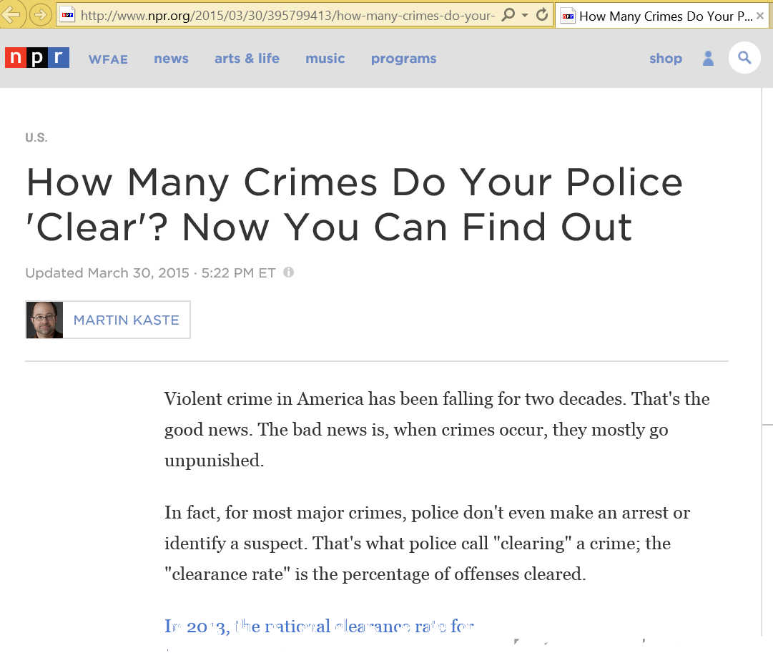
Clearance Rates (“Closing Cases”)
“In short, the falling crime rate we've enjoyed may come at a cost: police indifference when you report your stereo was stolen.”
From NPR.org March 30th 2015
Notes:
Why are Clearance Rates important:
They are official metrics tracked by local police departments and the FBI
They measure how effective at solving and thus, with crime feedback theory, also at preventing crime
Lower crime rates don’t tell the whole story – use example that “tradeoff”

Slide 4
Hypotheses
Testable Hypotheses
Non-Testable Hypotheses
Hypothesis | Potential Attributes
Type of crime | Crime Type (NIBRS raw class, NIBRS category/against)
Location of crime | Lat / Long, Distance to high risk locations (homeless shelter, etc.)
Victim Profile | Age, race, ethnicity, gender
“Crime waves” | Normalized rolling count of crimes in the last 7 or 30 days.
Information Provided (“Clues”) | Witness Present Flag, Witness Demographics (age, gender)
Time of Crime | Hour of the day
Day/Week of Crime | Day of the week, Week of the year
Extreme Weather | Days with Snow (e.g. Feb 2014 Snowstorm), Days with Severe Weather
Amount of Damage (Property Crimes only) | Property Damage Amount, Property Type
Hypothesis | Potential Attributes
Police/Department strategy | Not included in the dataset.
Police Response | Not included in the dataset.
Police Bias | Not included in the dataset
Officer / Department Training | Not included in the dataset
Demographics of Officer | Not included in the dataset
Association of Crimes (“Hidden Network”) | Not included in the dataset
Institutional Factors (DA Office, etc.) | Not included in the dataset
Other External Factors (e.g. media coverage of a crime) | Difficult to measure and out of scope. Would need to append data (e.g. # of media articles per crime)

Slide 5
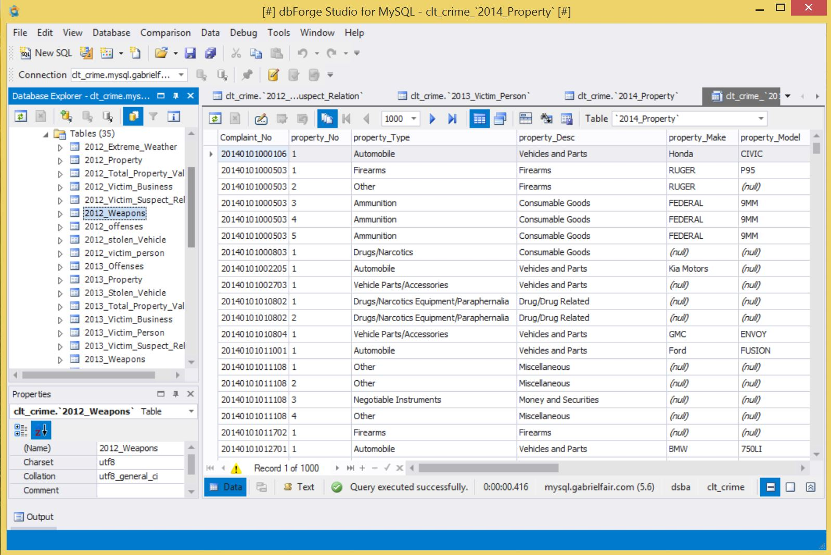
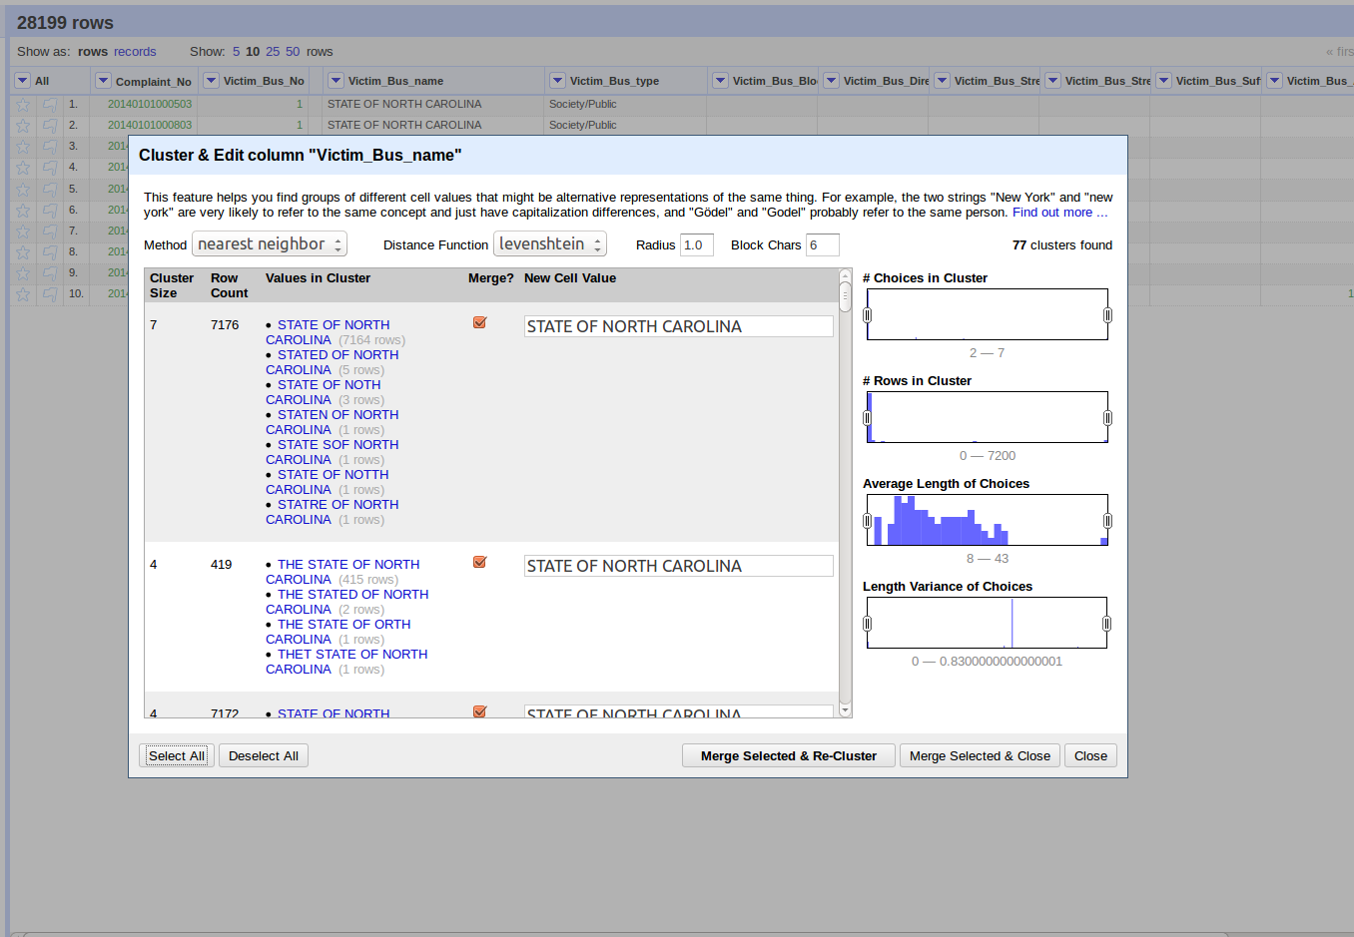
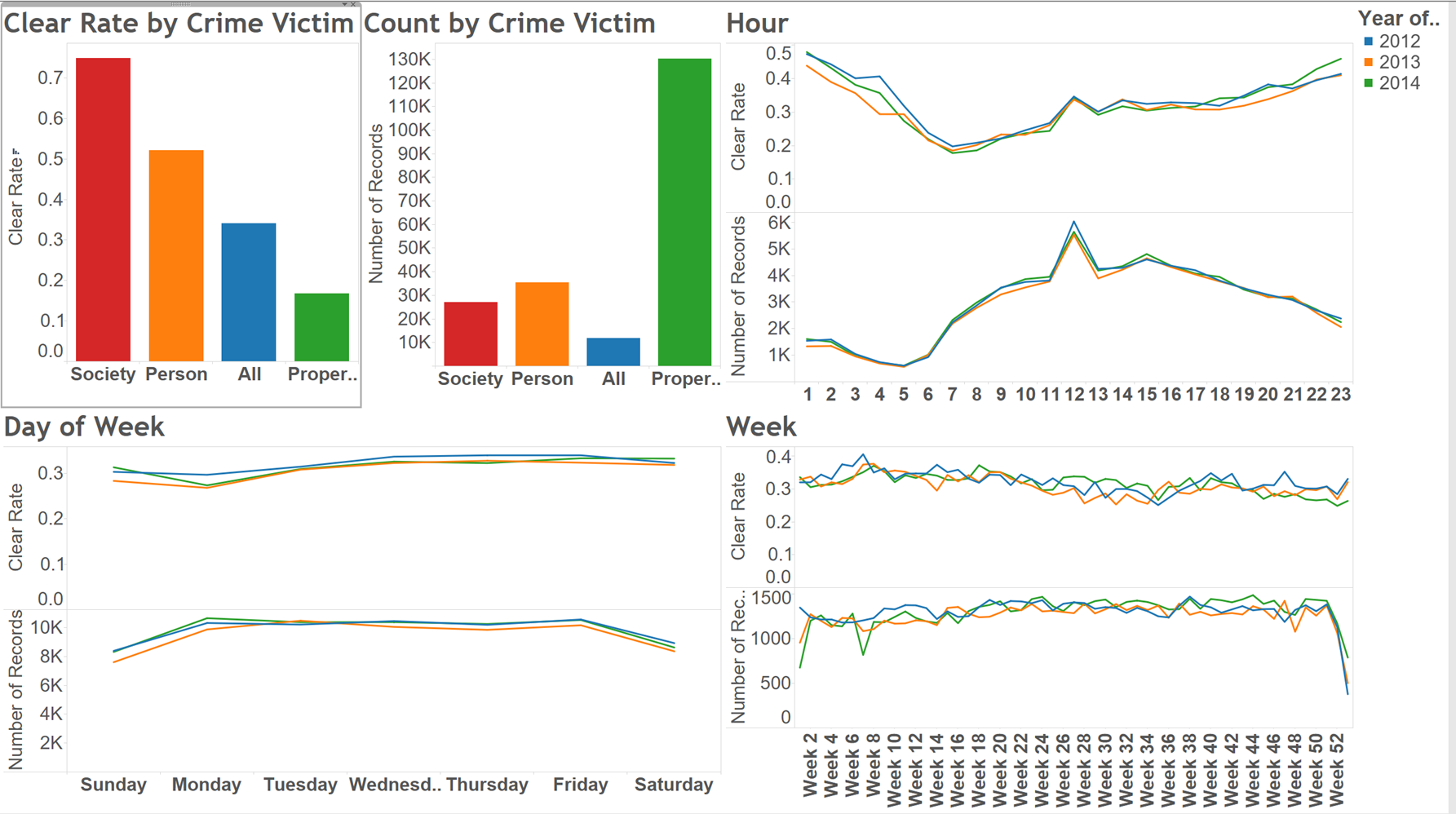
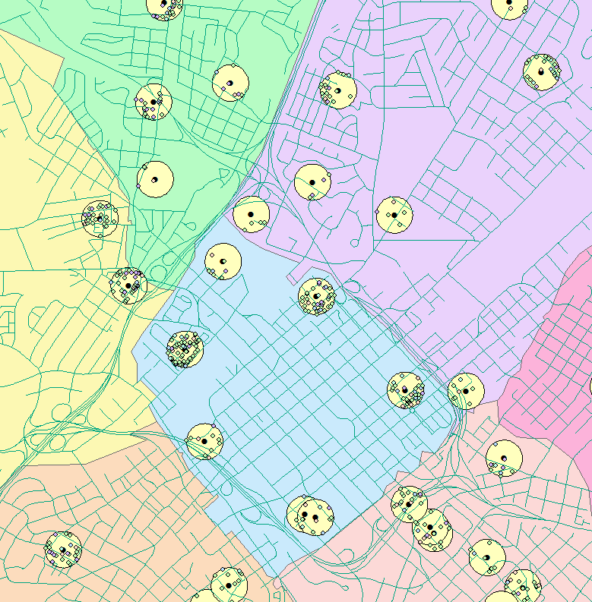
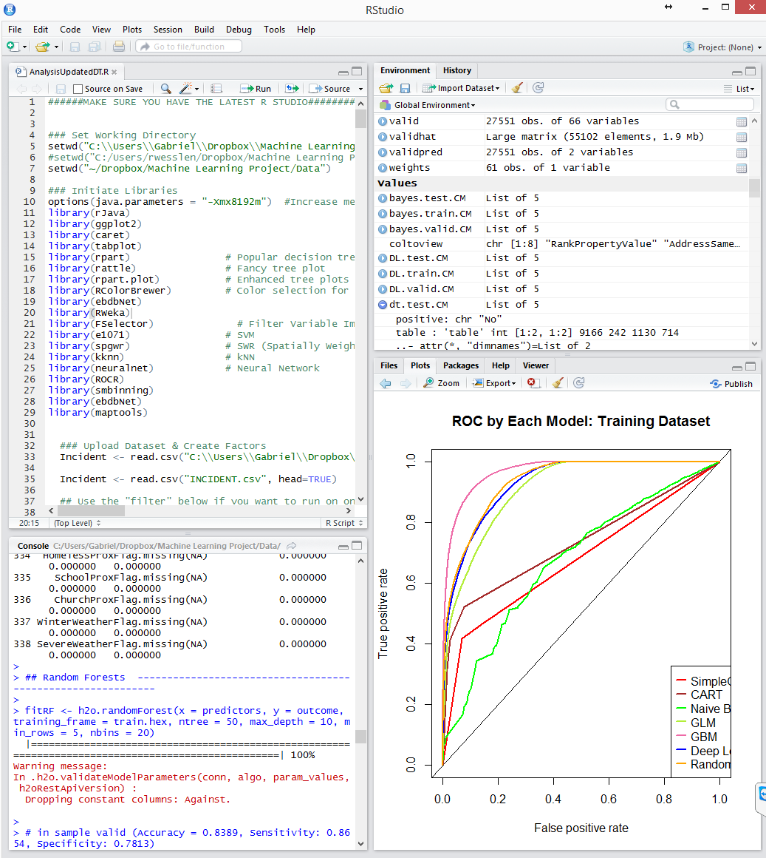

Tools Used
MySQL – SQL Database
OpenRefine – Data Wrangling
OpenGIS – Lat/Long Conversion
ArcGIS – Exploratory & Spatial Attributes
Tableau – Exploratory
SAS EG – Aggregating (merging) for model dataset
R Studio – Data preparation & interface with H2O
H2O – In-memory predictive analytics platform
Notes:
Our approach was to use the software and tools that would work best for the various parts of our project. For the data prep phase we used SQL, OpenRefine, and OpenGIS for the data wrangling. We then used ArcGIS and Tableau for exploring the data and looking for any high level patterns. External data sets were found and were run through SQL for standardization. Our datasets were merged with the external datasets we found, using the SAS EG software. Once we had our aggregated dataset we loaded this into R Studio for object building. Lastly, H2O was used for in-memory predictive analytics and fast data mining.

Slide 6
Data Preparation
Exclusions
Dependent Variable
Binary Flag = 1 if crime cleared, 0 if crime not cleared
Exclusions
Non-Crimes, Misc. Clearance Types, and Non-CLT
Feature Generation
50 variables from 12 categories, including 15 external
Dataset Partition
70% (Training), 20% (Validation), 10% (Test)
Variables by Category

Slide 7
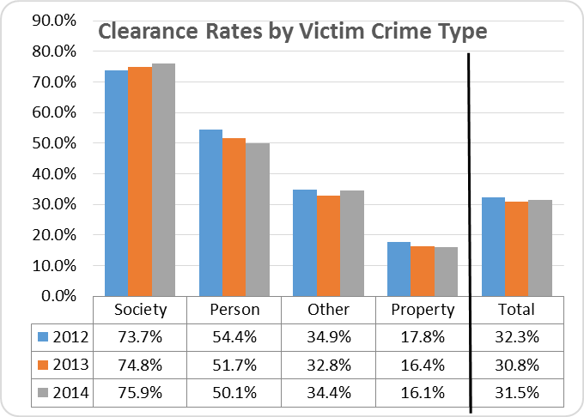
Variable Importance & Crime Type
Clearance Rates after exclusions (non-Crime, etc) applied
Notes:
Before running our models, we evaluated on a “filter” basis the variable of importance of each predictor using a statistical approach (Chi-Square). We chose Chi-Square given than nearly all of the variables were categorical and given that all variables were originally screened to ensure that they aligned to one of our hypotheses. However, as we explain later, most of our methods (like GBM and GLM with regularization) have their own wrapper based feature selection algorithms that will further refine the list of variables.
Notice the crime types are consistent year after year.

Slide 8
Models
Metrics used for Model Evaluation: 1) Accuracy
2) Area-under-the-Curve (AUC)
“Simple” CART
CART
Naïve Bayes*
Generalized Linear Models (with Regularization) (GLM)*
Deep Learning*
Gradient Boosting Model (GBM)*
Random Forests*
*Used H2O (via R Studio interface) to model
H20’s website: http://h2o.ai/
Notes:
For classification, we surveyed a range of models going from simple and intuitive (CART) to more complex, black box models like Gradient Boosting Models and Deep Learning. For more advanced models, we used the H2O R Wrapper to run H2O. H2O is an open-source machine and deep learning suite of applications used to increase the scalability for a broad range of algorithms. It uses in-memory compression to run millions of rows of data with a small cluster.
We started with a small decision tree where we selected for features with the largest predictive power. We called this our simple CART as it small and was easily interpretable. We then gave all of our features to a second decision tree to see if more variables would provide better predictive power.
Using the H2O engine we then used a Naïve Bayes on a limited number of variables with a Laplace smoother (lambda = 3). Fourth, we ran Regularized (Lasso) Generalized Linear Regression. We ran regularization on the model in order to reduce unnecessary and redundant features that are included in the dataset. We selected regularized instead of stepwise given that only regularization was available in the H2O package. We selected Lasso (Alpha = 1) instead of Ridge (Alpha = 0) because we found the Lasso performed better on the validation dataset.
In addition to the traditional methods (GLM, CART, Naïve Bayes), we ran three more advanced, black box methods: GBM, Deep Learning and Random Forests. For all three of these models, there were several tuning parameters (e.g. the number of trees and the maximum tree depth for GBM or the number of hidden neurons for Deep Learning).

Slide 9
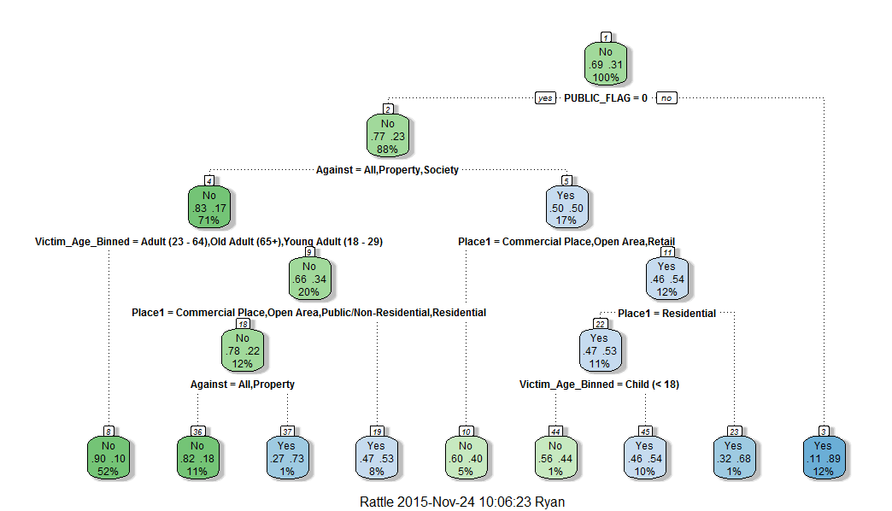





Simple CART
Notes:
And here is what our simple decision tree looks like. This “simple” CART that restricted our decision tree to only the top variables (from filter selection) in order to gain intuition on our dataset. In particular, we restricted the “type of crime” variable to the variable “Against” rather than the more detailed “NIBRS_Hi_Class” or “Category” because this variable had far fewer classes (only four versus 30+) which made the interpretation much easier.

Slide 10
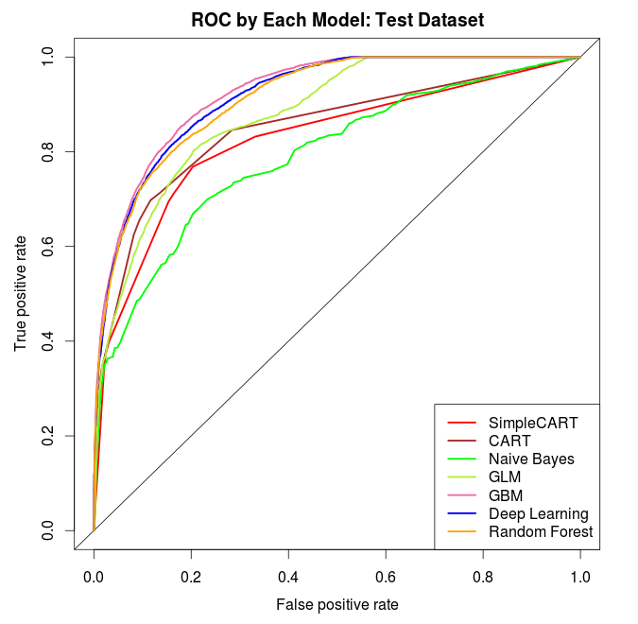
Model Evaluation
Appendix includes Model Tuning Parameters

Slide 11
Areas for future research
Rebuild the model with a crime type segmentation
Build three models: Person, society and property
Expand to multinomial classification
Add in “unfounded” and other clearance status that were excluded as classes
Append police strategy and response to reported crimes
Integrate domain expertise
Officer data like assignments, demographics, experience, level
Better account for spatial attributes (lat/long)
Use spatial models (spatially weighted regression models)
Get redacted data to find hidden relationships (same victim)
Use Network Science to evaluate connections between crimes.

Slide 12
Thank You
R Code is available on GitHub: https://github.com/wesslen/MachineLearningProject

Slide 13
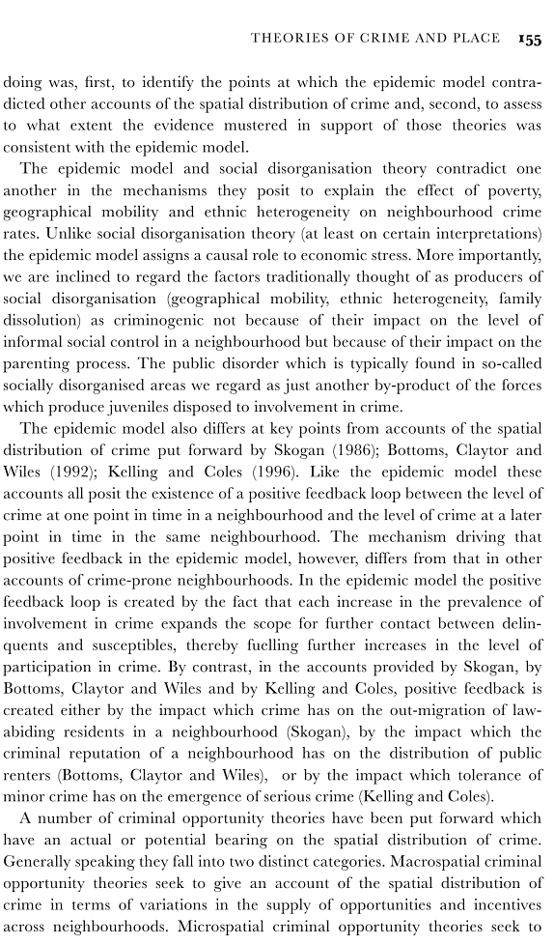
Crime Feedback Theories
1. Crime Occurs
2. Crime Reported
3. Police Collect Info
4. Police Prioritize Crime
5. Solve or not solve.
“…Each increase in the prevalence of involvement in crime expands the scope for further contact between delinquents and susceptibles, thereby fueling further increases in the level of participation in crime”
Weatherburn, Donald James., and Bronwyn Lind. Delinquent-prone Communities. Cambridge, UK: Cambridge UP, 2001. Print.
Notes:
A number of theories and crime models have been proposed over the years to explain the existence of a positive feedback loop between the level of crime at one point in time in a neighborhood, and the level of crime at a later point of time in the same neighborhood… Dr. Weatherburn, a crime professor at Cambridge writes, In the book “Delinquent-prone Communities” the following, “In the epidemic model of crime the positive feedback loop is created by the fact that each increase in the prevalence of involvement in crime expands the scope for further contact between delinquents and susceptibles, thereby fueling further increases in the level of participation in crime.”

Slide 14
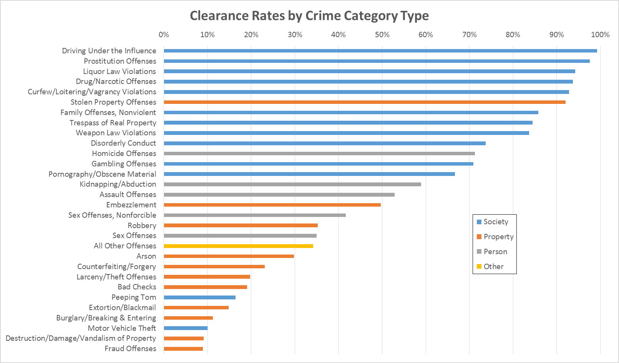
“Redhanded” Crimes

Slide 15
Clearance Status
Blue = Excluded from model
Yellow = Event in the Dependent Variable Flag (i.e. equal to 1)
Green = Non-event in the Dependent Variable Flag (i.e. equal to 0)

Slide 16
Model Tuning Parameters
Model | Tuning Parameters
CART (Simple and Normal) | Complexity =0.001, Minimum Split = 1000, Minimum Bucket Size =1000, Maximum Depth = 5
Naïve Bayes | Laplace Smoother = 3
GLM with Regularization | Alpha = 1 (Lasso)
GBM | Number of Trees = 200, Maximum Depth = 5, Interaction Depth = 2, Learning Rate = 0.2
Deep Learning | 3 Hidden Layers, each with 200 nodes
Random Forests | Number of Trees = 50, Maximum Depth = 10, Minimum Rows = 5, Number of Bins = 20

