Slide 1
PORTFOLIO MANAGEMENT & QUANTITATIVE TRADING
Deep Sequence Models in Commodity Markets
Testing and Optimizing the LSTM Momentum Hypothesis within the skfin Backtesting Engine
Gabriel Himmelein
Tomàs Planelles Alonso
Data Pipeline, PyTorch LSTM & Ensembling
Risk, Transaction Costs & Statistical Validation

Slide 2
01 / RESEARCH HYPOTHESIS
Can Regularized LSTMs Beat Linear Momentum?
Time-Series Momentum: Multi-horizon trend continuation across 1-week to 12-month lookbacks.
CORE OBJECTIVE
Net Sharpe Optimization After Market Impact
Deep Sequence Learning: Nonlinear regime extraction under strict capacity constraints.
Evaluating compact recurrent networks against Simple Momentum, RidgeCV, and LightGBM across five liquid commodity ETFs.
Quadratic Cost Policy: Trading partially toward Markowitz aim portfolios.
Asset Pricing Hygiene: Leak-free walk-forward splits with multi-seed ensembling.

Slide 3
02 / EMPIRICAL UNIVERSE (2007–2026)
Cross-Sector Volatility Dispersion & Fat Tails
Ticker | Commodity Sector | Ann. Mean | Ann. Vol | Passive SR | Kurtosis | Max Crash
DBC | Broad Diversified | 5.92% | 19.36% | 0.31 | 3.46 | -7.94%
USO | Crude Oil / Energy | 2.53% | 37.49% | 0.07 | 9.47 | -25.32%
GLD | Gold Bullion | 10.87% | 18.14% | 0.60 | 7.17 | -10.27%
SLV | Silver Bullion | 12.73% | 33.00% | 0.39 | 13.41 | -28.54%
DBA | Agriculture Basket | 3.94% | 16.68% | 0.24 | 6.41 | -8.61%
Portfolio Implication: 2x volatility spread and low cross-sector correlation (GLD–USO = 0.20) necessitate covariance scaling.

Slide 4
03 / METHODOLOGY & FEATURE ENGINEERING
Point-in-Time Walk-Forward Architecture
STEP 01
STEP 02
STEP 03
STEP 04
Data Alignment
25-Feature Tensor
Rolling Retraining
Risk Scaling
5,158 business days synchronized from DBA inception.
5d, 21d, 63d, 126d, 252d rolling momentum scales.
756-day training window updated every 21 days.
Markowitz weights scaled to 10% annual volatility.
Zero Look-Ahead Invariant: Next-day target y(t) = r(t+1) evaluated via h(t) · r(t+1)
TARGET_VOL = 0.10 / √260

Slide 5

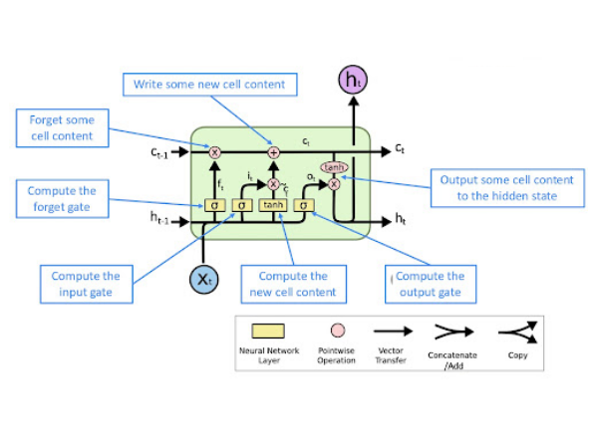
04 / SEQUENCE DATA INTEGRATION
Mapping Commodity Data to the LSTM Cell
Input Vector (xt): 25 standardized multi-horizon ETF momentum features daily.
Forget & Input Gates (ft, it): Prunes past noise and writes new trend signals.
Cell Memory (ct-1 → ct): Propagates 20-day regime context across time steps.
Hidden State (ht): 8-unit bottleneck summary emitted via output gate.
Return Readout (hT → ŷt): Linear head maps terminal hT to 5 returns.

Slide 6
05 / DEEP SEQUENCE SAFEGUARDS
Anti-Overfitting Safeguards for Noisy Returns
Compact Bottleneck (hs = 8)
Tail-Robust Huber Loss (δ = 0.01)
Eight hidden units prevent in-sample return memorization.
Linear tail penalty dampens extreme oil crash outliers.
Dropout & L2 Decay (1e-3)
Walk-Forward Buffer (_history_X)
Strong weight shrinkage prunes spurious recurrent parameters.
Cached trailing training rows preserve boundary sequence continuity.

Slide 7
06 / STRUCTURAL BREAKS & MEMORY LAG
Why Pre-2020 Hyperparameters Fail in Crisis Regimes
CRISIS-ROBUST SPECIFICATION
2012–2019 CALIBRATION WINNER (TRIAL 9)
Compact Regularized LSTM (lookback = 20)
Long-Memory LSTM (lookback = 32)
Parameters: 9 units, 32d window, weak decay (3.4e-4).
Parameters: 8 units, 20d window, strong decay (1e-3).
2012–2019 Sharpe: 0.65 in tranquil bear market.
Turning-Point Agility: Flushes pre-shock states within 1 month.
2020–2026 OOS Sharpe: Collapses to -0.07 via memory lag.
2020–2026 OOS Sharpe: Surges to 1.27 (0.81 Ensemble).

Slide 8
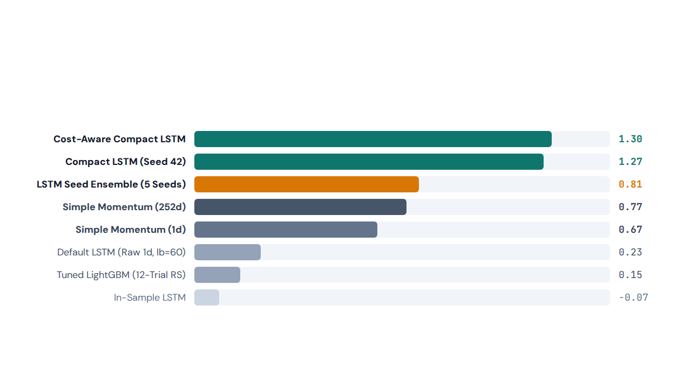
07 / OUT-OF-SAMPLE BENCHMARKING (2020–2026)
Walk-Forward Gross Sharpe Ratios (10% Target Volatility)

Slide 9
08 / ABLATION & INITIALIZATION ROBUSTNESS
Decomposing Feature Synergy & Seed Ensembling
1.27 vs 0.20
0.81 SR
-49% Turn
2×2 Ablation Synergy
Five-Seed Ensemble
Turnover Smoothing
Multi-horizon inputs require compact 20-day memory.
Equal-weighted holdings eliminate initialization variance.
Ensembling cuts annual trading volume in half.

Slide 10
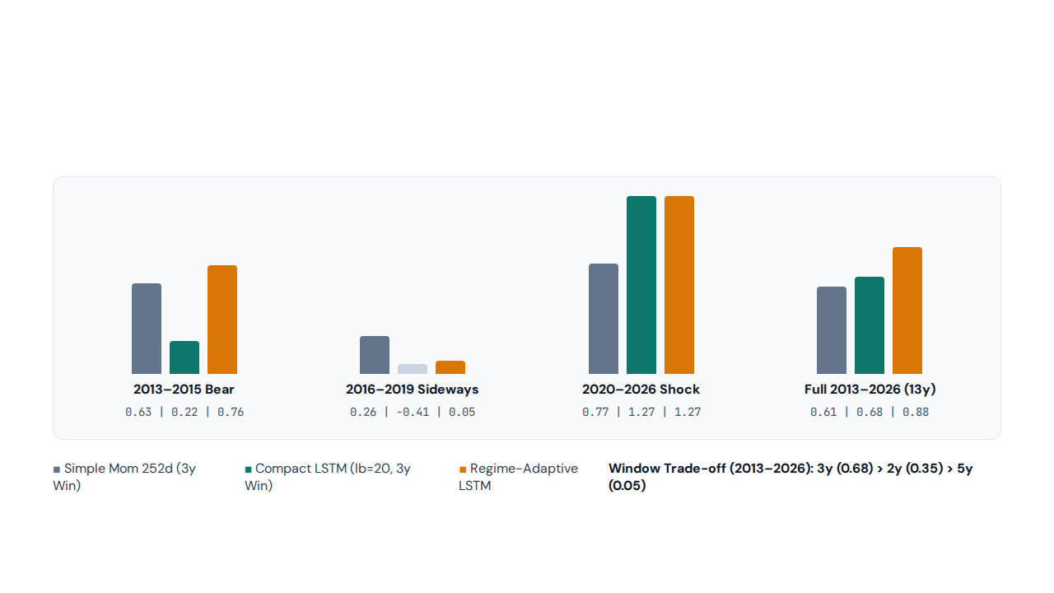
09 / HISTORICAL SUBPERIODS & WINDOW SENSITIVITY (2013–2026)
3-Year Rolling Window Balances Variance & Stationarity

Slide 11
10 / QUADRATIC MARKET IMPACT & NET PNL (2020–2026)
Net Performance After Volatility-Adjusted Transaction Costs
Strategy | Gross Ret | Net Ret | Cost Drag | Gross SR | Net SR | Max DD | Avg Hold
Cost-Aware Compact LSTM | 15.94% | 15.58% | -0.36% | 1.30 | 1.26 | -16.68% | 8.8d
Compact LSTM (Seed 42) | 17.56% | 16.71% | -0.84% | 1.27 | 1.21 | -22.18% | 9.4d
LSTM Seed Ensemble (5 Seeds) | 4.78% | 4.60% | -0.18% | 0.81 | 0.78 | -5.89% | 6.0d
Simple Momentum (252d) | 10.70% | 10.52% | -0.18% | 0.77 | 0.76 | -17.58% | 33.0d
Simple Momentum (1d) | 10.18% | 4.04% | -6.14% | 0.65 | 0.26 | -48.22% | 1.5d
Tuned LightGBM (RS) | 2.23% | -0.94% | -3.16% | 0.15 | -0.06 | -41.43% | 3.3d

Slide 12
11 / STATISTICAL & ECONOMIC SIGNIFICANCE
Empirical Summary of the LSTM Momentum Edge
1.26
-0.36%
0.88
-5.89%
Cost-Aware Net Sharpe
Annual Cost Drag
13-Year Adaptive SR
Ensemble Max Drawdown
Outperforms 252d Momentum (0.76)
57% lower market impact via past_h
Full 2013–2026 multi-regime span
Versus -17.58% for 252d Momentum
HAC Inference (Lo, 2002): Autocorrelation-adjusted standard errors confirm positive out-of-sample alpha.
Universe Stability: Positive net alpha persists under leave-one-ETF-out tests.

Slide 13
CONCLUSION & RESEARCH VERDICT
Compact Multi-Horizon LSTMs Outperform After Transaction Costs
Pairing 25 multi-scale momentum features with a 20-day Huber-regularized LSTM and cost-aware Markowitz optimization delivers superior risk-adjusted commodity returns.
Thank You — Questions & Discussion

