Slide 1

Grab Holdings Stock Presentation
Ticker: GRAB

Slide 2
What do they do?
Super app operating it Southeast Asia offering various services
Ride-hailing services
Food delivery
Parcel and grocery delivery
Financial services
E-commerce

Slide 3
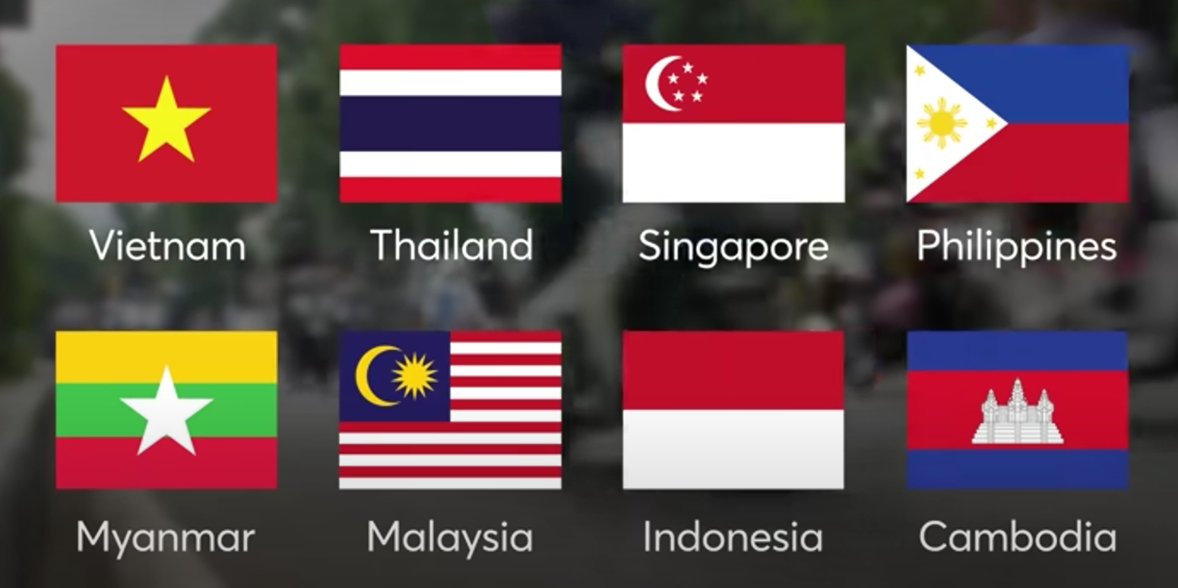
Operating in 8 countries in Southeast Asia

Slide 4
Region analysis Anthony Tan, CEO and Co founder: “We remain bullish on the growth outlook of Southeast Asia, and are firing on all cylinders to to capter the strong consumer demand trends.”
Large emerging market with young and growing population→ 680 million people, median age 30 years
One of the fastest growing digital economies in the world expected to surpass $330 billion by 2025 and could reach $1 trillion by 2030 according to a study (WEF)
E-commerce, ride-hailing, fintech, and online payments booming due to increasing internet penetration and smartphone adoption
Attracts foreign investment due to strategic location and competitive labor costs
Rising middle class due to rapid economic growth and urbanization
Strong tourism demand currently, and expected to grow in the next decade

Slide 5
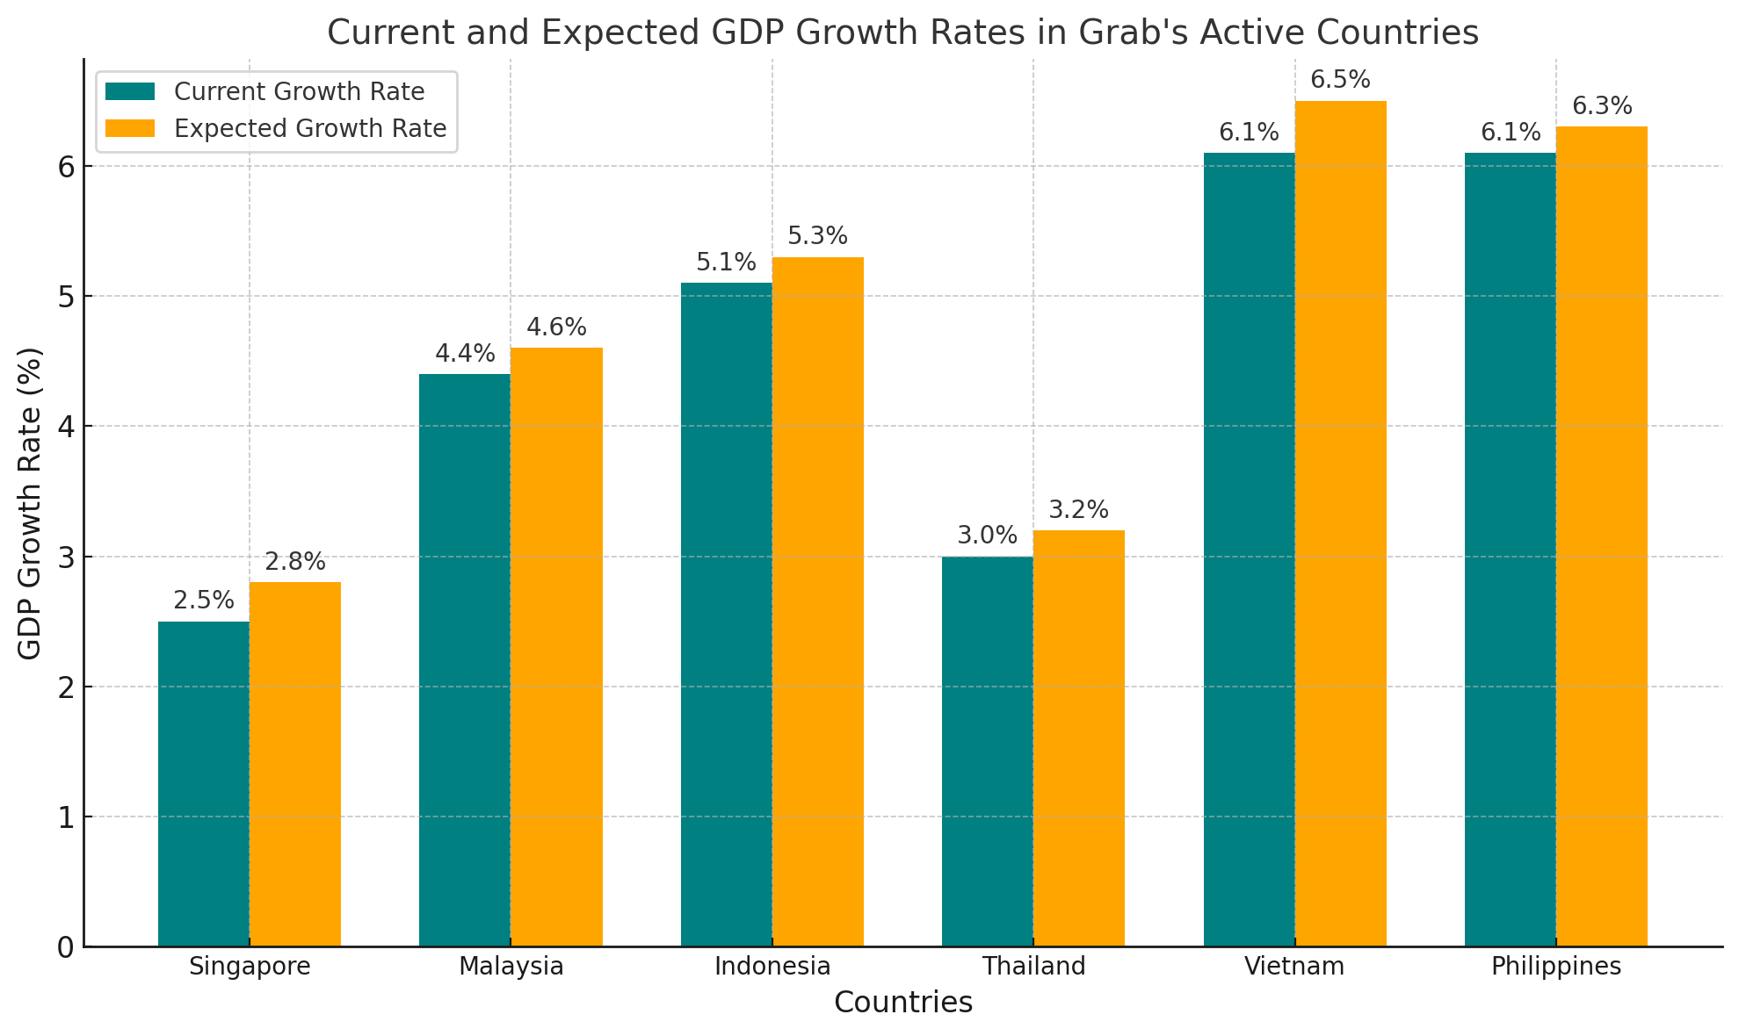
GDP Southeast Asia

Slide 6
Key numbers
42 million monthly transacting users on the Grab platform
Source of income for 13 million drivers and merchants

Slide 7
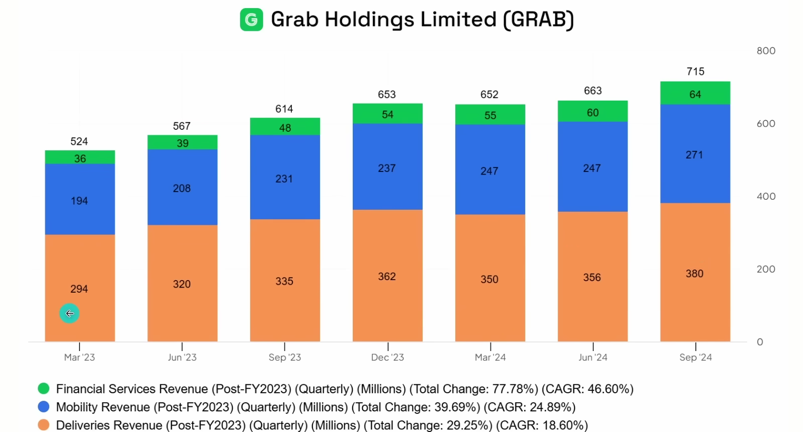

Slide 8
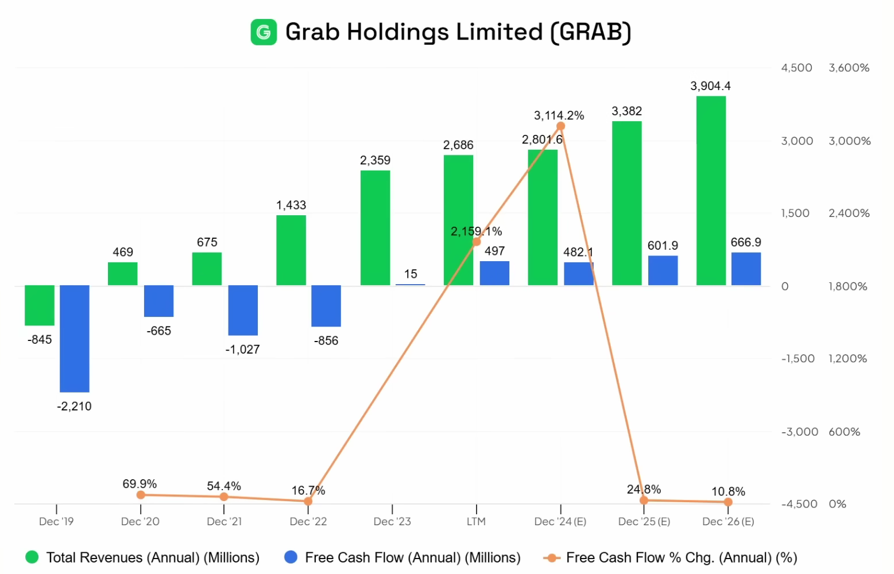
Free Cash Flow

Slide 9
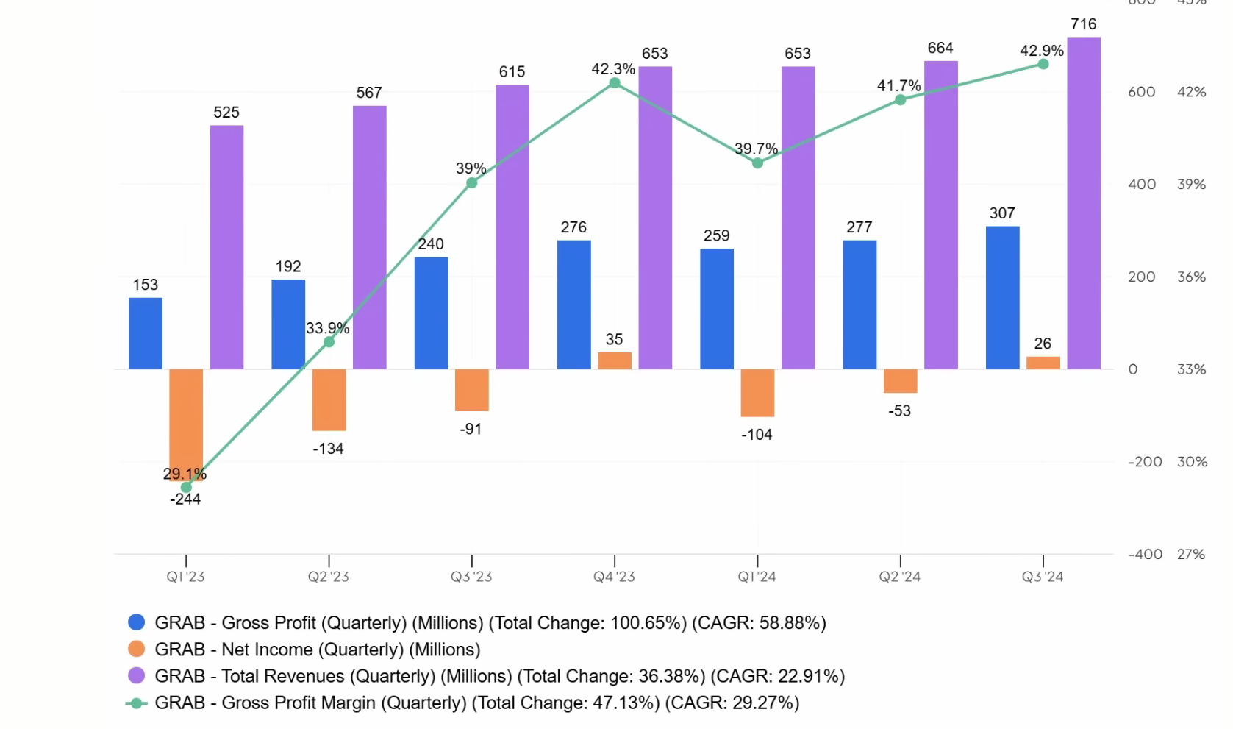
Profitability

Slide 10
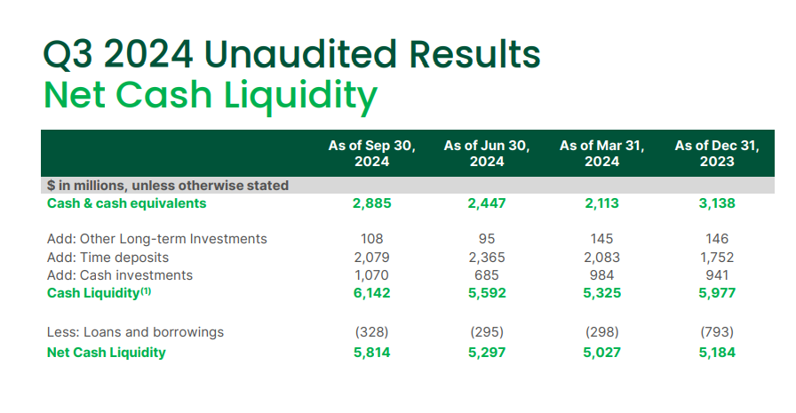
Strong Cash Reserves

Slide 11
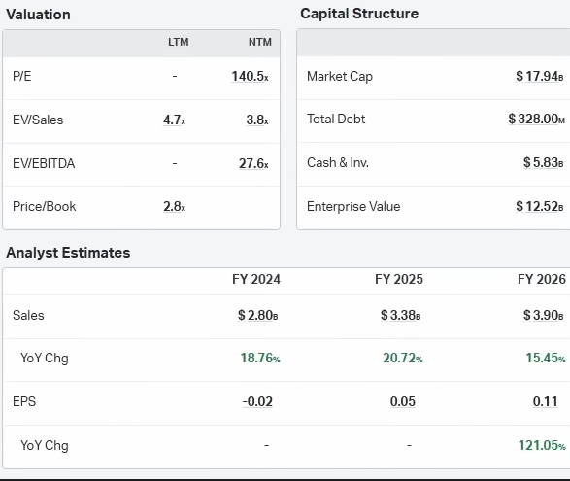
Valuation

Slide 12

CEO and Co-Founder Anthony Tan

Slide 13
Competition
Took over Uber’s regional operations in 2018, granting the company a 27,5% stake and a board seat for its CEO
Market leadership: “We are approximately 4x larger than our next biggest competitor in the region, leveraging our scale to improve cost efficiency.”

Slide 14
Conclusion
Profitable company set to capitalize on Southeast Asia economy expanding
Strong cash reserves
Modest valuation
Founder-led, driven CEO with good track record of executing
No immediate competition

Slide 15
Thank you for your attention

