Slide 1
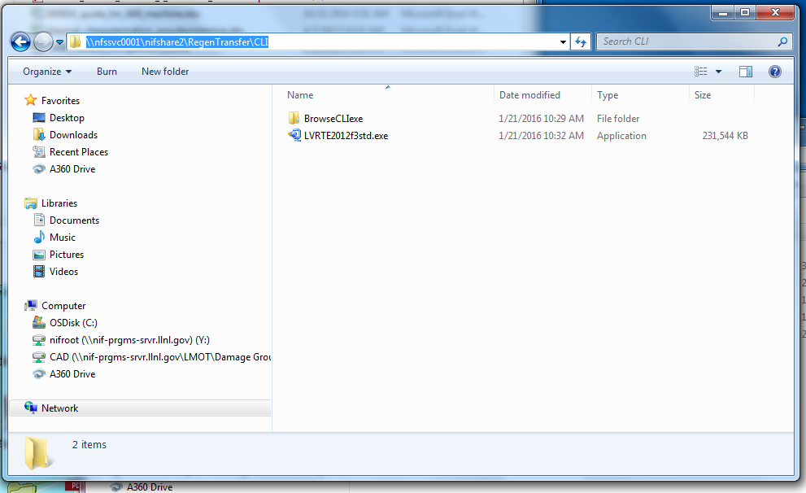

Install LV2012 runtime
Open BrowseCLI.exe

Slide 2
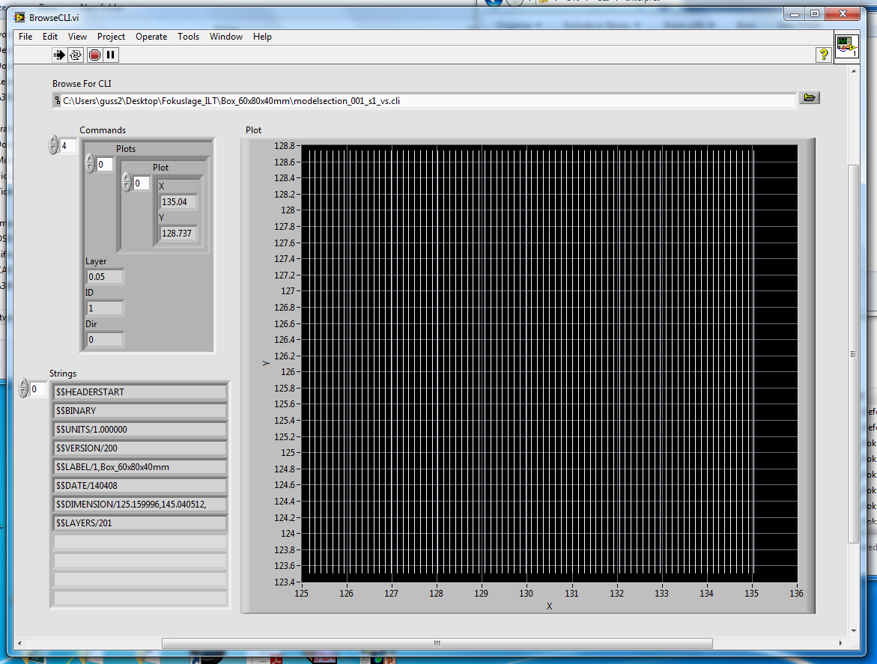
Change command
Choose CLI file

