Slide 1


Vireo
Project 2

Slide 2


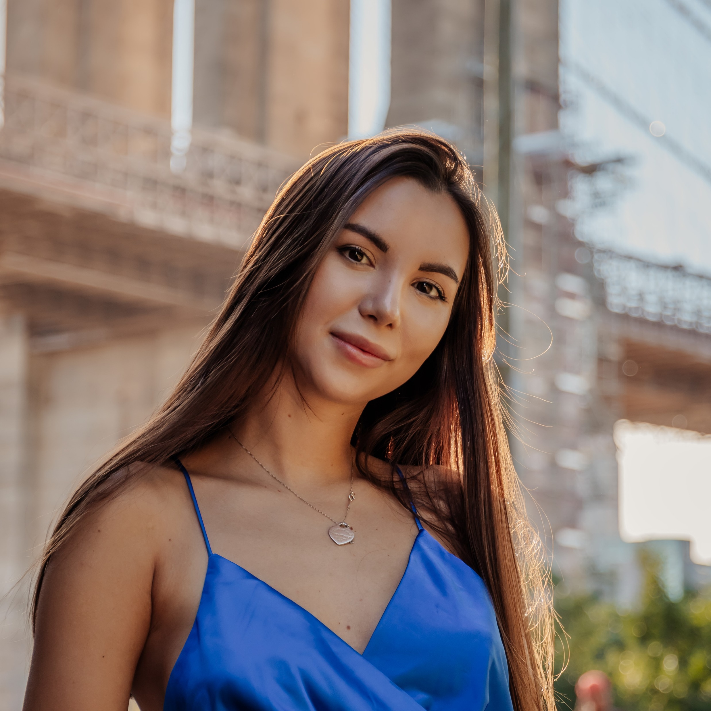
meet the VIREO team
Jonathan
Gabriel
Kristina

Slide 3
concept
We created the VIREO app to provide an information for users upon request to manage and prepare for their next trip. After choosing a country users will be provided with descriptions like
Key Phrases in native language
Currency
5-top Restaurants, Museums, Sightseeing Spots
Fun fact
Travel Restrictions during COVID-19 Users can also create a post about their recent trip and read other users posts.

Slide 4

technologies

Slide 5
For this project we used:
Sequalize
MySQL
express
express-handlebars
Bootstrap
FontAwesome
TravelAdvice API
Currency API

Slide 6
Demo
Click here: https://peaceful-peak-47552.herokuapp.com/

Slide 7
Challenges
Seeding the database through node
Adding an animation spinner
Incorporating an image into the user blog post
API limitations

Slide 8
Future developments
Implement user interactivity by adding new countries
User Authentication
Add a player for a language tutorial

