Slide 1
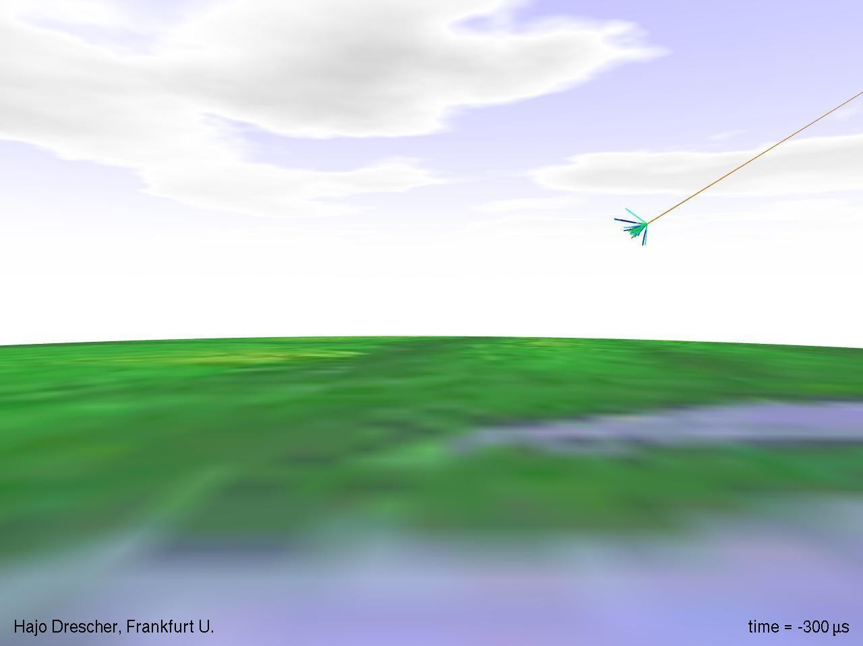
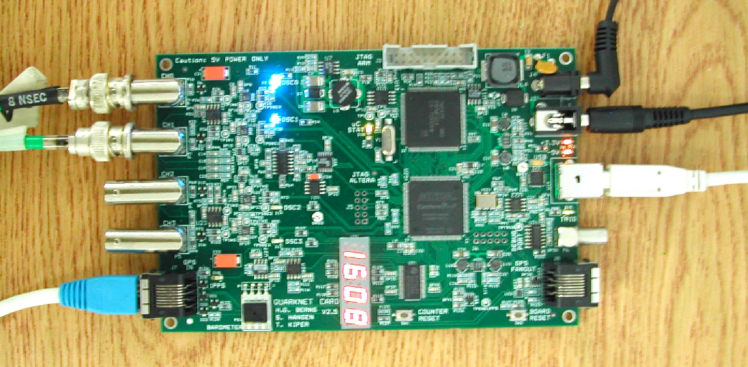
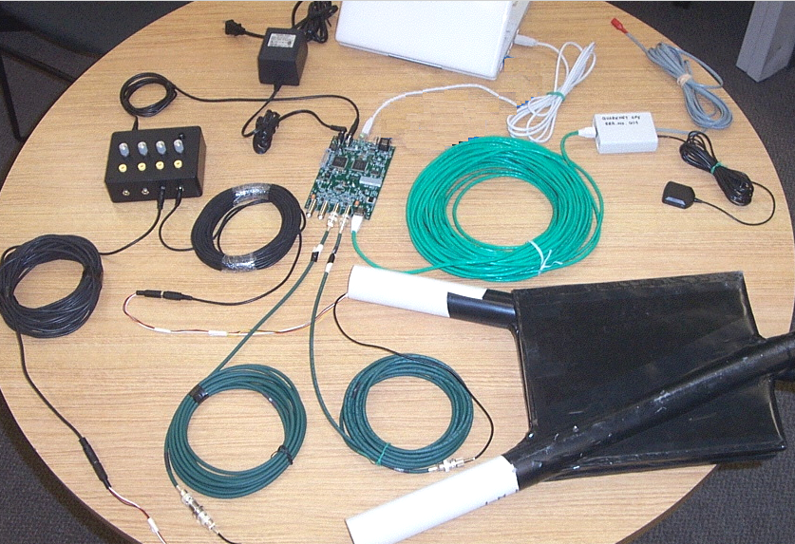
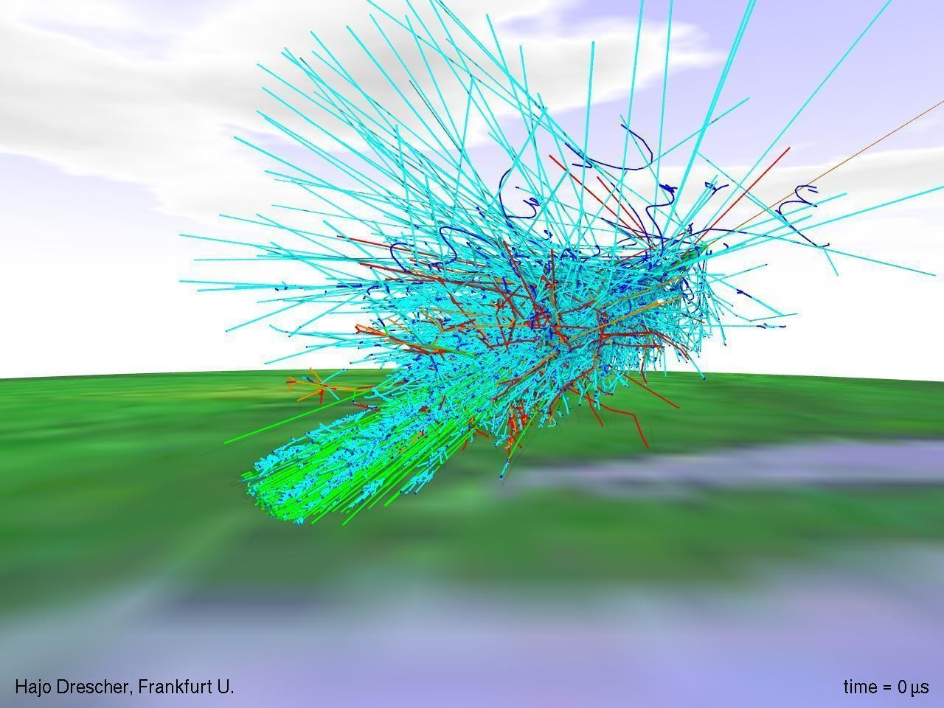
QuarkNet 2022 - Vanderbilt University
20-24 June 2022
Welcome!

Slide 2
QuarkNet 2022 - Vanderbilt University
20-24 June 2022
In-person meeting, Vanderbilt Physics Stevenson Center SC6322. Will try to run a Zoom for the meeting also, but likely up and down, here. VU Covid policy is to mask indoors if within 6 feet---please separate for snacking.
Monday, introductions, news, and talks
Tuesday, cosmic ray muon detectors, speed-of-”light”, showers, muon decay (anyone?)
Wednesday , Higgs@10 (with Jeremy Wegner, Ken Cecire)
Thursday, CRMD hardware in detail, scintillators, PMTs, DAQ card, GPS
Friday, implementation plans, survey, finish other data analysis

Slide 3
Administration
Check-ins around the room.
Sign the attendance sheet.
Our Admins will/have sent links to set new folks up as “vendors” for Vanderbilt, all legit and for paying the stipends.
We have four (five?) working sets of cosmic ray muon detectors (CRMDs) and have laptops for datataking and control.
We use the “standard” Java program Equip to control the boards/detectors. Though simpler programs are possible.
Registration and Survey for QuarkNet Central, links on the must-do-items page. Time for Survey Friday.
This years and prevous talks and data sets at GitHub Vanderbilt-QuarkNet Workshops

Slide 4
Lunch Venues Near Campus
21st Ave Side (the East side):
West End Side (the West side):
Chipotle Mexican Grill
Subway Sandwich
Panera Bread
San Antonio Taco Co.
Taco Mama-Hillsboro Village
Double Dogs
Shokku Ramen
Hopdoddy
Jason’s Deli
Jersey Mike’s Subs
Oscar’s Taco
Martin’s Bar-B-Que
Wendy’s
Newk’s Eatery
Bombay Palace
Taziki’s Mediterranean Cafe
And Many More...

Slide 5
Monday Schedule
News and Talks
8:30-9:00am Bill Gabella, administration and news
9:00-10:00am Will Johns, Update from CERN (Zoom)
10:00-10:10am Break
10:10-11:10am Vicki Greene, Flow and jet quenching in high-energy heavy ion collisions (Zoom)
11:10-12:10am Bill Gabella, LIGO and Gravitational Waves
12:10-1:30pm Lunch
1:30-2:30pm Kelly Holley-Bockelmann, Black Holes, Gravitational Waves
2:40-3:40pm Sara Frederick, Quasar Spectroscopy with SDSS
Think about the use of the weeks material for use in the classroom, see the Guide to Teacher Implementation Plan Development . We will discuss and brainstorm these Friday.

Slide 6
Tuesday Schedule
Cosmic Ray Muon Detectors (CRMDs), their use
9:00-10:00am Bill Gabella, Cosmic Rays, Muons, and QuarkNet CRMDs
10:00-10:10am Break
10:10am-12:00pm Discuss experiments from the manual, set them up: some subset of flux on telescope (vertical, east-west, north-south), shower setup, muon decay setup.
12:00-1:15pm Lunch
1:15-2:20pm Data analysis
2:20pm-2:30pm Break
2:30-3:30pm More data analysis, eLab and non-eLab

Slide 7
Wednesday Schedule
Higgs@10 --- 10 years since the announcement of the Higgs particle discovery, 4 July 2012
Led by Jeremy Wegner.
Link: (original, might change) https://quarknet.org/content/higgs10-workshop
9:00-Start Time
12:00-1:15pm Lunch
1:30pm-3:30pm Tentative Finish time
Other links of interest, Higgs@10...
Rice Workshop, 6-10 June 2022 and https://quarknet.org/content/2022-cosmic-neutrino-data-higgs10-workshop-ksu .
Last years Google Colab, Vanderbilt Coding agenda here .

Slide 8
Thursday Schedule
Hardware Day, Bill, Nick, Jeremy
9:00am-10:00am Bill Gabella, some details on the hardware, follow the signal...
12:00-1:15pm Lunch
1:30-3:30pm Analyze the PMT signals, compare with muon spectra, Green’s photon counting, experiment with ideas
Exerpts from Dan Green’s The Physics of Particle Detectors, Cambridge University
Press, 2000:
Chapter 2 – The photoelectric effect, photomultipliers, scintillators is here.
Appendix J – Statistics introduction, Appendix K – Monte Carlo models are here.

Slide 9
Friday Schedule
Last Day, implementation plans, survey, miscellaneous
9:00-12:00pm Implementation plans, discuss and brainstorm as a group; do the survey (surveymonkey.com)
12:00-1:30pm Lunch
1:30-3:30pm all other business

Slide 10
News
We miss you, Med!
Med Webster, long-time professor at Vanderbilt University in Physics and Astronomy passed away this year. We was the second mentor at Vanderbilt, after Bob Panvini.
He will be missed.

Slide 11
Useful Links for This Workshop
CRMD User Manual
https://github.com/gabella/VandyQuarkNet/tree/master/manuals
Vanderbilt QuarkNet “Drupal” group page: http://quarknet.i2u2.org/group/vanderbilt-university-quarknet-center

Slide 12
Useful Links
Vanderbilt QuarkNet Site, GitHub: https://github.com/gabella/VandyQuarkNet
Vanderbilt QuarkNet Site, older web pages: http://www.hep.vanderbilt.edu/~gabellwe/qnweb/
Vanderbilt QuarkNet “Drupal” group page: http://quarknet.i2u2.org/group/vanderbilt-university-quarknet-center
Vanderbilt QuarkNet Workshop 2021 page:
https://github.com/gabella/VandyQuarkNet/tree/master/quarknet2021
QuarkNet Cosmic Ray eLab Teacher page: http://www.i2u2.org/elab/cosmic/teacher/
QuarkNet CMS eLab page: http://www.i2u2.org/elab/cms/home/project.jsp

