Slide 1
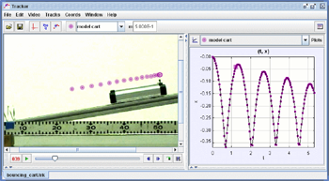
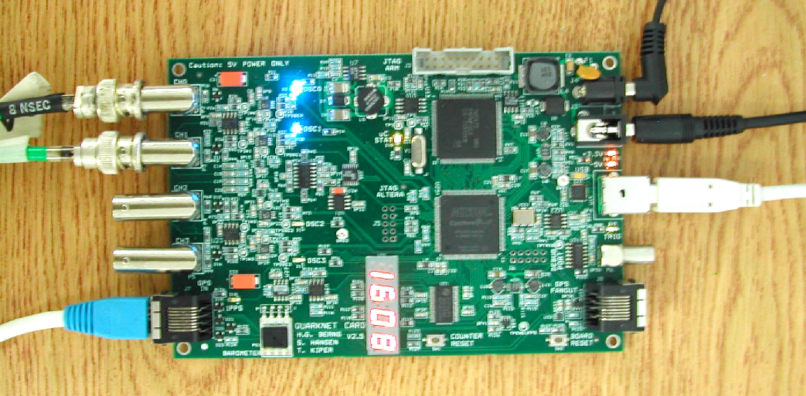
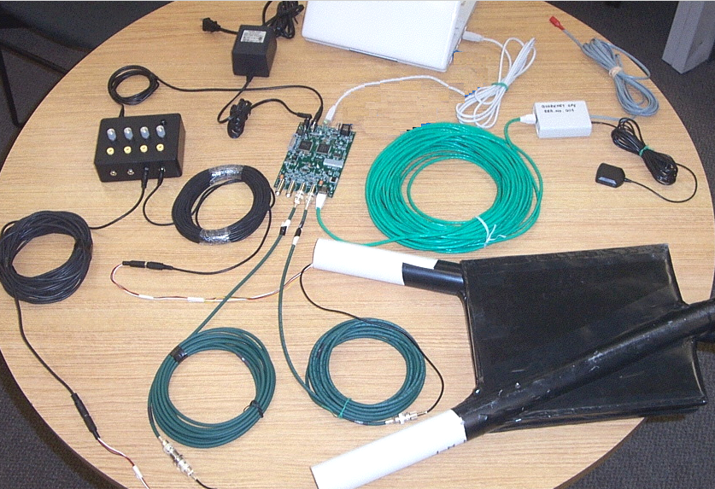
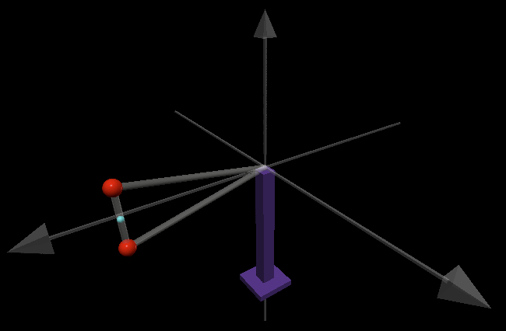
QuarkNet 2023 - Vanderbilt University
19-23 June 2023
Welcome!

Slide 2
QuarkNet 2023 - Vanderbilt University
19-23 June 2023
In-person meeting, Vanderbilt Physics Stevenson Center SC6322. Will try to run a Zoom for the meeting also, but likely up and down, here.
Monday, introductions, news, and talks, Juneteenth!
Tuesday, making “YouTube-style videos”
Wednesday, mo’ making “YouTube-style videos”
Thursday, making “YouTube-style videos,” share results
Friday, CRMDs, must do items and survey

Slide 3
Administration
Check-ins around the room.
Sign the attendance sheet.
Our Admins will send links to set new folks up as “vendors” for Vanderbilt, all legit and for paying the stipends.
We have three working sets of cosmic ray muon detectors (CRMDs) and have laptops for datataking and control.
We use the “standard” Java program Equip to control the boards/detectors. Though simpler programs are possible.
Registration and Survey for QuarkNet Central, links on the must-do-items page. Time for Survey Friday.
This years and prevous talks and data sets at GitHub Vanderbilt-QuarkNet Workshops

Slide 4
Lunch Venues Near Campus
21st Ave Side (the East side):
West End Side (the West side):
Chipotle Mexican Grill
Subway Sandwich
Panera Bread
San Antonio Taco Co.
Taco Mama-Hillsboro Village
Double Dogs
Shokku Ramen
Hopdoddy
Jason’s Deli
Jersey Mike’s Subs
Oscar’s Taco
Martin’s Bar-B-Que
Wendy’s
Newk’s Eatery
Bombay Palace
Taziki’s Mediterranean Cafe
And Many More...

Slide 5
Monday Schedule
News and Talks
8:30-9:00am Bill Gabella, administration and news
9:00-10:00am Dale Julson, High Energy Physics and CMS
10:00-10:10am Break
10:10-11:10am Bill Gabella, LIGO and Gravitational Waves
11:10-12:10am Krystal Ruiz-Rocha, LISA and Gravitational Waves
12:10-1:30pm Lunch
1:30-2:30pm Charreau Bell, ChatGPT
2:40-3:40pm Sara Frederick, Quasars
Think about the use of the weeks material for use in the classroom, see the Guide to Teacher Implementation Plan Development . We will discuss and brainstorm these Friday.

Slide 6
Tuesday Schedule
YouTube Style videos
Morning Show examples, filming, analysis, and animation
Bill’s Google Doc notes, Video Analysis (Tracker), Animation, and Editing
12:00-1:15pm Lunch
Afternoon Plan and shoot some video.

Slide 7
Wednesday Schedule
YouTube Style videos
Morning Discuss projects, and show draft results
12:00-1:15pm Lunch
Afternoon Project work

Slide 8
Thursday Schedule
YouTube Style videos
Morning Project work
12:00-1:15pm Lunch
Afternoon Project work

Slide 9
Friday Schedule
Last Day, implementation plans, survey, miscellaneous
Morning Discuss the CRMDs, start a run, show/discuss video projects, use in the classroom
12:00-1:30pm Lunch
Afternoon Must do items, survey, CRMDs, and all other business

Slide 10
Useful Links
CRMD User Manual
https://github.com/gabella/VandyQuarkNet/tree/master/manuals
Vanderbilt QuarkNet “Drupal” group page: http://quarknet.i2u2.org/group/vanderbilt-university-quarknet-center
Vanderbilt QuarkNet Site, GitHub: https://github.com/gabella/VandyQuarkNet
Vanderbilt QuarkNet Site, older web pages: http://www.hep.vanderbilt.edu/~gabellwe/qnweb/
Vanderbilt QuarkNet Workshop 2022 page:
https://github.com/gabella/VandyQuarkNet/tree/master/quarknet2022
QuarkNet Cosmic Ray eLab Teacher page: http://www.i2u2.org/elab/cosmic/teacher/
QuarkNet CMS eLab page: http://www.i2u2.org/elab/cms/home/project.jsp

