Slide 1
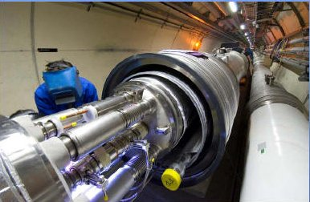
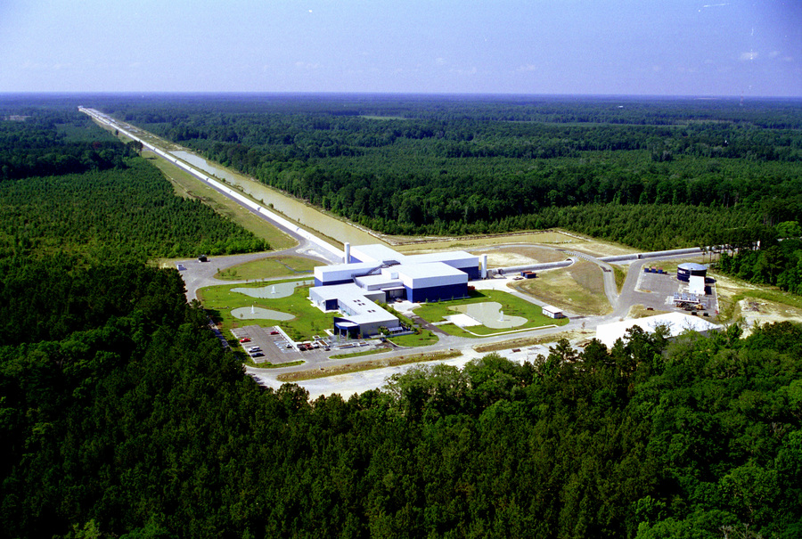
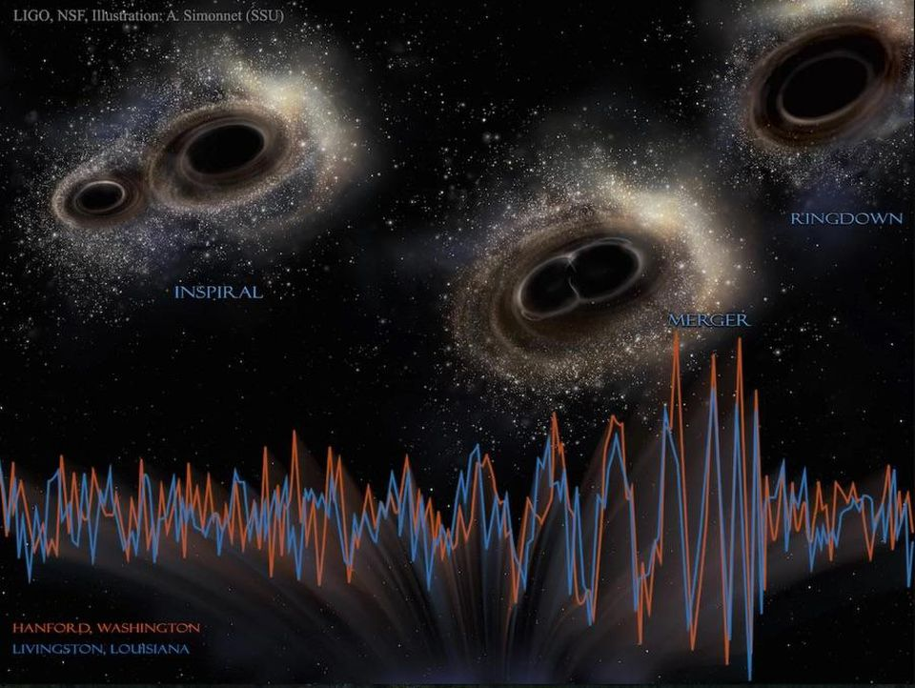
CERN/LHC/CMS, LIGO, Astro---Misc
Bill Gabella
Monday 22 June 2020
Vanderbilt-QuarkNet Workshop
Ref: https://gracedb.ligo.org/

Slide 2
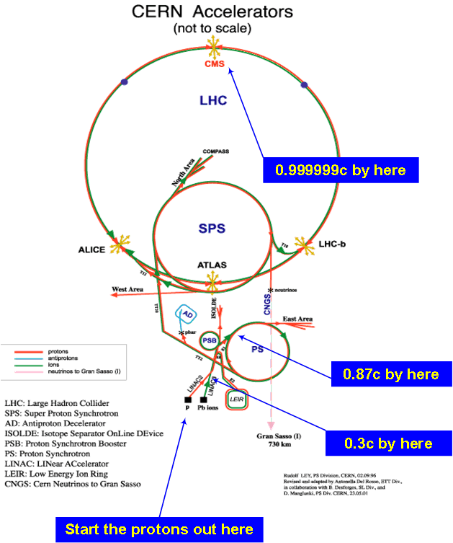
Large Hadron Collider (LHC)‏
Energies:
Linac 50 MeV
PSB 1.4 GeV
PS 28 GeV
SPS 450 GeV
LHC 6.5 TeV
Link: https://home.cern/topics/large-hadron-collider
Ref: Introduction to Accelerators, Elena Wildner, CERN

Slide 3
LHCParameters
Circumference | 26659 m
Dipole operating temp | 1.9 deg K
Main RF frequency | 400.8 MHz
“Bucket,” 1/frequency | 2.5 ns
Energy per beam | 6.5 TeV, operating
Dipole Magnetic Field | 7.7 T
Ions Energy per nucleon | 2.56 TeV/n = 6.5*82/208 (Pb-208)
no. of protons | 1.2e11 per bunch
no. of bunches | <= 2604/2748
bunch length, 4sigma | 1-1.25 ns
bunch size, x & y at IP, 1 sigma | 52 x 66 microns
Ref: www.cern.ch

Slide 4
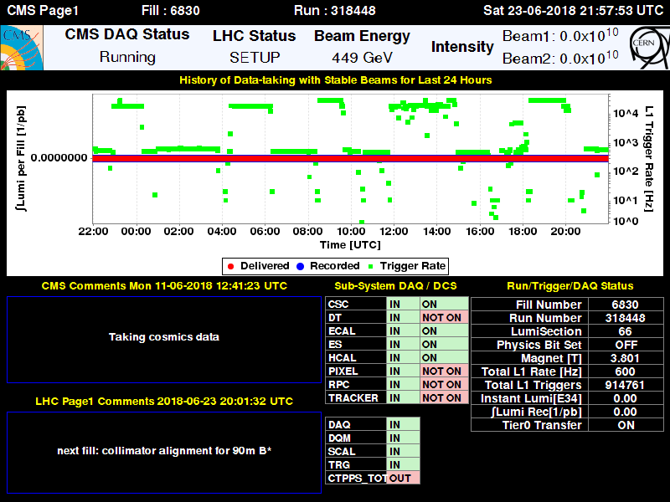
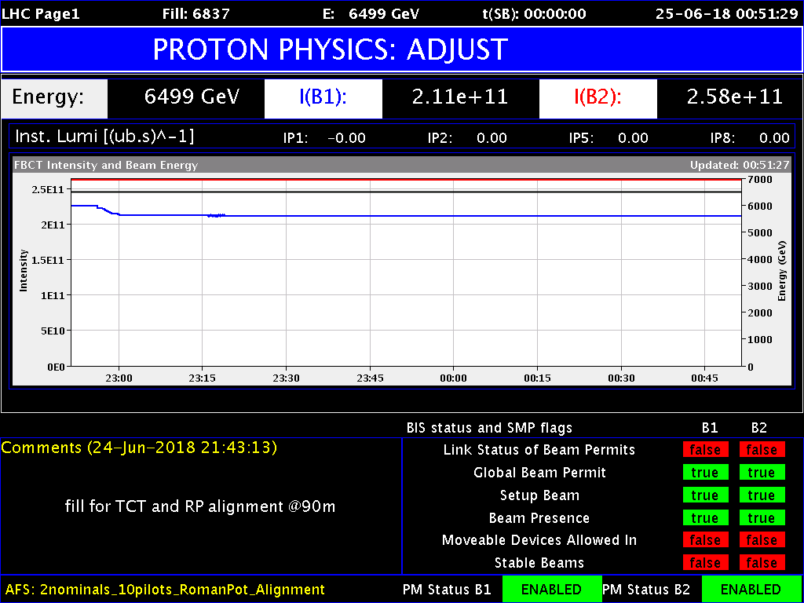
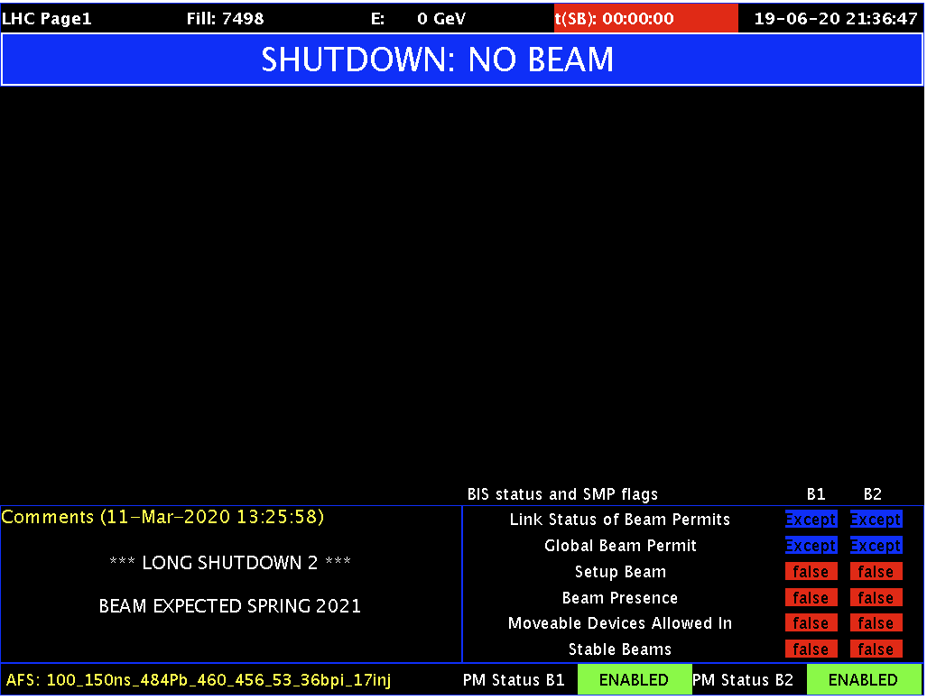
Current Status Op Vistar – Long Shudown 2
Click Here
https://op-webtools.web.cern.ch/vistar/vistars.php?usr=LHC1

Slide 5
Long Shutdown 2 Goals...
Upgrade the whole LHC injector chain;
Energy to 7 TeV? 20% higher luminosity?
Maintenance on the LHC and the Detectors;
Start on aspects of the Accelerator Consolidation Project and
the HL-LHC, aka the High-Luminosity LHC (even more protons per bunch and/or more bunches.
LS2 runs to Spring 2021 (see next slide, Will’s talk)
LS3 starts (maybe) 2024 and runs 2.5 years until mid-2026.

Slide 6
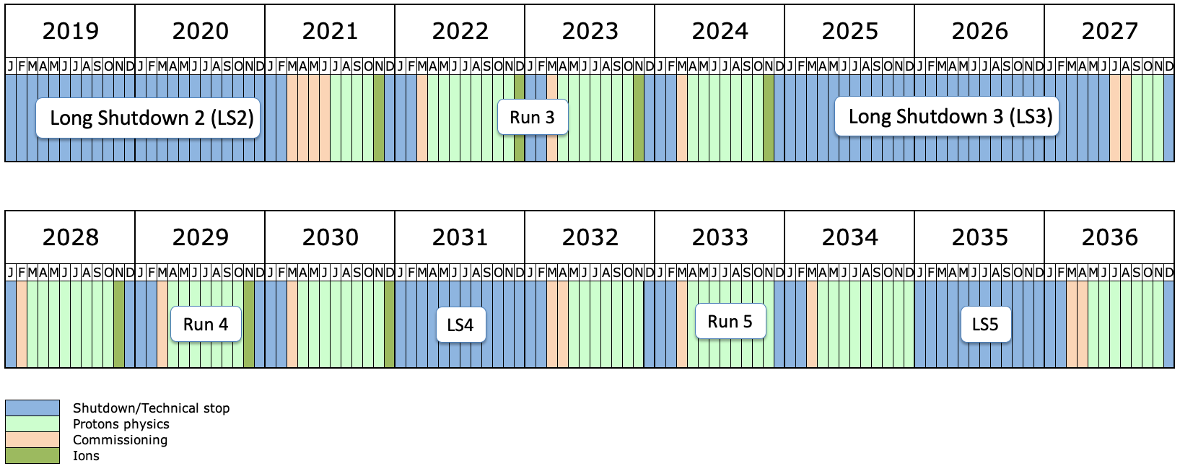
LHC Long-term Schedule 2019-2036
Proton Collisions Start, “LHC Start May 2021”
Today, “Special Physics runs”
Long Shutdown 2, started Dec 2018 to May 2021, main purpose is LHC Injectors Upgrade
LHC Status
LHC Schedule, 13 Dec 19
Long term schedule https://lhc-commissioning.web.cern.ch/lhc-commissioning/schedule/LHC-long-term.htm

Slide 7
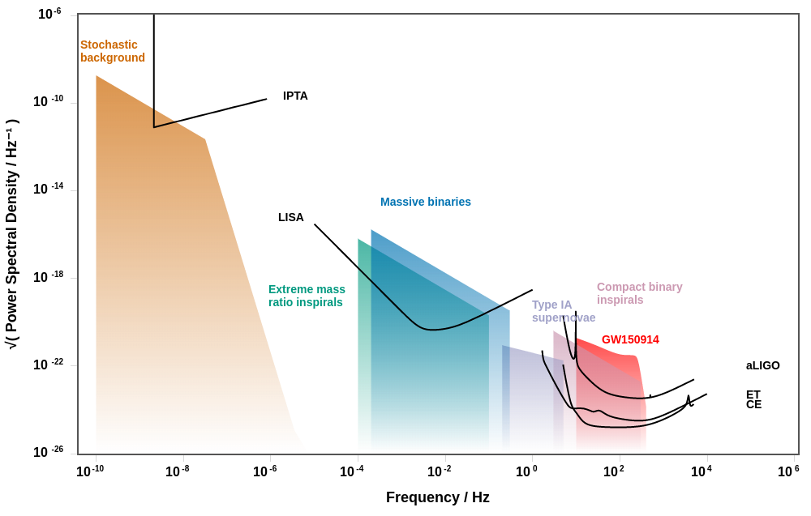
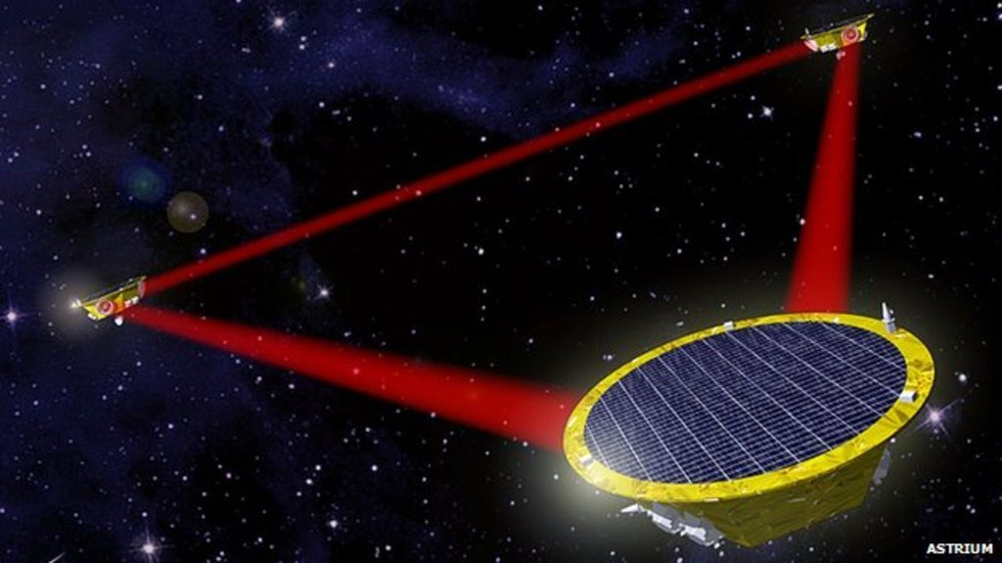
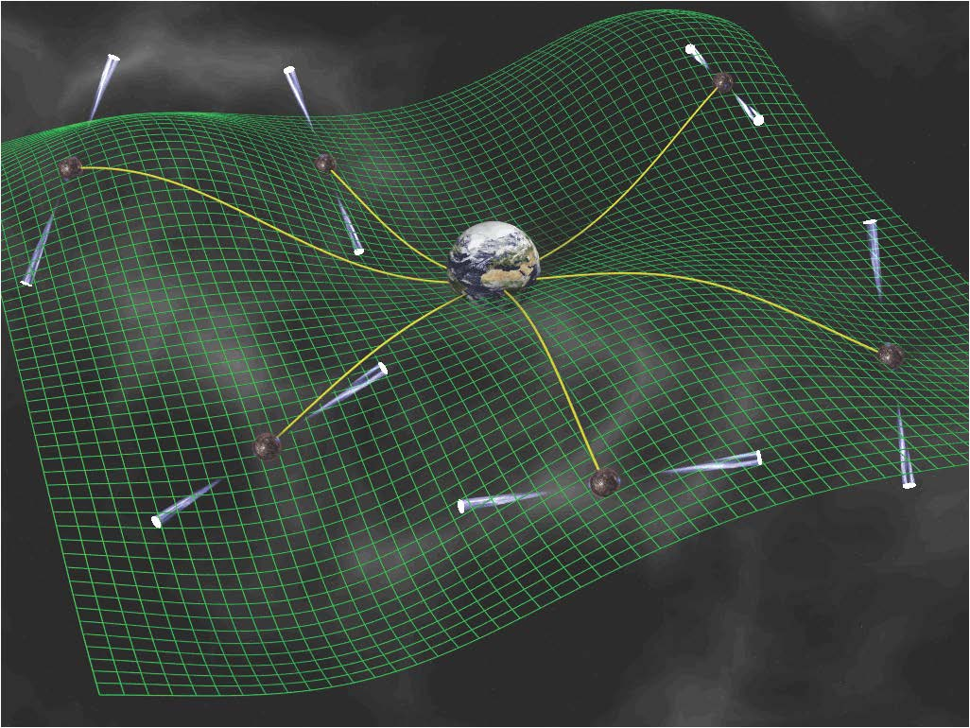
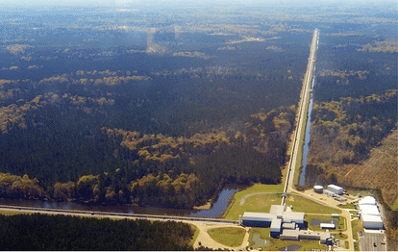
Gravitational Waves – the whole shebang
once
per year
once
per day
once
per sec
http://gwplotter.com/

Slide 8
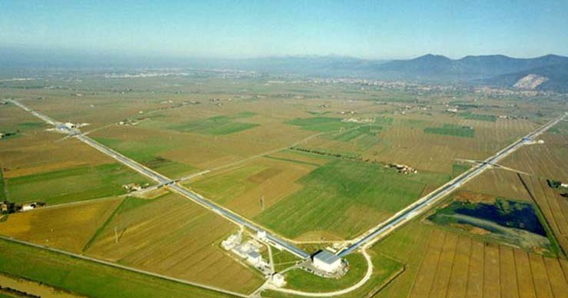
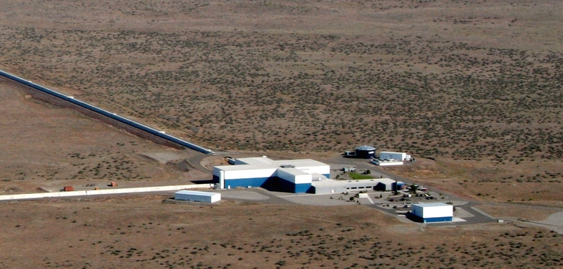
Gravitational Waves – aLIGO & VIRGO
VIRGO, Cuscina, Italy
VIRGO, Cascina, Italy
LIGO, Livingston, LA
LIGO, Hanford, WA

Slide 9
Gravitational Waves – aLIGO & VIRGO
Karan Jani is a member of LIGO and LIGO Scientific Collaboration, talks tomorrow morning.
aLIGO = Advanced Laser Interferometer Gravitational-Wave Observatory, https://www.ligo.org/ and https://www.ligo.caltech.edu/
Virgo, http://www.virgo-gw.eu/, in Cascina, Italy, in a network with Hanford and Livingston Observatories in LIGO
Restarted observations on 1 April 2019, so-called “O3” run. Paused in March 2020 for covid-19.
Seeing a binary black hole merger every week, more or less, https://gracedb.ligo.org/latest/
Continuing evidence of “unexpected” black hole masses, and caught a large mass ratio event GW190412, 30 and 8 Msol.

Slide 10
Gravitational Waves – In a Picture
Source of Gravitational Waves is mass-energy motion that is not spherically symmetric.
Strong GW sources have small sizes, high mass, and fast motion.
The first “order” in the expansion is quadrupole radiation.
  In Electricity and Magnetism the first “order” is dipole radiation.

Slide 11

Gravitational Waves – In a Picture
Two modes, + and X
Dots are masses hanging out in space with little self-attraction. They are NOT a metal ring! That is bound by atomic forces and the effect of the GW is miniscule.

Slide 12
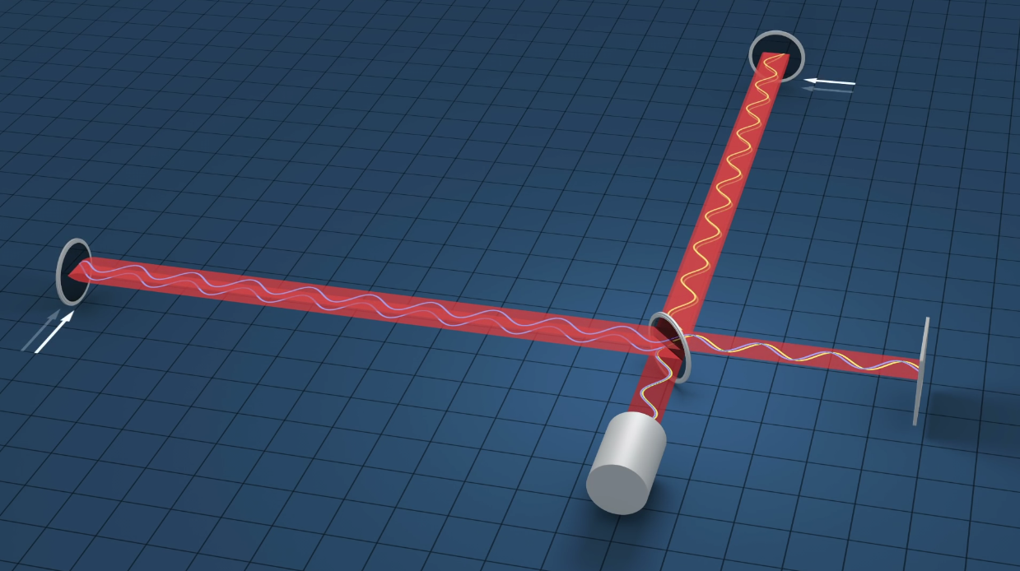
Big Michelson Interferometer, 4 km arms
YouTube link https://youtu.be/tQ_teIUb3tE

Slide 13
Pulsar Timing Arrays, ex. Nanograv
Steve Taylor recently joined Vanderbilt’s Physics and Astronomy Department and with the Nanograv collaboration will talk at 11:10am today!
Looking at the lowest frequency (longest timescale sources) gravitational waves.
Collection of fast millisecond pulsars as good clocks and look for a delay or advance of a pulse relative to another pulsar in a different place in the sky (Hellings Downs curve).
Links:
  NANOGrav collaboration
  International PTA
  Pulsar Search Collaboratory
  ATNF Pulsar Catalog

Slide 14
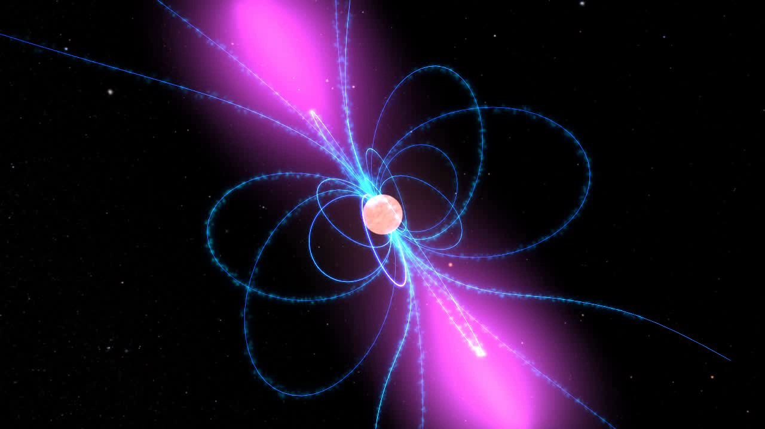

Pulsars
Pulsars are Neturon Stars “aimed” at us; lighthouse effect
Jocelyn Bell Burnell, 1967

Slide 15
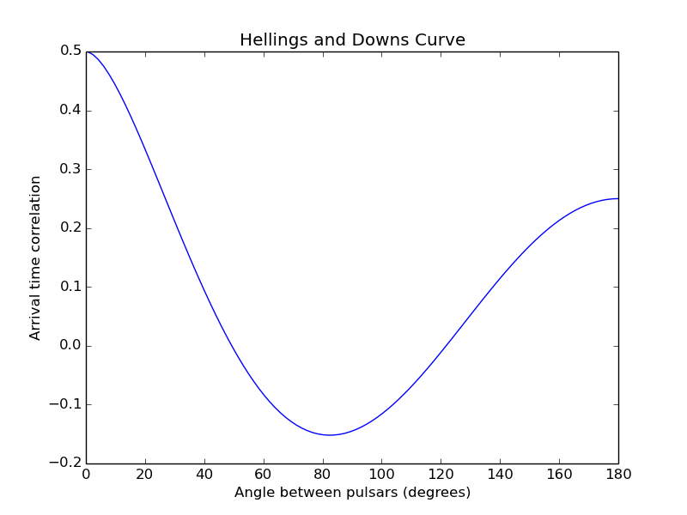
Timing Array
Collect the best (stable and predictable), fastest pulsars into a network of “clocks.”
How look for a hiccup of a passing gravitational wave.
Clocks at different angles are
correlated in timing, Hellings
Downs curve.

Slide 16
Goals
Steve knows better...
Discover the stochastic background gravitational waves of the universe in their frequency band, ~1 nHz (or once per 31.7 years, or sizes using the speed-of-light of L~9.7 pc NOW, much smaller in the past)
When that is understood start looking for new things.

Slide 17
Laser Interferometric Space Antenna (LISA)
Space-based mission, in the R&D and building phase.
  Trio of spacecraft with laser links
  2.5 billion meter arm length (1 AU is 150 billion meters)
  Orbits the sun slightly behind Earth in about the same orbit
  Lifetime 4 years, can be extended to 10 years
European Space Agency mission with significant effort and money from NASA.
Launches in 2034, or thereabouts.
Looking at the “middle” frequency (mid-range timescale sources) gravitational waves, 10⁻⁴ to 1 Hz
Sources: medium size binary black hole mergers, stellar size BHs orbiting, small objects orbiting and merging with supermassive BHs (so-called EMRIs)

Slide 18
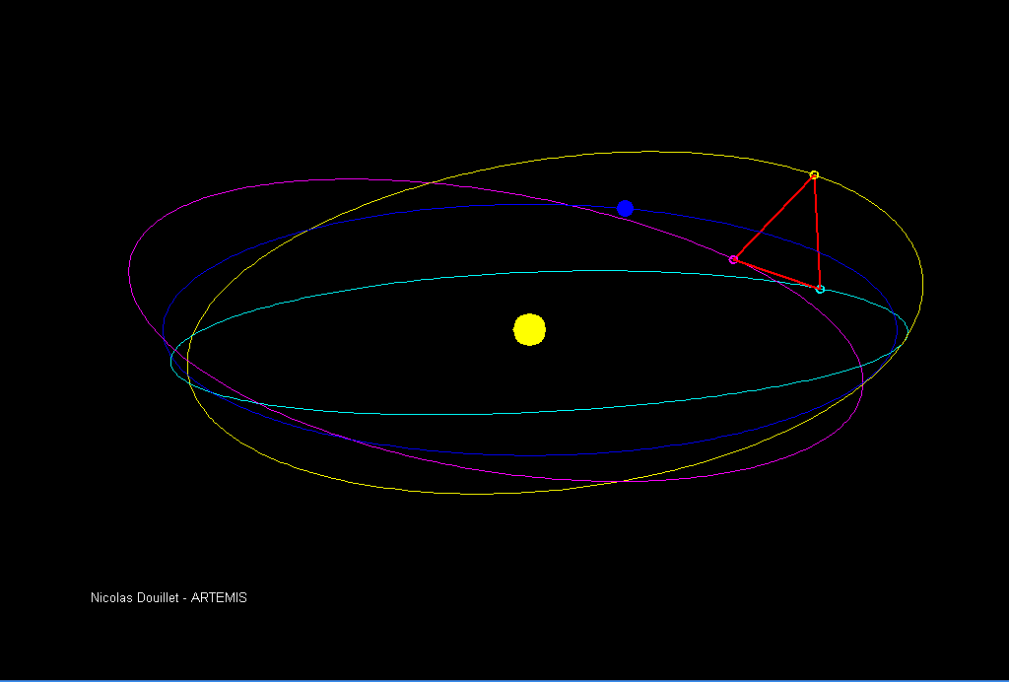
LISA
Orbit

Slide 19
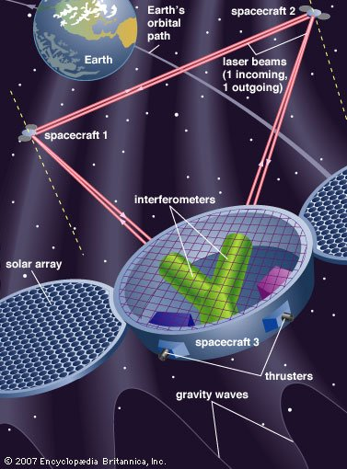
LISA
Two bi-directional lasers on each spacecraft
Timing delays are the signal
  Lots of interesting algebraic relations among the different times
source https://www.britannica.com/science/gravitational-wave

Slide 20
LISA
Links:
  LISA Mission
  ESA LISA site
  NASA LISA site

Slide 21
Links
aa

Slide 22
Backup

Slide 23
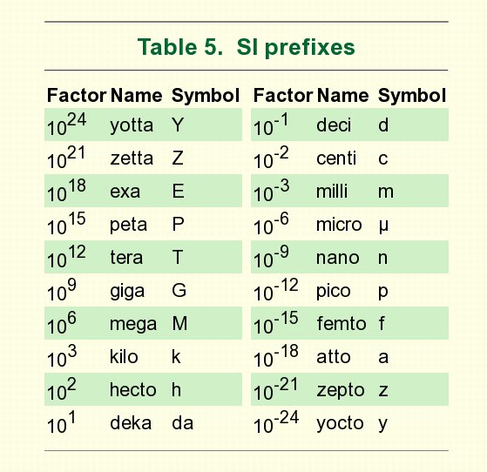
SI Prefixes

Slide 24
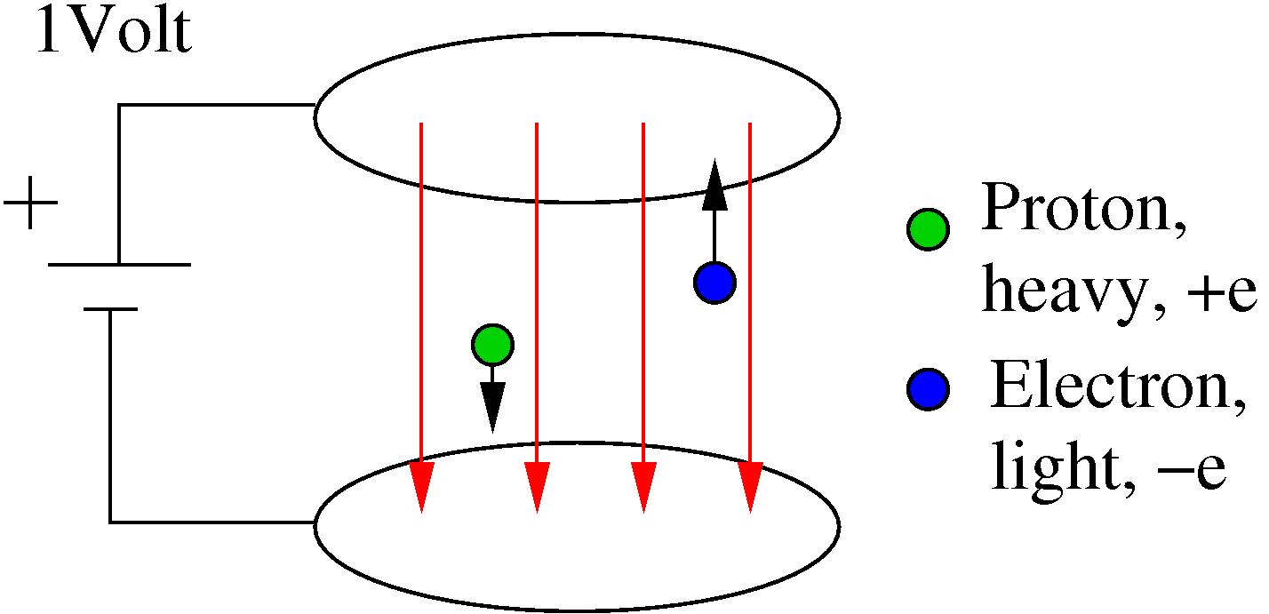
Units?

Slide 25


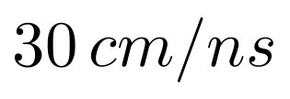
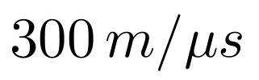

Speed of Light
Fastest possible speed is the speed of light
in vacuum.
Defined as

Slide 26
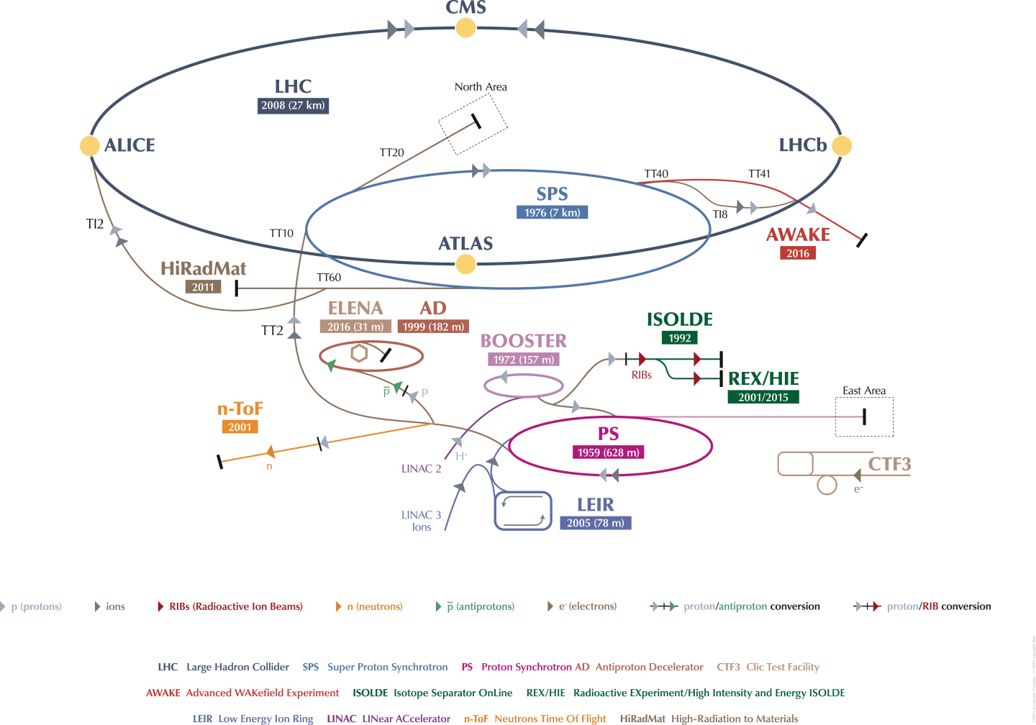
Large Hadron Collider (LHC)‏

Slide 27
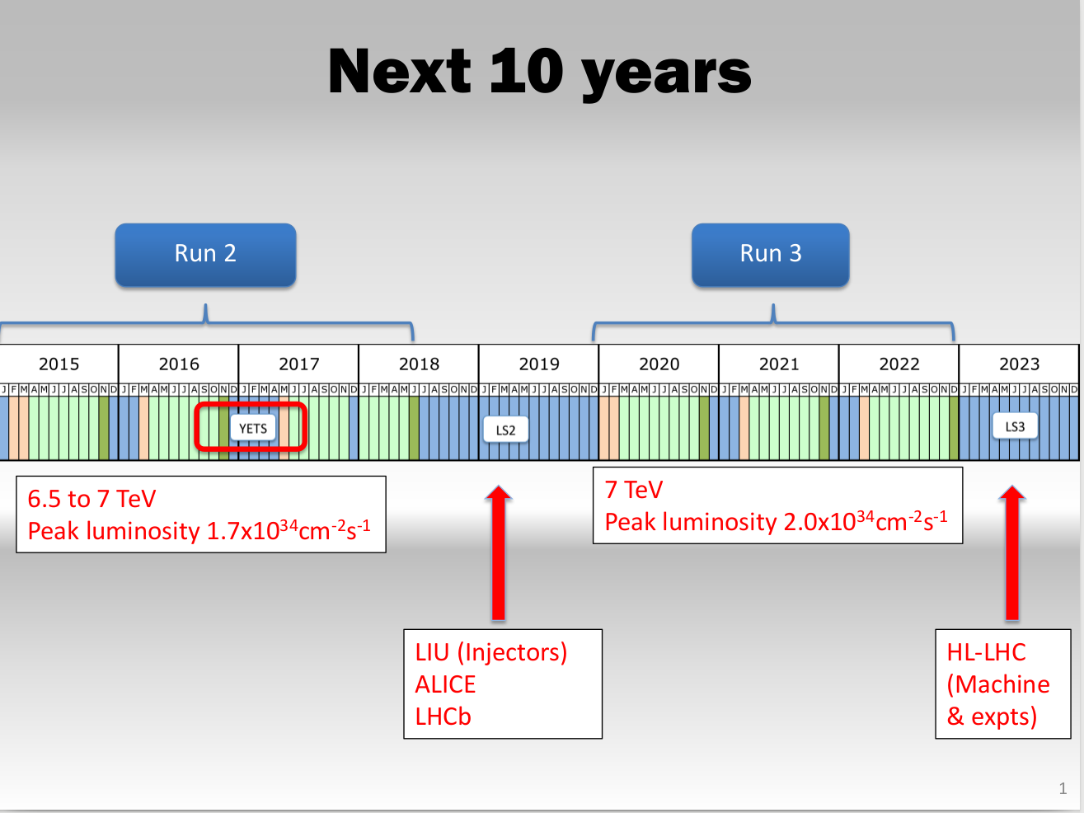
2015 Plan: LS2 changed,
starts later and takes two years;
Run 3 starts May 2021 now.
http://lhc-commissioning.web.cern.ch/lhc-commissioning/schedule/LHC-schedule-update.pdf

Slide 28
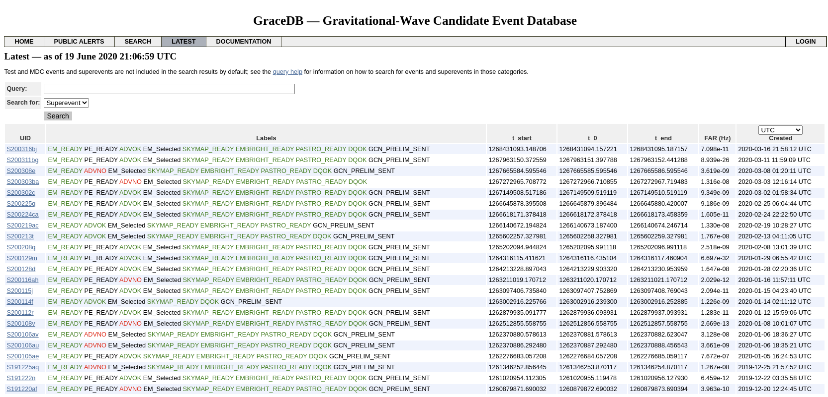
LIGO GraceDB Latest
Gracedb Latest at https://gracedb.ligo.org/latest/
False Alarm Rate in per sec
once per year is 3.3e-8 Hz,
16 March 2020

Slide 29
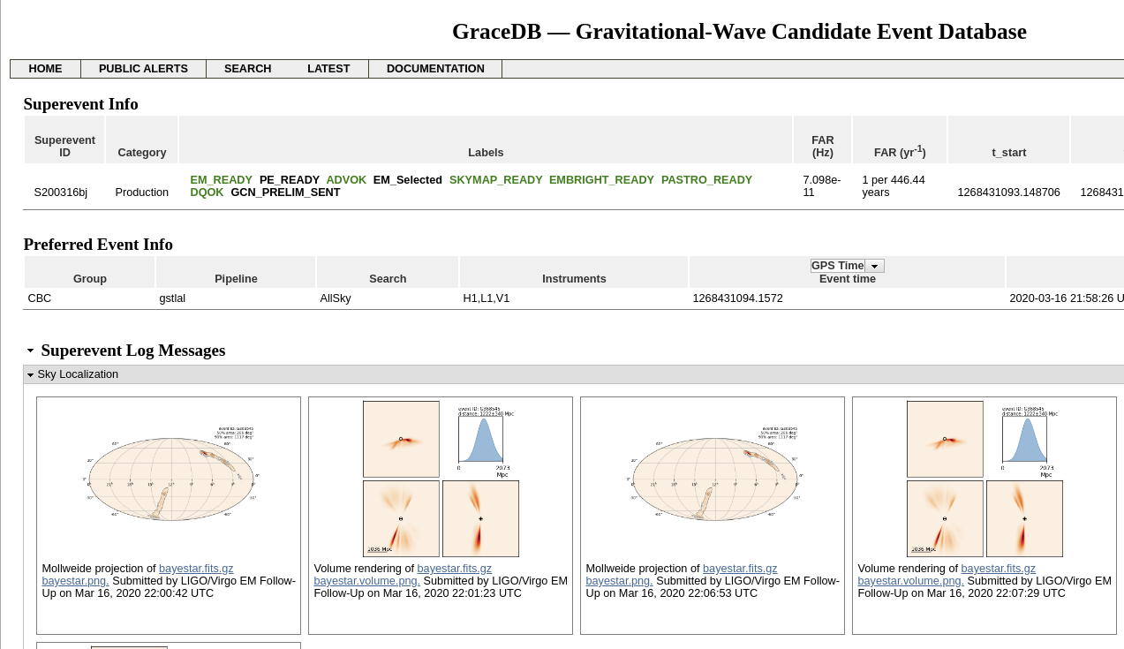
LIGO GraceDB Latest – S190521r
FAR 1/146yrs https://gracedb.ligo.org/superevents/S200316bj/view/

Slide 30
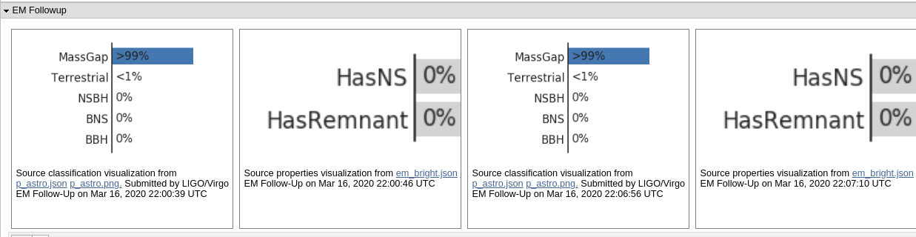
LIGO GraceDB Latest – S190521r

