Slide 1
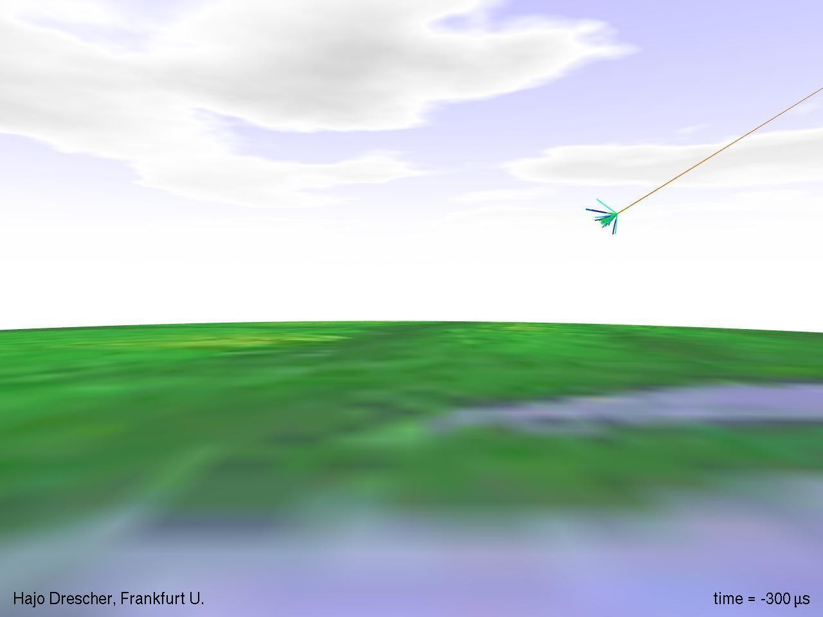
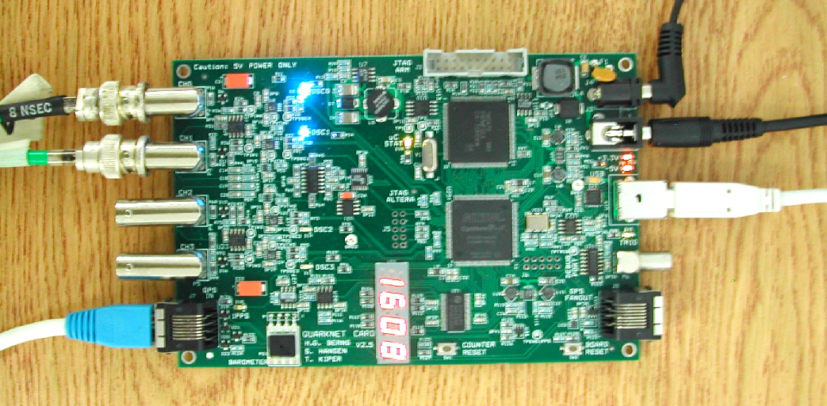
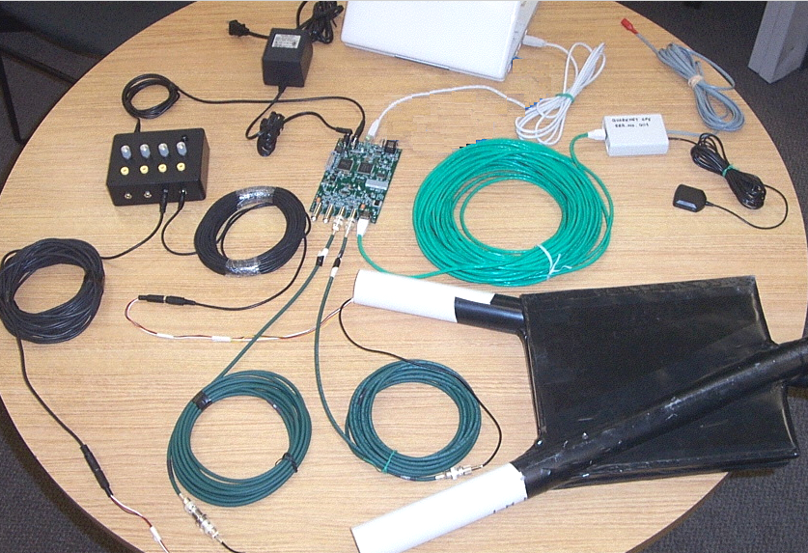
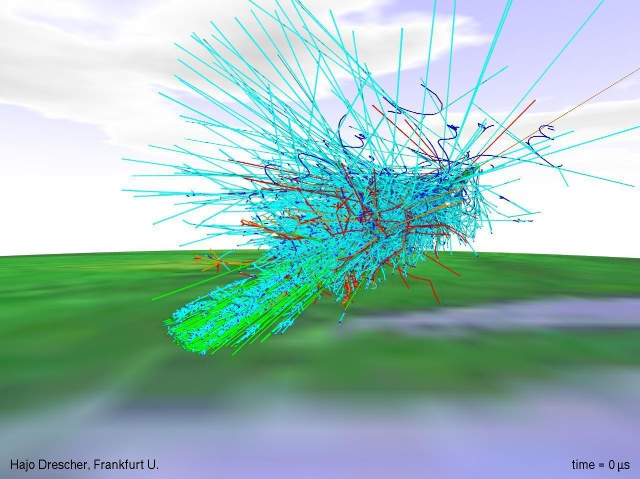
QuarkNet 2020 - Vanderbilt University
22-26 June 2020
Welcome!

Slide 2
QuarkNet 2020 - Vanderbilt University
22-26 June 2020
Welcome!
Zoom (zoom.us) meeting 9am to 12:10pm each day.
The week in a nutshell:
Monday Morning, news and talks
Tuesday Morning, talks
Wednesday Morning, Cosmic Ray Muon Detector from the lab
Thursday Morning, neutrinos workshop (with Ken Cecire)
Friday Morning, neutrinos, online teaching discussion, paperwork
All Online! on Zoom, coordinates Meeting ID: 999 1401 8433, Password: 937318 Zoom Link w/PW

Slide 3
Administration
Check-ins around the “room.”
Keep your attendance and send me a signed letter.
Some may need the IRS W-9 form and ACH bank direct deposit form needed to process your stipend.
We have two working sets of cosmic ray muon detectors (CRMDs) and have laptops for datataking and control. We have a third set with non-standard (small) scintillator paddles good for shielding experiments.
We use the “standard” Java program Equip to control the boards/detectors.
Registration and Survey for QuarkNet Central, links on the must-do-items page.
Putting talks and data sets at GitHub Vanderbilt-QuarkNet Workshop 2020

Slide 4
Monday Schedule
news and talks
9:00-10:00am Bill Gabella talk, administration and news
10:00-10:10am Break
10:10-11:10am Will Johns
11:10-12:10pm Steve Taylor

Slide 5
Tuesday Schedule
Talks
9:00-10:00am Karan Jani
10:00-10:10am Break
10:10-11:10am Brenda Fabela
11:10-12:10pm Vicki Greene

Slide 6
Wednesday Schedule
Cosmic Ray Muon Detector, follow the signal and hardware
9:00am-12:10pm Bill in the 9th Floor lap running around, following direction, measuring whatever can be measured, some data to look at too.

Slide 7
Thursday Schedule
Neutrino Workshop
9:00am-12:00pm Neutrino Workshop with Ken Cecire, QuarkNet Page

Slide 8
Friday Schedule
Neutrino Workshop
9:00am-12:10pm Neutrino Workshop, see link previous page

Slide 9
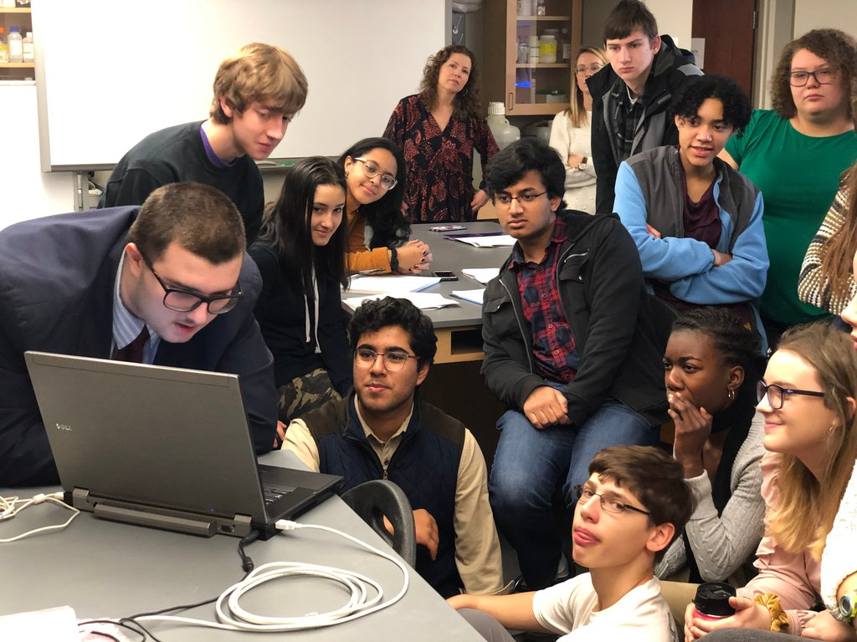
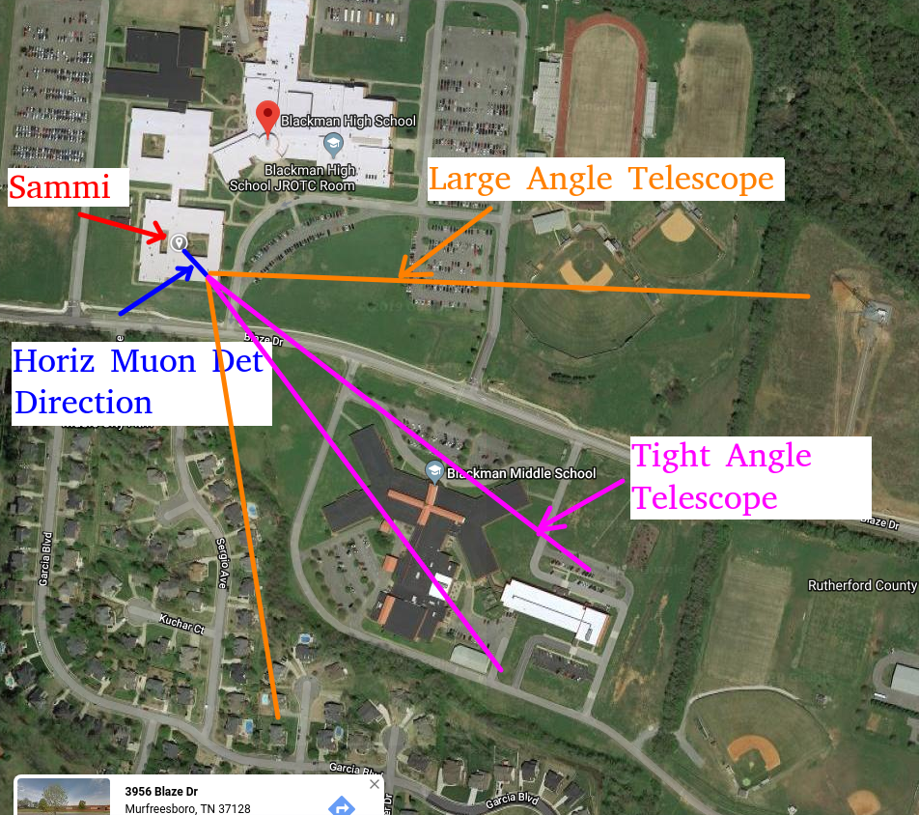
News
Congratulations to Kim Baumann, Blackman HS, and her student Sammi H.!
Sammi used the CRMDs for a semester long capstone plus. Included a talk the School for Science and Math at Vanderbilt (SSMV in the Center for Science Outreach). He investigated using the cosmic ray muons for muography---seeing inside objects for high dense regions by muon attenuation. Very hard with our CRMDs...could maybe see a bridge overpass vs open sky, but without tracking trajectories takes a lot of data.
Looking for buildings vs open field

Slide 10
Useful Links for This Workshop
CRMD User Manual
https://github.com/gabella/VandyQuarkNet/tree/master/manuals
Vanderbilt QuarkNet “Drupal” group page: http://quarknet.i2u2.org/group/vanderbilt-university-quarknet-center
QuarkNet Virtual Neutrinos at Vanderbilt by Ken Cecire: https://quarknet.org/content/virtual-neutrino-workshop-vanderbilt
QuarkNet Virtual Neutrino template:
https://quarknet.org/content/virtual-neutrino-workshop-template-2020
QuarkNet Virtual Neutrino UofF page:
https://quarknet.org/content/neutrino-data-workshop-prototype-uf

Slide 11
Useful Links
Vanderbilt QuarkNet Site: http://www.hep.vanderbilt.edu/~gabellwe/qnweb/
Vanderbilt QuarkNet “Drupal” group page: http://quarknet.i2u2.org/group/vanderbilt-university-quarknet-center
Vanderbilt QuarkNet Workshop 2018 page:https://quarknet.i2u2.org/content/vanderbilt-quarknet-worskhop-2018
QuarkNet Cosmic Ray eLab Teacher page: http://www.i2u2.org/elab/cosmic/teacher/
QuarkNet CMS eLab page: http://www.i2u2.org/elab/cms/home/project.jsp
QuarkNet LIGO eLab Page: https://www.i2u2.org/elab/ligo/teacher/
2017 Marla Glover’s CMS Open Data Page: http://quarknet.i2u2.org/content/vanderbilt-cms-data-agenda
2016 Ken Cecire's LIGO eLab page: https://quarknet.i2u2.org/content/ligo-e-lab-workshop-vanderbilt

