Slide 1
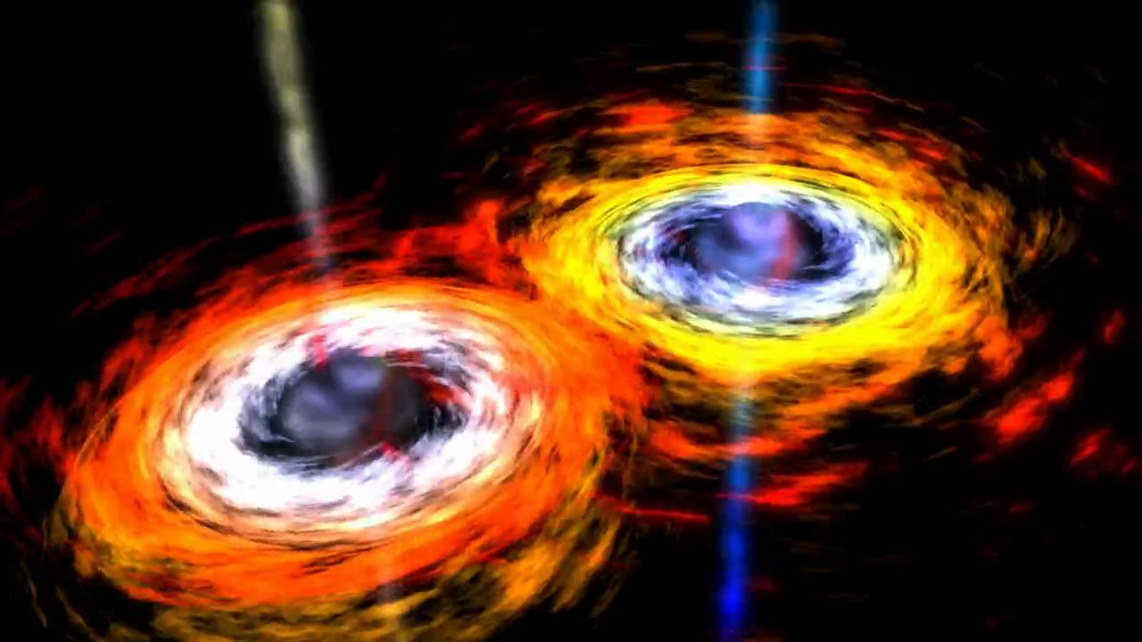
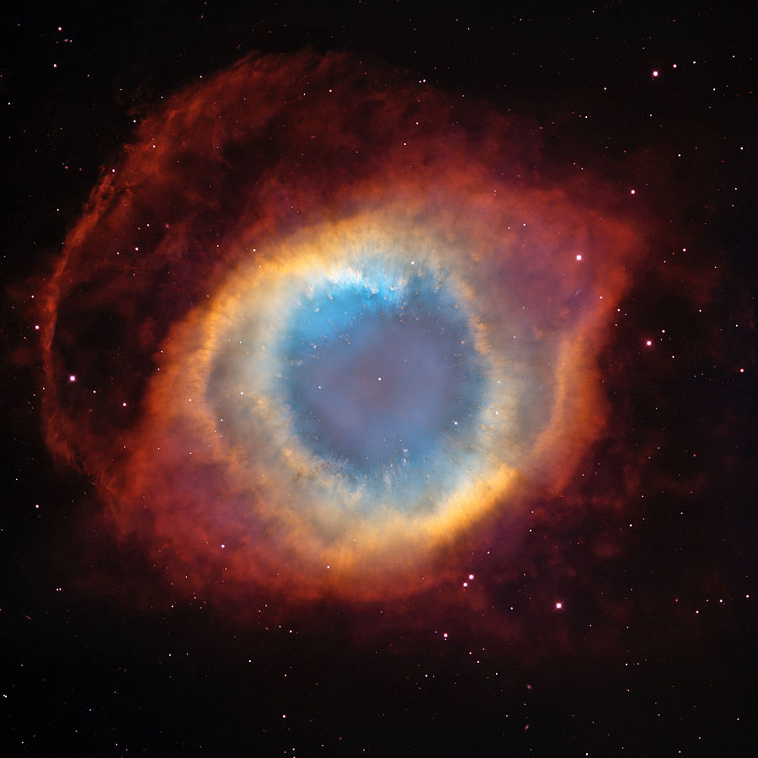
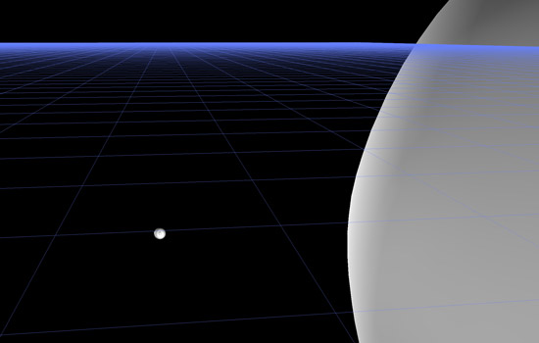
Gravitational Waves – Sources and Detectors
Orbiting Massive Bodies
Supernova, NGC7293-Helix Nebula
Extreme Mass Ratio Black hole Mergers
Credit: https://www.rit.edu/news/story.php?id=47936

Slide 2
Gravitational Waves are “ripples in spacetime.”
Ripples in space time...hard to do, spacetime is very “rigid” or “stiff.”
Need matter in motion to create Gravitational Waves, recall charges in motion create electromagnetic waves.
The motion cannot be spherically symmetric. Conservation of mass and conservation of linear momentum (of the mass) means the first “moment of the mass distribution” that can cause GWs is “quadrupole.”
Large masses and fast changes in time create stronger GWs.
  Black holes are small and massive. In binary orbits with another black hole, orbital speeds can reach more than 30% the speed-of-light! Small is good because they can get very close before they “touch” or “merge.”

Slide 3
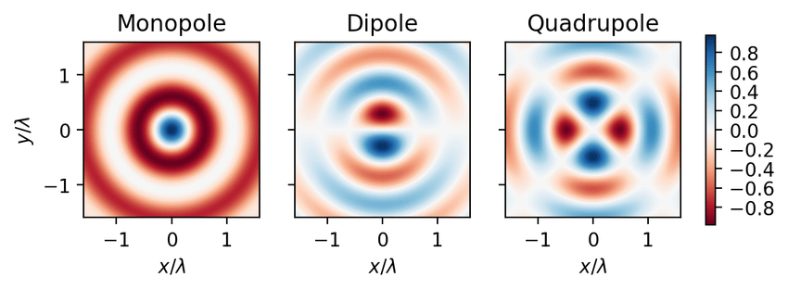
The Moments of a (Mass) Distribution
Like a pulsing
mass / star.
A mass moving
back and forth.
Mass in complicated
motion, or it turns out
orbiting each other.

Slide 4
Quardrupole is the first to give GWs
Like a pulsing
mass / star.
A mass moving
back and forth.
Mass in complicated
motion, or it turns out
orbiting each other.

Slide 5




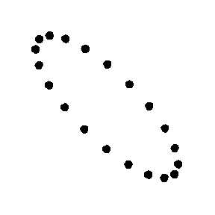
Nature of Gravitational Waves, and strain
Of all 10 possible components to h, it simplifies to two polarizations. One with a motion that shrinks (grows) in one direction while growing (shrinking) in the other direction. The other polarization is just rotated by 45 degrees.
hplus polarization
hcross polarization
Wave headed into the page, Y up, X left.

Slide 6
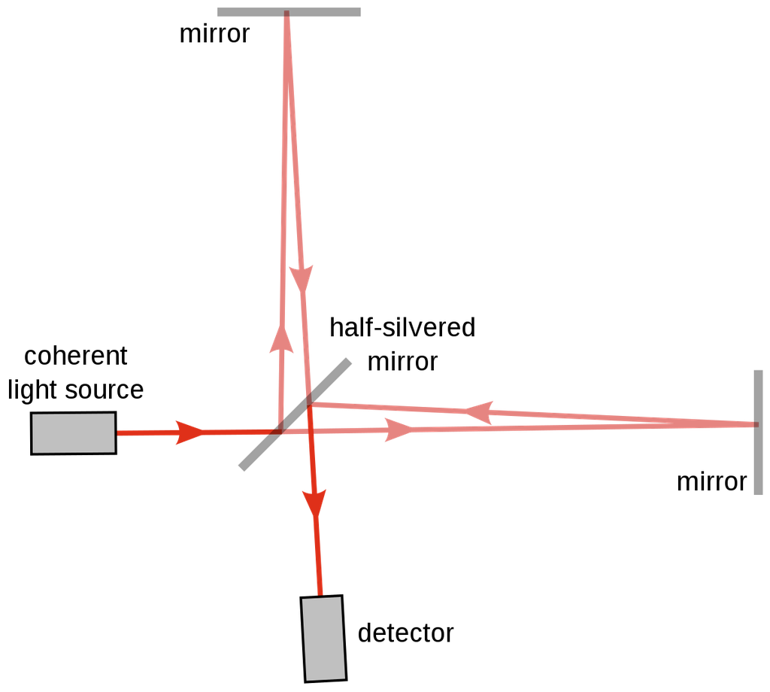
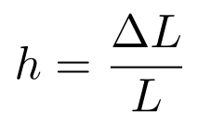
The strain is
For ideal “test masses” the Gravitational Waves manifests as a physical “strain,” a change in length over length.
Y
?
?
X
Interferometer is natural detector (though not easy).

Slide 7
Y
Y
X
X

Slide 8
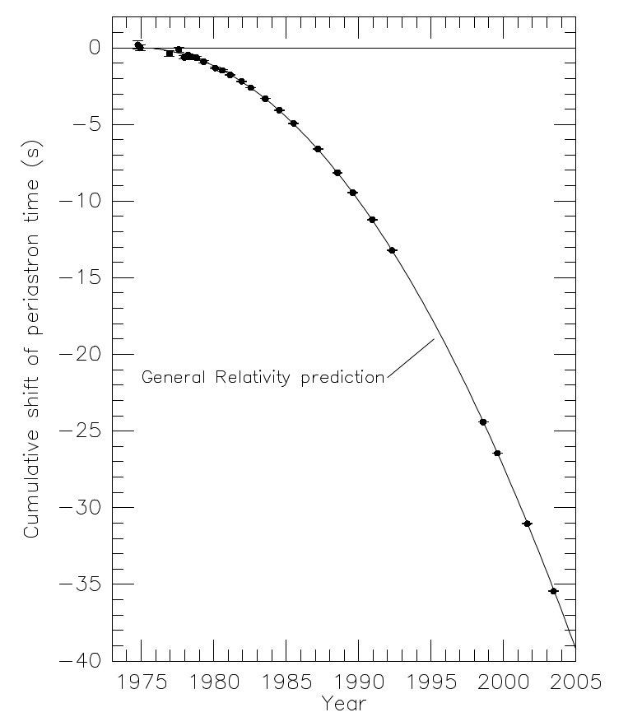
Hulse-Taylor Pulsar gave strong evidence for GWs
Pulsar mass 1.44 Msol, companion 1.39 Msol.
The orbital change in the pulsar PSR B1913+16 (Hulse-Taylor Pulsar) could be explained by energy loss from gravitational waves.
Weisberg and Taylor, “Relativistic Binary Pulsar B1913+16: Thirty
Years of Observations and Analysis” arXiv 0407149

Slide 9
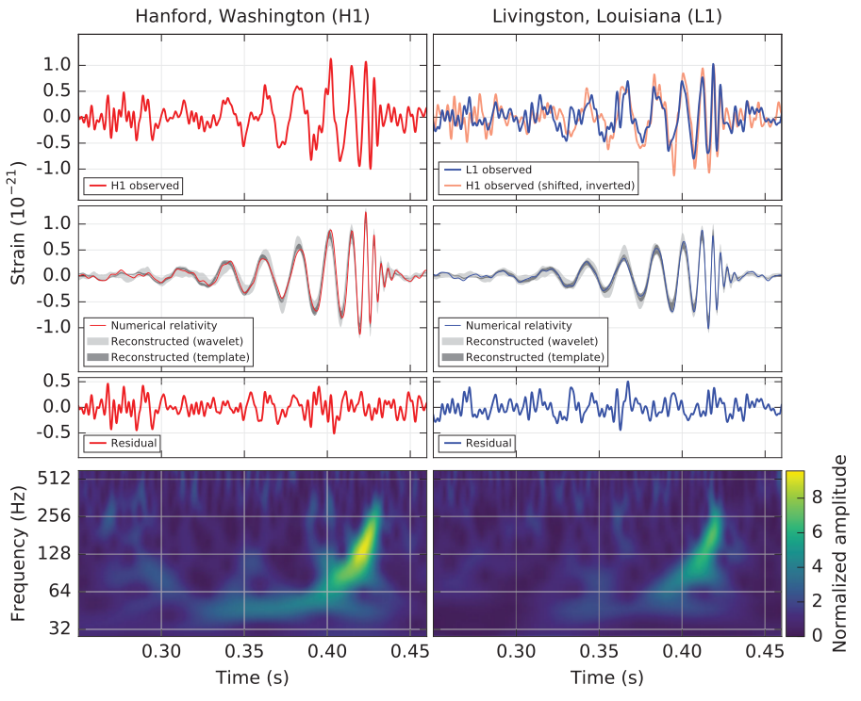
LIGO first direct observation, GW150914
Direct Discovery by LIGO of a gravitational wave announced on 11 February 2016 for a wave on 14 September 2015---event labeled GW150914.
SNR = 24, 5 sigma detection!
Pretty after filtering out the known seismic frequencies.

Slide 10
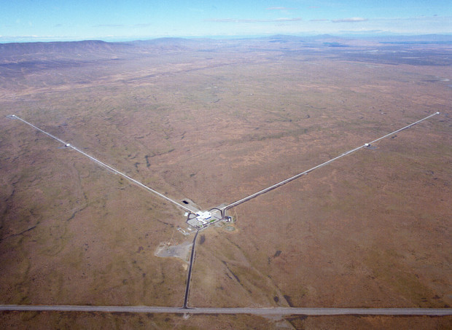
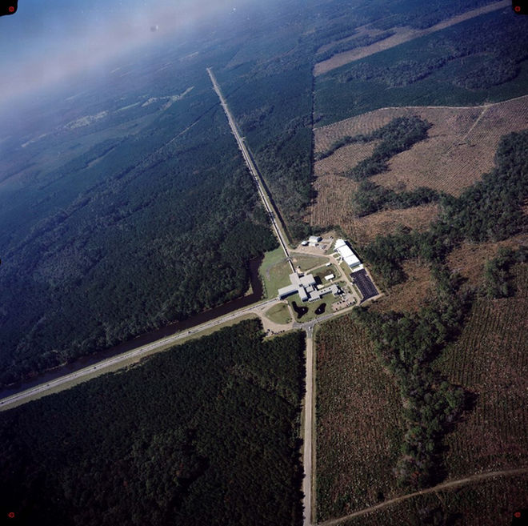
LIGO, ground-based Gravitational Wave Detectors
LIGO Livingston, LA (LLO)
LIGO Hanford, WA (LHO)
LIGO – Laser Interferometric Gravitational Wave Observatory
LVK – LIGO, Virgo (Italy), KAGRA (Japan) collaboration, sometimes LSC

Slide 11
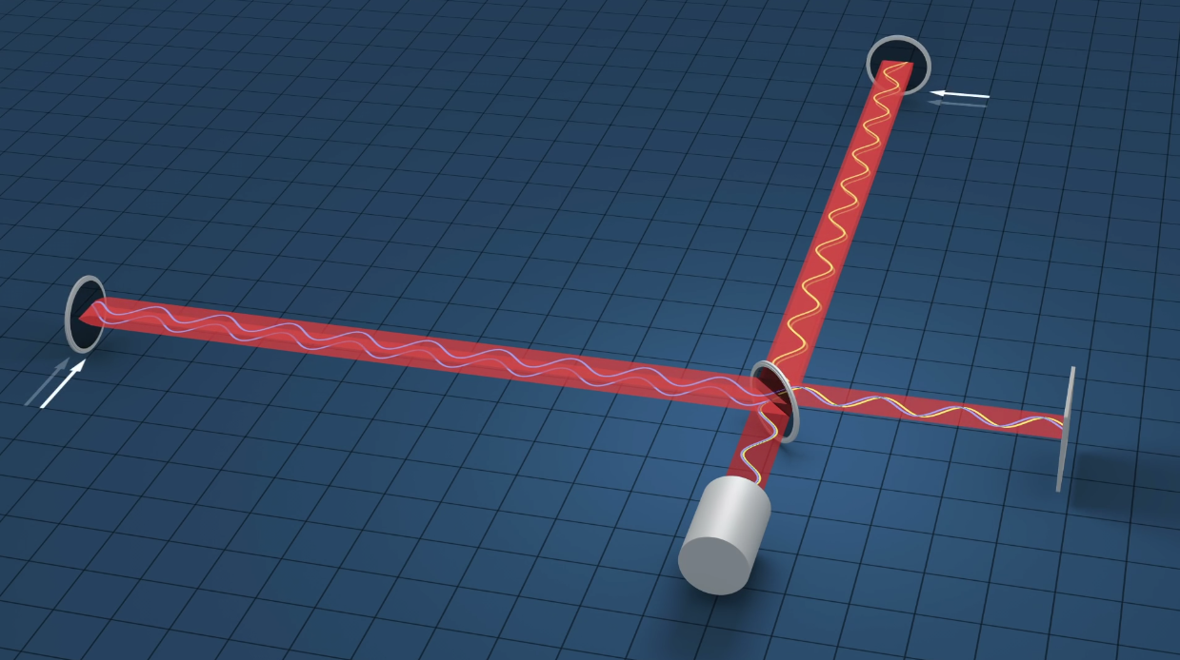
Big Michelson Interferometer, 4 km arms
YouTube link https://youtu.be/tQ_teIUb3tE

Slide 12
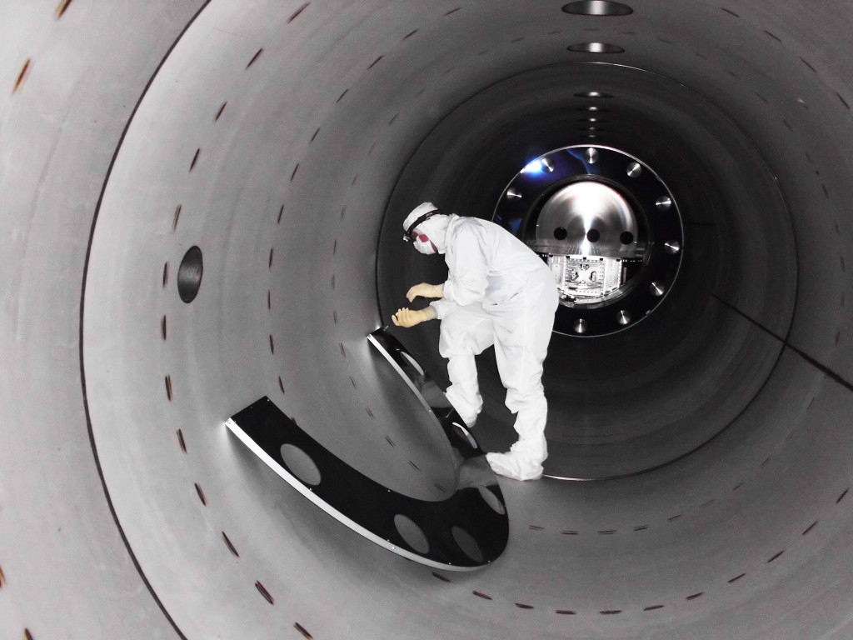
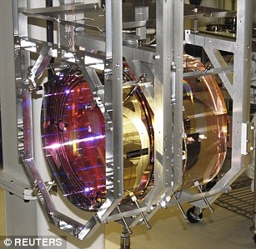
LIGO Hardware
LIGO “Test Mass” in 4-element suspension
LIGO Vacuum Tube
Ref: some hardware images

Slide 13
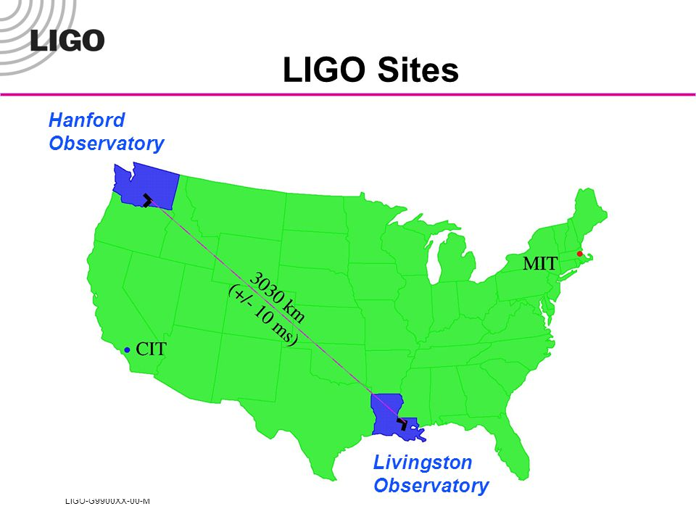
Also Virgo, Cascina, Italy and
KAGRA, Japan

Slide 14
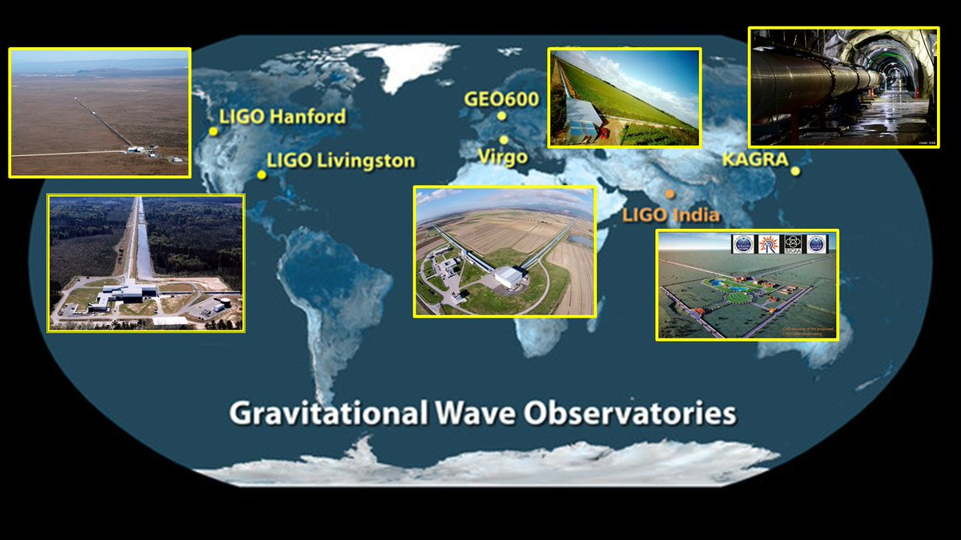

Slide 15
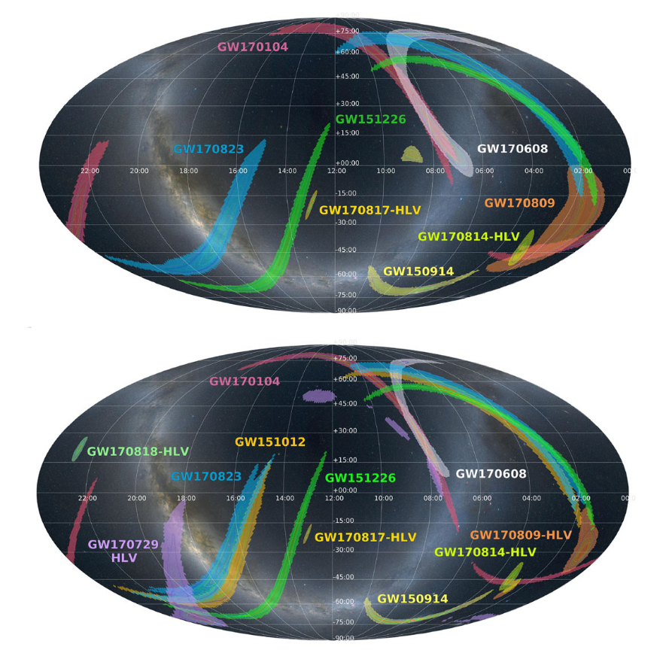

Slide 16
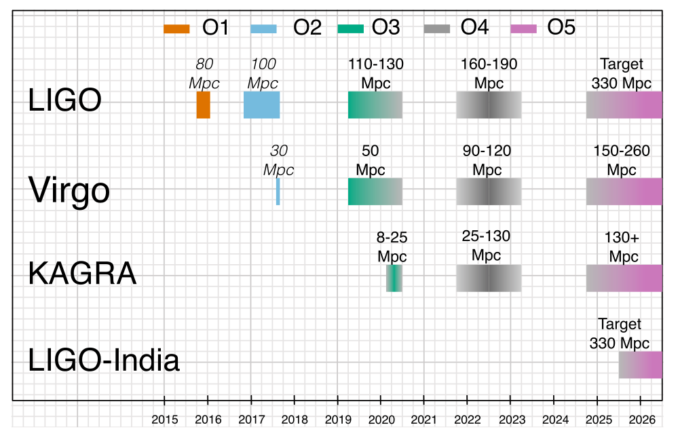

Slide 17
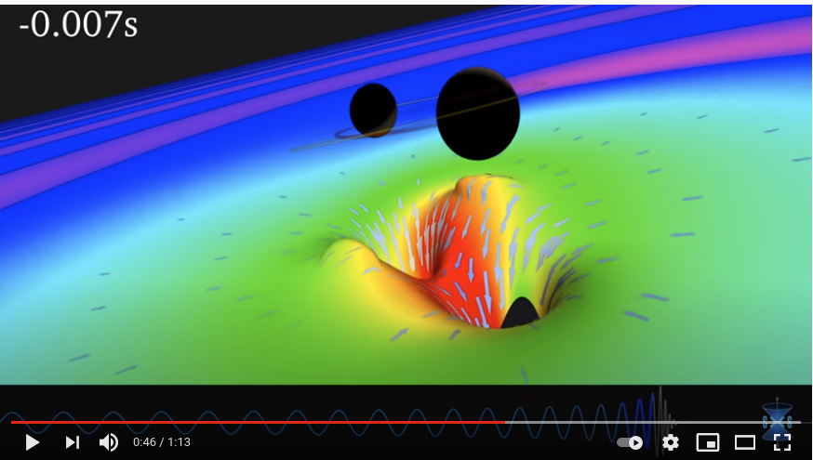
Sources, Binary Black Holes
Binary Black Holes inspiral, merger, and ringdown. First discovered/seen GW150914, announced April 2016.
https://youtu.be/1agm33iEAuo 1m13s, no matter around, GW150914 parameters

Slide 18
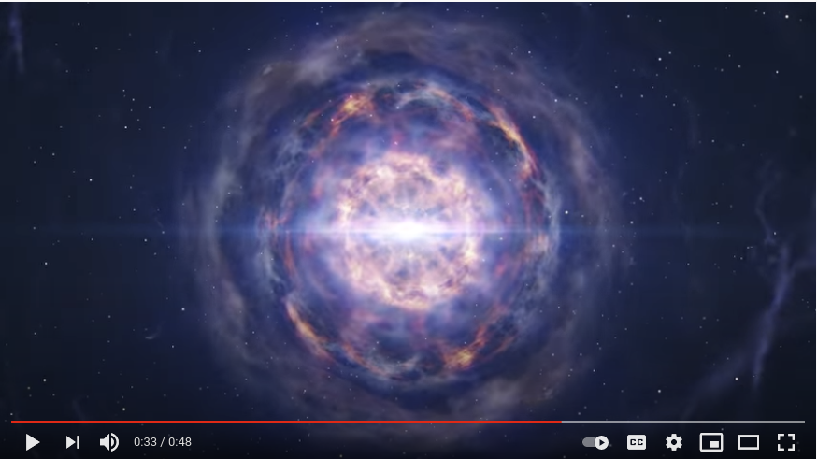
Sources, Binary Neutron Stars
Binary Neutron Stars also inspiral, merger, and ringdown. First GW170817 . Seen in all optical and other EM bands.
https://youtu.be/bBCArmUPgCw 48s, matter around, kilonova, heavy elements created.

Slide 19
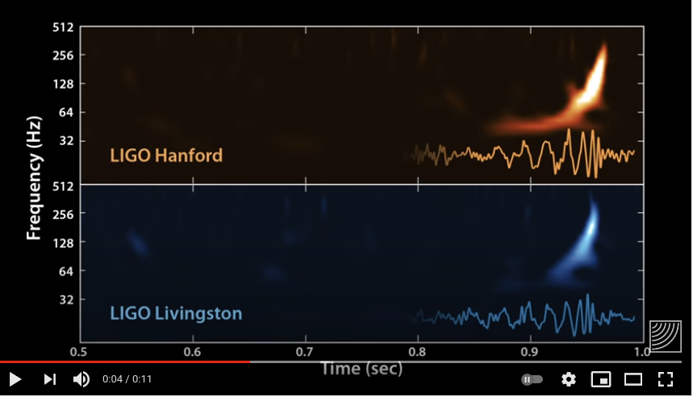
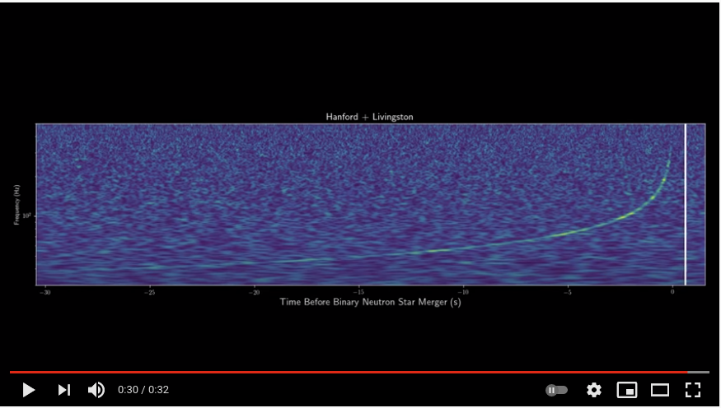
Sources, Waveforms---The Strain
Waveforms, the strain in the interferometer(s)
Binary Black Holes, GW150914, here
Binary Neutron Stars, GW170817, here

Slide 20
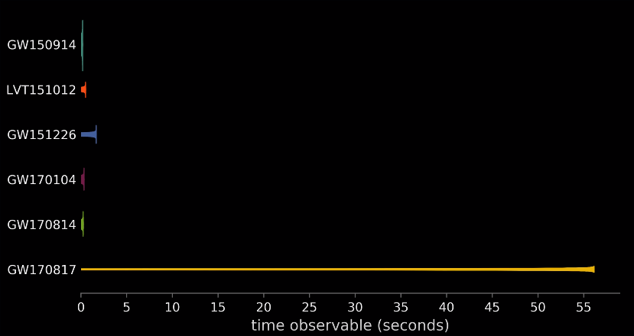
GW170817 with other BH GW Sources
YouTube video, animated waveforms, here

Slide 21
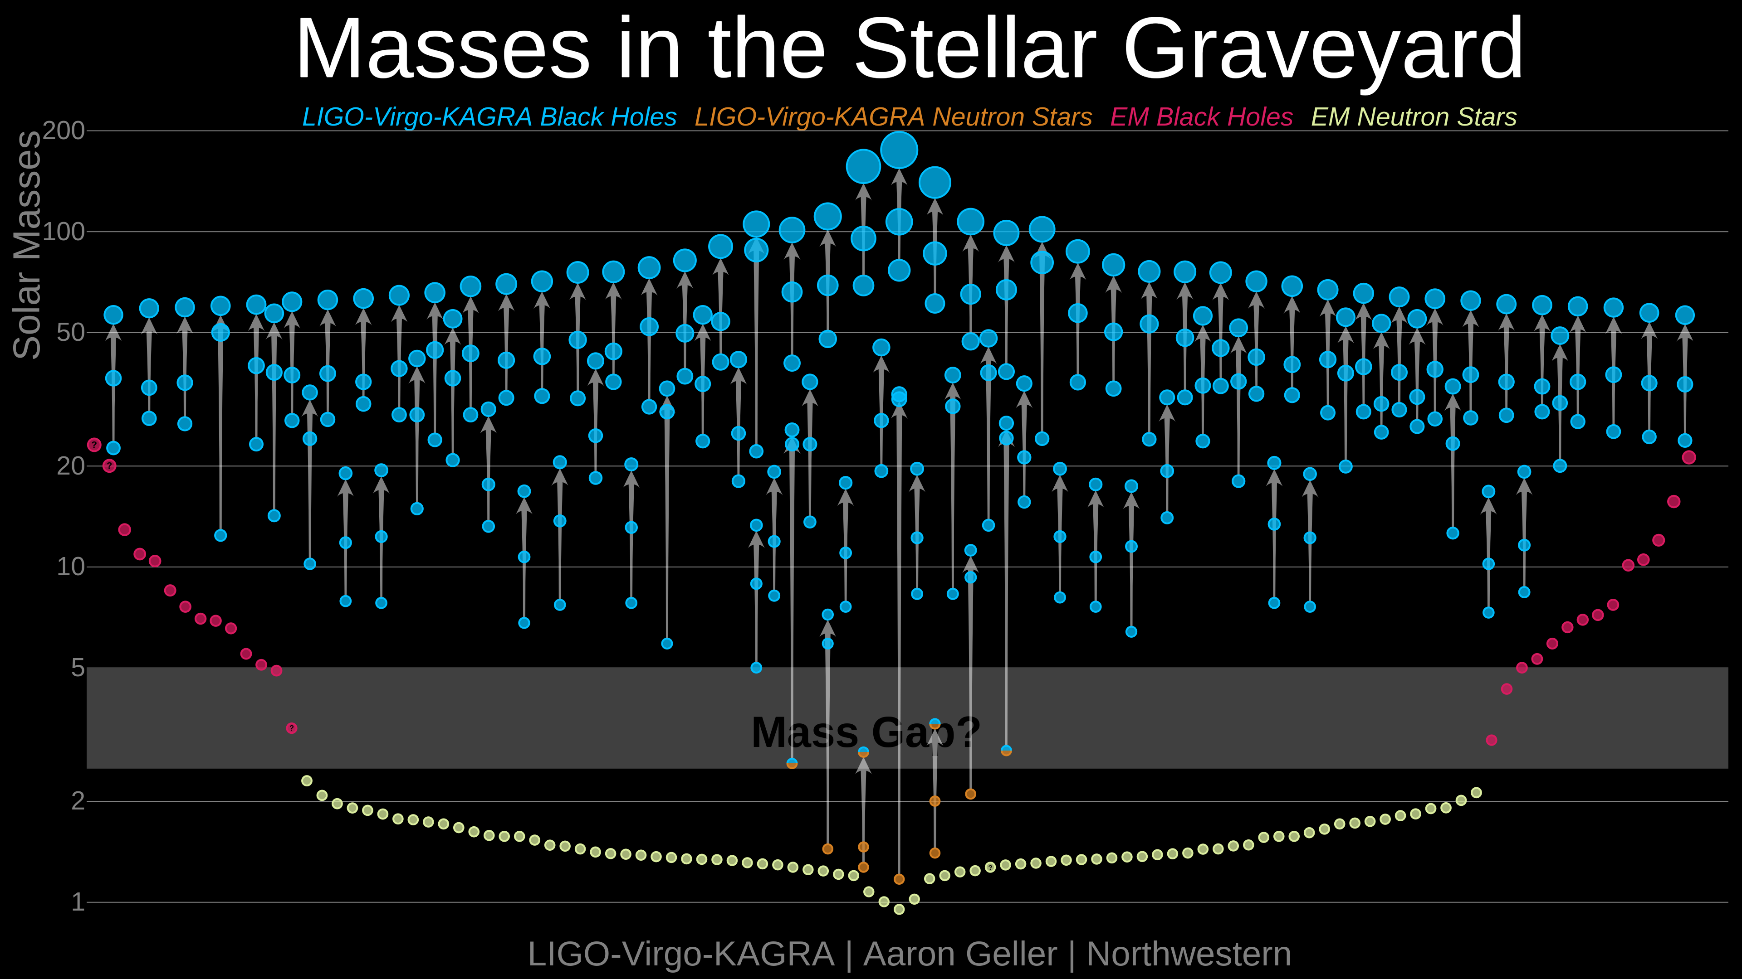
Population of Black Holes and Neutron Stars
https://media.ligo.northwestern.edu/
above in 2022
Reference to 2020 Image

Slide 22
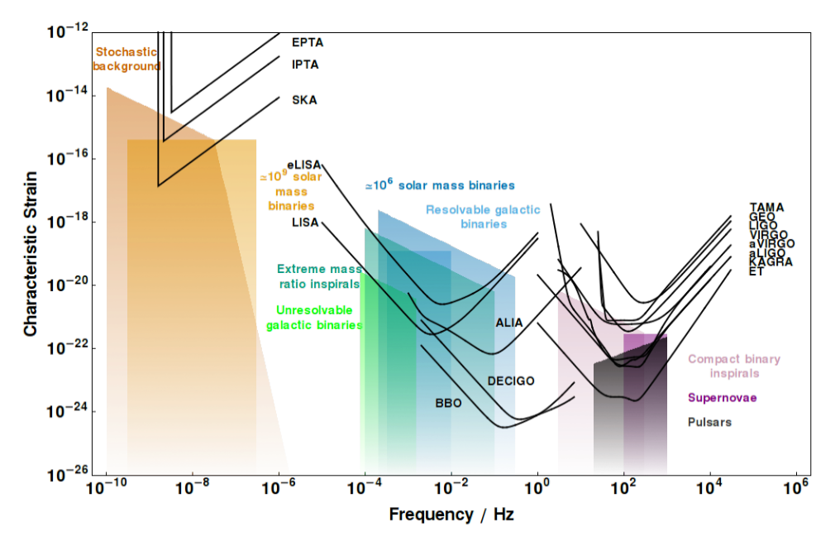

Strain Curves from Moore et al.
Pulsar Timing Arrays
http://gwplotter.com/
Spaced-based
Ground-based
1pc
30km
wavelength, m
3e16
3e12
3e8
3e4
Notes:
http://www.ast.cam.ac.uk/~cjm96/noise_curve.pdf

Slide 23
Summary
Gravitational Waves are ripples in spacetime, caused by massive objects moving fast.
  Have to have a Quadrupole Moment or higher—and orbits do.
  Most observed events are form Binary Black Holes losing energy and merging, but also from binary neutron stars, and neutron star-black hole binaries.
LIGO had a direct detection in 2015 and with Virgo (Europe) and KAGRA (Japan) continue to operate.
  In previous runs, O1-3, the group has announced 93 events.
  LIGO and KAGRA started data taking in May 2023, O4; Virgo will join later.
  Seeing a great many (more) candidates each day.

Slide 24
Vanderbilt Connection
Kelly Holley-Bockelmann and Karan Jani and group are members of LIGO, since September 2020.
  Led by Karan Jani, newly hired assistant professor at Vanderbilt, researching Intermediate Mass Black Holes and Lunar based GW detectors.
LISA is the space-based detector being built by ESO with NASA contributing. Kelly is chair of the NASA LISA Study team.
PTAs/Pulsar Timing Arrays uses the pulsars in the Milky Way as good clocks to detect GWs passing by...long time scales, data taking for 15 years. Steve Taylor is the spokesperson for the Nanograv collaboration, the US PTA effort.

Slide 25
Thank you for your
Attention!
Questions? Comments?

Slide 26
Backup

Slide 27
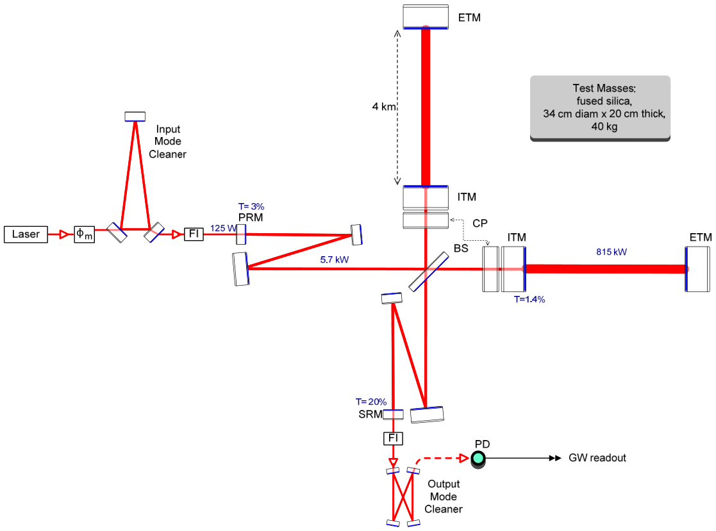

Slide 28
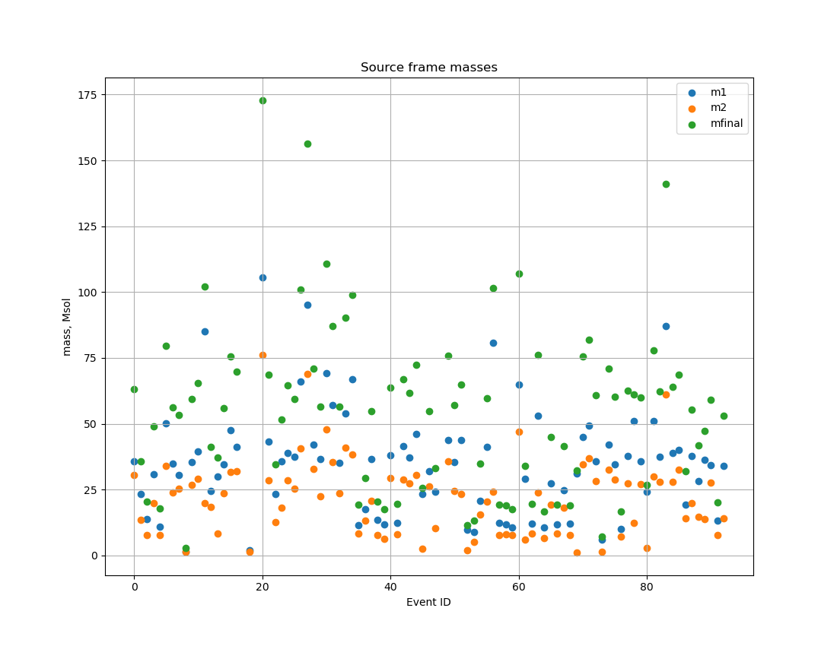
Catalog GWTC-3
The publicly released table of gravitational wave events, see the page
https://www.gw-openscience.org/eventapi/html/GWTC/
Event GW190521_v3, first Intermediate Mass Black Hole (IMBH), 156.3 Msol
https://www.gw-openscience.org/about/

Slide 29
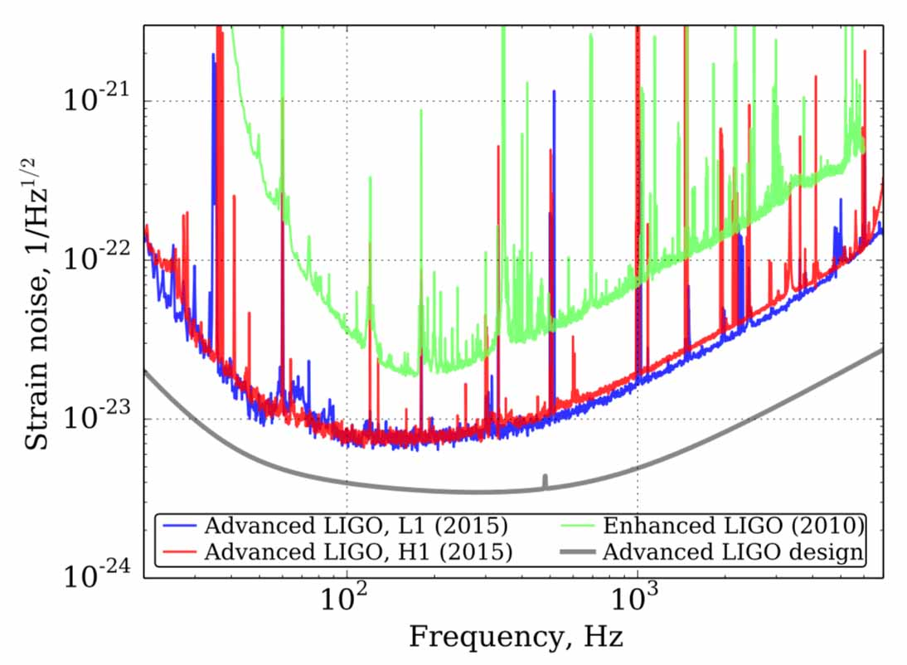
Seismic Noise aLIGO and initial
Above the
background
noise.
Below the noise.

Slide 30
Links
LIGO Teacher’s page here
LIGO Student’s page here
LIGO CalTech Educational Resources here
LIGO Scientific Collaboration, LSC
LIGO Document Server
CalTech GW media assets page.
Kelly Holley-Bockelmann's TEDx Nashville Talk 2016 about GW150914.
Pulsar timing array, Nanograv
LISA Consortium, space-based GW detectors
Gravitational Wave Open Science Center

Slide 31
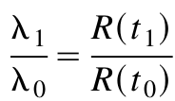
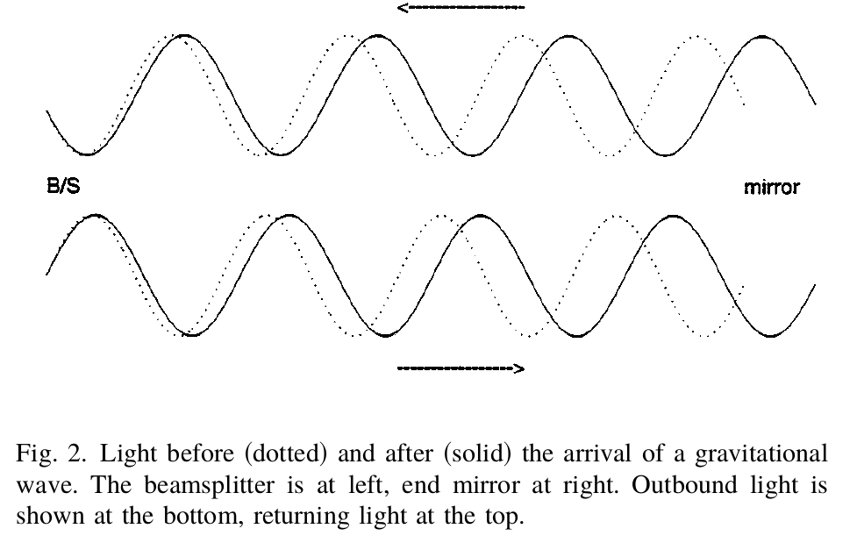
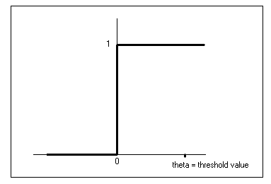
Saulson, If Light Waves…
We know in the expanding Universe, light continuously experiences the increase in scale by expanding continuously itself.
NOT the case for a light wave in LIGO...
  The wave filling the cavity IS stretched by the sudden onset of the gravitational wave.
  Light travel time, 2x4km is 27μs,
  but GW oscillates at 20 Hz, 50ms.
h_0
ΔL
time
Ref: Saulson, If Light Waves…,
AmJPhys 65, 501 (1997)

Slide 32
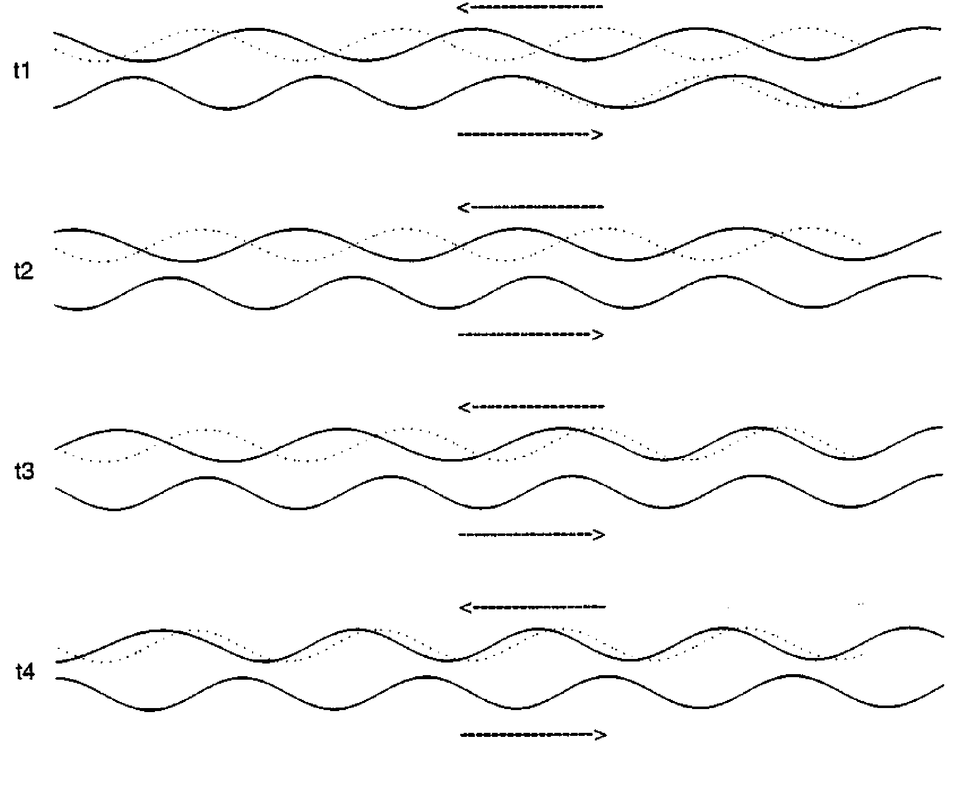
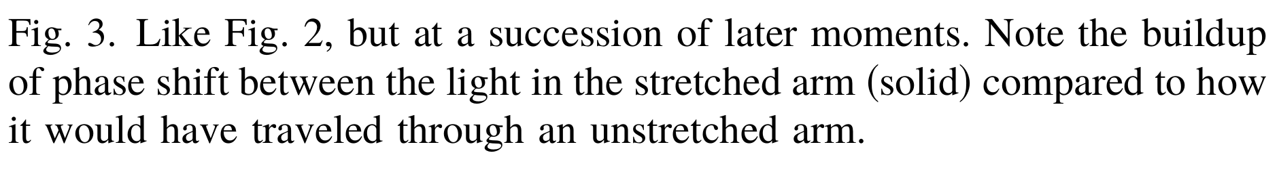
As the Wave runs through...
ΔL

Slide 33
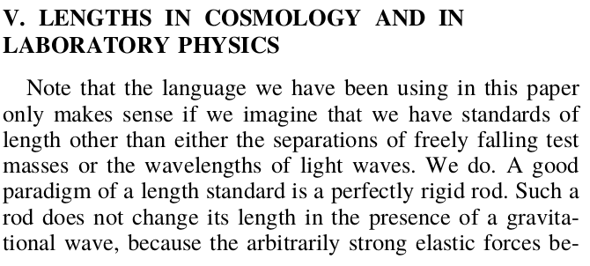
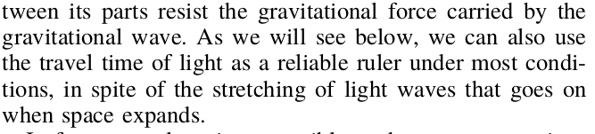
Saulson, If Light Waves…, says rods are still rigid!

Slide 34
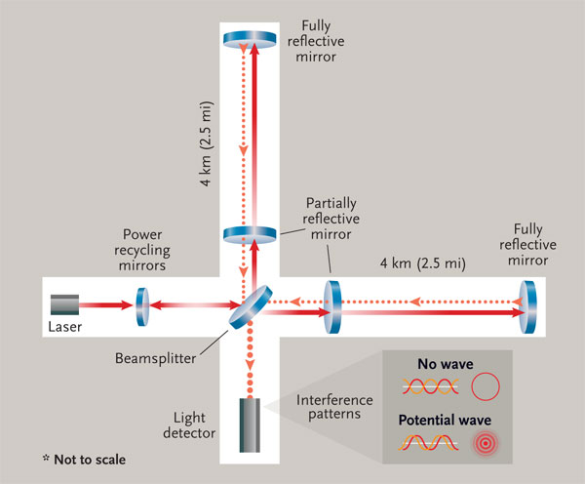
LIGO Inteferometer
4km long

Slide 35
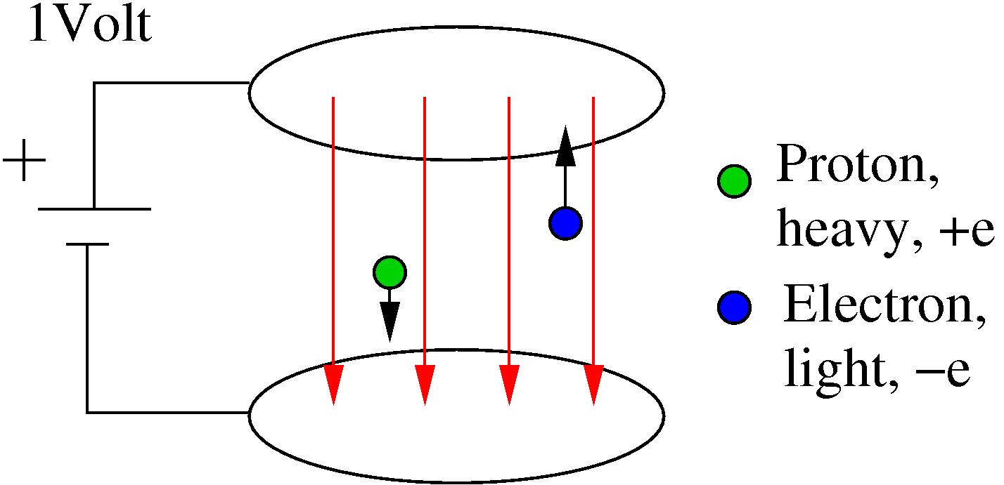
Units?

Slide 36
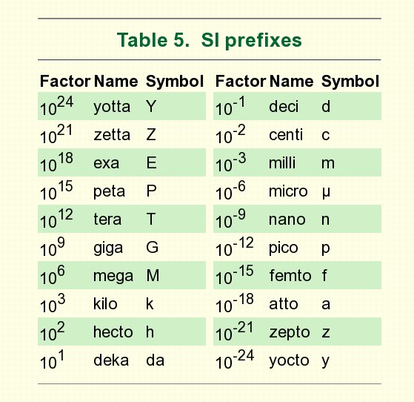
SI Prefixes

Slide 37
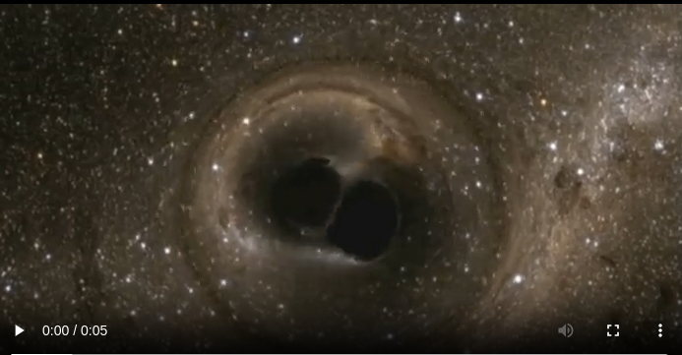
Merging Black Holes
ref: http://www.techinsider.io/binary-black-holes-confirmed-gravitional-waves-2016-2

Slide 38
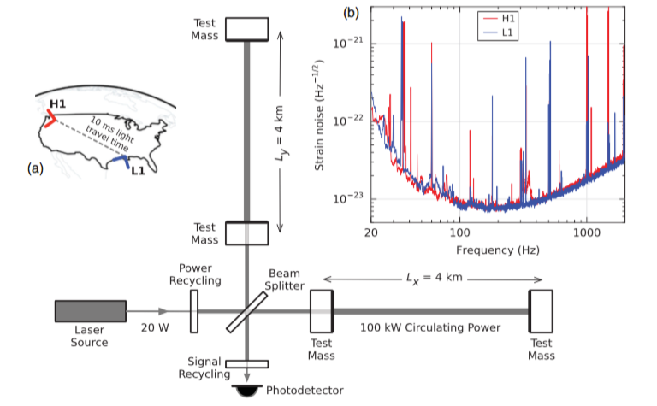
Schematic, Map, and Noise

Slide 39
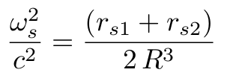
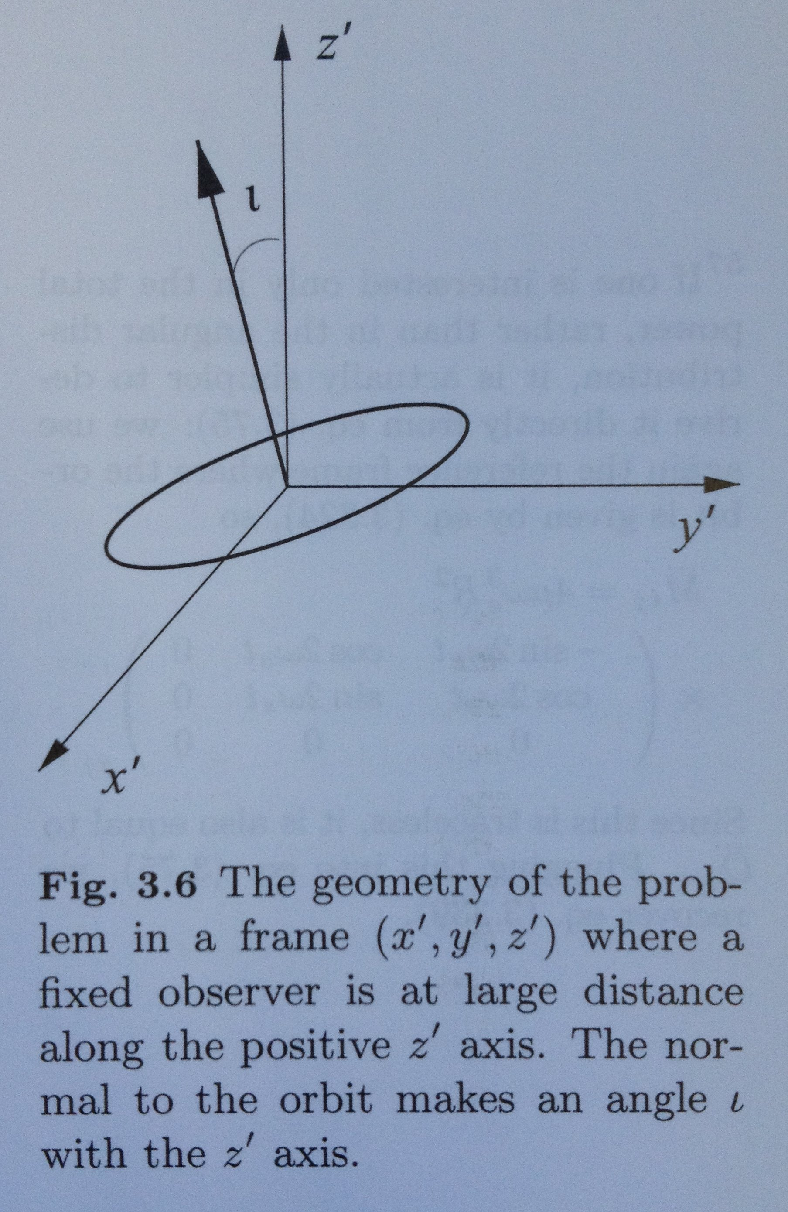



GW strain for Circular Orbit
rs1 is 2GM_1/c^2, Schwarzschild radius for
mass M_1, etc.
r is distance from Earth to system.
R is the separation of the two bodies.
ref: Maggiore around Eqn. 3.332.

Slide 40
Some Constants
Schwarzschild radius | 2GM/c^2 | 2953 m for Msun
GR Units, Mass | GM/c^2 | 1477 m for Msun
GR Units, Power | c^5/G | 3.628e52 W
GR Units, Energy | c^4/G | 1.210e44 J/m
parsec, pc |  | 3.09e16 m = 3.262 ly
astronomical unit, au |  | 149.6e9 m
light-year, ly |  | 0.946e16 m = 0.307 pc
fine structure constant | e^2/(4pi eps0)/hbar c | 0.00730 = 1/137.04
wavelength-energy | h c | 1.24 eV μm, 1.24 GeV fm

Slide 41
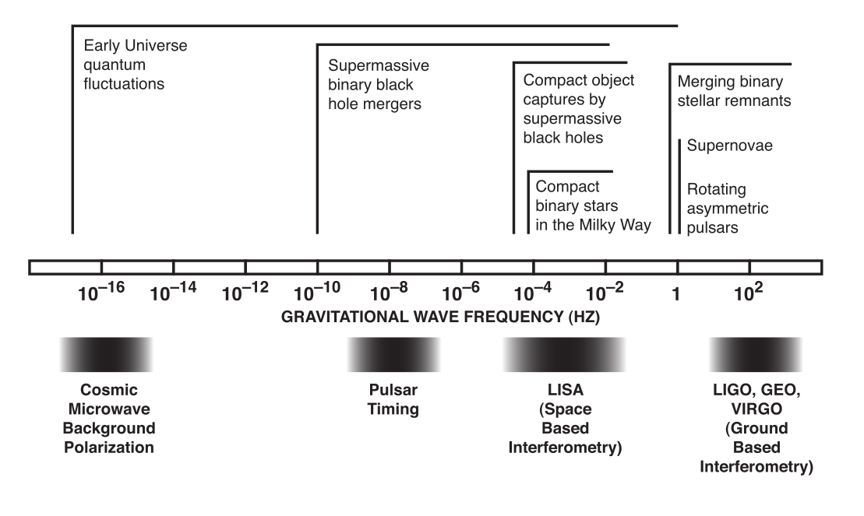
Gravitational Wave Spectrum

Slide 42
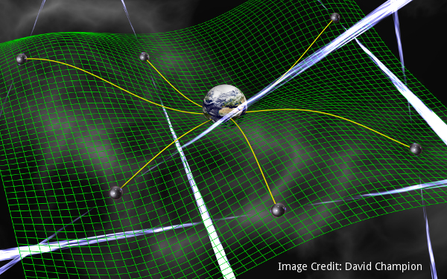
Pulsar Timing Arrays
Millisecond pulsars are very good clocks scattered around the Universe.
By measuring them once in a while, you can detect a hiccup in the reception of the pulse at Earth.
With enough “clocks” you
can decide if there was a
gravitational wave and from
where it may have come.
See chart, sensitive to very,
very long wavelengths, and
thus very, very small
frequencies. Size of the
Universe sort of waves!
Ref: NANOGrav collaboration

Slide 43
Pulsar Timing Arrays
Several collaborations working at radio astronomy facilities to measure millisecond pulsars:
NANOGrav, US and NASA, using Arecibo and Green Bank.
The International Pulsar Timing Array uses many radio telescopes.
The European Pulsar Timing Array
The Parkes Pulsar Timing Array (part of the IPTA)
and others.

Slide 44
Space-Based
Laser Interferometer Space Antenna, LISA, is a set of satellites with lasers bouncing in a triangle arrangement.
  No seismic effects!
  Very long baseline, 2.5e9 m each leg.
  Control of craft subtle, “drag-free flying” with free test masses inside as reference.
Currently mostly European LISA Mission with NASA/US support. LISA could launch in 2037 (factsheet).
  In the hardware testing/development and design phase, soon to choose the aerospace company that will build the spacecraft.
LISA Pathfinder satellite experiment tested several components for eLISA, early 2016.

Slide 45
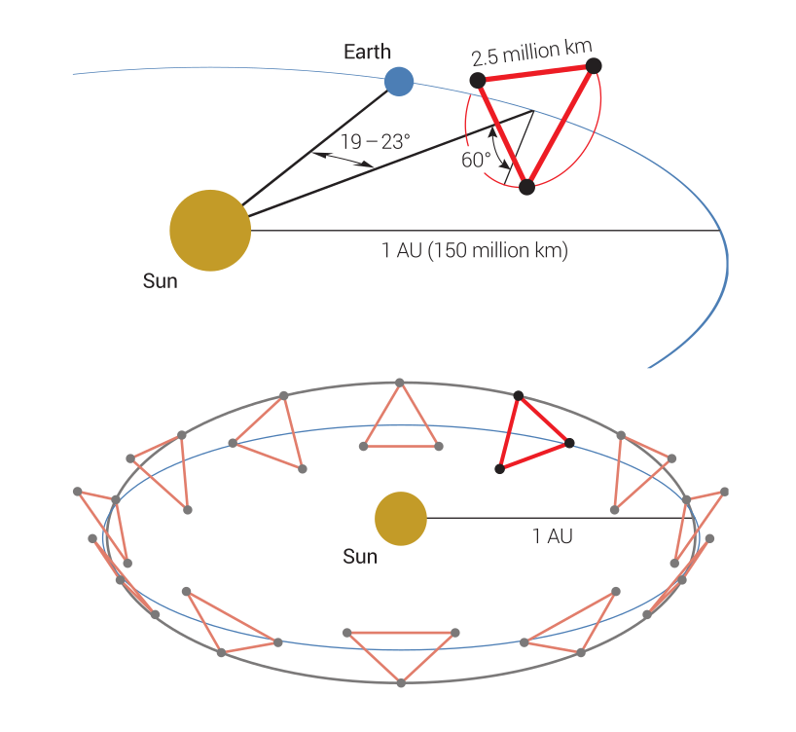
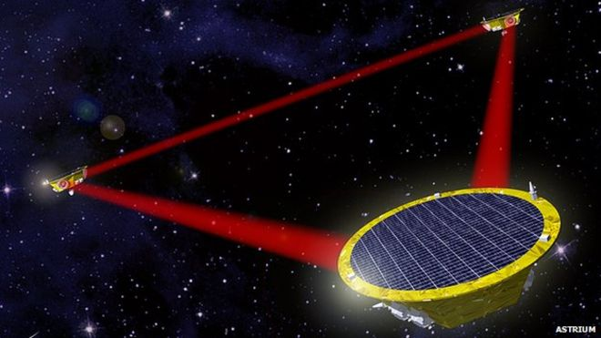
LISA
LISA has a full equilateral triangle of lasers and baseline of 2.5e9 m. ESA mission with NASA participation.
Chinese have two groups working on this idea:
  TianQin
  TAIJI
Credit

Slide 46
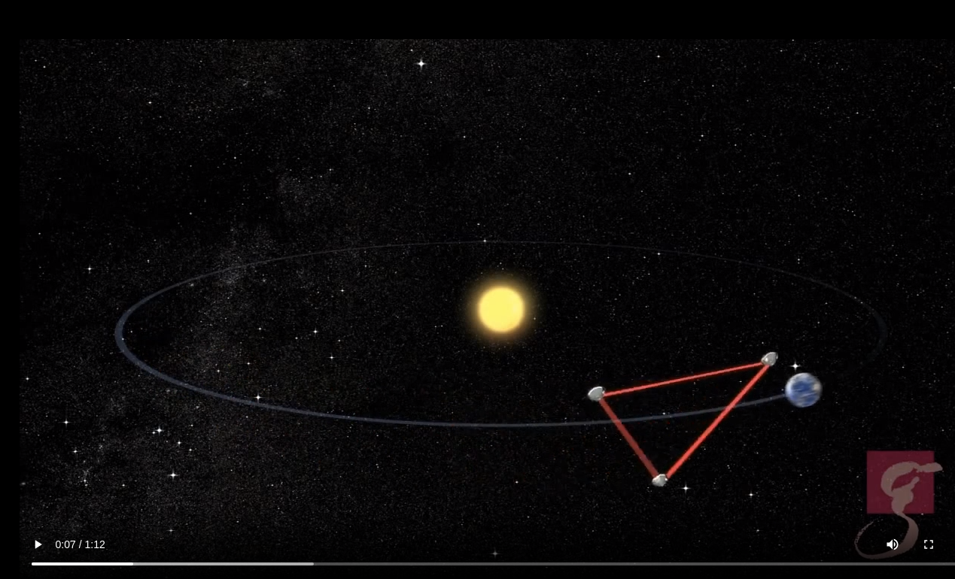
LISA Orbit
https://svs.gsfc.nasa.gov/vis/a030000/a030500/a030569/slide_09-A1_LISA_orbits2.mp4

Slide 47
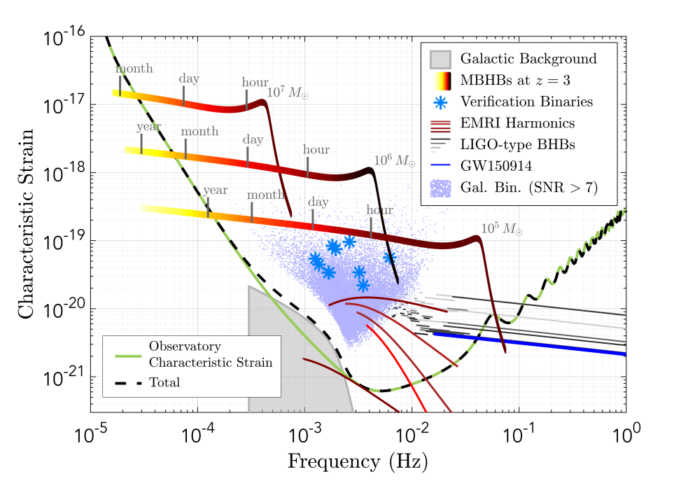
LISA Astrophysical Sources
Credit

Slide 48
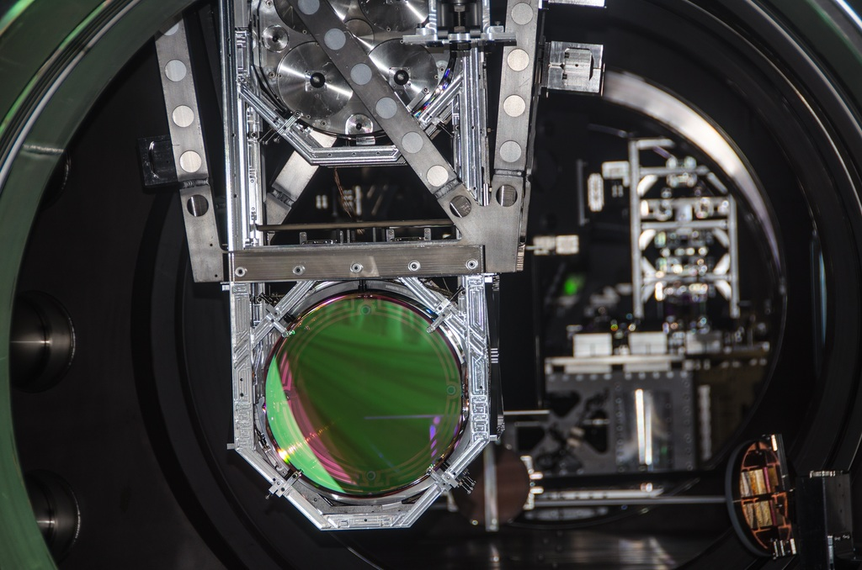
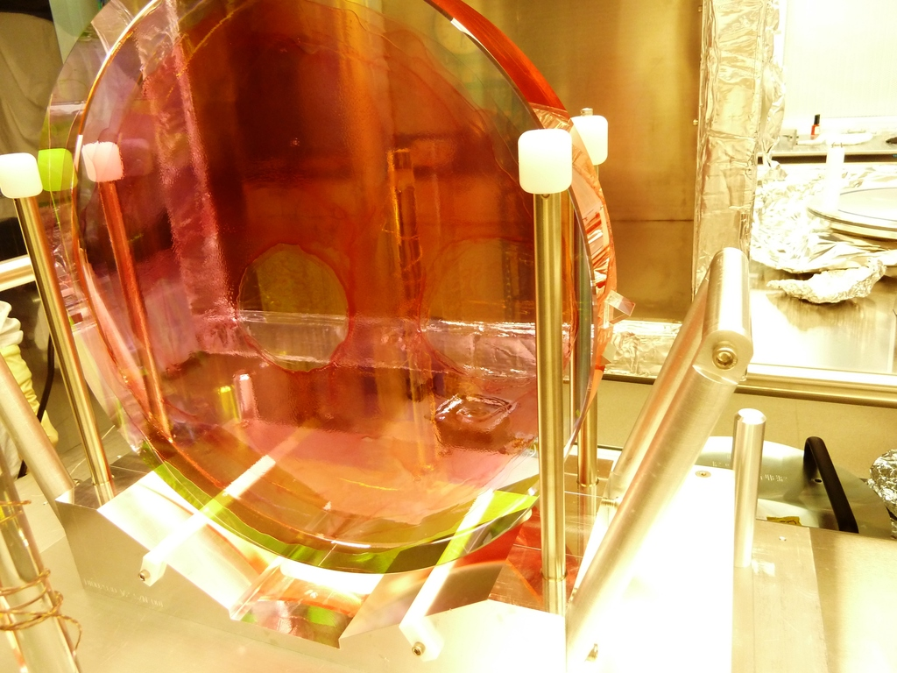
LIGO Hardware
LIGO “Test Mass” in suspension
Beam Splitter

Slide 49


Strain Curve, Strain Sensitivity, Amplitude Spectral Density, Power Spectral Density...OH MY!
“per root Hz” is usually called the strain sensitivity, or sometimes amplitude spectral density

Slide 50


Strain Curve, etc...
Characteristic Strain
Square root of Power Spectral Density is the amplitude spectral density.
Ref: Cole’s online app .

