Slide 1
Vanderbilt Particle Physics
Professors Paul Sheldon, Will Johns,
and Med Webster
Global computing infrastructure to support Particle Physics and other research making use of very large datasets (CMS at the LHC generates 0.5 Petabytes per year)
CMS detector at the CERN Large Hadron Collider, general purpose detector, discovered the source of mass, the Higgs particle

Slide 2
Cosmic Rays, high energy particles coming from space
The particles that hit our atmosphere:
90% protons (hydrogen nuclei)
9% alpha particles (helium nuclei)
remainder solar wind particles and their
debris

Slide 3
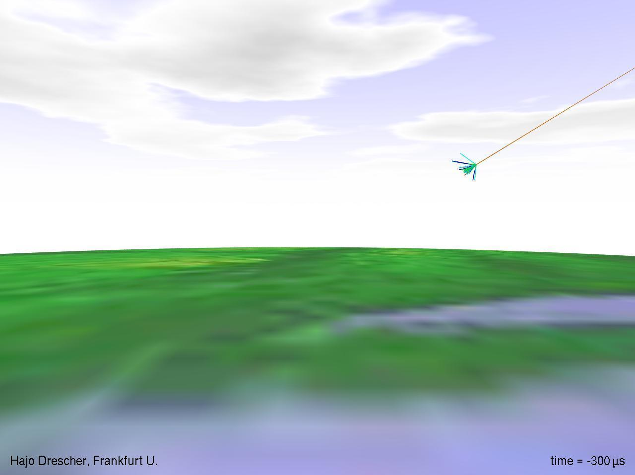
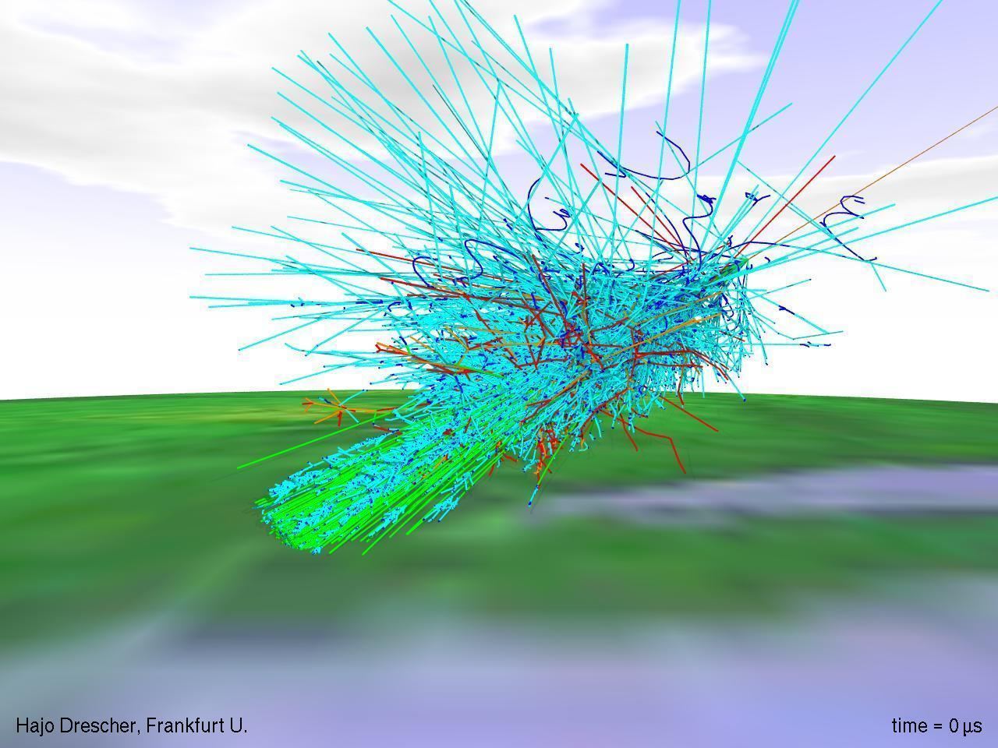

Slide 4
Earth's Surface
The particles that hit our atmosphere clobber the nuclei of the atoms and molecules:
create a shower of x-rays, gamma rays,
and light
also make a lot of muons (like an electron but heavier), with mass 106 MeV (compare to an electron with mass 0.511 MeV).

Slide 5
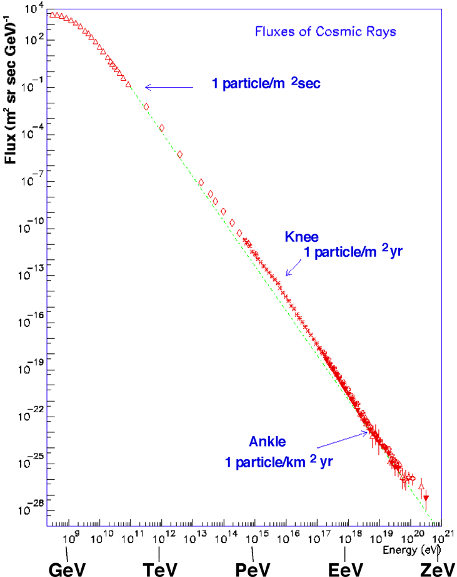
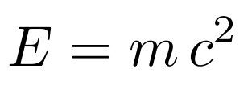
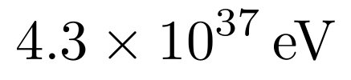
Energy and Quantity
eV is short for electron-Volt,
and gives the energy of an
object...or its mass!
Energy equals mass times
speed of light squared (just
some constant, but a big one)
proton mass 0.924 GeV
electron mass 0.511 MeV
muon mass 106 MeV
my mass
billion
trillion

Slide 6


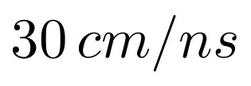
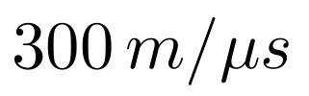

Speed of Light
Fastest possible speed is the speed of light
in vacuum.
Defined as

Slide 7
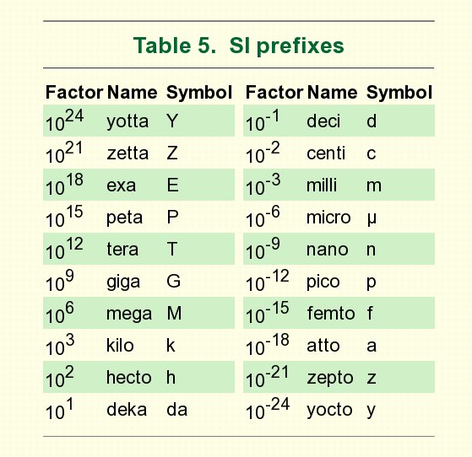
SI Prefixes

Slide 8
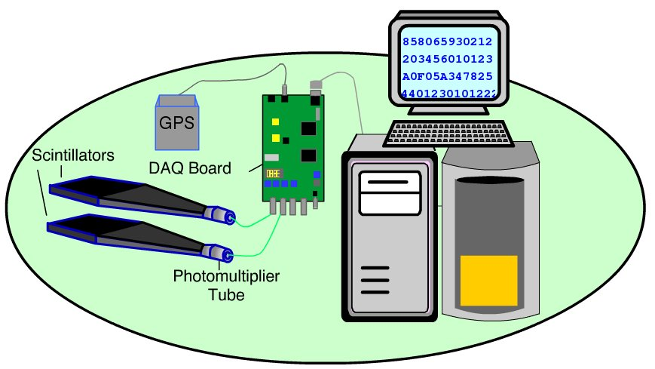
QuarkNet Detectors
Flash description at http://www18.i2u2.org/elab/cosmic/flash/daq_only_standalone.html .

Slide 9
Pieces / Parts
Scintillation Counter: Cosmic Rays create light in the scintillators. The photomultiplier converts light to an electronic pulse.
Data Acquisition (DAQ) Board: When the signal is in a certain range, the DAQ executes onboard logic and processes the signal. The result may be a string of data sent to a local computer.
Computer: The DAQ sends data to a local computer for storage and later analysis. The hexadecimal text includes information on pulse size and GPS time for signals from each counter.

Slide 10
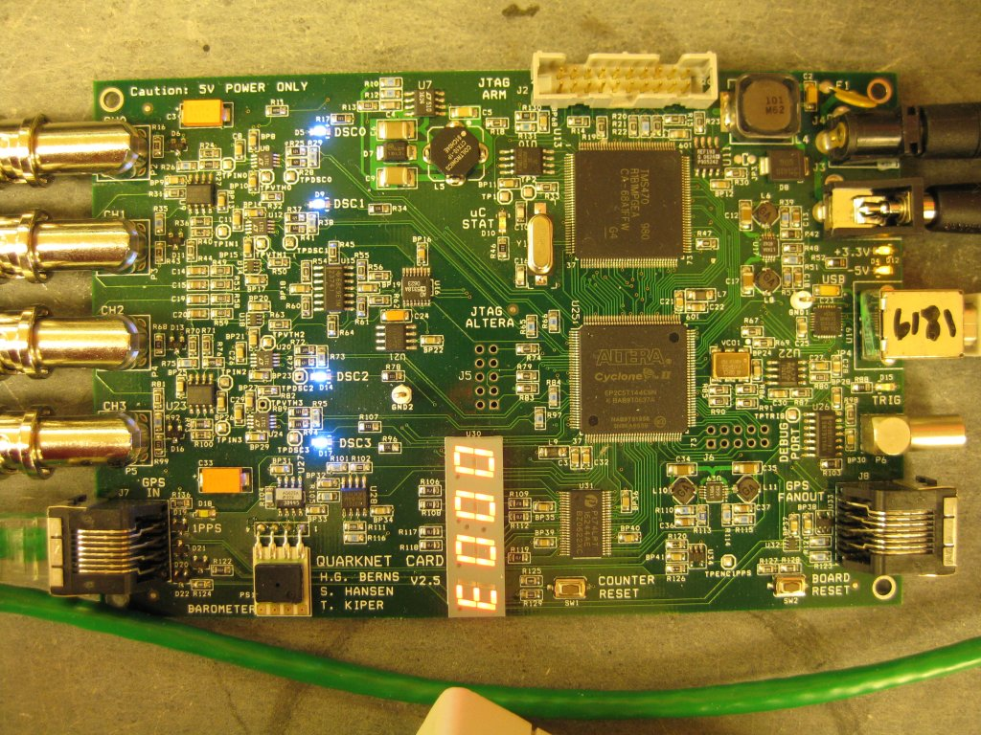
Detectors Details 1/3
DAQ board is Quarknet v2.5. It has 4 coax connectors for the PMT, and ethernet for the GPS, USB to communicate with the computer, input power, and a power out to an electrical box that powers the 4 PMTs. PMT voltages are no. 1, 550V; no. 2, 735V; no. 3, 925V, and no. 4, 885V, approximately.
Power IN and OUT
to Power Cond. for
the PMTs
Coax from PMT
USB to Computer
GPS Conn

Slide 11
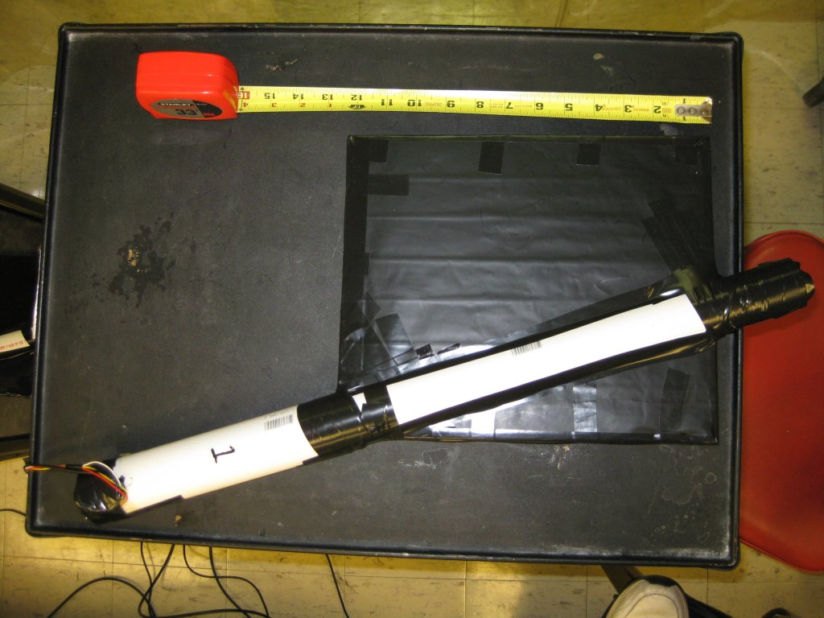
Detectors Details 2/3
Scintillator "paddle" is 12x10 inches connected to a cylindrical photomultiplier tube (PMT).

Slide 12
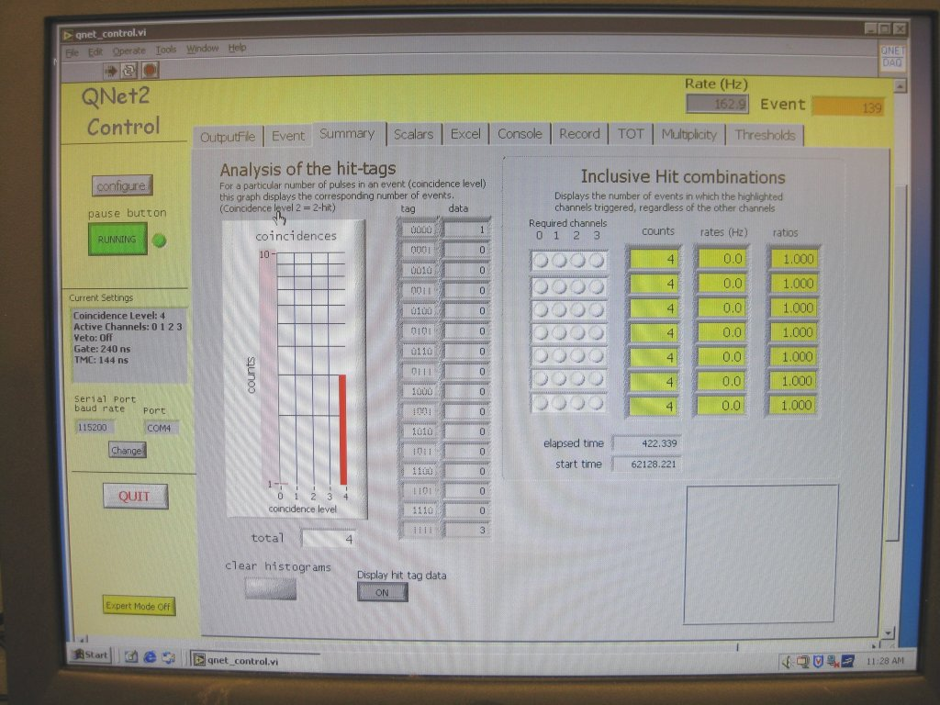
Detectors Details 3/3
On the computer a program written in LabView configures the DAQ card, receives the data, and writes to the computer files.

Slide 13
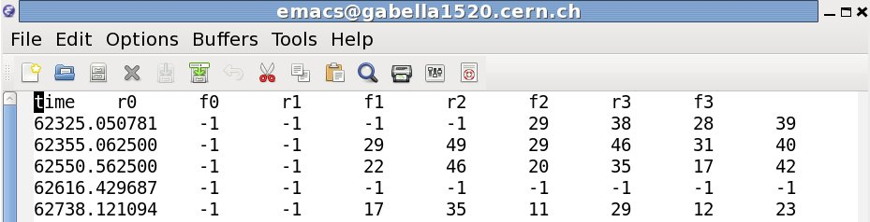
Data Handling - Spreadsheet 1/4
You must take data in the Excel tab, presumable a file with a CSV extension. The file is actually "tab separated." In an editor...
time - the time stamp in units of seconds
r0, r1, r2, r3 - the time at the rising edge of the corresponding PMT pulse
f0, f1, f2, f3 - the time at the falling edge of the corresponding PMT pulse
rN and fN time is in “ticks,” 40/32 ns = 1 tick. Older boards use 24/32 ns = 1 tick. The two boards use two different internal clocks, new at 25.0 and older at 41.666 MHz.
Google Drive folder, http://drive.google.com

Slide 14
Data Handling - Spreadsheet 2/4
Copy the file, xxxx.csv into your Google Docs/Drive area.
Rename it xxxx.tsv (for tab separated values).
Right Click and open the file the Google Sheets.
Extend out the columns for our calculations: click on column “I” (the last one) and extend the column 1 right. You can use the down arrow that shows in the column. Add about 6 columns.
Leave one blank column between the left table of numbers and the set we will calculate.
In the next column over, “K”, put a title like “r3-r1” (that is the difference in the risetime for paddle no. 4 and no. 2).
Under that column create a math formula for the difference, sometime like “=h2-d2” and then Copy and Paste for the whole column. Check a couple of the numbers by eye/hand. Make sure it is working.
If there were no other delays in the signals to the computer, that column would give the speed of the particles through the paddles.

Slide 15
Data Handling - Spreadsheet 3/4
Start looking at the differences of the risetimes.
The units on the rise and falltimes is 40/32 ns = 1.25 ns.
Remember the speed of light in useful units is 30 cm/ns.
For the list of measurements of interest, do some simple statistics in the spreadsheet:
Count the number, “= count(k2:k30)”, find the average or mean, “=average(k2:k30)”, and the standard deviation or spread in the measurements (not the error in the mean), “=stdev(k2:k30)”.

Slide 16
Data Handling - Spreadsheet 4/4
Particle Physicists love to plot "histograms" or frequency plots. In Spreadsheets you use the “frequency” function to make a column of frequency data and then you plot it as a Scatter plot.
It looks something like “=frequency(k2:k30; n2:n21)”. The data is k2:k30 and the set of numbers to use as bins are n2:n21.

Slide 17
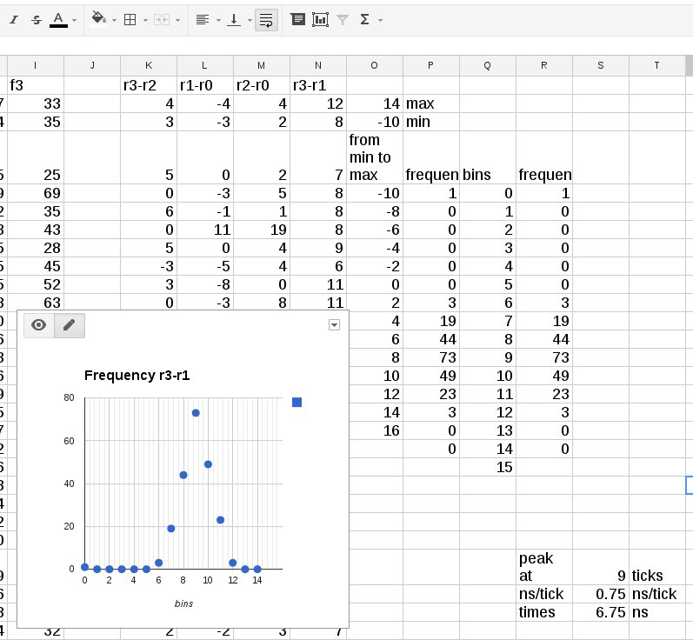
Create bins anyway you can
In top cell, =frequency(N2:N216,O5:O18)

Slide 18
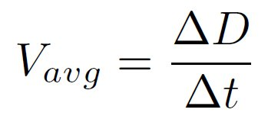
Data Handling - Results
Look for changes in time that are all about the same.
Toss out any obviously bad data
Remember average speed is "change in distance / change in time"

Slide 19
Websites:
Vanderbilt Particle Physics, http://www.hep.vanderbilt.edu/~focuser/index.php
Particle Adventure, http://www.particleadventure.org
Interactions (news), http://www.interactions.org/cms
Compact Muon Solenoid at the CERN LHC, http://cms.cern.ch
Cosmic Rays (wikipedia), http://en.wikipedia.org/wiki/Cosmic_ray
QuarkNet, http://quarknet.fnal.gov
Cosmic Ray e-Lab, http://www18.i2u2.org/elab/cosmic/home/
Detector Description, http://www18.i2u2.org/elab/cosmic/flash/daq_only_standalone.html
New Manual for DAQ Card

