Slide 1
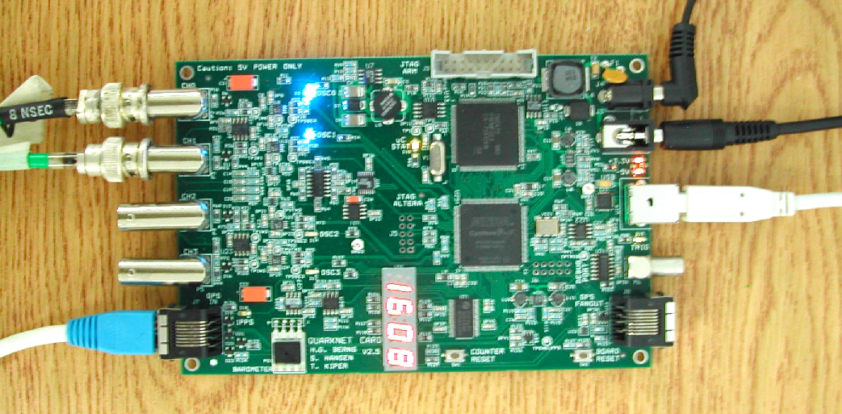
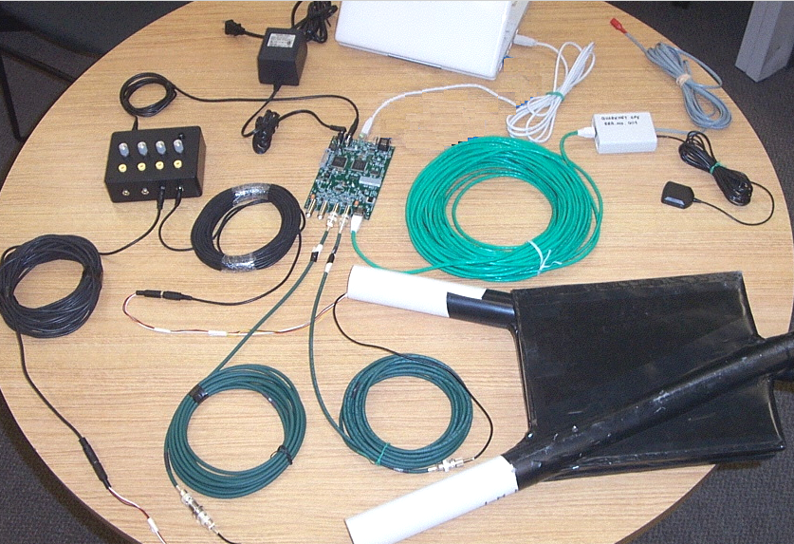
QuarkNet 2024 - Vanderbilt University
17-21 June 2024
Welcome!

Slide 2
QuarkNet 2024 - Vanderbilt University
17-21 June 2024
Meeting in Vanderbilt Physics Stevenson Center SC6322.
Monday, Introductions, News, and Talks,
Tuesday, Muon decay
Wednesday, Muon decay, day 2, Juneteenth!
Thursday, Speed-of-light (muons)
Friday, Telescope and Shower mode and Shielding, must do items and survey

Slide 3
Administration
Check-ins around the room.
Sign the attendance sheet.
Our Admins will send links to set new folks up as “vendors” for Vanderbilt, all legit and for paying the stipends.
We have three working sets of cosmic ray muon detectors (CRMDs) and have laptops for datataking and control.
We use the “standard” Java program Equip to control the boards/detectors. Though simpler programs are possible.
Registration and Survey for QuarkNet Central, links on the must-do-items page. Time for Survey Friday.
This years and prevous talks and data sets at GitHub Vanderbilt-QuarkNet Workshops

Slide 4
Lunch Venues Near Campus
21st Ave Side (the East side):
West End Side (the West side):
Chipotle Mexican Grill
Subway Sandwich
Panera Bread
San Antonio Taco Co.
Taco Mama-Hillsboro Village
Double Dogs
Shokku Ramen
Hopdoddy
Jason’s Deli
Jersey Mike’s Subs
Oscar’s Taco
I Love Sushi
Martin’s Bar-B-Que
Wendy’s
Bombay Palace
Taziki’s Mediterranean Cafe
And Many More...

Slide 5
Week’s Agenda
Agenda in Google Docs
Google Doc Agenda Vanderbilt-QuarkNet 2024
Zoom Link, not guaranteed
Vanderbilt QuarkNet Zoom Link

Slide 6
Monday Schedule
News and Talks
8:30-9:00am Bill Gabella, administration and news
9:00-10:00am Nick Spurlock (BME), PCR, LDNA, and CASPAR
10:00-10:10am Break
10:10-11:10am Bill Smith and Krystal Ruiz-Rocha, Gravitational waves and news from LIGO and LISA
11:10-12:10am Will Johns, The Pixel Detector and CERN
12:10-1:30pm Lunch
1:30-2:30pm Aaron Stemo, Quasars/AGN
2:40-3:40pm Roman Berens, Black Holes and theoretical physics
3:40 – 4pm Think about the use of the weeks material for use in the classroom, see the Guide to Teacher Implementation Plan Development . We will discuss and brainstorm these Friday.

Slide 7
Tuesday Schedule
Google Docs Agenda
Muon Decay, CRMDs, eLabs and Python
12:00-1:30pm Lunch

Slide 8
Wednesday Schedule
Google Docs Agenda
Muon Decay, CRMDs, eLabs and Python
12:00-1:30pm Lunch

Slide 9
Thursday Schedule
Google Docs Agenda
Speed-of-muons, systematics
12:00-1:30pm Lunch

Slide 10
Friday Schedule
Google Docs Agenda
Finish Projects, Discuss Classroom Application, Administration/Surveys
12:00-1:30pm Lunch

Slide 11
Friday Schedule
Last Day, telescope, shower, implementation plans, survey, miscellaneous
Morning Discuss and maybe demo telescope and shower modes.
12:00-1:30pm Lunch
Afternoon Must do items, update survey, CRMDs, and all other business.
o If a teacher completed the Full Teacher Survey anytime in 2023, then complete the UPDATE: 2024 Teacher Survey (once during 2024).
https://www.surveymonkey.com/r/JNRN6BD Plan for ~6 minutes here.
oo OR...Spanish version of Update Survey: https://www.surveymonkey.com/r/JNP67QJ
o If a teacher did NOT complete the Full Teacher Survey anytime in 2023, then complete The Full Teacher Survey. https://www.surveymonkey.com/r/G8P3C8R We ask that an individual teacher complete this only once in 2024. Plan for ~15-20 minutes here.

Slide 12
Useful Links
CRMD User Manual
https://github.com/gabella/VandyQuarkNet/tree/master/manuals
Vanderbilt QuarkNet “Drupal” group page: http://quarknet.i2u2.org/group/vanderbilt-university-quarknet-center
Vanderbilt QuarkNet Site, GitHub: https://github.com/gabella/VandyQuarkNet
Vanderbilt QuarkNet Site, older web pages: http://www.hep.vanderbilt.edu/~gabellwe/qnweb/
Vanderbilt QuarkNet Workshop 2023 page:
https://github.com/gabella/VandyQuarkNet/tree/master/quarknet2023
QuarkNet Cosmic Ray eLab Teacher page: http://www.i2u2.org/elab/cosmic/teacher/
QuarkNet CMS eLab page: http://www.i2u2.org/elab/cms/home/project.jsp

