Slide 1
LISA Noise Curves - Consider Cornish and Robson arXiv 1803.01944v1 and Maggiore Chapter7
Bill Gabella
20180410
Refs:
Maggiore, Gravitational Waves, Chapter 7
Cornish and Robson, The construction and use of LISA sensitivity curves,
arXiv 1803.01944v1

Slide 2
Some Points about our Exops
Exop GW frequencies are low compared to either the round-trip time in a LISA arm (16.7 s) as a frequency, 60 mHz, or compared to f_star = c/(2pi L) which is 19.1 mHz.
Highest Exop GW frequency, see histogram in PrettyPlotsGWStrainEtc notebook, is XXXX
This puts us in the “LIGO Limit” where the LISA “signal response function of the instrument” (sky and polarization averaged) is the same at LIGO, \cal R = 1/5 per channel.
Oh yeah, C&R say that there are two independent Michelson interferometer channels below f_star and three above f_star.
So you can multiply signal, usual \cal R, by 2 or 3.
That is Sky and Polarization averaged.

Slide 3
Links
Cornish and Robson, https://arxiv.org/abs/1803.01944
aa

Slide 4
Backup

Slide 5
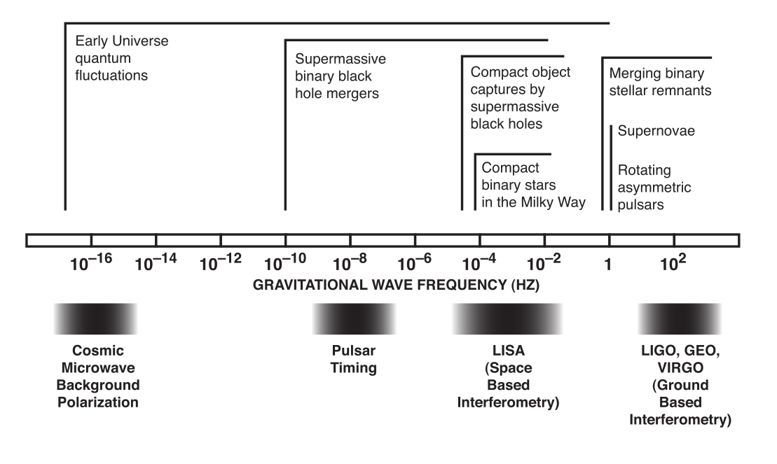
Gravitational Wave Spectrum

Slide 6
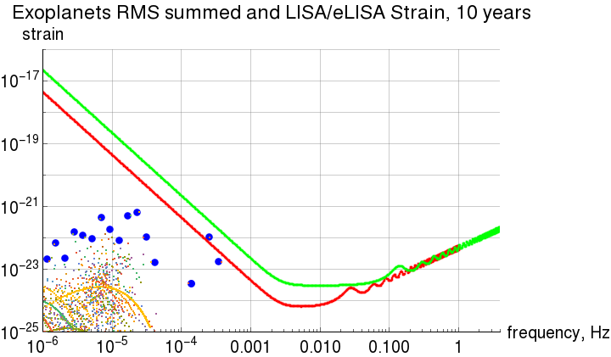
Strain from Exoplanets
WRONG!!
from 2016 work
Exop PSR J1719-1438,
“Diamond Planet”
WRONG!!
Notes:
http://www.ast.cam.ac.uk/~cjm96/noise_curve.pdf

