Slide 1
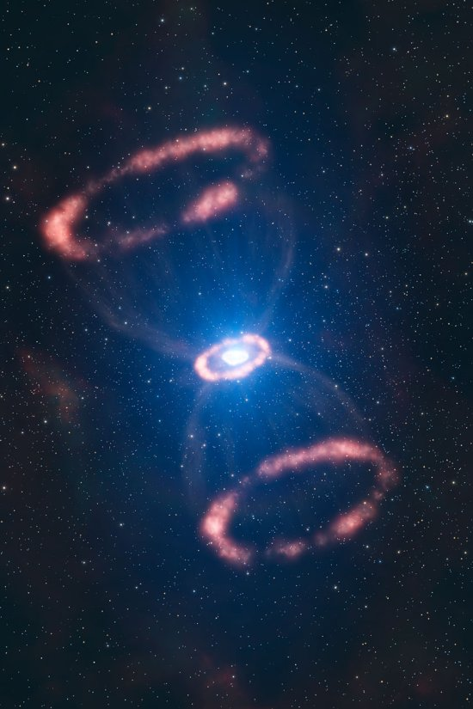

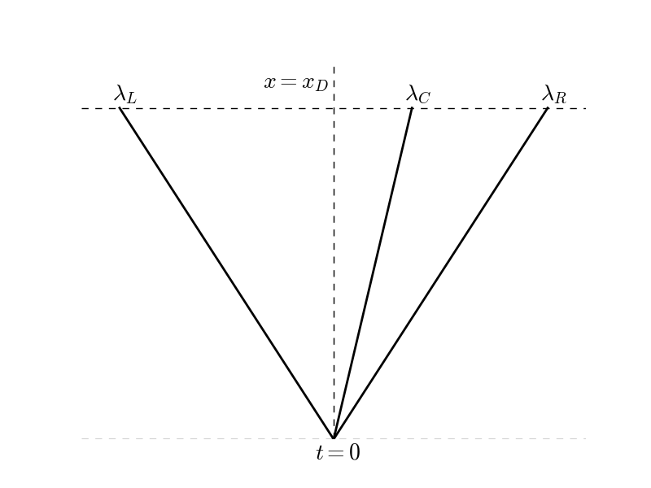
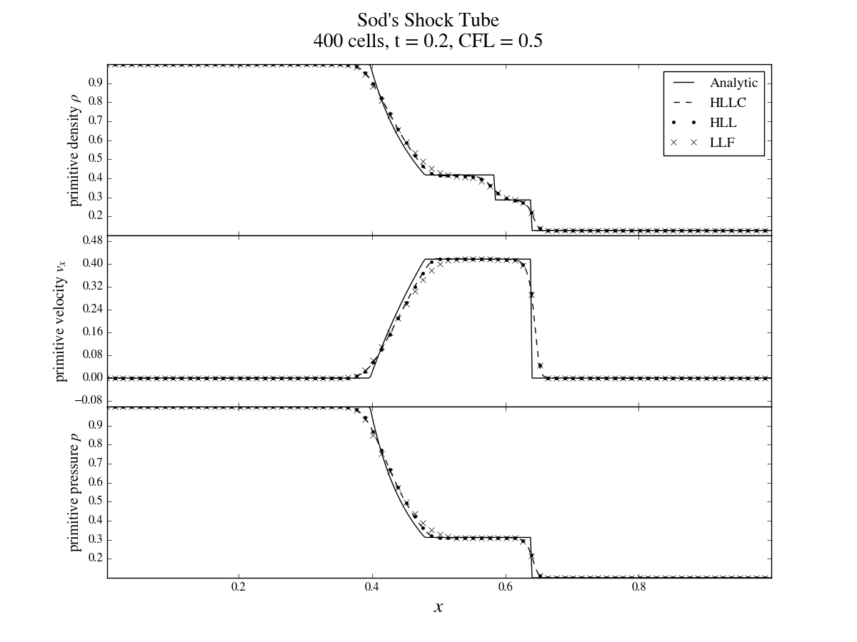
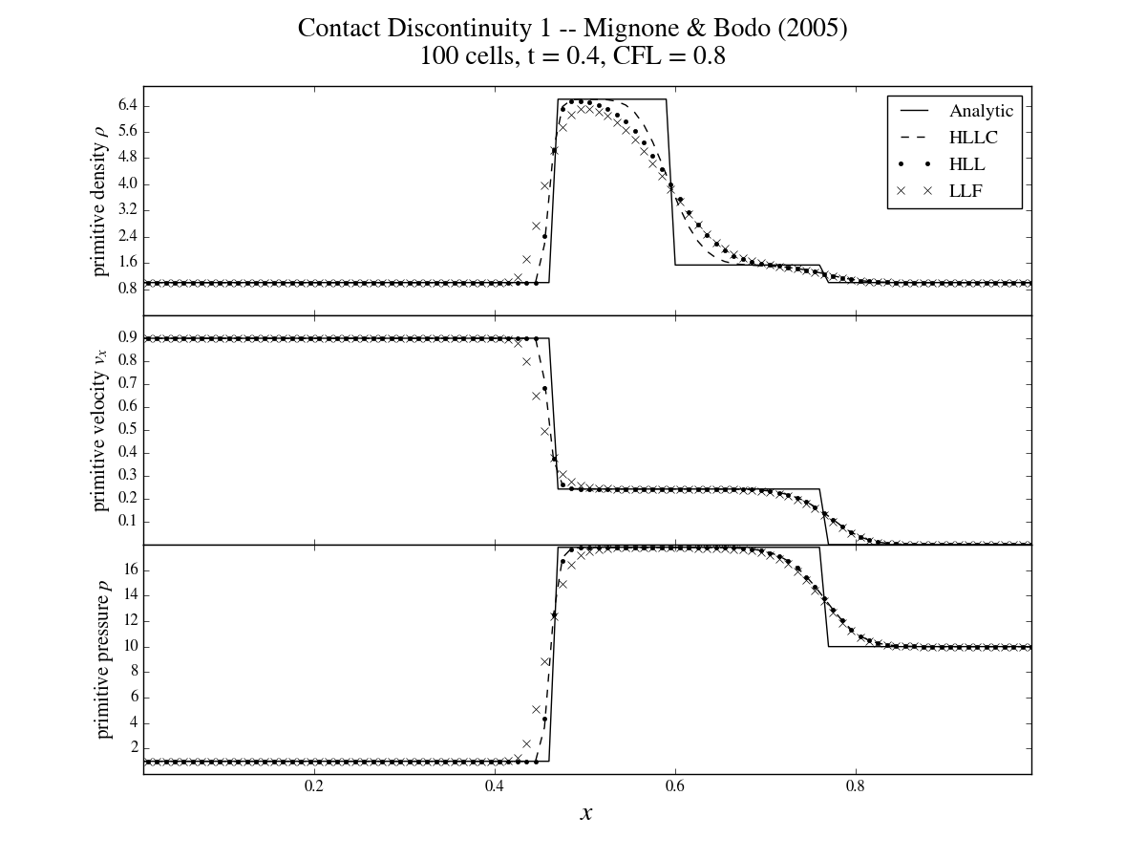
Comparing Three Riemann Solvers for Relativistic Hydrodynamics
Sam Dunham¹, Eirik Endeve^{2,3}, Anthony Mezzacappa^{2,3}
¹Fisk University, Department of Life and Physical Sciences, 1000 17th Ave N, Nashville TN, 37208
²University of Tennessee, Department of Physics and Astronomy, 401 Nielsen Physics Building, 1408 Circle Dr, Knoxville TN, 37916
³Oak Ridge National Laboratory, 1 Bethel Valley Rd, Oak Ridge TN, 37830
Background
Understanding the mechanism behind core-collapse supernovae is a fascinating question in and of itself, but its solution also has implications for topics such as metal distribution in the universe. This complex problem involves several moving parts, one of which is the transport, mixing, and redistribution of relativistic fluids, hydrodynamics. The governing equations are complex and non-linear, and therefore require numerical solutions. Finding stable and robust methods is very important because in order to draw a meaningful conclusion we need to know that the results we obtain are accurate and reliable.
Discontinuous Galerkin Approach
Discretize the spatial domain
Assume that the solution can be represented by a polynomial
Assume a number of points, or nodes, in each spatial element, say Np
These polynomials are local, i.e. they are discontinuous at the cell interfaces with the polynomials in the adjacent cells
This sets up a Riemann problem at each interface
Riemann Problem
Fluid-filled tube separated into two states by a divider
Different values of density, velocity, and pressure on either side of the divider – a discontinuity
At t = 0 the divider is removed and the fluid evolves according to the conservation of mass, energy, and momentum
How do the variables evolve—Riemann Fan (see figure)
The Three Solvers
Local Lax-Friedrichs (LLF)
Consider left and right moving waves to move with same speed
  Requires an estimate for the wave speed
Ignores contact discontinuity
Works for all hyperbolic conservative systems
Harten-Lax-van-Leer (HLL)
Consider left and right moving waves to move with different speeds
  Requires two estimates, one for each wave
Ignores contact discontinuity
Works for all hyperbolic conservative systems
Harten-Lax-van-Leer Contact (HLLC)
Consider left and right moving waves to move with different speeds
  Requires two estimates, one for each wave
Takes contact discontinuity into account
  Requires estimate for the contact wave speed
  This adds computational expense
Uses the fact that we are solving hydrodynamics equations
Test Cases: Riemann Problems
Sod's Shock Tube
Contact Discontinuity
Density: ρ
Velocity: v
Pressure: p
Γ: 4/3
Initial Conditions:
ρL = 1, vL = 0, pL = 1
ΡR = 0.125, vR = 0, pR = 0.01
Shocks around x = 0.4 and x = 0.65
The shock at x = 0.65 is a shock front, a point where the primitive variables change abruptly over a small spatial region.
The shock at x = 0.4 is the head of a rarefaction wave
Looking at the density around x = 0.57 we see another discontinuity. This is the contact discontinuity. Its defining feature is that it is discontinuous in the density but continuous in the velocity and pressure
Density: ρ
Velocity: v
Pressure: p
Γ: 4/3
Initial Conditions:
ρL = 1, vL = 0.9, pL = 1
ρR = 1, vR = 0, pR = 10
Very relativistic, v = 0.9c
Shock front around x = 0.8
The HLLC solver clearly captures the contact discontinuity better than both the LLF and HLL solvers
Approximate solvers do not capture the shock very well. This diffusiveness improves with a finer grid spacing
Conclusions and Future Work
Since the HLLC solver clearly does a better job of capturing the contact discontinuity, and because the contact discontinuity plays an important role in the physics of supernovae, we conclude that despite its added computational expense it is certainly the best choice for a Riemann solver.
With a Riemann solver chosen the next step will be to implement it in the code, which will involve deriving the appropriate equations from general relativistic hydrodynamics.
References
Harten, A., Lax, P.D., and van Leer, B. 1983, SIAM Re- view, 25(1):35,61
Mignone A, Bodo G Monthly Notices of the Royal Astronomical Society, vol. 368, issue 3 (2006) pp. 1040-1054
Background image from: https://taliasworld.files.wordpress.com/2013/07/p0320ay.jpg
Acknowledgments
We would like to thank the NSF for helping to fund this research:
NSF GP-1505933
We would also like to thank the GAANN program for helping to fund this research:
Department of Education P200A150173

