Slide 1





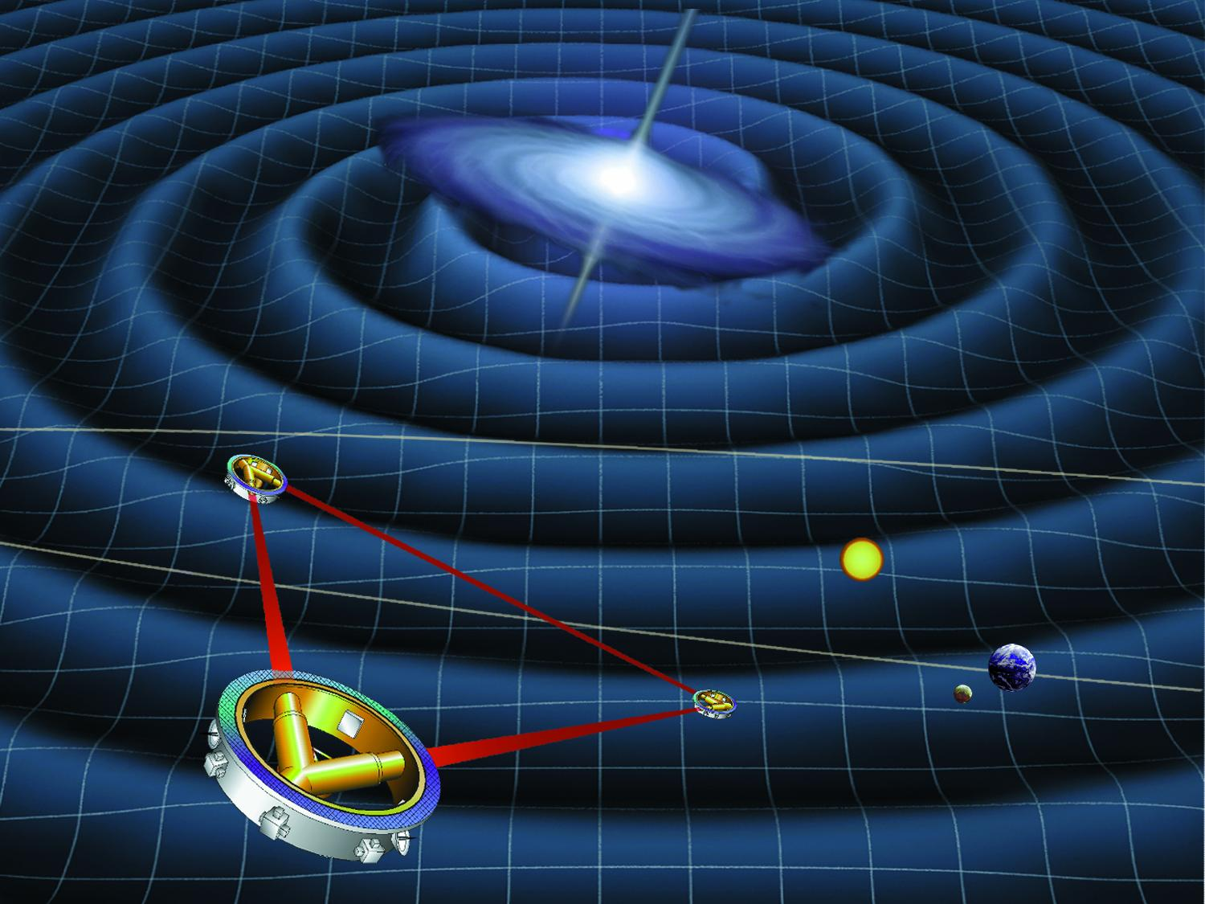
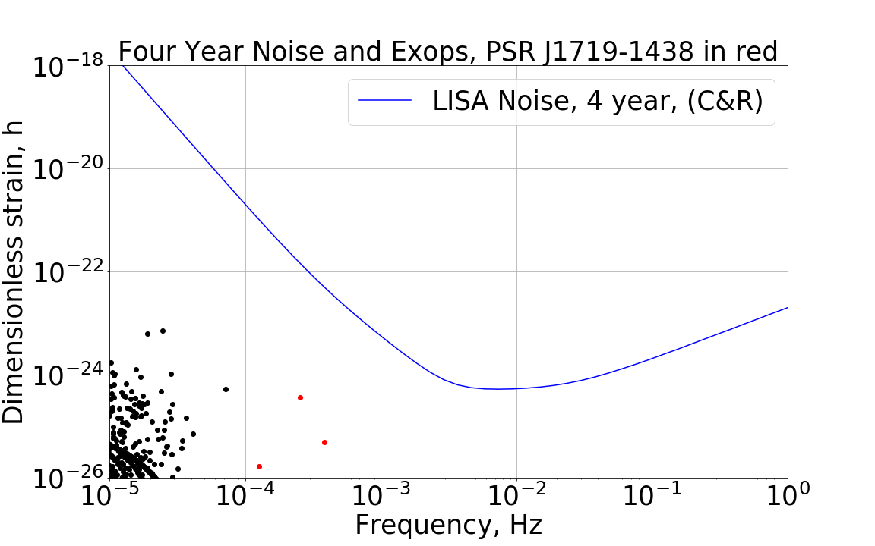
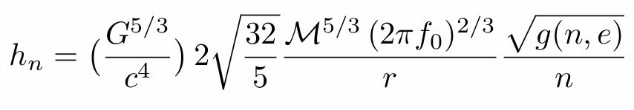
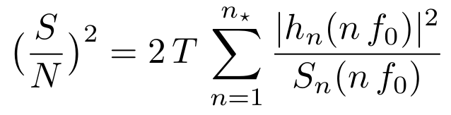
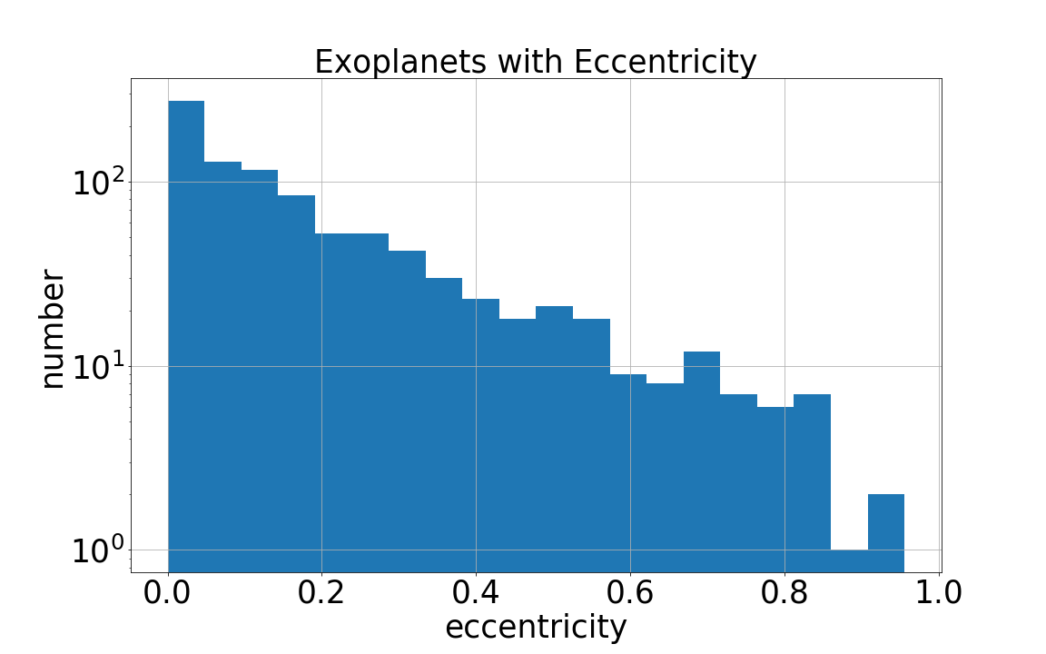
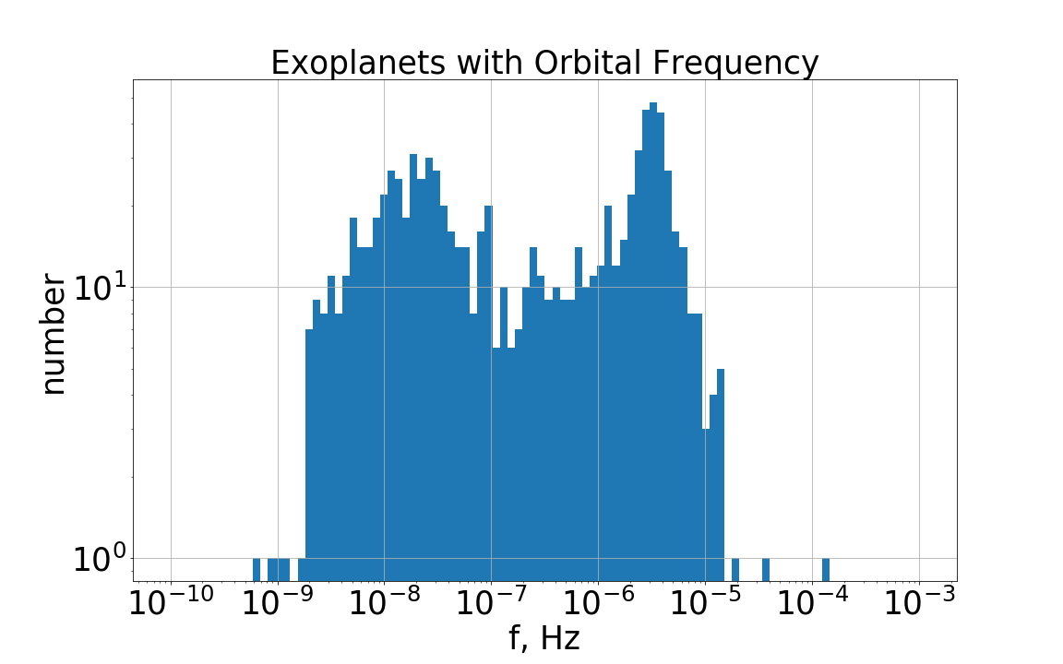
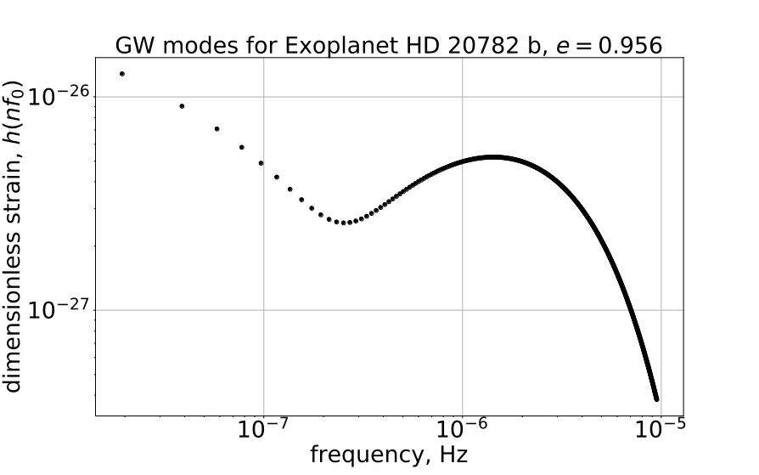
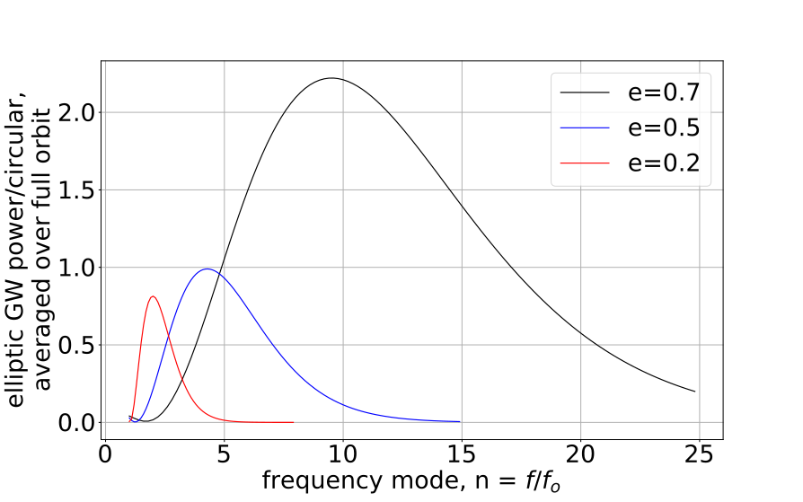
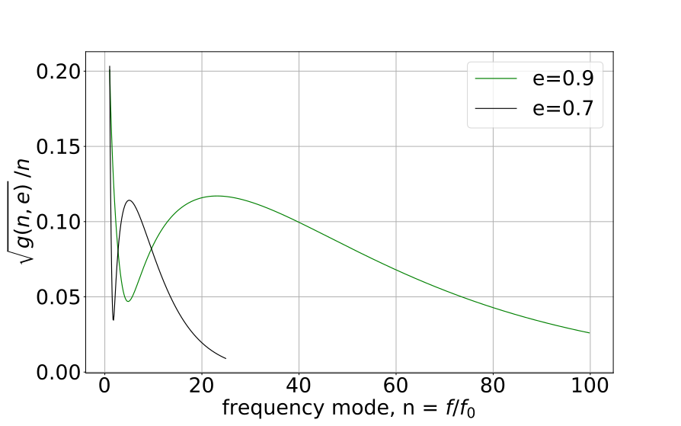
Music of the Spheres: the gravitational wave signal from exoplanets
William Gabella¹, Katelyn Breivik²,Yilen Gomez Maqueo Chew³,Kelly Holley-Bockelmann^{1,4}, Brittany Kamai⁵
1-Department of Physics and Astronomy, Vanderbilt University, Nashville, TN 37235 USA
2-Department of Physics and Astronomy, Northwestern University, Evanston, IL 60202 USA, also Center Interdisciplinary Exploration and Research in Astrophysics (CIERA),
Evanston, IL 60202 USA
3-Instituto de Astronomía, Universidad Nacional Autónoma de México, Ciudad Universitaria, 04510, Ciudad de México, México
4-Department of Physics, Fisk University, Nashville, TN 37208 USA
5-Division of Physics, Math and Astronomy, California Institute of Technology, Pasadena, CA 91125 USA
Motivating Question
With more than 3700 exoplanets discovered to date, could any individual planetary system or population of planetary systems be detected by LISA?
LISA Constellation
(credit NASA)
Exoplanets and LISA
We compare the current exoplanet population GW strains to the most up-to-date LISA noise curve[5] with the following caveats:
exoplanet GW frequencies are much less than laser round trip time (16.7s, equiv 60mHz) or f_star (19mHz), so in the “LIGO Limit”
no frequency evolution assumed over the four year integration time
using the R function, so nominally sky position and polarization averaged
Overview
We consider exoplanets as a source of gravitational waves (GW) for the LISA space-based gravitational wave detector
LISA is the Laser Interferometer Space Antenna, a joint ESA/NASA project expected to launch in 2034
The rich variety of exoplanets include many with high eccentricity which moves their GW spectrum to the LISA band.
Exoplanet GW Modes and
LISA Sensitivity Curve
Theory - GWs from Binaries
Masses in orbit exhibit a time-changing mass quadrupole moment and therefore emit GWs [1,2]. Averaged over a full orbit, the dimensionless strain can be written[3]
where the mass is the “chirp mass” and is m₁^{3/5}m₂^{3/5}/(m₁+m₂)^{1/5}, and h_{n} is at a multiple of the orbital frequency f₀, n f₀ with n=[1,2,3...], and eccentric orbits emit more GW power than similar circular orbits,
g(n,e) = (GW Power at f=n f₀ Elliptical orbit) / (GW Power Equiv. Circ. orbit at f=2 f_{o})
Observed Exoplanets
https://exoplanetarchive.ipac.caltech.edu/
3711 Confirmed Planets as of 12 April 2018
For GW strain calculation we need the following physical attributes of the planetary system: m₁ stellar mass, m₂ planetary mass, r distance to system, e orbital eccentricity, P orbital period. Which leaves 910 exoplanets that we can use for GW calculations.
host star | eccentricity | orbital period(d) | SNR
PSR J1719-1438 | 0.06 | 0.09071 | 0.001331
PSR J2322-2650 | 0.0017 | 0.323 | 4.899E-05
WASP-18 | 0.0092 | 0.9415 | 2.654E-05
KELT-1 | 0.0099 | 1.218 | 1.106E-05
WASP-43 | 0 | 0.8135 | 6.012E-06
WASP-19 | 0.002 | 0.7888 | 1.734E-06
HATS-18 | 0.166 | 0.8378 | 1.649E-06
Signal-to-Noise for top
few planets
Future Work
Consider collections of planetary systems on GW signal
Refine the noise/sensitivity curve analysis
Consider errors in exoplanet parameters for the SNR and noise/sensitivity analysis
Consider what parameters would make a planetary system detectable for LISA
Work our way up the mass scale: brown dwarf binaries, etc.
Eccentricity Increases GW Frequency
g(n,e) Ratio GW Power elliptical to circular
References
1. P. C. Peters and J. Mathews, “Gravitational Radiation from Point Masses in Keplerian Orbit,” Phys. Rev. 131 (1963) 435
2. M. Maggiore, “Gravitational Waves: Volume 1: Theory and Experiment,” Oxford Univ. Press, 2008
3. Amaro-Seoane et al., “Triplets of supermassive black holes: astrophysics, gravitational waves and detection,” Mon. Not. Royal Astro. Soc. 402 (2010) 2308
4. NASA Exoplanet Archive, This research has made use of the archive, which is operated by the California Institute of Technology, under contract with the National Aeronautics and Space Administration under the Exoplanet Exploration Program
5. N. Cornish and T. Robson, “The construction and use of LISA sensitivity curves,” 2018, arXiv:1802.01944
6. A. Ain, S. Kastha, and S. Mitra, “Stochastic Gravitational Wave Background from Exoplanets,” Phys. Rev. D, 91 (2015) 124023, arXiv:1504.01715v2
GW Strain
Strain modes for one
planet and its star

