Slide 1
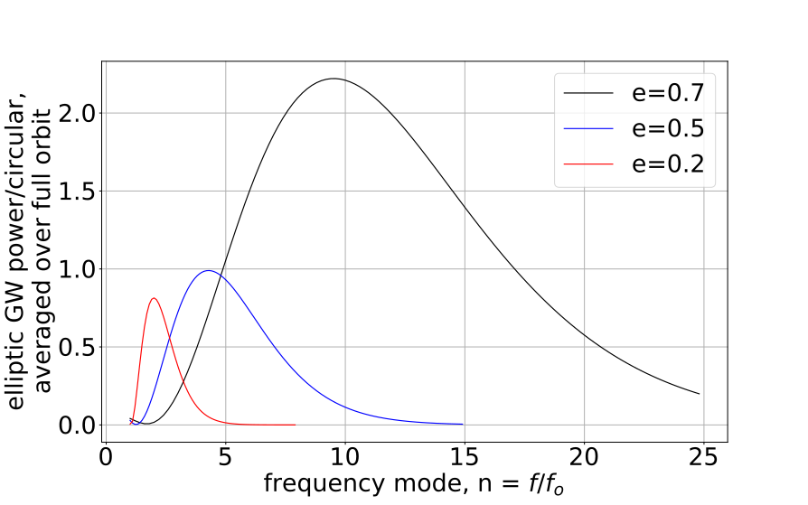
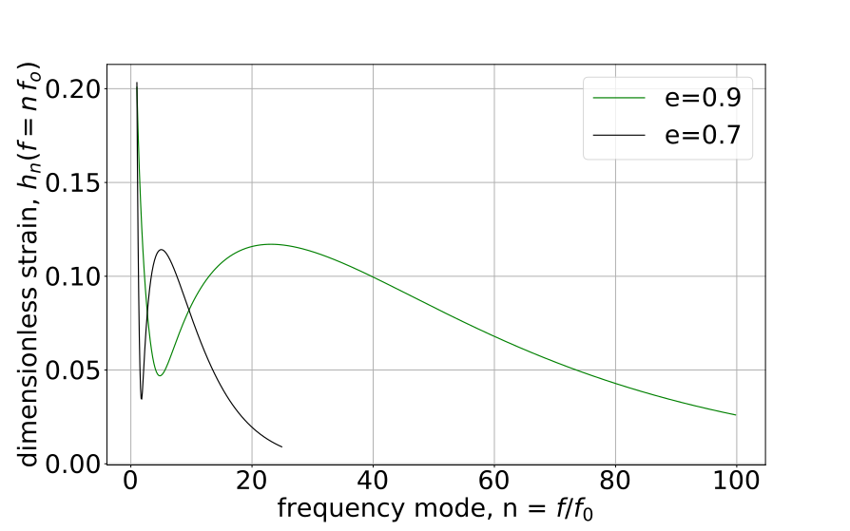
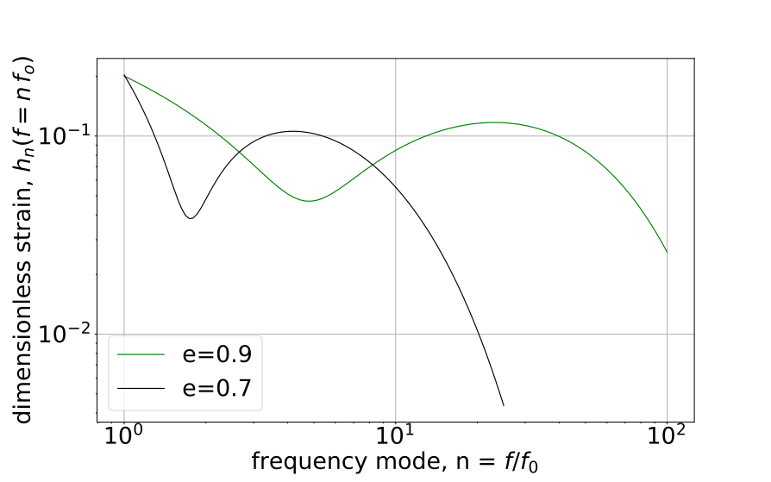
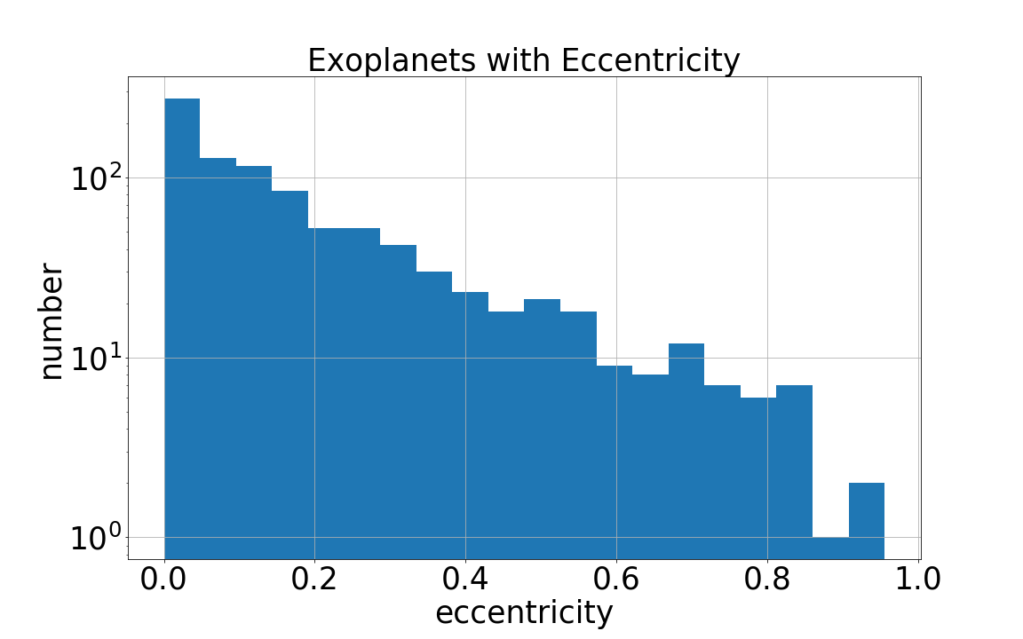
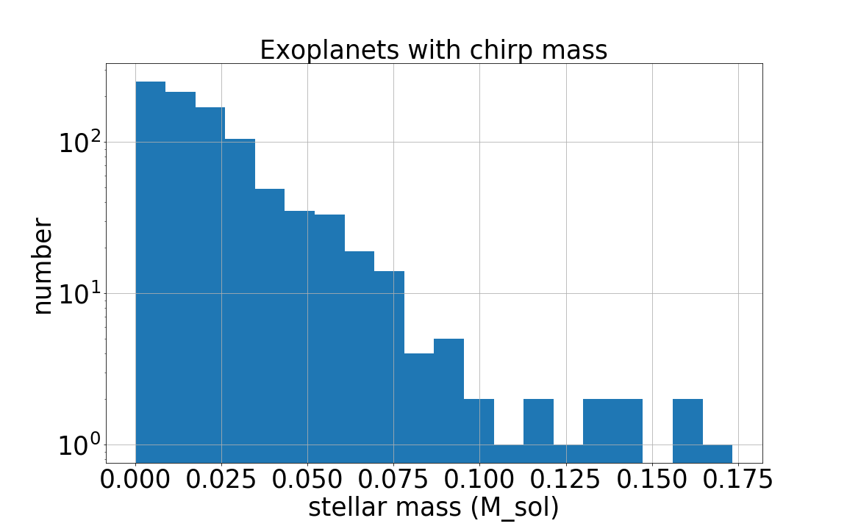
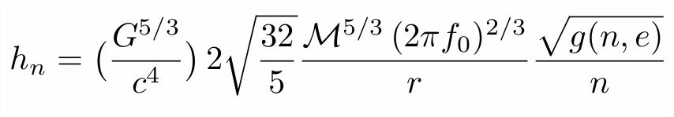
Music of the Spheres: the gravitational wave signal from exoplanets
VU Logo
CalTech Logo
William Gabella¹, Katelyn Breivik²,Yilen Gomez Maqueo Chew³,Kelly Holley-Bockelmann^{1,4}, Brittany Kamai⁵
Fisk Logo
1-Department of Physics and Astronomy, Vanderbilt University, Nashville, TN 37235 USA
2-Department of Physics and Astronomy, Northwestern University, Evanston, IL 60202 USA, also Center Interdisciplinary Exploration and Research in Astrophysics (CIERA),
Evanston, IL 60202 USA
3-Instituto de Astronomía, Universidad Nacional Autónoma de México, Ciudad Universitaria, 04510, Ciudad de México, México
4-Department of Physics, Fisk University, Nasvhille, TN 37208 USA
5-Division of Physics, Math and Astronomy, California Institute of Technology, Pasadena, CA 91125 USA
NW Logo
Abstract
We focus on a class of sources that has been largely ignored in the science case for the Laser Interferometer Space Antenna (LISA), a joint ESA/NASA space-based gravitational wave mission set to launch in 2034: stellar-exoplanet systems. These systems are a billion times closer, if much less massive, than say supermassive black holes, making exoplanets a potentially observable source class. With typical orbital periods of decades, most exoplanets would emit gravitational radiation at much lower frequencies than the current design of LISA. However, exoplanet surveys have unveiled a surprisingly rich variety of systems, from highly eccentric orbits to hot Jupiters to pulsar planets. Here, we investigate the gravitational wave signal from known exoplanets and predict the total signature of exoplanetary systems in the Milky Way.
g(n,e) RatioGW Power
elliptical to circular
UNAM Logo
LISA Sensitivity / Noise
aa
al signature of exoplanetary systems in the Milky Way.
Motivating Question
How weak are exoplanets in gravitational waves? If very weak individually, there are so many, and so close to us, will LISA see this as background?
NASA Exoplanet Archive
https://exoplanetarchive.ipac.caltech.edu/
3711 Confirmed Planets as of 8 April 2018
For GW strain calculation we need the following attributes:
m₁ stellar mass, st_mass
m₂ planet mass, pl_bmassj
r distance to system, st_dist
e orbital eccentricity, pl_orbeccen
P orbital period, pl_orbper
a orbital semi-major axis, pl_orbsmax
Which leaves 910 exoplanets that we can use for GW calculations.
Theory - GWs from Binaries
Masses in orbit exhibit a time-changing mass quadrupole moment and therefore emit GWs (Peters and Mathews, Maggiore). Averaged over a full orbit, they define the function
g(n,e) = GW Power at f=n*f₀ / GW Power Equiv. Circ. orbit at f=2f_{o}
And following Amaro-Seoane et al., the dimensionless strain can be written
where the mass is the “chirp mass” and is m₁^{3/5}m₂^{3/5}/(m₁+m₂)^{1/5}, and
h_{n} is at a multiple of the orbital frequency f₀, nf₀ and n=[1,2,3...].
References
P. C. Peters and J. Mathews, “Gravitational Radiation from Point Masses in Keplerian Orbit,” Phys. Rev. 131 (1963) 435;
M. Maggiore, “Gravitational Waves: Volume 1: Theory and Experiment,” Oxford Univ. Press, 2008;
Amaro-Seoane et al., “Triplets of supermassive black holes: astrophysics, gravitational waves and detection,” Mon. Not. Royal Astro. Soc. 402 (2010) 2308;
NASA Exoplanet Archive, This research has made use of the archive, which is operated by the California Institute of Technology, under contract with the National Aeronautics and Space Administration under the Exoplanet Exploration Program;
N. Cornish and T. Robson, “The construction and use of LISA sensitivity curves,” 2018, arXiv:1802.01944.

Slide 2



junk like my 8.5x11 rectangle for layout
Darn my TexMaths is not working
Three rectangles on previous slide are guides, delete when done
Abstract
stuff
and more stuff

