Slide 1
Sub -test 1
Notes:
Example item

Slide 2
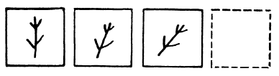
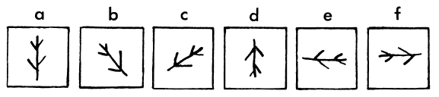
Example
Notes:
Example item

Slide 3
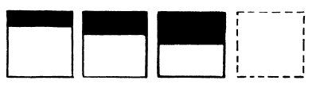
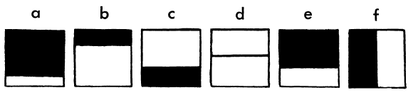
Notes:
Training item

Slide 4
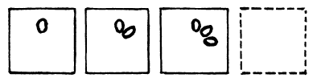
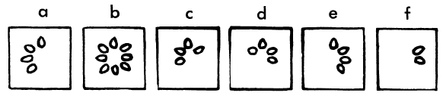
Notes:
Training item

Slide 5
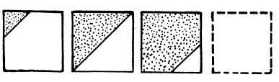
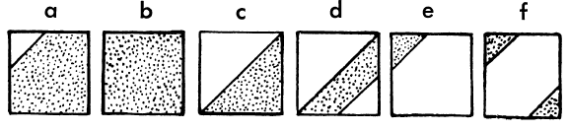
Notes:
1

Slide 6
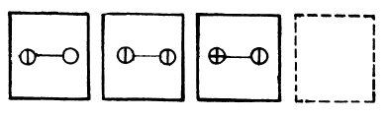
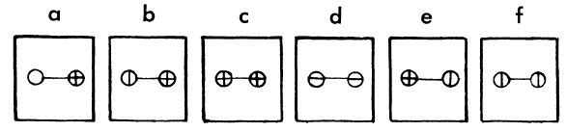
Notes:
2

Slide 7
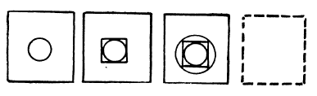
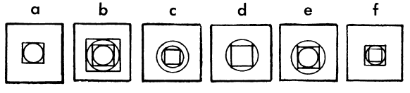
Notes:
3

Slide 8
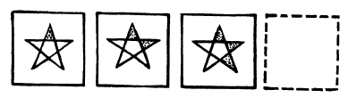
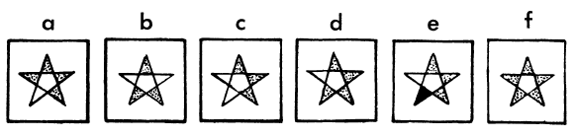
Notes:
4

Slide 9
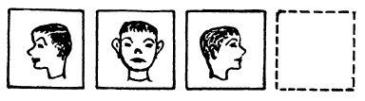
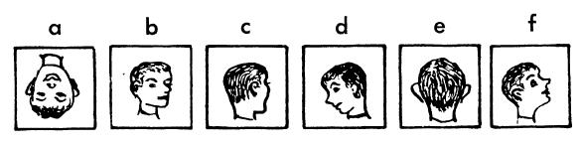
Notes:
5

Slide 10
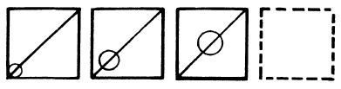
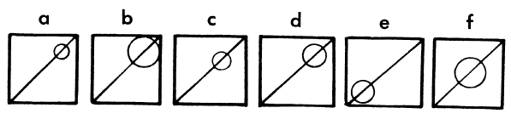
Notes:
6

Slide 11
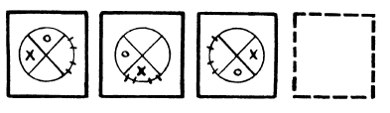
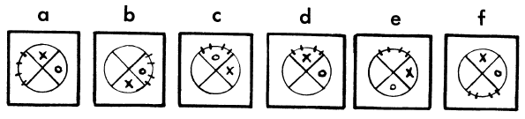
Notes:
7

Slide 12
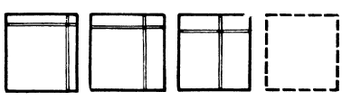
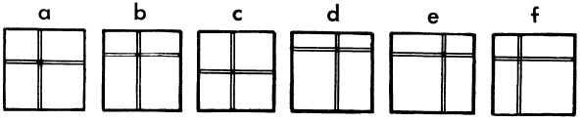
Notes:
8

Slide 13
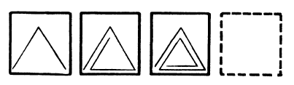
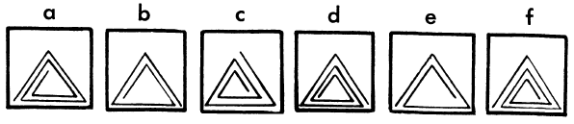
Notes:
9

Slide 14
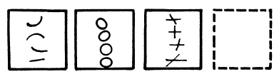
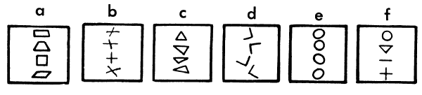
Notes:
10

Slide 15
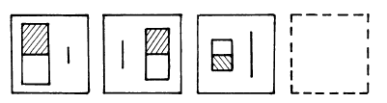
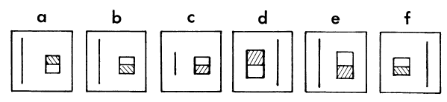
Notes:
11

Slide 16
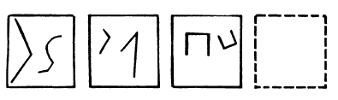
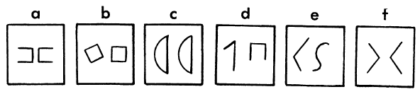
Notes:
12

Slide 17
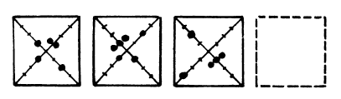
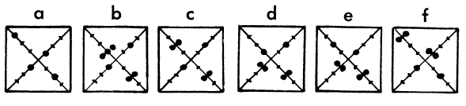
Notes:
13

Slide 18
Sub -test 2
Notes:
Example item

Slide 19
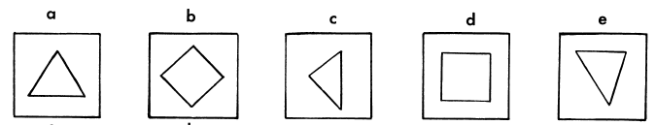
Example
Please select two correct answers:
Notes:
Example item

Slide 20
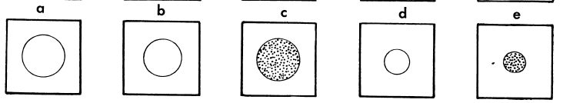
Please select two correct answers:
Notes:
Training item

Slide 21
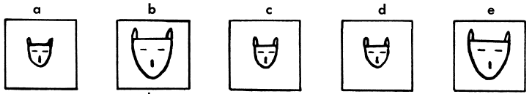
Please select two correct answers:
Notes:
1

Slide 22
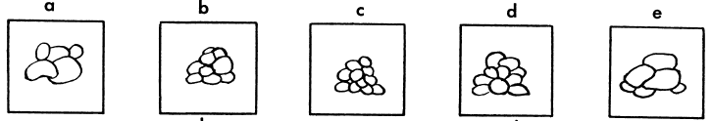
Please select two correct answers:
Notes:
2

Slide 23
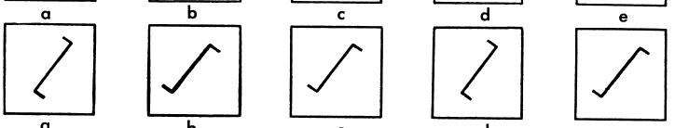
Please select two correct answers:
Notes:
3

Slide 24
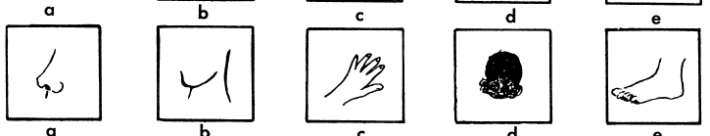
Please select two correct answers:
Notes:
4

Slide 25
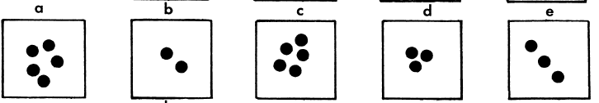
Please select two correct answers:
Notes:
5

Slide 26
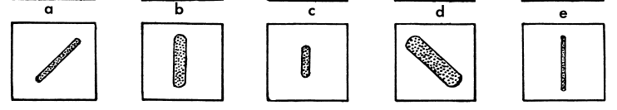
Please select two correct answers:
Notes:
6

Slide 27
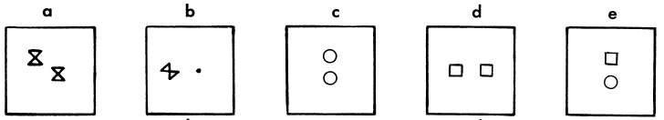
Please select two correct answers:
Notes:
7

Slide 28
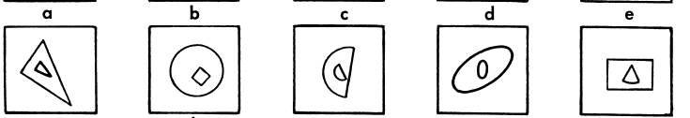
Please select two correct answers:
Notes:
8

Slide 29
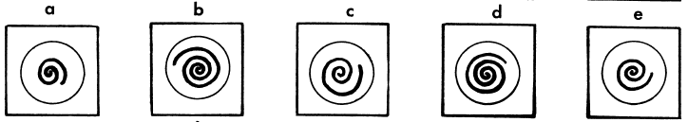
Please select two correct answers:
Notes:
9

Slide 30
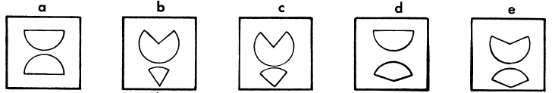
Please select two correct answers:
Notes:
10

Slide 31
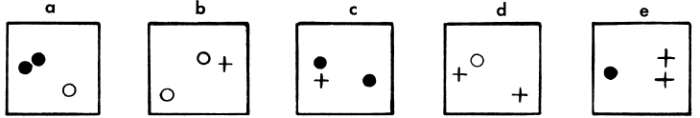
Please select two correct answers:
Notes:
11

Slide 32
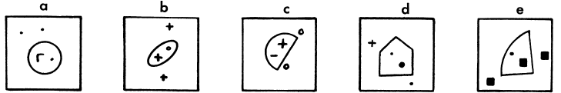
Please select two correct answers:
Notes:
12

Slide 33
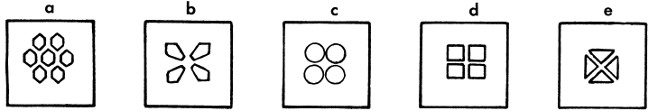
Please select two correct answers:
Notes:
13

Slide 34
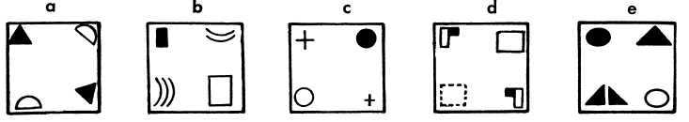
Please select two correct answers:
Notes:
14

Slide 35
Sub -test 3
Notes:
Example item

Slide 36
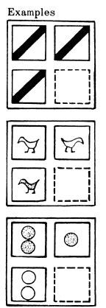
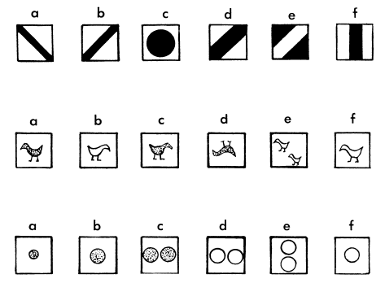
Example
Notes:
Example item

Slide 37
Notes:
Training item

Slide 38
Notes:
Training item

Slide 39

Notes:
1

Slide 40

Notes:
2

Slide 41

Notes:
3

Slide 42

Notes:
4

Slide 43

Notes:
5

Slide 44

Notes:
6

Slide 45

Notes:
7

Slide 46

Notes:
8

Slide 47

Notes:
9

Slide 48

Notes:
10

Slide 49

Notes:
11

Slide 50

Notes:
12

Slide 51

Notes:
13

Slide 52
Sub -test 4
Notes:
Example item

Slide 53


Example
Notes:
Example item

Slide 54


Notes:
Training item

Slide 55


Notes:
Training item

Slide 56


Notes:
1

Slide 57


Notes:
2

Slide 58


Notes:
3

Slide 59


Notes:
4

Slide 60


Notes:
5

Slide 61


Notes:
6

Slide 62


Notes:
7

Slide 63


Notes:
8

Slide 64


Notes:
9

Slide 65


Notes:
10

