Slide 1
All comments in RED are intended as explanation for Gabe
We will now do a group memory test. This will be similar to the individual memory tasks you completed earlier.
First, we’ll do a practice round
Next

Slide 2
In this practice round, you will have 15 seconds to remember 3 images, 3 words and a one sentence story.
You will answer as a group.
This means that each group member can look at all three types of stimuli (images, words, story), or you can divide the tasks amongst yourselves.
After the 15 seconds is up, we will ask you questions about all three types of things: images, words, story. There will be roughly the same number of questions about each type.
Next

Slide 3
In this practice round, you have 15 seconds to memorise the following stimuli as a group. Each person can look at different stimuli if they choose (by clicking on one of the buttons). The time starts when everyone in your group has clicked on a button below.
Is this possible? (i.e. can we stop anyone from looking at the stimuli until everyone has clicked on a button?)
Images
Words
Story
There is a clock in the bottom corner that tells you how much time is left.
Time remaining:
0:15

Slide 4
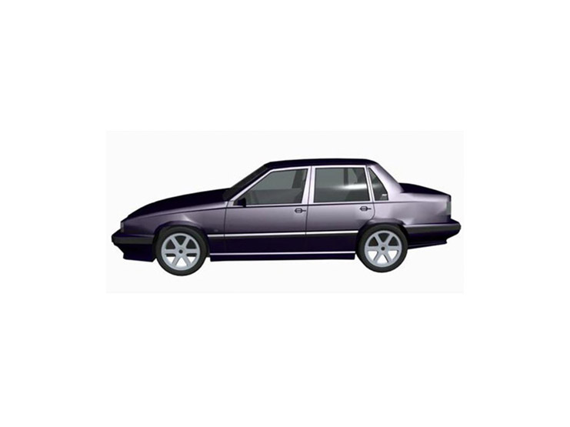
Images Practice
Remember this car (1/3)
Click the arrow to go back to the options page
Click to see a different angle
1/3
Time remaining:
0:15

Slide 5
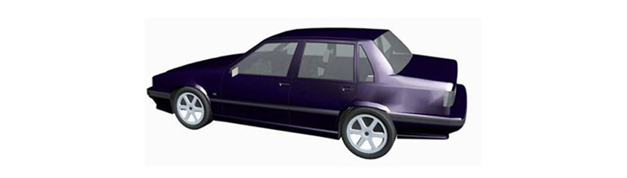
Images Practice
Remember this car (2/3)
Click the arrow to go back to the options page
Previous
Next
2/3
Time remaining:
0:15

Slide 6
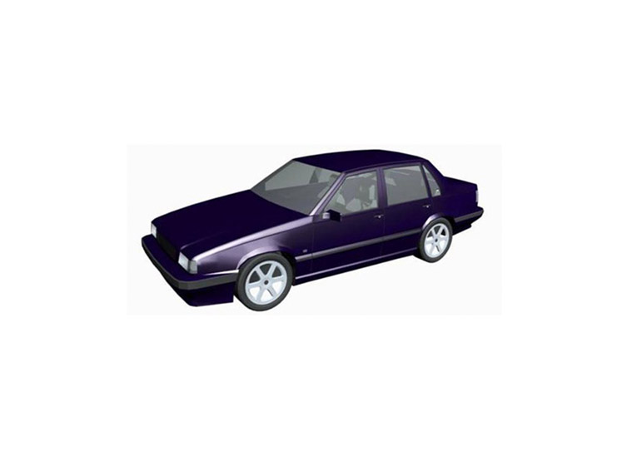
Images Practice
Remember this car (3/3)
Click the arrow to go back to the options page
Previous
3/3
Time remaining:
0:15

Slide 7
Words Practice (1)
Click the arrow to go back to the options page
Mountain
Next
Click NEXT to see the next word
1/3
Time remaining:
0:12

Slide 8
Words Practice (2)
Click the arrow to go back to the options page
Cold
Previous Word
Next Word
2/3
Time remaining:
0:15

Slide 9
Words Practice (3)
Click the arrow to go back to the options page
Snow
Previous Word
Next Word
3/3
Time remaining:
0:08

Slide 10
Story practice
Click the arrow to go back to the options page
Short example ‘story’:
Joe was running late for a job interview because his train broke down outside of Chicago

Slide 11
Next we will ask you some questions about the stimuli. Remember, you answer these as a group.
Continue to questions

Slide 12
Practice question 1 Which of the following are target words (tick ALL that apply, then hit next)
SNOW
patrol
wet
Next
Question 1 of 3

Slide 13
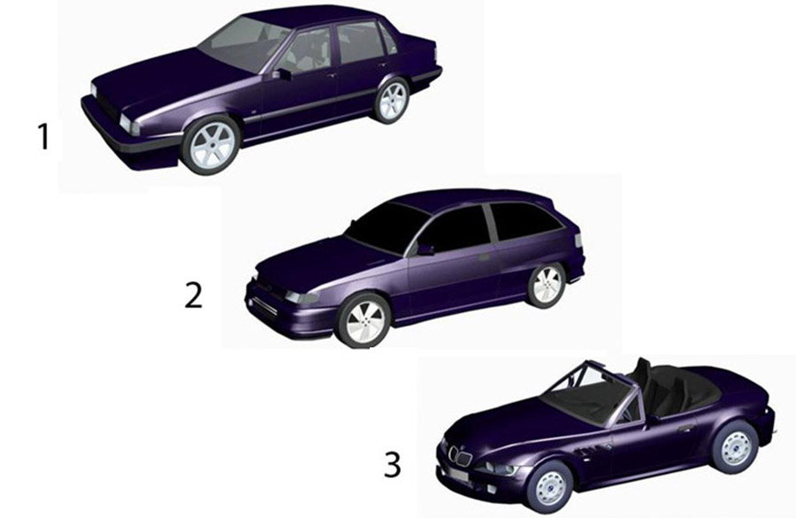
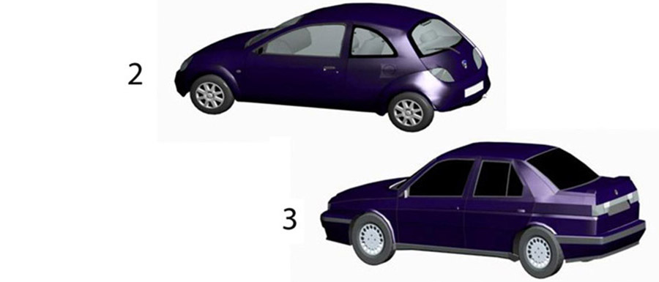
Practice 2 Which of the following cars is a “target” car? [type 1, 2 or 3]
1
2
2
3
3
Question 2 of 3

Slide 14
Practice question 3: Why was Joe running late? Because:
His train broke down
He lived in Chicago
His job interview ran over time
Question 3 of 3

Slide 15
Your group will now have 50 seconds to memorize 6 images, 12 words and a short story. You will answer as a group.
You’re NOT allowed to write anything down.
Remember, group member can look at all three types of stimuli OR you can divide the tasks amongst yourselves. Take a minute to discuss a strategy.
After the 50 seconds is up, we will ask you questions about all three types of things: images, words, story. There will be roughly the same number of questions about each type.
Next

Slide 16
This is now the test. You will have 50 seconds to memorise the following stimuli as a group. The time starts when everyone has clicked on a button below.
Images
Words
Story

Slide 17
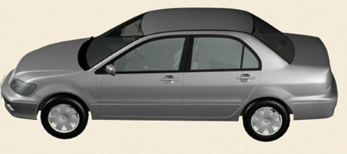
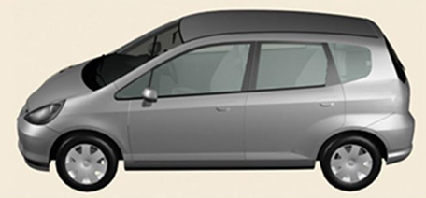
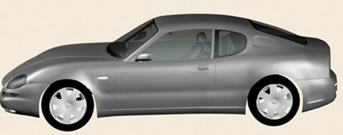
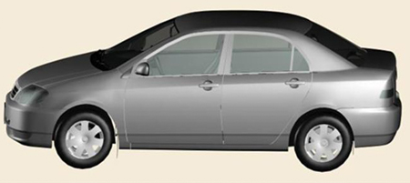
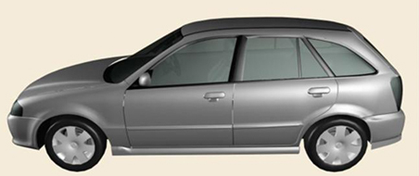
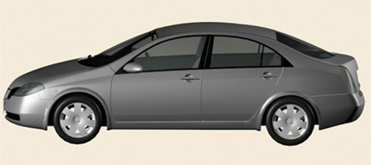
Remember the following cars (click next for a different angle)
Click the arrow to go back to the options page
Next
Time remaining:
0:48
Images TEST

Slide 18
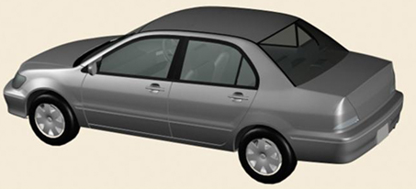
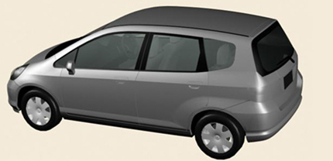
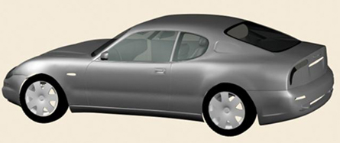
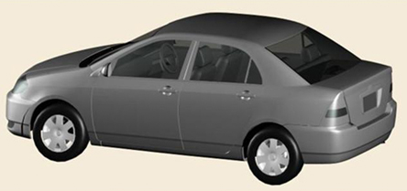
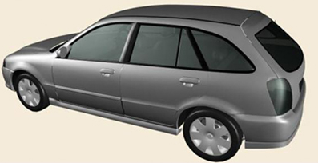
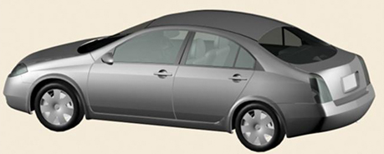
Remember the following cars (click next for a different angle)
Click the arrow to go back to the options page
Previous
Next
Time remaining:
0:48
Images TEST

Slide 19
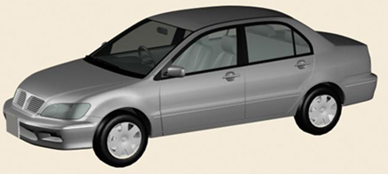
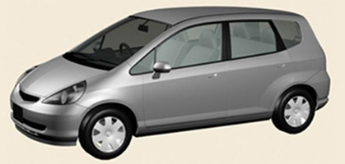
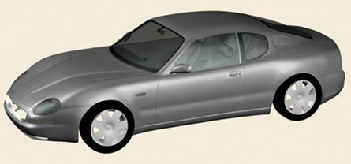
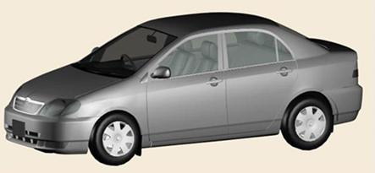
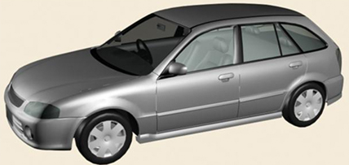
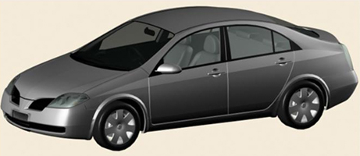
Remember the following cars (click PREVIOUS for a different angle)
Click the arrow to go back to the options page
Previous
Time remaining:
0:48
Images TEST

Slide 20
Words TEST
Click the arrow to go back to the options page
Pistol
Can we have a max time that one word will stay up (e.g. 2 seconds)
Next Word
Click Next Word when you’re ready
Time remaining:
0:50
1/12

Slide 21
Words TEST
Click the arrow to go back to the options page
Fork
Previous Word
Next Word
Time remaining:
0:47
2/12

Slide 22
Words TEST
Words TEST
Words TEST
Click the arrow to go back to the options page
Pot
Previous Word
Next Word
Time remaining:
0:42
3/12

Slide 23
Words TEST
Click the arrow to go back to the options page
Sword
Previous Word
Next Word
Time remaining:
0:39
4/12

Slide 24
Words TEST
Click the arrow to go back to the options page
Vodka
Previous Word
Next Word
Time remaining:
0:35
5/12

Slide 25
Words TEST
Click the arrow to go back to the options page
Rum
Previous Word
Next Word
Time remaining:
0:30
6/12

Slide 26
Words TEST
Click the arrow to go back to the options page
Bomb
Previous Word
Next Word
Time remaining:
0:38
7/12

Slide 27
Words TEST
Click the arrow to go back to the options page
Pan
Previous Word
Next Word
Time remaining:
0:40
8/12

Slide 28
Words TEST
Click the arrow to go back to the options page
Wine
Previous Word
Next Word
Time remaining:
0:15
9/12

Slide 29
Words TEST
Click the arrow to go back to the options page
Spatula
Previous Word
Next Word
Time remaining:
0:02
10/12

Slide 30
Words TEST
Click the arrow to go back to the options page
Bourbon
Previous Word
Next Word
Time remaining:
0:05
11/12

Slide 31
Words TEST
Click the arrow to go back to the options page
Rifle
Previous Word
Next Word
Time remaining:
0:06
12/12

Slide 32
Story TEST
Click the arrow to go back to the options page
STORY
A recent survey of supermarket shoppers in Baytown revealed that eight out of ten trolleys have faulty wheels or are difficult to steer. More than half of people reported having had accidents with their trolleys. These ranged from collisions with other shoppers to knocking into stacks of groceries on display. Retailers claim that the problem is not with the trolleys, but that shoppers are not using them carefully.
Time remaining:
0:30

Slide 33
Next we will ask you some questions about the stimuli.
Continue to questions

Slide 34
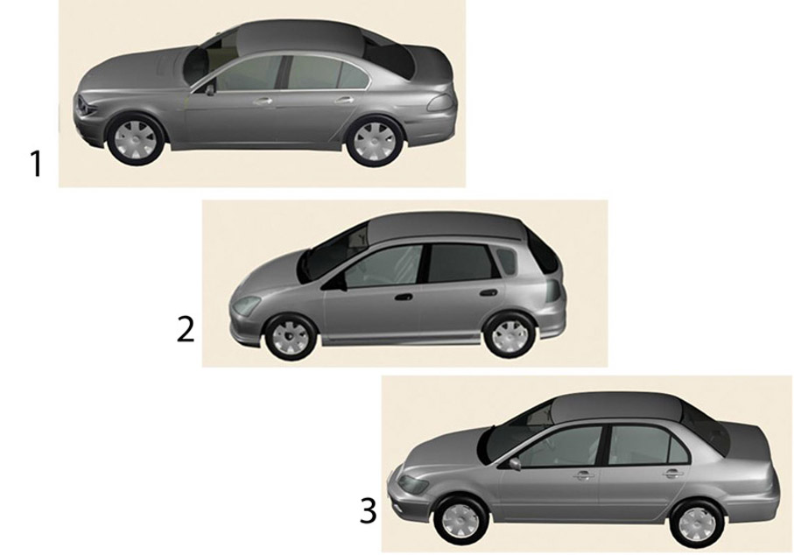
Which of the following is a “target” car? [type 1, 2 or 3]
Answer: 3
Notes:
Slide 4

Slide 35
Story Question More than half the respondents reported what?
Collisions with other shoppers
Running into stacks of groceries
Having accidents with their carts

Slide 36
Which of the following are target words (tick ALL that apply, then hit next)
FORK
PAN
knife
Next

Slide 37
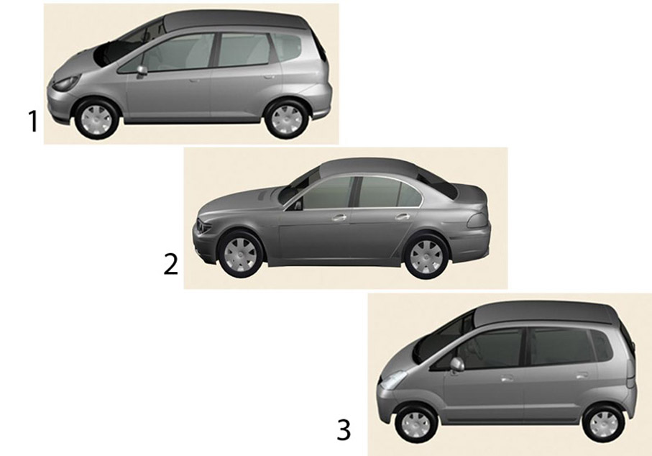
Which of the following is a “target” car? [type 1, 2 or 3]
Answer: 1
Notes:
Slide 10

Slide 38
Which of the following are target words (tick ALL that apply, then hit next)
SPATULA
beer
BOMB
Next

Slide 39
Story Question When was the survey done?
Recently
Last year
A week ago

Slide 40
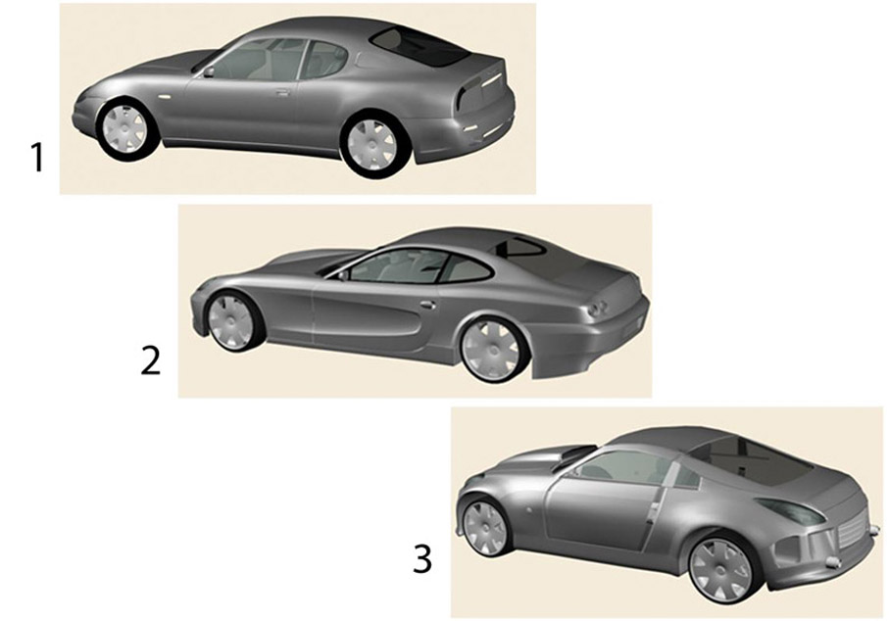
Which of the following is a “target” car? [type 1, 2 or 3]
Answer: 1
Notes:
Slide 17

Slide 41
Which of the following are target words (tick ALL that apply, then hit next)
whiskey
lemon
gun
Next

Slide 42
Story Question What proportion of shopping carts had some sort of issue?
60%
70%
80%

Slide 43
Which of the following are target words (tick ALL that apply, then hit next)
gun
PISTOL
trout
Next

Slide 44
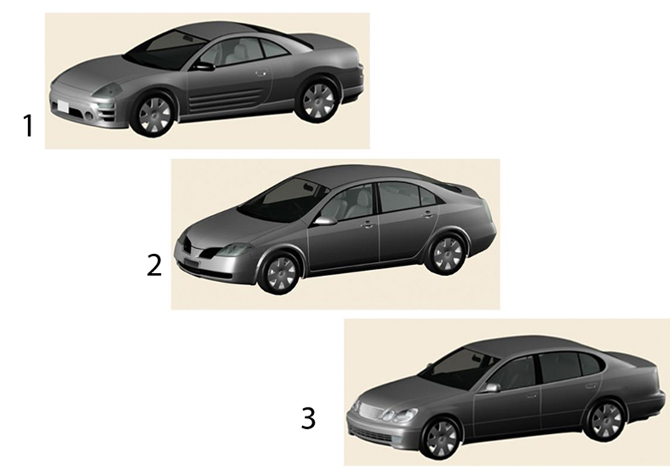
Which of the following is a “target” car? [type 1, 2 or 3]
Answer: 2
Notes:
Slide 35

Slide 45
Story Question What problems did customers identify with the carts?
They make an annoying noise
They have faulty wheels
They can be difficult to move

Slide 46
Story Question The survey took place in
Bankstown
Baytown
Bridgetown

Slide 47
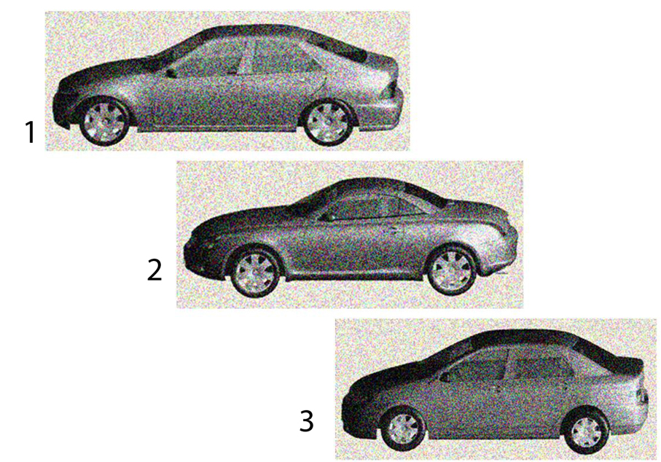
Which of the following is a “target” car? [type 1, 2 or 3]
Answer: 3
Notes:
Slide 83

Slide 48
Which of the following are target words (tick ALL that apply, then hit next)
WINE
FORK
SWORD
Next

Slide 49
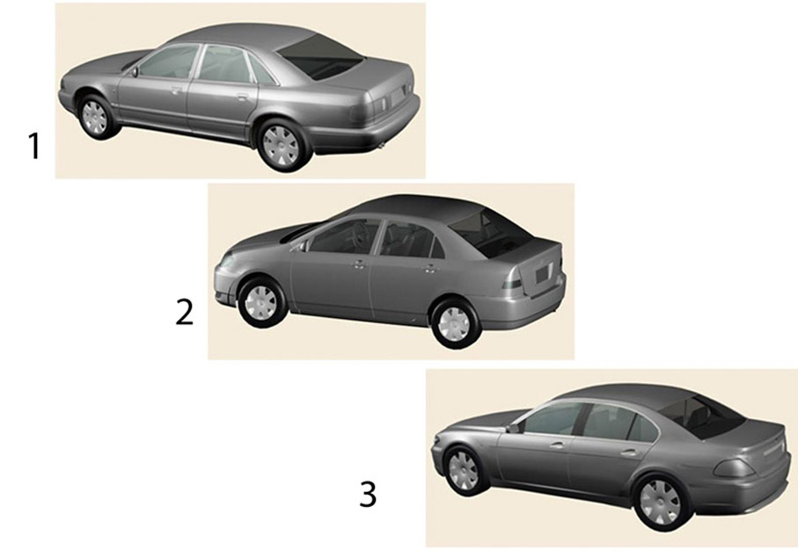
Which of the following is a “target” car? [type 1, 2 or 3]
Answer: 2
Notes:
Slide 22

Slide 50
Which of the following are target words (tick ALL that apply, then hit next)
RUM
pencil
POT
Next

Slide 51
Story Question Retailers responded to the survey by
Saying they will fix their carts
Claiming the problem is with the customers
Promising they’ll look into the issue

