Slide 1
All comments in RED are intended as explanation for Gabe
We will now do a group memory test. This will be similar to the group memory task you completed earlier.
As a refresher, we’ll do a practice round
Next

Slide 2
In this practice round, you will have 15 seconds to remember 3 images, 3 words and a one sentence story.
You will answer as a group.
This means that each group member can look at all three types of stimuli (images, words, story), or you can divide the tasks amongst yourselves.
After the 15 seconds is up, we will ask you questions about all three types of things: images, words, story. There will be roughly the same number of questions about each type.
Next

Slide 3
In this practice round, you have 15 seconds to memorise the following stimuli as a group. Each person can look at different stimuli if they choose (by clicking on one of the buttons). The time starts when everyone in your group has clicked on a button below.
Is this possible? (i.e. can we stop anyone from looking at the stimuli until everyone has clicked on a button?)
Images
Words
Story
There is a clock in the bottom corner that tells you how much time is left.
Time remaining:
0:15

Slide 4
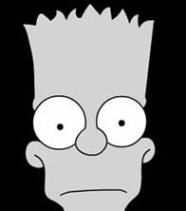
Images Practice
Remember this “target” face (1/3)
Click the arrow to go back to the options page
Click to see a different angle
1/3
Time remaining:
0:15

Slide 5
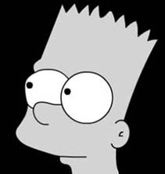
Images Practice
Remember this “target” face (2/3)
Click the arrow to go back to the options page
Previous
Next
2/3
Time remaining:
0:15

Slide 6
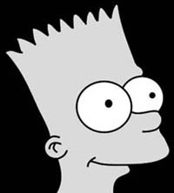
Images Practice
Remember this “target” face (3/3)
Click the arrow to go back to the options page
Previous
3/3
Time remaining:
0:15

Slide 7
Words Practice (1)
Click the arrow to go back to the options page
Tree
Next
Click NEXT to see the next word
1/3
Time remaining:
0:12

Slide 8
Words Practice (2)
Click the arrow to go back to the options page
Pine
Previous Word
Next Word
2/3
Time remaining:
0:15

Slide 9
Words Practice (3)
Click the arrow to go back to the options page
Root
Previous Word
Next Word
3/3
Time remaining:
0:08

Slide 10
Story practice
Click the arrow to go back to the options page
Short example ‘story’:
A poll, conducted a week ago by Pew Research, found that 60% of people prefer vanilla to chocolate

Slide 11
Next we will ask you some questions about the stimuli. Remember, you answer these as a group.
Continue to questions

Slide 12
Practice question 1 Which of the following are target words (tick all the apply, then hit next)
TREE
PINE
grow
Next
Question 1 of 5

Slide 13
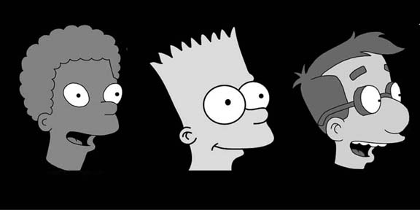
Practice 2 Which of the following is a “target” face? [type 1, 2 or 3]
Question 2 of 5

Slide 14
Practice 3 Which of the following are target words (tick all the apply, then hit next)
oven
mitt
scandal
Next
Question 1 of 3

Slide 15
Practice 4: Which company conducted the poll?
Pew
Gallup
Rasmussun
Question 3 of 3

Slide 16
Your group will now have 50 seconds to memorize 6 images, 12 words and a short story. You will answer as a group.
You’re NOT allowed to write anything down.
Remember, each group member can look at all three types of stimuli OR you can divide the tasks amongst yourselves.
Take a minute to discuss a strategy.
After the 50 seconds is up, we will ask you questions about all three types of things: images, words, story. There will be roughly the same number of questions about each type.
Everyone in the group should hit Next on their laptop to continue.
Next

Slide 17
Remember: you will have 50 seconds to memorise the following stimuli as a group.
The time starts when everyone has clicked on a button below.
Images
Words
Story

Slide 18
Words TEST
Click the arrow to go back to the options page
Garlic
Can we have a max time that one word will stay up (e.g. 2 seconds)
Next Word
Click Next Word when you’re ready
Time remaining:
0:50
1/12

Slide 19
Words TEST
Click the arrow to go back to the options page
Wood
Previous Word
Next Word
Time remaining:
0:47
2/12

Slide 20
Words TEST
Words TEST
Words TEST
Click the arrow to go back to the options page
Sugar
Previous Word
Next Word
Time remaining:
0:42
3/12

Slide 21
Words TEST
Click the arrow to go back to the options page
Coal
Previous Word
Next Word
Time remaining:
0:39
4/12

Slide 22
Words TEST
Click the arrow to go back to the options page
Clarinet
Previous Word
Next Word
Time remaining:
0:35
5/12

Slide 23
Words TEST
Click the arrow to go back to the options page
Trumpet
Previous Word
Next Word
Time remaining:
0:30
6/12

Slide 24
Words TEST
Click the arrow to go back to the options page
Cinnamon
Previous Word
Next Word
Time remaining:
0:38
7/12

Slide 25
Words TEST
Click the arrow to go back to the options page
Flute
Previous Word
Next Word
Time remaining:
0:40
8/12

Slide 26
Words TEST
Click the arrow to go back to the options page
Kerosine
Previous Word
Next Word
Time remaining:
0:15
9/12

Slide 27
Words TEST
Click the arrow to go back to the options page
Vanilla
Previous Word
Next Word
Time remaining:
0:02
10/12

Slide 28
Words TEST
Click the arrow to go back to the options page
Gasoline
Previous Word
Next Word
Time remaining:
0:05
11/12

Slide 29
Words TEST
Click the arrow to go back to the options page
Violin
Previous Word
Next Word
Time remaining:
0:06
12/12

Slide 30
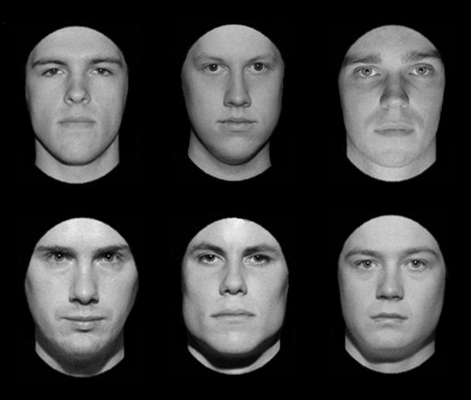
Remember the following faces (click next for a different angle)
Click the arrow to go back to the options page
Next
Time remaining:
0:48
Images TEST

Slide 31
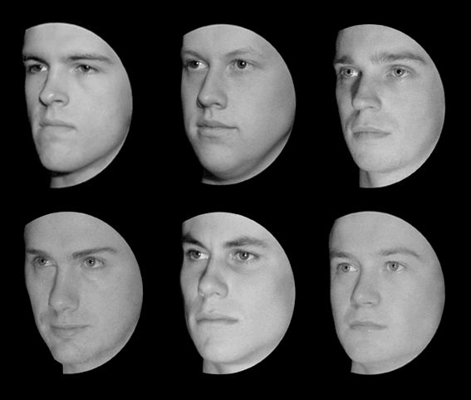
Remember the following faces (click next for a different angle)
Click the arrow to go back to the options page
Previous
Next
Time remaining:
0:48
Images TEST

Slide 32
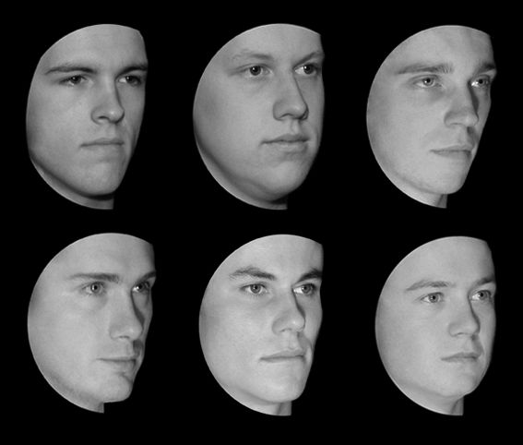
Remember the following faces (click PREVIOUS for a different angle)
Click the arrow to go back to the options page
Previous
Time remaining:
0:48
Images TEST

Slide 33
Story TEST
Click the arrow to go back to the options page
STORY
Michael Simpson earned a reputation for being stubborn after refusing to accept pay cheques. Instead of the cheques, he wanted his wages to be paid in cash. He eventually won the battle and collected ten thousand dollars in back pay. His wife was pleased because she had been forced to cook on a camping stove, after services to their home were cut off eighteen months ago.
Time remaining:
0:30

Slide 34
Next we will ask you some questions about the stimuli.
Continue to questions

Slide 35
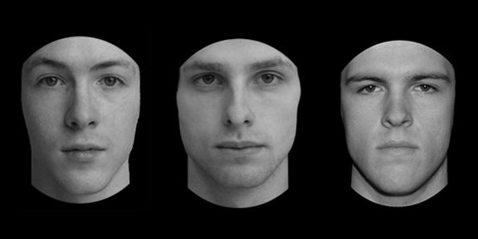
Which of the following is a “target” face? [type 1, 2 or 3]
1
2
3
Answer: 3

Slide 36
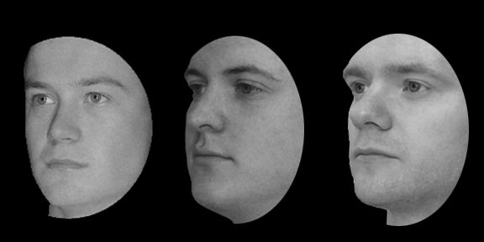
Which of the following is a “target” face? [type 1, 2 or 3]
1
2
3
Answer: 1

Slide 37
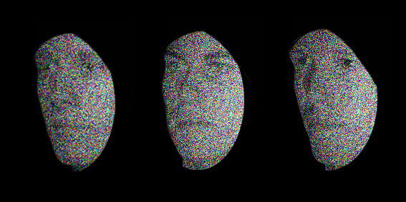
Which of the following is a “target” face? [type 1, 2 or 3]
1
2
3
Answer: 2

Slide 38
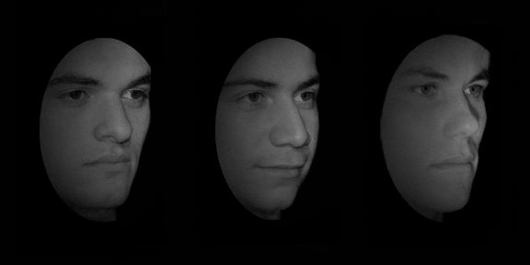
Which of the following is a “target” face? [type 1, 2 or 3]
1
2
3
Answer: 3

Slide 39
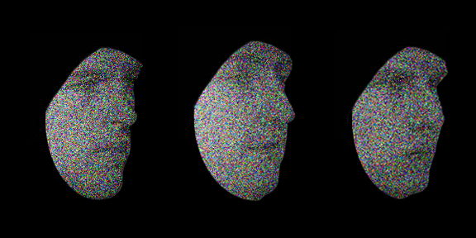
Which of the following is a “target” face? [type 1, 2 or 3]
1
2
3
Answer: 1

Slide 40
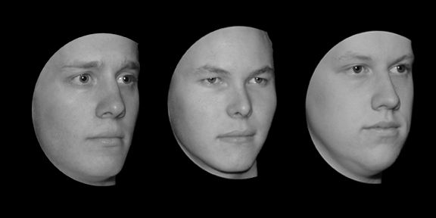
Which of the following is a “target” face? [type 1, 2 or 3]
1
2
3
Answer: 3

Slide 41
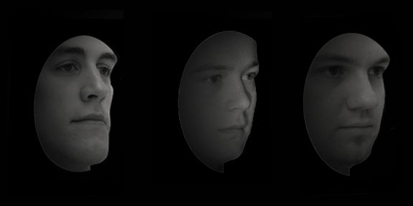
Which of the following is a “target” face? [type 1, 2 or 3]
1
2
3
Answer: 2

Slide 42
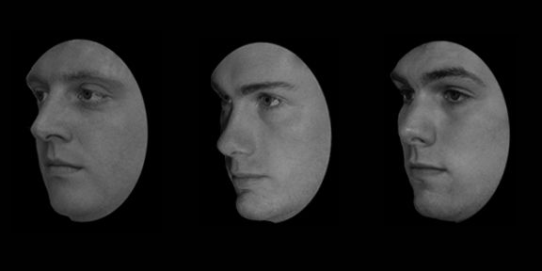
Which of the following is a “target” face? [type 1, 2 or 3]
1
2
3
Answer: 2

Slide 43
Story Question What was the name of the man in the story?
Michael Sanderson
Michael Sampson
Michael Simpson

Slide 44
Story Question Michael had a reputation for being:
Stubborn
Inflexible
Rude

Slide 45
Story Question How much back pay did Michael receive?
Ten thousand dollars
Eleven thousand dollars
Twelve thousand dollars

Slide 46
Story Question How did Michael’s wife feel when he finally got paid?
Relieved
Pleased
Grateful

Slide 47
Story Question How long ago did the services in Michael’s house get turned off
18 months ago
6 months ago
12 months ago

Slide 48
Story Question Why did Michael refuse to accept his pay cheques
Because he was stubborn
Because he wanted his cheques paid in cash
Because he could only pay his utilities with cash

Slide 49
Which of the following are target words (tick ALL that apply, then hit next)
oil
KEROSINE
priest
Next

Slide 50
Which of the following are target words (tick ALL that apply, then hit next)
salt
basement
piano
Next

Slide 51
Which of the following are target words (tick ALL that apply, then hit next)
WOOD
harmonica
TRUMPET
Next

Slide 52
Which of the following are target words (tick ALL that apply, then hit next)
FLUTE
CLARINET
piano
Next

Slide 53
Which of the following are target words (tick ALL that apply, then hit next)
GARLIC
VIOLIN
VANILLA
Next

Slide 54
Which of the following are target words (tick ALL that apply, then hit next)
chair
pepper
horn
Next

Slide 55
Which of the following are target words (tick ALL that apply, then hit next)
sand
SUGAR
drum
Next

Slide 56
Which of the following are target words (tick ALL that apply, then hit next)
COAL
electricity
lemon
Next

