Slide 1
All comments in RED are intended as explanation for Gabe
We will now do a group memory test. This will be extremely similar to the group memory tasks you completed earlier in the session.
Next

Slide 2
As a reminder, your group will have 50 seconds to memorize 6 images, 12 words and a short story.
You will answer as a group.
You’re NOT allowed to write anything down.
Remember, each group member can look at all three types of stimuli OR you can divide the tasks amongst yourselves.
Take a minute to discuss a strategy.
After the 50 seconds is up, we will ask you questions about all three types of things: images, words, story. There will be roughly the same number of questions about each type.
Everyone in the group should hit “Next” on their laptop.
Next

Slide 3
Remember: you will have 50 seconds to memorise the following stimuli as a group. The time starts when everyone has clicked on a button below.
Images
Words
Story

Slide 4
Words TEST
Click the arrow to go back to the options page
Bluebird
Can we have a max time that one word will stay up (e.g. 2 seconds)
Next Word
Click Next Word when you’re ready
Time remaining:
0:50
1/12

Slide 5
Words TEST
Click the arrow to go back to the options page
Chisel
Previous Word
Next Word
Time remaining:
0:47
2/12

Slide 6
Words TEST
Words TEST
Words TEST
Click the arrow to go back to the options page
Eagle
Previous Word
Next Word
Time remaining:
0:42
3/12

Slide 7
Words TEST
Click the arrow to go back to the options page
Screwdriver
Previous Word
Next Word
Time remaining:
0:39
4/12

Slide 8
Words TEST
Click the arrow to go back to the options page
Crow
Previous Word
Next Word
Time remaining:
0:35
5/12

Slide 9
Words TEST
Click the arrow to go back to the options page
Wrench
Previous Word
Next Word
Time remaining:
0:30
6/12

Slide 10
Words TEST
Click the arrow to go back to the options page
Pants
Previous Word
Next Word
Time remaining:
0:38
7/12

Slide 11
Words TEST
Click the arrow to go back to the options page
Nails
Previous Word
Next Word
Time remaining:
0:40
8/12

Slide 12
Words TEST
Click the arrow to go back to the options page
Shoes
Previous Word
Next Word
Time remaining:
0:15
9/12

Slide 13
Words TEST
Click the arrow to go back to the options page
Canary
Previous Word
Next Word
Time remaining:
0:02
10/12

Slide 14
Words TEST
Click the arrow to go back to the options page
Skirt
Previous Word
Next Word
Time remaining:
0:05
11/12

Slide 15
Words TEST
Click the arrow to go back to the options page
Blouse
Previous Word
Next Word
Time remaining:
0:06
12/12

Slide 16
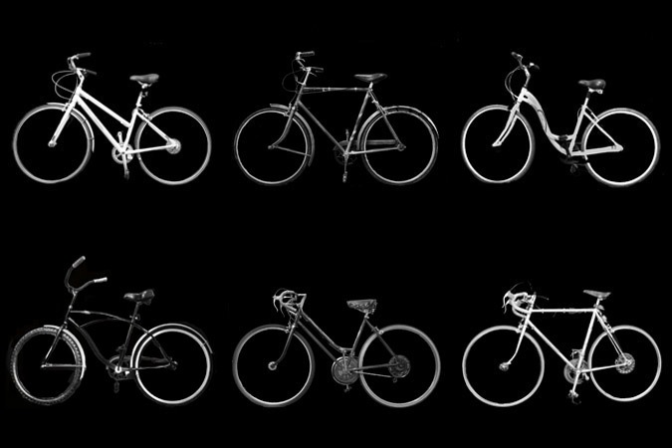
Remember the following images
Click the arrow to go back to the options page
Time remaining:
0:48
Images TEST

Slide 17
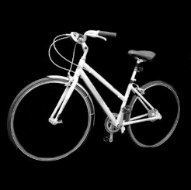
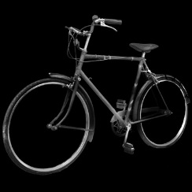
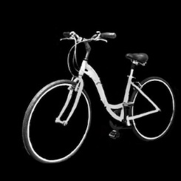
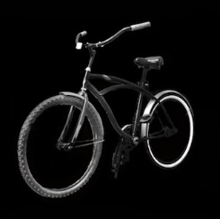
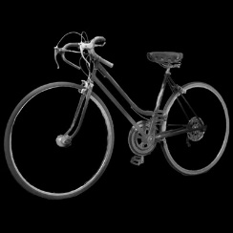
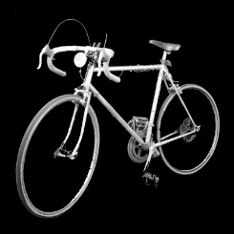
Remember the following images
Click the arrow to go back to the options page
Time remaining:
0:48
Images TEST

Slide 18
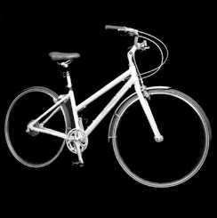
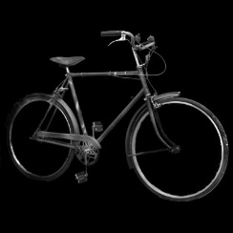
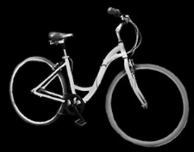
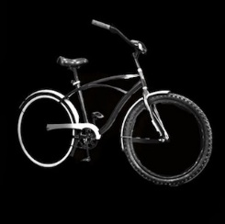
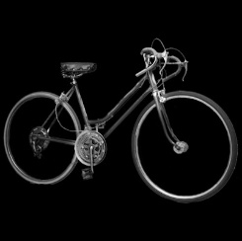
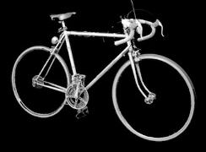
Remember the following images
Click the arrow to go back to the options page
Time remaining:
0:48
Images TEST

Slide 19
Story TEST
Click the arrow to go back to the options page
STORY
At 7:35 on Monday evening, Joe Garcia of San Francisco was watching television as he dressed to go out. A weather bulletin interrupted the program to warn that thunderstorms would move into the area within the next two to three hours. The announcer said the storm could bring hail and up to four inches of rain and cause the temperature to drop by fifteen degrees. Joe decided to stay home. He took off his coat and sat down to watch old movies.
Time remaining:
0:30

Slide 20
Next we will ask you some questions about the stimuli.
Continue to questions

Slide 21
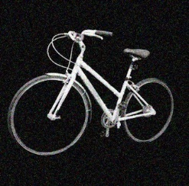
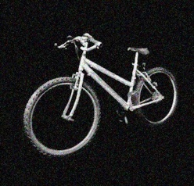
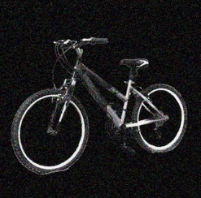
Which of the following is a “target” bike? [type 1, 2 or 3]
I’ve left these unjumbled, but ultimately we’d want them to be in a random-looking order (e.g. image; story; image; word …)
1
2
3
Answer:1

Slide 22
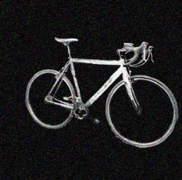
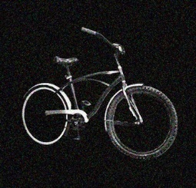
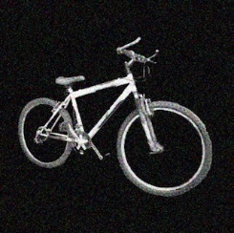
Which of the following is a “target” bike? [type 1, 2 or 3]
1
2
3
Answer: 2

Slide 23
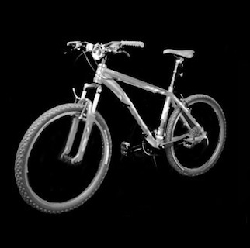
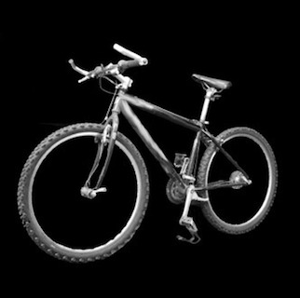
Which of the following is a “target” bike? [type 1, 2 or 3]
1
2
3
Answer: 1

Slide 24
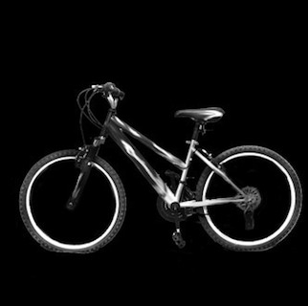
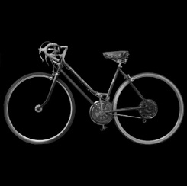
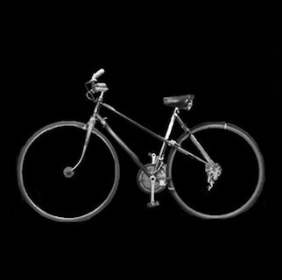
Which of the following is a “target” bike? [type 1, 2 or 3]
1
2
3
Answer: 2

Slide 25
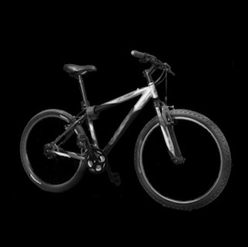
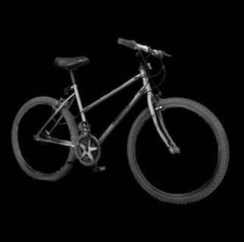
Which of the following is a “target” bike? [type 1, 2 or 3]
1
2
3
Answer: 3

Slide 26
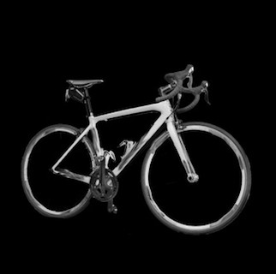
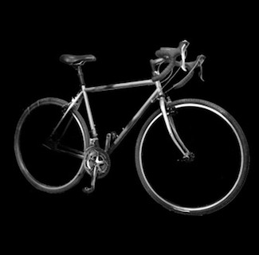
Which of the following is a “target” bike? [type 1, 2 or 3]
1
2
3
Answer: 3

Slide 27
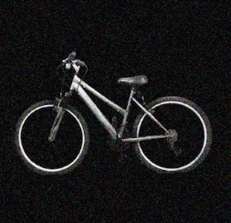
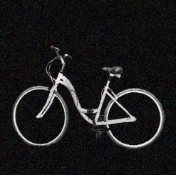
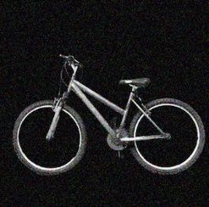
Which of the following is a “target” bike? [type 1, 2 or 3]
1
2
3
Answer: 2

Slide 28
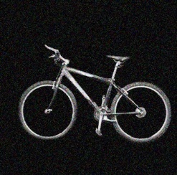
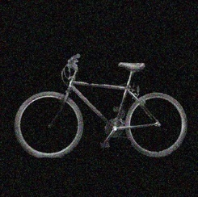
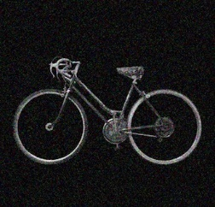
Which of the following is a “target” bike? [type 1, 2 or 3]
1
2
3
Answer: 3

Slide 29
Story Question What was the name of the main character?
Joe
Jose
Joel

Slide 30
Story Question What time of day was it when the story started?
Evening
Afternoon
Morning

Slide 31
Story Question How did Joe find about the weather?
He was watching a news program
A weather report interrupted the program he was watching
He saw a weather bulletin between shows

Slide 32
Story Question Where was the weather predicted to be bad
San Jose
San Diego
San Fransisco

Slide 33
Story Question What day did the story take place
Monday
Sunday
Tuesday

Slide 34
Story Question What was predicted to happen to the temperature
drop to fifteen degrees
drop by fifteen degrees
drop by four degrees

Slide 35
Story Question What did the main character do when he heard the news?
Call in sick
Watch old movies
Go back to watching TV programs

Slide 36
Story Question How many inches of rain were forecast
4
15
2

Slide 37
Which of the following are target words (tick ALL that apply, then hit next)
child
BLUEBIRD
chapel
Next

Slide 38
Which of the following are target words (tick ALL that apply, then hit next)
CANARY
socks
robin
Next

Slide 39
Which of the following are target words (tick ALL that apply, then hit next)
hammer
SKIRT
apple
Next

Slide 40
Which of the following are target words (tick ALL that apply, then hit next)
shirt
saw
wren
Next

Slide 41
Which of the following are target words (tick ALL that apply, then hit next)
CHISEL
SCREWDRIVER
sparrow
Next

Slide 42
Which of the following are target words (tick ALL that apply, then hit next)
silver
NAILS
EAGLE
Next

Slide 43
Which of the following are target words (tick ALL that apply, then hit next)
CROW
rock
rook
Next

Slide 44
Which of the following are target words (tick ALL that apply, then hit next)
BLOUSE
PANTS
WRENCH
Next

