Slide 1
All comments in RED are intended as explanation for Gabe
Next are some tests of memory. We’ll start with a quick practice.

Slide 2
IMAGES_1

Slide 3
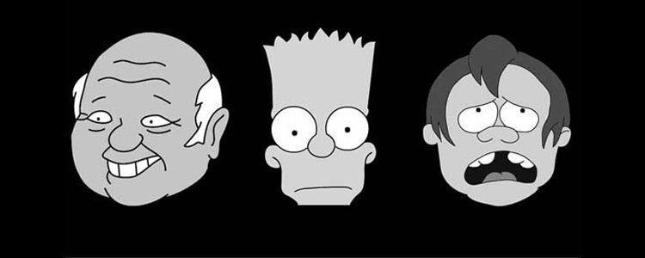
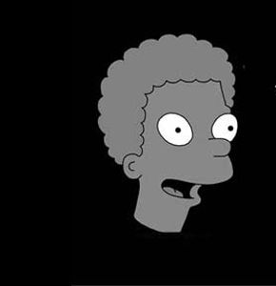
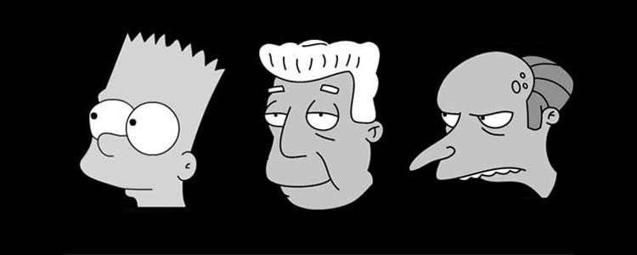
Look at these 6 faces for a few seconds. We’ll call these “target faces”. Press any key when you’re ready to continue.

Slide 4
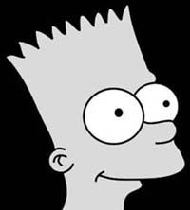
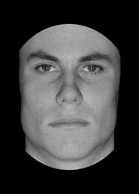
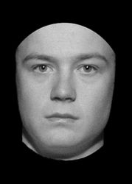
Practice 1 Which of the following faces is a “target” face? [type 1, 2 or 3]
1
2
3

Slide 5
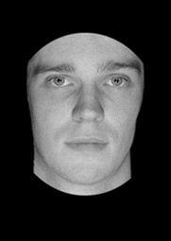
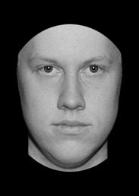
Practice 2 Which of the following faces is a “target” face? [type 1, 2 or 3]
1
2
3

Slide 6
Next you will review 6 target faces for 20 seconds. You can see them front-on, or in profile. Focus on each target face and try to remember it. Press any key when you’re ready to start

Slide 7
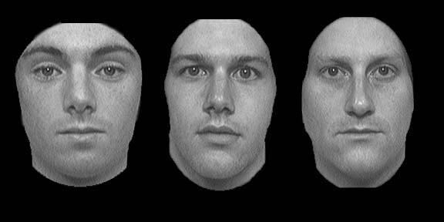
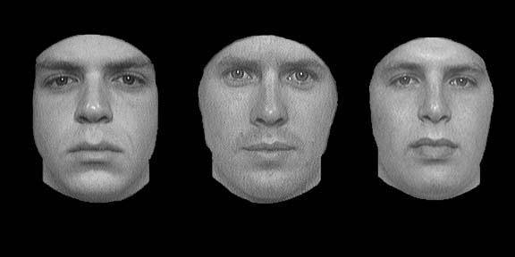
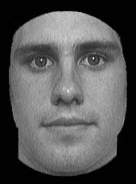
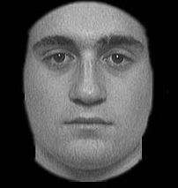
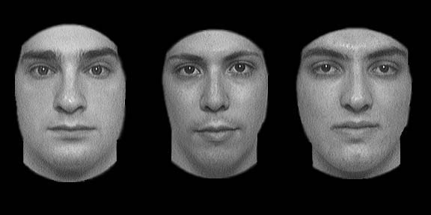
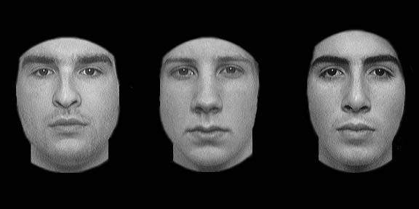
Next

Slide 8
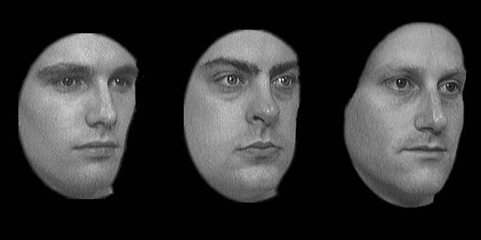
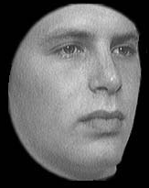
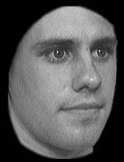
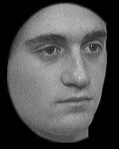
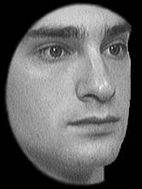
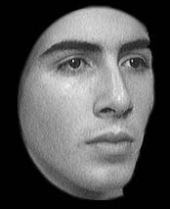
Previous
Next

Slide 9
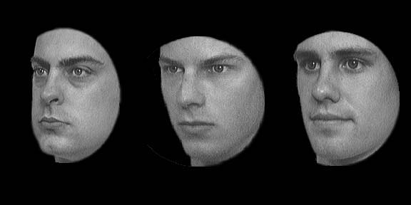
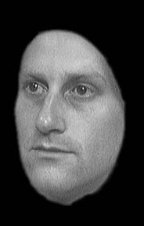
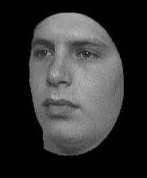
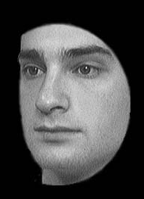
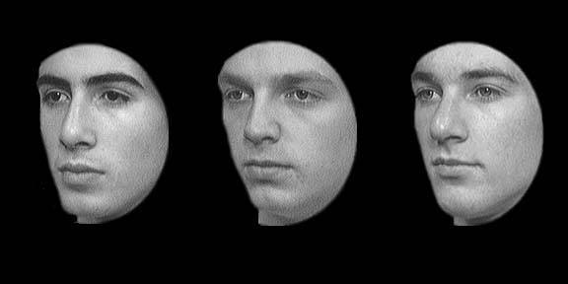
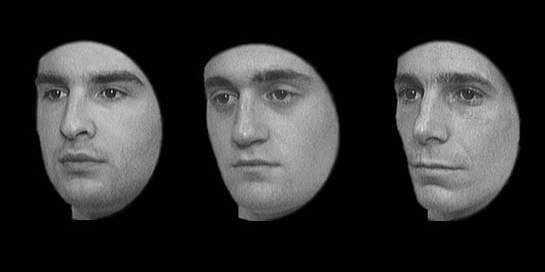
Back

Slide 10
Now your memory of those faces will be tested. For each question, try to identify which face is the “target” face.

Slide 11
Test Which of the following faces is a “target” face? [type 1, 2 or 3]
1
2
3
Answer: 3
1/9
Notes:
Bob Front

Slide 12
Test Which of the following faces is a “target” face? [type 1, 2 or 3]
1
2
3
Answer: 3
2/9
Notes:
Dan Front

Slide 13
Test Which of the following faces is a “target” face? [type 1, 2 or 3]
1
2
3
Answer: 1
3/9
Notes:
Jim Front

Slide 14
Test Which of the following faces is a “target” face? [type 1, 2 or 3]
1
2
3
Answer: 1
4/9
Notes:
Zach Left

Slide 15
Test Which of the following faces is a “target” face? [type 1, 2 or 3]
1
2
3
Answer: 3
5/9
Notes:
Jim Left

Slide 16
Test Which of the following faces is a “target” face? [type 1, 2 or 3]
1
2
3
Answer: 2
6/9
Notes:
Matt Left

Slide 17
Test Which of the following faces is a “target” face? [type 1, 2 or 3]
1
2
3
Answer: 3
7/9
Notes:
Bright

Slide 18
Test Which of the following faces is a “target” face? [type 1, 2 or 3]
1
2
3
Answer: 3
8/9
Notes:
Z front

Slide 19
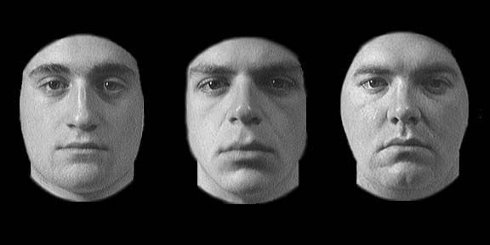
Test Which of the following faces is a “target” face? [type 1, 2 or 3]
1
2
3
Answer: 1
9/9
Notes:
Matt front

Slide 20
Here’s a reminder of the faces. You have 10 seconds to refresh your memory.

Slide 21
For the last six questions, some of the images are deliberately blurred to make things more challenging.

Slide 22
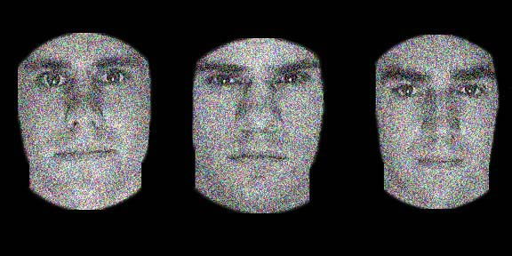
Test Which of the following faces is a “target” face? [type 1, 2 or 3]
1
2
3
Answer: 1
1/6
Notes:
J Blurred

Slide 23
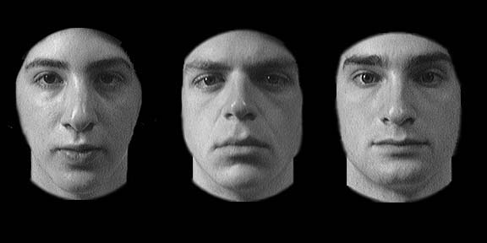
Test Which of the following faces is a “target” face? [type 1, 2 or 3]
1
2
3
Answer: 3
2/6
Notes:
N Front

Slide 24
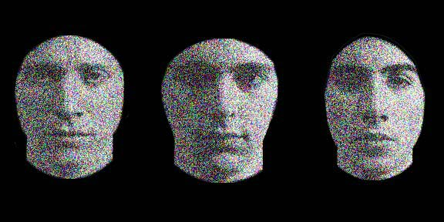
Test Which of the following faces is a “target” face? [type 1, 2 or 3]
1
2
3
Answer: 3
3/6
Notes:
Zblurred

Slide 25
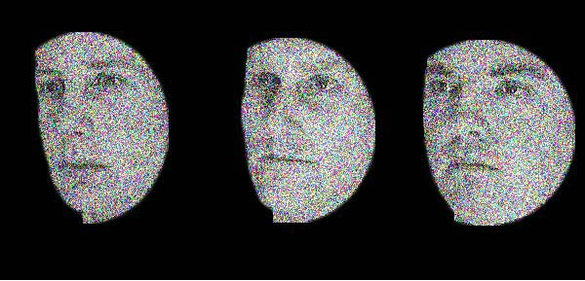
Test Which of the following faces is a “target” face? [type 1, 2 or 3]
1
2
3
Answer: 2
4/6
Notes:
B Blurred Right

Slide 26
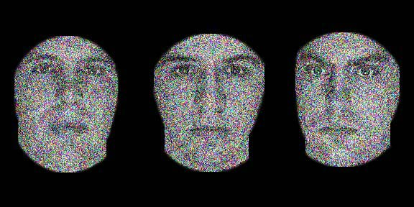
Test Which of the following faces is a “target” face? [type 1, 2 or 3]
1
2
3
Answer: 1
5/6

Slide 27
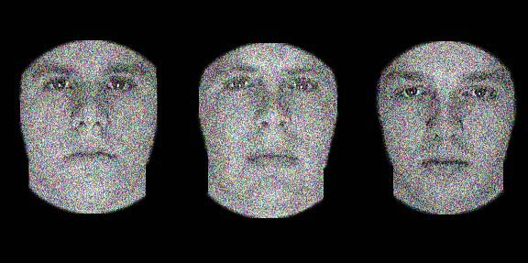
Test Which of the following faces is a “target” face? [type 1, 2 or 3]
1
2
3
Answer: 2
6/6
Notes:
D Noisy front

Slide 28
END OF IMAGES_1

Slide 29
WORDLIST_1 (four-legged animals, precious stones, human dwellings)

Slide 30
Next, we’ll test word memory. In this task, you’ll be presented with a set of ‘target words’. Word will appear for a maximum of 2 seconds.
We’ll start with a practice. In the practice round, you only have to remember 3 target words.
Continue to Practice Round

Slide 31
Blue
Can we have a max time that one word will stay up (e.g. 2 seconds)
Next
Click NEXT to see the next word
1/3

Slide 32
Yellow
Previous Word
Next Word
2/3

Slide 33
Red
Previous Word
Next Word
3/3

Slide 34
Practice question 1 Which of the following are target words (tick ALL that apply, then hit next)
RED
Rust
BLUE
I’ve put the correct responses in capitals to make things easier for coding, but obviously we don’t want this distinction in the actual test!
Next
1/2

Slide 35
Practice question 2 Which of the following are target words (tick ALL that apply, then hit next)
Green
Baseball
Egg
After a few seconds (or when people hit next) can we have a popup saying: “sometimes, none of the words will be a target word! In that case, just hit NEXT”
Next
2/2

Slide 36
You will now be presented with 12 target words. Try to remember all of them. Each word will show up separately. In total, you have 20 seconds to remember the words. You’re not allowed to write anything down.
Continue to Word Test

Slide 37
Horse
Next
1/12

Slide 38
Cave
Previous Word
Next Word
2/12

Slide 39
Lion
Previous Word
Next Word
3/12

Slide 40
Opal
Previous Word
Next Word
4/12

Slide 41
Tiger
Previous Word
Next Word
5/12

Slide 42
Pearl
Previous Word
Next Word
6/12

Slide 43
Hut
Previous Word
Next Word
7/12

Slide 44
Emerald
Previous Word
Next Word
8/12

Slide 45
Sapphire
Previous Word
Next Word
9/12

Slide 46
Tent
Previous Word
Next Word
10/12

Slide 47
Hotel
Previous Word
Next Word
11/12

Slide 48
Cow
Previous Word
Next Word
12/12

Slide 49
As in the practice questions, you’ll be presented with sets of three words. Identify ALL the target words.
I’ve put the correct responses in capitals to make things easier, but obviously we don’t want this distinction in the actual test!

Slide 50
Test question Which of the following are target words (tick all the apply, then hit next)
house
TIGER
HUT
Next
1/8

Slide 51
Test question Which of the following are target words (tick all the apply, then hit next)
HOTEL
coffee
mountain
Next
2/8

Slide 52
Test question Which of the following are target words (tick all the apply, then hit next)
COW
dog
EMERALD
Next
3/8

Slide 53
Test question Which of the following are target words (tick all the apply, then hit next)
ruby
pig
balloon
Next
4/8

Slide 54
Test question Which of the following are target words (tick all the apply, then hit next)
apartment
TIGER
diamond
Next
5/8

Slide 55
Test question Which of the following are target words (tick all the apply, then hit next)
pearl
scarf
HOTEL
Next
6/8

Slide 56
Test question Which of the following are target words (tick all the apply, then hit next)
boat
penny
cat
Next
7/8

Slide 57
Test question Which of the following are target words (tick all the apply, then hit next)
LION
SAPPHIRE
cave
Next
8/8

Slide 58
END OF WORDLIST_1

Slide 59
STORY_1 (Anna Thompson)

Slide 60
The last memory task asks you to remember a very short story.
Once again, we’ll start with a practice. In the practice round, you only have to remember one sentence.
Continue to Practice Round

Slide 61
Practice ‘story’:
Peter was hungry, so he went to the store on the corner of his street and bought a hamburger.

Slide 62
Practice question 1: Why did Peter go to the store? [Type 1, 2 or 3]
Because he was hungry
1)
2)
To get coffee
3)
To buy food for his dog
I’ve put the correct responses in bold
1/2

Slide 63
Practice question 1: What did Peter eat? [Type 1,2 or 3]
Hamburger
1)
2)
Sandwich
3)
Fries
2/2

Slide 64
Now for the actual task. You will be presented with a slightly longer story. You will have 30 seconds to read it. Try to take in as much information as possible.
After the 30 seconds are up, we’ll ask you some questions about the story. Your answers are important.

Slide 65
Anna Thompson of South Boston, employed as a cook in a school cafeteria, reported at the police station that she had been held up on State Street the night before and robbed of $56. She had four small children, the rent was due, and they had not eaten for two days. The police, touched by the woman’s story, collected money for her.
Time remaining:
0:30

Slide 66
What was the name of the main character
Anna Thompson
1)
2)
Anna Tompkins
3)
Hanna Tompkins
1/9

Slide 67
How many children did she have
4
1)
2)
5
3)
6
2/9

Slide 68
On what street was she robbed?
State Street
1)
2)
South Street
3)
Sixth street
3/9

Slide 69
What was her job?
Cook
1)
2)
She didn’t have a job
3)
Janitor
4/9

Slide 70
When did she report being robbed
One night after the robbery
1)
2)
Two nights after the robbery
3)
A week after the robbery
5/9

Slide 71
How much money was stolen?
$65
1)
2)
$56
3)
$66
6/9

Slide 72
How long had the family not eaten for?
2 days
1)
2)
1 day
3)
They missed 2 meals
7/9

Slide 73
What did the police do?
Arrest the thief
1)
2)
Collect money for the woman
3)
Give the woman food
8/9

Slide 74
Where did the story take place?
South Boston
1)
2)
Somerville
3)
North Boston
9/9

Slide 75
END OF STORY_1

