Slide 1
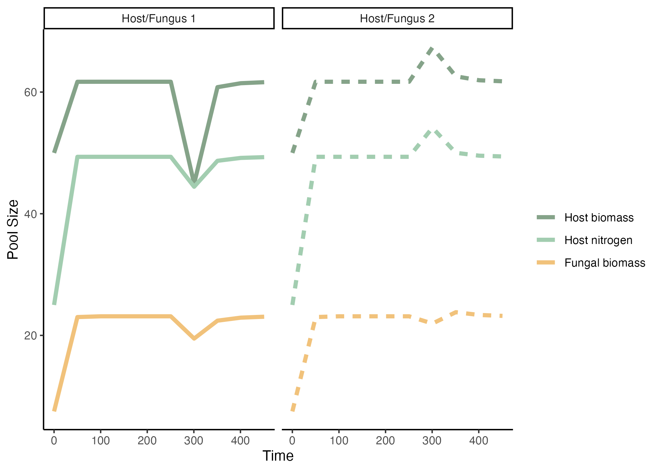

Slide 2
Resistance

Slide 3
Resistance
Resilience

Slide 4
Resistance
Resilience
Percent recovery
Time to recovery

Slide 5
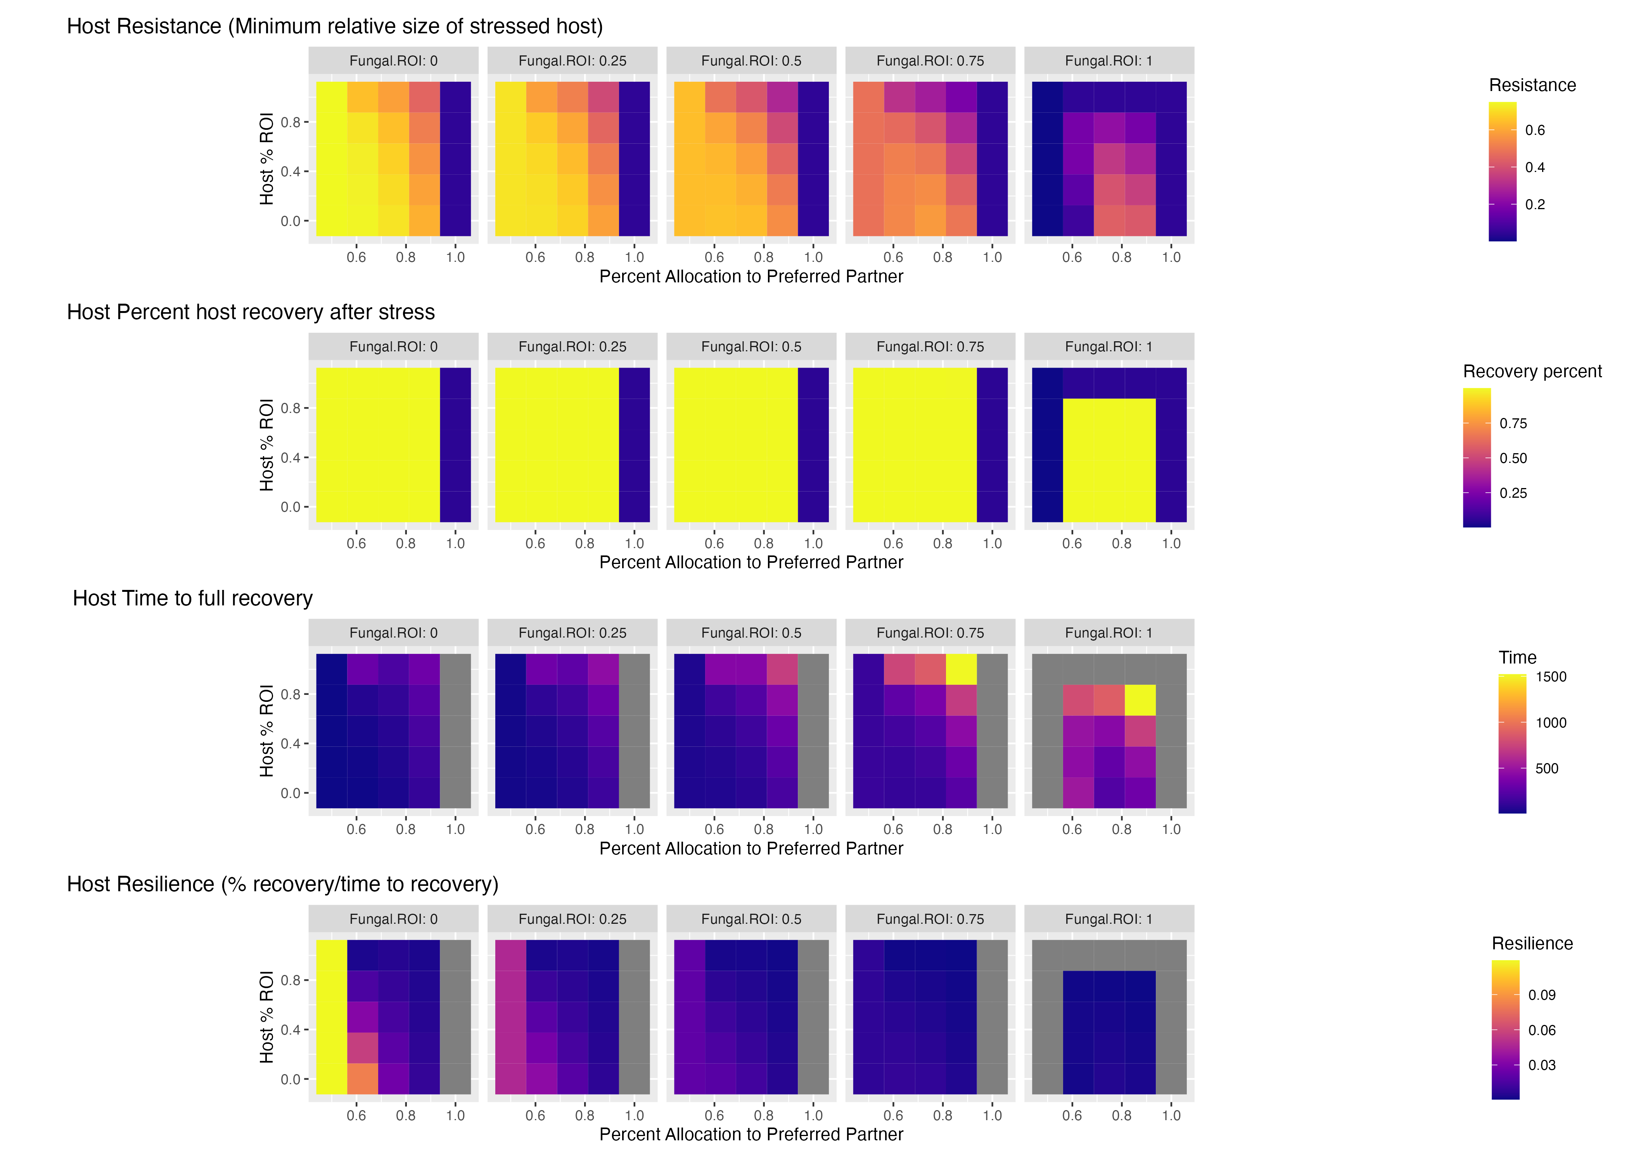
HOST
STRESS

Slide 6
HOST
STRESS

Slide 7
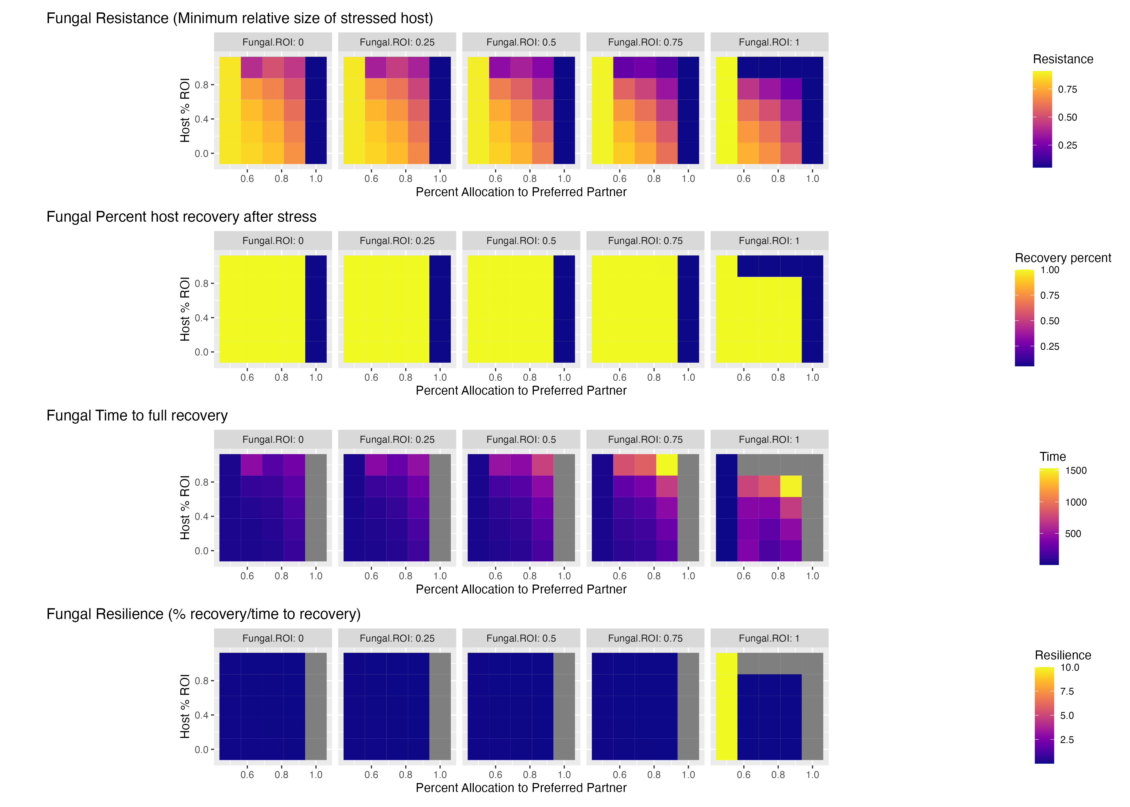
HOST
STRESS

Slide 8
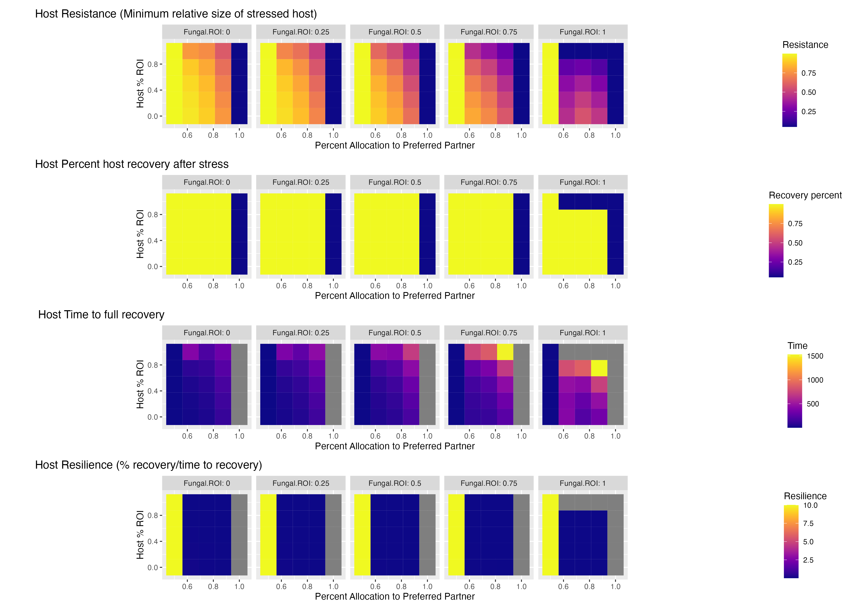
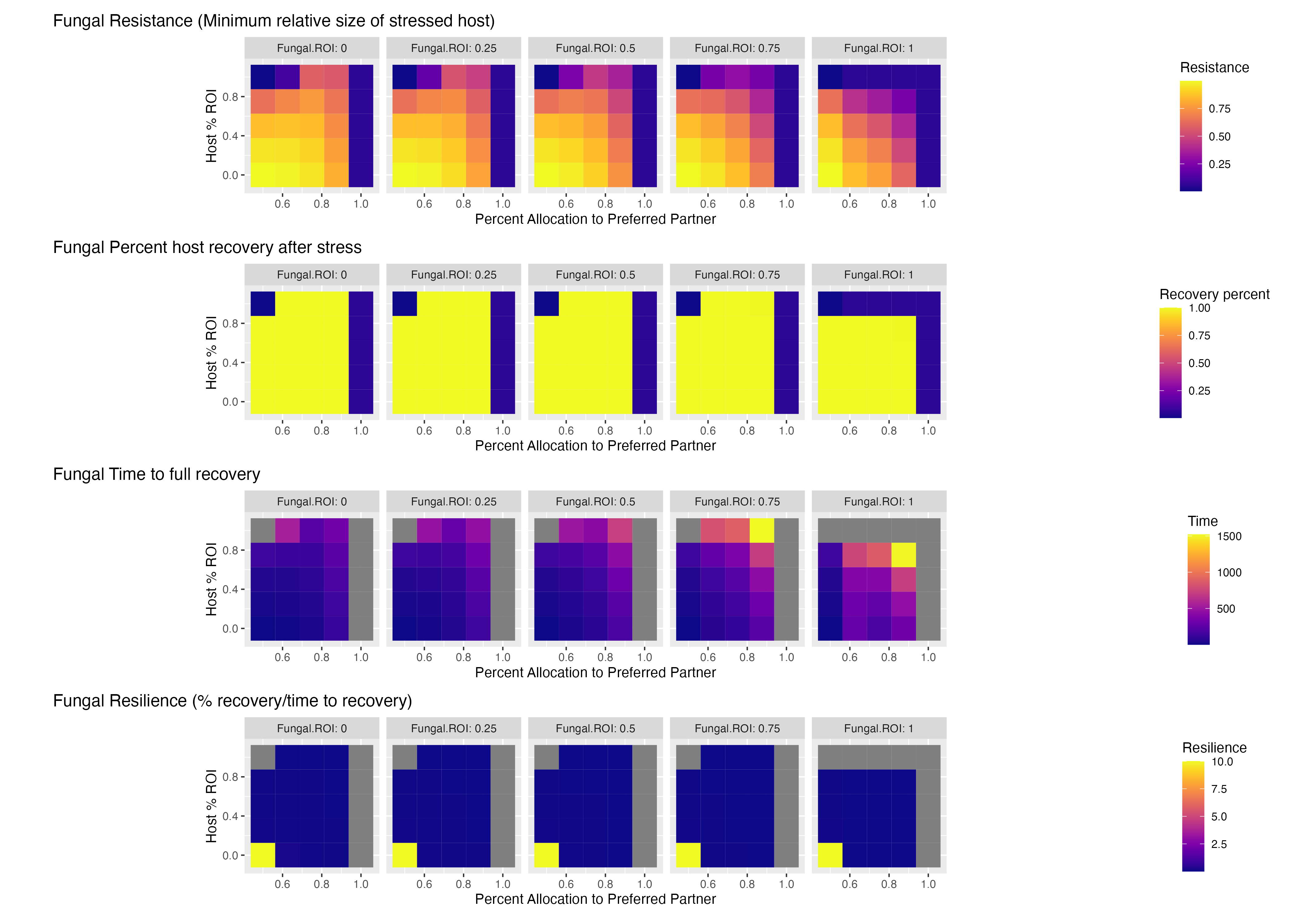
FUNGAL
STRESS

Slide 9
HOST
STRESS
FUNGAL
STRESS

Slide 10
HOST
STRESS
FUNGAL
STRESS

