Slide 1
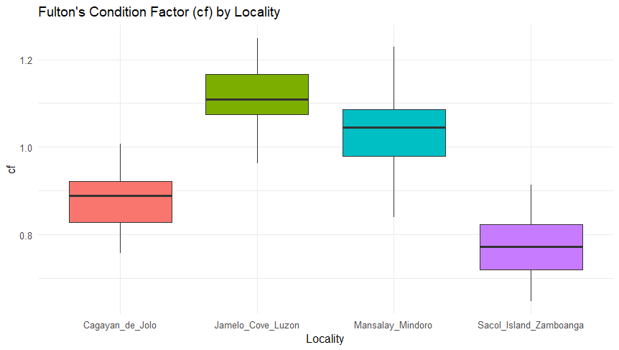
Table #. Kruskal-Wallis with Dunn Test and Bonferroni for Fulton's Condition Factor (cf).
Comparison | Adjusted p-value | Significance
Cagayan - Jamelo | < 0.0001 | ***
Cagayan - Mansalay | < 0.0001 | ***
Jamelo - Mansalay | 0.1113
Cagayan - Sacol | 0.0183 | *
Jamelo - Sacol | < 0.0001 | ***
Mansalay - Sacol | < 0.0001 | ***

Slide 2
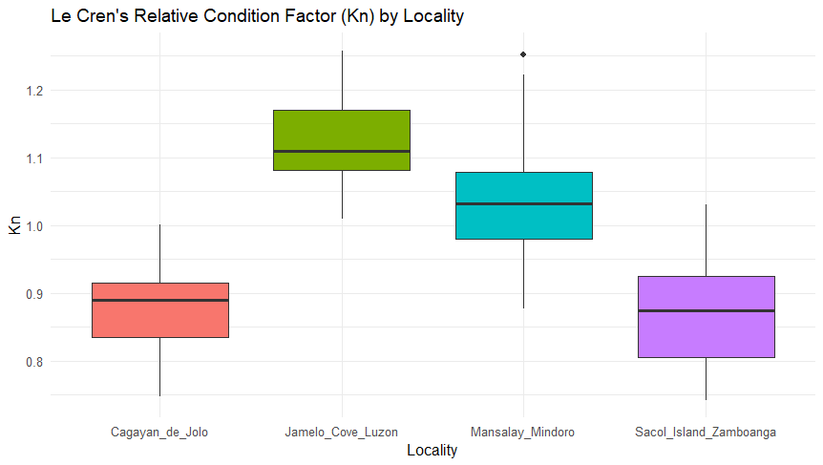
Table #. Kruskal-Wallis with Dunn Test and Bonferroni for Le Cren's Relative Condition Factor (Kn)
Comparison | Adjusted p-value | Significance
Cagayan - Jamelo | < 0.0001 | ***
Cagayan - Mansalay | < 0.0001 | ***
Jamelo - Mansalay | 0.0379
Cagayan - Sacol | 1
Jamelo - Sacol | < 0.0001 | ***
Mansalay - Sacol | < 0.0001 | ***

