Slide 1



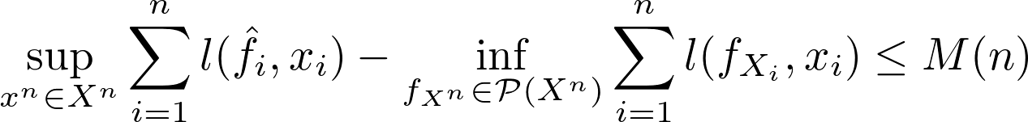
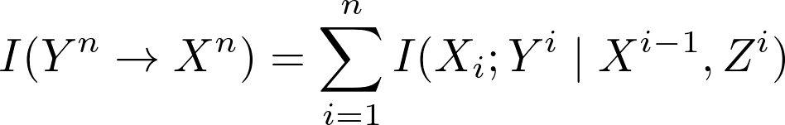


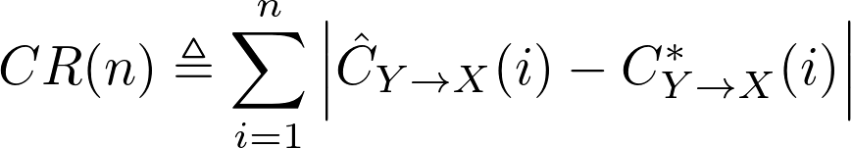
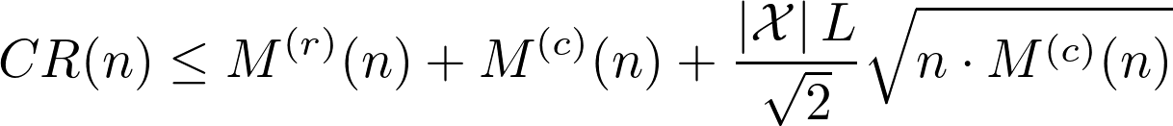


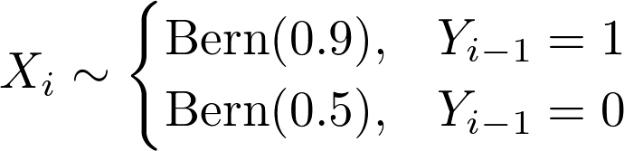
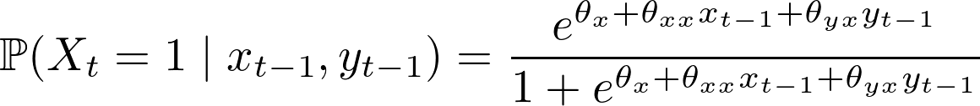
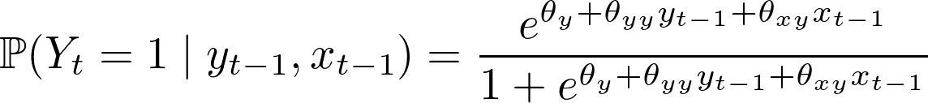
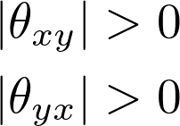
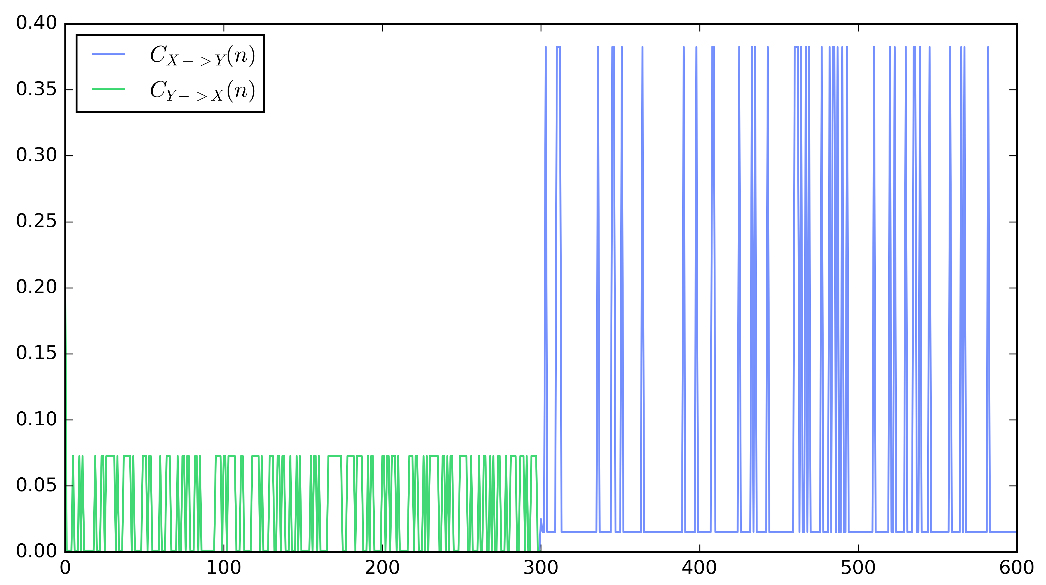
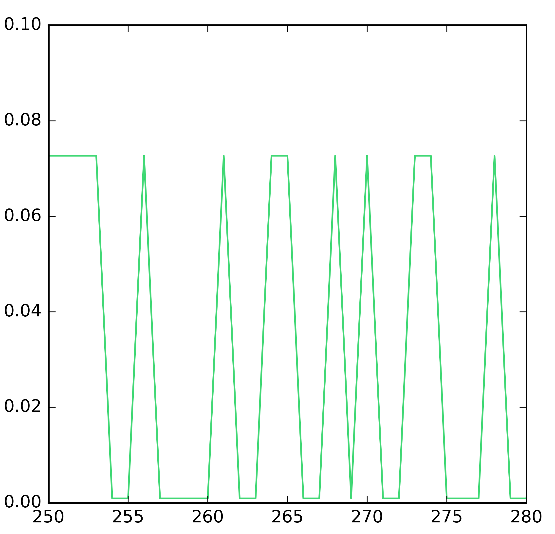
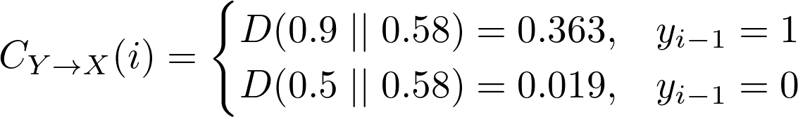
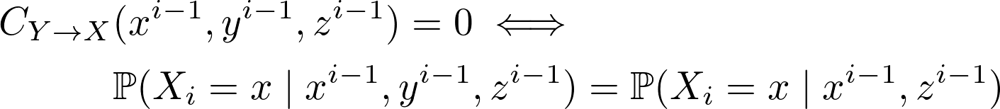
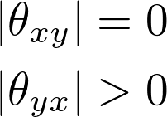
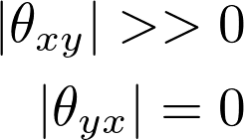
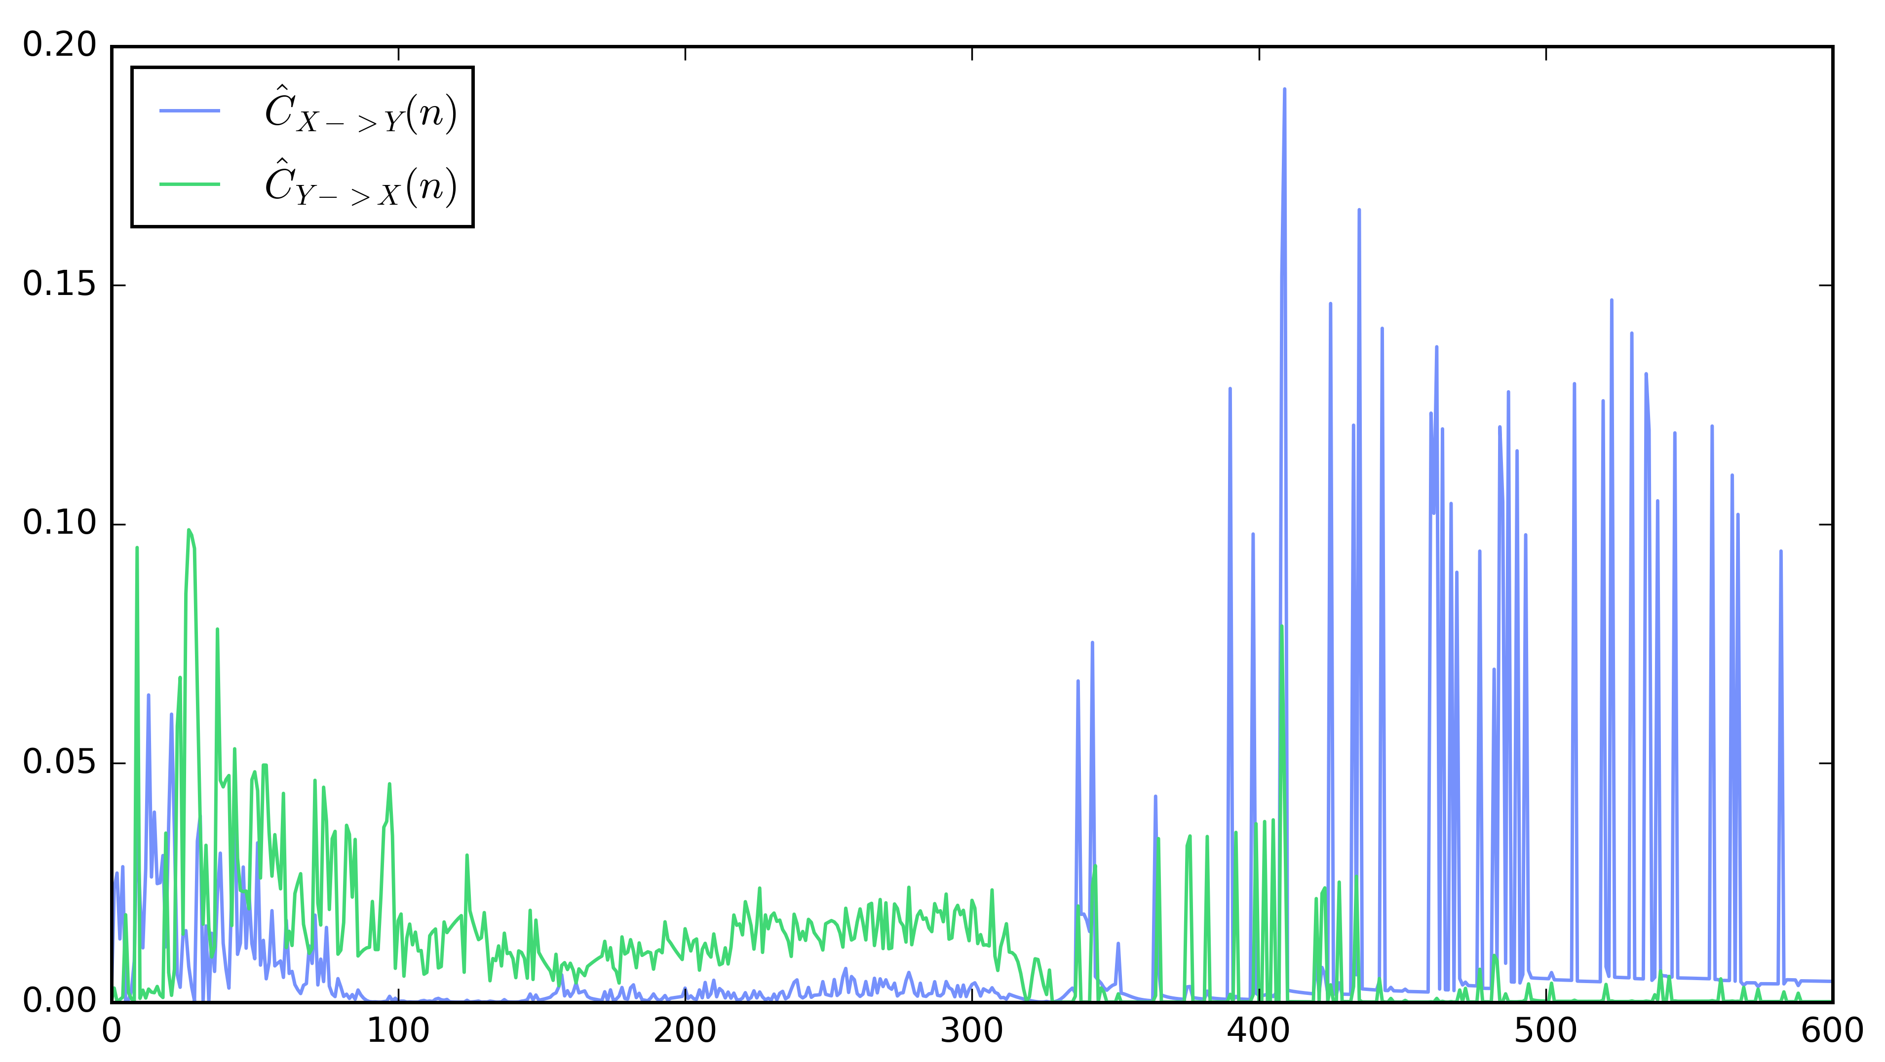
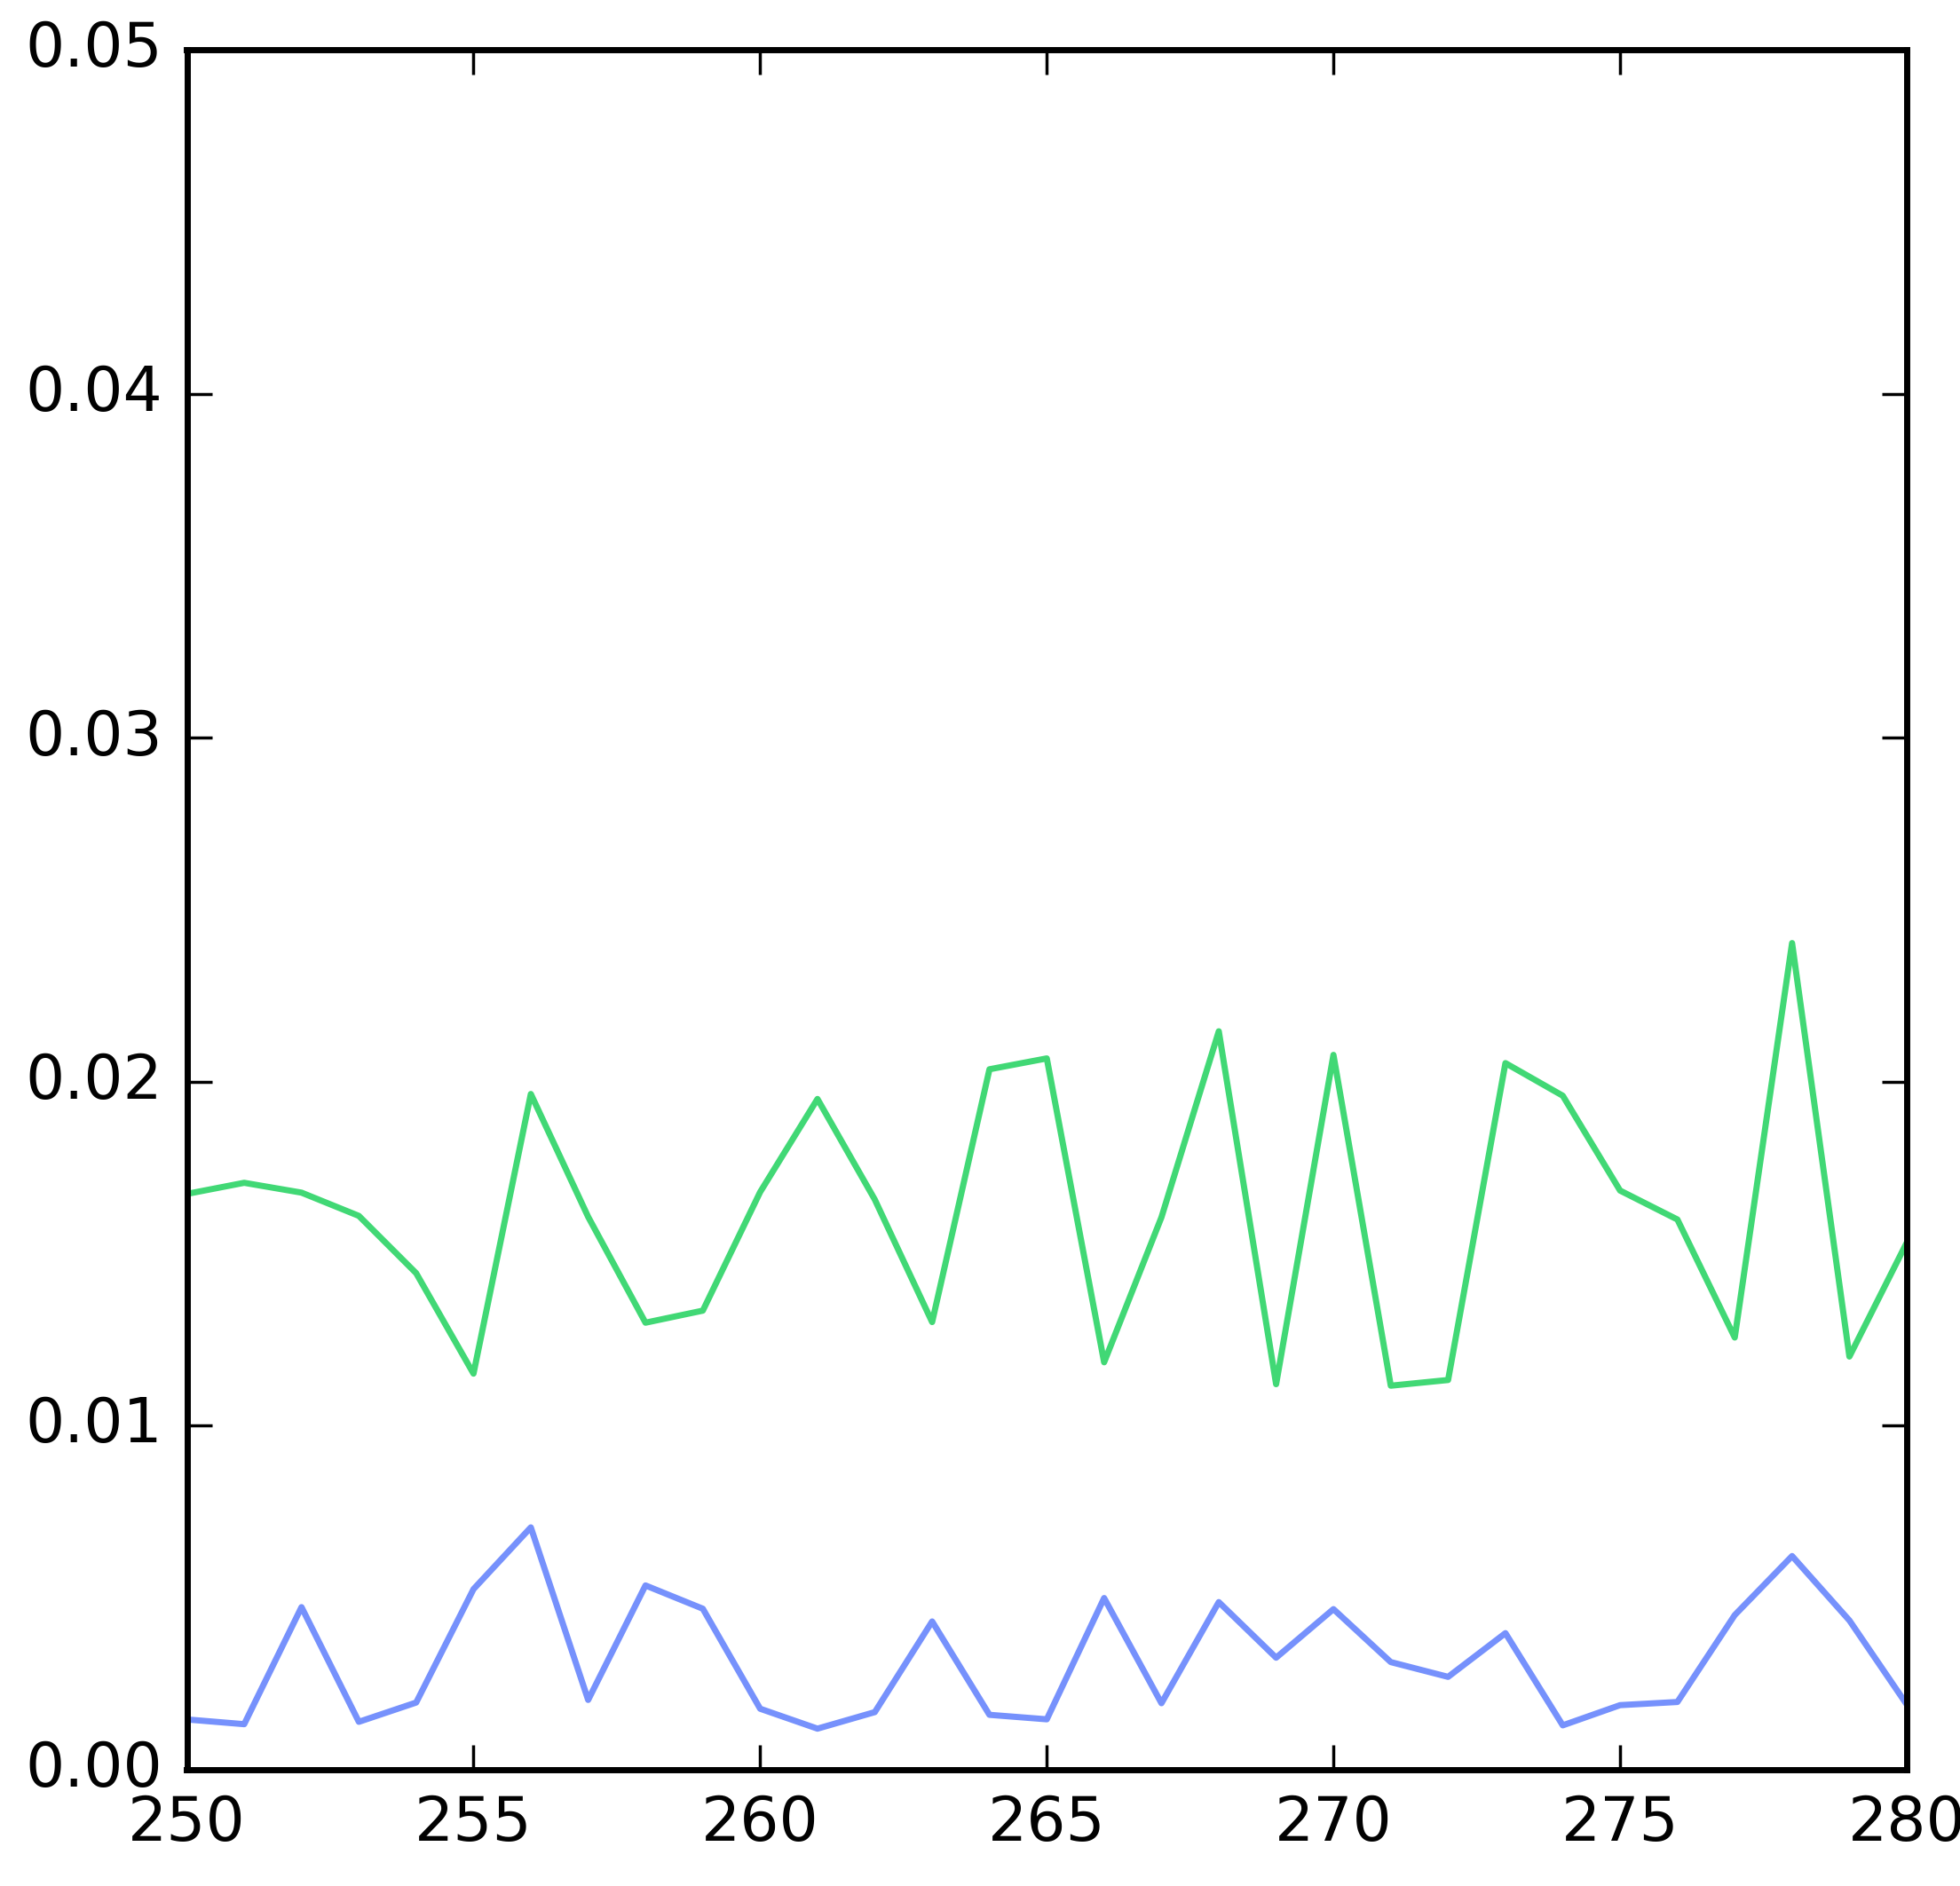
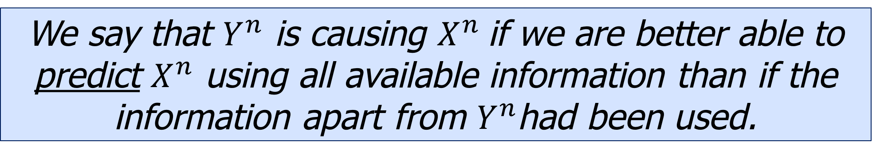
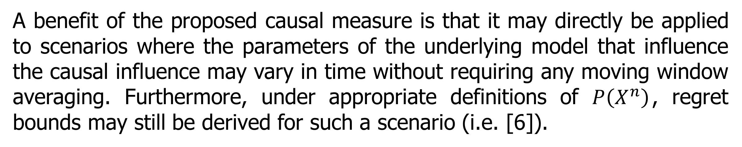
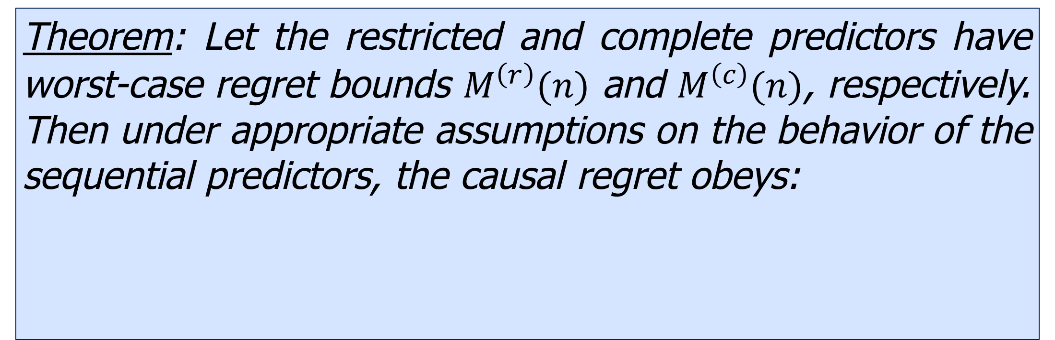
A Sample Path Measure of Causal Influence
Gabriel Schamberg¹ and Todd P Coleman²
¹ Department of Electrical and Computer Engineering
² Department of Bioengineering
University of California, San Diego, La Jolla, CA, USA
Introduction
Sequential Prediction
In 1969, Granger proposed the following philosophy for detecting causal influence [1]:
Estimations of the causal measure can be obtained by leveraging results from the field of sequential prediction [5].
We say that $Y^{n}$ is causing $X^{n}$if we are better able to predict $X^{n}$ using all available information than if the information apart from $Y^{n}$had been used.
Sequential Predictor:
Self-Information Loss:
While his original treatment was limited to linear autoregressive Gaussian models, Granger’s philosophy has continued to motivate causality research. In particular, multiple information theoretic variations of Granger causality have emerged:
Worst-Case Regret (Bounds):
Directed Information [2][3]:
Estimating the Causal Measure
Transfer Entropy [4]:
The causal measure may be estimated by utilizing two sequential predictors, one with the complete history and one with the restricted history. The estimate is then compared with the causal measure that is obtained by using the best distributions chosen from reference classes.
These notions of information transfer apply more generally than the original Granger causality formulation as they do not rely on linearity or Gaussianity, however, all methods mentioned thus far rely on taking expectations over the sequences and are entirely determined by the underlying model.
Estimated Measure:
Reference Optimal Measure:
Sample Path Causal Measure
Causality Regret:
We introduce a measure of causality that is dependent on the realization of a collection of processes. This is motivated by the fact that specific patterns may elicit greater causal influence than other patterns, even in stationary systems.
The goal is to use the regret bounds on the sequential predictors to bound the causality regret.
Observed Processes:
Theorem: Let the restricted and complete predictors have worst-case regret bounds $M^{\left(r\right)}(n)$ and $M^{\left(c\right)}(n)$, respectively. Then under appropriate assumptions on the behavior of the sequential predictors, the causal regret obeys:
“Complete” Distribution:
“Restricted” Distribution:
Causal Measure:
Time-Varying Scenario
A benefit of the proposed causal measure is that it may directly be applied to scenarios where the parameters of the underlying model that influence the causal influence may vary in time without requiring any moving window averaging. Furthermore, under appropriate definitions of $P\left(X^{n}\right)$, regret bounds may still be derived for such a scenario (i.e. [6]).
Motivating Example
Suppose we have the pair $(X^{n},Y^{n})$ of binary processes such that:
Signal Model:
Properties
Non-negativity:
Intuitively, $Y^{n}$ causes $X^{n}$ to a greater extent at times when $Y_{i}=1$. To formalize this, we identify the restricted distribution:
Expected Causality is Transfer Entropy (for Stationary Processes):
True Causal Measure:
Defining $D(p|\left|q\right)$ to be the KL-Divergence between Bernoulli distributions:
Model parameter change point
Zero Causality iff $X_{i}$ Conditionallly Independent of $Y^{i−1}:$
Rare high causality events
By contrast, the transfer entropy takes only a single small value:
Estimated Causal Measure:
[1] C. W. Granger, “Investigating causal relations by econometric models and cross-spectral methods,” Econometrica: Journal of the Econometric Society, pp. 424–438, 1969.
[2] H. Marko, “The bidirectional communication theory–a generalization of information theory,” IEEE Transactions on communications, vol. 21, no. 12, pp. 1345–1351, 1973.
[3] J. Massey, “Causality, feedback, and directed information,” in Proc. Int. Symp. Inf. Theory Applic.(ISITA-90), 1990, pp. 303-305
[4] T. Schreiber, “Measuring information transfer,” Physical review letters, vol. 85, no. 2, p. 461, 2000.
[5] N. Merhav and M. Feder, “Universal prediction,” IEEE Transactions on Information Theory, vol. 44, no. 6, pp. 2124-2147, 1998.
[6] A. Sancetta et al., “Universality of bayesian predictions,” Bayesian Analysis, vol. 7, no. 1, pp. 1–36, 2012.
The parameter-space is discretized and the parameters are estimated using a Bayesian updating scheme with uniform prior and “shrinking towards the prior” [6].

